Slide 1
Instance and Media
Recovery Structures

Slide 2
Objectives
After completing this lesson, you should be able to do the following:
  Describe the Oracle processes, memory structures, and files relating to recovery
  Identify the importance of checkpoints, redo log files, and archived log files
  Describe ways to tune instance recovery

Slide 3

Overview
Instance
SGA
Shared pool
Java Pool
Large Pool
Shared SQL
and PL/SQL
User
process
Server
process
Database
buffer cache
Redo log
buffer
Data dict.
cache
PGA
SMON
DBWn
PMON
CKPT
LGWR
ARCn
Datafile 1
Control
file
Redo log
file 1
Parameter
file
Datafile 2
Redo log
file 2
Password
file
Datafile 3
Archived
log files
Database
Notes:
Overview
The Oracle server uses many memory components, background processes, and file structures for its backup and recovery mechanism. This lesson reviews the concepts presented in the Oracle9i Database Administration Fundamentals I course, with an emphasis on backup and recovery requirements.
Oracle Instance
An Oracle instance consists of memory areas (mainly System Global Area [SGA]) and background processes, namely PMON, SMON, DBWn, LGWR, and CKPT. An instance is created during the nomount stage of the database startup after the parameter file has been read. If any of these processes terminate, the instance shuts down.

Slide 4
Notes:
Overview (continued)
Memory Structures
Background Processes
The User Process
The user process is created when a user starts a tool such as SQL*Plus, Oracle Forms Developer, Oracle Reports Developer, Oracle Enterprise Manager, and so on. This process might be on the client or server, and provides an interface for the user to enter commands that interact with the database.

Slide 5
Notes:
Overview (continued)
The Server Process
The server process accepts commands from the user process and performs steps to complete user requests. If the database is not in a shared server configuration, a server process is created on the machine containing the instance when a valid connection is established.
Oracle Database
An Oracle database consists of the following physical files:
Other files:
Dynamic Views
The Oracle server provides a number of standard views to obtain information on the database and instance. These views include:
V$SGA: Queries the size of the instance for the shared pool, log buffer, data buffer cache, and fixed memory sizes (operating system-dependent)
V$INSTANCE: Queries the status of the instance, such as the instance mode, instance name, startup time, and host name
V$PROCESS: Queries the background and server processes created for the instance
V$BGPROCESS: Queries the background processes created for the instance
V$DATABASE: Lists status and recovery information about the database. It includes information on the database name, the unique database identifier, the creation date, the control file creation date and time, the last database checkpoint, and other information.
V$DATAFILE: Lists the location and names of the datafiles that are contained in the database. It includes information relating to the file number and name, creation date, status (online or offline), enabled (read-only, read-write), last datafile checkpoint, size, and other information.

Slide 6
Large Pool
  Can be configured as a separate memory area in the SGA to be used for:
    Oracle backup and restore operations
    I/O server processes
    Session memory for the shared servers
  Is sized by the LARGE_POOL_SIZE parameter
Notes:
The Large Pool
The large pool is used to allocate sequential I/O buffers from shared memory. For I/O slaves and Oracle backup and restore, the RDBMS allocates buffers that are a few hundred kilobytes in size.
Configuring the large pool prevents RMAN from competing with other subsystems for the same memory. Recovery Manager (RMAN) uses the large pool for backup and restore when you set the DBWR_IO_SLAVES or BACKUP_TAPE_IO_SLAVES parameters to simulate asynchronous I/O. If neither of these parameters is enabled, then Oracle allocates backup buffers from local process memory rather than shared memory. Hence, the large pool is not used.
Sizing the Large Pool
If LARGE_POOL_SIZE is set, then Oracle attempts to get memory from the large pool. If this value is not large enough, then Oracle does not try to get buffers from the shared pool.
If the LARGE_POOL_SIZE initialization parameter is not set, then the Oracle server attempts to allocate shared memory buffers from the shared pool in the SGA.
If Oracle cannot get enough memory, then it obtains I/O buffer memory from local process memory and writes a message to the alert.log file indicating that synchronous I/O is used for the backup.

Slide 7
Notes:
Large Pool Parameters
LARGE_POOL_SIZE:
Description: Size of the large pool allocation heap, in bytes (can specify values in K or M)
Default: 0 if both of the following are true:
The pool is not required by parallel execution
DBWR_IO_SLAVES is not set
Otherwise, derived from the values of PARALLEL_MAX_SERVERS, PARALLEL_THREADS_PER_CPU, CLUSTER_DATABASE_INSTANCES, DISPATCHERS, and DBWR_IO_SLAVES.
Minimum: 300 KB
Maximum: At least 2 GB (the maximum is operating system-specific)
To determine how the large pool is being used, query V$SGASTAT:
SQL> SELECT *
2> FROM v$sgastat
3> WHERE pool = 'large pool';
POOL NAME BYTES
----------- --------------- --------
large pool free memory 4194304*
Note: Set this initialization parameter only if an error is reported in the alert.log stating that it does not have enough memory and that it will not start I/O slaves.
DBWR_IO_SLAVES: This parameter is only relevant on systems with only one database writer process (DBW0). This parameter specifies the number of I/O slaves that is used by the DBW0 process. The DBW0 process and its slaves always write to disk. By default, the value is 0 and I/O slaves are not used.
If DBWR_IO_SLAVES is set to a nonzero value, the numbers of I/O slaves used by the ARCn process and LGWR process is set to 4. However, the number of I/O server processes used by Recovery Manager is set to 4 only if asynchronous I/O is disabled (either your platform does not support asynchronous I/O or DISK_ASYNCH_IO is set to false.
Typically, I/O slaves are used to simulate asynchronous I/O on platforms that do not support or implement it inefficiently. However, I/O slaves can be used even when asynchronous I/O is being used. In that case, the I/O slaves use asynchronous I/O.

Slide 8
Notes:
Large Pool Parameters (continued)
BACKUP_TAPE_IO_SLAVES: It specifies whether I/O server processes, also called slaves, are used by the Recovery Manager to backup, copy, or restore data to tape.
When BACKUP_TAPE_IO_SLAVES is set to TRUE, an I/O slave process is used to write to or read from a tape device.
If this parameter is set to FALSE (the default), then I/O slaves are not used for backups; instead, the shadow process engaged in the backup accesses the tape device.
Note: Because a tape device can be accessed only by one process at any given time, this parameter is a Boolean, which allows or does not allow the deployment of an I/O slave process to access a tape device.
In order to perform duplex backups, this parameter must be enabled, otherwise an error will be signaled. Recovery Manager configures as many slaves as needed for the number of backup copies requested when this parameter is enabled.

Slide 9
Database Buffer Cache, DBWn, and Data files
Instance
SGA
Shared pool
Java pool
Large pool
Shared SQL
and PL/SQL
User
process
Server
process
Database
buffer cache
Redo log
buffer
Data dict.
cache
PGA
SMON
DBW0
PMON
CKPT
LGWR
ARCn
DBW1
Datafile 1
Control
file
Redo log
file 1
Parameter
file
Datafile 2
Redo log
file 2
Datafile 3
Password
file
Archived
log files
Database
Notes:
Function of the Database Buffer Cache
The database buffer cache is an area in the SGA that is used to store the most recently used data blocks.
The server process reads tables, indexes, and undo segments from the datafiles into the buffer cache where it makes changes to data blocks when required.
The Oracle server uses a least recently used (LRU) algorithm to determine which buffers can be overwritten to accommodate new blocks in the buffer cache.
Function of the DBWn Background Process
The database writer process (DBWn) writes the dirty buffers from the database buffer cache to the datafiles. It ensures that sufficient numbers of free buffers (buffers that can be overwritten when server processes need to read in blocks from the datafiles) are available in the database buffer cache.
The database writer regularly synchronizes the database buffer cache and the datafiles: this is the checkpoint event triggered in various situations.
Although one database writer process is adequate for most systems, you can configure additional processes (DBW1 through DBW9) to improve write performance if your system modifies data heavily. These additional database writer processes are not useful on uniprocessor systems.

Slide 10
Notes:
Function of the DBWn Background Process (continued)
Datafiles
Data files store both system and user data on a disk. This data may be committed or uncommitted.
Datafiles Containing Only Committed Data
This is normal for a closed database, except when failure has occurred or the “shutdown abort” option has been used. If the instance is shutdown using the normal, immediate or transactional option, the datafiles contain only committed data. This is because all uncommitted data is rolled back, and a checkpoint is issued to force all committed data to a disk.
Datafiles Containing Uncommitted Data
While an instance is started, datafiles can contain uncommitted data. This happens when data has been changed but not committed (the changed data is now in the cache), and more space is needed in the cache, forcing the uncommitted data off to disk. Only when all users eventually commit will the datafiles contain only committed data. In the event of failure, during subsequent recovery, the redo logs and rollback segments are used to synchronize the datafiles.
Configuring Tablespaces
Tablespaces contain one or more datafiles. It is important that tablespaces are created carefully to provide a flexible and manageable backup and recovery strategy. Here is a typical configuration of tablespaces, taking into account requirements for backup and recovery operations:
System: Backup and recovery is more flexible if system and user data is contained in different tablespaces.
Temporary: If the tablespace containing temporary segments (used in sort, and so on) is lost, it can be re-created, rather than recovered.
Undo: The procedures for backing up undo tablespaces are exactly the same as for backing up any other read/write tablespace. Because the automatic undo tablespace is so important for recovery and for read consistency, you should back it up frequently.
Read-only data: Backup time can be reduced because a tablespace must be backed up only when the tablespace is made read-only.
Highly volatile data: This tablespace should be backed up more frequently, also reducing recovery time.
Index data: Tablespaces to store only index segments should be created. These tablespaces can often be re-created instead of recovered.

Slide 11
Redo Log Buffer, LGWR, and Redo Log Files
Instance
SGA
Shared pool
Java pool
Large pool
Shared SQL
and PL/SQL
User
process
Server
process
Database
buffer cache
Redo log
buffer
Data dict.
cache
PGA
SMON
DBWn
PMON
CKPT
LGWR
ARCn
Datafile 1
Control
file
Redo log
file 1
Parameter
file
Datafile 2
Redo log
file 2
Password
file
Datafile 3
Archived
log files
Database
Notes:
Function of the Redo Log Buffer
The redo log buffer is a circular buffer that holds information about changes made to the database. This information is stored in redo entries.
Redo entries contain the information necessary to reconstruct, or redo, changes made to the database by INSERT, UPDATE, DELETE, CREATE, ALTER, or DROP operations. Redo entries are used for database recovery, if necessary.
Redo entries are copied by Oracle server processes from the user’s memory space to the redo log buffer.

Slide 12
Notes:
Function of the LGWR Background Process
The log writer (LGWR) writes redo entries from the redo log buffer to the redo log files as follows:
When the redo log buffer is one-third full
When a timeout occurs (every three seconds)
When there is 1 MB of redo
Before DBWn writes modified blocks in the database buffer cache to the datafiles
When a transaction commits
Function of Redo Log Files
Redo log files store all changes made to the database. If the database is to be recovered to a point in time when it was operational, redo logs are used to ensure that all committed transactions are committed to disk, and all uncommitted transactions are rolled back. The important points relating to redo log files are as follows:
LGWR writes to redo log files in a circular fashion. This behavior results in all members of a log file group being overwritten.
Although it is mandatory to have at least two log groups to support the cyclic nature, in most cases, you would need more than two redo log groups.
You can create additional log file groups using the following SQL command:
ALTER DATABASE [database]
ADD LOGFILE [GROUP integer] filespec
[, [GROUP integer] filespec]...]
To drop an entire online redo log group, use the following SQL command:
ALTER DATABASE [database]
DROP LOGFILE
{GROUP integer|('filename'[,'filename']...)}
[,{GROUP integer|('filename'[,'filename']...)}]...
To avoid a single-point media failure, it is recommended that you multiplex redo logs.

Slide 13
Notes:
Redo Log Switches
At a log switch, the current redo log group is assigned a log sequence number that identifies the information stored in that redo log group and is also used for synchronization.
A log switch occurs when LGWR stops writing to one redo log group and begins writing to another.
A log switch occurs when LGWR has filled one log file group.
A DBA can force a log switch by using the ALTER SYSTEM SWITCH LOGFILE command.
A checkpoint occurs automatically at a log switch.
Processing can continue as long as at least one member of a group is available. If a member is damaged or unavailable, messages are written to the LGWR trace file and to the alert log.
Dynamic Views
V$LOG: Lists the number of members in each group. It contains:
The group number
The current log sequence number
The size of the log
The number of members
Status (ACTIVE, CLEARING, CLEARING_CURRENT,CURRENT, INACTIVE or UNUSED)
Lowest SCN in the log
V$LOGFILE: It contains:
Group number for each member
Status (STALE, INVALID,DELETED, or blank)
Redo log member names
V$LOG_HISTORY: Contains information on log history from the control file.

Slide 14
Multiplexed Redo Log Files
Group 1
Group 2
Group 3
Disk 1
(Member a)
log1a.rdo
log2a.rdo
log3a.rdo
Disk 2
(Member b)
log1b.rdo
log2b.rdo
log3b.rdo
Notes:
Guidelines for Multiplexing
The redo log file configuration requires at least two redo log members per group, with each member on a different disk to guard against failure.
Keep the following points in mind:
All members of a group contain identical information and are of the same size.
Group members are updated simultaneously.
Each group should contain the same number of members of the same size.
The locations of the online redo log files can be changed by renaming the online redo log files. Before renaming the online redo log files, make sure that the new online redo log file exists. The Oracle server changes only the pointers in the control files, but does not physically rename or create any operating system files. If the old file is an Oracle-managed file and it exists, then it is deleted.

Slide 15
Notes:
Guidelines for Multiplexing (continued)
How to Relocate a Redo Log File
1. If the log file is current, perform a log switch by using:
ALTER SYSTEM SWITCH LOGFILE;
2. Copy the redo log file from the previous location to the new location by using the operating system copy utility (cp in Unix or COPY in Windows NT)
3. Use the ALTER DATABASE RENAME FILE command to make the change in control files:
ALTER DATABASE [database]
RENAME FILE 'filename'[, 'filename']...
TO 'filename'[, 'filename']...
Note: You can also add a new member to the group and then drop the old member.
How to Add a Member to a Group
You can add new members to existing redo log file groups by using the following SQL
command:
ALTER DATABASE [database]
ADD LOGFILE MEMBER
[ 'filename' [REUSE]
[, 'filename' [REUSE]]...
TO {GROUP integer
|('filename'[, 'filename']...)
}
]...
How to Drop a Member from a Group
You may want to drop an online redo log member if it becomes INVALID. Use the following SQL command:
ALTER DATABASE [database]
DROP LOGFILE MEMBER 'filename'[, 'filename']...
Note: You cannot drop a member from the current or active redo log file group.

Slide 16
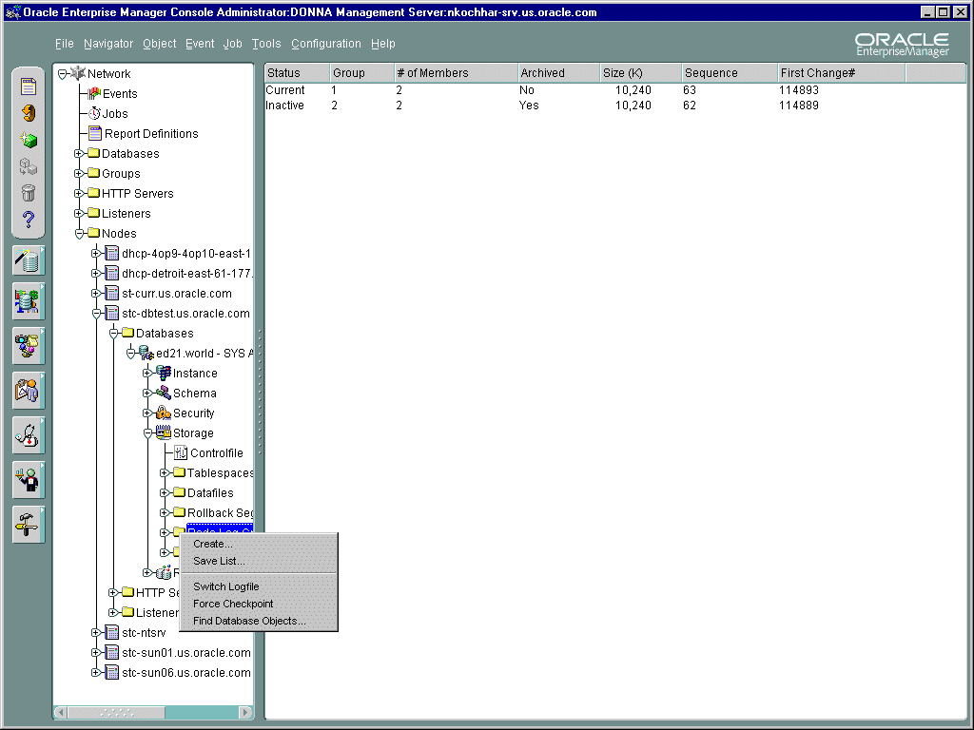
Redo Log Files in Enterprise Manager
Notes:
Using Oracle Enterprise Manager
Using the Redo Log Groups folder, you can switch the current redo log group, trigger a checkpoint in a redo log group, create a new redo log group, and rename, remove, or add new redo log group members.
1. Select your node and database in the Navigator tree.
2. Select Storage > Redo Log Groups.
3. Select the appropriate action from the right mouse menu.

Slide 17
Database Checkpoints
  Checkpoints are used to determine where recovery should start
  Checkpoint position - where recovery starts
  Checkpoint queue - link list of dirty blocks
Notes:
Database Checkpoints
Checkpoint Position
The position in the redo log where recovery is to start is referred to as the checkpoint position. All of the referenced data blocks prior to that point have already been written to disk by DBWn. It is defined as the “distance” between it and the end of the redo log. It can also be thought of as the “age” of the first entry in the checkpoint queue, a link list of dirty blocks arranged in order by when the block was first dirtied.
Checkpoint Queue
Each entry in the checkpoint queue includes the identifier of the data block (that is, file number and block number) and the location in the redo log where the block was first dirtied called the Redo Byte Address or RBA. It also contains the location in the redo log where the data block was last changed. The first entry in the checkpoint queue identifies the oldest dirty block in the database buffer cache. DBWn writes blocks from the buffer cache in the order of the checkpoint queue, deleting each entry as the block is written.

Slide 18
Types of Checkpoints
  Full checkpoint
    All dirty buffers are written
    SHUTDOWN NORMAL, IMMEDIATE, or TRANSACTIONAL
    ALTER SYSTEM CHECKPOINT
  Incremental checkpoint (Fast-Start checkpoint)
    Periodic writes
    Only write the oldest blocks
  Partial checkpoint
    Dirty buffers belonging to the tablespace
    ALTER TABLESPACE BEGIN BACKUP
    ALTER TABLESPACE tablespace OFFLINE NORMAL
Notes:
Types of Checkpoints
A procedure known as a full checkpoint is done when either the database is shut down (except abnormally) or manually initiated with the command ALTER SYSTEM CHECKPOINT. In a full checkpoint, DBWn writes all the dirty buffers in the database buffer cache to the datafiles.
An incremental checkpoint, also known as fast-start checkpoint, is a continuously active checkpoint. DBWn periodically writes out buffers from the checkpoint queues to advance the incremental checkpoint in memory. Incremental checkpoints cause DBWn to write blocks from the buffer cache so that the earliest buffer to be dirtied gets written first. Incremental checkpoints do not update datafile headers. The incremental checkpoint is recorded in the control file.
The ALTER TABLESPACE BEGIN BACKUP command causes a partial checkpoint of just the dirty buffers in the buffer cache that belong to that tablespace.
The ALTER TABLESPACE tablespace OFFLINE NORMAL command also initiates a partial checkpoint.

Slide 19
CKPT Process
Instance
SGA
Shared pool
Java pool
Large pool
Shared SQL
and PL/SQL
User
process
Server
process
Database
buffer cache
Redo log
buffer
Data dict.
cache
PGA
SMON
DBWn
PMON
CKPT
LGWR
ARCn
Datafile 1
Control
file
Redo log
file 1
Parameter
file
Datafile 2
Redo log
file 2
Password
file
Datafile 3
Archived
log files
Database
Notes:
Checkpoint Process (CKPT)
The checkpoint process (CKPT) is responsible for signaling DBWn at checkpoints and updating the datafiles and control files of the database to indicate the most recent checkpoint.
Every three seconds, CKPT records the RBA from the oldest entry in the checkpoint queue in the control file. This RBA represents the point in the redo log at which instance recovery is to begin after an instance failure. It can do this because all of the data blocks represented in prior redo records are guaranteed to have been written to disk by DBWn.
Only in the event of a log switch, does CKPT also write this information to the headers of the datafiles. To improve performance not all of the headers are written at once, but rather they are updated in groups in what is referred to as a “lazy write.” Log switches do not force all dirty buffers to be written to disk.

Slide 20
Multiplexed Control Files
Instance
SGA
Shared pool
Java pool
Large pool
Shared SQL
and PL/SQL
User
process
Server
process
Database
buffer cache
Redo log
buffer
Data dict.
cache
PGA
SMON
DBWn
PMON
CKPT
LGWR
ARCn
Datafile 1
Redo log
file 1
Control
files
Parameter
file
Datafile 2
Redo log
file 2
Password
file
Datafile 3
Archived
log files
Database
Notes:
Control File Function
The control file is a binary file that describes the structure of the database. It must be available for writing by the Oracle server whenever the database is mounted or open. Its default name is operating system-dependent. Without this file, the database cannot be mounted and recovery or re-creation of the control file will be required. The recommended configuration is a minimum of two control files on different disks to minimize the impact of a loss of one control file.
Control File Contents
Database name
Time stamp of database creation
Synchronization information (checkpoint and log sequence information) needed for recovery
Names and locations of datafiles and redo log files
Archiving mode of the database
Current log sequence number
Recovery Manager backup meta data

Slide 21
Notes:
Control File Function (continued)
Dynamic View
To obtain the location and names of the control files, use either the dynamic performance view V$PARAMETER or the dynamic performance view V$CONTROLFILE.
SQL> SELECT name
2> FROM v$controlfile;
NAME
-----------------------
/ORADATA/u01/ctrl01.ctl
/ORADATA/u02/ctrl02.ctl
2 rows selected.
How to Multiplex the Control File
To add a new control file or change the number or location of the control file, follow these steps:
1. Shut down the database.
2. Make a copy of the existing control file to a different device by using operating system commands.
3. Edit or add the CONTROL_FILES parameter and specify names for all the control files.
4. Start the database.

Slide 22
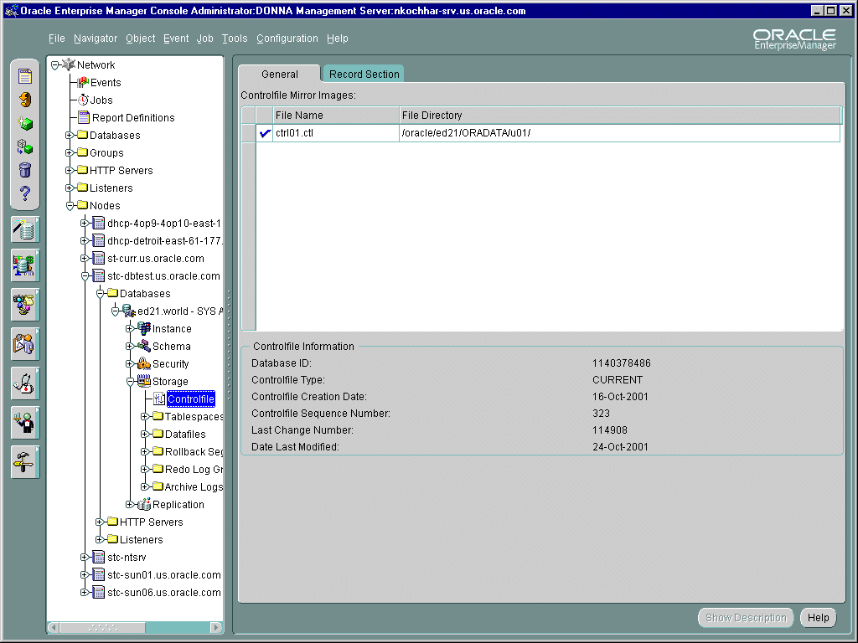
Control Files in Enterprise Manager
Notes:
Using Oracle Enterprise Manager
You can select the Controlfile icon from the Storage Management folder to see a property sheet with the names of the control files created for the database and other statistics.

Slide 23
ARCn Process and Archived Log Files
Instance
SGA
Shared pool
Java pool
Large pool
Shared SQL
and PL/SQL
User
process
Server
process
Database
buffer cache
Redo log
buffer
Data dict.
cache
PGA
SMON
DBWn
PMON
CKPT
LGWR
ARC0
ARC1
Datafile 1
Control
file
Redo log
file 1
Parameter
file
Redo log
file 2
Archived
log files
dest 2
Datafile 2
Password
file
Datafile 3
Password
file
Archived
log files
dest 1
Database
Notes:
Function of the Archive Background Process
The ARCn process is an optional process. When enabled, it archives the redo log files to designated storage areas. This process has a great significance in backup, restoration, and recovery of a database set to ARCHIVELOG mode, where databases are operational 24 hours a day and 7 days a week.
The ARCn process initiates when a log switch occurs and copies one member of the last (unarchived) redo log group to at least one of the destinations specified by one or more initialization parameters.
Archived Log Files
When the database is set to ARCHIVELOG mode, the LGWR process waits for the online redo log files to be archived (either manually or through the ARCn process) before they can be reused.
If an online redo log file is corrupt, another member from the same group is used. Archived logs are beneficial to the backup and recovery process because:
A database backup, combined with archived redo log files, guarantees that all committed data can be recovered to the point of failure.
Valid database backups can be taken while the database is online.

Slide 24
Notes:
Function of the Archive Background Process (continued)
Archiving Considerations
The choice of whether to enable archiving depends on the availability and reliability requirements of each database. Archived logs can be stored in more than one location (duplexing or multiple destinations), because they are vital for recovery. For production databases, it is recommended that you use the archive log feature with multiple destinations.

Slide 25
Database Synchronization
  All datafiles (except offline and read-only) must be synchronized for the database to open.
  Synchronization is based on the current checkpoint number.
  Applying changes recorded in the redo log files synchronizes datafiles.
  Redo log files are automatically requested by the Oracle server.
Notes:
Database Synchronization
An Oracle database cannot be opened unless all datafiles, redo logs, and control files are synchronized. In this case, recovery is required.
Database File Synchronization
For the database to open, all datafiles must have the same checkpoint number, unless they are offline or part of a read-only tablespace.
Synchronization of all Oracle files is based on the current redo log checkpoint and sequence numbers.
Archived and online redo log files recover committed transactions and roll back uncommitted transactions to synchronize the database files.
Archived and online redo log files are automatically requested by the Oracle server during the recovery phase. Make sure logs exist in the requested location.

Slide 26
Phases for Instance Recovery
1. Datafiles out-of-synch
2. Roll forward (redo)
3. Committed and non- committed data in files
4. Roll back (undo)
5. Committed data in files
Instance
SGA
Shared pool
Java pool
Large pool
Shared SQL
and PL/SQL
Database
buffer cache
Redo log
buffer
Data dict.
cache
SQL*Plus
Server
process
SMON
DBWn
PMON
CKPT
LGWR
ARCn
PGA
146.5
146.5
146.5
Datafile 1
Control
file
Redo log
file 1
146.5
145
Checkpoint
Undo
Datafile
Redo log
file 2
Undo
146.5
Datafile 3
Database
Notes:
Crash Recovery Phases
Unlike media recovery, Oracle performs crash recovery and instance recovery automatically after an instance failure. Crash and instance recovery recover a database to its transaction-consistent state just before instance failure. By definition, crash recovery is the recovery of a database in a single-instance configuration or an Oracle Real Application Clusters configuration in which all instances have crashed. In contrast, instance recovery is the recovery of one failed instance by a live instance in an Oracle Real Application Clusters configuration.
Crash Recovery Phases
1. The datafiles are not synchronized.
2. During the cache recovery or roll forward phase, all of the changes recorded in the redo log files since the last checkpoint are reapplied to the datafiles. This phase also regenerates undo or rollback data.
3. The datafiles now contain committed and perhaps uncommitted changes. The database is opened.
4. During the transaction recovery or rollback phase, any changes that were not actually committed are rolled back.
5. The datafiles now contain only committed changes to the database.

Slide 27
Notes:
Crash Recovery Phases (continued)
Instance Recovery Phases

Slide 28
Tuning Crash and Instance
Recovery Performance
  Tuning the duration of instance and crash recovery
  Tuning the phases of instance recovery
Notes:
Tuning Crash and Instance Recovery Performance
Instance and crash recovery are the automatic application of redo log records to Oracle data blocks after an instance failure.
The principal means of balancing the duration of instance recovery and daily performance is by influencing how aggressively Oracle advances the checkpoint. You can minimize the number of blocks processed during recovery by keeping the checkpoint only a few blocks behind the most recent redo log record. However, there will be increased performance overhead for normal operations due to frequent checkpointing.

Slide 29
Tuning the Duration of Instance and Crash Recovery
Methods to keep the duration of instance and crash recovery within user-specified bounds:
  Set initialization parameters to influence the number of redo log records and data blocks involved in recovery.
  Size the redo log file to influence checkpointing frequency.
  Issue SQL statements to initiate checkpoints.
  Parallelize instance recovery operations.
Notes:
Tuning Crash and Instance Recovery Performance (continued)
There are several methods you can use to keep the duration of instance and crash recovery within user-specified bounds.
Fast-start fault recovery functionality can be used to control instance recovery. This reduces the roll forward time by making it bounded and predictable, and also eliminates the time required to perform rollback. The foundation of fast-start fault recovery is the fast-start checkpointing architecture. A target time to complete the roll forward phase of recovery is specified by means of an initialization parameter.
The size of the redo log file directly influences checkpointing. The smaller the size of the smallest log, the more aggressively Oracle writes dirty buffers to disk to ensure that the position of the checkpoint has advanced to the current log, before that log completely fills, so that it can be reused.

Slide 30
Initialization Parameters
Influencing Checkpoints
Parameter
FAST_START_MTTR_TARGET
LOG_CHECKPOINT_TIMEOUT
LOG_CHECKPOINT_INTERVAL
Definition
Expected MTTR specified in seconds
Amount of time that has passed since the incremental checkpoint at the position where the last write to the redo log occurred
Number of redo log file blocks that can exist between an incremental checkpoint and the last block written to the redo log
Notes:
Using Initialization Parameters to Affect Recovery
You can use three initialization parameters to influence how aggressively Oracle advances the checkpoint.
Fast-start checkpointing occurs continuously, advancing the checkpoint time as blocks are written. A target (bounded) time to complete the roll forward phase of recovery is specified by means of the FAST_START_MTTR_TARGET parameter, and Oracle automatically varies the checkpoint writes to meet that target.
You should use only the FAST_START_MTTR_TARGET parameter, instead of a combination of FAST_START_IO_TARGET, LOG_CHECKPOINT_INTERVAL, and LOG_CHECKPOINT_TIMEOUT as in previous releases. FAST_START_MTTR_TARGET provides the most precise control over the duration of recovery and eliminates the need to set values manually for LOG_CHECKPOINT_INTERVAL and LOG_CHECKPOINT_TIMEOUT.
The V$INSTANCE_RECOVERY dynamic view provides the current recovery parameter settings.

Slide 31
Notes:
Using Initialization Parameters to Affect Recovery (continued)
V$INSTANCE_RECOVERY

Slide 32
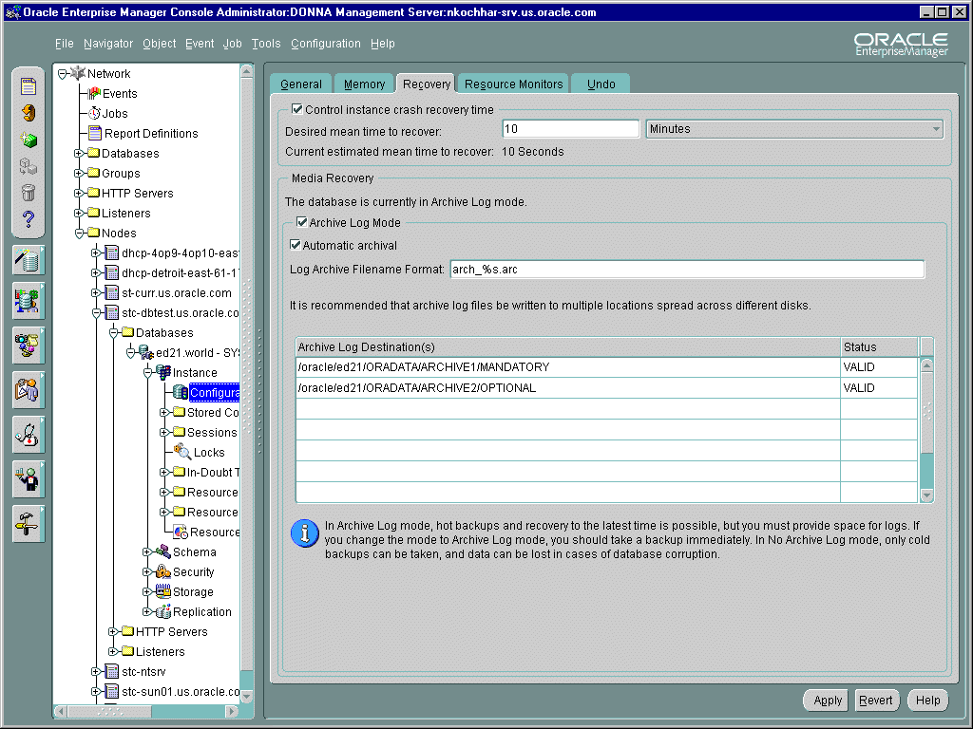
Controlling Instance Crash Recovery Time
Notes:
Using Oracle Enterprise Manager to Control Instance Crash Recovery Time
The Recovery Page of the Configuration Property Sheet can be used to set FAST_START_MTTR_TARGET.

Slide 33
V$INSTANCE_RECOVERY
  Used to monitor the mechanisms that are available to limit recovery I/O
  Statistics from this view to calculate which parameter has the greatest influence on checkpointing
Notes:
V$INSTANCE_RECOVERY
This view monitors the mechanisms that are available to users to limit recovery I/O. Those mechanisms are:
Set the LOG_CHECKPOINT_TIMEOUT initialization parameter
Set the LOG_CHECKPOINT_INTERVAL initialization parameter
Set the FAST_START_MTTR_TARGET initialization parameter
Set the size of the smallest redo log
V$INSTANCY_RECOVERY Columns
RECOVERY_ESTIMATED_IOS: Contains the number of dirty buffers in the buffer cache. In Oracle9i Standard Edition, this column is always NULL.
ACTUAL_REDO_BLKS: The current actual number of redo blocks required for recovery
TARGET_REDO_BLKS: The current target number of redo blocks that must be processed for recovery. This value is the minimum value of the following three columns, and identifies which of the three user-defined limits determines checkpointing.
LOG_FILE_SIZE_REDO_BLKS: Maximum number of redo blocks required to guarantee that a log switch does not occur before the checkpoint completes.

Slide 34
Notes:
V$INSTANCE_RECOVERY (continued)
LOG_CHKPT_TIMEOUT_REDO_BLKS: Number of redo blocks that need to be processed during recovery to satisfy the LOG_CHECKPOINT_TIMEOUT parameter. The value displayed is not meaningful unless that parameter has been set.
LOG_CHKPT_INTERVAL_REDO_BLKS: Number of redo blocks that need to be processed during recovery to satisfy the LOG_CHECKPOINT_INTERVAL parameter. The value displayed is not meaningful unless that parameter has been set.
FAST_START_IO_TARGET_REDO_BLKS: This column is obsolete and maintained only for compatibility reasons. The value of this column is always NULL.
TARGET_MTTR: Effective MTTR (mean time to recover) target value in seconds. The TARGET_MTTR value is calculated based on the value of the FAST_START_MTTR_TARGET parameter (the TARGET_MTTR value is used internally), and is usually an approximation of the parameter's value. However, if the FAST_START_MTTR_TARGET parameter value is very small (for example, one second), or very large (for example, 3600 seconds), the calculation will produce a target value dictated by system limitations. In such cases, the TARGET_MTTR value will be the shortest calculated time, or the longest calculated time that recovery is expected to take. If FAST_START_MTTR_TARGET is not specified, the value of this field is the current estimated MTTR.
ESTIMATED_MTTR: The current estimated mean time to recover (MTTR) based on the number of dirty buffers and log blocks (0 if FAST_START_MTTR_TARGET is not specified). Basically, this value tells you how long you could expect recovery to take based on the work your system is doing right now.
CKPT_BLOCK_WRITES: Number of blocks written by checkpoint writes

Slide 35
Tuning the Phases of
Crash and Instance Recovery
  Tuning the roll forward phase
  Tuning the rollback phase
Notes:
Tuning the Phases of Instance Recovery
You can use parameters to control the rolling forward and rolling back phases of instance recovery to increase the efficiency of the recovery. The total recovery time required is the sum of the time required to roll forward and roll back.

Slide 36
Tuning the Rolling Forward Phase
  Parallel block recovery
  RECOVERY_PARALLELISM specifies the number of concurrent recovery processes
Notes:
Tuning the Rolling Forward Phase
The RECOVERY_PARALLELISM initialization parameter is used to specify the number of concurrent process for instance or crash recovery operations. Using multiple processes in effect provides parallel block recovery. Different processes are allocated to different blocks during the roll forward phase.
The RECOVERY_PARALLELISM initialization parameter specifies the number of concurrent recovery processes for instance or crash recovery only. Media recovery is not affected by this parameter. Use the PARALLEL clause in the RECOVER DATABASE statement for media recovery.

Slide 37
Tuning the Rolling Back Phase
  Fast-start on-demand rollback
  Fast-start parallel rollback
Notes:
Tuning the Rolling Back Phase
Fast-start on-demand rollback is an automatic feature which allows new transactions to begin immediately after the roll forward phase of recovery completes. If a user attempts to access a row that is locked by a dead transaction, only the changes needed to complete the transaction are rolled back. The rollback is on-demand.

Slide 38
Fast-Start On-Demand Rollback
Server process encountering data to be rolled back performs the following:
  Rolls back the block containing the required row
  Hands off further recovery, which may be in parallel, to SMON
Improved
response
Notes:
Fast-Start On-Demand Rollback
A user transaction initiates rollback on only the block the transaction is attempting to access. The remainder of the blocks are recovered in the background by SMON, potentially in parallel. The advantage is that a transaction does not have to wait until all work of a long transaction is rolled back.

Slide 39
Fast-Start Parallel Rollback
SMON
P000
P001
P002
P003
Undo
segment
Tables
Notes:
Fast-Start Parallel Rollback
Fast-start parallel rollback enables SMON to act as a coordinator and use multiple server processes to complete the rollback operation. Parallel rollback is automatically started when SMON determines that the dead transaction has generated a large number of undo blocks.
It is mainly useful in a system that has long-running transactions, particularly parallel INSERT, UPDATE, and DELETE operations.

Slide 40
Controlling Fast-Start Parallel Rollback
FAST_START_PARALLEL_ROLLBACK parameter
Value
FALSE
LOW (default)
HIGH
Maximum Parallel Recovery Servers
None
2 * CPU_COUNT
4 * CPU_COUNT
Notes:
Controlling Fast-Start Parallel Rollback
The number of processes involved in transaction recovery is set through the dynamic initialization parameter FAST_START_PARALLEL_ROLLBACK. The valid values for this parameter and its impact on fast-start parallel rollback are shown in the table.

Slide 41
Monitoring Parallel Rollback
  V$FAST_START_SERVERS: Provides information about all the recovery slaves performing parallel transaction recovery
  V$FAST_START_TRANSACTIONS: Contains information about the progress of the transactions that Oracle is recovering
Notes:
Monitoring Parallel Rollback
Use the following query to monitor the use of parallel query slaves for fast-start parallel rollback:
SELECT * FROM v$fast_start_servers;
STATE UNDOBLOCKSDONE PID
---------- -------------- ---
RECOVERING 99 10
IDLE 0 11
IDLE 0 12
IDLE 0 13

Slide 42
Notes:
Monitoring Parallel Rollback (continued)
Use the following query to verify the status of fast-start rollback:
SELECT usn, state, undoblksdone, undoblkstotal
FROM v$fast_start_transactions;
USN STATE UNDOBLOCKSDONE UNDOBLOCKSTOTAL
--- ---------- -------------- ---------------
2 RECOVERING 82 365
The USN column specifies which undo segment the rollback is taking place from, while the UNDOBLKSDONE and UNDOBLKSTOTAL indicate the amount of work done and the total amount of work, respectively.

Slide 43
Summary
In this lesson, you should have learned how to:
  Identify components of the instance and database that are significant to recovery
  Tune crash and instance recovery

Slide 44
Practice 7 Overview
This practice covers the following topics:
  Querying dynamic performance views to determine the current state and structure of the database
  Explaining the use of specific initialization parameters
  Mirroring of the control files and redo log files

Slide 45
Practice 7
Notes:
Practice 7: Instance and Media Recovery Structures
1. Query the V$ view that you use to find the names of all datafiles in the database.
2. Query the V$ views that you use to find the current online redo log group and names
of all redo log files in the database.
3. Query the V$ view that you use to find the names of all control files in the database.
4. Query the V$ view that you use to find the name of the database.
5. Query the V$ view that you use to locate processes still connected to the instance before shutting down the database.
6. Query the v$ view that you use to find the instance name, instance status, and host name.
7. Which initialization parameter configures the memory area in the SGA that buffers recovery information before being written to disk?
8. What is the large pool, when is it used, and what initialization parameter configures
it?
9. Describe the significance of the parameter FAST_START_MTTR_TARGET during instance recovery.
10. In preparation for the use of Oracle Enterprise Manager, perform target discovery and set your Preferred Credentials.
Oracle Classroom Only
If you are in an Oracle Classroom you must perform the following four steps that are specific to the Oracle Classroom setup:
a. Click on the omsconfig file update icon on the desktop and enter the name of the UNIX server that your class is using. Your instructor will provide the server name. Please enter it exactly as it is given to you. This is a case sensitive entry.
b. Open an MSDOS window.
c. At the command prompt enter: oemctl start oms
Wait for the message: "The Oracleoracle901_homeManagementServer service was started successfully."
d. Close the MSDOS window.
Start the Oracle Enterprise Manager Console and set the Administrator to sysman and the password to oem_temp. When prompted, change the password to oracle. Select Discover Nodes from the Navigator and enter the host name of the server of your working database.
Set the Preferred Credentials for your database and server (node) for running jobs on the Preferred Credentials page. Select your database and supply the username sys and password secure or the ones provided by your instructor. Scroll down in the list to where the nodes are listed. Highlight your database server node and enter the username and password of your account on that server.

Slide 46
Practice 7
Notes:
Practice 7: Instance and Media Recovery Structures (continued)
11. Set up mirroring of the control files so that you have two control files. Place your second control file in the $HOME/ORADATA/u02 directory.
12. Set up mirroring of the online redo log files so that you have two members per group. Place the second member of each group in the $HOME/ORADATA/u04 directory.
13. Query V$LOGFILE to verify your changes.

