Slide 1
Configuring the Database Archiving Mode

Slide 2
Objectives
After completing this lesson, you should be able to do the following:
  Describe the differences between ARCHIVELOG and NOARCHIVELOG modes
  Configure a database for ARCHIVELOG mode
  Enable automatic archiving
  Perform manual archiving of logs
  Configure multiple archive processes
  Configure multiple destinations, including remote destinations

Slide 3
Redo Log History
LGWR
No redo history
052
054
053
Redo history
051
052
Online redo log files
Notes:
Redo Log History
All transactions are recorded in the online redo log files. This allows for automatic recovery of transactions in the event of a database failure.
If the database is configured for NOARCHIVELOG mode, no redo history is saved to archived log files, and recovery operations are limited and a loss of transaction work may occur. This is the result of the automatic recycling of log files, where older log files needed for recovery are overwritten and only the most recent part of the transaction history is available.
You can configure a database in ARCHIVELOG mode, so that a history of redo information is maintained in archived files. The archived redo log files can be used for media recovery.
The database can be initially created in ARCHIVELOG mode, but it is configured for NOARCHIVELOG mode by default.

Slide 4
NOARCHIVELOG Mode
LGWR
No redo history
Online redo
log files
052
053
054
053
052
052
053
054
053
Notes:
NOARCHIVELOG Mode
By default, a database is created in NOARCHIVELOG mode. The characteristics of operating a database in NOARCHIVELOG mode are as follows:
Redo log files are used in a circular fashion.
A redo log file can be reused immediately after a checkpoint has taken place.
After redo logs are overwritten, media recovery is only possible to the last full backup.
Implications of NOARCHIVELOG Mode
If a tablespace becomes unavailable because of a failure, you cannot continue to operate the database until the tablespace has been dropped or the entire database has been restored from backups.
You can perform operating system backups of the database only when the database is shut down. It must have been shut down with the NORMAL, IMMEDIATE, or TRANSACTIONAL option.
You must back up the entire set of datafiles and control files during each backup. Although you can backup the online redo log files, it is not necessary. The files in this type of backup are all consistent and do not need recovery, so the online logs are not needed.
If the online redo log files have been overwritten, you will lose all data since the last full backup.

Slide 5
Notes:
NOARCHIVELOG Mode (continued)
Media Recovery Options in NOARCHIVELOG Mode
You must restore the datafiles and control files from a full database backup. If you used the Export utility to back up the database, you can use the Import utility to restore lost data. However, this results in an incomplete recovery and the work of transactions performed after the export will be lost.

Slide 6
ARCHIVELOG Mode
LGWR
Redo
history
Online redo
log files
053
052
051
054
053
051
052
052
051
054
053
053
053
Archived
log files
Notes:
ARCHIVELOG Mode
A filled redo log file cannot be reused until a checkpoint has taken place and the redo log file has been backed up by the ARCn background process. An entry in the control file records the log sequence number of the archived log file.
The most recent changes to the database are available at any time for instance recovery, and the archived redo log files can be used for media recovery.
Archiving requirements
The database must be in ARCHIVELOG mode. Issuing the command to put the database into ARCHIVELOG mode updates the control file. The ARCn background processes can be enabled to implement automatic archiving.
Sufficient resources should be available to hold generated archived redo log files.

Slide 7
Notes:
ARCHIVELOG Mode (continued)
Implications of Setting the Database in ARCHIVELOG Mode
The database is protected from loss of data when media failure occurs.
You can back up the database while it is online.
When a tablespace other than SYSTEM goes offline as a result of media failure, the remainder of the database remains available because tablespaces (other than SYSTEM) can be recovered while the database is open.
Media Recovery Options
You can restore a backup copy of the damaged files and use archived log files to bring the datafiles up-to-date while the database is online or offline.
You can recover the database to a specific point in time.
You can recover the database to the end of a specified archived log file.
You can recover the database to a specific system change number (SCN).

Slide 8

Changing the Archiving Mode
1
SHUTDOWN NORMAL/IMMEDIATE/TRANSACTIONAL
2
STARTUP MOUNT
4
ALTER DATABASE OPEN
Initialization
parameters
Control
file
3
ALTER DATABASE ARCHIVELOG
5
Full database backup
Notes:
Changing the Archiving Mode
The initial archiving mode is set in the CREATE DATABASE statement. The default is NOARCHIVELOG mode, which eliminates the archiving of redo information generated during the creation of the database.
You change the ARCHIVELOG mode by using the ALTER DATABASE command while the database is in the Mount state.
SQL> ALTER DATABASE [ archivelog | noarchivelog ]
where:
archivelog establishes ARCHIVELOG mode for redo log file groups
noarchivelog establishes NOARCHIVELOG mode for redo log file groups

Slide 9
Notes:
Changing the Archiving Mode (continued)
A user must have the ALTER SYSTEM privilege to alter the ARCHIVELOG mode of the database.
Note: After the mode has been changed from NOARCHIVELOG mode to ARCHIVELOG, you must back up all the datafiles and the control file. Your previous backup is not usable anymore because it was taken while the database was in NOARCHIVELOG mode.
The new backup that is taken after putting the database into ARCHIVELOG mode is the back up against which all your future archived redo log files will apply.
Setting the database in ARCHIVELOG mode does not enable the Archiver (ARCn) processes.

Slide 10
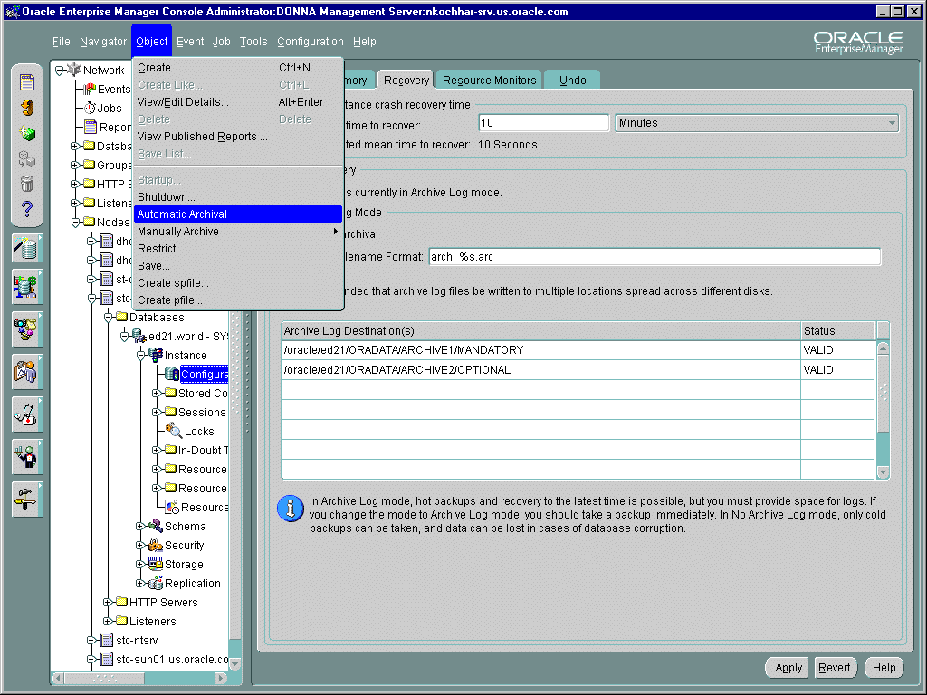
Setting the Archiving Mode
Notes:
Using Oracle Enterprise Manager
The Recovery Page of the Configuration Property Sheet can be used to set the ARCHIVELOG mode. Also, through the Object menu you can toggle automatic archiving of online redo log files on or off.

Slide 11
Automatic and Manual Archiving
  Automatic archiving: LOG_ARCHIVE_START=TRUE
  Manual archiving: LOG_ARCHIVE_START=FALSE
ARC0
053
053
053
053
DBA
Notes:
Automatic and Manual Archiving
The Archive Process
After a database is set in ARCHIVELOG mode, you must decide whether online redo log files are to be archived automatically or manually. This is the second step in creating archived redo log files to use for recovery.
Automatic Versus Manual Archiving
In automatic archiving, the ARCn background processes are enabled and they copy redo log files as they are filled.
In manual archiving, you must use SQL*Plus or Oracle Enterprise Manager to copy the files.
It is recommended that you enable automatic archiving of log files.

Slide 12
Notes:
Automatic and Manual Archiving (continued)
Guidelines
Before deciding on the archive mode (automatic or manual), you must set the database in ARCHIVELOG mode.
Failure to switch to ARCHIVELOG mode will prevent ARCn from copying redo log files.
The database should be shut down cleanly (by using the normal, immediate, or transactional option) before enabling the archive process.
Note: If the archive processes (ARCn) fail for any reason, after transaction activity has filled up all the redo logs, the Oracle server stalls. Setting the database in ARCHIVELOG mode tells the Oracle server not to overwrite the online redo log unless it is archived. Thus archiving online redo logs must keep pace with the transaction activity on the system (generation of redo logs).

Slide 13
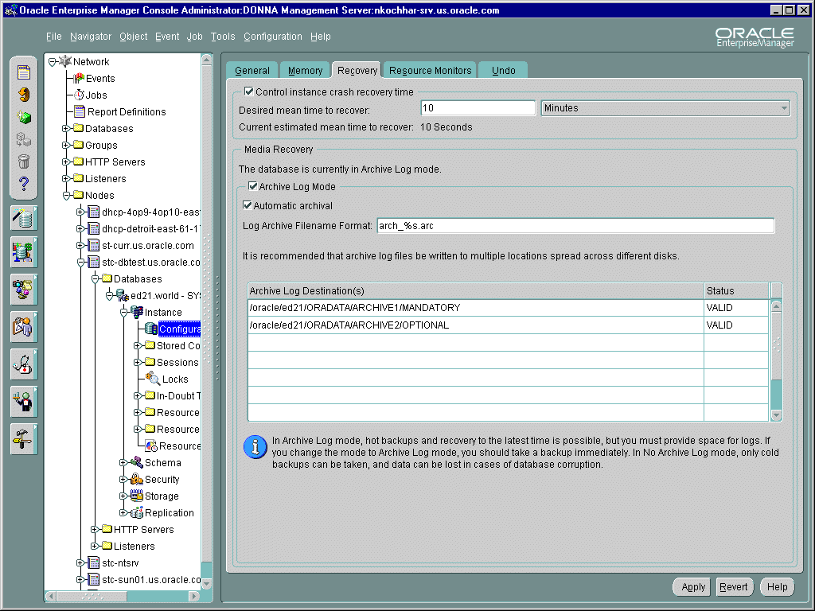
Enabling Automatic Archiving
Notes:
Using Oracle Enterprise Manager
The Recovery Page of the Configuration Property Sheet can be used to enable automatic archiving.

Slide 14
Specifying Multiple ARCn Processes
  The dynamic parameter LOG_ARCHIVE_MAX_PROCESSES controls the number of archive processes started at instance startup.
  A maximum of ten ARCn processes can be specified.
  The number of ARCn processes can be changed with ALTER SYSTEM.
Notes:
LOG_ARCHIVE_MAX_PROCESSES Parameter
Parallel Data Definition Language (DDL) and parallel Data Manipulation Language (DML) operations may generate a large number of redo log files. A single ARC0 process to archive these redo log files might not be able to keep up. Oracle starts additional processes as needed. However if you wish to avoid the run-time overhead of invoking the additional processes, you can specify the number of processes to be started at instance startup.
You can specify up to ten ARCn processes by using the LOG_ARCHIVE_MAX_PROCESSES parameter.
When LOG_ARCHIVE_START is set to TRUE, an Oracle instance starts up with as many archiver processes as defined by LOG_ARCHIVE_MAX_PROCESSES.
You can always spawn additional archive processes, up to the limit set by LOG_ARCHIVE_MAX_PROCESSES, or kill archive processes at any time during the instance life.

Slide 15
Stop or Start Additional Archive Processes
LOG_ARCHIVE_MAX_PROCESSES=2
ARC1
ARC0
053
053
053
Online redo logs
ARC2
Archived redo logs
ALTER SYSTEM SET LOG_ARCHIVE_MAX_PROCESSES = 3;
Notes:
Dynamic Number of ARCn Processes
During a period of heavy transaction load or activity, you can temporarily start additional archive processes to eliminate archiving bottlenecks. After the transaction activity returns to a normal level, you can stop some of the ARCn processes.
For example, every day of the month you start the instance with two archive processes. During the last day of each month, the activity always increases, so you start additional processes:
SQL> ALTER SYSTEM SET LOG_ARCHIVE_MAX_PROCESSES=3;
The day after, if the instance is not shut down, you can issue the following SQL command to stop the additional archive process:
SQL> ALTER SYSTEM SET LOG_ARCHIVE_MAX_PROCESSES=2;

Slide 16
Enabling Automatic Archiving at Instance Startup
Archived
Archived
Archived log files
Current
051
051
052
053
051
Online redo logs
ARC0
051
LOG_ARCHIVE_START=TRUE
LOG_ARCHIVE_MAX_PROCESSES=n
052
052
Notes:
Enabling Automatic Archiving at Instance Startup
If the database is in ARCHIVELOG mode, then archiver processes can be started every time the database instance is started by setting the parameter:
LOG_ARCHIVE_START = boolean
where:
TRUE automatically starts n ARCn processes upon instance startup, where n is determined by the value of LOG_ARCHIVE_MAX_PROCESSES.
FALSE inhibits ARCn from starting upon instance startup.
After the initialization parameter is set, the ARCn processes automatically start upon instance startup, eliminating the need for you to start automatic archiving manually.

Slide 17
Enabling Automatic Archiving
After Instance Startup
1
2
ALTER SYSTEM ARCHIVE LOG START;
051
052
051
052
Online redo logs
ARC0
3
051
Notes:
Enabling Automatic Archiving After Instance Startup
You can enable automatic archiving by using the ALTER SYSTEM command.
You can optionally specify the archiving destination with the TO option on the ALTER SYSTEM ARCHIVE LOG START command.

Slide 18
Disabling Automatic Archiving
2
Initialization
parameters
LOG_ARCHIVE_START
1
ALTER SYSTEM ARCHIVE LOG STOP;
051
052
Online redo logs
ARC0
051
052
Notes:
Disabling Automatic Archiving
You can always stop archive processes regardless of how you started them by using the ALTER SYSTEM command in SQL*Plus or Oracle Enterprise Manager.
Note: Stopping ARCn processes does not set the database in NOARCHIVELOG mode. When all groups of redo logs are used and not archived, the database will stall if it is in ARCHIVELOG mode.

Slide 19
Manually Archiving Online
Redo Log Files
1
ALTER SYSTEM ARCHIVE LOG CURRENT;
051
052
053
Online redo logs
Server
Process
051
2
052
Notes:
Manual Archiving of Redo Log Files
If your database is in ARCHIVELOG mode and you have not enabled automatic archiving, you must manually archive online redo log files.
In addition, you can use manual archiving when automatic archiving is enabled to re-archive an inactive group to another destination.
You must connect with administrator privileges to issue the ALTER SYSTEM ARCHIVE LOG command.

Slide 20
Notes:
Manual Archiving of Redo Log Files (continued)
When you manually archive online redo log files you can use the following options with the ALTER SYSTEM ARCHIVE LOG command:

Slide 21
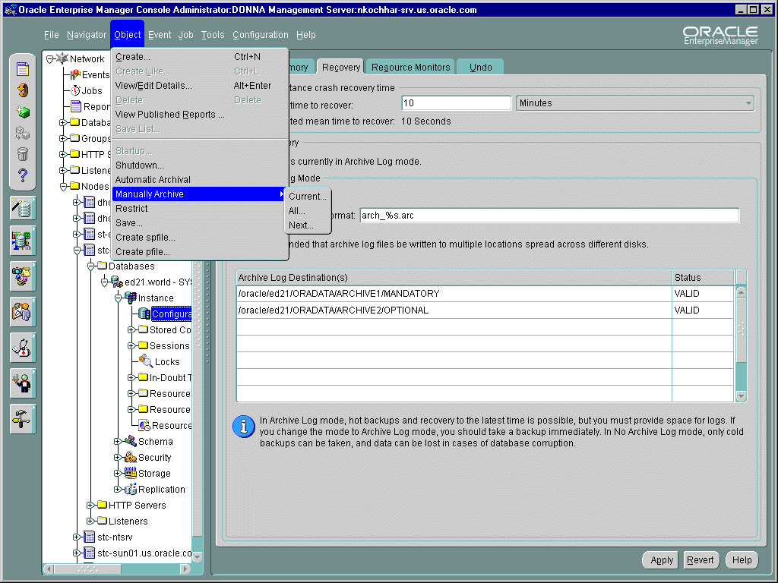
Manually Archiving Online Redo Log Files
Notes:
Using Oracle Enterprise Manager
Through the Object menu you can manually archive online redo log files.

Slide 22
Specifying the Archive Log Destination
  Use LOG_ARCHIVE_DEST_n to specify up to ten archival destinations.
  Use LOG_ARCHIVE_FORMAT to include the log sequence number and thread number as part of the filename.
Notes:
Specifying the Archived Log Destination
LOG_ARCHIVE_DEST_n Parameter
The LOG_ARCHIVE_DEST_n parameters (where n = 1,2,3,4,5...10) define up to ten archive log destinations. This parameter is valid only if you have installed Oracle Enterprise Edition. In Oracle8i, you can only define up to five destinations.
LOG_ARCHIVE_DEST and LOG_ARCHIVE_DUPLEX_DEST Parameters
An alternative means of defining multiple archiving locations is to specify a primary location by using the LOG_ARCHIVE_DEST parameter and to use the LOG_ARCHIVE_DUPLEX_DEST parameter to define a backup destination.
Note: The two methods for defining archive destinations are mutually exclusive. For Oracle Enterprise Edition users, the LOG_ARCHIVE_DEST parameter has been deprecated in favor of the LOG_ARCHIVE_DEST_n parameters. If Oracle Enterprise Edition is not installed, or is installed, but you have not specified any LOG_ARCHIVE_DEST_n parameters, this parameter is valid.
LOG_ARCHIVE_FORMAT Parameter
The LOG_ARCHIVE_FORMAT is used to include the log sequence number and the thread number as part of the filename.

Slide 23
Specifying Multiple Archive
Log Destinations
Use LOG_ARCHIVE_DEST_n to specify up to ten archival destinations, which can be on a:
  Local disk
  Remote standby database
log_archive_dest_1 = "LOCATION=/archive1"
log_archive_dest_2 = "SERVICE=standby_db1"
Notes:
Specifying Multiple Archive Locations
The LOG_ARCHIVE_DEST_n parameters are dynamic parameters that can be modified at the system or session level. A maximum of ten destinations can be specified by using a suffix ranging from 1 to 10.
The destination can be either:
A local file system location, defined by using the keyword LOCATION. The location specified must be valid and cannot be an NFS-mounted directory.
An Oracle Net alias for a remote destination, specified by using the SERVICE keyword. The service name specified is resolved by using the local tnsnames.ora file to identify the remote database. Oracle9i supports shipping of archive log files to a remote node with IPC or TCP/IP. Only one archive destination per remote database can be specified.
Note: When configuring archive log destinations, make sure that the path names are set according to the operating system environment.
You must specify the LOCATION parameter for at least one destination.

Slide 24
LOG_ARCHIVE_DEST_n Options
  Set archive location as MANDATORY or OPTIONAL
  Define time before retry in case of failures
log_archive_dest_1="LOCATION=/archive/ MANDATORY REOPEN"
log_archive_dest_2="SERVICE=standby_db1
MANDATORY REOPEN=600"
log_archive_dest_3="LOCATION=/archive2/
OPTIONAL"
Notes:
Additional Options with LOG_ARCHIVE_DEST_n
MANDATORY Versus OPTIONAL
When using the LOG_ARCHIVE_DEST_n parameters, a destination can be designated as either mandatory or optional as shown below:
MANDATORY implies that archiving to this destination must complete successfully before an online redo log file can be overwritten.
OPTIONAL implies that an online redo log file can be reused even if it has not been successfully archived to this destination. This is the default.
REOPEN Attribute
The REOPEN attribute defines whether archiving to a destination must be re-attempted in case of failure. If a number is specified along with the keyword REOPEN, as in REOPEN=600, the archiver attempts to write to this destination after the specified number of seconds following a failure. The default is 300 seconds. There is no limit on the number of attempts made to archive to a destination. Any errors in archiving are reported in the alert file at the primary site.
If REOPEN is not specified, errors at optional destinations are recorded and ignored. No further redo logs will be sent to these destinations. Errors at mandatory destinations will prevent reuse of the online redo log until the archiving is successful. The status of an archive destination is set to ERROR whenever archiving is unsuccessful.

Slide 25
Specifying a Minimum Number of Local Destinations
  LOG_ARCHIVE_MIN_SUCCEED_DEST parameter
  An online redo log group can be reused only if:
    Archiving has been done to all mandatory locations
    The number of local locations archived is greater than or equal to the value of the LOG_ARCHIVE_MIN_SUCCEED_DEST parameter
LOG_ARCHIVE_MIN_SUCCEED_DEST = 2
Notes:
Specifying the Minimum Number of Successful Archive Locations
The number of destinations that need to be archived successfully before an online redo log file can be used is determined based on the following settings:
The number of destinations defined as MANDATORY
The value of the LOG_ARCHIVE_MIN_SUCCEED_DEST parameter. The value specifies a lower bound on the number of local destinations that need to be archived. If this number is less than the number of mandatory local destinations, it has no effect on the archiving behavior. If this number exceeds the number of mandatory local destinations, the number of local destinations archived must be at least equal to this value before an online redo log file can be reused.

Slide 26
Notes:
Specifying the Minimum Number of Successful Archive Locations (continued)
Example: Consider a case where LOG_ARCHIVE_MIN_SUCCEED_DEST is set to 2. If the number of mandatory local destinations is 3, then these three locations must be archived before an online redo log file can be reused. On the other hand, if the number of mandatory local archive destinations is 1, then at least one optional local archive destination must be archived before an online redo log file can be reused. In other words, the LOG_ARCHIVE_MIN_SUCCEED_DEST can be used to make archiving to one or more optional destinations mandatory, but not vice versa.

Slide 27
Controlling Archiving to a Destination
  An archival destination can be disabled by using the dynamic initialization parameter LOG_ARCHIVE_DEST_STATE_n
  Archiving to a destination can be enabled again
LOG_ARCHIVE_DEST_STATE_2 = DEFER
ALTER SYSTEM SET log_archive_dest_state_3 = DEFER;
LOG_ARCHIVE_DEST_STATE_2 = ENABLE
ALTER SYSTEM SET log_archive_dest_state_3 = ENABLE;
Notes:
LOG_ARCHIVE_DEST_STATE_n Parameter
The state of an archive destination can be changed dynamically. By default, an archive destination is in the ENABLE state, indicating that the Oracle server can use this destination.
The state of an archive destination can be modified by setting the corresponding LOG_ARCHIVE_DEST_STATE_n parameter. For example, to stop archiving to a mandatory location temporarily when an error has occurred, the state of that destination can be set to DEFER. A destination may be defined, but is set to DEFER in the parameter file. This destination can then be enabled when another destination has an error or needs maintenance.
Note: Archiving is not performed to a destination when the state is set to DEFER. If the state of this destination is changed to ENABLE, any missed logs must be manually archived to this destination.

Slide 28
Specifying the Filename Format
Online redo
log files
Group 1
Group 2
Archived log file
053
053
052
052
ARC0
ARC0
052
053
053
/ORADATA/archive/
arch%s.arc
052
LOG_ARCHIVE_DEST_n
LOG_ARCHIVE_FORMAT
Notes:
Specifying LOG_ARCHIVE_FORMAT
LOG_ARCHIVE_FORMAT = extension
Where extension should include the variables %s or %S for log sequence number. The default value is operating system-specific.
Examples
UNIX: LOG_ARCHIVE_FORMAT=arch%s.arc
Windows: LOG_ARCHIVE_FORMAT = %%ORACLE_SID%%T%TS%S.ARC, where %ORACLE_SID% is translated to the database SID
Filename Options
%s or %S: Includes the log sequence number as part of the filename
%t or %T: Includes the thread number as part of the filename
Using %S causes the value to be a fixed length padded to the left with zeros

Slide 29
Obtaining Archive Log Information
Dynamic Views
V$ARCHIVED_LOG
V$ARCHIVE_DEST
V$LOG_HISTORY
V$DATABASE
V$ARCHIVE_PROCESSES
Command Line
ARCHIVE LOG LIST
Notes:
Dynamic Views
You can view information about the archived log files by using the following views:
V$ARCHIVED_LOG: Displays archived log information from the control file.
V$ARCHIVE_DEST: For the current instance, describes all archive log destinations, the current value, mode, and status.
SELECT destination, binding, target, status
FROM v$archive_dest;
DESTINATION BINDING TARGET STATUS
---------------------- --------- ------- --------
/db1/oracle/DEMO/arch MANDATORY PRIMARY VALID
/db2/oracle/DEMO/arch OPTIONAL PRIMARY DEFERRED
standbyDEMO OPTIONAL STANDBY ERROR
OPTIONAL PRIMARY INACTIVE
OPTIONAL PRIMARY INACTIVE

Slide 30
Notes:
Dynamic Views (continued)
Note: The query displays five rows, each representing information for a possible destination. A status of INACTIVE indicates that this destination is not defined. A status of VALID indicates the destination is enabled and error-free.
To check for errors and the log sequence number at which the error occurred for each destination, use the following query:
SELECT destination,fail_sequence,error
FROM v$archive_dest
WHERE status='ERROR';
DESTINATION FAIL_SEQ ERROR
------------ -------- -------------------------------
standbyDEMO 2010 ORA-12154: TNS:could not resolve service name
1 row selected.
V$LOG_HISTORY: Contains log file information from the control file.
V$DATABASE: Current state of archiving.
V$ARCHIVE_PROCESSES: Provides information about the state of the various ARCH processes for the instance.
SELECT * FROM v$archive_processes;
PROCESS STATUS LOG_SEQUENCE STAT
------- ---------- ------------- -----
0 ACTIVE 2014 BUSY
1 ACTIVE 0 IDLE
2 ACTIVE 0 IDLE
3 STOPPED 0 IDLE
4 STOPPED 0 IDLE
5 STOPPED 0 IDLE
6 STOPPED 0 IDLE
7 STOPPED 0 IDLE
8 STOPPED 0 IDLE
9 STOPPED 0 IDLE
10 rows selected.
One row for each of the 10 possible archiver processes is displayed. A status of ACTIVE indicates that the process is up and running. A process that is currently archiving has a state of BUSY. The LOG_SEQUENCE column for a busy process shows the current log sequence number it is archiving.
Note: You can also use the RMAN LIST command to obtain information about archived redo log files recorded in the repository.

Slide 31
Notes:
Archive Log Information
The ARCHIVE LOG LIST command provides the DBA with information about the log mode and status of archiving for the database:
SQL> ARCHIVE LOG LIST
Database log mode Archive mode
Automatic archival Enabled
Archive destination /ORADATA/ARCHIVE1/
Oldest online log sequence 1304
Next log sequence to archive 1305
Current log sequence 1305

Slide 32
Summary
In this lesson, you should have learned how to:
  Configure a database for ARCHIVELOG mode
  Enable automatic archiving
  Perform manual archiving of logs
  Configure multiple archive processes
  Configure multiple destinations

Slide 33
Practice 8 Overview
This practice covers the following topics:
  Enabling and disabling automatic archiving
  Configuring multiple archiver processes
  Configuring multiple archiving destinations
  Performing manual archiving of redo log files

Slide 34
Notes:
Practice 8: Configuring the Database Archiving Mode
1. Make changes to the initialization parameters as follows:
Enable archiving
Archive log files to two destinations: your_home_directory/ORADATA/ARCHIVE1 and your_home_directory/ORADATA/ ARCHIVE2 directories. Your_home_directory/ORADATA/ARCHIVE1 is mandatory and your_home_directory/ORADATA/ARCHIVE2 is optional.
Use the archiving format of arch_%s.arc
Spawn two archive processes at instance start
2. Invoke SQL*Plus, connect as sysdba,and shut down the instance with the Immediate option.
3. Start up the database in MOUNT mode.
4. List the parameters LOG_ARCHIVE_DEST, LOG_ARCHIVE_START, and LOG_ARCHIVE_FORMAT, and note the values.
5. Execute the ARCHIVE LOG LIST command. Note the database log mode of the database and whether automatic archiving is enabled.
6. Set the database in ARCHIVELOG mode.
7. Open the database.
8. Update your SPFILE.
9. Execute the ARCHIVE LOG LIST command. Verify that two archiver processes are running.
10. Execute the ALTER SYSTEM SWITCH LOGFILE command twice, then show the values of the ARCHIVE parameters. Do you see any archived log files? What is the format of the filename?
11. Stop automatic archiving by executing the ALTER SYSTEM ARCHIVE LOG STOP command.
12. Execute the ALTER SYSTEM SWITCH LOGFILE command enough times to cycle through all the online redo log groups. What happens and why?
13. Establish a second telnet session and invoke SQL*Plus. Connect as sysdba.
14. Enable automatic archiving by using the ALTER SYSTEM ARCHIVE LOG START command.
15. Return to your first session. What happened and why?

