Slide 1
Oracle Recovery Manager
Overview and Configuration

Slide 2
Objectives
After completing this lesson, you should be able to do the following:
  Identify the features and components of RMAN
  Describe the RMAN repository and control file usage
  Describe channel allocation
  Describe the Media Management Library interface
  Connect to RMAN without the recovery catalog
  Configure the RMAN environment

Slide 3
Recovery Manager Features
RMAN provides a flexible way to:
  Back up the database, tablespaces, datafiles, control files, and archive logs
  Store frequently executed backup and recovery operations
  Perform incremental block-level backup
  Skip unused blocks
  Specify limits for backups
Notes:
Recovery Manager Features
Recovery Manager (RMAN) is an Oracle utility that you use to manage the backup, restore, and recovery operations on Oracle databases. RMAN has a powerful command language that is independent of the operating system.
Recovery Manager has a command-line interface. Oracle Enterprise Manager also provides a graphical user interface for the Recovery Manager. Recovery Manager can be used on databases of Oracle8 or later releases.
RMAN provides several features not available when you make user-managed backups with operating system commands.
You can store frequently executed operations as scripts in the database.
Using the incremental block-level backup feature you can limit the backup to only those blocks that have changed since the previous backup. This may also reduce the time it takes to perform recovery operations in ARCHIVELOG mode.
You can use RMAN to manage the size of backup pieces and save time by parallelizing the backup operation.
RMAN operations can be integrated with the scheduling of the operating system to automate backup operations.

Slide 4
Recovery Manager Features
RMAN provides a flexible way to:
  Detect corrupted blocks during backup
  Increase performance through:
    Automatic parallelization
    Generation of less redo
    Restricting I/O for backups
    Tape streaming
  Manage backup and recovery tasks
Notes:
Recovery Manager Features (continued)
You can detect block corruption. The information relating to the block corruption that is detected during backup can be obtained by using the V$BACKUP_CORRUPTION and V$COPY_CORRUPTION dynamic views.
RMAN provides performance enhancements such as:
Automatic parallelization of backup, restore, and recovery operations
No generation of extra redo during online database backups
Backups that are restricted to limit reads per file, per second to avoid interfering with OLTP work
Prevention of flooding of any one file with reads and writes while still keeping a tape drive streaming, using multiplexing
RMAN has a media management API to work seamlessly with third-party media management tools interfacing with storage devices providing increased speed and reliability.
Under the user-managed method you need to keep track of all database files and backups. In a recovery situations you must locate backups for each datafile, copy them to the correct place using operating system commands, and choose which logs to apply. RMAN manages these tasks automatically. This advantage of using RMAN is especially true if you use Oracle Managed Files.

Slide 5


Recovery Manager Components
Server
session
(polling)
Recovery
Manager
(RMAN)
Enterprise Manager
Target
database
Server
session
(rcvcat)
Server
session
(channel)
Server
session
(channel)
Server
session
(channel)
Server
session
(default)
MML
Recovery
catalog DB
Disk
Disk
Notes:
Recovery Manager Components
Recovery Manager Executable: The Recovery Manager command-line interface is invoked through the executable RMAN. RMAN interprets user commands and appropriately invokes server sessions to perform the desired tasks.
Oracle Enterprise Manager: The Oracle Enterprise Manager Backup, Recovery, and Catalog Maintenance wizards provide a graphical user interface to Recovery Manager.
Note: The wizards and property sheets are only available when you are connected to a Management Server.
Server Sessions: The server processes (UNIX) or threads (Windows NT) invoked by RMAN connect to the target database to perform the backup, restore, and recovery functions through a PL/SQL interface.
Target Database: The database for which backup and recovery operations are being performed using RMAN is called the target database. The control file of the target database contains information about its physical structure, such as the size and location of datafiles, online and archived redo log files, and control files. This information is used by the server sessions invoked by RMAN in backup and recovery operations.

Slide 6
Notes:
Recovery Manager Components (continued)
RMAN Repository: The data used by RMAN for backup, restore, and recovery operations is referred to as RMAN metadata. It is stored in the control file of the target database and in an optional recovery catalog database.
Although it is not mandatory to create a recovery catalog to use RMAN, it is beneficial to use a recovery catalog. The recovery catalog should be located in a database different from the target database. The creation and maintenance of the recovery catalog is discussed in another lesson.
Channel: To perform and record backup and recovery operations, RMAN requires a link to the target database. This link is referred to as a channel. You can allocate channels manually or preconfigure channels using automatic channel allocation.
Media Management Library: The media management library (MML) is used by RMAN when writing to or reading from tapes. The additional media management software required for using the tape medium is provided by media and storage system vendors.

Slide 7
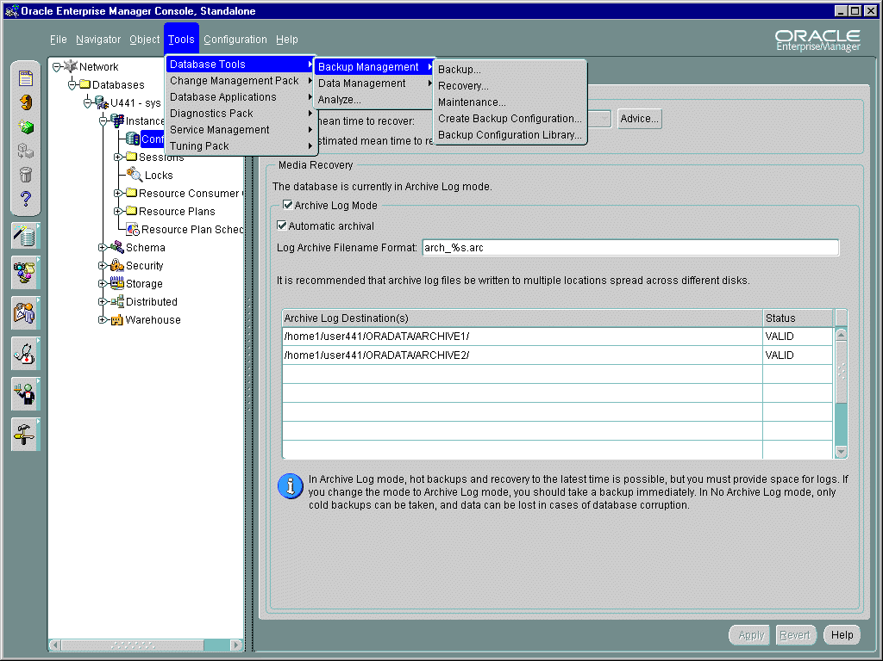
Using the Backup Management Wizards
Notes:
Using Oracle Enterprise Manager
You can access the Backup Management wizards and property sheets by using one of the following methods:
From the Console Navigator tree, select the database that you want to administer; then, choose the tool from the context-sensitive Backup Management menu.
From the Storage Management container of the Console Navigator tree, select the tablespace or datafile that you want to administer; then, choose the tool from the context-sensitive Backup Management menu.
From the Object menu, select the Backup Management menu.
From the Tools menu, expand the Database Tools menu and select the Backup Management menu.

Slide 8
RMAN Repository: Using the Control File
  RMAN repository is metadata about target database and backup and recovery operations.
  RMAN repository is always stored in the control file of the target database.
  CONTROL_FILE_RECORD_KEEP_TIME determines the minimum age in days of a record before it can be overwritten.
  The control file can grow in size.
Notes:
Using the Control File as the RMAN Repository
RMAN stores information about the target database and its backup and recovery operations in the RMAN repository. The target database control file can be used as the exclusive storage location for this information. The amount of information stored can increase depending on the frequency of backups, the number of archived redo log files that are generated, and the retention period for RMAN records.
Setting CONTROL_FILE_RECORD_KEEP_TIME
The CONTROL_FILE_RECORD_KEEP_TIME parameter specifies the minimum number of days RMAN information is stored in the control file before being overwritten. A low value results in information being overwritten more frequently, thus minimizing control file growth. If a recovery catalog is used, a lower value should be chosen. The default is seven days.
If the size of the control file is too small to store all the information for the time specified by CONTROL_FILE_RECORD_KEEP_TIME, then the control file grows. Before the control file grows, certain steps are performed:
1. Free space in the control file is used.
2. Entries older than CONTROL_FILE_RECORD_KEEP_TIME are overwritten.
3. If no more space is available, the control file grows as needed until reaching the operating file size system limit.

Slide 9
Channel Allocation
Disk
Server
Session
Channel (disk)
RMAN
Target
database
Server
Session
Channel (sbt)
Notes:
Channel Allocation
A channel represents one stream of data to a device type. A channel must be allocated before you execute backup and recovery commands. Each allocated channel establishes a connection from the RMAN executable to a target or auxiliary database instance (either a database created with the duplicate command or a temporary database used in TSPITR) by starting a server session on the instance. This server session performs the backup and recovery operations. Only one RMAN session communicates with the allocated server sessions.
Each channel usually corresponds to one output device, unless your MML is capable of hardware multiplexing.
You can allocate channels manually or preconfigure channels for use in all RMAN sessions using automatic channel allocation.
Manual Channel Allocation
The ALLOCATE CHANNEL command with a RUN command and the ALLOCATE CHANNEL FOR MAINTENANCE command issued at the RMAN prompt are used to allocate a channel manually. Manual channel allocation overrides automatic allocation.

Slide 10
Notes:
Channel Allocation (continued)
Automatic Channel Allocation
In Oracle9i, you can preconfigure channels for use in all RMAN sessions using automatic channel allocation.
RMAN provides a preconfigured DISK channel that you can use for backups and copies to disk.
In addition, you can configure a set of persistent, automatic channels. You specify automatic channels to disk or tape by using the CONFIGURE CHANNEL command.

Slide 11
Automatic Channel Allocation
  Change the default device type:
  Configure parallelism for automatic channels:
  Configure automatic channel options:
RMAN> CONFIGURE DEFAULT DEVICE TYPE TO sbt;
RMAN> CONFIGURE DEVICE TYPE DISK PARALLELISM 3;
RMAN> CONFIGURE CHANNEL DEVICE TYPE DISK
2> FORMAT = ‘/BACKUP/RMAN/%U';
RMAN> CONFIGURE CHANNEL DEVICE TYPE DISK
2> MAXPIECESIZE 2G;
Notes:
Configuring Automatic Channels
You can save persistent configuration information such as channel parameters, parallelism, and the default device type in the RMAN repository. You can configure automatic channels for use in backup, restore, recovery, and maintenance jobs.
When a channel is automatically allocated by RMAN, its name is in the format ora_devicetype_n (ora_sbt_tape_n or ora_disk_n).
If you do not specify a format, RMAN uses %U by default, which guarantees a unique identifier. %U specifies a convenient shorthand for %u_%p_%c that guarantees uniqueness in generated backup filenames. %u specifies an 8-character name constituted by compressed representations of the backup set number and the time the backup set was created. %p specifies the piece number within the backup set. %c specifies the copy number of the backup piece within a set of duplexed backup pieces.
You can override automatic channels by using the ALLOCATE CHANNEL command to allocate channels manually. The automatic channel feature is mutually exclusive with the manual channel feature: RMAN uses one or the other for every job.
By default, RMAN has preconfigured a disk channel so that you can back up to disk without doing any manual configuration. Hence, if you are backing up to disk rather than to a media manager, you can immediately begin backing up to disk.

Slide 12
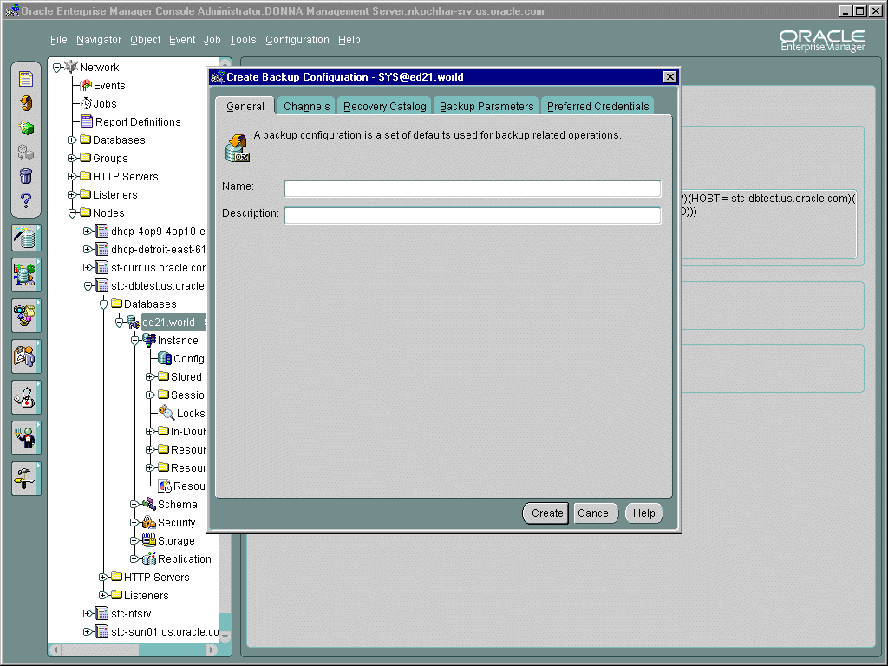
Channel Allocation Using OEM
Notes:
Channel Allocation Using the Create Backup Configuration Wizard
The Create Backup Configuration Wizard enables you to define a configuration with a set of defaults for backup and recovery. On the General page you provide a name and description for a set of defaults used for backup, recovery, and catalog maintenance operations. On the Channels page you specify whether the configuration will be used for backups using an image copy or for backups using a backup set.

Slide 13
Manual Channel Allocation
  BACKUP, COPY, RESTORE, and RECOVER commands require at least one channel.
  Allocating a channel starts a server process on the target database.
  Channels affect the degree of parallelism.
  Channels write to different media types.
  Channels can be used to impose limits.
RMAN> RUN {
2> ALLOCATE CHANNEL c1 TYPE disk
3> FORMAT = '/db01/BACKUP/usr0520.bak';
4> BACKUP DATAFILE '/db01/ORADATA/users01.dbf';}
Notes:
Manually Allocating a Channel
Recovery Manager uses the channel processes to communicate between the Oracle server and the operating system.
An Oracle server process for the target database is created for every channel allocated. Every BACKUP, COPY, RESTORE, or RECOVER command issued in Recovery Manager requires at least one channel.
The number of channels allocated will be the maximum degree of parallelization that is used during backup, restore, or recovery.
The type of media desired determines the type of channel allocated. Query the V$BACKUP_DEVICE view to determine supported device types.
You can impose limits for the COPY and BACKUP commands by specifying parameters in the ALLOCATE CHANNEL command:
Read rate: Limits number of buffers read per second, per file to reduce online performance through excessive disk I/O.
allocate channel … rate = integer
Kbytes: Limits backup piece file size created by a channel. This is useful when there are maximum file sizes for an operating system or device type.
allocate channel … maxpiecesize = integer

Slide 14
Notes:
Manually Allocating a Channel (continued)
MAXOPENFILE: Limits the number of concurrently open files for a large backup (default 16). This prevents too many files from being open.
ALLOCATE CHANNEL … MAXOPENFILE = integer
Examples of Allocating a Channel
ALLOCATE CHANNEL FOR MAINTENANCE DEVICE TYPE disk;
This command allocates a channel for the DELETE command, because a file will be removed from the disk. Maintenance channels cannot be used for any other I/O operation, such as backup or copy.
RMAN> RUN {
2> ALLOCATE CHANNEL d1 DEVICE TYPE disk
3> FORMAT = ’/db01/BACKUP/%U’;
4> BACKUP DATAFILE ’/…/u03/users01.dbf’;}
The second example allocates a channel named d1, where all files created by this channel will have the format ’/db01/BACKUP/%U’. The channel backs up one datafile, /db01/ORADATA/u03/users01.dbf.

Slide 15
Media Management
Recovery Manager
Oracle server session
Media management library
Media management server software
Tape library or single tape
Notes:
Media Management
To use tape storage for your database backups, RMAN requires a media manager. A media manager is a utility that loads, labels, and unloads sequential media, such as tape drives for the purpose of backing up, restoring, and recovering data. The Oracle server calls MML software routines to back up and restore datafiles to and from media that is controlled by the media manager.
Some media management products can manage the entire data movement between Oracle datafiles and the backup devices. Some products that use high-speed connections between storage and media subsystems can reduce much of the backup load from the primary database server.
Note that the Oracle server does not need to connect to the media management library (MML) software when it backs up to disk.
The Oracle Backup Solutions Program (BSP) provides a range of media management products that are compliant with Oracle's MML specification. Software that is compliant with the MML interface enables an Oracle server session to back up to a media manager and request the media manager to restore backups. Check with your media vendor to determine whether it is a member of the Oracle BSP.

Slide 16
Notes:
Media Management (continued)
Before you can begin using RMAN with a media manager, you must install it and make sure that RMAN can communicate with it.Instructions for this procedure should be available in the media manager vendor's software documentation.
Depending on the product that you are installing, the following basic steps apply:
1. Install and configure the media management software on the target host or production network. No RMAN integration is required at this stage.
2. Ensure that you can make non-RMAN backups of operating system files on the target database host. This step makes later troubleshooting much easier. Refer to your media management documentation to learn how to back up files to the media manager.
3. Obtain and install the third-party media management module for integration with the Oracle server. This module must contain the library that Oracle loads when accessing the media manager.
After you install the media management software, the media management library should already be integrated with the Oracle server.
Backup and Restore Operations Using a Media Manager
The following Recovery Manager script performs a datafile backup to a tape drive controlled by a media manager:
run {
# Allocating a channel of type 'sbt' for serial device
ALLOCATE CHANNEL ch1 DEVICE TYPE 'sbt';
BACKUP DATAFILE 3;
}
When Recovery Manager executes this command, it sends the backup request to the Oracle server session performing the backup. The Oracle server session identifies the output channel as a media management device and requests the media manager to load a tape and write the output.
The media manager labels and keeps track of the tape and names of files on each tape.
The media manager handles restore as well as backup operations. When you restore a file, the following steps occur:
1. The Oracle server requests the restore of a particular file.
2. The media manager identifies the tape containing the file and reads the tape.
3. The media manager passes the information back to the Oracle server session.
4. The Oracle session writes the file to disk.

Slide 17
Types of Connections with RMAN
  Target database
  Recovery catalog database
  Auxiliary database
    Standby database
    Duplicate database
    TSPITR instance
Notes:
Types of Database Connections with RMAN
You can use Recovery Manager to connect to the following types of databases:
Target database: You are connected to the target database with the SYSDBA privilege. You must have this privilege for the connection to succeed.
Recovery catalog database: This is an optional database which is configured for the RMAN repository.
Auxiliary database: An auxiliary database is a database that is created using the RMAN DUPLICATE command. Or it may be a temporary database that is used during tablespace point-in-time recovery (TSPITR). A standby database is a copy of your production database that can be used for disaster recovery.

Slide 18
Connecting Without a Recovery Catalog
Server
process
(polling)
Server
process
(default)
Recovery
manager
(RMAN)
Target
database
  Starting RMAN locally
  Starting RMAN remotely
UNIX: $ ORACLE_SID=DB01; export ORACLE_SID
$ rman target / as sysdba
Windows NT: C:\> set ORACLE_SID=DB01
C:\> rman target / as sysdba
rman target sys/target_pwd@DB01
Notes:
Connecting to the Target Database Without a Catalog
Local Connection
For a local RMAN connection, at an operating system prompt, enter the following:
UNIX: $ ORACLE_SID=DB01; export ORACLE_SID
$ rman target /
Windows: C:\> SET ORACLE_SID=DB01
C:\> rman target /
Optionally, you can specify the keyword NOCATALOG as follows:
$ rman target / nocatalog
NOCATALOG is the default mode.
Remote Connection
To connect from another server, use the net service name for the target database:
$ rman target sys/target_pwd@DB01

Slide 19
Notes:
Connecting to the Target Database Without a Catalog (continued)
Connection Process
After you type the RMAN connection command, the following events occur:
A user process is created for Recovery Manager.
The user process creates two Oracle server processes:
One default process connected to the target database for executing SQL commands, resynchronizing the control file, and recovery roll forward
One polling process connected to the target database to locate Remote Procedure Call (RPC) completions (only one per instance)
Backup and recovery information is retrieved from the control file.

Slide 20
Additional RMAN Command
Line Arguments
  Writing RMAN output to a log file:
  Executing a command file when RMAN is invoked:
$ rman target sys/oracle
log $HOME/ORADATA/u03/rman.log append
$ rman target sys/oracle
log $HOME/ORADATA/u03/rman.log append
@’$HOME/STUDENT/LABS/my_rman_script.rcv’
Notes:
RMAN Command Line Arguments
The LOG = 'filename' argument specifies the file where RMAN output will be recorded. If you do not specify this argument, then RMAN writes its message log file to standard output. If the specified file cannot be opened, RMAN will not abort. Instead, the output goes to standard output.
The APPEND keyword specifies that new output should be appended to the end of the message log file. If you do not specify this parameter, and a file with the same name as the message log file already exists, RMAN will overwrite it.
You can use the CMDFILE = 'filename' to run a file containing RMAN commands. You can omit the quotes around the filename, if the first character of the filename is alphabetic. RMAN terminates after running the command file.

Slide 21
Recovery Manager Modes
  Interactive mode
    Use it when doing analysis
    Minimize regular usage
    Avoid using with log option
  Batch mode
    Meant for automated jobs
    Minimize operator errors
    Set the log file to obtain information
Notes:
Recovery Manager
Recovery Manager acts as a command-line interpreter (CLI) with its own command language. There are two modes of operation with the RMAN: interactive and batch.
Interactive Mode: To run RMAN commands interactively, start RMAN and then type commands into the command-line interface. For example, you can start RMAN from the UNIX command shell and then execute interactive commands as follows:
$ rman target sys/sys_pwd@db1
RMAN> BACKUP DATABASE;
Batch Mode: You can enter RMAN commands into a file, and then run the command file by specifying its name on the command line. The contents of the command file should be identical to commands entered at the command line.
When running in batch mode, RMAN reads input from a command file and writes output messages to a log file (if specified).

Slide 22
Notes:
Recovery Manager (continued)
RMAN parses the command file in its entirety before compiling or executing any commands. There is no need to place an exit command in the file because RMAN will terminate when the end of the file is reached.
Batch mode is most suitable for performing regularly scheduled backups by means of an operating system job-control facility.
$ rman target / @tbsbk.rcv log tbs.log
In this example, the user has created a file tbsbk.rcv, which contains the commands the user would have used interactively. RMAN would output the messages to the file tbs.log.
Using Oracle Enterprise Manager
The Run RMAN Script task allows you to issue any command or script within Oracle Enterprise Manager that can also be called from the RMAN command line. On the Parameters page, specify the parameter settings for the Run RMAN Script task.

Slide 23
RMAN Commands
  RMAN commands are of the following types:
  Stand-alone
    Executed only at the RMAN prompt
    Executed individually
    Cannot appear as subcommands within RUN
  Job
    Must be within the brackets of RUN
    Executed as a group
  Stand-alone or job
Notes:
RMAN Commands
RMAN has two basic types of commands: stand-alone and job commands.
Stand-alone commands are executed at the RMAN prompt and are generally self-contained. Following are some of the stand-alone commands:
CHANGE
CONNECT
CREATE CATALOG, RESYNC CATALOG
CREATE SCRIPT, DELETE SCRIPT, REPLACE SCRIPT
The job commands are usually grouped and RMAN executes the job commands inside of a RUN command block sequentially. If any command within the block fails, RMAN ceases processing; no further commands within the block are executed.
There are some commands that can be issued either at the prompt or within RUN. By executing stand-alone commands at the RMAN prompt, you can take advantage of the automatic channel functionality.
You can execute the commands in interactive mode or batch mode.

Slide 24
Notes:
Command Examples
To mount the target database
Issue the startup command as follows:
RMAN> STARTUP MOUNT
To shut down the target database
Issue the shutdown command as follows:
RMAN> SHUTDOWN IMMEDIATE
To list the current configuration of the target database
Use the REPORT command to obtain the configuration of the database as follows:
RMAN> REPORT SCHEMA;
Report of database schema
File K-bytes Tablespace RB Name
---- -------- ---------- --- -----------------
1 117760 SYSTEM *** …/ORADATA/u01/system_01.dbf
2 30720 UNDO1 *** …/ORADATA/u02/undotbs01.dbf
3 5120 USERS *** …/ORADATA/u04/users_01.dbf
4 5120 INDX *** …/ORADATA/u03/indx_01.dbf
5 5120 SAMPLE *** …/ORADATA/u02/sample_01.dbf
6 1024 QUERY_DATA *** …/ORADATA/u01/query_01.dbf

Slide 25
Job Command: Example
RUN command:
RMAN> RUN {
backup
incremental level 0
format ‘/u01/db01/backup/%d_%s_%p’
fileperset 5
(database include current controlfile);
sql ‘alter database archive log current’; }
Notes:
Job Commands
Unlike stand-alone commands, job commands must appear within the brackets of a RUN command. Following are examples of job commands:
ALLOCATE CHANNEL
SWITCH
RMAN executes the job commands inside of a RUN command block sequentially. If any command within the block fails, then RMAN ceases processing; no further commands within the block are executed. In effect, the RUN command defines a unit of command execution. When the last command within a RUN block completes, Oracle releases any server-side resources such as I/O buffers or I/O slave processes allocated within the block.

Slide 26
RMAN Configuration Settings
  RMAN is preset with default configuration settings
  Use the CONFIGURE command to:
    Configure automatic channels
    Specify the backup retention policy
    Specify the number of backup copies to be created
    Limit the size of backup sets
    Exempt a tablespace from backup
    Enable and disable backup optimization
Notes:
RMAN Configuration Settings
RMAN is preset with default configuration settings that apply to all RMAN sessions.
You can use the CONFIGURE command to configure persistent settings for RMAN backup, restore, duplication, and maintenance jobs. These settings are in effect for any RMAN session until the configuration is cleared or changed.
Using Oracle Enterprise Manager
You can use the Create Backup Configuration wizard to set defaults for backup and recovery. The wizard is accessed through the Oracle Enterprise Manager Console and requires a connection to a Management Server. On the General page, you give a name and description to a set of defaults used for backup, recovery, and catalog maintenance operations. On the Channels page you specify whether the configuration is for an image copy or backup set and provides additional specifications for the channel. On the Backup Parameters page you set storage parameters for the backup set.

Slide 27
The CONFIGURE Command
  Configure automatic channels:
  Implement retention policy by specifying a recovery window:
  Implement retention policy by specifying redundancy:
RMAN> CONFIGURE CHANNEL DEVICE TYPE DISK FORMAT '/db01/BACKUP/%U';
RMAN> CONFIGURE RETENTION POLICY TO RECOVERY
2> WINDOW OF 7 days;
RMAN> CONFIGURE RETENTION POLICY TO REDUNDANCY 2;
Notes:
Using the CONFIGURE Command
Configure Automatic Channels
You can specify the default backup location and file naming convention with the CONFIGURE CHANNEL command.
Configure Backup Retention Policies
You can use the CONFIGURE RETENTION POLICY command to create a persistent and automatic backup retention policy. Based on the criteria that you specify in the CONFIGURE command, RMAN determines when backups and copies of datafiles and control files are obsolete; that is, when they are no longer needed for media recovery. You can issue the REPORT OBSOLETE command to view obsolete files and DELETE OBSOLETE to delete them. You can issue the CONFIGURE RETENTION POLICY CLEAR command to return the setting to the default value.
You can implement a retention policy in one of the following mutually exclusive ways:
Specify a recovery window, which is a period of time that begins with the current time and extends backward in time to the point of recoverability. In the example, the CONFIGURE command ensures that for each datafile, one backup that is older than the point of recoverability (seven days) must be retained.

Slide 28
The CONFIGURE Command
  Configure duplexed backup sets:
  Configure backup optimization:
  Use the CLEAR option to return to the default value:
RMAN> CONFIGURE DATAFILE BACKUP COPIES FOR
2> DEVICE TYPE disk TO 2;
RMAN> CONFIGURE BACKUP OPTIMIZATION ON;
RMAN> CONFIGURE RETENTION POLICY CLEAR;
RMAN> CONFIGURE CHANNEL DEVICE TYPE sbt CLEAR;
Notes:
Using the CONFIGURE Command (continued)
Specify a redundancy value, which indicates that any number of backups or copies beyond a specified number need not be retained.
By default, RETENTION POLICY is configured to REDUNDANCY 1.
Configure Duplexed Backup Sets
You can create up to four copies of each backup piece in a backup set for all backup commands that use automatic channels. This applies only for datafiles and archived redo log files.
Configure Backup Optimization
You set backup optimization on so that the BACKUP command does not back up files to a device type if the identical file has already been backed up to the device type. For two files to be identical, their content must be exactly the same. The default value for backup optimization is OFF.
You can override backup optimization by using the FORCE option of the BACKUP command.

Slide 29
The SHOW Command
  Displays persistent configuration settings
  Use the SHOW command to display:
    Automatic channel configuration settings
    Backup retention policy settings
    Number of backup copies to be created
    Backup set size limit
    Tablespace excluded from backups
    Backup optimization status
  Use SHOW ALL to display all settings:
RMAN> SHOW ALL;
Notes:
The SHOW Command
The SHOW command is used to to display persistent configuration settings specified with the CONFIGURE command. These settings are configured for use with any RMAN session.
You can use the SHOW command to display the following:
Automatic channel configuration settings
SHOW CHANNEL;
SHOW DEVICE TYPE;
SHOW DEFAULT DEVICE TYPE;
RMAN retention policy configuration settings
SHOW RETENTION POLICY;
Number of backup copies
SHOW DATAFILE BACKUP COPIES;
Maximum size for backup sets
SHOW MAXSETSIZE;
Tablespaces excluded from whole database backups
SHOW EXCLUDE;
Status of backup optimization
SHOW BACKUP OPTIMIZATION;

Slide 30
LIST Command Operations
  Lists backup sets and copies of datafiles
  Lists backup sets and copies of any datafile for a specified tablespace
  Lists backup sets and copies containing archive logs for a specified range
Notes:
The LIST Command
The LIST command is used to produce a detailed report listing all information for the following:
Backup sets that contain a backup of a specified list of datafiles
Copies of a specified list of datafiles
Backup sets that contain a backup of any datafile that is a member of a specified list of tablespaces
Copies of any datafile that is a member of a specified list of tablespaces
Backup sets that contain a backup of any archived logs with a specified name or range
Copies of any archived logs with a specified name or range

Slide 31
The LIST Command
  List backups of all files in the database:
  List all backup sets containing the users01.dbf datafile:
  List all copies of datafiles in the SYSTEM tablespace:
RMAN> LIST BACKUP OF DATABASE;
RMAN> LIST BACKUP OF DATAFILE
2> "/db01/ORADATA/u03/users01.dbf";
RMAN> LIST COPY OF TABLESPACE "SYSTEM";
Notes:
Using the LIST Command
You must be connected to the target database. If you are connected in the NOCATALOG mode, then the database must be mounted. If you connect using a recovery catalog, then the target instance must be started (but does not need to be mounted).
List Database Backup
You can use this command to generate a list of backups of all files in the database.
List Backup Set
The example uses the LIST command to list all known backups of the datafile
“/db01/ORADATA/u03/users01.dbf”.
List Datafile Copies
The example uses the LIST command to list datafile copies for the SYSTEM tablespace.

Slide 32


The REPORT Command
  Produces a detailed analysis of the repository
  Produces reports to answer:
    Which files need a backup?
    Which backups can be deleted?
    Which files are unrecoverable?
Notes:
The REPORT Command
This command helps you analyze information in the RMAN repository in more detail.
Reports can be produced for a variety of questions, such as:
What is the structure of the database?
RMAN> REPORT SCHEMA;
Which files need to be backed up?
RMAN> REPORT NEED BACKUP ...;
Which backups can be deleted (that is, are obsolete)?
RMAN> REPORT OBSOLETE;
Which files are not recoverable because of unrecoverable operations?
RMAN> REPORT UNRECOVERABLE ...;

Slide 33
The REPORT NEED BACKUP Command
  Lists all datafiles that require a backup
  Assumes the most recent backup is used during a restore
  Provides four options:
    Incremental
    Days
    Redundancy
    Recovery window
  Without options, takes into account the configured retention policy
Notes:
The REPORT NEED BACKUP Command
The REPORT NEED BACKUP command is used to identify all datafiles that need a backup. The report assumes that the most recent backup would be used in the event of a restore.
There are four options:
Incremental: An integer specifies the maximum number of incremental backups that should be restored during recovery. If this number, or more, is required, then the datafile needs a new full backup.
For example, to report files needing three or more incremental backups for recovery:
RMAN > REPORT NEED BACKUP incremental 3 database;
Days: An integer specifies the maximum number of days since the last full or incremental backup of a file. The file needs a backup if the most recent backup is equal to or greater than this number.
For example, to report what system files have not been backed up for three days:
RMAN > REPORT NEED BACKUP days 3 tablespace system;
Redundancy: An integer specifies the minimum level of redundancy considered necessary. For example, redundancy level two requires a backup if there are not two or more backups.
Recovery window: A time window in which RMAN should be able to recover the database.

Slide 34
REPORT NEED BACKUP: Examples
  Files needing three or more incremental backups for recovery:
  Files have not been backed up for three days:
  Backup needed if there are not two or more:
  Backup needed to recover 3 days past:
RMAN> REPORT NEED BACKUP incremental 3;
RMAN> REPORT NEED BACKUP days 3;
RMAN> REPORT NEED BACKUP redundancy 2;
RMAN> REPORT NEED BACKUP
2> recovery window of 3 days;
Notes:
Using the REPORT NEED BACKUP Command
There are four options:
Incremental: An integer specifies the maximum number of incremental backups that should be restored during recovery. If this number, or more, is required, then the datafile needs a new full backup.
Days: An integer specifies the maximum number of days since the last full or incremental backup of a file. The file needs a backup if the most recent backup is equal to or greater than this number.
Redundancy: An integer specifies the minimum level of redundancy considered necessary. For example, redundancy level two requires a backup if there are not two or more backups.
Recovery window: A time window in which RMAN should be able to recover the database.

Slide 35
Recovery Manager Packages
Recovery Manager uses PL/SQL packages as its interface to:
  Target databases
  The recovery catalog
Target
database
dbms_backup_restore
dbms_rcvman
dbms_rcvcat
Recovery
Manager
dbms_rcvcat
dbms_rcvman
dbms_rcvman
PL/SQL
dbms_rcvman
Recovery
catalog
Target
control file
Notes:
Recovery Manager Packages
The RMAN executable uses PL/SQL packages to communicate with the target database and recovery catalog. The PL/SQL packages perform the following functions:
Maintain the RMAN repository in the control file or recovery catalog
Communicate with Oracle and the operating system to create, restore, and recover backup sets and image copies
Provide a consistent interface so that the RMAN executable can use either the recovery catalog or target database control file as its backup repository with no change in behavior
DBMS_RCVCAT and DBMS_RCVMAN
These are internal, undocumented packages created by the CREATE CATALOG command. DBMS_RCVMAN is created in the target database by the dbmsrman.sql and prvtrmns.plb scripts that are called by catproc.sql.
DBMS_RCVCAT is used by Recovery Manager to maintain information in the recovery catalog, and DBMS_RCVMAN queries the control file or recovery catalog.
DBMS_BACKUP_RESTORE Package
This package is created by the dbmsbkrs.sql and prvtbkrs.plb scripts called by catproc.sql. It is used to interface with Oracle and the operating system to create, restore, and recover backups of datafiles and archived redo log files.

Slide 36
RMAN Usage Considerations
  Resources: Shared memory, more processes
  Privileges given to users
    Database: SYSDBA
    Operating System: Access to devices
  Remote operations
    Set up the password file
    Ensure that the password file is backed up
  Globalization environment variables
  Format used for the time parameters in RMAN commands
Notes:
RMAN Usage Considerations
Before Recovery Manager is used, consider the following points:
Shared Resources on the System: Most of RMAN’s work is performed through Oracle server processes. The operations can also be performed in parallel to increase throughput. This implies that the PROCESSES parameter must be sufficiently high. From the OS standpoint, this means that shared memory and semaphores are adequately set.
Set of Users Performing Privileged Operations: You must decide on the set of users who perform privileged operations. Accordingly, you can set the users’ accounts with the necessary privileges at the operating system and at the Oracle database.
To start up and shut down a database, the user should have the SYSDBA privilege.

Slide 37
Notes:
RMAN Usage Considerations (continued)
Remote Operations: You need to use a password file to connect to the target database over Oracle Net to perform privileged operations, such as shutdown, startup, backup, and recovery from a remote machine. You may have to set up a password file. You should ensure that there is a strategy to backup the password file as well.
Globalization Environment Variables: Before invoking RMAN, set the NLS_DATE_FORMAT and NLS_LANG environment variables. These variables determine the format used for the time parameters in RMAN commands, such as RESTORE, RECOVER, and REPORT.
Use of the Recovery Catalog: When you use a recovery catalog, RMAN can perform a wider variety of automated backup and recovery functions. Use of the recovery catalog involves storage space and maintenance efforts.
You should also decide whether to have a database dedicated to maintain the recovery catalog of many target databases. Also consider the strategy to back up the recovery catalog.

Slide 38
Summary
  In this lesson, you should have learned how to:
  Configure the RMAN environment
  Use automatic channel allocation
  Manually allocate channels
  Connect to RMAN without the recovery catalog
  Retrieve information from the RMAN repository

Slide 39
Practice 9 Overview
This practice covers the following topics:
  Using Recovery Manager to connect to a target database in default NOCATALOG mode
  Obtaining information from the target database control file
  Configuring a retention policy
  Using the SHOW command to display RMAN environment settings

Slide 40
Notes:
Practice 9: Oracle Recovery Manager Overview and Configuration
1. List some of the benefits of using RMAN rather than user-managed backup and recovery procedures.
____________________________________________________________________
____________________________________________________________________
____________________________________________________________________
____________________________________________________________________
____________________________________________________________________
2. Describe some of the ways that RMAN uses the control file of the target database.
____________________________________________________________________
____________________________________________________________________
____________________________________________________________________
____________________________________________________________________
____________________________________________________________________
3. Connect to your database as the target database in the default NOCATALOG mode.
4. Use the RMAN REPORT command to generate a listing of your database structure.
5. Use the RMAN SHOW command to generate a listing of the RMAN configuration settings.
6. Use the RMAN CONFIGURE command to set the backup retention policy to a recovery window of 14 days.
7. Verify the setting for the backup retention policy.
8. Set the backup retention policy back to the default value.

