Slide 1
RMAN Backups

Slide 2
Objectives
After completing this lesson, you should be able to do the following:
  Identify types of RMAN specific backups
  Use the RMAN BACKUP command to create backup sets
  Back up the control file
  Back up the the archived redo log files
  Use the RMAN COPY command to create image copies

Slide 3
RMAN Backup Concepts
  Recovery Manager backup is a server-managed backup
  Recovery Manager uses Oracle server sessions for backup operations
  Can back up entire database, all datafiles in a tablespace, selected datafiles, control files, archived redo log files
  Closed database backup
    Target database must be mounted (not open)
    Includes datafiles, control files, archived redo log files
  Open database backup
    Tablespaces should not be put in backup mode
    Includes datafiles, control files, archived redo log files
Notes:
Types of Recovery Manager Backups
Recovery Manager provides functionality to back up:
The entire database, every datafile in a tablespace, or a single datafile
The control file
All or selected archived logs
Note: The online redo log files are not backed up when using Recovery Manager.
Closed Database Backups
A closed database backup is defined as a backup of the database while it is closed (offline). This is the same as the consistent database backup. If you are performing a closed backup, the target database must not be open. If you are using a recovery catalog, the recovery catalog database must be open.
Open Database Backups
An open database backup is defined as a backup of any portion of the database while it is open (online). Recovery Manager uses server processes to make copies of datafiles, control files, or archive logs. When using Recovery Manager, do not put tablespaces in backup mode using the ALTER TABLESPACE ... BEGIN BACKUP command. RMAN reads a block until a consistent read is obtained.

Slide 4
Recovery Manager Backups
Image copy
Datafile 3
Copy of datafile 3
Datafile 3
Control file
Copy of control file
Control file
ArchivedLog file
ArchivedLog file
Copy of archived log
Backup set
Datafile 1
Datafile 4
Datafile 1
Datafile 3
Control
file
Datafile 2
Control
file
Datafile 2
Datafile 4
Datafile 3
Backup
set 1
Backup
set 2
Backup
set 3
Notes:
Recovery Manager Backups
You can make the following types of backups with Recovery Manager:
Image copies are copies of a datafile, control file, or archived redo log file. A copy can be made by using Recovery Manager or an operating system utility. The image copy of a datafile consists of all the blocks of the datafile, including the unused blocks. The image copy can include only one file and a single operation of copy cannot be multiplexed.
Backup sets can include one or more datafiles, the control file, or archived redo log files. You can make a backup set in two distinct ways:
Full backup: In a full backup, you back up one or more files. In a full backup, all blocks containing data for the files specified are backed up.
Incremental backup: An incremental backup is a backup of datafiles that include only the blocks that have changed since the last incremental backup. Incremental backups require a base-level (or incremental level 0) backup, which backs up all blocks containing data for the files specified. Incremental level 0 and full backups copy all blocks in datafiles, but full backups cannot be used in an incremental backup strategy.
Note: You can configure automatic control file backup so that the control file and the current server parameter file are backed up when you issue a BACKUP or COPY command.

Slide 5
Backup Sets
Datafile 1
Datafile 4
Datafile 1
Datafile 3
Control
file
Datafile 2
Control
file
Datafile 2
Datafile 4
Datafile 3
Backup
set 1
Backup
set 2
Backup
set 3
Notes:
Backup Sets
A backup set consists of one or more physical files stored in an RMAN-specific format, on either disk or tape. You can make a backup set containing datafiles, control files, and archived redo log files. You can also back up a backup set. Backup sets can be of two types:
Datafile: Can contain datafiles and control files, but not archived logs
Archived log: Contains archived logs, not datafiles or control files
Note: Backup sets may need to be restored by Recovery Manager before recovery can be performed, unlike image copies which are on disks.
Control Files in Datafile Backup Sets
Each file in a backup set must have the same Oracle block size. When a control file is included, it is written in the last datafile backup set. A control file can be included in a backup set either:
Explicitly by using the INCLUDE CONTROL FILE syntax
Implicitly by backing up file 1 (the system datafile)
The RMAN BACKUP command is used to back up datafiles, archived redo log files, and control files. The BACKUP command backs up the files into one or more backup sets on disk or tape. You can make the backups when the database is open or closed. Backups can be full or incremental backups.

Slide 6
Characteristics of Backup Sets
  The BACKUP command creates backup sets.
  Backup sets usually contain more than one file.
  Backup sets can be written to a disk or tape.
  A restore operation is required to extract files from a backup set.
  Datafile backup sets can be incremental or full.
  Backup sets do not include never-used blocks.
Notes:
Characteristics of Backup Sets
A backup set is a logical structure that has the following characteristics:
A backup set contains one or more physical files called backup pieces.
A backup set is created by the BACKUP command. The FILESPERSET parameter controls the number of datafiles contained in a backup set.
A backup set can be written to disk or tape. Oracle provides one tape output by default for most platforms, known as SBT (System Backup to Tape), which writes to a tape device when you are using a media manager.
A restore operation must extract files from a backup set before recovery.
Archived redo log file backup sets cannot be incremental (they are full by default).
A backup set does not include data blocks that have never been used.

Slide 7

Backup Piece
  A backup piece is a file in a backup set.
  A backup piece can contain blocks from more than one datafile.
Backup set 1 (Logical)
Piece 1
Piece 1 (file)
Piece 2 (file)
Server
process
(channel)
Datafile 1
Datafile 4
Datafile 5
MML
Piece 2
Set 1
Backup set 2 (Logical)
Piece 1 (file)
Server
process
(channel)
Datafile 2
Datafile 3
Datafile 9
Set 2
MML
Notes:
Backup Piece
A logical backup set usually only has one backup piece. A backup piece is a single physical file that can contain one or more Oracle datafiles or archived logs.
For a large database, a backup set might exceed the maximum size for a single tape reel, physical disk, or operating system file. The size of each backup set piece can therefore be limited by using MAXPIECESIZE with the CONFIGURE CHANNEL or ALLOCATE CHANNEL commands.

Slide 8
Backup Piece Size
Backup piece size can be limited as follows:
RMAN> RUN {
2> ALLOCATE CHANNEL t1 TYPE 'SBT'
3> MAXPIECESIZE = 4G;
4> BACKUP
5> FORMAT 'df_%t_%s_%p' FILESPERSET 3
6> (tablespace users); }
Notes:
Backup Piece Size
You can use the following commands to restrict the size of a backup piece and generate more than one piece per set when required:
ALLOCATE CHANNEL … MAXPIECESIZE = integer
CONFIGURE CHANNEL … MAXPIECESIZE = integer
Specify the size in bytes, kilobytes (K), megabytes (M), or gigabytes (G).
Example (from slide)
Scenario: The USER_DATA tablespace needs to be backed up to one tape drive. The maximum file size for the tape drive is 4 GB.
Result: If the output file is less than 4 GB, only one backup piece will be written for the backup set. If the output size is greater than 4 GB, more than one backup piece will be written for the backup set. Each backup piece will have blocks from three files interspersed.
Note: In Oracle8i, the following command would be used:
SET LIMIT CHANNEL t1 KBYTES 4194304;

Slide 9
The BACKUP Command
RMAN> BACKUP
2> FORMAT '/BACKUP/df_%d_%s_%p.bus'
3> DATABASE filesperset = 2;
Datafile 1
Datafile 4
Datafile 1
Datafile 3
Control
file
Datafile 2
Control
file
Datafile 2
Datafile 4
Datafile 3
Backup
set 1
Backup
set 2
Backup
set 3
Notes:
The BACKUP Command
You can control the number of backup sets that Oracle produces as well as the number of input files that Recovery Manager places into a single backup set. If any I/O errors are received when reading files or writing backup pieces, the job is aborted.
When using the BACKUP command, you must do the following:
Mount or open the target database. Recovery Manager allows you to make an inconsistent backup if the database is in ARCHIVELOG mode, but you must apply redo logs to make the backups consistent for use in recovery operations.
Manually allocate a channel for execution of the BACKUP command if you are not using automatic channel allocation.
Optionally, you can do the following:
Specify naming convention for backup pieces. If you do not specify the FORMAT parameter, RMAN stores the backup pieces in a port-specific directory ($ORACLE_HOME/dbs on UNIX). If you do not specify a file name format, RMAN uses %U by default.
Include the control file in the backup set by using the INCLUDE CURRENT CONTROLFILE option.

Slide 10
Notes:
BACKUP Command Options

Slide 11
Notes:
BACKUP Command Options (continued)

Slide 12
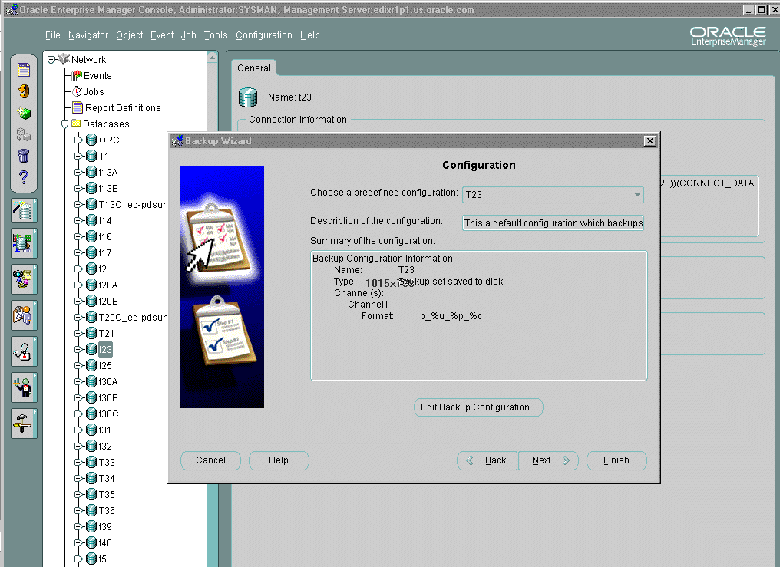
Creating a Backup Set
Notes:
Using Oracle Enterprise Manager
You can use the Backup Wizard to create a backup set. Using the Oracle Enterprise Manager’s Create Backup Configuration property sheets, you can edit an existing backup configuration or create other backup configurations. A backup configuration is automatically created for each target database by Enterprise Manager. In the backup configuration, you can specify the following options:
Create a configuration that backs up to disk using a backup set
Create a configuration that backs up to tape using a backup set
Create a configuration that uses an image copy
Set the limits for any backup or copy operation
Specify to have Media Management Software take over the backup and recovery of your files instead of using RMAN
Set storage parameters for the current backup set, overriding the Recovery Manager default settings that the Recovery Manager has calculated for datafiles or archivelogs
Register the database with the recovery catalog. A recovery catalog is created if you specify for the Enterprise Manager repository to be located in a local database.

Slide 13
Multiplexed Backup Sets
Multiplex two or more datafiles into a backup set for tape streaming.
filesperset = 3
Backup set
Datafile 1
Datafile 1,2,3,1,2,3…
Server
process
(channel)
Datafile 2
MML
Tape
Datafile 3
Notes:
RMAN Multiplexed Backup Sets
The technique of RMAN multiplexing is to simultaneously read files on disks and and then write them into the same backup piece. When more than one file is written to the same backup file or piece, Recovery Manager automatically performs the allocation of files to channels, multiplexes the files, and skips any unused blocks. With a sufficient number of files to back up concurrently, high-performance sequential output devices (for example, fast tape drives) can be streamed. This is important for backups that must compete with other online system resources. It is the responsibility of the operator or storage subsystem to change the tape on the target database where the tape drive is located. This process was designed for writing to tape but it can also be used to write to disk.
Multiplexing is controlled by the following:
The FILESPERSET parameter on the BACKUP command
The MAXOPENFILES parameter of the ALLOCATE CHANNEL and CONFIGURE CHANNEL commands
Example
The database contains three datafiles that will be multiplexed together into one physical file (set) and stored on tape. The datafiles are multiplexed by writing n number of blocks from datafile 1, then datafile 2, then datafile 3, then datafile 1, and so on until all files are backed up.

Slide 14
Parallelization of Backup Sets
Allocate multiple channels, optionally specify filesperset, and include many files.
Backup Set 1
Server
process
(channel)
Datafile 1
Datafile 4
Datafile 5
MML
Set 1
Backup Set 2
Server
process
(channel)
Datafile 2
Datafile 3
Datafile 9
Set 2
MML
Backup Set 3
Server
process
(channel)
Datafile 6
Datafile 7
Datafile 8
Set 3
MML
Notes:
Parallelization of Backup Sets
You can configure parallel backups by setting the PARALLELISM option of the CONFIGURE command to greater than 1 or manually allocate multiple channels. RMAN parallelizes its operation and writes multiple backup sets in parallel. The server sessions divide the work of backing up the specified files.
Example
RMAN> run {
2> allocate channel c1 type sbt;
3> allocate channel c2 type sbt;
4> allocate channel c3 type sbt;
5> backup
6> incremental level = 0
7> format '/disk1/backup/df_%d_%s_%p.bak‘
8> (datafile 1,4,5 channel c1 tag=DF1)
9> (datafile 2,3,9 channel c2 tag=DF2)
10> (datafile 6,7,8 channel c3 tag=DF3);
11> alter system archive log current;
12> }

Slide 15
Notes:
Parallelization of Backup Sets (continued)
When you create multiple backup sets and allocate multiple channels, RMAN automatically parallelizes its operation and writes multiple backup sets in parallel. The allocated server sessions share the work of backing up the specified datafiles, control files, and archived redo logs. Note that you cannot stripe a single backup set across multiple channels.
Parallelization of backup sets is achieved by:
Configuring PARALLELISM to greater than 1 or allocating multiple channels
Specifying many files to back up
Example
There are nine files that need to be backed up (datafiles 1 through 9).
Data files have been carefully assigned so that each set has approximately the same number of data blocks to back up (for efficiency).
Data files 1, 4, and 5 are assigned to backup set 1.
Data files 2, 3, and 9 are assigned to backup set 2.
Data files 6, 7, and 8 are assigned to backup set 3.
Note: You can use the FILESPERSET parameter to limit the number of datafiles that are included in a backup set.

Slide 16
Duplexed Backup Sets
Datafile 1
Datafile 1
Datafile 1
Datafile 2
Datafile 2
Datafile 2
BACKUP1
BACKUP2
Backup set
Notes:
Duplexed Backup Sets
You can create up to four identical copies of each backup piece by duplexing the backup set.
You can use the following commands to produce a duplexed backup set:
BACKUP COPIES
SET BACKUP COPIES
CONFIGURE … BACKUP COPIES
RMAN does not produce multiple backup sets, but produces identical copies of each backup piece in the set.
Example
This example shows how you can create two copies of the backup of datafiles 1 and 2:
RMAN> BACKUP COPIES 2 DATAFILE 1, DATAFILE 2
2> FORMAT '/BACKUP1/%U','/BACKUP2/%U';
RMAN places the first copy of each backup piece in /BACKUP1 and the second in /BACKUP2. RMAN produces one backup set with a unique key and generates two identical copies of each backup piece in the set.

Slide 17
Backups of Backup Sets
Datafile 1
Datafile 1
Datafile 2
Datafile 2
Backup set
Backup set
Notes:
Backing Up Backup Sets
You can back up a backup set as an additional way to manage your backups. You can use the RMAN BACKUP BACKUPSET command for disk-to-disk and disk-to-tape backups. This allows you to make an additional backup on tape or to move your backup from disk to tape.

Slide 18
Archived Redo Log File Backups
  Online redo log file switch is automatic.
  Archived log failover is performed.
  Back up archived logs that need backing up.
Notes:
Archived Redo Log File Backups
At the beginning of every BACKUP ... ARCHIVELOG command that does not include an UNTIL clause or SEQUENCE parameter, RMAN attempts to automatically switch out of and archive the current online redo log.
In Oracle9i, RMAN performs archived log failover. If any corrupt blocks are detected in an archived redo log file, RMAN searches other archiving destinations for a file without corrupt blocks.
In Oracle9i, Release 2, you can use the NOT BACKED UP integer TIMES clause of the BACKUP ARCHIVELOG command to back up only those logs that have not been backed up at least integer times. When calculating the number of backups for a file, RMAN only considers backups created on the same device type as the current backup. This option is a convenient way to back up archived logs on specified media (for example, you want to keep at least three copies of each log on tape).

Slide 19
Archived Redo Log Backup Sets
  Include only archived redo log files
  Are always full backups
RMAN> BACKUP
2> FORMAT '/disk1/backup/ar_%t_%s_%p'
3> ARCHIVELOG ALL DELETE ALL INPUT;
Notes:
Archived Redo Log File Backup Sets
A common problem experienced by DBAs is not knowing whether an archived log has been completely copied out to the archive log destination before attempting to back it up. Recovery Manager has access to control file or recovery catalog information, so it knows which logs have been archived and can be restored during recovery.
You can back up archived redo log files with the BACKUP ARCHIVELOG command or include them when backing up datafiles and control files with the BACKUP … PLUS ARCHIVELOG command.
Characteristics of Archived Log Backup Sets
Can include only archived logs, not datafiles or control files.
Are always full backups. (There is no logic in performing incremental backups because you can specify the range of archived logs to backup.)
Example (from slide)
This example backs up all archived redo logs to a backup set, where each backup piece contains three archived logs. After the archived logs are copied, they are deleted from disk and marked as deleted in the V$ARCHIVED_LOG view.

Slide 20
Backup Constraints
  The database must be mounted or open.
  Online redo log backups are not supported.
  Only “clean” backups are usable in NOARCHIVELOG mode.
  Only “current” datafile backups are usable in ARCHIVELOG mode.
Notes:
Backup Constraints
When performing a backup using Recovery Manager, you must be aware of the following:
The target database must be mounted for Recovery Manager to connect.
Backups of online redo logs are not supported.
If the target database is in NOARCHIVELOG mode, only “clean” tablespace and datafile backups can be taken (that is, backups of “offline normal” or “read only” tablespaces). Database backups can be taken only if the database has first been shut down cleanly and restarted in Mount mode.
If the target database is in ARCHIVELOG mode, only “current” datafiles can be backed up (restored datafiles are made current by recovery).
If a recovery catalog is used, the recovery catalog database must be open.

Slide 21
Image Copies
Datafile 3
Datafile 3
Copy of datafile 3
ArchivedLog file
ArchivedLog file
Copy of archived log
Notes:
Image Copies
An image copy contains a single datafile, archived redo log file, or control file. An image copy can be created with the RMAN COPY command or an operating system command.
When you create the image copy with the RMAN COPY command, the server session validates the blocks in the file and records the copy in the control file.

Slide 22
Characteristics of an Image Copy
  Can be written only to a disk
  Can be used for recovery immediately; does not need to be restored
  Is a physical copy of a single datafile, archived log, or control file
  Is most like an operating system backup (contains all blocks)
  Can be part of an incremental strategy
Notes:
Characteristics of an Image Copy
An image copy has the following characteristics:
An image copy can be written only to disk. Hence additional disk space may be required to retain the copy on the disk. When large files are being considered, copying may take a long time, but restoration time is reduced considerably because the copy is available on the disk.
If files are stored on disk, they can be used immediately (that is, they do not need to be restored from other media). This provides a fast method for recovery using the SWITCH command in Recovery Manager, which is equivalent to the ALTER DATABASE RENAME FILE SQL statement.
In an image copy all blocks are copied, whether they contain data or not, because an Oracle server process copies the file and performs additional actions such as checking for corrupt blocks and registering the copy in the control file. To speed up the process of copying, you can use the NOCHECKSUM parameter.
Image copy can be part of a full or incremental level 0 backup, because a file copy always includes all blocks. Use the level 0 option if the copy will be used in conjunction with an incremental backup set.
Image copy can be designated as a level 0 backup in incremental backup strategy, but no other levels are possible with image copy.

Slide 23
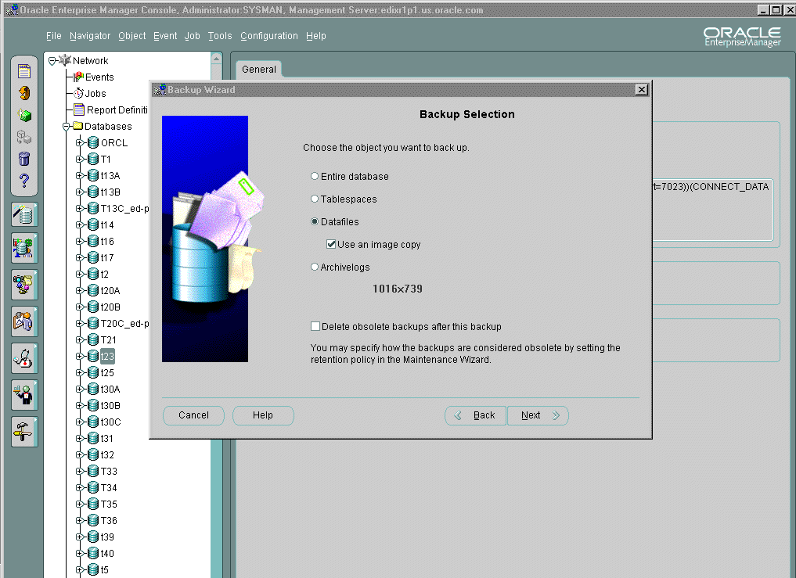
Creating an Image Copy
Notes:
Using Oracle Enterprise Manager
You can use the Backup Wizard to create an image copy. On the Configuration page, you specify an image copy configuration that you previously created through the Create Backup Configuration Wizard.

Slide 24
Image Copy: Example
Datafile 3
Datafile 3
Copy of datafile 3
Archived
log file
Archived
log file
Copy of archived log
RMAN> COPY
2> DATAFILE '/ORADATA/users_01_db01.dbf' TO
3> '/BACKUP/users01.dbf' tag=DF3,
4> ARCHIVELOG 'arch_1060.arc' TO
5> 'arch_1060.bak';
Notes:
Image Copies
The RMAN COPY command creates an image copy of a file. The output file is always written to disk. You can copy datafiles, archived redo log files, or control files. In many cases, copying datafiles is more beneficial than backing them up, because the output is suitable for use without any additional processing.
If you want to make a whole database backup with the COPY command, you must copy each datafile with a separate COPY statement. You can also make a copy of the control file and archived redo log files.
The example in the slide assumes that you are using automatic channel allocation. If you are manually allocating channels, include the COPY command within the RUN statement as follows:
RMAN> RUN {
2> ALLOCATE CHANNEL c1 type disk;
3> COPY
4> DATAFILE '/ORADATA/users_01_db01.dbf' to
5> '/BACKUP/users01.dbf' tag=DF3,
6> ARCHIVELOG 'arch_1060.arc' to
7> 'arch_1060.bak';}

Slide 25
The COPY Command
RMAN> COPY
2> DATAFILE 3 TO '/BACKUP/file3.dbf',
3> DATAFILE 1 TO '/BACKUP/file1.dbf';
Datafile 1
Datafile 1
Control
files
Redo log
file 1
Image copy
Datafile 2
Redo log
file 2
Datafile 3
Datafile 3
Image copy
Database
Notes:
The COPY Command
During the copy operation, an Oracle server process computes a checksum for each block to detect corruption. RMAN verifies the checksum when restoring the copy. This is referred to as physical corruption detection. You can use the NOCHECKSUM option to suppress the checksum operation and speed up the copy process. If the database is already maintaining block checksums, then this option has no effect.
You can use the CHECK LOGICAL option to test data and index blocks that pass physical corruption checks for logical corruption, for example, corruption of a row piece or index entry. If logical corruption is detected, the block is logged in the alert log and trace file of the server process.
You can set a threshold for logical and physical corruption with the MAXCORRUPT parameter. As long as the sum of physical and logical corruptions that is detected for a file remain below this value, the RMAN command completes and Oracle populates the V$DATABASE_BLOCK_CORRUPTION view with corrupt block ranges. If MAXCORRUPT is exceeded, then the command terminates without populating the views.

Slide 26
Image Copy Parallelization
One COPY command with many channels
RMAN> CONFIGURE DEVICE TYPE disk parallelism 4;
2> COPY # 3 files copied in parallel
3> datafile 1 TO '/BACKUP/df1.dbf',
4> datafile 2 TO '/BACKUP/df2.dbf',
5> datafile 3 TO '/BACKUP/df3.dbf';
RMAN> COPY # Second copy command
2> datafile 4 TO '/BACKUP/df4.dbf';
Notes:
Image Copy Parallelization
By default, Recovery Manager executes each COPY command serially. However, you can parallelize the copy operation by:
Using the CONFIGURE DEVICE TYPE … PARALLELISM
Or allocating multiple channels ( required in Oracle8i)
Specifying one COPY command for multiple files
You can allocate the channels manually as shown in the slide or by automatic channel configuration.
In the example, four channels are created, but only three will be used. This is how the command is executed:
1. Four channels are configured for writing to disk.
2. The first COPY command uses three channels (server processes), one for writing each datafile to disk.
3. The second COPY command does not execute until the previous COPY command has finished execution. It will use only one channel.
Note: When you use a high degree of parallelism, more machine resources are used, but the backup operation can be completed faster.

Slide 27
Copying the Whole Database
  Mount the database for a whole consistent backup.
  Use the REPORT SCHEMA command to list the files.
  Use the COPY command or make an image copy of each datafile.
  Use the LIST COPY command to verify the copies.
Notes:
How to Make an Image Copy of the Whole Database
To make an image copy of all the datafiles using Recovery Manager, follow this procedure:
1. Connect to RMAN and start up in mount mode:
RMAN> STARTUP MOUNT
2. Obtain a list of datafiles of the target database:
RMAN> REPORT SCHEMA;
3. Use the COPY command or script to create the copy of all datafiles listed above:
RMAN> COPY datafile 1 TO ’/BACKUP/df1.cpy’,
datafile 2 TO ’/BACKUP/df2.cpy ’,...;
4. Use the LIST COPY command to verify the copy:
RMAN> LIST COPY;
You can include the control file in the copy with the CURRENT CONTROLFILE command. In addition, if CONFIGURE CONTROLFILE AUTOBACKUP is ON, RMAN automatically backs up the control file after the COPY command is issued.

Slide 28
Making Incremental Backups
  Full backups contain all
  datafile blocks.
  Differential incremental
  backups contain only
  modified blocks from
  level n or lower.
  Cumulative incremental
  backups contain only
  modified blocks from
  level n-1 or lower.
Full backup
Differential
incremental backup
Cumulative
incremental backup
Notes:
RMAN Backup Types
Full Backups
A full backup differs from a whole database backup. A whole backup is composed of all of the datafiles and control file of the target database, whereas a full backup may contain one or more of the datafiles, the control file, or archived redo log files.
When performing a full backup, an Oracle server process reads the entire file and copies all blocks into the backup set, skipping only datafile blocks that have never been used. The server session does not skip blocks when backing up archived redo logs or control files.
A full backup is not a part of the incremental backup strategy. You can create and restore full backups of datafiles, datafile copies, tablespaces, database, control files, archive logs, and archive log copies. Note that backup sets containing archived redo logs are always full backups.

Slide 29
Notes:
RMAN Backup Types (continued)
Incremental Backups
An incremental backup is a backup that includes only the blocks that have changed since a previous incremental backup.
RMAN can create multilevel incremental backups as follows:
Differential backup: The default type of incremental backup which backs up all blocks changed after the most recent backup at level n or lower
Cumulative backup: Backs up all blocks changed after the most recent backup at level n-1 or lower
Incremental backups are specified through the INCREMENTAL keyword of the BACKUP command. You specify INCREMENTAL LEVEL = integer where integer is any integer from 0 to 4.
A level 0 backup must exist as the base backup for an incremental strategy. An incremental backup at level 0 is identical in content to a full backup, but unlike a full backup the level 0 backup is considered a part of the incremental strategy. If no level 0 backup exists when you run a level 1 or higher backup, RMAN makes a level 0 backup automatically.

Slide 30
Differential Incremental Backup: Example
n level backup of all blocks that have changed since the most recent backup at level n or lower.
Level 0
Level 0
Lvl
Day
0
2
2
1
2
2
2
0
Sun
Mon
Tue
Wed
Thu
Fri
Sat
Sun
Notes:
Differential Incremental Backup: Example
You are maintaining a 100 GB database, which is continuously growing. Based on existing hardware, you determine that open backups of the entire database take 4 hours. The database is online 24 hours a day, 7 days a week and the backups are consuming too much of the system resources during this period of time. Level 0 backups cannot be performed more than once a week, but fast recovery in case of failure is required. You therefore decide on the following backup and recovery strategy:
A level 0 backup will be performed each week on the day with the least activity. You determine this day to be Sunday.
RMAN> BACKUP INCREMENTAL level 0 database;
Incremental level 2 backups will be performed every day, except Wednesday. In this way, backups will be fast because only changed blocks from the previous day will be copied:
RMAN> BACKUP INCREMENTAL level 2 database;

Slide 31
Notes:
Differential Incremental Backup: Example (continued)
Wednesday is a day with less database activity, so all blocks changed since Sunday are copied to assist with speed of recovery. For example, if a failure occurs on Friday, then only Sunday, Wednesday, and Thursday backups need to be restored (Monday and Tuesday are not required):
RMAN> BACKUP INCREMENTAL level 1 database;
On Thursday, the incremental backup was replaced by a full backup. Because this does not change the backup base level, Friday’s backup copy changes since Wednesday. The backup therefore can be discarded before the next level 0. If by mistake the backup on Thursday was a level 0, then the backup on Friday copies all changed blocks since Thursday, which is the new base level. This backup must now be kept until the next level 0.

Slide 32
Cumulative Incremental Backup: Example
n level backup which contains all blocks changed since the previous backup at a level n – 1 or lower
Level 0
Level 0
Lvl
Day
0
2
2C
1
2
2C
2C
0
Sun
Mon
Tue
Wed
Thu
Fri
Sat
Sun
Notes:
Cumulative Incremental Backups: Example
Cumulative incremental backups have the following characteristics:
A cumulative incremental level n backup (where n > 0) copies all changed blocks since the previous backup at level n-1 or lower.
A cumulative incremental backup backs up blocks previously backed up at the same level. Therefore, they may take longer, write out more blocks, and produce larger backup files than non-cumulative backups.
Cumulative incremental backups are provided for recovery speed, because fewer backups must be applied at each level when recovering.
Example
Cumulative incremental backups duplicate changes already copied by the previous incremental backup at the same level. Therefore, if an incremental level 2 backup is taken, then the following cumulative level 2 backs up all newly modified blocks plus those backed up by the incremental level 2. This means that only one incremental backup of the same level is needed to completely recover.
RMAN> BACKUP INCREMENTAL level 2 cumulative database;

Slide 33
Backup in NOARCHIVELOG Mode
  Ensure sufficient space for the backup.
  Shut down using the NORMAL or IMMEDIATE clause.
  Mount the database.
  Allocate multiple channels if not using automatic.
  Run the BACKUP command.
  Verify that the backup is finished and cataloged.
  Open the database for normal use.
RMAN> BACKUP DATABASE FILESPERSET 3;
Notes:
How to Perform a Multiplexed Backup in NOARCHIVELOG Mode
1. Ensure that the destination directory where you want to store the backup is available and has sufficient space.
2. Shut down the database cleanly using the NORMAL, IMMEDIATE, or TRANSACTIONAL clause.
3. Mount the database.
4. If you are not using automatic channel allocation, allocate multiple channels and use a format string to multiplex channels to different disks.
5. Run the BACKUP command. Because the database is in NOARCHIVELOG mode, the incremental backups are not applicable, so use the full backup option.
6. Verify that the backup is finished and cataloged.
7. Open the database for normal use.

Slide 34
Control File and Server Parameter
File Autobackups
  Use the CONFIGURE CONTROLFILE AUTOBACKUP command to enable
  When enabled, RMAN automatically performs a back up of the control file and current server parameter file after BACKUP or COPY commands
  Back ups also occur after structural changes to the database
  Backup is given a default name
Notes:
Control File and Server Parameter File Autobackups
If CONFIGURE CONTROLFILE AUTOBACKUP is ON, RMAN automatically backs up the control file and the current server parameter file:
After every BACKUP or COPY command issued at the RMAN prompt
Whenever a BACKUP or COPY command within a RUN block is followed by a command that is neither BACKUP nor COPY
At the end of every RUN block if the last command in the block was either BACKUP or COPY
After database structural changes such as adding a new tablespace, altering the state of a tablespace or datafile (for example, bringing it online), adding a new online redo log, renaming a file, adding a new redo thread, and so forth. This type of autobackup, unlike the automatic backups described in the preceding circumstances, is only on disk. A failure of the autobackup will not cause the associated structural change to fail.
The control file autobackup occurs in addition to any backup or copy of the current control file that has been performed during these commands.
By default, CONFIGURE CONTROLFILE AUTOBACKUP is set to OFF.

Slide 35
Notes:
Control File and Server Parameter File Autobackups (continued)
RMAN automatically backs up the current control file using the default format of %F. You can change this format using the CONFIGURE CONTROLFILE AUTOBACKUP FORMAT and SET CONTROLFILE AUTOBACKUP FORMAT commands.
The format string must include the %F substitution variable. This variable translates into c-IIIIIIIIII-YYYYMMDD-QQ, where:
IIIIIIIIII stands for the DBID. The DBID is printed in decimal so that it can be easily associated with the target database.
YYYYMMDD is a time stamp in the Gregorian calendar of the day the backup is generated
QQ is the sequence in hexadecimal number that starts with 00 and has a maximum of 'FF' (256)
Example
RMAN> SET CONTROLFILE AUTOBACKUP FORMAT FOR DEVICE TYPE disk
2> TO 'controlfile_%F';
Note: You can use the Maintenance Wizard of Oracle Enterprise Manager to configure the autobackup feature.

Slide 36
Backing Up the Server Parameter File
  Automatically backed up when CONFIGURE CONTROLFILE AUTOBACK = ON
  Explicitly backed up with BACKUP SPFILE
RMAN> BACKUP COPIES 2 DEVICE TYPE sbt SPFILE;
Notes:
Backing Up the Server Parameter File
If CONFIGURE CONTROLFILE AUTOBACKUP is ON, then RMAN automatically backs up the current server parameter file in addition to the control file.
You can also use the BACKUP SPFILE command to back up the server parameter file explicitly.
The backup is only of the server parameter file currently in use by the instance. RMAN cannot back up other copies of the server parameter file. If the instance is started with a client-side initialization parameter file, then RMAN does not back up anything.
RMAN cannot make incremental backups of the server parameter file.

Slide 37
Tags for Backups and Image Copies
Logical name assigned to a backup set or image copy
month_full_backup
week_full_backup
Wednesday_1_backup
Datafiles 1,3
Datafile 3
Datafile 1
Datafiles 2,4
Datafile 4
Backup set
Backup set
Backup set
Notes:
Tags for Backups and Image Copies
A tag is a meaningful name that you can assign to a backup set or image copy. The advantages of user tags are as follows:
Tags provide a useful reference to a collection of file copies or a backup set.
Tags can be used in the LIST command to locate backed up files easily.
Tags can be used in the RESTORE and SWITCH commands.
The same tag can be used for multiple backup sets or file copies.
If a non-unique tag references more than one datafile, then Recovery Manager chooses the most current available file.
Example
Each month, a full backup of datafiles 1, 2, 3, and 4 is performed. The tag in the control file for this backup is month_full_backup, even though the physical filename generated is df_DB00_863_1.dbf.
Each week, a full backup of datafiles 3 and 4 is performed. The tag name for this backup is week_full_backup.

Slide 38

RMAN Dynamic Views
  V$ARCHIVED_LOG
  V$BACKUP_CORRUPTION
  V$COPY_CORRUPTION
  V$DATABASE_BLOCK_CORRUPTION
  V$BACKUP_DATAFILE
  V$BACKUP_REDOLOG
  V$BACKUP_SET
  V$BACKUP_PIECE
Notes:
RMAN Dynamic Views
You can use the following views to obtain RMAN information stored in the control file:
V$ARCHIVED_LOG shows which archives have been created, backed up, and cleared in the database.
V$BACKUP_CORRUPTION shows which blocks have been found corrupt during a backup of a backup set.
V$COPY_CORRUPTION shows which blocks have been found corrupt during an image copy.
V$DATABASE_BLOCK_CORRUPTION displays information about database blocks that were corrupted after the last backup.
V$BACKUP_DATAFILE is useful for creating equal-sized backup sets by determining the number of blocks in each datafile. It can also help you find the number of corrupt blocks for the datafile.
V$BACKUP_REDOLOG shows archived logs stored in backup sets.
V$BACKUP_SET shows backup sets that have been created.
V$BACKUP_PIECE shows backup pieces created for backup sets.

Slide 39
Monitoring RMAN Backups
  Correlate server sessions with channels using the SET COMMAND ID command.
  Query V$PROCESS and V$SESSION to determine which sessions correspond to which RMAN channels.
  Query V$SESSION_LONGOPS to monitor the progress of backups and copies.
  Use an operating system utility to monitor the process or threads.
Notes:
How to Monitor the Copy Process
To correlate a process with a channel during a backup:
1. Start Recovery Manager and connect to the target database and, optionally, the recovery catalog.
rman target / catalog rman/rman@rcat
2. Set the COMMAND ID parameter after allocating the channels and then copy the desired object.
run {
allocate channel t1 type disk;
set command id to 'rman';
copy datafile 1 to '/u01/backup/df1.cpy';
release channel t1;}
3. Query the V$SESSION_LONGOPS view to get the status of the copy.
SELECT sid, serial#, context, sofar, totalwork
round(sofar/totalwork*100,2) "% Complete",
FROM v$session_longops
WHERE opname LIKE 'RMAN:%'
AND opname NOT LIKE 'RMAN: aggregate%';

Slide 40
Notes:
How to Monitor the Copy Process (continued)
4. Using SQL*Plus and query V$PROCESS and V$SESSION to get the SID and SPID. Then use an operating system utility to monitor the process or threads.
SELECT sid, spid, client_info
FROM v$process p, v$session s
WHERE p.addr = s.paddr
AND client_info LIKE '%id=rman%';
Note: For monitoring the copy process, you must query the target database, and hence, the target database should be in Open or Mount state.

Slide 41
Miscellaneous RMAN Issues
  Abnormal termination of a Recovery Manager job
  Detecting physical and logical block corruption
  Detecting a fractured block during open backups
Notes:
Miscellaneous RMAN Issues
Abnormal Termination of Recovery Manager
Recovery Manager records only backup sets that have finished successfully in the control file. If a Recovery Manager job terminates abnormally, incomplete files might exist in the operating system. Recovery Manager will not use them, but you will need to remove them.
Detecting Corruption
Recovery Manager detects and can prohibit any attempt to perform operations that would result in unusable backup files or corrupt restored datafiles.
By default, error checking for physical corruption is enabled. Information about corrupt datafile blocks encountered during a backup are recorded in the control file and the alert log. The server identifies corrupt datafile blocks, but they are still included in the backup. The Oracle server records the address of the corrupt block and the type of corruption in the control file. To view corrupt blocks from the control file, view either V$BACKUP_CORRUPTION for backup sets or V$COPY_CORRUPTION for image copies.
RMAN tests data and index blocks for logical corruption and logs any errors in the alert.log and server session trace file. By default, error checking for logical corruption is disabled.

Slide 42
Notes:
Miscellaneous RMAN Issues (continued)
Detecting a Fractured Block
RMAN reads whole database blocks and determines whether the block is fractured by comparing the header and footer of each block. If it detects a fractured block, then it rereads the block until it gets a consistent block. This is one of the reasons why it is not necessary to put a tablespace in online backup mode when using RMAN for tablespace or datafile backups.
This mechanism also reduces the amount of redo generated during the backup because the entire block does not have to be written to the redo log file.

Slide 43
Summary
In this lesson, you should have learned how to:
  Determine what type of RMAN backups should be taken
  Make backups with the RMAN COPY and BACKUP commands
  Back up the control file
  Back up the archived redo log files

Slide 44
Practice 11 Overview
This practice covers the following topics:
  Using Recovery Manager to back up one tablespace datafile and a controlfile
  Using Recovery Manager to back up archived log files
  Using the RMAN COPY command to create an image copy of a database file

Slide 45
Notes:
Practice 11: RMAN Backups
1. What are the two supported backup types for Recovery Manager? List some of the differences between the two backup types.
2. Use RMAN to back up the datafiles belonging to the SAMPLE and USERS tablespaces. Be sure you also make a copy of the current control file. Your backups should be placed in the $HOME/BACKUP/RMAN directory and should use the format df_%d_%s_%p.bus for the file names.
3. Create an image copy of the datafiles belonging to the SYSTEM tablespace. The copy
should be placed in the $HOME/BACKUP/RMAN directory with the name of
sys0101.cpy. The tag should be SYSTEM01.
4. Using RMAN, back up the archived redo log files generated today to the $HOME/BACKUP/RMAN directory.
5. Obtain a listing of all datafiles that have not been backed up.

