Slide 1
RMAN Complete Recovery

Slide 2
Objectives
After completing this lesson, you should be able to do the following:
  Describe the use of RMAN for restoration and recovery
  Perform complete recovery in ARCHIVELOG mode
  Restore datafiles to different locations
  Relocate and recover a tablespace by using archived redo log files

Slide 3
Restoration and Datafile Media Recovery Using RMAN
  Restore files from backup sets or image copies by using the RMAN RESTORE command
  Recover files by using the RMAN RECOVER command
Notes:
Restoration and Datafile Media Recovery Using RMAN
RMAN automates the procedure for restoring files. When you issue the RESTORE command, RMAN uses a server session to restore the correct backups and copies. The RMAN repository is used to select the best available backup set or image copies to use in the restoration. By default, RMAN does not restore a file if the file is already in the correct place and its header contains the correct information. In releases before Oracle9i, the files were always restored.
When you issue the RMAN RECOVER command, RMAN applies changes from online redo log files and archived redo log files, or uses incremental backups to recover the restored files.
Using RMAN you can perform recovery at the following levels:
Database
Tablespace
Datafile
In complete recovery, all of the redo entries in the archived redo logs files and online redo log files are used to recover the database. The damaged files are restored from a backup and the log files are used to update the datafiles to the current point in time.

Slide 4
Using RMAN to Recover a Database in ARCHIVELOG Mode
rman target /
RMAN> STARTUP MOUNT
RMAN> RESTORE DATABASE;
RMAN> RECOVER DATABASE;
RMAN> ALTER DATABASE OPEN;
Notes:
Using RMAN to Restore a Database in ARCHIVELOG Mode
In this example you use RMAN to restore and recover the whole database.
This example assumes that:
A full backup taken using RMAN is available on disk.
The current control files were not damaged and do not need to be restored.
All datafiles are damaged or lost.

Slide 5
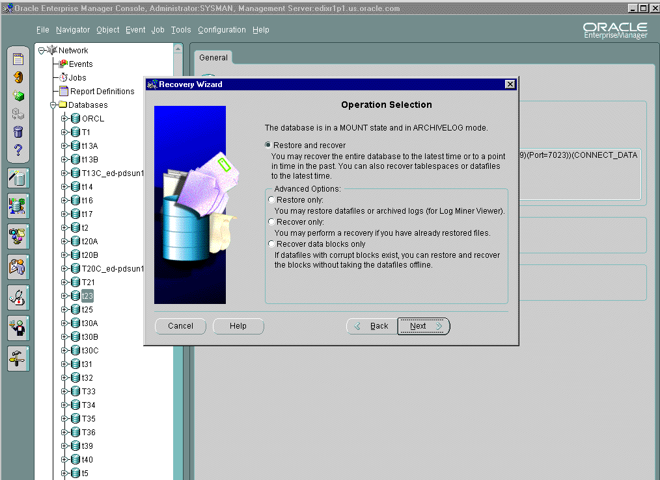
Using the Recovery Wizard
Notes:
Using Oracle Enterprise Manager
You can use the Recovery Wizard to restore and recover your database. You can access the wizard through the Oracle Enterprise Manager Console if you are connected to a Management Server. The state of the database determines which options are available. The wizard guides you through the specifications and then submits a recovery job through Oracle Enterprise Manager.

Slide 6
Using RMAN to Restore Datafiles to a New Location
  Use the SET NEWNAME command to restore the datafile to the new location.
  Use the SWITCH command to record the change in the control file.
SET NEWNAME FOR DATAFILE 1 to
‘/<newdir>/system01.dbf’;
SWITCH DATAFILE ALL;
Notes:
Restoring Datafiles to a New Location
If you have experienced media failure such as the loss of a disk drive, you may need to restore the datafiles to a new location.
Example
1. Connect to RMAN.
rman target
2. Mount the database.
RMAN> STARTUP MOUNT
3. Use RMAN to restore the datafile to the new location and record the change in the control file.
run{
set newname for datafile 1 to '/<newdir>/system01.dbf';
restore database;
switch datafile all;
recover database;
alter database open; }

Slide 7
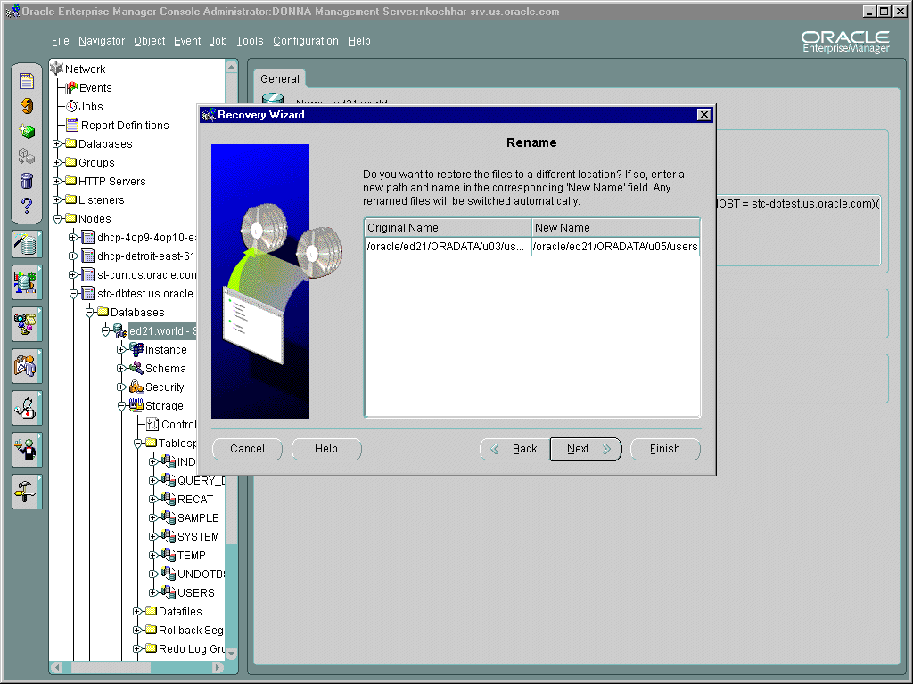
Restoring to a New Location
Notes:
Using Oracle Enterprise Manager
You can use the Recovery wizard to restore and recover your database. The Rename page enables you to restore the selected datafiles to a new location. When datafiles are restored to a new location, they are considered datafile copies. For this reason, a switch is automatically performed.

Slide 8
Using RMAN to Recover a Tablespace
Use the following RMAN commands to restore and recover a tablespace:
  RESTORE TABLESPACE
  RECOVER TABLESPACE
run{
sql “alter tablespace users offline immediate”;
restore tablespace users;
recover tablespace users;
sql “alter tablespace users online”;
}
Notes:
Using RMAN to Recover a Tablespace
If you have determined that you need to restore and recover the users tablespace, issue the RMAN commands as follows:
run{
sql "alter tablespace users offline immediate";
restore tablespace users;
recover tablespace users;
sql "alter tablespace users online";
}

Slide 9
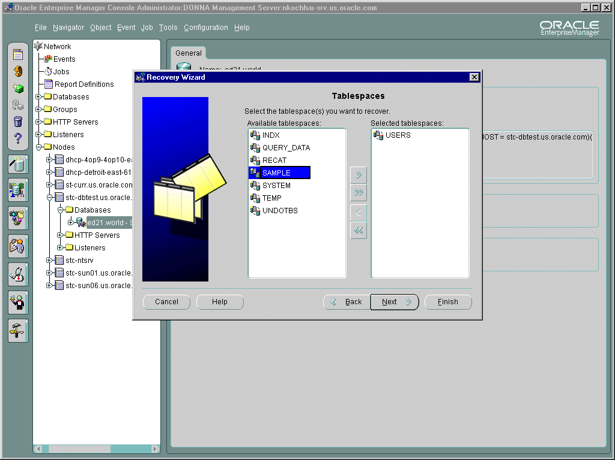
Tablespace Recovery
Notes:
Using Oracle Enterprise Manager
You can use the Recovery Wizard to restore and recover your database. On the Recovery Selection page you specify tablespace recovery. The Tablespaces page allows you to select the tablespaces that you want to recover. You can choose from the list of tablespaces shown in the Available tablespaces window.

Slide 10
Using RMAN to Relocate a Tablespace
  Use the SET NEWNAME command to restore the files.
  Use the SWITCH command to record the new names in the control file.
  Use the RECOVER TABLESPACE command to recover the datafiles of the tablespace.
Notes:
Using RMAN to Relocate a Tablespace
If a datafile cannot be accessed because of disk failure, you need to restore it to a new location or switch to an existing image copy.
The same procedure is useful when you want to relocate the tablespace, because you are running short of disk space in one drive or you are reorganizing the database to improve performance.
Example: You notice that u03 has been corrupted and the database is still open. Occasionally users complain that they cannot access information in datafile number 3.
The following is the procedure to restore the datafiles to a new location:
1. Check the location and size of the datafile on u03 , using the following command:
SQL> SELECT file#, name, bytes FROM v$datafile;
FILE# NAME BYTES
----- ------------------------ ----------
1 /ORADATA/u01/system01.dbf 120586240
2 /ORADATA/u02/undotbs.dbf 31457280
3 /ORADATA/u03/users01.dbf 5242880
...
You determine that there is enough space on u04 for datafile 3.

Slide 11
Notes:
Using RMAN to Relocate a Tablespace (continued)
2. Make sure that the file (tablespace if necessary) is offline so that it can be restored successfully using the RESTORE command.
3. Because the file was copied to a new location (using SET NEWNAME), the file must be made current by notifying the Oracle server of the new file location using the SWITCH command.
4. Use the RECOVER command to start applying the combination of incremental backups, cumulative backups, archived redo log files and online redo logs to the restored file to synchronize the database.
5. When recovery is finished, bring the datafile online. Notify users that the database is available for use, and that they should reenter any data that was not committed before system failure.
The following command can be used:
RUN{
SQL "alter tablespace users offline immediate";
SET NEWNAME FOR DATAFILE '/ORADATA/u03/users01.dbf' TO '/ORADATA/u04/users01.dbf'; #Specify where to restore the file
RESTORE TABLESPACE users; #Restore the datafile
SWITCH datafile 3;#Update the control file and recovery catalog
RECOVER TABLESPACE users; #Recover the tablespace
SQL "alter tablespace tbs1 online";}

Slide 12
Summary
In this lesson, you should have learned how to:
  Recover a database in ARCHIVELOG mode
  Restore datafiles to different locations if the original location is unavailable

Slide 13
Practices 13-1 and 13-2 Overview
These practices cover the following topics:
  Using RMAN to recover a tablespace
  Using RMAN to recover relocated datafiles

Slide 14
Practice 13-1
Notes:
Practice 13-1: RMAN Complete Recovery
Tablespace Recovery Using RMAN
1. Using RMAN, connect to your target database and enable autobackup of the control file. Configure controlfile autobackup using the following format: $HOME/BACKUP/RMAN/%F.bck
2. Make a whole database backup specifying the following format: $HOME/BACKUP/RMAN/df_%d_%s_%p.bus
3. Connect as sysdba in SQL*Plus and run the $HOME/STUDENT/LABS/lab13_01_03.sql script.
4. Invoke SQL*Plus, connect as sysdba and start your instance.
5. Using RMAN, connect to your target database and restore and recover the USERS tablespace.
6. Open the database after recovery completes.

Slide 15
Practice 13-2
Notes:
Practice 13-2: RMAN Complete Recovery
Recovering Datafiles to a New Location Using RMAN
1. Connect as sysdba in SQL*Plus and run the $HOME/STUDENT/LABS/lab13_02_01.sql script.
2. You have determined that u03 ($HOME/ORADATA/u03) is corrupted. You must relocate the datafile for the USERS tablespace to another location. $HOME/ORADATA/u04 has sufficient space. Using RMAN, construct a RUN block to relocate the datafile from u03 to u04 and recover the USERS tablespace. Include the command to open the database after recovery completes.

