Slide 1
RMAN Incomplete Recovery

Slide 2
Objectives
After completing this lesson, you should be able to do the following:
  Perform an incomplete database recovery by using UNTIL TIME
  Perform an incomplete database recovery by using UNTIL SEQUENCE

Slide 3
Incomplete Recovery of a Database
Using RMAN
1. Mount the database.
2. Allocate multiple channels for parallelization.
3. Restore all datafiles.
4. Recover the database by using UNTIL TIME, UNTIL SEQUENCE, or UNTIL SCN.
5. Open the database by using RESETLOGS.
6. Perform a whole database backup.
Notes:
Incomplete Recovery of a Database Using RMAN
The restore and recovery process for incomplete recovery follows the same procedure and syntax as complete recovery, except that all datafiles need to be restored from the past backup.
Note
The target database must be in mounted state.
You can restore using RMAN only if the backups were taken or registered with RMAN.

Slide 4
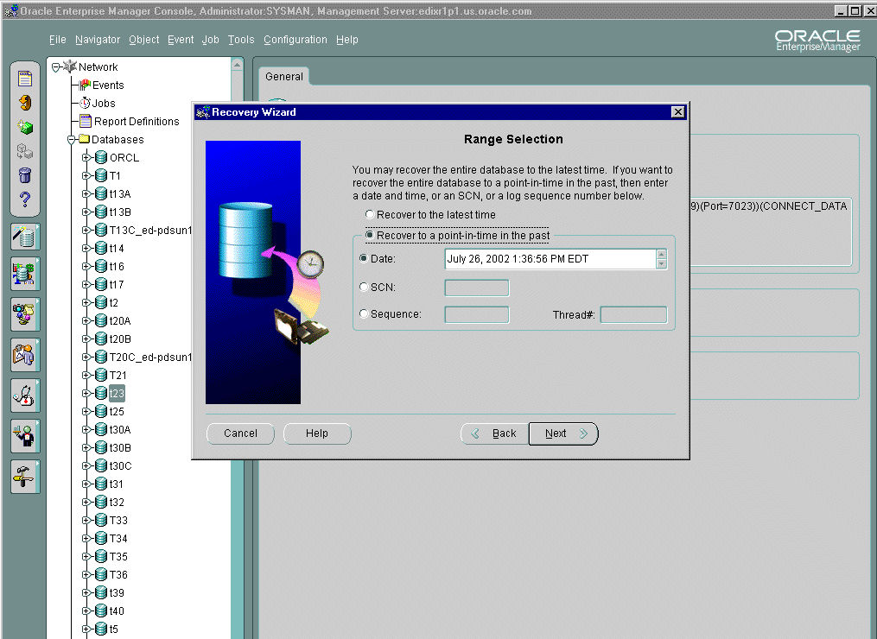
Specifying the Restore Time
Notes:
Using Oracle Enterprise Manager
You can use the Recovery Wizard to restore and recover your database. On the Range Selection page you must enter a date and time to restore to a previous point. You use Instance Management or the Console to open the database after the job has completed. You can view the status of the job by selecting the Active and History page tabs in the Console’s Job window.

Slide 5
RMAN Incomplete Recovery
UNTIL TIME: Example
RMAN> RUN {
2> ALLOCATE CHANNEL c1 TYPE DISK;
3> ALLOCATE CHANNEL c2 TYPE DISK;
4> SET UNTIL TIME = ‘2001-12-09:11:44:00';
5> RESTORE DATABASE;
6> RECOVER DATABASE;
7> ALTER DATABASE OPEN RESETLOGS; }
Notes:
RMAN Incomplete Recovery UNTIL TIME: Example
At 12:00 p.m. on Tuesday, December 9, 2001, you immediately shut down the database and begin recovery after determining that the EMPLOYEES table was dropped. The approximate time of failure is known and the database structure has not changed since 11:44 a.m. You can use the UNTIL TIME method:
1. If the target database is open, perform a clean shutdown.
2. Mount the target database. Do not back up the database during the recovery.
3. Insure that NLS_LANG and NLS_DATE_FORMAT environment variables are set appropriately:
$NLS_LANG=american
$NLS_DATE_FORMAT=’YYYY-MM-DD:HH24:MI:SS’
4. Start Recovery Manager and connect to the target database.
$rman target rman/rman@DB00
5. You can allocate multiple channels to improve the performance:
RMAN> run {allocate channel c1 type DISK;
allocate channel c2 type DISK;

Slide 6
Notes:
RMAN Incomplete Recovery UNTIL TIME: Example (continued)
6. Specify the time for recovery and restore all datafiles from a backup with RMAN commands. RMAN chooses the correct files based on the SET UNTIL command:
RMAN> ... set until time = ‘2001-12-09:11:44:00’;
RMAN> ... restore database;
Note: If you need to restore archived redo log files to a new location use the RMAN SET ARCHIVELOG DESTINATION TO <location> command.
7. Recover the database to the time specified in the SET UNTIL command:
RMAN> ... recover database;
8. Open the database by using the RESETLOGS option:
RMAN> ... alter database open resetlogs; }
9. Check that the table exists and perform a backup.
10. Notify users that the database is available for use, and that they should reenter any data that was not committed before system failure.
11. If using a recovery catalog, register the new incarnation of the database:
RMAN> reset database;

Slide 7

Specifying the Sequence
Notes:
Using Oracle Enterprise Manager
On the Range Selection page you must enter the redo log sequence number that is the upper limit of the recovery. This redo log will not be used in the recovery. You use Instance Management or the Console to open the database after the job has completed. You can view the status of the job by selecting the Active and History page tabs in the Console’s Job window.

Slide 8
RMAN Incomplete Recovery
UNTIL SEQUENCE: Example
RMAN> RUN {
2> SET UNTIL SEQUENCE 120 THREAD 1;
3> ALTER DATABASE MOUNT;
4> RESTORE DATABASE;
5> RECOVER DATABASE; # recovers through log 119
6> ALTER DATABASE OPEN RESESTLOGS;
7> }
Notes:
RMAN Incomplete Recovery UNTIL SEQUENCE: Example
The UNTIL SEQUENCE clause specifies a redo log sequence number and thread as an upper limit. RMAN selects only files that can be used to recover up to but not including the specified log sequence number. This example assumes that log sequence 120 was lost due to a disk crash and the database needs to be recovered using the available archived redo logs.

Slide 9
Summary
In this lesson, you should have learned how to:
  Perform an incomplete database recovery by using UNTIL TIME
  Perform an incomplete database recovery by using UNTIL SEQUENCE

Slide 10
Practice 15 Overview
This practice covers recovery with lost archived redo log files.

Slide 11
Notes:
Practice 15: RMAN Incomplete Recovery
Incomplete Recovery: Recovery with a Lost Archived Log
Make a whole database backup specifying the following format: $HOME/BACKUP/RMAN/df_%d_%s_%p.bus
Run the $HOME/STUDENT/LABS/lab15_02.sql script to switch the logs and create a new table.
Run the $HOME/STUDENT/LABS/lab15_03.sql script to simulate the loss of an archived redo log file.
Run the $HOME/STUDENT/LABS/lab15_04.sql script to simulate hardware failure.
Attempt to start the instance and open the database. What happens?
The Oracle server cannot locate the files for the USERS tablespace because of perceived media failure. Because archiving is enabled, you can attempt to perform a complete recovery. Use RMAN to restore the datafile for the USERS tablespace.
Use RMAN to recover the tablespace. Note the name and sequence number of any files that cannot be found.
Use RMAN with the UNTIL LOG SEQUENCE clause to perform incomplete recovery through the last good archived redo log file.
Once recovery is complete, open the database using the RESETLOGS option.
Make a new backup in the $HOME/BACKUP/RMAN directory with the following format:
df_%d_%s_%p.bus

