Slide 1
Recovery Catalog Creation and Maintenance

Slide 2
Objectives
After completing this lesson, you should be able to do the following:
  Describe the contents of the recovery catalog
  List the RMAN features which require the recovery catalog
  Create the recovery catalog
  Maintain the recovery catalog by using RMAN commands
  Use RMAN to register, resynchronize, and reset a database

Slide 3
Objectives
  Query the recovery catalog to generate reports and lists
  Create, store, and run scripts
  Describe methods for backing up and recovering the recovery catalog

Slide 4
Overview
Restore/Recovery
Recovery Manager (RMAN)
Enterprise Manager
Backup
Reporting
REPORT
LIST
Target
database
Control file
Stored
scripts
Catalog Maintenance
Register
Resynchronize
Reset
Change/Delete/Catalog
Backup /Restore/Recover
Catalog database
Notes:
Overview
The recovery catalog is a schema that is created in a separate database. It contains the RMAN metadata obtained from the target database control file. RMAN propagates information about the database structure, archived redo logs, backup sets, and datafile copies into the recovery catalog from the control file of the target database.
You should use a catalog when you have multiple target databases to manage.
RMAN stores, uses, and maintains the information in the recovery catalog. The recovery catalog is maintained by RMAN when you do the following:
1. Register the target database in the catalog.
2. Resynchronize the catalog with the control file of the target database.
3. Reset the database to a previous incarnation.
4. Change information about the backups or files.
5. Perform a backup, restore, or recovery operation.
You can use the REPORT and LIST commands to obtain information from the recovery catalog. You can store scripts in the recovery catalog.

Slide 5
Recovery Catalog Contents
The recovery catalog is an optional repository containing information on:
  Datafile and archived redo log file backup sets and backup pieces
  Datafile copies
  Archived redo log files
  The physical structure of the target database
Notes:
Recovery Catalog Contents
The recovery catalog contains information about:
Datafiles and archived redo log file backup sets and backup pieces:
The catalog stores information such as the name and time of the backup set.
Datafile copies:
The catalog records the time stamp and name of datafile copies.
Archived redo log files and copies of them:
The catalog maintains a record of which archived logs have been created by the server and any copies made by RMAN.
The physical structure of the target database:
It contains information similar to that contained in the target database control file.

Slide 6
Recovery Catalog Contents
The recovery catalog can also contain:
  Persistent RMAN configuration settings
  Stored job scripts
Notes:
Recovery Catalog Contents (continued)
The recovery catalog can also contain:
Configuration settings that are persistent across RMAN sessions and are set with the CONFIGURE command.
Stored scripts that are named sequences of commands. The scripts cannot be stored in the target database control file.

Slide 7
Benefits of Using a Recovery Catalog
The following features are available only when you use a recovery catalog:
  Metadata about multiple target databases in one catalog
  Metadata about multiple incarnations of a single target database
  Historical metadata
  Reporting on the target database at a noncurrent time
Notes:
Benefits of Using a Recovery Catalog
You can use a recovery catalog to store information about multiple target databases in a single recovery catalog. The recovery catalog can be used to store information about more than one incarnation of a single database. This allows you to report on the target database from a non-current incarnation.

Slide 8
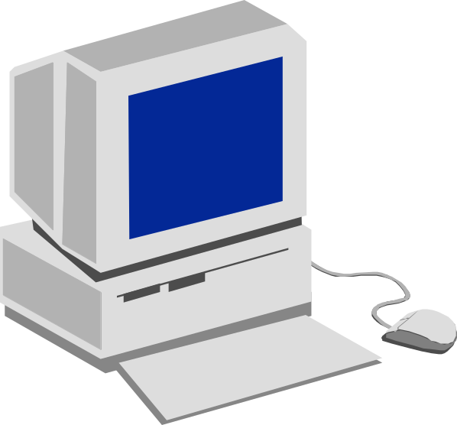
Creating Recovery Catalog
1. Create tablespace
2. Create catalog owner
3. Grant privileges
Catalog database
4. Create catalog
5. Connect to target database
6. Register target database
Target
database
Control file
Notes:
How to Create a Recovery Catalog
To create the recovery catalog, perform the following steps:
1. Connect to the catalog database and create a tablespace for the catalog:
SQL> CREATE TABLESPACE rman_ts
2> DATAFILE '<directory>/<name>'
3> SIZE 20M
4> EXTENT MANAGEMENT LOCAL UNIFORM SIZE 128K;
2. Create a user and schema for the recovery catalog:
SQL> CREATE USER rman_db01 IDENTIFIED BY rman_db01
2> DEFAULT TABLESPACE rman_ts
3> QUOTA UNLIMITED ON rman_ts;
3. Grant the roles and privileges to this user to maintain the recovery catalog and perform the backup and recovery operations.
SQL> GRANT recovery_catalog_owner TO rman_db01;
SQL> GRANT connect, resource TO rman_db01;

Slide 9
Notes:
How to Create a Recovery Catalog (continued)
4. Log in to the operating system and issue the RMAN command to invoke the RMAN command interpreter. Create the catalog. Use of the LOG option enables RMAN to output messages and commands to a file.
% rman catalog rman_db1/rman_db1@catdb log = catalog.log
create catalog tablespace rman_ts;
exit;
Note: When you use the LOG option, the output is directed to the file and you may not get the RMAN prompt. So the CREATE CATALOG command should be entered when the cursor appears on the new line. Similarly the exit command should be entered on the next new line. The purpose of the log is to help you review any errors that may arise in the process of creation of catalog so that corrective actions can be taken.
Check the catalog.log file created by RMAN to note if there are any errors in creation of the catalog. If you do find any errors, you should drop all objects under the catalog owner and re-create them from the beginning.
5. Connect to the target database. You must log in as a user with SYSDBA privileges on the target database to perform all the backup and recovery operations.
% rman target sys/oracle@db01
connected to target database: DB01 (DBID=472633597)
RMAN> connect catalog rman_db01/rman_db01@catdb
connected to recovery catalog database
RMAN>

Slide 10
Notes:
How to Create a Recovery Catalog (continued)
6. Register the target database in the catalog. If the target database is not registered in the recovery catalog, the catalog cannot be used to store information about the database. Recovery Manager uses the internal database identifier (DBID), which is calculated when the database is first created, as a unique identifier for the database. If you attempt to register a new database that has been created by copying an existing database and then changing the db_name, the register will fail. You can avoid this problem by using the DUPLICATE command, which copies the database from backups and generates a new database identifier.
To back up a copied database, create a new recovery catalog owner, and create the catalog in the new account
RMAN creates rows in the recovery catalog that contain information about the target database. RMAN copies all pertinent data about the target database from the control file into the recovery catalog.
RMAN> register database;
database registered in recovery catalog
starting full resync of recovery catalog
full resync complete
RMAN>
Using Oracle Enterprise Manager
For Oracle9i, a recovery catalog is created if you specify that the Enterprise Manager repository is to be located in a local database. Refer to the Configuration Assistant online help for details.
The recovery catalog will be created in the CATTBS tablespace for you by default with the recovery catalog user and password of rman/rman.

Slide 11
Connecting Using a Recovery Catalog
  Example on UNIX
  Example on Windows NT
$ ORACLE_SID=db01; export ORACLE_SID
$ rman target /
RMAN> connect catalog rman_db01/rman_db01@catdb
C:\> set ORACLE_SID=db01
C:\> rman target /
RMAN> connect catalog rman_db01/rman_db01@catdb
Notes:
How to Connect to Recovery Manager
To connect to RMAN using a recovery catalog, perform the following steps:
1. Initiate an RMAN session from the target database.
On Windows NT you may invoke the command prompt before issuing the following RMAN command or you can invoke the command line interface using the Run option from Start menu.
rman target sys/oracle@db01
connected to target database:DB01(DBID=XXXXXXXXXX)
RMAN>
2. Connect to the recovery catalog database.
RMAN> connect catalog rman_db01/rman_db01@catdb
connected to recovery catalog database
RMAN>

Slide 12
Recovery Catalog Maintenance
Restore / Recovery
Recovery Manager (RMAN)
Enterprise Manager
Backup
Reporting REPORT
LIST
Target
database
Control file
Stored
scripts
Catalog Maintenance
Register
Resynchronize
Reset
Change/Delete/Catalog
Backup /Restore/Recover
Catalog database
Notes:
Catalog Maintenance Commands
The CATALOG, CHANGE, and DELETE commands can be used to update the recovery catalog manually. These commands were reviewed in a previous lesson.
RESYNC and RESET are covered in this lesson.

Slide 13
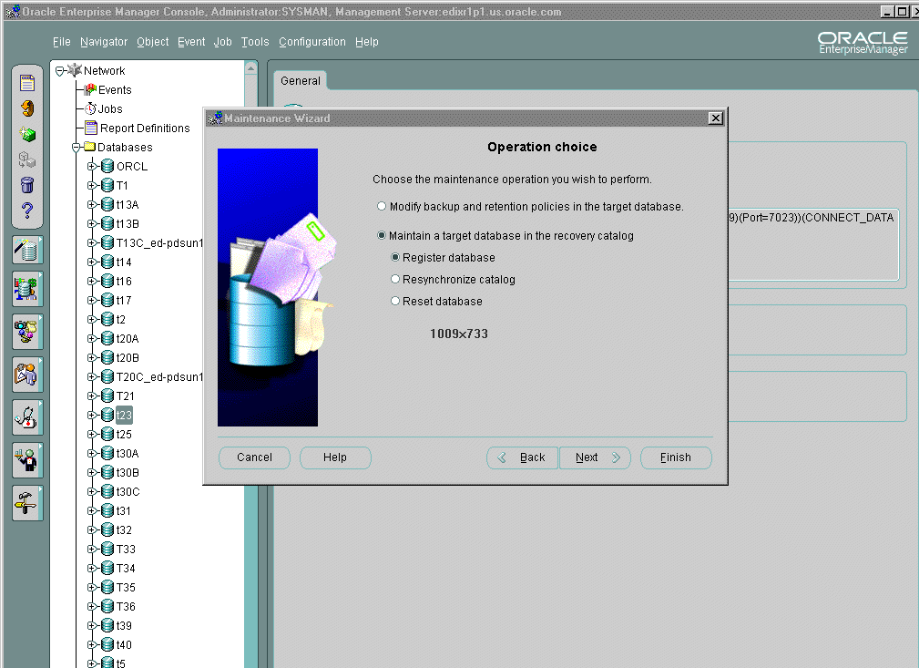
Catalog Maintenance
Notes:
Using Oracle Enterprise Manager
The Maintenance Wizard helps you perform basic recovery catalog operations like register the database, reset the database, and resynchronize the catalog. The Maintenance Wizard guides you through the process of defining the recovery catalog operation and submits a catalog maintenance job through Oracle Enterprise Manager to complete the operation.

Slide 14
Resynchronization of the
Recovery Catalog
Resynchronization of the recovery catalog happens:
  Automatically with BACKUP and COPY commands
  Manually with RESYNC CATALOG command
Catalog database
RMAN >
Target
database
Control file
Notes:
Resynchronizing the Recovery Catalog
Resynchronization of the recovery catalog ensures that the metadata is current with the target control file.
Resynchronizations can be full or partial. In a partial resynchronization, RMAN reads the current control file to update changed data, but does not resynchronize metadata about the database physical schema: datafiles, tablespaces, redo threads, rollback segments, and online redo logs. In a full resynchronization, RMAN updates all changed records, including schema records.
RMAN automatically detects when it needs to perform a full or partial resynchronization and executes the operation as needed. You can also force a full resynchronization by issuing a RESYNC CATALOG command.
To ensure that the catalog stays current, run the RESYNC CATALOG command periodically. A good rule of thumb is to run it at least once every n days, where n is the setting for the initialization parameter CONTROL_FILE_RECORD_KEEP_TIME. Because the control file employs a circular reuse system, backup and copy records eventually get overwritten. Resynchronizing the catalog ensures that these records are stored in the catalog and are not lost.

Slide 15
Using RESYNC CATALOG for Resynchronization
Issue the RESYNC CATALOG command when you:
  Add or drop a tablespace
  Add or drop a datafile
  Relocate a database file
$ rman target / catalog rman/rman@catdb
RMAN> RESYNC CATALOG;
Notes:
Using the RESYNC CATALOG Command
Any structural changes to the database cause the control file and recovery catalog to become “out of synch.” The catalog will be synchronized automatically when a BACKUP or COPY command is issued with a connection to the catalog. However, this synchronization can cause a delay in the backup operation.
The RESYNC CATALOG command updates the following records:
Log history: Created when a log switch occurs. Recovery Manager tracks this information so that it knows what archive logs it should expect to find.
Archived redo log: Associated with archived logs that were created by archiving an online log, by copying an existing archived log, or by restoring an archived log backup set.
Backup history: Associated with backup sets, backup pieces, backup set members, proxy copies, and image copies.
Physical schema: Associated with datafiles and tablespaces.
Using Oracle Enterprise Manager
You can use the Maintenance Wizard to resynchronize the catalog.

Slide 16
Resetting a Database Incarnation
  Use the RESET DATABASE command:
    To direct RMAN to create a new database incarnation record
    To distinguish between opening with RESETLOGS and an accidental restore operation of an old control file
  Open with RESETLOGS after RESET DATABASE
Notes:
Using the RESET DATABASE Command
An incarnation of a database is a number that is used to identify a version of the database before the log sequence number being reset to zero. This prevents archived and online redo logs from being applied to an incorrect incarnation of the database. The RESET DATABASE command is used by Recovery Manager to store database incarnation information in the recovery catalog. All subsequent backups and log archives are associated with the new database incarnation.
If the target database is recovered to a point in the past, the database must be opened with the RESETLOGS option. In this case, Recovery Manager cannot use the recovery catalog again until a RESET DATABASE command is issued. This enables Recovery Manager to distinguish between a RESETLOGS and an accidental restore operation of an old control file.
Using Oracle Enterprise Manager
You can use the Maintenance Wizard to reset the Recovery Catalog for the target database.

Slide 17
Notes:
Using the RESET DATABASE Command (continued)
Example
RMAN> reset database;
database registered in recovery catalog
starting full resync of recovery catalog
full resync complete
RESET DATABASE TO INCARNATION Key Command
The RESET DATABASE TO INCARNATION <identifier> command is used to undo the effects of a RESETLOGS operation by restoring backups of a prior incarnation of the database. You must specify the primary key of the record for the database incarnation to which you return:
RMAN> reset database to incarnation <identifier>;
Note: The identifier is obtained by the LIST INCARNATION OF DATABASE command.
Example
RMAN> list incarnation of database;
DB Key Inc Key DB Name DB ID CUR Reset SCN
------ ------- ------- ---------- --- ---------
1 2 ORACLE 1186311932 YES 25730
1 421 ORACLE 1186311932 NO 172279
RMAN> reset database to incarnation 421;

Slide 18
Recovery Catalog Reporting
Restore/Recovery
Recovery Manager (RMAN)
Enterprise Manager
Backup
Reporting REPORT
LIST
Target
database
Control file
Stored
scripts
Catalog Maintenance
Register
Resynchronize
Reset
Change
Backup /Restore/Recover
Catalog database
Notes:
Recovery Catalog Reporting
These commands analyze and list information contained inside the recovery catalog.
REPORT Command
You can use the REPORT command to analyze various aspects of the backup, copy, restore, and recovery operations.
LIST Command
You can use the LIST command to display information on backup sets, file copies, and archived logs that are stored in the recovery catalog.
Views
In addition to the REPORT and LIST commands, you can use SQL commands to query the data dictionary and dynamic views that are created when the recovery catalog is created.

Slide 19

Viewing the Recovery Catalog
Data dictionary views:
  RC_DATABASE
  RC_DATAFILE
  RC_STORED_SCRIPT
  RC_STORED_SCRIPT_LINE
  RC_TABLESPACE
Notes:
Data Dictionary Views
The recovery catalog views are non-normalized views that are optimized for RMAN usage rather than user queries. You can usually use the RMAN reporting commands to obtain the needed information from the recovery catalog.
You can use the recovery catalog views as shown in the following examples:
Example 1
To determine which databases are currently registered in the recovery catalog:
SQL> select * from rc_database;
DB_KEY DBINC_KEY DBID NAME RESETLOGS_CHANGE# RESETLOGS
------ --------- ---------- ---- ----------------- ---------
1 2 1943591421 DB01 60533 25-JUL-02

Slide 20
Notes:
Data Dictionary Views (continued)
Example 2
To determine which tablespaces are currently stored in the recovery catalog for the target database:
SQL> SELECT DB_KEY, DBINC_KEY, DB_NAME, TS#, NAME,
CREATION_CHANGE# CHANGE#, CREATION_TIME CRE_DATE
FROM rc_tablespace;
DB_KEY DBINC_KEY DB_NAME TS# NAME CHANGE# CRE_DATE
------ --------- ------- -- ------ ------- ---------
1 2 DB01 3 DATA01 9611 25-JUL-02
1 2 DB01 1 RBS 9599 25-JUL-02
1 2 DB01 4 RMAN_TS 14023 25-JUL-02
1 2 DB01 0 SYSTEM 3 25-JUL-02
1 2 DB01 2 TEMP 9605 25-JUL-02
Example 3
To determine which scripts are currently stored in the recovery catalog for the target database:
SQL> SELECT * FROM rc_stored_script;
DB_KEY DB_NAME SCRIPT_NAME ------- -------- --------------------------------------
1 DB01 nightlybackup
1 DB01 archivebackup

Slide 21
Stored Scripts
Restore/Recovery
Recovery Manager (RMAN)
Enterprise Manager
Backup
Reporting REPORT
LIST
Target
database
Control file
Stored
scripts
Catalog Maintenance
Register
Resynchronize
Reset
Change
Backup /Restore/Recover
Catalog database
Notes:
Stored Scripts
A Recovery Manager script is a set of commands that:
Specify frequently used backup, recover, and restore operations
Are created using the CREATE SCRIPT command
Are stored in the recovery catalog
Can be called only by using the RUN command
Enable you to plan, develop, and test a set of commands for backing up, restoring, and recovering the database
Minimize the potential for operator errors
Storing and Viewing Scripts
As an example, a script named level0backup can be created and stored in the recovery catalog to make an incremental level 0 backup. Storing the script in the recovery catalog enables any DBA using Recovery Manager to access the scripts.
You can display a list of stored scripts by querying the RC_STORED_SCRIPT view.
You can query the RC_STORED_SCRIPT_LINE view to list the text of a specified stored script or you can use the PRINT SCRIPT command.

Slide 22
Script Examples
  Use CREATE SCRIPT to store a script.
  Use EXECUTE SCRIPT to run a script.
RMAN> create script Level0Backup {
backup
incremental level 0
format ‘/u01/db01/backup/%d_%s_%p’
fileperset 5
(database include current controlfile);
sql ‘alter system archive log current’; }
RMAN > run {execute script Level0Backup;}
Notes:
Creating and Using Stored Scripts
Backup, restore, and recovery operations are generally automated using scripts. RMAN provides a way of storing these scripts in the recovery catalog. You create scripts by using the CREATE SCRIPT command. Use the EXECUTE SCRIPT command within the braces of the RUN command to execute the script.

Slide 23
Managing Scripts
  Use REPLACE SCRIPT to rewrite a script
  Use DELETE SCRIPT to remove a script
  Use PRINT SCRIPT to display a script
RMAN> REPLACE SCRIPT Level0Backup {
…
fileperset 3
…
}
RMAN> DELETE SCRIPT Level0Backup;
RMAN> PRINT SCRIPT Level0Backup;
Notes:
Managing Stored Scripts
You can rewrite a script with the REPLACE SCRIPT command. You must supply the entire script, not just the changed lines.
You can use the PRINT SCRIPT command to print a stored script to standard output or the RMAN message log. To print to a message log, specify the log filename with the LOG argument at the command line. If you do not specify this argument, Recovery Manager writes message output to standard output.

Slide 24
Backup of Recovery Catalog
  Whole database backup of the database containing the recovery catalog
  Tablespace backup of the tablespace containing the recovery catalog
  Export:
    If catalog database is not very large, you can export the database at regular intervals.
    If catalog database is large, export the schema containing the recovery catalog.
Notes:
Backup of Recovery Catalog
It is critical to have a tested backup strategy for the recovery catalog. The recovery catalog is a schema of objects that is stored in a database. The considerations for backup of the recovery catalog are similar to those of a schema.
You could use one of the following strategies to back up the recovery catalog:
Whole database backup: You can take a whole database backup by using RMAN or operating system commands.
Tablespace backup: If the recovery catalog is stored in a separate tablespace (as recommended) and the catalog database is operated in ARCHIVELOG mode, you can take an online backup of the tablespace containing the recovery catalog.
Export: If the database that contains the catalog is not very large, you can export the database at regular intervals. However, when the catalog database is large, export may take a very long time and consume a large amount of disk storage. Then you can export the schema containing the recovery catalog.
Always store the recovery catalog in a separate database from your target database. Also ensure that the files related to the catalog database are isolated on disks that are different from those that contains the target database.

Slide 25
Recovering the Recovery Catalog
  Create a database from a previous backup of the recovery catalog database.
  Relocate the catalog into another database and import the data.
  Import the entire database from an export.
Notes:
Recovering the Recovery Catalog
The strategy to recover a recovery catalog would depend on the nature of failure and the backup strategy in place.
If the database that contains the recovery catalog is damaged, and has to be rebuilt, then you should consider the following recovery options:
You can create a database from a previous backup of the recovery catalog database.
You can decide to locate the catalog in another database. In that database, create a user and grant the user the RECOVERY_CATALOG_OWNER privilege. You can import the data from the export of the previous catalog owner into the schema of the newly created user.
You can create a new database and import the entire database from an export of the recovery catalog database.
When the recovery catalog has been rebuilt, you should resynchronize the catalog with the control file of the target database immediately.
During resynchronization, Recovery Manager may add records for files that no longer exist, because files being re-cataloged are not verified. Remove such records by issuing the CHANGE … UNCATALOG command.

Slide 26
Summary
In this lesson, you should have learned that:
  Before using the recovery catalog, you must register the target database
  You should resynchronize the catalog frequently using the control file
  Scripts can be stored in the recovery catalog

Slide 27
Practice 17 Overview
This practice covers the following topics:
  Creating the recovery catalog
  Registering a target database with the recovery catalog
  Listing the incarnation of a target database
  Storing a script in the recovery catalog and executing it

Slide 28
Notes:
Practice 17: RMAN Recovery Catalog Creation and Maintenance
Execute the lab17_01.sql script to create the recat tablespace for the recovery catalog and the rcuser schema.
Connect to the recovery catalog database using RMAN. Create the catalog in the recat tablespace.
Connect to your target database and recovery catalog using RMAN.
Execute the command to resynchronize the control file and recovery catalog. What happens? Why?
Register the target database in the recovery catalog.
Using RMAN, list all the database incarnations registered in the catalog.
Enter the RESET DATABASE command at the RMAN prompt. What happens?
View the $HOME/LABS/lab17_08.sql script. In SQL*Plus connect to your target database as system/manager and execute the script to create an online operating system copy of the SAMPLE tablespace datafile in your $HOME/BACKUP directory.
Using RMAN, add the backup made in step 8 to the recovery catalog.
Using RMAN, confirm that the datafile has been added to the recovery catalog.
Use the RMAN command to remove the backup of the SAMPLE tablespace datafile from the recovery catalog. Do not remove the file from the operating system.
Using SQL*Plus, connect to your recovery catalog database and query the RC_DATAFILE_COPY view to confirm that the datafile has been removed from the recovery catalog.
Create an RMAN script to make a whole database backup with following information:
Name of script: nightback
Channel name: dbnD (n is the student account number)
Channel type: Disk
Format: $HOME/BACKUP/RMAN/%b%d%s%p
Level: Database (No archivelogs)
tag: nback
Note: Do not run this script at this time.
Use the PRINT command to query the recovery catalog and verify the script creation.

