Slide 1
Export and Import Utilities

Slide 2
Objectives
After completing this lesson, you should be able to do the following:
  Describe the uses of the Export and Import utilities
  Describe Export and Import concepts and structures
  Perform simple Export and Import operations
  List guidelines for using Export and Import

Slide 3
Oracle Export and Import Utilities
Oracle
database
Export
Import
Oracle
database
Notes:
Export and Import Utilities
The Export utility provides a simple way for you to transfer data objects between Oracle databases, even if they reside on platforms with different hardware and software configurations.
When you run Export against an Oracle database, objects (such as tables) are extracted, followed by their related objects (such as indexes, comments, and grants), if any. The extracted data is written to an Export file, which is an Oracle binary-format dump file that is typically located on disk or tape.
The Import utility reads the object definitions and table data from an Export dump file. It inserts the data objects into an Oracle database.

Slide 4
Oracle Export and Import Utility Overview
You can use these utilities to do the following:
  Archive historical data
  Save table definitions to protect them from user error failure
  Move data between machines and databases or between different versions of the Oracle server
  Transport tablespaces between databases
Notes:
Export and Import Utility Overview
The Export utility can provide a logical backup of:
Database objects
A tablespace
An entire database
The Import utility is used to read a valid Export file for moving data into a database. Redo log history cannot be applied to objects that are imported from an export file, therefore data loss may occur, but can be minimized.
You can use the Export and Import utilities to complement normal operating system backups by using them to:
Create a historical archive of a database object or entire database; for example, when a schema is modified to support changing business requirements.
Save table definitions in a binary file. This may be useful for creating and maintaining a baseline of a given schema structure.
Move data from one Oracle database version to another, such as upgrading from Oracle8i to Oracle9i.

Slide 5
Notes:
Export and Import Utility Overview (continued)
You use these utilities to protect against:
User errors where a user may accidentally drop or truncate a table
A table that has become logically corrupted
An incorrect batch job or other DML statement that has affected only a subset of the database
You use these utilities to recover:
A logical database to a point different from the rest of the physical database when multiple logical databases exist in separate tablespaces of one physical database
A tablespace in a very large database (VLDB) when tablespace point-in-time recovery (TSPITR) is more efficient than restoring the whole database from a backup and rolling it forward
Note: This lesson addresses the Export and Import utilities and discusses how they affect backup and recovery operations. For a detailed description of these utilities, refer to the Oracle9i Database Utilities manual.

Slide 6
Methods of Invoking the
Export and Import Utilities
  Command-line interface
  An interactive dialog
  Parameter files
  Oracle Enterprise Manager
Notes:
Invoking Export and Import
You can invoke Export and Import and specify parameters by using any of the following methods:
Command-line entries
Interactive prompts
Parameter files
Oracle Enterprise Manager Data Management Wizard
To use Export, you must have the CREATE SESSION privilege on an Oracle database. To export tables owned by another user, you must have the EXP_FULL_DATABASE role enabled. This role is granted to all DBAs. If you do not have the system privileges contained in the EXP_FULL_DATABASE role, you cannot export objects contained in another user’s schema.
To use Import, you need the privilege CREATE SESSION to log on to the Oracle database server. This privilege belongs to the CONNECT role established during database creation.
You can do an import even if you did not create the export file. However, if the export file was created by someone other than you, you can import that file only if you have the IMP_FULL_DATABASE role.
Note: Many options are only available by using the command-line interface. However, you can use a parameter file with command line.

Slide 7
Export Modes
Table Mode
Table definitions
Table data (all or selected rows)
Owner’s table grants
Owner’s table indexes
Table constraints
User Mode
Tables definitions
Tables data
Owner’s grants
Owner’s indexes
Tables constraints
Tablespace Mode
Table definitions
Grants
Indexes
Table constraints
Triggers
Full Database Mode
Tables definitions
Tables data
Grants
Indexes
Tables constraints
Notes:
Export Modes
Table Mode
Table mode exports specified tables in the user’s schema, rather than exporting all tables. A privileged user can export specified tables owned by other users.
User Mode
User mode exports all objects for a user’s schema. Privileged users can export all objects in the schemas of a specified set of users. This mode can be used to complement a full database export.
Tablespace Mode
Tablespace mode can be used to export all tables in the specified tablespace.
The transportable tablespace feature enables you to move a set of tablespaces from one Oracle database to another.
Moving data by way of transportable tablespaces can be much faster than performing either an import/export of the same data, because transporting a tablespace only requires the copying of datafiles and integrating the tablespace structural information. You can also use transportable tablespaces to move index data, thereby avoiding the index rebuilds you would have to perform when importing table data.

Slide 8
Notes:
Export Modes (continued)
Full Database Mode
Full database mode exports all database objects, except those in the SYS schema. Only privileged users can export in this mode.
Note: This is a partial treatment. For more information on modes and objects, refer to the Oracle9i Database Utilities manual.

Slide 9
Invoking Export
  Syntax:
  Examples:
exp keyword = value, value2, … ,valuen
exp hr/hr TABLES=employees,departments
rows=y file=exp1.dmp
exp system/manager OWNER=hr direct=y
file=expdat.dmp
exp \'username/password AS SYSDBA\'
TRANSPORT_TABLESPACE=y
TABLESPACES=ts_emp log=ts_emp.log
Notes:
Invoking Export
Command-Line Export
You can copy database data to an operating system file by using the command-line mode of the Export utility. This file is only readable by the Import utility.
Examples
Create an export file named exp1.dmp that includes the EMPLOYEES and DEPARTMENTS tables from the HR schema, including rows:
exp hr/hr tables=employees,departments rows=y file=exp1.dmp
Note: The table name can contain any number of '%' pattern matching characters, which can each match zero or more characters in the table name against the table objects in the database.
Create a fast export file named expdat.dmp that includes all objects from the HR schema:
exp system/manager owner=hr direct=y
Note: The default export filename is expdat.dmp.

Slide 10
Notes:
Invoking Export (continued)
Create an export file named expdat.dmp that includes all definitions of objects belonging to the TS_EMPLOYEES tablespace and generate a log file named ts_employees.log:
exp \'username/password AS SYSDBA\' TRANSPORT_TABLESPACE=y\
TABLESPACES=ts_employees LOG=ts_employees.log

Slide 11
Notes:
Partial List of Export Parameters

Slide 12
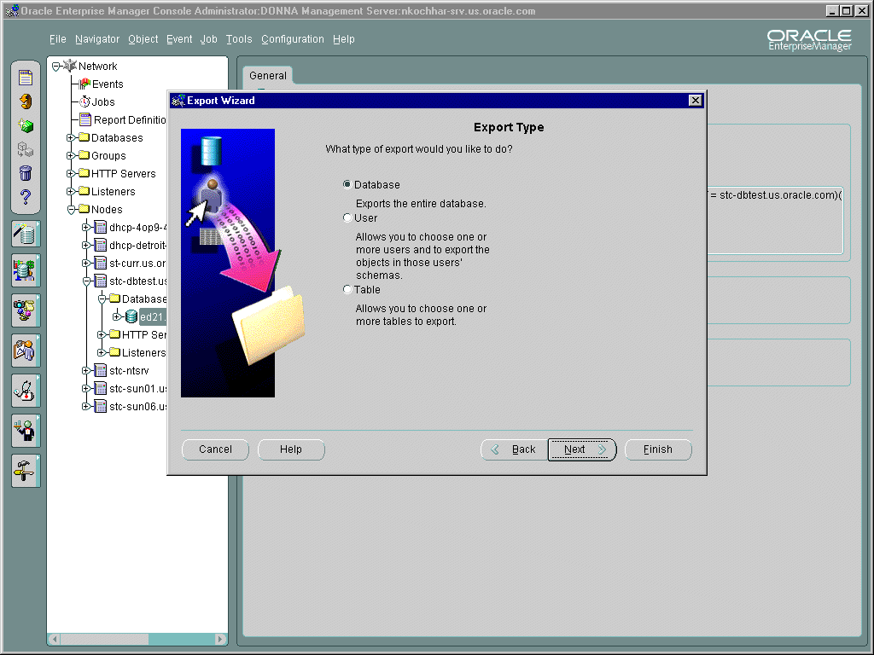
Using the Export Wizard
Notes:
Using Oracle Enterprise Manager
You can use the Export Wizard, one of the Data Management wizards, to specify what you want to export and submit an Export job through Enterprise Manager to complete the operation.

Slide 13
Direct-Path Export Concepts
Export
Oracle Server
Generate SQL
commands
Two-Task
common
(TTC)
SQL
command
processing
Buffer
cache
manager
Write blocks
Export
Dump file
Read blocks
TTC
buffer
Evaluating
buffer
Buffer
cache
Direct Path
Direct Path
Conventional Path
Notes:
Direct-Path Export Concepts
By using the Direct-Path feature, you can extract data much faster. When the DIRECT=Y parameter is specified, the Export utility reads directly from the data layer instead of going through the SQL-command processing layer.
Mechanics of Direct-Path Export
Direct mode of export can be set by specifying the DIRECT=Y parameter.
Direct-path export does not compete with other resources of the Instance.
If in direct-read mode, it reads database blocks into a private area used by the session.
Rows are transferred directly into the Two-Task Common (TTC) buffer for transport.
The data in the TTC buffer is in the format that the Export utility expects.

Slide 14
Direct-Path Export Features
  The type of Export is indicated on the screen output, export dump file, and the log file.
  Data is already in the format that Export expects, avoiding unnecessary data conversion.
  Uses an optimized SQL SELECT statement.
Notes:
Direct-Path Export
The direct-path option of the Export utility introduces some features that differentiate it from the conventional-path Export.
Direct-Path Features
The type of export is indicated on the screen output, export dump file, and the log file specified with the LOG parameter.
Data is already in the format that Export expects, thus avoiding unnecessary data conversion. The data is transferred to Export client, which then writes the data into the Export file.
The direct-path Export uses an optimized SELECT * FROM table without any predicate.
Note: The format of the column data and specification in the Export dump file differ from those of conventional-path Export.

Slide 15
Direct-Path Export Restrictions
  The direct-path option cannot be invoked interactively.
  Client-side and server-side character sets must be the same.
  The BUFFER parameter has no affect.
Notes:
Direct-Path Export Restrictions
The direct-path option of the Export utility has some restrictions that differentiate it from the conventional-path Export.
The direct-path export feature cannot be invoked by using an interactive EXP session.
When the direct-path option is used, the client-side character set must match the character set of the server side. Use the NLS_LANG environment variable to set the same character set as the server one.
The BUFFER parameter of the Export utility has no effect on direct-path Export; it is used only by the conventional-path option. You can use the RECORDLENGTH parameter to specify the size of the buffer that Export uses for writing to the export file.
Rows in tables that contain objects and LOBs will be exported using conventional path, even if direct path was specified. Import will correctly handle these conventional path tables within direct path dump files.

Slide 16
Specifying Direct-Path Export
  As command line argument to the Export command:
  As a keyword in a parameter file:
exp userid=hr/hr full=y direct=y
exp parfile=<Parameter file>
Parameter file
…..(Other Parameters)
DIRECT = Y
…...(Other Parameters)
Notes:
Specifying Direct-Path Export
Before direct-path Export can be used, you must make sure the catexp.sql script has been run. On UNIX, it can be found in $ORACLE_HOME/rdbms/admin.
Command-Line Option
You can invoke direct-path export by using the DIRECT command-line parameter at the operating system prompt.
$ exp user=hr/hr full=y direct=y
Parameter File
An example of a parameter file, exp_par.txt:
USERID=hr/hr
TABLES=employees,departments
FILE=exp_one.dmp
DIRECT=Y
Invoke Export with the parameter file from the operating system prompt:
$ exp parfile=exp_param.txt

Slide 17
Uses of the Import Utility for Recovery
  Create table definitions
  Extract data from a valid Export file
  Import from a complete or cumulative Export file
  Recover from user-error failures
Notes:
Import Utility
The Import utility reads the object definitions and table data from an Export dump file. It inserts the data objects into an Oracle database. Import functionality includes:
Creating table definitions because the table definitions are stored in the Export file. Choosing to import data without rows will create just the table definitions.
Extracting data from a valid export file by using the Table, User, Tablespace, or Full Import modes
Importing data from a complete or cumulative Export file
Recovering from user failure errors where a table is accidentally dropped or truncated by using one the previously mentioned methods

Slide 18
Import Modes
Mode Description
Table Import specified tables into a schema.
User Import all objects that belong to a
schema
Tablespace Import all definitions of the objects contained in the tablespace
Full Database Import all objects from the export file
Notes:
Import Modes
Table Mode
Table mode imports all specified tables in the user’s schema, rather than all tables. A privileged user can import specified tables owned by other users.
User Mode
User mode imports all objects for a user’s schema. Privileged users can import all objects in the schemas of a specified set of users.
Tablespace Mode
Tablespace mode allows a privileged user to move a set of tablespaces from one Oracle database to another.
Full Database Mode
Full database mode imports all database objects, except those in the SYS schema. Only privileged users can import in this mode.

Slide 19
Invoking Import
  Syntax:
  Examples:
imp keyword = value or keyword = value, value2, … value n
imp hr/hr TABLES=employees,departments
rows=y file=exp1.dmp
imp system/manager FROMUSER=hr file=exp2.dmp
imp \'username/password AS SYSDBA\'
TRANSPORT_TABLESPACE=y
TABLESPACES=ts_employees
Notes:
Invoking Import
Import Examples
Import into the HR schema, the EMPLOYEES and DEPARTMENTS tables, including rows, by using the Export file named exp1.dmp.
$ imp hr/hr tables=employees,departments rows=y file=exp1.dmp
Import all objects belonging to the HR schema, including rows, by using the export file named exp2.dmp.
$ imp system/manager FROMUSER=hr file=exp2.dmp
Import all definitions of objects belonging to the TS_EMPLOYEES tablespace, by using the export file named expdat.dmp.
$ imp \'username/password AS SYSDBA\' \
TRANSPORT_TABLESPACE=y TABLESPACES=ts_employees
If the file parameter is not specified, Import looks for the default file expdat.dmp.
Note: Command-line mode options are similar to interactive mode options but offer more functionality.

Slide 20
Notes:
Partial List of Import Parameters

Slide 21
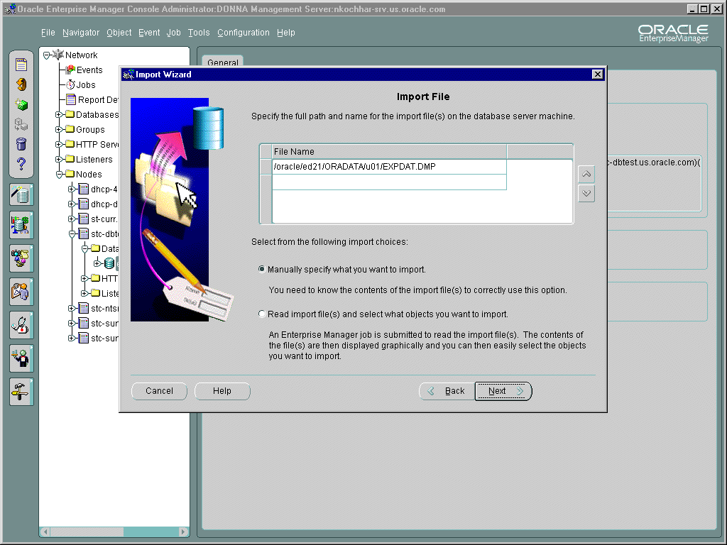
Using the Import Wizard
Notes:
Using Oracle Enterprise Manager
The Import Wizard, one of the Data Management Wizards, guides you through the process of specifying what you want to import and submits an Import job through the Enterprise Manager Job System to complete the operation.

Slide 22
Invoking Import as SYSDBA
  You need to invoke Import as SYSDBA under the following conditions:
    At the request of Oracle technical support
    When importing a transportable tablespace set
  To invoke Import as SYSDBA:
imp \'username/password AS SYSDBA\'
Notes:
Importing as SYSDBA
SYSDBA is used internally and has specialized functions. Its behavior is not the same as for generalized users. Therefore, you should not typically need to invoke Import as SYSDBA, except in the following situations:
At the request of Oracle technical support
When importing a transportable tablespace set
To invoke Import as SYSDBA, use the following syntax, adding any desired parameters or parameter file names:
imp \'username/password AS SYSDBA\'
or, optionally:
imp \'username/password@instance AS SYSDBA\'
If either the username or password is omitted, Import will prompt you for it.This example shows the entire connect string enclosed in quotation marks and backslashes. This is because the string, AS SYSDBA, contains a blank; a situation for which most operating systems require that the entire connect string be placed in quotation marks or marked as a literal by some method. Additionally, some operating systems also require that quotation marks on the command line be preceded by an escape character. In this example, backslashes are used as the escape character. If the backslashes were not present, the command line parser that Import uses would not understand the quotation marks and would remove them before calling Import.

Slide 23
Import Process Sequence
1. New tables are created
2. Data is imported
3. Indexes are built
4. Triggers are imported
5. Integrity constraints are enabled on the new tables
6. Any bitmap, functional, and/or domain indexes are built
Notes:
Import Process Sequence
When importing a table, the export file is read and the table and data are created in the following order:
1. New tables are created
2. Data is imported
3. Indexes are built
4. Triggers are imported
5. Integrity constraints are enabled on the new tables
6. Any bitmap, functional, and domain indexes are built
This sequence prevents data from being rejected due to the order in which tables are imported. This sequence also prevents redundant triggers from firing twice on the same data (once when it is originally inserted and again during the import).
The order in which you import tables may be important if you do not import all the objects that a user owns. For, example, if the table with the foreign key has a referential check on the table with the primary key, and the foreign key table is imported first, then all rows that reference the primary key that have not been imported will be rejected if the constraints were enabled. For a full database Export this is not a problem.

Slide 24
Globalization Support Considerations
  The Export file identifies the character encoding scheme that is used for the character data in the file.
  The Import utility translates data to the character set of its host system.
  A multibyte character set Export file must be imported into a system that has the same characteristics.
Notes:
Globalization Support Considerations
When moving data from one Oracle database by one character set to a database with a different character set, ensure the data conversion is handled appropriately. You can do this by setting the NLS_LANG environment variable to the character set definition of the database from which the data is being exported. Not setting this correctly could cause unwanted conversion of characters in the data, possibly causing loss of data.
Examples
Converting from a 7-bit ASCII character set, such as American English, to an 8-bit character set such as Danish, no conversion is needed because all characters have an equivalent character in the Danish alphabet.
When converting from an 8-bit ASCII character set, such as Danish, to a 7-bit character set such as American English, the extra Danish characters that are not found in the American alphabet may be converted to question marks (?). In this case the question marks are substituted for the unknown Danish characters which, is the appropriate result.
In the 8-bit to 8-bit data movement, whether characters are lost depends upon the specifics of the languages used to enter the data. For example, the Spanish alphabet has letters that are not in the Danish alphabet, so moving data from a Spanish database to a Danish one might result in possible conversion and therefore possible loss of those characters.

Slide 25
Summary
In this lesson, you should have learned how to:
  Describe the uses of Export and Import
  Describe Export and Import concepts and structures
  Perform simple Export and Import operations
  List guidelines for using Export and Import

Slide 26
Practice 18 Overview
This practice covers the following topics:
  Using the Export utility
  Using the Import utility

Slide 27
Notes:
Practice 18: Export and Import Utilities
1. Invoke the Export utility to export the EMPLOYEES and DEPARTMENTS tables in the HR schema.
2. Invoke SQL*Plus and connect as HR. Drop the EMPLOYEES and DEPARTMENTS tables.
3. Restore the EMPLOYEES and DEPARTMENTS tables by using the import utility.
4. Query the EMPLOYEES and DEPARTMENTS tables to get the number of rows in each of those tables.

