Slide 1
Diagnostic and Tuning Tools

Slide 2
Objectives
After completing this lesson, you should be able to do the following:
  Identify key tuning components of the alert log file
  Identify key tuning components of background
  trace files
  Identify key tuning components of user trace files
  Collect statistics with Oracle Enterprise Manager
  Describe how Statspack collects statistics
  Collect statistics with Statspack
  Identify dynamic performance views useful in tuning
  Describe other tools used for tuning

Slide 3
Maintenance of the Alert Log File
  The alert log file consists of a chronological log of messages and errors.
  Check the alert log file regularly to:
    Detect internal errors (ORA-600) and block corruption errors
    Monitor database operations
    View the nondefault initialization parameters
  Remove or trim the file regularly after checking.
Notes:
The Alert Log File
It is important for the database administrator to check the alert log file regularly to detect problems before they become serious.
The following information is logged in the alert log file:
Internal errors (ORA-600) and block corruption errors (ORA-1578 or ORA-1498)
Operations that affect database structures and parameters, and statements such as CREATE DATABASE, STARTUP, SHUTDOWN, ARCHIVE LOG, and RECOVER
The values of all non-default initialization parameters at instance startup
The location of the alert log file is given by the BACKGROUND_DUMP_DEST parameter

Slide 4
Tuning Components of the Alert Log File
The alert log file contains the following information
which can be used in tuning the database:
  Checkpoint start and end times
  Incomplete checkpoints
  Time to perform archiving
  Instance recovery start and complete times
  Deadlock and timeout errors
Notes:
Checkpoint Start and End Times
These values are written into the alert log file only if the LOG_CHECKPIONTS_TO_ALERT parameter has been set to True.

Slide 5
Background Processes Trace Files
  The Oracle server dumps information about
  errors detected by any background process
  into trace files.
  Oracle Support uses these trace files to diagnose
  and troubleshoot.
  These files do not usually contain tuning information.
Notes:
Background Processes Trace Files
The background processes create these files. In general these files contain diagnostic information, not information regarding performance tuning. However, by using events, information can be written to these files regarding performance. Database events can be set by the DBA, but usually only under the supervision of Oracle Support.

Slide 6
User Trace Files
  Server process tracing can be enabled or disabled at the session or instance level.
  A user trace file contains statistics for traced SQL statements in that session.
  User trace files are created on a per server process basis.
  User trace files can also be created by:
    Backup control file to trace
    Database SET EVENTs
Notes:
User Trace Files
Server processes can generate user trace files at the request of the user or DBA.
Instance-Level Tracing
This trace logging is enabled or disabled by the SQL_TRACE initialization parameter. The default value is False.
Session-Level Tracing
The following statement enables the writing to a trace file for a particular session:
EXECUTE dbms_system.set_sql_trace_in_session (8,12,TRUE);
where 8 and 12 are the system identifier and serial numbers of the connected user.
The dbms_system package is created when the catproc.sql script is run. This script is located in the following directory:
On UNIX systems
$ORACLE_HOME/rdbms/admin
On Windows
%ORACLE_HOME%\rdbms\admin
To enable the writing of a trace file for your current session, run the command:
ALTER SESSION SET sql_trace=TRUE;

Slide 7
Views, Utilities, and Tools
Tools and views that are available to the DBA for determining performance:
  Oracle Enterprise Manager
  Diagnostics and tuning packs
  Statspack
  v$xxx dynamic troubleshooting and performance views
  dba_xxx dictionary views
  Oracle wait events
  utlbstat.sql and utlestat.sql scripts
Notes:
Views, Utilities, and Tools
Oracle Enterprise Manager
Oracle Enterprise Manager has many GUI tools to assist you in managing the database. The Diagnostics Pack and the Tuning Pack include various managers that offer insight into many performance management areas, such as graphical monitoring, analysis, and automated tuning of a database.
Statspack
Statspack can be used to gather statistics. Statspack can collect statistics over a period of time and have the statistics stored in the database. This collection offers you the opportunity to compare statistics over different periods of time. A hard copy report can be generated from any two snapshots. In addition to the instance statistics, Statspack also generates information on SQL statements present in the Library Cache during the beginning or ending snapshots.

Slide 8
Notes:
Views, Utilities, and Tools (continued)
Dictionary and Dynamic Views
The Oracle server displays all system statistics in the v$sysstat view and provides many other views for performance and troubleshooting information. You can query these views to find cumulative totals since the instance started, but this is often unhelpful. If your instance is rarely shut down, the statistics may cover a long period and have little meaning.
Oracle displays data storage statistics in dba_xxx views that help you in troubleshooting table, cluster, and index storage.
Oracle Wait Events
If you are troubleshooting, you need to know when a process has waited for any resource. A list of wait events is present in the server.
Some dictionary views display the events for which sessions had to wait.
The utlbstat and utlestat Utilities
The utlbstat.sql and utlestat.sql scripts produce a report similar to Statspack. The two main differences are:
The statistics collected are not stored in the database
Only one report can be generated
Conversely Statspack collects multiple snapshots that are stored in the database. Reports can then be generated using any two snapshots.

Slide 9
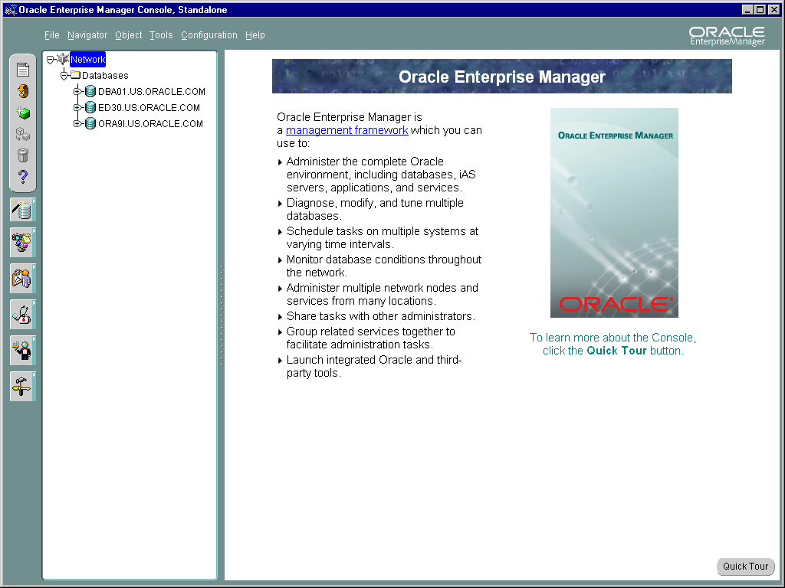
Oracle Enterprise Manager Console
Notes:
Oracle Enterprise Manager Console
The administrator uses the Oracle Enterprise Manager GUI console to manage the database. There are three packs that can be added to the Oracle Enterprise Manager console, these are:
Diagnostics Pack
Lock Monitor
Performance Manager
Performance Overview
Top Sessions
Top SQL
Trace Data Viewer
Tuning Pack
Oracle Expert
Outline Management
SQL Analyze
Tablespace Map
Change Management Pack
Change Manager
The Diagnostic and Tuning packs will be used during the running of this course.

Slide 10
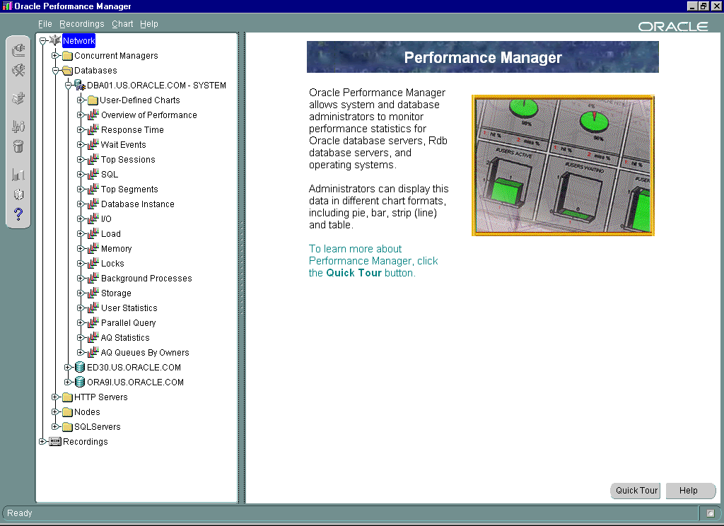
Performance Manager
Notes:
Performance Manager
Performance Manager is an optional package not included as part of the basic Oracle Enterprise Manager that is shipped with the database.
The Performance Manager application captures, computes, and presents performance data in a graphical, real-time view that allows you to monitor the key metrics required to:
Use memory effectively
Minimize disk I/O
Avoid resource contention
The data is separated into different charts and displayed in real-time mode, but can be recorded for replay.
Predefined Charts
There are seventeen different categories of predefined charts are available for display. Each category has a set of specific charts that focus on the parent subject. Here are listed some of the chart categories:
I/O
These charts include File I/O Rate, File I/O Rate Details, Network I/O Rate, and System I/O Rate.

Slide 11
Notes:
Performance Manager (continued)
Contention
These charts include Circuit, Dispatcher, Free List Hit %, Latch, Lock, Queue, Redo Allocation Hit %, Rollback NoWait Hit %, and Shared Server.
Database / Instance
These charts include Process, Session, System Statistics, Table Access, Tablespace, Tablespace Free Space, # Users Active, # Users Logged on, # Users Waiting, # Users Waiting for Locks, and # Users Running.
Load
These charts include Buffer Gets Rate, Network Bytes Rate, Redo Statistics Rate, Sort Rows Rate, Table Scan Rows Rate, and Throughput Rate.
Memory
These charts include Buffer Cache Hit %, Data Dictionary Cache Hit %, Library Cache Hit %, Library Cache Details, SQL Area, Memory Allocated, Memory Sort Hit %, Parse Ratio, and Read Consistency Hit %.
Top Resource Consumers
Top Resource Consumers is one of the predefined charts for database services.
Overview of Performance
The overview displays a composite of the most commonly used charts from the other categories. Use the overview charts to get an overall picture of your database activity and then drill down to the more specific reports if you need to. The set includes the following:
Overview of Throughput is a group chart for the Overview of Performance class. The icon depicts four small bar graphs.
Overview of Performance Default Chart is an individual chart for the Overview of Performance class. The icon depicts a bar graph.
User-Defined Charts
You can define new charts and display windows containing charts in many categories. If you have defined any charts of your own, you can select from among them by using this category.

Slide 12
Overview of Oracle Expert
Tuning Methodology
Specify tuning scope
Collect data
View and edit data and rules
Analyze data
Review recommendations
Implement recommendations
Notes:
Overview of Oracle Expert Tuning Methodology
Oracle Expert
Oracle Expert is an optional package and is not part of the basic Oracle Enterprise Manager that is shipped with the database.
Methodology
Oracle Expert provides automated performance tuning with integrated rules. It automates:
Collecting data
Analyzing data
Generating recommendations
Creating scripts for recommendations implementation
Oracle Expert does not implement the recommendations made. The recommended modifications are stored in text files. These files can be edited; therefore you decide which recommendations to implement on the system.

Slide 13
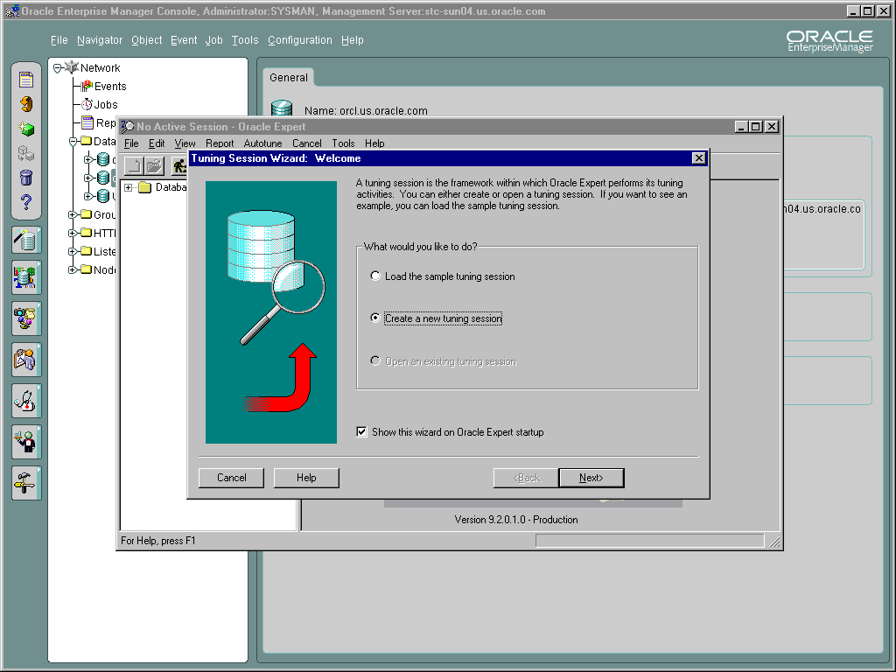
Tuning Using Oracle Expert
Notes:
Tuning Using Oracle Expert
From the Oracle Enterprise Manager console start Oracle Expert. It is possible to use a set of data from a previous collection or to collect a new set.

Slide 14
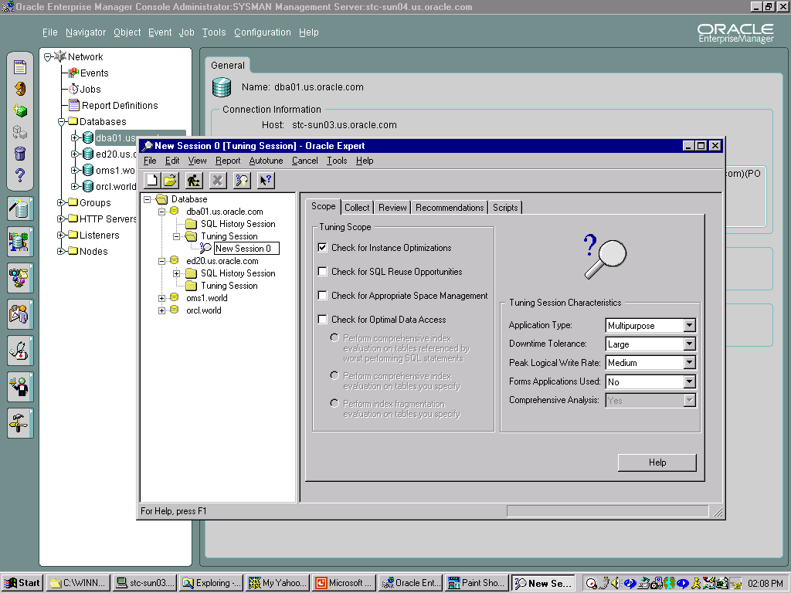
Tuning Using Oracle Expert
Notes:
Tuning Using Oracle Expert (continued)
Select the Tuning Scope. This will determine the amount of data that must be collected. The broader the scope, the more time will be required for the collection and analyze stages.

Slide 15
Statspack
  Installation of Statspack using the
  spcreate.sql script
  Collection of statistics execute statspack.snap
  Automatic collection of statistics using the spauto.sql script
  Produce a report using the spreport.sql script
  To collect timing information, set
  TIMED_STATISTICS = True
Notes:
Statspack
Installation of the Statspack Package
Installing the Statspack utility creates the perfstat user, who owns all PL/SQL code and database objects created (including the Statspack tables, the constraints, and the Statspack package). During the installation you will be prompted for the perfstat user’s default and temporary tablespaces.
The Statspack package has been available with Oracle Database from Oracle8.1.6. When initially installed roughly 80 MBs of the perfstat user’s default tablespace is used. This may grow later with the tables storing snapshot information.
Collecting Statistics
To take a snapshot of performance data, log on to SQL*Plus as the perfstat user, and then execute the statspack.snap procedure. This stores the current performance statistics in the Statspack tables, which can be used as a baseline snapshot for comparison with another snapshot taken at a later time.

Slide 16
Notes:
Statspack (continued)
Automatically Collecting Statistics
To compare performance from one day, week, or year to the next, there must be multiple snapshots taken over a period of time. The best method to gather snapshots is to automate the collection at regular time intervals.
The spauto.sql script makes use of the dbms_job package to provide an automated method for collecting statistics. The supplied script schedules a snapshot every hour, on the hour. This can be changed to suit the requirements of the system.
Producing a Report
To examine the change in statistics between two time periods, execute the spreport.sql file while being connected to the perfstat user. The user is shown a list of collection periods and selects a start and end period. The difference between the statistics at each end point is then calculated and put into a file named by the user.

Slide 17
Statspack Output
Information found on the first page:
  Database and instance name
  Time at which the snapshots were taken
  Current sizes of the caches
  Load profile
  Efficiency percentages of the instance
  Top five wait events
Notes:
First Page of the Statspack Report
The first page summarizes the report. The items found on this page include most of the information that the DBA requires to enhance performance. Each of these areas will be covered in greater depth during the course.
Cache Sizes
The current size of the buffer cache, shared pool, and log buffer are shown here in KB. Also included here is the value of the primary block size.
Load Profile
One value given here is per second and the other is per transaction. What is shown includes the redo size and the physical reads and physical writes performed during the snapshot period.
Instance Efficiency Percentages
The items listed here are ones that are most often used for tuning a database. These statistics are used to indicate that workloads have changed on the database.
Top Five Wait Events
The full list of wait events appears later in the report and will be dealt with later in the course. The top contention items are listed under this heading.

Slide 18
Statspack Output
Information found in the remainder of the document:
  Complete list of wait events
  Information on SQL statements currently in
  the pool
  Instance activity statistics
  Tablespace and file I/O
  Buffer pool statistics
Notes:
Statspack Output
Wait events are also ordered by wait time so as to put the most problematic events at the top. Statspack also attempts to put those wait events which are not a problem (for example, pmon timer) at the end of the list, regardless of what the time value is.
SQL Statements
Statspack also gives information about the SQL statements that are stored in the shared SQL area. You use this section to determine which statements will provide the best return on time invested in tuning SQL statements.
Several different ordered lists of SQL statements are given. SQL statements are sorted in order of number of executions, number of parse calls, number of buffer gets, number of reads. By ordering the SQL statements by these different columns, it is easier to determine which statements are causing the heavy workload. These statements should then be tuned first, so as to get the highest return on time spent.

Slide 19
Statspack Output
Information found in the remainder of the document:
  Rollback or undo segment statistics
  Latch activity
  Dictionary cache statistics
  Library cache statistics
  System Global Area (SGA) statistics
  Startup values for initialization parameters
Notes:
Statspack Output
Rollback or Undo Segment Statistics
Because a database can be set to use either rollback or undo segments, Statspack covers both options.
SGA Statistics
This is made up of two lists, a memory summary, and a breakdown of each area.
Startup Values for Initialization Parameters
Because many initialization parameters are dynamic, that is, can be changed without stopping and starting the database, there is no guarantee that the current value will be the one used if the system is restarted.

Slide 20
Dictionary and Special Views
The following dictionary and special views provide useful statistics after using the dbms_stats package:
  dba_tables, dba_tab_columns
  dba_clusters
  dba_indexes, index_stats
  index_histogram, dba_tab_histograms
This statistical information is static until you reexecute dbms_stats.
Notes:
Dictionary and Special Views
When you need to look at data storage in detail, you need to use the dbms_stats package, which collects statistics and populates columns in some dba_xxx views.
dbms_stats populates columns in the views concerned with:
Table data storage within extents and blocks:
dba_tables
dba_tab_columns
Cluster data storage within extents and blocks:
dba_clusters
Index data storage within extents and blocks, and indexation usefulness:
dba_indexes
index_stats
Non-indexed and indexed columns data distribution:
dba_tab_histograms
index_histogram
This package is described in more detail in the lesson “Using Oracle Blocks Efficiently.”

Slide 21
Displaying Systemwide Statistics
v$sysstat
statistic#
name
class
value
v$sgastat
pool
name
bytes
v$event_name
event number
name
parameter1
parameter2
parameter3
v$system_event
event
total_waits
total_timeouts
time_waited
average_wait
Notes:
Displaying Systemwide Statistics
Systemwide Statistics
All kinds of system wide statistics are cataloged in the v$statname view: about 290 statistics are available.
The server displays all calculated system statistics in the v$sysstat view. You can query this view to find cumulative totals since the instance started.

Slide 22
Notes:
Displaying Systemwide Statistics (continued)
Example
SQL> SELECT name, class, value FROM v$sysstat;
NAME CLASS VALUE
------------------ ------ ----------
logons cumulative 1 6393
logons current 1 10
opened cursors cumulative 1 101298
table scans (short tables) 64 6943
table scans (long tables) 64 344
table scans (rowid ranges) 64 0
redo entries 2 1126226
redo size 2 816992940
The results shown are only a partial display of the output.
Systemwide Statistics
These statistics are classified by the tuning topic and the debugging purpose. The classes include general instance activity, redo log buffer activity, locking, database buffer cache activity, and so on.
For the complete list of classes, refer to your release documentation.

Slide 23
Notes:
Displaying Systemwide Statistics (continued)
SGA Global Statistics
Server displays all calculated memory statistics in the v$sgastat view. You can query this view to find cumulative totals of detailed SGA usage since the instance started.
Example
SQL> SELECT * FROM v$sgastat;
POOL NAME BYTES
------ ------------------------- ----------
fixed_sga 46136
db_block_buffers 409600
log_buffer 524288
shared pool free memory 8341616
shared pool SYSTEM PARAMETERS 42496
shared pool transaction 64800
shared pool dictionary cache 156524
shared pool library cache 358660
shared pool sql area 551488
……
The results shown are only a partial display of the output.
Wait Events Statistics
All kinds of wait events are cataloged in the v$event_name view: about 290 events are available.
Cumulative statistics for all sessions are stored in v$system_event, which shows the total waits for a particular event since instance startup.
When you are troubleshooting, you need to know if a process has waited for any resource.

Slide 24
Displaying Session-Related Statistics
v$statname
statistic#
name
class
v$sesstat
sid
statistic#
value
v$session
sid
serial#
username
osuser
v$session_event
sid
event
total_waits
total_timeouts
time_waited
average_wait
max_wait
v$event_name
event#
name
parameter1
parameter2
parameter3
v$session_wait
sid
seq#
event
p1/2/3
p1/2/3 text
p1/2/3 raw
wait time
seconds_in_wait
state
Notes:
Session-Related Statistics
Session data is cumulative from connect time.
You can display current session information for each user logged on.
The v$mystat view displays the statistics of the current session.
Example: Determine the type of connection the users have.
SQL> SELECT sid, username, type, server
2 FROM v$session;
SID USERNAME TYPE SERVER
----- ------------ ----------- ----------------
1 BACKGROUND DEDICATED
2 BACKGROUND DEDICATED
3 BACKGROUND DEDICATED
4 BACKGROUND DEDICATED
5 BACKGROUND DEDICATED
6 BACKGROUND DEDICATED
9 SYSTEM USER DEDICATED
Oracle server displays all calculated session statistics in the v$sesstat view. You can query this view to find session cumulative totals since the instance started.

Slide 25
Notes:
Session-Related Statistics (continued)
Example: Determine the sessions that consume more than 30,000 bytes of PGA memory.
SQL> SELECT username, name, value
2 FROM v$statname n, v$session s, v$sesstat t
3 WHERE s.sid=t.sid
4 AND n.statistic#=t.statistic#
5 AND s.type='USER'
6 AND s.username is not null
7 AND n.name='session pga memory'
8 AND t.value > 30000;
USERNAME NAME VALUE
---------- ------------------- -----------
SYSTEM session pga memory 468816
Session Wait Events Statistics
The v$session_event shows, by session, the total waits for a particular event since instance startup.
The v$session_wait view lists the resources or events for which active sessions are waiting.
When you are troubleshooting you need to know if a process has waited for any resource. The structure of v$session_wait makes it easy to check in real time whether any sessions are waiting and why.
SQL> SELECT sid, event
2 FROM v$session_wait
3 WHERE wait_time = 0;
SID EVENT
----- ---------------------------------------
1 pmon timer
2 rdbms ipc message
3 rdbms ipc message
9 rdbms ipc message
16 rdbms ipc message
17 rdbms ipc message
10 rdbms ipc message
5 smon timer
8 rows selected.
You can then investigate further to see whether such waits occur frequently and whether they can be correlated with other phenomena, such as the use of particular modules.

Slide 26
Oracle Wait Events
  A collection of wait events provides information
  on the sessions that had to wait or must wait for different reasons.
  These events are listed in the v$event_name view, which has the following columns:
    EVENT#
    NAME
    PARAMETER1
    PARAMETER2
    PARAMETER3
Notes:
List of Events
There are about 290 wait events in the Oracle server, including:
Free Buffer Wait
Latch Free
Buffer Busy Waits
Db File Sequential Read
Db File Scattered Read
Db File Parallel Write
Undo Segment Tx Slot
Undo Segment Extension
For the complete list, refer to Oracle9i Database Reference, Release 2 (9.2), “Appendix A” Part Number A96536-01.

Slide 27
The v$event_name View
SQL> SELECT name, parameter1, parameter2, parameter3
2 FROM v$event_name;
NAME PARAMETER1 PARAMETER2 PARAMETER3
------------------------------- ---------- ---------- ----------
PL/SQL lock timer duration
alter system set mts_dispatcher waited
buffer busy waits file# block# id
library cache pin handle addr pin address 0*mode+name
log buffer space
log file switch
(checkpoint incomplete)
transaction undo seg# wrap# count
...
286 rows selected.
Notes:
Parameters Describing a Wait Event
The Buffer Busy Waits Event
The buffer busy waits event records waits for a buffer to become available. This wait indicates that there are some buffers in the buffer cache that multiple processes are attempting to access concurrently.
This event is accompanied by three parameters:
FILE# and BLOCK#: These parameters identify the block number in the data file that is identified by the file number for the block for which the server needs to wait.
ID: The buffer busy wait event is called from different places in the session. Each place in the kernel points to a different reason. ID refers to the place in the session calling this event.
The Log File Switch (Checkpoint Incomplete) Event
The Log File Switch (Checkpoint Incomplete) waits for a log switch because the session cannot wrap into the next log. Wrapping cannot be performed because the checkpoint for that log has not completed.
This event has no parameter.

Slide 28
Statistics Event Views
  v$session_event: Waits for an event for each session that had to wait
  v$session_wait: Waits for an event for current active sessions that are waiting
  v$system_event: Total waits for an event, all sessions together
Notes:
Statistics for Waiting Sessions
The statistics results of the sessions that had to wait or are currently waiting for a resource are stored in the v$session_event and v$session_wait views.
Cumulative statistics for all sessions are stored in v$system_event. As such this view does not show the same granularity as v$session_wait.
Using the db file scattered read event as an example:
The v$session_event view offers information on which sessions experience waits for the db file scattered read event, providing the session has not logged off the database. However, this view cannot give information on which segments the session accessed that experienced the wait.
The v$session_wait view offers the lowest granularity. For the db file scattered read event the view shows the file and the block number that the session is currently waiting for or the last wait event for a session.
The v$system_event view will inform you that there were waits for the db file scattered read event, but will not offer information on which session experienced the waits. This information is calculated from instance startup and represents sessions that may have logged off the database.

Slide 29
The v$session_event View
SQL> SELECT sid, event, total_waits,average_wait
2 FROM v$session_event
3 WHERE sid=10;
SID EVENT TOTAL_WAITS AVERAGE_WAIT
---- ------------------------------ ----------- -------------
10 buffer busy waits 12 5
10 db file sequential read 129 0
10 file open 1 0
10 SQL*Net message to client 77 0
10 SQL*Net more data to client 2 0
10 SQL*Net message from client 76 0
Notes:
The v$session_event View
The v$session_event view shows event information totaled for individual sessions and contains the following columns:
event: Name of the wait event
total_waits: Total number of waits for event
total_timeouts: Total number of timeouts for event
time_waited: Total time waited for this event, in hundredths of a second
average_wait: The average time waited for this event, in hundredths of a second
time_waited_micro: Total time waited for this event, in micro seconds.
The v$session_event view summarizes all session waits for every session listed in v$session. You can join the sid column to v$session.sid to find user details.

Slide 30
The v$session_wait View
SQL> SELECT sid, seq#, event, wait_time, state
2 FROM v$session_wait;
SID SEQ# EVENT WAIT STATE
TIME
--- - -- ---- --------------------------- ----- -------
1 1284 pmon timer 0 WAITING
2 1697 rdbms ipc message 0 WAITING
3 183 rdbms ipc message 0 WAITING
4 4688 rdbms ipc message 0 WAITING
5 114 smon timer 0 WAITING
6 14 SQL*Net message from client -1 WAITED
SHORT
TIME
Notes:
The v$session_wait View
This view lists the resources or events for which sessions are waiting.
Columns
sid: Session identifier
seq#: Sequence number identifying the wait
event: Resource or event waited for
p1text: Description of first additional parameter, which corresponds to the parameter1 described for the v$event_name view
p1: First additional parameter value
p1raw: First additional parameter value, in hexadecimal
p2text: Description of second additional parameter, which corresponds to the parameter2 described for the v$event_name view
p2: Second additional parameter value
p2raw: Second additional parameter value in hexadecimal
p3text: Description of third additional parameter, which corresponds to the parameter3 described for the v$event_name view
p3: Third additional parameter value

Slide 31
Notes:
The v$session_wait View (continued)
Columns (continued)
p3raw: Third additional parameter value in hexadecimal
wait_time
seconds_in_wait: Number of seconds the event waited
state: Waiting, Waited Unknown Time, Waited Short Time (less than one one-hundredth of a second), or Waited Known Time (the value is stored in the wait_time column)
Note: Not all of the parameter columns are used for all events.
The TIMED_STATISTICS Initialization Parameter
Set the TIMED_STATISTICS parameter to True to retrieve values in the wait_time column. It is a dynamic initialization parameter.
Value
>0
=0
=-1
=-2
Explanation
The session’s last wait time
The session is currently waiting
The value was less than 1/100 of a second
The system cannot provide timing information

Slide 32
The v$system_event View
SQL> SELECT event, total_waits, total_timeouts,
2 time_waited, average_wait
3 FROM v$system_event
4 ORDER BY time_waited DESC;
EVENT TOTAL_ TOTAL_ TIME_ AVERAGE_
WAITS TIMEOUTS WAITED WAIT
----------------- ------ -------- ------ ----------
latch free 5 5 5 1
pmon timer 932 535 254430 272.993562
process startup 3 8 2.66666667
buffer busy waits 12 0 5 5
...
34 rows selected.
Notes:
The v$system_event View
The v$system_event view shows the total waits for a particular event since instance startup.
If you are performing ongoing tuning, you need to know when a process has waited for any resource. Therefore, it becomes useful to query this view each time the system slows down.
The v$system_event view contains the following columns:
event: Name of the wait event
total_waits: Total number of waits for event
total_timeouts: Total number of timeouts for event
time_waited: Total time waited for this event, in hundredths of a second
average_wait: The average time waited for this event, in hundredths of a second
time_waited_micro: Total time waited for this event, in micro seconds.
The output from this view should be ordered by the time waited, because this will place the most waited for events at the top of the list. Remember that this view includes idle events, such as pmon timer, which should be ignored, because the process is idle. To collect information on the time an event waits you must set TIMED_STATISTICS to True or STATISTICS_LEVEL to Typical or All.

Slide 33
Dynamic Troubleshooting and Performance Views
V$ views:
  Based on X$ tables
  Listed in v$fixed_table
X$ tables:
  Not usually queried directly
  Dynamic and constantly changing
  Names abbreviated and obscure
Populated at startup and cleared at shutdown
Notes:
Dynamic Troubleshooting and Performance Views
V$ Views
These are based on X$ tables, therefore some V$ views are available in the NOMOUNT and MOUNT stages.
They are listed in v$fixed_table.
The V$ views (actually synonyms for V_$ views) belong to the sys user.
X$ Tables
These are not usually queried directly; not all the information is necessarily useful and column names tend to be abbreviated and obscure.
The X$ tables are memory structures that hold instance information and are available when the instance is in a NOMOUNT or MOUNT state.
The X$ tables are dynamic and their contents are constantly changing.
The V$ views and the underlying X$ tables are populated at instance startup and cleared at shutdown.
They hold timing information if you set the TIMED_STATISTICS parameter to True or if you execute the following SQL command:
SQL> ALTER SYSTEM SET timed_statistics = True;

Slide 34
Troubleshooting and Tuning Views
Instance/Database
v$database
v$instance
v$option
v$parameter
v$backup
v$px_process_sysstat
v$process
v$waitstat
v$system_event
Disk
v$datafile
v$filestat
v$log
v$log_history
v$dbfile
v$tempfile
v$tempstat
v$segment_statistics
Contention
v$lock
v$rollname
v$rollstat
v$waitstat
v$latch
Notes:
Troubleshooting and Tuning Views
Views Pertaining to the Instance/Database
v$px_process_sysstat: Parallel query system statistics
v$process: Information about currently active processes
v$waitstat: Contention statistics
v$system_event: Total waits for particular events
Views Pertaining to Disk Performance
v$filestat: Data file read/write statistics
v$tempstat: Information about file read/write statistics for temporary tablespace data files
v$segment_statistics: Offers statistics on I/O per segment.
Views Pertaining to Contention
v$latch: Statistics for each type of latch
v$rollstat: Statistics for all online rollback segments
v$waitstat: Block contention statistics (the TIMED_STATISTICS parameter should be set to True)

Slide 35
Troubleshooting and Tuning Views
Memory
v$buffer_pool_statistics
v$db_object_cache
v$librarycache
v$rowcache
v$sysstat
v$sgastat
User/Session
v$lock
v$open_cursor
v$process
v$transaction
v$px_sesstat
v$px_session
v$sesstat
v$session_event
v$sort_usage
v$session_wait
v$session
v$session_object_cache
Notes:
Troubleshooting and Tuning Views (continued)
Session-Related Statistics
v$lock: Locks currently held by the server and outstanding requests for a lock or latch
v$open_cursor: Cursors currently opened and parsed by each session
v$sort_usage: Size of temporary segments and sessions creating them; identification of processes doing disk sorts
v$sesstat: User session statistics
v$session_event: Information on waits for an event by a session
v$session_wait: Resources or events for which active sessions are waiting
v$px_sesstat: Information about the sessions executing SQL statements in parallel
Views Pertaining to Memory
v$buffer_pool_statistics: Buffer pools allocation on the instance
v$db_object_cache: Database objects cached in the library cache
v$librarycache: Library cache performance and activity statistics
v$rowcache: Data dictionary hits and misses activity
v$sysstat: Basic instance statistics

Slide 36
utlbstat and utlestat Scripts
  Gather performance figures over a defined period.
  Produce a hard-copy report.
  Should set TIMED_STATISTICS to True.
  Execute from SQL*Plus connected as SYSDBA.
  Statspack provides clearer statistics.
Notes:
Begin and End Scripts
Many dynamic views display cumulative totals since the instance started, but this is rarely helpful. If your instance is infrequently shut down, the statistics may cover a long period and have little meaning.
You should gather performance figures over a defined period, probably your busiest time of day or month end, and produce a hard-copy report.
You can do this by running the utlbstat.sql script at the beginning of the defined period and then utlestat.sql at the end of the period. These scripts are both stored in the $ORACLE_HOME/rdbms/admin directory on UNIX and in %ORACLE_HOME%\Rdbms\Admin on Windows.
The utlestat.sql script also generates a hard-copy report in the current directory. This report contains statistics for the collection period, gathered by looking at the differences between the beginning and end statistics.

Slide 37
DBA-Developed Tools
  Develop your own scripts.
  Use the supplied packages for tuning.
  Schedule periodic performance checking.
  Take advantage of the Enterprise Manager Event service to track specific situations.
  Take advantage of the Oracle Enterprise Manager Job service to:
    Automate the regular execution of administrative tasks.
    Apply tasks that automatically solve problems detected by the Oracle Enterprise Manager event service.
Notes:
In-House Scripts
The utilities and Oracle tools may not provide all the statistics you need.
Therefore, you can create your own scripts to do the following:
Check for free space in every data file
Determine whether segments have enough space to be able to extend
Describe schema structures to show tables and associated indexes
Use Oracle-supplied packages (created by $ORACLE_HOME/rdbms/ admin/dbms*.sql scripts) (refer to the Oracle Database Administration course for more information)
One of the problems with in-house scripts is that it takes time for a new DBA to learn what scripts to use to perform what tasks. Most DBAs will be familiar with Statspack and / or utlbstat / utlestat reports.

Slide 38
Level of Statistics Collection
The initialization parameters that determine the level of statistic collection are:
  STATISTICS_LEVEL
  TIMED_STATISTICS
  TIMED_OS_STATISTICS
  DB_CACHE_ADVICE
Notes:
Level of Statistics Collection
The level of statistic collection on the database is determined by the value of the STATISTICS_LEVEL parameter. The values for this parameter are:
Basic: No advisory or other statistical data is collected. You can manually set other statistic collection parameters such as TIMED_STATISTICS and DB_CACHE_ADVICE.
Typical: This is the default value. Data is collected for segment level statistics, timed statistics and all advisories. The value of other statistic collection parameters is overridden.
All: Collection is made of all the Typical level data, the timed operating system statistics and the row source execution statistics. The value of other statistic collection parameters is overridden.
Query v$statistics_level to determine which parameters are affected by the STATISTICAL_LEVEL parameter.

Slide 39
Notes:
Level of Statistics Collection (continued)
These statistic parameters can also be set individually. These parameters are:
TIMED_STATISTICS: Set to True to collect time statistics
DB_CACHE_ADVICE: This parameter accepts the following values:
Off
No statistics collected and no memory used.
Ready
No statistics collected, but memory is allocated. Having DB_CACHE_ADVICE set to Ready prevents memory errors when needing to collect statistics on buffer cache utilization.
On
Statistics collected and memory allocated. Changing the status of DB_CACHE_ADVICE from Off to On can raise an error if the required memory is not available.
TIMED_OS_STATISTICS: Specifies the interval (in seconds) at which Oracle collects operating system statistics when a request is made from the client to the server or when a request completes.
These parameters are discussed in greater detail in later lessons of this course.

Slide 40
Summary
In this lesson, you should have learned how to:
  Use the alert log file
  Get information from background processes
  trace files
  Trace user SQL statements
  Collect statistics from dictionary and dynamic performance troubleshooting views
  Use the Statspack utility to collect
  performance data
  Retrieve wait events information

Slide 41
Notes:
Practice 2
The goal of this practice is to familiarize you with the different methods of collecting statistical information. Throughout this practice Oracle Enterprise Manager can be used if desired. SQL Worksheet can be used instead of SQL*Plus, and there are many uses for the Oracle Enterprise Manager console. (Solutions for Oracle Enterprise Manager can be found in Appendix B).
1. Log on as directed by the instructor. If the database is not already started, connect to SQL*Plus by using sys/oracle as sysdba, then start up the instance with the STARTUP command. Ensure that the password for user system is set to oracle. Check that TIMED_STATISTICS has been set to True; if it has not, then set it by using the ALTER SYSTEM statement.
2. Connect to SQL*Plus as the system user and run a command that will create a trace file for this session. Run a query to count the number of rows in the dba_tables dictionary view. To locate your new trace file easier, if possible, delete all the trace files in the USER_DUMP_DEST directory before running the trace. Remember to disable the trace command after running the query.
3. At the operating system–level view the resulting trace file located in the directory set by USER_DUMP_DEST. (Do not try to interpret the content of the trace file, because this is the topic of a later lesson.)
4. Open two sessions, the first as hr/hr and the second as sys/oracle as sysdba. From the second session, generate a user trace file for the first session by using the dbms_system.set_sql_trace_in_session procedure. Get the sid and serial# from v$session.
5. Confirm that the trace file has been created in the directory set by USER_DUMP_DEST
6. Connect to SQL*Plus by using sys/oracle as sysdba and create a new tablespace (tools) to hold the tables and other segments that are required by Statspack. This tablespace must be 200 MB and dictionary managed (this is not a requirement of Statspack, but will be used later in the course). Name the data file tools01.dbf and place it in the $HOME/ORADATA/u05 directory.
Note: Dictionary managed is not the default.
7. Confirm and record the amount of free space that is available within the tools tablespace by querying the dba_free_space view. Also, check if the tablespace is dictionary managed.

Slide 42
Notes:
Practice 2 (continued)
Connect by using sys/oracle as sysdba, then install Statspack by using the spcreate.sql script that is located in your $HOME/STUDENT/LABS directory. Use the following settings when asked by the installation program:
User’s password = perfstat
User’s default tablespace = TOOLS
User’s temporary tablespace = TEMP
9. Query dba_free_space to determine the amount of free space left in the tools tablespace. The difference between this value and the one recorded in step 7 will be the space required for the initial installation of Statspack.
Note: The amount of storage space that is required will increase in proportion to the amount of information stored within the Statspack tables, that is, the number of snapshots.
10. Manually collect current statistics using Statspack by running the snap.sql script located in $HOME/STUDENT/LABS. This will return the snap_id for the snapshot just taken, which should be recorded.
11. To have Statspack automatically collect statistics every three minutes execute the spauto.sql script located it your $HOME/STUDENT/LABS directory. Query the database to confirm that the job has been registered using the user_jobs view.
Note: The spauto.sql script in the $HOME/STUDENT/LABS directory has been altered from the spauto.sql script shipped with the Oracle database. The alteration has changed the time between snapshots from 1 hour to 3 minutes.
12. After waiting for a period in excess of three minutes query the stats$snapshot view to list what snapshots have been collected. There must be at least two snapshots before moving to the next step.
Note: If the job scheduler is not working, check the value of the JOB_QUEUE_PROCESSES parameter. The value should be greater than 0.
13. When there are at least two snapshots, start to generate a report. This is performed using the spreport.sql script found in the $HOME/STUDENT/LABS directory. The script lists the snapshot options available and then requests the beginning snap id and the end snap id. The user is then requested to give a filename for the report. It is often best left to the default.
14. Locate the report file in your current directory. Use any text editor to open and examine the report. The first page shows a collection of the most queried statistics.

Slide 43
Notes:
Practice 2 (continued)
15. Connect to the database as a system administrator sys/oracle as sysdba.
16. Query the database to determine which system wait events have been registered since startup using v$system_event.
Dynamic Performance Views
17. Determine whether there are any sessions actually waiting for resources, using v$session_wait.
18. Stop the automatic collection of statistics by removing the job. This is performed by connecting as perfstat/perfstat and querying the user_jobs view to get the job number. Then execute the dbms_job.remove procedure.
19. Connect to your database using Oracle Enterprise Manager. The lecturer will supply the information required to connect to the Oracle Management Server. When you have connected to the database use Oracle Enterprise Manager to explore the database. Examine items such as the number of tablespaces, users, and tables.
Oracle Classroom Only
If you are in an Oracle classroom you must perform the following four steps that are specific to the Oracle classroom setup:
a. Click the omsconfig file update icon on the desktop and enter the name of the UNIX server your class is using. Your instructor will provide the server name. Please note that this is a case-sensitive entry.
b. Open an MSDOS window.
c. At the command prompt enter: oemctl start oms
Wait for the message: “The Oracleoracle901_homeManagementServer service was started successfully.”

Slide 44
Notes:
Practice 2 (continued)
Oracle Classroom Only (continued)
d. Close the MSDOS window.
Start the Oracle Enterprise Manager Console and set the Administrator to sysman and the password to oem_temp. When prompted, change the password to oracle. Select Discover Nodes from the Navigator and enter the host name of the server of your working database.
i. From the Start menu > Programs > Oracle – OracleHome > Enterprise Manager Console
ii. Make sure the Login to the Oracle Management Server is selected.
iii. Administrator: sysman
iv. Password: oem_temp
v. Management server is your machine.
vi. When prompted to change the sysman password to oracle.
vii. Select Navigator > Discover Nodes from the console menu, or select Discover Nodes from the right mouse shortcut menu to open the Discover Nodes dialog box.
viii. From the Discovery Wizard: Introduction page, click Next, enter the name of your UNIX database server, and click Next.
ix. Click Next, give your regular administrator access to your database.
x. Click Finish, then OK. If your discovery was not successful contact your instructor.
20. From Oracle Enterprise Manager load Oracle Expert and create a new tuning session. Limit the tuning scope to “Check for Instance Optimizations.” This is done to reduce the time taken to collect information. Collect a new set of data.
Note: Do not implement the changes that Oracle Expert recommends, because this will be done during the course.

