Slide 1
Database Configuration and I/O Issues

Slide 2
Objectives
After completing this lesson, you should be able to do the following:
  List the advantages of distributing different Oracle file types
  Diagnose tablespace usage problems
  List reasons for partitioning data in tablespaces
  Describe how checkpoints work
  Monitor and tune checkpoints
  Monitor and tune redo logs

Slide 3
Oracle Processes and Files
Process Oracle file I/O
Data files Log Archive Control
CKPT Read/Write Read/Write
DBWn Write
LGWR Write Read/Write
ARCn Read Write Read/Write
SERVER Read/write Read Write Read/Write
Notes:
Oracle Processes and Files
Whereas most server processes only read from disk, sort direct write server processes write to disk.
The CKPT process only accesses the data file headers; the DBWn process writes out the actual table data.
The server process reads the redo logs, writes to the archive logs, and read/writes to the control file under certain backup and recovery operations. For example, when performing manual archiving the user process that issued the statement performs the archiving process.

Slide 4
Performance Guidelines
Basic performance rules are as follows:
  Keep disk I/O to a minimum.
  Spread your disk load across disk devices
  and controllers.
  Use temporary tablespaces where appropriate.
Notes:
Performance Guidelines
For very heavy online transaction processing (OLTP) applications, there are concurrency problems when using dictionary managed tablespaces because the dictionary must be accessed for space management operations during extent allocation. With locally managed tablespaces, there is no dictionary intervention, and therefore fewer concurrency problems.
When users are created, a temporary tablespace is designated for any disk sorts and the creation of temporary tables. These areas should be separate from other database objects. If users do not have a temporary tablespace, then the default temporary tablespace is used.
Tables and indexes should be split into separate tablespaces, because indexes and tables are often inserted into and read from simultaneously. Tables that contain LOB data types, for example BLOBs and CLOBs, should have the LOB data placed into a tablespace separate from the actual table.

Slide 5
Distributing Files Across Devices
  Separate data files and redo log files.
  Stripe table data.
  Reduce disk I/O unrelated to the database.
Notes:
Guidelines
In general, to reduce the activity on an overloaded disk, move one or more of its heavily accessed files to a less active disk.
Redo log files are written sequentially by the LGWR process. Put the redo log files on a disk with no other activity or a low incidence of reads and writes: LGWR can write much faster if there is no concurrent activity.
Redo log files and archive logs should be placed on different disks.
If users concurrently access a large table, then striping across separate data files and disks can help to reduce contention.
Try to eliminate I/O unrelated to the Oracle server on disks that contain database files. This is also helpful in optimizing access to redo log files and enables you to monitor all data file activities on such disks with the v$filestat dynamic performance view.
Knowing the types of operation that predominate in your application and the speed with which your system can process the corresponding I/Os, you can choose the disk layout that maximizes performance.

Slide 6
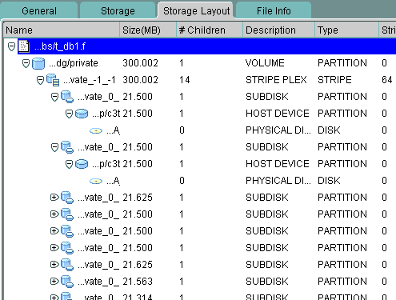
IO Topology Support
Notes:
IO Topology Support
To help you diagnose and solve disk I/O performance problems, typically caused when more than one “hot” file exists on a single physical device, you can monitor various statistics provided for this purpose. If you are using EMC disk sub-systems, you can use the file mapping feature provided by Oracle Enterprise Manager.
To find the available mappings of files to logical volumes, and logical volumes to physical devices, you need to drill down the Oracle Enterprise Manager navigation tree: Network > Databases > Storage > Datafiles. When you select a specific file, its physical storage information is available under the Storage Layout tab.
To use this feature, you have to first enable the mapping service for your database.

Slide 7
Tablespace Usage
  Reserve the system tablespace for data
  dictionary objects.
  Create locally managed tablespaces to avoid space management issues.
  Split tables and indexes into separate tablespaces.
  Create rollback segments in their own tablespaces.
  Store very large objects in their own tablespace.
  Create one or more temporary tablespaces.
Notes:
Guidelines
Each database should have separate tablespaces specified for:
Data dictionary objects
Rollback segments and undo segments
Temporary segments
Tables
Indexes
Very large objects
Note: These objects can be CLOBs, BLOBs, tables or partitions.
Most production databases have more tablespaces than this. The important principle is to separate data of different types and uses for housekeeping and backup purposes.
The system tablespace contains only data dictionary objects owned by sys. No other users should have the ability to create objects in the system tablespace. No user should have a quota allocated on the system tablespace. Stored objects such as packages and database triggers form part of the data dictionary and as such are stored in the system tablespace, but these objects do not require any space allocation on behalf of the user.
Rollback segments should use rollback segment tablespaces exclusively.
Only undo segments can exist in undo tablespaces.

Slide 8
Locally Managed system Tablespace
Create databases that have a locally managed system tablespace.
CREATE DATABASE mydb
…
DATAFILE 'system01.dbf' SIZE 100M EXTENT MANAGEMENT LOCAL
…
DEFAULT TEMPORARY TABLESPACE temp
TEMPFILE 'temp01.dbf' SIZE 15M
…;
Notes:
Locally Managed system Tablespace
It is strongly recommended that all tablespaces be locally managed. Having locally managed tablespaces eliminates extent fragmentation and provides superior performance benefits over dictionary managed tablespaces.
When creating a database with a locally managed system tablespace a default temporary tablespace must be included in the CREATE DATABASE statement.
When the system tablespace is locally managed:
It is not possible to create dictionary managed tablespaces.
It is not possible to migrate locally managed tablespace to dictionary managed type.
It is possible to transport dictionary managed tablespaces into a database with locally managed system tablespace. Note that after the transport, dictionary managed tablespaces cannot be made read/write. The tablespaces can be migrated to locally managed and then made read/write.
It is possible to DROP the READ ONLY dictionary managed tablespace when SYSTEM tablespace is locally managed.
If the database is created using the Database Configuration Assistant (DBCA) then a locally managed system tablespace is the default.

Slide 9

Diagnostic Tools for Checking
I/O Statistics
Server I/O utilization
  System I/O utilization
  v$filestat
  v$tempstat
  v$datafile
Data files
  Performance tools
Statspack
Notes:
Monitoring Use of Files
You can use the following tools to determine the I/O utilization of data files in an existing database:
v$filestat view
v$tempstat view
File I/O monitor using Oracle Enterprise Manager
File statistics in Statspack

Slide 10
Using the v$filestat View
SQL> SELECT phyrds, phywrts, d.name
2 FROM v$datafile d, v$filestat f
3 WHERE d.file#=f.file#
4 ORDER BY d.name;
PHYRDS PHYWRTS NAME
---------- -------- --------------------
806 116 /…/u01/system01.dbf
168 675 /…/u04/temp01.dbf
8 8 /…/u02/sample01.dbf
26 257 /…/u02/undots01.dbf
65012 564 /…/u03/users01.dbf
8 8 /…/u01/query01.dbf
6 rows selected
Notes:
Using the v$filestat View
You can query v$filestat to determine the number of disk I/Os per disk file.
Summarize all of the I/Os on data files on a per-disk basis to find the data files most likely to cause a disk bottleneck.
The v$filestat view contains the following columns:
file#: File number (join to file# in v$datafile for the name)
Phyrds: Number of physical reads done
Phywrts: Number of physical writes done
phyblkrd: Number of physical blocks read
phyblkwrt: Number of physical blocks written
readtim: Time spent doing reads
writetim: Time spent doing writes
Note: The readtim and writetim columns contain 0 if the TIMED_STATISTICS parameter is set to False.

Slide 11
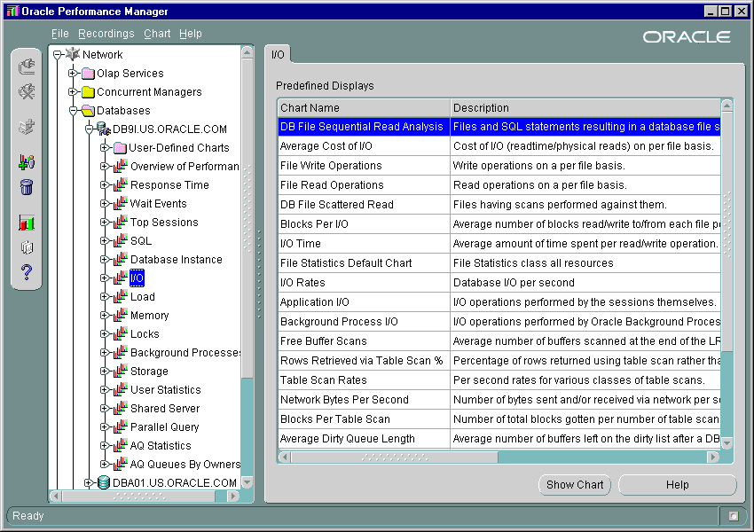
Performance Manager: I/O Statistics
Notes:
Performance Manager: I/O Statistics
Many statistics are available using the I/O set of charts. The above screenshot does not show all the charts that are available.
Information regarding how many reads and writes are being performed per data file can be collected from the I/O Statistics in Performance Manager.

Slide 12
I/O Statistics
SQL> SELECT d.tablespace_name TABLESPACE,
2 d.file_name, f.phyrds, f.phywrts
3 FROM v$filestat f, dba_data_files d
4 WHERE f.file# = d.file_id;
TABLESPACE FILE_NAME PHYRDS PHYWRTS
------------- ----------------- ------ -------
UNDO1 /u02/undots01.dbf 26 257
SAMPLE /u02/sample01.dbf 65012 564
USERS /u03/users01.dbf 8 8
SYSTEM /u01/system01.dbf 806 116
TEMP /u04/temp01.dbf 168 675
QUERY_DATA /u01/query01.dbf 8 8
6 rows selected.
Notes:
I/O Statistics
The above statistics are viewed by running the SQL statement shown. However, a similar output is available in the Statspack report. Using either method you can observe how well the I/O load is distributed across the disk devices.
To correctly determine the good from the bad, you must have information regarding which type of objects are stored in which tablespaces. For this example:
The users tablespace holds tables created by individual users.
The sample tablespace holds tables required by all users on the system.
The query_data tablespace holds tables that are read-only.
The most active files can be determined from the above output. In the example shown on the slide, the sample tablespace is being hit heavily. About 98% of the reads are being performed on the sample01.dbf data file, whereas the query01.dbf data file has 0.0001% of the disk reads performed against it. The problem that should be resolved is why the sample tablespace is being heavily read. Things to look for would be to determine how many full table scans are being performed, are indexes being used, and should you create some indexes on relevant tables?
If the load cannot be reduced, then you should spread the load between other devices.

Slide 13
File Striping
  Operating system striping:
    Use operating system striping software or a redundant array of inexpensive disks (RAID).
    Determine the right stripe size.
  Manual striping: Use the CREATE TABLE or ALTER TABLE command with the ALLOCATE clause.
Notes:
File Striping
Operating System Striping
Your operating system may allow striping, in which what appears to be a single contiguous file is actually spread among multiple devices. You can use operating system striping software, such as a logical volume manager.
If your operating system offers striping, you should take advantage of it. You must think about the size of the stripe, which should be a multiple of the value that you have set for DB_FILE_MULTIBLOCK_READ_COUNT (this parameter will be discussed in a subsequent section).
With OS striped database files with a stripe width close to (or less than) DB_FILE_MULTIBLOCK_READ_COUNT x DB_BLOCK_SIZE, you may get two or more physical reads for each Oracle server read because you have to access two or more disks.
The most common variety of striped file system is the redundant array of inexpensive disks (RAID). Different levels of RAID striping have varying degrees of safety checks built in.
Manual Striping
You can create tablespaces so that they consist of multiple files, each on a separate disk. You then create tables and indexes so that they are spread across these multiple files.

Slide 14
Notes:
File Striping (continued)
Manual Striping (continued)
You can stripe by:
Creating objects with MINEXTENTS greater than 1, where each extent is slightly smaller than the striped data files
Allocating extents to a file explicitly:
SQL> ALTER TABLE employees
2 ALLOCATE EXTENT
3 (DATAFILE 'sample01.dbf' SIZE 10 M);
Keep in mind that striping by hand is a labor-intensive task. The Oracle server fills the extents that you have created one after another. At any given time, one extent is likely to be hot and the others less active.
As with many other tuning issues, you can make the right choice only when you have thorough knowledge of how the data is used.

Slide 15
Tuning Full Table Scan Operations
  Investigate the need for full table scans.
  Configure the DB_FILE_MULTIBLOCK_READ_COUNT
  initialization parameter to:
    Determine the number of database blocks the server reads at once
    Influence the execution plan of the
    cost-based optimizer
  Monitor long-running full table scans with v$session_longops view.
Notes:
Tuning Full Table Scan Operations
Investigating Full Table Scans
High activity on one disk is often caused by a query requiring tuning. The goal of performance tuning is to increase the effectiveness with which data is accessed.
Tuning Full Table Scans
The DB_FILE_MULTIBLOCK_READ_COUNT initialization parameter determines the maximum number of database blocks read in one I/O operation during a full table scan. Setting this parameter can reduce the number of I/O calls required for a full table scan, thus improving performance.
I/O is a function of the operating system, so there are limits specific to the operating system imposed on the setting of this parameter. The server’s ability to read multiple blocks is limited by the operating system upper limit on the number of bytes that can be read in a single I/O call.

Slide 16
Notes:
Tuning Full Table Scan Operations (continued)
Tuning Full Table Scans (continued)
For most platforms the limit of the DB_FILE_MULTIBLOCK_READ_COUNT parameter is operating–system specific. This parameter is dynamic, so individual sessions can use ALTER SESSION SET command to set a larger size for batch-type work.
Setting the DB_FILE_MULTIBLOCK_READ_COUNT parameter dictates how many I/O calls are required to complete a table scan. For example, if DB_FILE_MULTIBLOCK_READ_COUNT is set to 16, and the Oracle block size is 4 KB, then a sequential scan of a 64 KB table can be read in one pass. This improves the speed of the table scan and overall query performance. The goal of setting the DB_FILE_MULTIBLOCK_READ_COUNT parameter is to perform table scans with fewer, larger I/O operations. This is done by evaluating the number of blocks required to complete each table scan over time, then adjusting the parameter so that most scans can be performed in one I/O.
The total number of I/Os that are actually required to perform a full table scan also depends on other factors, such as the size of the table and whether parallel query is being used.
The cost-based optimizer uses all of these factors, including the DB_FILE_MULTIBLOCK_READ_COUNT parameter, to determine the cost of full table scans. The cost-based optimizer favors full table scans when the cost is lower than index scans.

Slide 17
Table Scan Statistics
  SQL> SELECT name, value FROM v$sysstat
  2 WHERE name LIKE '%table scan%';
  NAME VALUE
  -------------------------------------- -----
  table scans (short tables) 125
  table scans (long tables) 30
  table scans (rowid ranges 0
  table scans (cache partitions) 0
  table scans (direct read) 0
  table scan rows gotten 21224
  table scan blocks gotten 804
  7 rows selected.
Notes:
Table Scan Statistics
The query on the above slide provides an overview of how many full table scans are taking place.
The values for table scans (long tables) and table scans (short tables) relate to full table scans. A long table is one with more than 4 blocks and a short table is 4 or less blocks.
If the value of table scans (long tables) is high, then a large percentage of the tables accessed were not indexed lookups. Your application may need tuning or you should add indexes. Make sure that the appropriate indexes are in place and valid.

Slide 18
Monitoring Full Table Scan Operations
  Determine the progress of long operations using:
  Use SET_SESSION_LONGOPS to populate
  v$session_longops.
SQL> SELECT sid, serial#, opname,
2 TO_CHAR(start_time,'HH24:MI:SS') AS "START",
3 (sofar/totalwork)*100 AS PERCENT_COMPLETE
4 FROM v$session_longops;
dbms_application_info.set_session_longops
(rindex, slno, "Operation X", obj, 0, sofar,
totalwork, "table", "tables");
Notes:
Monitoring Full Table Scan Operations
Users and DBAs can monitor the progress of various operations that run for longer than 6 seconds and thus estimate completion time. The Oracle server maintains statistics tracking the progress of such operations and makes it available to users through the v$session_longops dynamic performance view.
These various operations monitored by v$session_longops include many backup and recovery functions, statistics gathering, and query execution.
The dbms_application_info package contains a procedure, set_session_longops, to populate the view from an application. The procedure has the following parameters:
Rindex: A token which represents the v$session_longops row to update. Set this to set_session_longops_nohint to start a new row. Use the returned value from the prior call to reuse a row.
Slno: Saves information across calls to set_session_longops. It is for internal use and should not be modified by the caller.

Slide 19
Notes:
Monitoring Full Table Scan Operations (continued)
Op_name: Specifies the name of the long running task. It appears as the opname column of v$session_longops. The maximum length is 64 bytes. The default value is Null.
Target: Specifies the object that is being worked on during the long running operation. The default value is 0.
Context: Any number the client wants to store. It appears in the context column of v$session_longops. The default value is 0.
Sofar: Any number the client wants to store. It appears in the sofar column of v$session_longops. This is typically the amount of work that has been done so far. The default value is 0.
Totalwork: Any number the client wants to store. It appears in the totalwork column of v$session_longops. This is typically an estimate of the total amount of work that needs to be done in this long running operation. The default value is 0.
Target_desc: Specifies the description of the object being manipulated in this long operation and provides a caption for the TARGET parameter. This value appears in the target_desc field of v$session_longops. The maximum length is 32 bytes. The default value is “unknown target.”
Units: Specifies the units in which sofar and totalwork are being represented. It appears as the units field of v$session_longops. The maximum length is 32 bytes. The default value is Null.
In the example as the process completes each object, v$session_longops is updated on the procedure’s progress.
DECLARE
rindex BINARY_INTEGER;
slno BINARY_INTEGER;
totalwork NUMBER;
sofar NUMBER;
obj BINARY_INTEGER;
BEGIN
rindex := dbms_application_info.set_session_longops_nohint;
sofar := 0;
totalwork := 10;
WHILE sofar < 10 LOOP
-- update obj based on sofar and perform task on object target
sofar := sofar + 1;
dbms_application_info.set_session_longops(rindex, slno,
"Operation X",obj,0,sofar,totalwork,"table","tables");
END LOOP;
END;

Slide 20
Checkpoints
The two most common types of checkpoints are:
  Incremental checkpoints
    CKPT updates the control file.
    During a log switch CKPT updates the control file
    and the data file headers.
  Full checkpoints
    CKPT updates the control file and the data file headers.
    DBWn writes out all buffers on the checkpoint queue.
Notes:
Checkpoints
Incremental Checkpoint
During the normal running of the database, buffers that get modified (dirty buffers) are added to end of the checkpoint queue. The checkpoint queue is a linked list of all dirty buffers, ordered by when they were first modified; therefore a dirty buffer is only listed once in the checkpoint queue. The first entry in the checkpoint queue is always the buffer that has been dirty for the longest time. Buffers are removed from the checkpoint queue after DBWn writes them to disk.
Each record in the redo log is assigned a redo byte address (RBA). When a block is first modified it is entered in the checkpoint queue. The RBA of the redo record recording that change is also included. All buffers that were modified prior to the first buffer in the checkpoint queue will already have been written to the data files.
Every three seconds the CKPT process records, in the control file, the RBA from the first entry in the checkpoint queue. In the event of instance failure this RBA will give the location in the redo logs at which to start recovery. This RBA is referred to as the checkpoint position. At a log switch the database will, in addition, update the checkpoint information in the header block of each data file. This log switch does not force a write of any data to the data files.

Slide 21
Full Checkpoints
Two categories of full checkpoints
  Complete
  Tablespace
Notes:
Full Checkpoints
Full checkpoints can be divided into two categories:
Complete Checkpoint
All modified buffers are written to the data files and then the checkpoint information is written to the control file and data file headers.
This form of a checkpoint is performed during an instance shutdown (not for an instance crash or shutdown abort).
A full complete checkpoint can be manually performed using the command:
ALTER SYSTEM CHECKPOINT;
Tablespace Checkpoint
A tablespace checkpoint involves DBWn writing to disk only the dirty buffers that belong to the tablespace concerned. The actions that cause a tablespace checkpoint include:
Issuing the command:
ALTER TABLESPACE <tname> BEGIN BACKUP;
Taking a tablespace offline

Slide 22
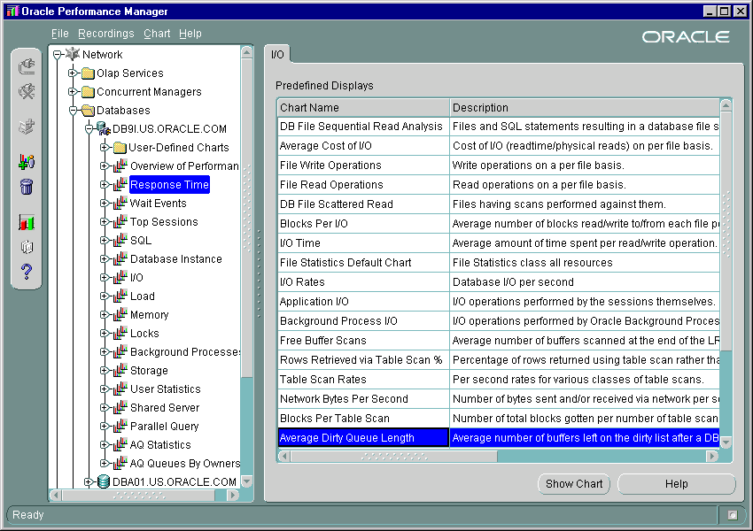
Performance Manager: Response Time
Notes:
Performance Manager: Response Time
Using the Average Dirty Queue Length chart under the Response Time section it is possible to determine the average length of the checkpoint queue.

Slide 23
Regulating the Checkpoint Queue
Regulate the checkpoint queue with the following initialization parameters:
  FAST_START_IO_TARGET
  LOG_CHECKPOINT_INTERVAL
  LOG_CHECKPOINT_TIMEOUT
  FAST_START_MTTR_TARGET
Notes:
Regulating the Checkpoint Queue
The length of the checkpoint queue is going to be a determining factor in the period of time required to recover an instance after failure. For faster recovery a shorter queue should be maintained. However, a shorter queue means more writes for DBWn to perform, which can adversely affect performance. Obviously a compromise must be found.
The maximum length of the checkpoint queue is determined by the parameter from the following list that provides the shortest recovery time:
LOG_CHECKPOINT_TIMEOUT: The number of seconds that has passed between the checkpoint position and the last write to the redo. No block in the buffer cache will be dirty longer than this time.
LOG_CHECKPOINT_INTERVAL: The number of operating system blocks in the redo log between the checkpoint position and the end of the redo log.
FAST_START_IO_TARGET: The number of I/O operations the database should take to perform crash recovery of a single instance.
FAST_START_MTTR_TARGET: The average number of seconds the database should take to perform crash recovery of a single instance.
Note: The checkpoint queue is also limited by the size of the redo log file, because the number of redo blocks between the checkpoint position and the end of the redo log cannot be more than 90% of the length of the smallest log file.

Slide 24
Defining and Monitoring
Fast Start Checkpointing
Use v$instance_recovery to obtain the following information:
  RECOVERY_ESTIMATED_IOS
  LOG_FILE_SIZE_REDO_BLKS
  LOG_CHKPT_TIMEOUT_REDO_BLKS
  LOG_CHKPT_INTERVAL_REDO_BLKS
  TARGET_MTTR
  ESTIMATED_MTTR
Notes:
Defining and Monitoring Fast Start Checkpointing
To specify a value for FAST_START_IO_TARGET, decide on the required service level after discussion with users and administrators. Translate this time to an equivalent number of data file I/Os by using the average I/O time statistic from the v$filestat view.
Monitoring Impact of Parameters on Recovery Time
Use the v$instance_recovery view to obtain the following information:
RECOVERY_ESTIMATED_IOS: The estimated number of data blocks to be processed during recovery based on the in-memory value of the fast-start checkpoint parameter
ACTUAL_REDO_BLKS: The current number of redo blocks required for recovery
TARGET_REDO_BLKS: The goal for the maximum number of redo blocks to be processed during recovery. This value is the minimum of the following three columns:
LOG_FILE_SIZE_REDO_BLKS: The maximum number of redo blocks required to guarantee that a log switch does not occur before the checkpoint completes

Slide 25
Notes:
Defining and Monitoring Fast Start Checkpointing (continued)
Monitoring Impact of Parameters on Recovery Time (continued)
LOG_CHKPT_TIMEOUT_REDO_BLKS: The number of redo blocks that need to be processed during recovery to satisfy LOG_CHECKPOINT_TIMEOUT
LOG_CHKPT_INTERVAL_REDO_BLKS: The number of redo blocks that need to be processed during recovery to satisfy LOG_CHECKPOINT_INTERVAL
TARGET_MTTR: Effective mean time to recover target value in seconds. This value is calculated based on the value of the FAST_START_MTTR_TARGET parameter and the system limitations.
ESTIMATED_MTTR: The current estimated mean time to recover. Basically, the time recovery would take based on the work your system is doing right now.

Slide 26
Redo Log Groups and Members
LGWR
Group 1
Group 2
Group 3
Disk 1
Member
Member
Member
Disk 2
Member
Member
Member
Notes:
Redo Log Groups and Members
Online redo log files are organized in groups. A group must have one or more members. All members of a group have identical contents. You should have two or more members in each group for safety, unless you are mirroring all files at a hardware level.
The above diagram shows one method of assigning redo log members to disk space. This method will support redo logging adequately. If archiving is enabled, you may need to have groups on different disks as well as the members so that archiving does not contend with the redo log writer.

Slide 27
Online Redo Log File Configuration
  Size redo log files to minimize contention.
  Provide enough groups to prevent waiting.
  Store redo log files on separate, fast devices.
  Monitor the redo log file configuration with:
    v$logfile
    v$log
    v$log_history
Notes:
Online Redo Log File Configuration
Redo log files in the same group should ideally be on separate, fast devices, because LGWR writes to them almost continuously. Properly size redo log files to minimize contention and frequency of log switches: as a guide, a redo log file should be able to contain at least 20 minutes of redo data. You can use the Redo Size statistics in the Statspack report to help determine the proper size for your redo log files.
Monitoring Redo Log File Information
You can query the v$logfile and v$log dynamic performance views to obtain information about the name, location, size, and status of the online redo log files.
Any waits for Log File Parallel Write in v$system_event indicate a possible I/O problem with the log files.
The Oracle server does not provide a means of monitoring redo disk I/Os, so you must use operating system disk monitoring commands. On most UNIX systems, sar (system activity reporter) is useful for this purpose.

Slide 28
Notes:
Online Redo Log File Configuration (continued)
Monitoring Redo Log File Information (continued)
# sar -d 1 1
SunOS stc-sun101 5.6 Generic_105181-16 sun4u 02/01/01
22:30:03 device %busy avque r+w/s blks/s avwait avserv
22:30:04
sd0 93 0.9 179 657 0.0 5.2
sd0,a 93 0.9 179 657 0.0 5.2
sd0,b 0 0.0 0 0 0.0 0.0
sd0,c 0 0.0 0 0 0.0 0.0
sd1 0 0.0 0 0 0.0 0.0
sd1,c 0 0.0 0 0 0.0 0.0
sd1,h 0 0.0 0 0 0.0 0.0
sd6 0 0.0 0 0 0.0 0.0
%busy is the percentage of time the device was busy during the polling period, avque is the average queue size, r+w/s and blks/s are reads and writes per second and blocks per second, respectively, avwait is the average wait time per request, and avserv is number of milliseconds per average seek. The sar command can be set up to record historical system information, making it even more useful to the DBA.
Another useful UNIX utility for monitoring disk activity is iostat. The output of iostat is simpler than that of sar:
# iostat -D
sd0 sd1 sd6 nfs1
rps wps util rps wps util rps wps util rps wps util
2 1 1.4 7 2 6.0 0 0 0.0 0 0 0.0
rps and wps are reads per second and writes per second, respectively, and util is the percentage of disk utilization.

Slide 29
Increasing the Performance of Archiving
  Allow the LGWR process to write to a disk different from the one the ARCn process is reading.
  Share the archiving work during a temporary increase in workload:
  Increase the number of archive processes.
  Change archiving speed:
    LOG_ARCHIVE_MAX_PROCESSES
    LOG_ARCHIVE_DEST_n
ALTER SYSTEM ARCHIVE LOG ALL
TO <log_archive_dest>
Notes:
Increasing the Performance of Archiving
Archive Log File Configuration
If you choose to archive, it is even more important to have more than two redo log groups. When a group switches to another group, the DBWn process must checkpoint as usual, and one file must be archived. You must allow time for both of these operations before the LGWR process needs to overwrite the file again.
Obtaining Information about Archived Log Files and Their Location
You can query the v$archived_log dynamic performance view to display archived log information from the control file, including archive log names. An archive log record is inserted after the online redo log is successfully archived or cleared (the name column is null if the log was cleared).
The v$archive_dest dynamic performance view describes, for the current instance, all the archive log destinations, as well as their current values, modes, and statuses.
Note: The LOG_ARCHIVE_DEST_n parameter is valid only if you have installed the Oracle Enterprise Edition. However, you cannot use both LOG_ARCHIVE_DEST_n and LOG_ARCHIVE_DEST because they are not compatible.

Slide 30
Diagnostic Tools
  v$archive_dest
  v$archived_log
  v$archive_processes
Archived
logs
LOG_ARCHIVE_DEST_STATE_n
Notes:
Regulating Archiving Speed
Occasionally, on busy databases, a single arc0 process cannot keep up with the volume of information written to the redo logs. With the Oracle database you can define multiple archive processes by using the LOG_ARCHIVE_MAX_PROCESSES parameter.
The LGWR process starts a new ARCn process whenever the current number of ARCn processes is insufficient to handle the workload. If you anticipate a heavy workload for archiving, you can get another process to share the work by regularly running the command:
SQL> ALTER SYSTEM ARCHIVE LOG ALL TO ’directory_name’;
The v$archive_processes view has one row for each archive process. The status column shows the state of the archive process, (Stopped, Scheduled, Starting, Active, Stopping, and Terminated). The state column indicates whether the process is currently Busy or Idle.
Note: The number of archiver processes used by the database is automatically set to 4 when the DBWR_IO_SLAVES parameter is set to a value greater than 0.

Slide 31
Summary
In this lesson, you should have learned how to:
  List the advantages of distributing different Oracle file types
  Diagnose tablespace usage problems
  List reasons for segmenting data in tablespaces
  Describe how checkpoints work
  Monitor and tune checkpoints
  Monitor and tune archive logging

Slide 32
Notes:
Practice 3
Throughout this practice Oracle Enterprise Manager can be used if desired. SQL Worksheet can be used instead of SQL*Plus and there are many uses for the Oracle Enterprise Manager console. (Solutions for Oracle Enterprise Manager can be found in Appendix B).
1. Connect as system/oracle and diagnose database file configuration by querying the v$datafile, v$logfile and v$controlfile dynamic performance views.
2. Diagnose database file usage by querying the v$filestat dynamic performance view, combine with v$datafile to get the data file names.
3. Determine whether there are waits for redo log files by querying the v$system_event dynamic performance view, where the waiting event is ‘log file sync’ or ‘log file parallel write’.
Waits for log file sync are indicative of slow disks that store the online logs or unbatched commits. The log file parallel write is much less useful because this event only shows how often LGWR waits, not how often server processes wait. If LGWR waits without impacting user processes, there is no performance problem. If LGWR waits, it is likely that the log file sync event (mentioned above) will also be evident.
4. Connect as perfstat/perfstat and diagnose file usage from Statspack.
a. Generate a Statspack report using $HOME/STUDENT/LABS/spreport.sql.
b. Locate and open the report file.
c. Examine the report and search for the “File IO Stats” string.
Note: On a production database care should be taken in monitoring the disk and controller usage by balancing the workload across all devices. If your examination shows a distinct over-utilization of a particular data file, consider resolving the cause of the amount of I/O. For example, investigate the number of full table scans, clustering of files on a specific device, and under-utilization of indexes. If after this the problem remains then look at placing the data file on a low utilization device.
5. Connect as system/oracle and enable checkpoints to be logged in the alert file by setting the value of the LOG_CHECKPOINTS_TO_ALERT parameter to True using the ALTER SYSTEM SET command.

Slide 33
Notes:
Practice 3 (continued)
6. Connect as sh/sh and execute the $HOME/STUDENT/LABS/lab03_06.sql script to provide a workload against the database.
7. At the operation system level use the editor to open the alert log file (located in the directory specified by BACKGROUND_DUMP_DEST). Then determine the checkpoint frequency for your instance by searching for messages containing the phrase “Completed Checkpoint.” The time difference between two consecutive messages is the checkpoint interval.
Open the alert log file using an editor and search for the line: Completed checkpoint. The line before this will be the time at which the checkpoint occurred. Search for the following checkpoint time and then subtract to obtain the time between checkpoints.
Note: On a production system the checkpoint interval should range between 15 minutes to 2 hours. The actual interval depends on the type of application and the amount of data manipulation language (DML) activity.

