Slide 1
Sizing Other SGA Structures

Slide 2
Objectives
After completing this lesson, you should be able to do the following:
  Monitor and size the redo log buffer
  Monitor and size the Java pool
  Control the amount of Java session memory used by a session

Slide 3
The Redo Log Buffer
Redo
log
buffer
Database buffer
cache
Shared pool
Library cache
Data dictionary cache
User global area
Server
process
LGWR
ARCn
Control files
SQL> UPDATE employees
2 SET salary=salary*1.1
3 WHERE employee_id=736;
Data files
Archived
log files
Redo log files
Notes:
Redo Log Buffer Content
The Oracle server processes copy redo entries from the user’s memory space to the redo log buffer for each DML or DDL statement. The redo entries contain the information necessary to reconstruct or redo changes made to the database by DML and DDL operations. They are used for database recovery and take up continuous sequential space in the buffer.
The redo log buffer is a circular buffer. The server processes can copy new entries over the entries in the redo log buffer that have already been written to disk. The LGWR process normally writes fast enough to ensure that space is always available in the buffer for new entries. The LGWR process writes the redo log buffer to the active online redo log file (or members of the active group) on disk. The LGWR process copies to disk all redo entries that have been entered into the buffer since the last time LGWR wrote to disk.
What Causes LGWR to Write?
LGWR writes out the redo data from the redo log buffer when:
A user process commits a transaction
Every three seconds
When the redo log buffer is one-third full
When a DBWn process writes modified buffers to disk, if the corresponding redo log data has not already been written to disk

Slide 4
Sizing the Redo Log Buffer
  Adjust the LOG_BUFFER parameter.
  Default value: Either 512K or 128K * the value of CPU_COUNT, whichever is greater.
Notes:
Sizing the Redo Log Buffer
If transactions are long or numerous, then larger values of LOG_BUFFER will reduce log file I/O. The smaller the buffer is the more often it will get to be one-third full.
Frequent COMMIT statements clear out the buffer, thus a smaller buffer can be used.
The default value of LOG_BUFFER is the greater of 512K or 128K * CPU_COUNT.
Example
SQL> SELECT 'v$parameter' "View name", name,
2 to_number (value,'9999999') "Value"
3 FROM v$parameter
4 WHERE name = 'log_buffer'
5 UNION
6 SELECT 'v$sgastat' "View name", name, bytes
7 FROM v$sgastat
8 WHERE name ='log_buffer';
View name NAME Value
------------ ----------- -------
V$PARAMETER log_buffer 120320
V$SGASTAT log_buffer 120320
Note: If the size is larger than the parameter setting, then the v$sgastat view displays this.

Slide 5
Diagnosing Redo Log Buffer Inefficiency
SQL> UPDATE employees
2 SET salary=salary*1.1
3 WHERE employee_id=736;
Server
process
Server
process
LGRW
SQL> DELETE FROM employees
2 WHERE employee_id=7400;
ARCH
Archived
log files
Redo log files
Notes:
Diagnosing Problems
On machines with fast processors and relatively slow disks, the processors may be filling the rest of the redo log buffer in the time it takes the LGWR process to move a portion of the buffer out to disk.
For this reason, a larger buffer makes it less likely that new entries will collide with the part of the buffer still being written. However, if the amount of redo being generated is greater than the rate at which it is able to be copied out, then no matter how big the redo buffer, it will finally fill up. In these cases you must either ensure enough redo log buffer space exists to see the system through to the next “quiet” time or speed up the copying process.
Server processes may request space from the redo log buffer to write new entries and not find any. They must wait for LGWR to flush the buffer to disk.
Tuning Goal
Tuning the redo log buffer means ensuring that the space required by server processes in the redo log buffer is sufficient. However, too much space will reduce the amount of memory that can be allocated to other areas. It is also important to note that the DBA can adopt practices that will reduce the amount of redo that must be performed. These practices will be mentioned later in this lesson.

Slide 6
Using Dynamic Views to Analyze Redo Log Buffer Efficiency
  v$session_wait
  Log Buffer Space event
  v$sysstat
  Redo Buffer Allocation Retries
  Redo Entries
Redo log buffer
Notes:
Dynamic Views
The v$session_wait view indicates through the Log Buffer Space event if there are any waits for space in the log buffer because the session is writing data into the log buffer faster than LGWR can write it out.
SQL> SELECT sid, event, seconds_in_wait, state
2 FROM v$session_wait
3 WHERE event = 'log buffer space%';
SID EVENT SECONDS_IN_WAIT STATE
--- ---------------- --------------- ---------
15 log buffer space 110 WAITING
Redo Buffer Allocation Retries Statistic Ratio
The value of Redo Buffer Allocation Retries should be near 0. This number should not be greater than 1% of the redo entries. If this value increments consistently, then processes have had to wait for space in the buffer.

Slide 7
Notes:
Dynamic Views (continued)
SQL> SELECT r.value "Retries", e.value "Entries",
2 r.value/e.value*100 "Percentage"
3 FROM v$sysstat r, v$sysstat e
4 WHERE r.name = 'redo buffer allocation retries'
5 AND e.name='redo entries';
Retries Entries Percentage
---------- ---------- ----------
0 189 0
The wait may be caused by the log buffer being too small, by checkpointing, or by archiving. In this case you should:
Increase the size of the redo log buffer, if necessary, by changing the value of the LOG_BUFFER initialization parameter.
Alternatively, improve the checkpointing or archiving process.
The redo log buffer is normally small and a modest increase can greatly enhance throughput.
The SECONDS_IN_WAIT value of the Log Buffer Space event indicates the time spent waiting for space in the redo log buffer because the log switch does not occur.
This is an indication that the buffers are being filled up faster than LGWR is writing. Disk I/O contention on the redo log files could be causing this wait.
The Redo Buffer Allocation Retries statistic in v$sysstat view reflects the number of times a user process waits for space in the redo log buffer to copy new entries over the entries that have been written to disk. LGWR normally writes fast enough to ensure that space is always available in the buffer for new entries, even when access to the redo log is heavy.
SQL> SELECT name, value
2 FROM v$sysstat
3 WHERE name = 'redo buffer allocation retries';
Note: The v$sysstat view displays another statistic, Redo Log Space Requests:
SQL> SELECT name, value
2 FROM v$sysstat
3 WHERE name='redo log space requests';
This statistic indicates that the active log file is full and that the Oracle server is waiting for archive log space to be allocated.

Slide 8
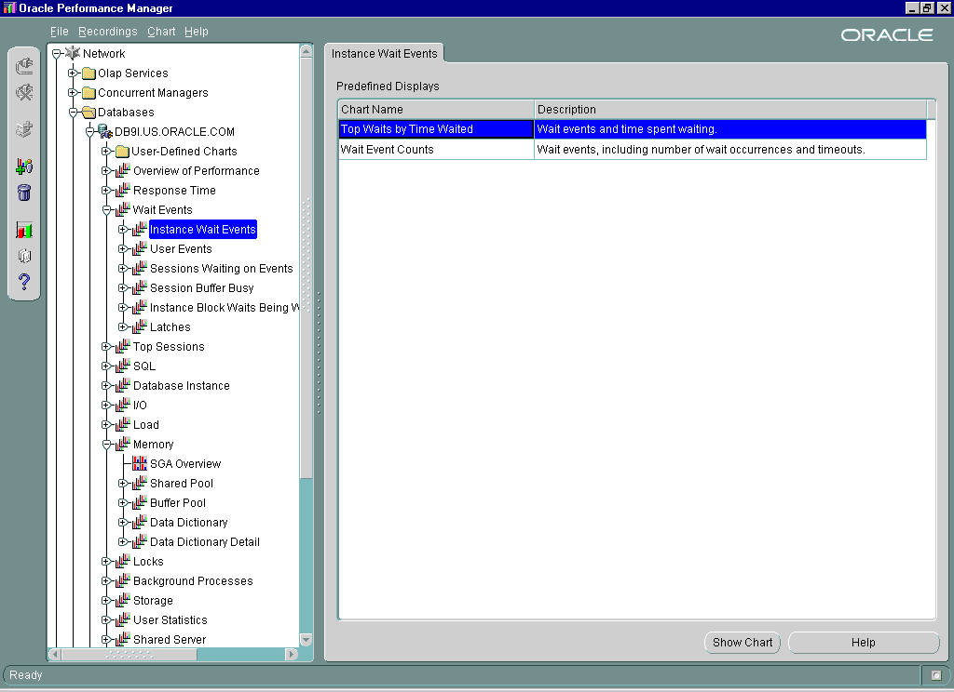
Performance Manager
Notes:
Performance Manager
This Performance Manager window displays wait events that have been reported for the instance.
Instance Wait Events
The Instance Wait Events chart displays the top wait events for the database. If the Log Buffer Space event appears, then it indicates that some time is spent waiting for space in the redo log buffer.
You should investigate by using one of the following options:
Make the log buffer bigger if it is small.
Move the log files to faster disks. It is generally not a good idea to have the redo logs on striped disks that are using Redundant Arrays of Inexpensive Disks (RAID) level 5. For more information about the use of striped disks, refer to Appendix E, “Redundant Arrays of Inexpensive Disks Technology (RAID).”
Performance Manager: Memory
The Memory chart provides an overview of the SGA. Two of the factors shown are the log buffer and the Java pool, which is dealt with later in this lesson.

Slide 9
Redo Log Buffer Tuning Guidelines
  There should be no Log Buffer Space waits.
  Redo Buffer Allocation Retries value should be near 0 and should be less than 1% of redo entries.
SQL> SELECT sid, event, seconds_in_wait, state
2 FROM v$session_wait
3 WHERE event = 'log buffer space';
SQL> SELECT name, value
2 FROM v$sysstat
3 WHERE name IN ('redo entries',
4 'redo buffer allocation retries');
Notes:
SECONDS_IN_WAIT for Log Buffer Space Event
In v$session_wait, if the SECONDS_IN_WAIT value for the Log Buffer Space event indicates some time spent waiting for space in the redo log buffer, then consider:
Making the log buffer bigger if it is small
Moving the log files to faster disks such as striped disks by using RAID level 0
SQL> SELECT sid, event, seconds_in_wait, state
2 FROM v$session_wait
3 WHERE event = 'log buffer space%';
SID EVENT SECONDS_IN_WAIT STATE
---- ----------------- --------------- -------
5 log buffer space 110 WAITING

Slide 10
Notes:
Further Investigations
Investigate the possible reasons why the LGWR process is slow in freeing buffers:
There is disk I/O contention on the redo log files. Check that the redo log files are stored on separate, fast devices.
In the v$system_event view, check the number of occurrences of the Log File Switch Completion event, which identifies the log file switch waits because of log switches.
SQL> SELECT event, total_waits, time_waited, average_wait
2 FROM v$system_event
3 WHERE event like 'log file switch completion%';
Increase the size of the redo log files.
DBWn has not completed checkpointing the file when the LGWR needs the file again. LGWR must wait.
In the alert log file, check for the message “CHECKPOINT NOT COMPLETE.”
In the v$system_event view, check the number of occurrences of the Log File Switch (Checkpoint Incomplete) event, which identifies the log file switch waits because of incomplete checkpoints.
SQL> SELECT event, total_waits, time_waited, average_wait
2 FROM v$system_event
3 WHERE event like 'log file switch (check%';
Check the frequency of checkpoints and set an appropriate value for FAST_START_MTTR_TARGET.
Check the size and number of redo log groups.
The archive process cannot write to the archived redo log files or cannot complete the archive operation fast enough. Therefore, it prevents the LGWR from writing.
Confirm that the archive device is not full
Add redo log groups.
In the v$system_event view, check the number of the occurrences of the Log File Switch (Archiving Needed) event, which identifies the log file switch waits because of the archiving issue.
SQL> SELECT event, total_waits, time_waited, average_wait
2 FROM v$system_event
3 WHERE event like 'log file switch (arch%';
The LGWR process starts a new ARCn process whenever the current number of ARCn processes is insufficient to handle the workload. If you anticipate a heavy workload for archiving, such as during bulk loading of data, specify the maximum number of multiple archive processes with the LOG_ARCHIVE_MAX_PROCESSES initialization parameter. This parameter is dynamic and can be changed using the ALTER SYSTEM statement.

Slide 11
Reducing Redo Operations
Ways to avoid logging bulk operations in the redo log:
  Direct Path loading without archiving does not generate redo.
  Direct Path loading with archiving can use Nologging mode.
  Direct Load Insert can use Nologging mode.
  Some SQL statements can use Nologging mode.
Notes:
Reducing Redo Operations
SQL*Loader and the Nologging Mode
Conventional path loading generates redo log entries just as any DML statement. When using direct path, redo log entries are not generated if:
The database is in Noarchivelog mode
The database is in Archivelog mode, but logging is disabled. Logging can be disabled by setting the NOLOGGING attribute for the table or by using the UNRECOVERABLE clause in the control file.
Direct Load Insert and Nologging Mode
The Nologging option:
Applies to tables, tablespaces, and indexes.
Does not record changes to data in the redo log buffer. Some minimal logging is still carried out, for operations such as extent allocation.
Is not specified as an attribute at the INSERT statement level, but is instead specified when using the ALTER or CREATE command for the table, index, or tablespace.
If NOLOGGING is set at the tablespace level, it specifies that NOLOGGING is the default option for new objects created in the tablespace, but it does not affect the NOLOGGING capabilities of objects already created in the tablespace.

Slide 12
Notes:
Reducing Redo Operations (continued)
Direct Load Insert and Nologging Mode (continued)
Is set before the load and is reset to LOGGING once the load completes. If a media failure occurs before a backup is taken, then all tables and indexes that have been modified, may be corrupted.
SQL Statements that Can Use Nologging Mode
Although you can set the NOLOGGING attribute for a table, index, or tablespace, Nologging mode only applies to a few operations on the object for which the attribute is set, such as:
CREATE TABLE ... AS SELECT
CREATE INDEX
ALTER INDEX ... REBUILD
DIRECT PATH INSERT
The following statements are nevertheless unaffected by the NOLOGGING attribute: UPDATE, DELETE, conventional path INSERT, and various DDL statements not listed above.
Note: For backward compatibility, UNRECOVERABLE is still supported as an alternate keyword with the CREATE TABLE statement. This alternate keyword may not be supported in future releases.

Slide 13
Monitoring Java Pool Memory
Limit Java session memory usage:
  JAVA_SOFT_SESSIONSPACE_LIMIT
  JAVA_MAX_SESSIONSPACE_SIZE
SQL> SELECT * FROM v$sgastat
2 WHERE pool = 'java pool';
POOL NAME BYTES
----------- ---------------------- ----------
java pool free memory 30261248
java pool memory in use 19742720
Notes:
Limiting Java Session Memory
The DBA uses the following parameters to limit the amount of memory used for each Java session:
JAVA_SOFT_SESSIONSPACE_LIMIT: When a user’s session-duration Java state exceeds this size, a warning is written into an RDBMS trace file. The default is 1 MB. You use this parameter to specify a soft limit on Java memory usage in a session, as a means to warn you if something goes wrong.
JAVA_MAX_SESSIONSPACE_SIZE: When a user’s session-duration Java state attempts to exceed this size, the session is killed with an out-of-memory failure. The default is 4 GB. This limit is purposely set very high so as not to be visible normally. If a user-invoked Java program is not self-limiting in its memory usage, this setting can place a hard limit on the amount of session space made available to it. When the value for this parameter is exceeded the following error message is displayed:
ORA-29554: unhandled Java out of memory condition

Slide 14
Sizing the SGA for Java
  SHARED_POOL_SIZE:
    8 KB per loaded class
    50 MB for loading large JAR files
  Configure Oracle Shared Server
  JAVA_POOL_SIZE
    24 MB default
    50 MB for medium-sized Java application
Notes:
How the Enterprise Java Engine (EJE) Uses the Shared and Large Pool
The Java engine uses about 8 KB per loaded class. The class loader also temporarily uses the shared pool while loading and resolving classes into the database. While loading and resolving particularly large JAR files, you can use 50 MB of shared pool memory.
The UGA, when using shared server processes, is allocated in the large pool when the LARGE_POOL_SIZE is included in the parameter file.
How the Enterprise Java Engine (EJE) Uses the Java Pool
The Java pool is a structure in the SGA that is used for all session-specific Java code and data within the EJE. During instance startup, the Java pool is allocated a fixed amount of memory equal to the JAVA_POOL_SIZE parameter.
Generally, the JAVA_POOL_SIZE should be set to 50 MB or higher for large applications. The default value of 24 MB should be adequate for typical Java stored procedure usage.

Slide 15
Summary
In this lesson, you should have learned how to:
  Monitor and size the redo log buffer
  Monitor and size the Java pool
  Control the amount of Java session memory used by a session

Slide 16
Notes:
Practice 7
Throughout this practice Oracle Enterprise Manager can be used if desired. SQL Worksheet can be used instead of SQL*Plus and there are many uses for the Oracle Enterprise Manager console. (Solutions for Oracle Enterprise Manager can be found in Appendix B).
1. Connect as perfstat/perfstat and collect a snapshot of the current statistics by running the $HOME/STUDENT/LABS/snap.sql script. Record the snapshot ID for later use.
2. Connect as user sh/sh and run the $HOME/STUDENT/LABS/lab07_02.sql script in the $HOME/STUDENT/LABS directory to put a workload on the database.
3. Connect as system/oracle and query the v$sysstat view to determine whether there are space requests for the redo log buffer.
4. Connect as perfstat/perfstat and collect another set of statistics using the $HOME/STUDENT/LABS/snap.sql script. Then use $HOME/STUDENT/LABS/spreport.sql to generate a report using the two snapshot IDs that you have collected. From the list of snapshots select a beginning and end value. The beginning is the value recorded in step 1 and the end value step 4. Record the name of the report file. View the generated file using an editor and locate the “log buffer space” statistic.
5. Connect as sys/oracle AS sysdba and increase the size of the redo log buffer in the spfile by changing the value of the LOG_BUFFER parameter. Because this parameter is static you must specify spfile.
6. To have the new value for the LOG_BUFFER take effect, you must restart the instance. Then confirm that the change has occurred.

