Slide 1
SQL Statement Tuning

Slide 2
Objectives
After completing this lesson, you should be able to do the following:
  Control optimizer options
  Use optimizer hints
  Employ plan stability
  Use stored outlines
  Use SQL Trace and TKPROF

Slide 3
Overview
The purpose of this lesson is:
  To provide methods to determine the resources used by SQL statements:
    Oracle Enterprise Manager
    Statspack
    Explain plan
    SQL Trace and TKPROF
    Autotrace
  To determine which SQL statements possibly require tuning
  Not to tune the actual SQL statements
Notes:
Overview
In this lesson you will examine the different methods that can be used to determine the resources used by a SQL statement. If you know the resources used by a SQL statement, then you can determine which statements are the best candidates for tuning.
This course does not cover SQL tuning. For further information on this topic, the Oracle9i: SQL Tuning Workshop course is recommended.

Slide 4
Optimizer Modes
There are two types of optimizer modes:
  Rule-based:
    Uses a ranking system
    Syntax- and data dictionary-driven
  Cost-based:
    Chooses the path with lowest cost
    Statistics-driven
Notes:
Optimizer Modes
Rule-Based Optimization
In this mode, the server process chooses its access path to the data by examining the query. This optimizer has a complete set of rules for ranking access paths. The rule-based optimizer (RBO) is syntax-driven, in that it uses the statement syntax in combination with data dictionary information about the data structures to determine which execution plan to use. This optimizer mode is supported for backward compatibility.
Cost-Based Optimization
In this mode, the optimizer examines each statement and identifies all possible access paths to the data. The resource cost of each access path is calculated and the least expensive one is chosen. The cost is based mainly on the number of logical reads. The cost-based optimizer (CBO) is statistics-driven in that it uses statistics generated for the objects involved in the SQL statement to determine the most effective execution plan. You should use this optimizer mode for new applications, particularly if they use the Parallel Query feature, bitmap indexes or bitmap join indexes.
Note: For additional information about the ranking used by the rule-based optimizer, refer to the Oracle9i Database Concepts Release 2 (9.2) manual (Part Number A96524-01).

Slide 5
Setting the Optimizer Mode
  At the instance level:
    optimizer_mode =
    {Choose|Rule|First_rows|First_rows_n|
    All_rows}
  At the session level:
    ALTER SESSION SET optimizer_mode =
    {Choose|Rule|First_rows|First_rows_n|
    All_rows}
  At the statement level:
    Using hints
Notes:
Setting the Optimizer Mode
The optimizer mode can be set at the:
Instance level by using the OPTIMIZER_MODE parameter
Session level, by using the ALTER SESSION command
Statement level, by using hints
The DBA is responsible for setting the OPTIMIZER_MODE parameter at the instance level, because this requires restarting the instance. Typically, application developers can set the OPTIMIZER_MODE at the session level, as well as use hints in SQL statements.
The OPTIMIZER_MODE Parameter
The default value is Choose. This means that the optimizer uses the cost-based mode (All_rows) if statistics are available for at least one of the tables involved. Otherwise, it uses rule-based optimization.
The other possible values are Rule, First_rows, First_rows_n, and All_rows. The first one forces rule-based optimization regardless of the existence of any statistics. The last two represent different ways of using cost-based optimization.
Note: If any table involved has a degree of parallellization greater than 1 or a parallel hint, then the default behavior for the statement is cost-based optimization.

Slide 6
Notes:
Setting the Optimizer Mode (continued)
The OPTIMIZER_MODE Option at the Session Level
First_rows minimizes immediate response time (possibly at the expense of overall response time) and First_rows_n minimizes immediate response time for the first n rows (possibly at the expense of overall response time). The value of n can be 1, 10, 100, or 1000. All_rows minimizes total response time (throughput).
Developers can set this option using the ALTER SESSION command.
SQL> ALTER SESSION SET OPTIMIZER_MODE = value;
Note: For backward compatibility, the OPTIMIZER_GOAL option of the ALTER SESSION command is still supported as an alternative for the OPTIMIZER_MODE option.

Slide 7
Using Hints in a SQL Statement
SQL> CREATE index gen_idx on customers
2 (cust_gender);
SQL> SELECT /*+ INDEX(customers gen_idx)*/
2 cust_last_name, cust_street_address,
3 cust_postal_code
4 FROM sh.customers
5 WHERE UPPER (cust_gender) = ‘M';
Notes:
Using Hints in a SQL Statement
You may know information about your data that the optimizer does not know. For example, you may know that a certain index is more selective for certain queries. Based on this information, you may be able to choose a more efficient execution plan than the optimizer. In such a case, use hints to force the optimizer to use the optimal execution plan.
You can code hints into a statement, as shown below:
SQL> SELECT /*+ First_rows */ *
2 FROM hr.employees;
Hints, which influence the optimizer mode, include Parallel, Rule, First_rows, First_rows_n, and All_rows. Hints always override session-level settings and session level settings always override instance level settings.
Example
In the example in the above slide there is an index on the cust_gender column of the customers table. There are very few male customers, therefore the statement runs faster using the gen_idx index. To force the optimizer to use the index, put in a hint.
Note: Refer to the Oracle9i Database Performance Tuning Guide and Reference
Release 2 (9.2) manual (Part Number A96533-01) for a listing of all available hints.

Slide 8
Optimizer Plan Stability
  Users can stabilize execution plans, to force applications to use a desired SQL access path.
  A consistent execution path is thereby maintained through database changes.
  This is done by creating a stored outline consisting of hints.
  The OPTIMIZER_FEATURES_ENABLE parameter enables the optimizer to retain CBO features of previous versions.
Notes:
Optimizer Plan Stability
For every statement, the optimizer prepares a tree of operations called an execution plan, which defines the order and methods of operation that the server follows to execute the statement.
Because the optimizer may have incomplete information, sometimes the best possible plan is not chosen. In these cases, you may find it worthwhile to influence the optimizer’s plan selection by rewriting the SQL statement, using hints, or by using other tuning techniques. When satisfied, you may want to ensure that the same plan is generated whenever the same statement is recompiled, even when factors that affect optimization may have changed.
Stored outlines provide the user with a means of stabilizing execution plans across Oracle releases, database changes, or other factors that normally cause an execution plan to change. You can create a stored outline containing a set of hints used by the optimizer to create an execution plan.
The OPTIMIZER_FEATURES_ENABLE parameter allows a version of the Oracle server to run with the CBO features of an earlier version. This parameter should be left as its default, which is the current release. However, if you want to retain the previous CBO features while performing the upgrade then refer to the Oracle9i Database Performance Tuning Guide and Reference Release 2 (9.2) manual (Part Number A96533-01).

Slide 9
Plan Equivalence
  SQL statement text must match the text in a
  stored outline.
  Plans are maintained through:
    New Oracle versions
    New statistics on objects
    Initialization parameter changes
    Database reorganization
    Schema changes
Notes:
Plan Equivalence
SQL Statement Equivalence
Plan stability relies on exact textual matching of queries when determining whether a query has a stored outline. The matching criteria are the same used to determine whether an execution plan in the shared pool can be reused.
Stored outlines rely partially on hints that the optimizer uses to achieve stable execution plans. Therefore, the degree to which plans remain equivalent depends on the capabilities of the hints the plans use. The execution steps included in a stored outline include row access methods, join order, join methods, distributed accesses, and view/sub query merging. Distributed access does not include the execution plan on the remote node.
Plan Stability
These plans are maintained through many types of database and instance changes. Therefore, if you develop applications for mass distribution, you can use stored outlines to ensure that all your customers access the same execution plans. For example, a stored outline can prevent the use of new indexes, until the stored outline is rebuilt.

Slide 10
Creating Stored Outlines
SQL> ALTER SESSION
2 SET CREATE_STORED_OUTLINES = train;
SQL> SELECT … FROM … ;
SQL> SELECT … FROM … ;
SQL> CREATE OR REPLACE OUTLINE co_cl_join
2 FOR CATEGORY train ON
3 SELECT co.crs_id, ...
4 FROM courses co
5 , classes cl
6 WHERE co.crs_id = cl.crs_id;
Notes:
Creating Stored Outlines
The server can create outlines automatically or you can create them for specific SQL statements. Outlines use the cost-based optimizer, because they rely on hints.
Categories
Stored outlines can be grouped by categories. The same SQL statement can have a stored outline in more than one category. For example, you may want to have an OLTP category and a DSS category. If a category name is omitted, then outlines are placed in the DEFAULT category.
CREATE_STORED_OUTLINES Parameter
Oracle creates stored outlines automatically for all executed SQL statements when you set CREATE_STORED_OUTLINES to True or to a category name. When set to True the DEFAULT category is used. You can deactivate the process by setting the parameter to False. When this parameter is used, the outline names are also generated automatically.
CREATE OUTLINE Command
You can also create stored outlines for a specific statement by using the CREATE OUTLINE command. One advantage of this approach is that you can specify a name for the stored outline.

Slide 11
Using Stored Outlines
  Set the USE_STORED_OUTLINES parameter to True or to a category name:
  Both CREATE_STORED_OUTLINES and USE_STORED_OUTLINES can be set at the instance or session level.
SQL> ALTER SESSION
2 SET USE_STORED_OUTLINES = train;
SQL> SELECT … FROM … ;
Notes:
Using Stored Outlines
If USE_STORED_OUTLINES is set to True, then outlines from the DEFAULT category are used. If USE_STORED_OUTLINES is set to a category name, then the outlines from that category are used. If there is no matching outline in the specified category, but there is one in the DEFAULT category, then that outline is used.
The SQL statement must match the text of the statement in the outline. This means that hints used in the outline must be used in the statement text to cause a match but values in bind variables do not need to match.
To determine a SQL statement’s execution plan, the following logic is used:
The statement is compared, using text and outline category, to outlines in the library cache.
If no matching statement is found, the data dictionary is queried for a matching outline.
If a matching outline is found, the outline is integrated into the statement and the execution plan is created.
If no outline is found, the statement is executed using normal (non-outline) methods.
If an outline specifies the use of an object that cannot be used (for example, it references an index that no longer exists), the statement will simply not use the hint.
To verify that a stored outline is being used, the explain plan for a statement must be compared when running with and without USE_STORED_OUTLINES set.

Slide 12
Using Private Outlines
Private outlines are:
  Edited without affecting the running system
  Copies of current storage outlines
  Controlled using the USE_PRIVATE_OUTLINES parameter
Notes:
Using Private Outlines
With the USE_PRIVATE_OUTLINES parameter you control the use of private outlines. A private outline is an outline that is seen only by your session and whose data resides in your parsing schema. Changes made to such an outline are not seen by other sessions and applying a private outline to the compilation of a statement can be done only in your session. Only when you explicitly choose to save your edits back to the public area are they seen by the rest of the users. The outline is cloned into your schema at the onset of the outline editing session. All subsequent editing operations are performed on that clone until you are satisfied with the edits and choose to publicize them. Any editing done by you does not impact the rest of the user community, which continues to use the public version of the outline until the edits are explicitly saved. When a private outline is created, an error is returned if the prerequisite outline tables to hold the outline data do not exist in the local schema. The dbms_outln_edit.create_edit_tables procedure creates these tables.
Prerequisites to Using Private Outlines
When USE_PRIVATE_OUTLINES is enabled and an outlined SQL statement is issued, the optimizer retrieves the outline from the session private area. If no outline exists then the optimizer will not use an outline to compile the statement.
If USE_STORED_OUTLINES is enabled then outlines in the public area are used.

Slide 13
Editing Stored Outlines
Editing and using private outlines:
  Create the outline tables in the current schema.
  Copy the selected outline to private outline.
  Edit the outline stored as a private outline.
  To use the private outline, set the USE_PRIVATE_OUTLINE parameter.
  To allow public access to the new stored outline, overwrite the stored outline.
  Reset USE_PRIVATE_OUTLINE to False.
Notes:
Editing Stored Outlines
Assume that you want to edit the DEV01 outline. The steps are as follows:
1. Connect to a schema from which the outlined statement can be executed and make sure that the CREATE ANY OUTLINE and SELECT privileges have been granted. Use the dbms_outln_edit.create_edit_tables procedure to create outline editing tables locally.
2. Clone the outline being edited to the private area by using the following:
SQL> CREATE PRIVATE OUTLINE p_DEV01
2 FROM dev01;
3. Edit the outline, either with the Outline Editor in Oracle Enterprise Manager or manually by querying the local ol$hints tables and performing DML against the appropriate hint tables. Use the dbms_outln_edit.change_join_pos procedure to change the join order.
4. If manually editing the outline, then resynchronize the stored outline definition by using the following so-called identity statement:
SQL> CREATE PRIVATE OUTLINE p_dev01
2 FROM PRIVATE p_dev01;

Slide 14
Notes:
Editing Stored Outlines (continued)
5. To accomplish the same task as in step 4 you can also use:
SQL> dbms_outln_edit.refresh_private_outline;
Or
SQL> ALTER SYSTEM FLUSH SHARED_POOL;
6. Test the edits. Set USE_PRIVATE_OUTLINES=True and run the outline statement or run EXPLAIN PLAN on the statement.
7. If you want to preserve these edits for public use, then publicize the edits with the following statement.
SQL> CREATE OR REPLACE OUTLINE dev01
2 FROM PRIVATE p_dev01;
8. Disable private outline usage by setting the USE_PRIVATE_OUTLINES parameter to False.

Slide 15
Maintaining Stored Outlines
  Use the outln_pkg package to:
    Drop outlines or categories of outlines
    Rename categories
  Use the ALTER OUTLINE command to:
    Rename an outline
    Rebuild an outline
    Change the category of an outline
  Outlines are stored in the outln schema
Notes:
Maintaining Stored Outlines
Use procedures in the outln_pkg package to manage stored outlines and their categories. These procedures are:
drop_unused: Drops outlines that have not been used since they were created
drop_by_cat: Drops outlines assigned to the specific category name
update_by_cat: Reassigns outlines from one category to another
Outlines can also be managed with the ALTER/DROP OUTLINE commands.
Plans can be exported and imported by exporting the outln schema, where all outlines are stored. Outlines can be queried from tables in the schema:
ol$: Outline name, category, creation timestamp and the text of the statement
ol$hints: The hints for the outlines in ol$
The equivalent data dictionary views are dba_outlines and dba_outline_hints.
Note: Because the user outln is automatically created with the database, its password should be changed.

Slide 16
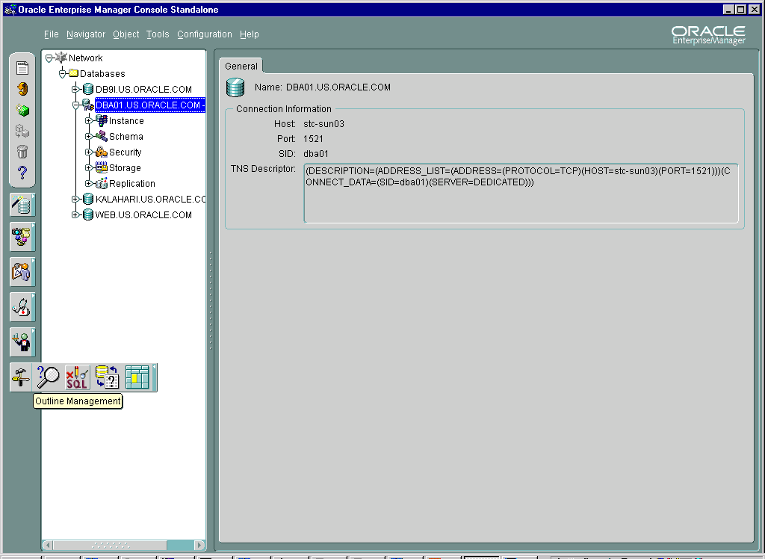
Oracle Enterprise Manager:
Maintaining Stored Outlines
Notes:
Oracle Enterprise Manager: Maintaining Stored Outlines
You can use the Oracle Enterprise Manager console to maintain stored outlines on a database. From this manager you can create, drop, or modify stored outlines.

Slide 17
Overview of Diagnostic Tools
  Statspack
  EXPLAIN PLAN
  SQL trace and TKPROF
  SQL*Plus autotrace feature
  Oracle SQL Analyze
Notes:
Overview of Diagnostic Tools
Numerous diagnostic tools are available for evaluating the performance of SQL statements and PL/SQL modules. Each tool provides a developer or DBA with a varying degree of information:
Statspack: This utility collects information regarding database statistics and SQL statements.
EXPLAIN PLAN: This is executed within a session for a SQL statement.
SQL Trace: This utility provides detailed information regarding the execution of SQL statements.
TKPROF: This is an operating system utility that takes the output from a SQL Trace session and formats it into a readable format.
Autotrace: This is a SQL*Plus feature. Autotrace generates an execution plan for a SQL statement and provides statistics relative to the processing of that statement.
Oracle SQL Analyze: This is part of the Oracle Enterprise Manager Tuning Pack and it provides a powerful user interface for tuning SQL statements.

Slide 18
SQL Reports in Statspack
The following reports on statements are provided
by Statspack:
  SQL ordered by gets
  SQL ordered by reads
  SQL ordered by executions
  SQL ordered by parse calls
Notes:
SQL Reports in Statspack
Statspack gives four different views based on SQL statements stored in the shared pool at the time of either the beginning snapshot or the ending snapshot. The report provides these statements in four different sections. These sections are:
SQL ordered by gets
SQL ordered by reads
SQL ordered by executions
SQL ordered by parse calls
These reports can be examined to see which SQL statements are having the most impact on the performance of the database. These are the best SQL statements to tune because tuning them is most likely to improve performance dramatically.

Slide 19
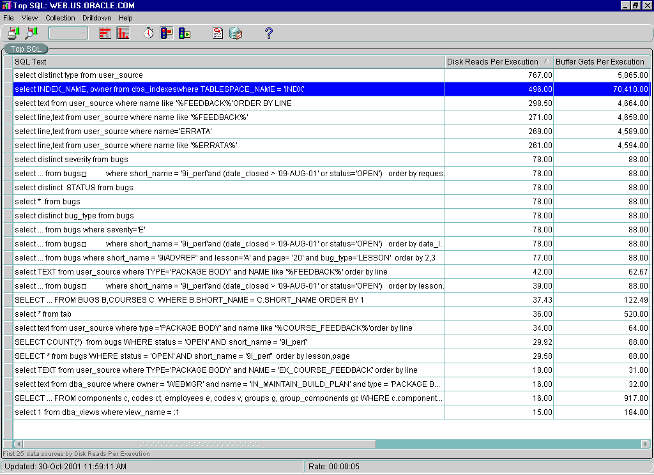
Performance Manager: Top SQL
Notes:
Performance Manager: Top SQL
Use Top SQL to determine which SQL statement consumes the most resources. These are usually the best candidates for tuning because they provide the highest return for the tuning effort. You can sort the listing on any of the displayed columns.

Slide 20
Generate the Execution Plan
  Can be used without tracing
  Needs the plan_table table utlxplan.sql
  Create the explain plan:
SQL> EXPLAIN PLAN FOR
2 SELECT last_name FROM hr.employees;
Notes:
Generate the Execution Plan
To generate the execution plan of a particular SQL statement you can use the EXPLAIN PLAN command in SQL*Plus without using tracing. You must create a table called plan_table using the supplied utlxplan.sql script. The useful columns for most purposes are operation, options, and object_name.
To explain the plan for a query, use the following syntax:
EXPLAIN PLAN [SET STATEMENT_ID = ‘...’]
[INTO my_plan_table]
FOR SELECT ….
If you do not use a STATEMENT_ID in the EXPLAIN PLAN statement, you may want to truncate the plan_table table prior to generating another execution plan. The STATEMENT_ID provides an easy method of marking a particular statement in the plan_table table. This is especially useful when there are many versions of the same statement.
The v$sql_plan view can be used to gather this information, however, v$sql_plan holds information only for SQL statements currently in the library cache, whereas the plan_table table will hold the information until removed.

Slide 21
Query the plan_table Table
Query plan_table to display the execution plans:
  Query plan_table directly.
  Use script utlxpls.sql (hide Parallel Query information).
  Use script utlxplp.sql (show Parallel Query information).
  Use the dbms_xplan package.
SQL> SELECT *
2 FROM TABLE(dbms_xplan.display);
Notes:
Query the plan_table table
You query the plan_table table to check the execution plan. The execution plan shows how the SQL statement would be executed if you chose to run it at that moment. Remember that if you make changes before executing the statement (creating an index, for example), the actual execution plan may be different.
The plan_table table can be queried:
Directly
Using utlxpls.sql
Displays only the columns that tend to be the most useful
Using utlxplp.sql
Displays extra columns of use to Parallel Query
Using the dbms_xplan package
Displays only the columns that tend to be the most useful
Note: For additional information on the columns in the plan_table table, refer to the Oracle9i Database Performance Tuning Guide and Reference Release 2 (9.2) manual (Part Number A96533-01).

Slide 22
Using SQL Trace and TKPROF
To use SQL trace and TKPROF:
  Set the initialization parameters.
  Run the application.
  Format the trace file with TKPROF.
  Interpret the output.
SQL> ALTER SESSION SET sql_trace = True;
SQL> ALTER SESSION SET sql_trace = False;
Notes:
Using SQL Trace and TKPROF
A particular sequence of steps is necessary to properly diagnose SQL statement performance with SQL Trace and TKPROF:
The first step is to ensure appropriate initialization parameters have been set. These can be set at the instance level; some parameters can also be set at the session level.
SQL Trace must be invoked at either the instance or session level. Generally, it is better if it is invoked at the session level.
Run the application or SQL statement you want to diagnose.
Turn off SQL Trace. This is necessary to close the trace file properly at the operating system level.
Use TKPROF to format the trace file generated during the trace session. Unless the output file is formatted, it is very difficult to interpret the results.
Use the output from TKPROF to diagnose the performance of the SQL statement.

Slide 23
Notes:
Using SQL Trace and TKPROF (continued)
Initialization Parameters
Two parameters in the parameter file control the size and destination of the output file from the SQL trace facility:
MAX_DUMP_FILE_SIZE = n: This parameter is measured in bytes if K or M is specified; otherwise the number represents operating system blocks. The default value is 10,000 operating system blocks. When a trace file exceeds the size defined by the parameter value, the following message appears at the end of the file: *** Trace file full ***
USER_DUMP_DEST = directory: This parameter determines the trace file destination.
To obtain timing information you must set the TIMED_STATISTICS parameter to True. The TIMED_STATISTICS parameter can also be set dynamically at the session level, using the ALTER SESSION command.
The timing statistics have a resolution of one one-hundredth of a second.

Slide 24
Enabling and Disabling SQL Trace
  At the instance level:
  SQL_TRACE = {True|False}
  At the session level:
SQL> ALTER SESSION SET
2 SQL_TRACE = {True|False};
SQL> EXECUTE dbms_session.set_sql_trace
2 ({True|False});
SQL> EXECUTE
2 dbms_system.set_sql_trace_in_session
3 (session_id, serial_id, {True|False});
Notes:
Enabling and Disabling SQL Trace
SQL Trace can be enabled or disabled using different methods at either the instance or the session level.
Instance Level
Setting the SQL_TRACE parameter at the instance level is one way to enable tracing. However, it requires that the instance be shut down and then restarted when tracing is no longer needed. This method also imposes a significant performance cost, because all sessions for the instance are traced.
Session Level
Session-level tracing results in less cost to overall performance, because specific sessions can be traced. Three methods for enabling or disabling SQL Trace are:
Using the ALTER SESSION command, which results in tracing for the duration of the session or until the value is set to False.
Using the dbms_session.set_sql_trace procedure for the session.
Using the dbms_system.set_sql_trace_in_session procedure to enable tracing in a session, other than the current one.

Slide 25

Formatting the Trace File with TKPROF
$ tkprof tracefile.trc output.txt [options]
tracefile.trc
output.txt
USER_DUMP_DEST
Notes:
Formatting the Trace File with TKPROF
Use TKPROF to format the trace file into a readable output:
tkprof tracefile outputfile [sort=option] [print=n] [explain=username/password] [insert=filename] [sys=NO] [record=filename] [table=schema.tablename]
The trace file is created in the directory specified by the USER_DUMP_DEST parameter and the output is placed in the directory specified by the output filename.
SQL Trace also gathers statistics for recursive SQL statements. Because you cannot directly affect the amount of recursive SQL that the server executes, these figures are not very useful. Use the SYS=No option of TKPROF to suppress the output of these figures.
When you specify the EXPLAIN parameter, TKPROF logs on to the database with the username and password provided. It then works out the access path for each SQL statement traced and includes that in the output. Because TKPROF logs on to the database, it uses the information available at the time that TKPROF is run, not at the time the trace statistics were produced. This could make a difference if, for example, an index has been created or dropped since tracing the statement.
TKPROF also reports library cache misses. This indicates the number of times that the statement was not found in the library cache.

Slide 26
Notes:
Formatting the Trace File with TKPROF (continued)
You can enter tkprof at the operating system level to obtain a listing of all the available options and output. The options include:
TRACEFILE: The name of the trace output file
OUTPUTFILE: The name of the formatted file
SORT=option: The order in which to sort the statements
PRINT=n: Store the first n statements in the output file
EXPLAIN=user/password: Run EXPLAIN PLAN as the specified username
INSERT=filename: Causes the output to be formatted as a series of SQL INSERT statements in a script file
SYS=NO: Ignore recursive SQL statements run as user sys
AGGREGATE=[Y/N]: If you specify AGGREGATE = NO, TKPROF does not aggregate multiple uses of the same SQL text
RECORD=filename: Record statements found in the trace file
TABLE=schema.tablename: Put execution plan into specified table (rather than the default of the plan_table table)
The sort options include the following:
prscnt, execnt,fchcnt: Number of times parse, execute, and fetch were called
prscpu,execpu,fchcpu: CPU time parsing, executing, and fetching
prsela,exela,fchela: Elapsed time parsing, executing, and fetching
prsdsk,exedsk,fchdsk: Number of disk reads during parse, execute, and fetch
prsqry,exeqry,fchqry: Number of buffers for consistent read during parse, execute, and fetch
prscu,execu,fchcu: Number of buffers for current read during parse, execute, and fetch
prsmis,exemis: Number of misses in library cache during parse and execute
exerow,fchrow: Number of rows processed during execute and fetch
Userid: The ID of the user who parsed the cursor

Slide 27
TKPROF Statistics
  Count: Number of execution calls
  CPU: CPU seconds used
  Elapsed: Total elapsed time
  Disk: Physical reads
  Query: Logical reads for consistent read
  Current: Logical reads in current mode
  Rows: Rows processed
Notes:
TKPROF Statistics
TKPROF collects the following statistics:
Count: The number of times the statement was parsed or executed and the number of fetch calls issued for the statement.
CPU: Processing time for each phase, in seconds. If the statement was found in the shared pool or if the parse took less than 1/100 of a second then this value will be 0.
Elapsed: Elapsed time, in seconds (this is not usually very helpful, because other processes affect elapsed time)
Disk: Physical data blocks read from the database files (usually the statistic is quite low if the data was buffered)
Query: Logical buffers retrieved for consistent read (usually for SELECT statements)
Current: Logical buffers retrieved in current mode (usually for DML statements)
Rows: Rows processed by the outer statement (for SELECT statements, this is shown for the fetch phase; for DML statements, it is shown for the execute phase)
The sum of Query and Current is the total number of logical buffers accessed.

Slide 28
SQL*Plus Autotrace
  Create the plan_table table.
  Create and grant the plustrace role.
Autotrace syntax:
SQL> @$ORACLE_HOME/sqlplus/admin/plustrce.sql
SQL> GRANT plustrace TO scott;
SET AUTOTRACE [ Off | On | Traceonly ]
[ Explain | Statistics ]
Notes:
SQL*Plus Autotrace
SQL*Plus autotrace can be used instead of SQL Trace. The advantage of using autotrace is that you do not have to format a trace file and it automatically displays the execution plan for the SQL statement.
However, autotrace does parse and execute the statement, whereas explain plan only parses the statement.
The steps for using autotrace are:
1. Create the plan_table table using the utlxplan.sql script.
2. Create the plustrace role by executing the plustrce.sql script. This grants SELECT privileges on V$ views to the role and grants the role to the dba role. Grant the plustrace role to users who do not have the dba role.
3. Set autotrace to the level desired:
Off: Autotrace turned off (This is the default.)
On: Includes the optimizer execution path and the SQL statement execution statistics
On Explain: Shows only the optimizer execution path
On Statistics: Shows only the SQL statement execution statistics
Traceonly: Same as On, but suppresses the user's query output

Slide 29
Summary
In this lesson, you should have learned how to:
  Describe how the optimizer is used
  Describe how hints are used
  Explain the concept of plan stability
  Explain the use of stored outlines
  Use SQL Trace and TKPROF

Slide 30
Notes:
Practice 11
The objective of this practice is to familiarize you with SQL statement execution plans and to interpret the formatted output of a trace file generated using SQL Trace and the formatted output generated by TKPROF. Throughout this practice Oracle Enterprise Manager can be used if desired. SQL Worksheet can be used instead of SQL*Plus and there are many uses for the Oracle Enterprise Manager console. (Solutions for Oracle Enterprise Manager can be found in Appendix B).
1. Connect as hr/hr and create the plan_table table under the hr schema, if it is not already created, by running the $ORACLE_HOME/rdbms/admin/utlxplan.sql script.
Note: If plan_table already exists and holds rows then truncate the table.
2. Set the optimizer mode to rule based using the ALTER SESSION command and generate the explain plan for the statement $HOME/STUDENT/LABS/lab11_02.sql. View the generated plan by querying object name, operation, option, and optimizer from the plan_table table.
3. Truncate the plan_table table. Change the optimizer mode to cost based by setting the value to All_rows and rerun the explain plan for $HOME/STUDENT/LABS/lab11_02.sql. Notice that the optimizer mode and the explain plan have changed.
4. Truncate the plan_table table and set the optimizer mode to Rule by using the ALTER SESSION command. This time generate the explain plan for the $HOME/STUDENT/LABS/lab11_04.sql script. Examine the script which is a copy of $HOME/STUDENT/LABS/lab11_02.sql except that it changes the line “SELECT * ” to include a hint /*+ all_rows*/ for the optimizer. View the generated execution plan by querying object name, operation, option, and optimizer from plan_table table.
5. Exit out of SQL*Plus, change the directory to $HOME/ADMIN/UDUMP and delete all the trace files already generated.
Note: This step is performed only to make it easier to find the trace file generated. It is not a requirement of SQL Trace.
6. Connect as sh/sh and enable SQL Trace, using the ALTER SESSION command, to collect statistics for the script, $HOME/STUDENT/LABS/lab11_06.sql. Run the script. After the script has completed, disable SQL Trace, then format your trace file using TKPROF. Use the options SYS=NO and EXPLAIN= sh/sh. Name the file myfile.txt.

Slide 31
Notes:
Practice 11 (continued)
7. View the output file myfile.txt and note the CPU, current, and query figures for the fetch phase. Do not spend time analyzing the contents of this file because the only objective here is to become familiar and comfortable with running TKPROF and SQL*Trace.

