Slide 1
Application Tuning

Slide 2
Objectives
After completing this lesson, you should be able to do the following:
  Explain the role of the DBA in tuning applications
  Move tables using the ALTER TABLE command
  Redefine a table online
  Create different types of indexes
  Build and manage index-organized tables
  Explain and plan OLTP, DSS, and hybrid systems

Slide 3
The Role of the Database Administrator
  Application tuning is the most important part of tuning.
  DBAs are not always directly involved in application tuning.
  However, DBAs must be familiar with the impact that poorly written SQL statements can have upon database performance.
Notes:
Database Administrator Tasks
Application design and application tuning provide the greatest performance benefits. However, the method in which data is selected and the amount of data that is selected has serious implications for application performance if the statements that execute those operations are not properly written.
As a database administrator (DBA), you are not always directly involved in the tuning of an application; application developers are often responsible for developing applications and writing SQL statements. However, as a DBA you must be aware of the impact that poorly written SQL statements can have on the database environment. You should be able to provide assistance with application tuning and identify inefficient SQL statements. You should also be aware of optimizer plan stability, implemented through stored outlines and query rewrites using materialized views and dimensions.

Slide 4
Moving Tables Using ALTER TABLE
Tables can be moved using the ALTER TABLE command. This allows:
  Privileges and constraints to be kept
  The table structure to be changed
  Movement to another tablespace
  The command to be parallelized
SQL> ALTER TABLE hr.employees
2 MOVE
3 TABLESPACE users;
Notes:
Moving Tables Using ALTER TABLE
Tables can be moved by:
Using export and import: The problem with this method is that for a period of time the table is unavailable to users and the table must be dropped from the database before the import starts.
Using the CREATE TABLE …AS SELECT… command: This command will copy across to the new table all the data, but the constraints, triggers, and so on will not be transferred to the new table.
Using the ALTER TABLE …MOVE command to move the table can:
Move the table
Keep the constraints, triggers, and so on valid
Move the table using parallelization
After moving a table with an ALTER TABLE …MOVE command, any indexes on the table will be invalid. You can revalidate them with an ALTER INDEX …REBUILD command, including the ONLINE keyword for faster processing.

Slide 5
Redefining a Table Online
Online table redefinition enables you to:
  Modify the storage parameters of the table
  Move the table to a different tablespace in the same schema
  Add support for parallel queries
  Add or drop partitioning support
  Re-create the table to reduce fragmentation
  Change the organization of a normal table (heap organized) to an index-organized table and
  vice versa
  Add or drop a column
Notes:
Redefining a Table Online
Use the dbms_redefinition package to redefine a table online. This package will redefine a table without taking the table offline, except for a short period that is not determined by the size of the table.
In addition to having execute privileges on the dbms_redefinition package, you also require the following privileges:
CREATE ANY TABLE
ALTER ANY TABLE
DROP ANY TABLE
LOCK ANY TABLE
SELECT ANY TABLE
To perform an online redefinition of a table you must perform the following steps:
1. Choose one of the following two methods of redefinition:
Use the primary keys to perform the redefinition. This is the default and preferred method. The pre-redefinition and the post-redefinition versions of the tables have the same primary key columns.
Use the rowids. This method is used if the primary key method cannot be used. Index-organized tables should not be redefined with this method.

Slide 6
Notes:
Redefining a Table Online (continued)
2. Use the dbms_redefinition.can_redef_table() procedure to verify that the table can be redefined online using the redefining method selected.
3. Create an empty interim table (in the same schema as the table to be redefined) with all of the desired attributes. This table must contain the redefined columns, triggers, indexes, grants and constraints. Any referential constraints involving the interim table must be created disabled.
4. Start the redefinition process by calling the dbms_redefinition.start_redef_table() procedure, providing the following information:
The table to be redefined
The interim table name
The column mapping
List the columns that are to be included in the interim table. If the column mapping information is not supplied, then it is assumed all the columns (with their names unchanged) are to be included in the interim table.
The method of redefinition
5. Execute the dbms_redefinition.finish_redef_table() procedure to complete the redefinition of the table. This procedure performs the following tasks:
The original table is redefined such that it has all the attributes, indexes, constraints, grants and triggers of the interim table.
The referential constraints involving the interim table now involve the post-redefined table and are enabled.
Optionally, rename any indexes, triggers, and constraints that were created on the interim table and that are now defined on the redefined table. If the redefinition was done using rowids, then the post-redefined table will have a hidden column (m_row$$). It is recommended that this column be labeled as unused and then dropped.

Slide 7
B-Tree Indexes
Index entry
Root
Branch
Index entry header
Leaf
Key column length
Key column value
Row ID
Notes:
B-Tree Indexes
When to Create B-Tree Indexes
B-tree indexes typically improve the performance of queries that select a small percentage of rows from a table. As a general guideline, you should create indexes on tables that are often queried for less than 5% of the table’s rows. If you select 5% or more of the data it may mean visiting just about every portion of the table anyway, making it less efficient than a full scan. On the other hand, an index can be used to eliminate a potentially expensive sort when many rows are selected, if all data can be retrieved from an index, or where the indexed columns can be used for joining to other tables.
How Indexes Grow
Indexes are always balanced and they grow from the bottom up. As rows are added, the leaf block fills. When the leaf block is full, the Oracle server splits it into two blocks and puts 50% of the block’s contents into the original leaf block and 50% into a new leaf block.
If another block is added to the index, this newly added block must be added to the directory entry in the parent branch block. If this parent branch block is full, the parent branch block is split in a similar way to the leaf block, with 50% of the existing contents being divided between the existing and new branch blocks. If required, this pattern is repeated until the place where the root block becomes a branch block and a new root block is added.

Slide 8
Rebuilding Indexes
To assist in the rebuilding of indexes use:
  ONLINE: Keeps the index available during the
  rebuild operation
  COMPUTE STATISTICS: Collects the statistics while rebuilding the index
Notes:
Rebuilding Indexes
The more levels an index has, the less efficient it may be. Additionally, an index with many rows deleted might not be efficient. Typically, if 15% of the index data is deleted, then you should consider rebuilding the index.
You should rebuild your indexes regularly. However, this can be a time-consuming task, especially if the base table is very large. In the Oracle database, you can create and rebuild indexes online. Parallelization is possible as well. While the index is being rebuilt, the associated base table remains available for queries and DML operations.
SQL> ALTER INDEX i_name REBUILD ONLINE;
The ONLINE keyword specifies that DML operations on the table or partition be allowed during rebuilding of the index.
Restriction: Parallel DML is not supported during online index building. If you specify ONLINE and then run parallel DML statements, an error is returned.
You can also compute statistics for the cost-based optimizer while rebuilding the index. Adding the compute statistics procedure has very little effect on the performance of the rebuild because the entire index is being accessed anyway. The command is:
SQL> ALTER INDEX I_name REBUILD COMPUTE STATISTICS;
You can combine the ONLINE and COMPUTE STATISTICS clauses into one statement.

Slide 9
Compressed Indexes
When creating the index:
When rebuilding the index:
Specify NOCOMPRESS (the default) to disable key compression.
SQL> CREATE INDEX emp_last_name_idx
2 ON hr.employees
3 (last_name, first_name)
4 COMPRESS;
SQL> ALTER INDEX emp_last_name_idx
2 REBUILD COMPRESS;
Notes:
Key Compression
You may be able to save disk storage by creating or rebuilding indexes with the COMPRESS option. Instead of storing the complete key value in such indexes, the server stores the unique portion of a key just once and includes only the rowid for the rows with that key value. In the case of unique indexes, this option is only valid for indexes with multiple attribute keys, because a single-column unique index has no duplicate values. In nonunique compressed indexes, all duplicate values are stored with this technique, whether they occur in a single or multiple key situation.
Use the COMPRESS option to enable key compression in a CREATE or ALTER INDEX …REBUILD command. You can provide an optional integer value to indicate a prefix length, that is, the number of key columns that are to be grouped for compression purposes. For unique indexes, valid prefix length values range from 1 to one less than the number of key columns (the default value). For nonunique indexes, the valid range of prefix length values is from 1 to the number of key columns. The default prefix length for nonunique indexes is the number of key columns.

Slide 10
Bitmap Indexes
Table
File 3
Block 10
Block 11
Index
Block 12
Block 13
Start
ROWID
End
ROWID
Key
Bitmap
<Blue, 10.0.3, 12.8.3, 1000100100010010100>
<Green, 10.0.3, 12.8.3, 0001010000100100000>
<Red, 10.0.3, 12.8.3, 0100000011000001001>
<Yellow, 10.0.3, 12.8.3, 0010001000001000010>
Notes:
Bitmap Indexes
With bitmap indexes, you can store data that has few distinct values within the column, such as gender or job_title. The index consists of a range of rows stored in the index and then a map of binary values for each key. The value is “on,” that is 1, if the key is true for that row. In the example on the slide, the value in the bitmap is on for only one color. If the row item is blue, then the value is a 1 for blue and 0 for all other combinations.
Bitmap indexes perform best when there are few variations for the value, but millions of rows. Bitmap indexes also help resolve Boolean type constraints; for example, if the user requires all items that are blue and yellow or if the green or red items are wanted.
DML statements do not perform well with bitmap indexes, so for high DML activity, do not use a bitmap index.

Slide 11
Bitmap Indexes
  Used for low-cardinality columns
  Good for multiple predicates
  Uses minimal storage space
  Best for read-only systems
  Good for very large tables
Notes:
Bitmap Indexes (continued)
When to Create Bitmapped Indexes
Bitmap indexes are intended for low-cardinality columns that contain a limited number of values.
If you use a query with multiple WHERE conditions, the Oracle server can use logical bit-AND or bit-OR operations to combine this bitmap with bitmaps for other columns.
Performance Considerations
Bitmap indexes use little storage space: one entry per distinct key value, stored in a compressed form. Each bitmap is divided into bitmap segments (up to one-half block).
They work very fast with multiple predicates on low-cardinality columns.
They are particularly suited to large, read-only systems such as decision support systems.
DML statements slow down performance:
They are not suited for OLTP applications.
Locking is at the bitmap-segment, not entry, level.
Bitmap indexes store null values, whereas B-tree indexes do not.
Parallel query, parallel data manipulation language (PDML), and parallelized CREATE statements work with bitmap indexes.

Slide 12
Creating and Maintaining
Bitmap Indexes
SQL> CREATE BITMAP INDEX departments_idx
2 ON hr.departments(manager_id)
3 STORAGE (INITIAL 200K NEXT 200K
4 PCTINCREASE 0 MAXEXTENTS 50)
5* TABLESPACE indx;
Notes:
Creating and Maintaining Bitmap Indexes
In a data warehousing environment, data is usually maintained by way of bulk inserts and updates. Index maintenance is deferred until the end of each DML operation. For example, if you insert 1,000 rows, then the inserted rows are placed into a sort buffer and then the updates of all 1,000 index entries are batched. Thus each bitmap segment is updated only once per DML operation, even if more than one row in that segment changes.
In the Oracle database, there are different parameters affecting the sort area depending on the value of WORKAREA_SIZE_POLICY. See the chapter titled “Optimizing Sort Operations” for more details.

Slide 13
B-Tree Indexes and Bitmap Indexes
B-Tree Indexes Bitmap Indexes
Suitable for high-cardinality Suitable for low-cardinality
columns columns
Updates on keys relatively Updates to key columns very
inexpensive expensive
Inefficient for queries using Efficient for queries using
AND/OR predicates AND/OR predicates
Row-level locking Bitmap segment-level locking
More storage Less storage
Useful for OLTP Useful for DSS

Slide 14
Reverse Key Index
KEY ROWID
----- -------------------
1257 0000000F.0002.0001
2877 0000000F.0006.0001
4567 0000000F.0004.0001
6657 0000000F.0003.0001
8967 0000000F.0005.0001
9637 0000000F.0001.0001
9947 0000000F.0000.0001
... ...
EMPLOYEE_ID LAST_NAME ...
----------- ---------
7499 ALLEN
7369 SMITH
7521 WARD ...
7566 JONES
7654 MARTIN
7698 BLAKE
7782 CLARK
... ... ...
Index on employee_id column
employees table
Notes:
Reverse Key Index
Definition
Creating a reverse key index reverses the bytes of each column key value. In the case of a composite key the column order is kept, but the bytes of each column are reversed.
When to Create Reverse Key Indexes
An ever-increasing key (such as sequential numbers for invoices, employee ids, or order numbers) repetitively degrades the index height (BLEVEL statistic); you can avoid forced block splits by spreading the index entries more evenly.
Disadvantage
When application statements specify ranges then the reverse key index cannot be used, because the keys are not in sequential order. In this case the CBO will choose an explain plan that uses a full table scan.

Slide 15
Creating Reverse Key Indexes
  Create a reverse key unique index:
  Create a unique index, then alter the index to be reverse key:
SQL> CREATE UNIQUE INDEX i1_t1 ON t1(c1)
2 REVERSE PCTFREE 30
3 STORAGE(INITIAL 200K NEXT 200K
4 PCTINCREASE 0 MAXEXTENTS 50)
5 TABLESPACE indx;
SQL> CREATE UNIQUE INDEX i2_t1 ON t1(c2);
SQL> ALTER INDEX i2_t1 REBUILD REVERSE;
Notes:
Identifying Reverse Key Indexes
Use the following query to list the names of all reverse key indexes:
SQL> SELECT index_name, index_type
2 FROM dba_indexes
3 WHERE index_type like '%REV';
INDEX_NAME INDEX_TYPE
--------------------------
I2_T1 NORMAL/REV

Slide 16
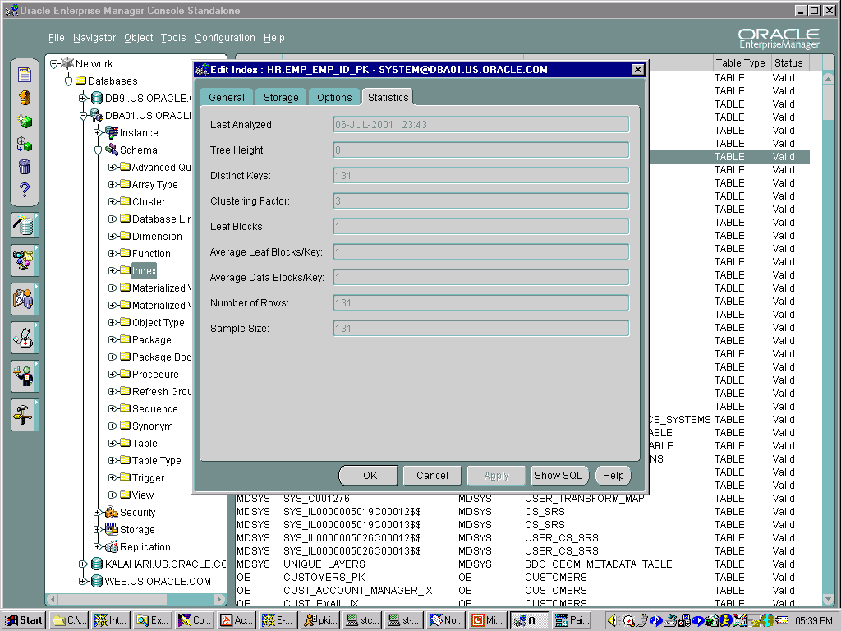
Oracle Enterprise Manager:
Index Management
Notes:
Oracle Enterprise Manager: Index Management
Use the Oracle Enterprise Manager console to provide management for different objects stored within the database. In the example shown in the slide the statistics collected for an index are examined.

Slide 17
Index-Organized Tables
Regular table access
IOT access
ROWID
Non-key columns
Key column
Row header
Notes:
Index-Organized Tables
Definition
An index-organized table is like a regular table with an index on one or more of its columns, but instead of maintaining two separate segments for the table and the B-tree index, the database system maintains one single B-tree structure that contains both the primary key value and the other column values for the corresponding row.
For index-organized tables, a primary key constraint is mandatory.
Index-organized tables are suitable for frequent data access through the primary key or through any key that is a prefix of the primary key, such as in applications that use inverted indexes. An inverted index keeps the value and all its locations together; this meets the requirement for the index-organized table having a primary key. Each word has one entry and that entry records all the places in which the word occurs. This means that the index can be used to re-create the entire document. Inverted indexes are used in Intermedia.
Benefits
No duplication of the values for the primary key column (index and table columns in indexed tables), therefore less storage is required.
Faster key-based access for queries that involve an exact match, a range search, or both.

Slide 18
Index-Organized Tables and Heap Tables
  Compared to heap tables, IOTs have:
    Faster key-based access to table data
    Reduced storage requirements
    Secondary indexes and logical rowids
  IOTs have the following restrictions:
    Must have a primary key
    Cannot be clustered
Notes:
Logical rowids
Index-organized tables do not have regular (physical) rowids. However, the concept of logical rowids was introduced to overcome certain restrictions caused by the lack of physical rowids. Logical rowids give the fastest possible access to rows in IOTs by using two methods:
A physical guess whose access time is equal to that of physical rowids
Access without the guess (or after an incorrect guess); this performs a primary key access of the IOT
The guess is based on knowledge of the file and block that a row resides in. The latter information is accurate when the index is created, but changes if the leaf block splits. If the guess is wrong and the row no longer resides in the specified block, then the remaining portion of the logical rowid entry, the primary key, is used to get the row.
Logical rowids are stored as a variable-length field, where the size depends on the primary key value being stored.
The UROWID data type enables applications to use logical rowids in the same way they use rowids, for example, selecting rowids for later update or as part of a cursor. UROWID can also be used to store rowids from other databases, accessed by way of gateways. The UROWID type can also be used to reference physical rowids.

Slide 19
Creating Index-Organized Tables
SQL> CREATE TABLE country
2 ( country_id CHAR(2)
3 CONSTRAINT country_id_nn NOT NULL,
4 country_name VARCHAR2(40),
5 currency_name VARCHAR2(25),
6 currency_symbol VARCHAR2(3),
7 map BLOB,
8 flag BLOB,
9 CONSTRAINT country_c_id_pk
10 PRIMARY KEY (country_id))
11 ORGANIZATION INDEX
12 TABLESPACE indx
13 PCTTHRESHOLD 20
14 OVERFLOW TABLESPACE users;
Notes:
Creating Index-Organized Tables
Regular B-tree index entries are usually small. They consist of only the primary key value and a rowid value for each row. Many of these small index entries can be stored in a leaf block. This is not necessarily the case for index-organized tables because they store full rows or at least as much as fits without exceeding the limit set by PCTTHRESHOLD.
Storing large entries in index leaf blocks slows down index searches and scans. You can specify that the rows go into an overflow area by setting a threshold value that represents a percentage of block size.
The primary key column must always be stored in the IOT index blocks as a basis for searching. But you can place non-key values in a separate area, the row overflow area, so that the B-tree itself remains densely clustered.

Slide 20
IOT Row Overflow
indx tablespace
users tablespace
Segment = COUNTRY_C_ID_PK
IOT_type = IOT
Segment_type = INDEX
Index_type = IOT - TOP
Segment = SYS_IOT_OVER_n
IOT_type = IOT_OVERFLOW
Segment_type = TABLE
Rows within
PCTTHRESHOLD
Remaining part of the row
Notes:
IOT Row Overflow
The PCTTHRESHOLD Clause
This clause specifies the percentage of space reserved in the index block for an index-organized table row. If a row exceeds the size calculated based on this value, all columns after the column named in the INCLUDING clause are moved to the overflow segment. If OVERFLOW is not specified, then rows exceeding the threshold are rejected. PCTTHRESHOLD defaults to 50 and must be a value from 0 to 50.
The INCLUDING Clause
This clause specifies the column at which to divide an index-organized table row into index and overflow portions. The server accommodates all non-key columns up to the column specified in the INCLUDING clause in the index leaf block, provided it does not exceed the specified threshold.
The OVERFLOW Clause and Segment
This clause affects the index-organized table data rows that exceed the threshold set. The overflow data is placed in the data segment defined by the segments attributes, which specify the tablespace, storage, and block utilization parameters.

Slide 21
Querying dba_tables for IOT Information
SQL> SELECT table_name, iot_name, iot_type
2 FROM dba_tables;
TABLE_NAME IOT_NAME IOT_TYPE
----------------- -------- ------------
COUNTRY IOT
SYS_IOT_OVER_2268 COUNTRY IOT_OVERFLOW
Notes:
The dba_tables Dictionary View
The iot_type and iot_name columns of the dba_tables view provide information about index-organized tables.
If there is no overflow area for an IOT, then there is only a single dictionary entry per IOT. The value of iot_type is IOT and the iot_name field is blank.
If an overflow area has been specified, then its name appears as an additional new table in the list of table names. The overflow table is called sys_iot_over_nnnn (where nnnn is the object ID of the table segment) in dba_tables. The column iot_type is set to IOT_Overflow for this table and iot_name is set to the name of the index-organized table to which it belongs.

Slide 22
Querying dba_indexes and dba_segments for IOT information
SQL> SELECT index_name, index_type,
2 tablespace_name, table_name
2 FROM dba_indexes;
INDEX_NAME INDEX_TYPE TABLESPACE TABLE_NAME
--------------- ---------- ---------- ----------
COUNTRY_C_ID_PK IOT - TOP INDX COUNTRY
SQL> SELECT segment_name, tablespace_name,
2 segment_type
3 FROM dba_segments;
SEGMENT_NAME TABLESPACE_NAME SEGMENT_TYPE
----------------- --------------- ------------
SYS_IOT_OVER_2268 USER TABLE
COUNTRY_C_ID_PK INDX INDEX
Notes:
Querying dba_indexes and dba_segments for IOT information
The dba_indexes Dictionary View
The IOT table name listed is the same as that used in the CREATE TABLE command, but an index name is also listed for the table, with a default name of sys_iot_top_nnnn.
The dba_segments Dictionary View
The name of the overflow segment is listed here with the same name as mentioned above, sys_iot_top_nnnn. The table itself is listed as sys_iot_top_nnnn.

Slide 23
Using a Mapping Table
SQL> CREATE TABLE country
2 ( country_id CHAR(2)
3 CONSTRAINT country_id_nn NOT NULL
4 , country_name VARCHAR2(40)
5 , currency_name VARCHAR2(25)
6 , currency_symbol VARCHAR2(3)
7 , CONSTRAINT country_c_id_pk
8 PRIMARY KEY (country_id))
9 ORGANIZATION INDEX
10 MAPPING TABLE TABLESPACE users;
Notes:
Using a Mapping Table
The Oracle database allows a bitmap index to be built on an IOT, providing that there is a mapping table, because the rowids of an IOT do not remain consistent.
A bitmap index on an IOT is similar to a bitmap index on a heap table, except that the rowids used in the bitmap index on an IOT are those of a mapping table and not the base table. The mapping table maintains a mapping of physical rowids (needed by the bitmap index code) to logical rowids (needed to access the IOT). There is one mapping table per IOT and it is used by all the bitmap indexes created on that IOT.
In a heap-organized base table, a bitmap index is accessed using a search key. If the key is found, the bitmap entry is converted to a physical rowid used to access the base table. In an IOT, a bitmap index is also accessed using a search key. If the key is found, the bitmap entry is converted to a physical rowid used to access the mapping table. The access to the mapping table yields a logical rowid. This logical rowid is used to access the IOT using either the guess data block address (if it is valid) or the primary key. Though a bitmap index on an IOT does not store logical rowids, it is still logical in nature.
The movement of rows in an IOT does not leave the bitmap indexes built on that IOT unusable. The movement of rows in the IOT invalidates the guess data block address in some of the mapping table’s logical rowid entries, however the IOT can still be accessed using the primary key.

Slide 24
Maintaining a Mapping Table
  Collect statistics on a mapping table by analyzing the IOT.
  Query the dba_indexes view to determine the percentage accuracy of the mapping table.
  Rebuild the mapping table if required, using the ALTER TABLE command.
  Use the MINIMIZE RECORDS_PER_BLOCK clause of ALTER TABLE for the mapping table.
SQL> SELECT index_name, pct_direct_access
2 FROM dba_indexes
3 WHERE pct_direct_access IS NOT NULL;
Notes:
Maintaining a Mapping Table
Examine the column pct_direct_access column of the dba_indexes view. The value in this column is an indication of the percentage of rows with a valid guess for a secondary index on an IOT. This column is populated when the IOT is analyzed.
To rebuild the mapping table the mapping table needs to be dropped and recreated. The following command will drop the mapping table associated with the countries table:
SQL> ALTER TABLE countries MOVE NOMAPPING;
Note: To drop a mapping table there must be no bitmap indexes on the IOT.
To create a mapping table on the countries IOT use the command:
SQL> ALTER TABLE countries MOVE MAPPING TABLE;
The recommendation is to use the MINIMIZE RECORDS_PER_BLOCK parameter on mapping tables that are heavily indexed with bitmap indexes. When enabled the Oracle database restricts the number of records in any block of the mapping table to the maximum number of records in any block of the indexed table. This enables the bitmap index to allocate fewer bits per block and results in smaller bitmap indexes.
The NOMINIMIZE RECORDS_PER_BLOCK clause disables this optimization.

Slide 25
The ANALYZE Statement
Use the ANALYZE statement to:
  VALIDATE STRUCTURE
  LIST CHAINED ROWS
  Collect statistics not used by the optimizer, such as information on free list blocks
  Sample a number (instead of a percentage) of rows
SQL> ANALYZE TABLE hr.employees VALIDATE STRUCTURE;
Notes:
The ANALYZE Statement
The ANALYZE statement is the predecessor of the dbms_stats package and can be used to collect similar information. The dbms_stats package is superior and is thus the recommended method of collecting statistics. However, the following cannot be collected using the dbms_stats package:
To use the VALIDATE or LIST CHAINED ROWS clauses
To sample a number (rather than a percentage) of rows
To collect statistics not used by the optimizer (such as information on free list blocks)

Slide 26
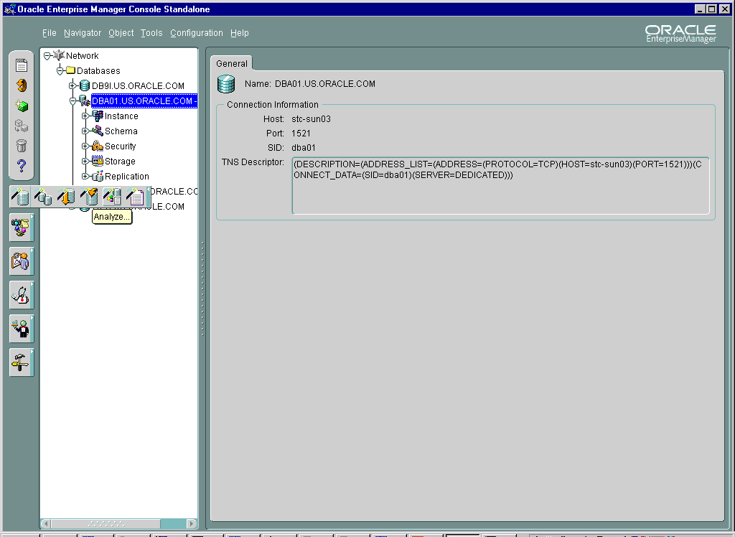
Oracle Enterprise Manager:
Collect Statistics
Notes:
Oracle Enterprise Manager: Collect Statistics
By selecting Analyze in the Oracle Enterprise Manager console the DBA can collect statistics on various objects. There is also the option to use the dbms_stats package (recommended) or ANALYZE.

Slide 27
OLTP Systems
  High-throughput, insert- and update-intensive
  Large, continuously growing data volume
  Concurrent access by many users
  Tuning goals:
    Availability
    Speed
    Concurrency
    Recoverability
Notes:
OLTP Systems
Typical OLTP Applications
Airline reservation systems
Large order-entry applications
Banking applications
Requirements
High availability (7 days a week/24 hours a day)
High speed
High concurrency
Reduced time recovery

Slide 28
OLTP Requirements
  Explicit extent allocation
  Indexes:
    Not too many (B-tree better than bitmap)
    Reverse key for sequence columns
    Rebuilt regularly
  Clusters for tables in join queries:
    Index clusters for growing tables
    Hash clusters for stable tables
  Materialized views
  Index-organized tables
Notes:
OLTP Requirements
Space Allocation
Avoid the performance load of dynamic extent allocation; allocate space explicitly to tables, clusters, and indexes.
Check growth patterns regularly to find the rate at which extents are being allocated so that you can create extents appropriately.
Indexing
Indexing is critical to data retrieval in OLTP systems. DML statements on indexed tables need index maintenance and this is a significant performance overhead. Your indexing strategy must be closely geared to the real needs of the application.
Indexing a foreign key helps child data to be modified without locking the parent data.
B-tree indexing is better than bitmap indexing, because of locking issues affecting DML operations: when a B-tree index entry is locked, a single row is locked, whereas when a bitmap index entry is locked, a whole range of rows are locked.
Reverse key indexes avoid frequent B-tree block splits for sequence columns.
You should rebuild indexes regularly.

Slide 29
Notes:
OLTP Requirements (continued)
Materialized Views
Materialized views are discussed in another lesson. They can reduce the amount of table joins on a system. There are not many opportunities for using materialized views in an OLTP system; most benefits are found in DSS.
Index-Organized Tables
An IOT provides fast access to data, because the table data is stored within the index structure.
Hash Clustering
Using hash clusters should speed up access on equality queries. But you should not choose this data structure for a table that is:
Heavily inserted into, because of the use of space and the number of blocks that must be visited
Heavily updated using larger column values, because of migration probability
If a table is growing, there are likely to be many collisions on hash keys and this leads to storing rows in overflow blocks. To avoid this situation, correctly estimate the HASHKEYS value. With a large number of hash keys for a given number of rows, the likelihood of a collision decreases.

Slide 30
OLTP Application Issues
  Use declarative constraints instead of application code.
  Make sure that code is shared.
  Use bind variables rather than literals for optimally shared SQL.
  Use the CURSOR_SHARING parameter.
Notes:
OLTP Application Issues
Integrity Constraints
If there is a choice between keeping application logic in procedural code or using declarative constraints, keep in mind that constraints are always less expensive to process. Referential integrity and check constraints are the main types to consider here.
Shared Code
You should make certain that code is shared by using stored procedural objects, such as packages, procedures, and functions.
Bind Variables
You want to keep the overhead of parsing to a minimum. Try to ensure that the application code uses bind variables rather than literals.
The CURSOR_SHARING Parameter
Using the CURSOR_SHARING parameter determines the level of cursor sharing. The following values are valid:
Exact: Shares cursors only for exact SQL statements. This is the default value.
Similar: Cursors are shared if changing literals to bind variables generates the same execution path as when the parameter is set to Exact.
Force: Shares cursors by changing literals to bind variables, even if the execution path changes.

Slide 31
Decision Support Systems
(Data Warehouses)
  Queries on large amounts of data
  Heavy use of full table scans
  Tuning goals:
    Fast response time
    Focus on SQL
    statement tuning
  The Parallel Query feature is designed for data warehouse environments
Data
Notes:
Characteristics of Decision Support Systems
Decision support applications distill large amounts of information into understandable reports. They gather data from OLTP systems and use summaries and aggregates in retrieving it. They make heavy use of full table scans as an access method.
Decision-makers in an organization use this data to determine which strategies the organization should take.
Example: A marketing tool determines the buying patterns of consumers based on information gathered from demographic data to determine which items sell best in which locations.
Requirements
Fast response time: When you design a data warehouse, make sure that queries on large amounts of data can be performed within a reasonable timeframe.
Focus on SQL statement tuning.

Slide 32
Data Warehouse Requirements
Storage allocation:
  Set the block size and DB_FILE_MULTIBLOCK_READ_COUNT carefully.
  Make sure that extent sizes are multiples of this parameter value.
  Run dbms_stats regularly.
Notes:
Data Warehouse Requirements
Block Size
Data warehouse applications typically perform many table scans; therefore consider a higher value for the block size parameter. Even if this means re-creating a large database, it is almost certainly worthwhile, because a larger block size facilitates read-intensive operations, which are characteristic of data warehouse applications.
Another option is available; you can create a new tablespace with the required block size, thus having multiple block sizes in the same database.
The DB_FILE_MULTIBLOCK_READ_COUNT Parameter
Pay particular attention to setting the DB_FILE_MULTIBLOCK_READ_COUNT parameter. During full table scans and fast full index scans this parameter determines how many database blocks are read into the buffer cache with a single operating system read call. A larger value decreases the estimated cost of full table scans and therefore the CBO will favor table scans over index searches.

Slide 33
Further Data Warehouse Requirements
  Evaluate the need for indexes:
    Use bitmap indexes when possible.
    Use index-organized tables for (range) retrieval by primary keys.
    Generate histograms for indexed columns that are not distributed uniformly.
  Clustering: Consider hash clusters for performance access.
Notes:
Further Data Warehouse Requirements
Indexing
You should minimize the space and performance overhead of index maintenance. Because most queries usually use full table scans, you can:
Dispense with indexes altogether
Maintain them only for a few tables that are accessed selectively
Regularly generate histograms for tables with non-uniformly distributed data
Choose bitmap indexes for queries on columns with few distinct values; they offer much faster retrieval access
Use index-organized tables for faster, key-based access to table data for queries involving exact matches or range searches and complete row data retrieval
Clustering
Consider using both types of clusters; particularly hash clusters. Do not cluster tables that grow regularly during bulk loads.

Slide 34
Data Warehouse Application Issues
  Parsing time is less important.
  The execution plan must be optimal:
    Use the Parallel Query feature.
    Tune carefully, using hints if appropriate.
    Test on realistic amounts of data.
    Consider using PL/SQL functions to code logic
    into queries.
  Bind variables are problematic.
Notes:
Parsing Time
The time taken to parse SELECT statements is likely to be a very small proportion of the time taken to execute the query. Tuning the library cache is much less of an run for data warehouse than for OLTP systems.
Your priority is an optimal access path in the execution plan; small variations can cost minutes or hours. Developers must:
Use parallelized queries, which enable multiple processes to work together simultaneously to process a single SQL statement.
Use symmetric multiprocessors (SMP), clustered, or massively parallel processing (MPP) configurations. These configurations gain the largest performance benefits because the operation can be effectively split among many CPUs on a single system.
Use the EXPLAIN PLAN command to tune the SQL statements and hints to control access paths.
If your application logic uses bind variables, you lose the benefit of this feature: the optimizer makes a blanket assumption about the selectivity of the column, whereas with literals, the cost-based optimizer uses histograms. Be careful when setting the CURSOR_SHARING parameter; it could force a change from literal values to system-generated bind variables.

Slide 35
Hybrid Systems
OLTP Data Warehouse
Performs index searches More full table scans
Uses B-tree indexes Uses bitmap indexes
Uses reverse key indexes Uses index-organized tables
CURSOR_SHARING set to CURSOR_SHARING should Similar can assist performance be left on Exact
Should not use Parallel Query Employs Parallel Query for large operations
PCTFREE according to PCTFREE can be set to 0
expected update activity
Shared code and bind variables Literal variables and hints
Uses ANALYZE indexes Generates histograms
Notes:
Hybrid System Issues
OLTP needs more indexes than data warehouse does. They do not necessarily use the same type of indexes, because of DML/OLTP and queries/data warehouse issues.
OLTP should not use parallel query, whereas Data Warehouse needs it.
Data warehouse requires tightly packed data blocks for optimal full table scans. Individual rows are generally not updated in a data warehouse environment. Therefore, PCTFREE should be set to 0 for data warehouse databases, whereas a PCTFREE of 0 for OLTP will lead to chaining, because rows are typically more dynamic.
The cost-based optimizer takes histogram statistics into account when the predicate of a query uses columns that have histograms generated. This means that if you have generated histogram statistics it is important for them to be accurate; otherwise the optimized execution path might not be chosen.

Slide 36
Summary
In this lesson, you should have learned how to do the following:
  Explain the role of the DBA in tuning applications
  Move tables using the ALTER TABLE command
  Redefine a table online
  Create different types of indexes
  Build and manage index-organized tables
  Explain and plan OLTP, DSS, and hybrid systems

Slide 37
Notes:
Practice 15
Throughout this practice Oracle Enterprise Manager can be used if desired. SQL Worksheet can be used instead of SQL*Plus and there are many uses for the Oracle Enterprise Manager console. (Solutions for Oracle Enterprise Manager can be found in Appendix B).
1. Connect as hr/hr, drop the new_employees table, and create an IOT called new_employees in the hr schema. Give the table the same columns as the hr.employees table. Make the employee_id column the primary key and name the primary key index new_employees_employee_id_pk.
2. Confirm the creation of the table by querying the user_tables and the user_indexes views.
3. Populate the new_employees table with the rows from the hr.employees table.
4. Create a secondary B-tree index on the last_name column of the new_employees table. Place the index in the indx tablespace. Name the index last_name_new_employees_idx. Collect the statistics for the secondary index.
5. Confirm the creation of the index by using the user_indexes view in the data dictionary. Query the index_name, index_type, blevel, and leaf_blocks.
6. Create a reverse key index on the department_id of the employees_hist table. Place the index in the indx tablespace. Name the index emp_hist_dept_id_idx.
7. Confirm the creation of the index and that it is a reverse key index, by querying the user_indexes view in the data dictionary. Query the index_name, index_type, blevel, and leaf_blocks.
8. Create a bitmap index on the job_id column of the employees_hist table. Place the index in the indx tablespace. Name the index bitmap_emp_hist_idx.
9. Confirm the creation of the index and that it is a bitmapped index by querying the user_indexes view in the data dictionary. Query the index_name, index_type, blevel, and leaf_blocks.

