Slide 1
Using Materialized Views

Slide 2
Objectives
After completing this lesson, you should be able to
do the following:
  Create materialized views
  Refresh materialized views
  Create nested materialized views
  Create UNION ALL materialized views
  Explain the use of query rewrites
  Enable and control query rewrites

Slide 3
Materialized Views
  Instantiations of a SQL query
  May be used for query rewrites
  Refresh types:
    Complete or Fast
    Force or Never
  Refresh modes:
    Manual
    Automated (synchronous or asynchronous)
Notes:
Materialized Views
A materialized view (MV) stores both the definition of a view and the rows resulting from the execution of the view. Like a view, it uses a query as the basis, but the query is executed at the time the view is created and the results are stored in a table. You can define the table with the same storage parameters as any other table and place it in the tablespace of your choice. You can also index and partition the materialized view table, like other tables, to improve the performance of queries executed against them.
When a query can be satisfied with data in a materialized view, the server transforms the query to reference the view rather than the base tables. By using a materialized view, expensive operations such as joins and aggregations do not need to be re-executed; instead the statement is rewritten to query the materialized view.

Slide 4
Creating Materialized Views
SQL> CREATE MATERIALIZED VIEW
2 depart_sal_sum AS
3 SELECT d.department_name, SUM(e.salary)
4 FROM hr.departments d, hr.employees e
5 WHERE d.department_id = e.department_id
6 GROUP BY d.department_name;
Notes:
Creating Materialized Views
Materialized views have an advantage over regular views in that the result of the view is stored for future use. This means that the query does not have to be rebuilt every time the query is run.
One of the problems with materialized views is that the data stored in the view can become outdated with the next modification to the underlying tables. Therefore, it is required to refresh the data periodically.

Slide 5
Refreshing Materialized Views
The required parameters are:
  A list of materialized views to refresh
  The refresh method: F-Fast, ?-Force, C-Complete
  Set push_deferred_rpc to True, if using updatable materialized views
  Refresh after errors
    True: Allows the process to continue after an error
    False: Refresh will stop with errors (default value)
  Atomic refresh
    True: All refreshes are done in one transaction
    False: Each refresh is a separate transaction
SQL> EXEC dbms_mview.refresh ('SALES_MV', -
2 'F', '', True, False, 0,0,0, False);
Notes:
Refreshing Materialized Views
Materialized views use the same internal mechanism as snapshots and they support several refreshing techniques.
A complete refresh of a materialized view involves truncating existing data and reinserting all the data based on the detail tables by reexecuting the query definition from the CREATE command.
Fast refreshes apply the changes that are made since the last refresh and do not do a complete rebuild. The following two types of fast refresh are available:
Fast refresh using materialized view logs: In this case, all changes to the base tables are captured in a log and then applied to the materialized view.
Fast refresh using rowid range: A materialized view can be refreshed using fast refresh after direct path loads, based on the rowids of the new rows. Direct loader logs are required for this refresh type.
A view defined with a refresh type of Force refreshes with the fast mechanism if that is possible. Otherwise, a complete refresh is used. Force is the default refresh type.
The Never option suppresses all refreshes of the materialized view.

Slide 6
Notes:
Refreshing Materialized Views (continued)
Manual refreshes are performed using the dbms_mview package. The dbms_mview package provides a number of procedures and functions to manage materialized views, including the REFRESH, REFRESH_DEPENDENT, and REFRESH_ALL_MVIEWS procedures.
Automatic refreshing can be performed:
On commit: When the ON COMMIT option is specified for a materialized view, that view will be updated whenever changes to one of the base tables are committed. The update to the materialized view occurs asynchronously when the transaction is committed and therefore does not degrade the user’s perceived performance.
At a specified time: Refreshes of a materialized view can be scheduled to occur at a specified time. For example, a view can be refreshed every Monday at 9:00 a.m. by using the START WITH and NEXT clauses. In order for such refreshes to occur, the instance must initiate job processes with the JOB_QUEUE_PROCESSES parameter set to a value greater than 0.

Slide 7
Materialized Views: Manual Refreshing
  Refresh specific materialized views:
  Refresh materialized views based on one or more base tables:
  Refresh all materialized views that are due to be refreshed:
dbms_mview.refresh
(’CUST_SALES’, parallelism => 10);
dbms_mview.refresh_dependent (’SALES’);
dbms_mview.refresh_all_mviews;
Notes:
Materialized Views: Manual Refresh
The following is a list of possible refresh scenarios for materialized views:
Refresh specific materialized views by using the dbms_mview.refresh procedure
Refresh all materialized views that depend on a given set of base tables by using the dbms_mview.refresh_dependent procedure
Refresh all materialized views that have not been refreshed since the last bulk load to one or more detail tables by using the dbms_mview.refresh_all_mviews procedure
The procedures in the package use a number of parameters to specify:
Refresh method
Whether to proceed if an error is encountered
Whether to use a single transaction (consistent refresh)
Which rollback segment to use
Server job queues are used to run the refresh job. Therefore the appropriate initialization parameters, JOB_QUEUE_PROCESSES and JOB_QUEUE_INTERVAL, must be set to enable job queue refresh processes.

Slide 8
Nested Materialized Views
TOTAL_SALES
Level 2
PROD_MV
SALES_CUST_MV
Level 1
PRODUCTS
CUSTOMERS
SALES
Level 0
Notes:
Nested Materialized Views
The Oracle database allows the use of full or fast refreshes with nested material views containing joins and aggregates. The nested structure is allowed to be unbounded.
You can create materialized views containing aggregates or joins on top of other aggregated or joined materialized views. Being able to create aggregated and joined nested materialized views, is of great use in data warehouse environments where often materialized views are built on other materialized views that themselves have been built as aggregates from multiple tables.
Nested Replicated Materialized Views
Aggregated or joined materialized views can be built on data replicated from another database, using materialized views.
Restrictions
The middle layer views (level 1 in the example) must be materialized views containing joins, aggregates, or both. If this requirement is not met then an error is reported when creating the higher-level materialized view.

Slide 9
Notes:
Nested Materialized Views (continued)
Restrictions (continued)
Specifying a fast refresh ON COMMIT is not supported for the higher-level materialized view (level 2 in the preceding example).
It is important to sequence the refresh times. For accurate materialized views you must start refreshing at the lowest level, level 1, and work up. In the previous example given, it is recommended that materialized views PROD_MV and SALES_CUST_MV be refreshed before TOTAL_SALES. The Oracle database does not report errors if refreshes occur out of sequence and the materialized views will not be marked stale.

Slide 10
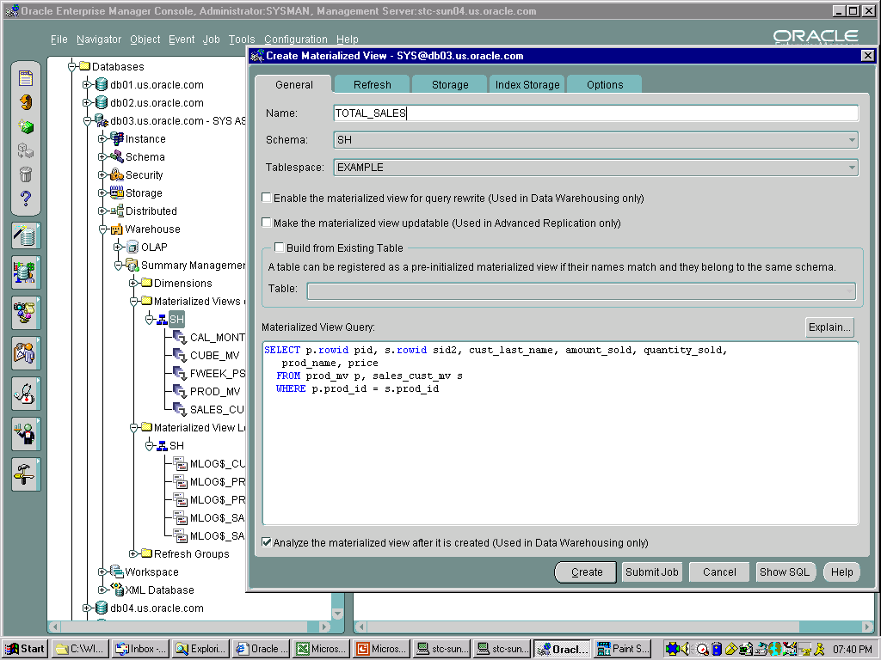
Nested Materialized View Example
Notes:
Nested Materialized View Example
The example in this slide builds the structure shown previously. The screenshot shows the Oracle Enterprise Manager console creating the materialized view total_sales. The following example demonstrates the complete nested materialized view build. The same sequence should be followed when building the nested materialized views using Oracle Enterprise Manager. To provide a fast refresh capability, the base tables on level 0 require materialized view logs.
SQL> CREATE MATERIALIZED VIEW LOG ON sh.sales
2 WITH SEQUENCE,
3 ROWID (cust_id, time_id, prod_id)
4 INCLUDING NEW VALUES;
SQL> CREATE MATERIALIZED VIEW LOG ON sh.customers
2 WITH SEQUENCE, ROWID (cust_id)
3 INCLUDING NEW VALUES;
SQL> CREATE MATERIALIZED VIEW LOG ON sh.products
2 WITH SEQUENCE,
3 ROWID (prod_id, prod_name, prod_list_price)
4 INCLUDING NEW VALUES;

Slide 11
Notes:
Nested Materialized View Example (continued)
Create the materialized views required for level 1. Ensure that all views at this level contain either aggregates or joins. For the next level to be fast refreshable the materialized views on this level must have materialized view logs created as well.
SQL> CREATE MATERIALIZED VIEW sales_cust_mv
2 REFRESH FAST ON DEMAND AS
3 SELECT c.rowid cid, s.rowid sid,
4 cust_last_name, time_id, prod_id,
5 amount_sold, quantity_sold
6 FROM sales s, customers c
7 WHERE s.cust_id = c.cust_id;
SQL> CREATE MATERIALIZED VIEW LOG on sales_cust_mv
2 WITH ROWID
3 INCLUDING NEW VALUES;
SQL> CREATE MATERIALIZED VIEW prod_mv
2 REFRESH FAST ON COMMIT AS
3 SELECT prod_id, prod_name,
4 MIN(prod_list_price) PRICE
5 FROM products
6 GROUP BY prod_id, prod_name;
SQL> CREATE MATERIALIZED VIEW LOG ON prod_mv
2 WITH SEQUENCE, ROWID
3 INCLUDING NEW VALUES;
Create the materialized view total_sales.
SQL> CREATE MATERIALIZED VIEW total_sales
2 REFRESH FAST AS
3 SELECT p.rowid pid, s.rowid sid2,
4 cust_last_name, amount_sold,
5 quantity_sold, prod_name, price
6 FROM prod_mv p, sales_cust_mv s
7 WHERE p.prod_id = s.prod_id;

Slide 12
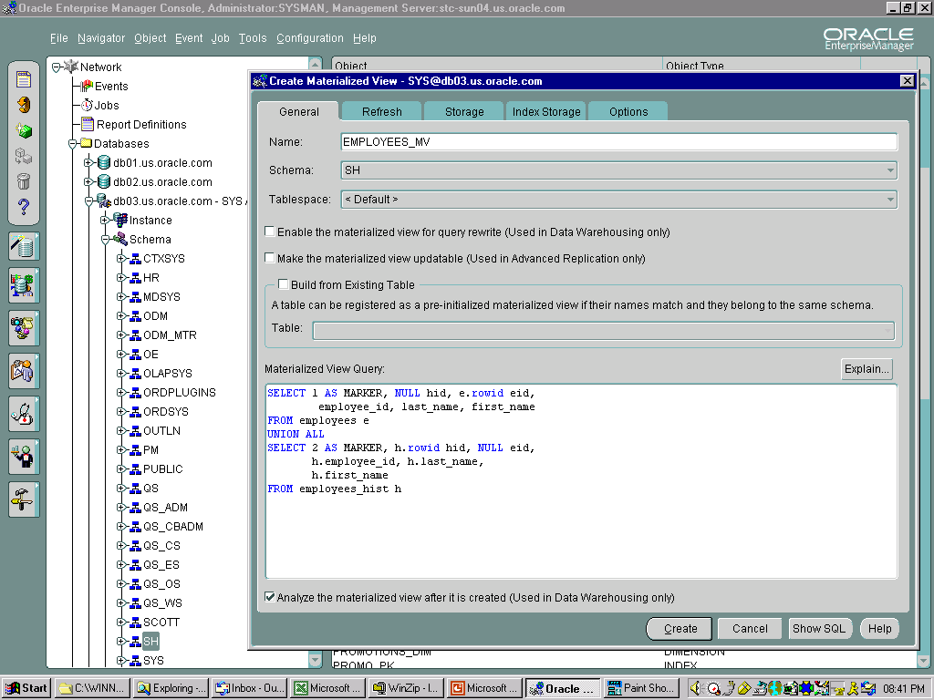
Union All Materialized Views
Notes:
Union All Materialized Views
You can specify the fast refresh option on a materialized view utilizing the UNION ALL construct. To determine the table from which a row originates, because all the rows from each table are present, you use a column, named MARKER that is an alphanumeric constant. Each table is assigned a constant value for all rows.
Materialized views can be built on top of this view. A materialized view can be fast refreshable with aggregate functions and joins.
Materialized view logs must be created on all the base tables, using the WITH ROWID option.
For the materialized view shown the following logs must be created:
SQL> CREATE MATERIALIZED VIEW LOG ON employees
2 WITH ROWID,
3 SEQUENCE (employee_id, last_name, first_name)
4 INCLUDING NEW VALUES;
SQL> CREATE MATERIALIZED VIEW LOG ON employees_hist
2 WITH ROWID,
3 SEQUENCE (employee_id, last_name, first_name)
4 INCLUDING NEW VALUES;

Slide 13
Notes:
Union All Materialized Views (continued)
The materialized view can be created using the command as follows:
SQL> CREATE MATERIALIZED VIEW employees_mv
2 REFRESH FAST ON DEMAND AS
3 (SELECT 1 AS MARKER, NULL hid, e.rowid eid,
4 employee_id, last_name, first_name
5 FROM employees e
6 UNION ALL
7 SELECT 2 AS MARKER, h.rowid hid, NULL eid,
8 h.employee_id, h.last_name, h.first_name
9 FROM employees_hist h );
The materialized view can be fast refreshed using the command as follows:
SQL> EXECUTE dbms_mview.refresh –
2 ('employees_mv', 'F', '', True, False,-
3 0,0,0, False);

Slide 14
Query Rewrite Overview
  To use materialized views instead of the base tables, a query must be rewritten.
  Query rewrites are transparent and do not require any special privileges on the materialized view.
  Materialized views can be enabled or disabled for query rewrites.
  Query rewrites can:
    Ignore alphabetic case
    Recognize equivalent joins
    Compare the defining text of a named view
Notes:
Query Rewrite Overview
Accessing a materialized view may be significantly faster than accessing the underlying base tables, so the optimizer rewrites a query to access the view when the query allows it. The query rewrite activity is transparent to applications. In this respect, their use is similar to the use of an index.
Users do not need explicit privileges on materialized views to use them. Queries executed by any user with privileges on the underlying tables can be rewritten to access the materialized view.
Ignore Alphabetic Case
Text match rewrite is able to ignore alphabetic case where SQL lexical semantics do not distinguish uppercase from lowercase.
Join Equivalence Recognition
Query rewrite is able to make many transformations based upon the recognition of equivalent joins.
Text Match Rewrite with Named View Defining Text
Text match rewrite compares the defining text of a named view with the defining text of a materialized view.

Slide 15
Query Rewrites
  The QUERY_REWRITE_ENABLED initialization parameter must be set to True.
  The QUERY REWRITE privilege allows users to enable materialized views.
  The Summary Advisor of the dbms_olap package has options to use materialized views.
Notes:
Query Rewrites
The optimizer performs a rewrite of the query; the rewrite is transparent to the application. The ability to perform rewrites must be enabled either at the session level or at the instance level by using the QUERY_REWRITE_ENABLED parameter.
To enable or disable individual materialized views for query rewrites requires the GLOBAL QUERY REWRITE or the QUERY REWRITE system privilege. Both privileges allow users to enable materialized views in their own schema. The GLOBAL QUERY REWRITE privilege requires that the materialized view be in the user’s schema, whereas the QUERY REWRITE privilege requires that the user own the base tables and the materialized view.
Overview of the Summary Advisor in the dbms_olap Package
Materialized views provide high performance for complex, data-intensive queries. The summary advisor helps you achieve this performance benefit by choosing the proper set of materialized views for a given workload. In general, as the number of materialized views and space allocated to materialized views is increased, query performance improves. But the additional materialized views have some cost: they consume additional storage space and must be refreshed, which increases maintenance time. The summary advisor considers these costs and makes the most cost-effective trade-off when recommending the creation of new materialized views and evaluating the performance of existing materialized views.

Slide 16
Creating a Materialized View
SQL> CREATE MATERIALIZED VIEW sales_summary
2 TABLESPACE users
3 PARALLEL (DEGREE 4)
4 BUILD IMMEDIATE
5 ENABLE QUERY REWRITE
6 AS
7 SELECT p.prod_name,
8 SUM (s.quantity_sold),
8 SUM (s.amount_sold)
9 FROM sales s, products p
10 WHERE s.prod_id = p.prod_id
11 GROUP BY p.prod_name;
Notes:
Creating a Materialized View
The syntax for creating a materialized view is similar to the CREATE SNAPSHOT command. There are some additional options. In the example in the slide, the BUILD IMMEDIATE option will cause the materialized view to be populated when the CREATE command is executed. This is the default behavior. You can choose the BUILD DEFERRED option, which creates the structure but does not populate it until the first refresh occurs.
One other option, ON PREBUILT TABLE, is used when you want a pre-Oracle8i table to be the source of a materialized view.
The ENABLE/DISABLE QUERY REWRITE clause determines whether query rewrites are automatically enabled for the materialized view.

Slide 17
Materialized Views and
Query Rewrites: Example
SQL> SELECT p.prod_name,SUM (s.quantity_sold),
2 SUM (s.amount_sold)
3 FROM sales s, products p
4 WHERE s.prod_id = p.prod_id
5 GROUP BY p.prod_name;
SQL> select operation, object_name
2 from v$sql_plan
3 where object_name like 'SALES%';
OPERATION NAME
---------------------- -----------------
SELECT STATEMENT
TABLE ACCESS SALES_SUMMARY
Notes:
Materialized Views and Query Rewrites
The execution plan for the query (from the v$sql_plan view) shows that the query did not run against the two base tables, but simply scanned the materialized view table. This example illustrates the power of materialized views and query rewrites. The table comprising the materialized view substitutes completely for the base tables and all the operations on them named in the query.

Slide 18
Enabling and Controlling
Query Rewrites
  Initialization parameters:
    OPTIMIZER_MODE
    QUERY_REWRITE_ENABLED
    QUERY_REWRITE_INTEGRITY
  Dynamic and session-level parameters:
    QUERY_REWRITE_ENABLED
    QUERY_REWRITE_INTEGRITY
  Hints: REWRITE and NOREWRITE
  Dimensions
Notes:
Query Rewrite Parameters
The following parameters control query rewrites:
OPTIMIZER_MODE: Query rewrites are only available under cost-based optimization; if rule-based optimization is used, query rewrites do not occur. This parameter can be changed using an ALTER SESSION command.
QUERY_REWRITE_ENABLED: This parameter can be set to False to suppress query rewrites even when using the cost-based optimizer. This parameter can be altered dynamically for the whole instance as well as for individual sessions.
QUERY_REWRITE_INTEGRITY: This parameter can also be reset dynamically for the instance and for an individual session. It accepts the following values:
Enforced (the default): Enables query rewrites only if the server can guarantee consistency. Only up-to-date materialized views and enabled validated constraints are used for query rewrites.
Trusted: Allows query rewrites based on declared, but not necessarily enforced, relationships. All updated materialized views and constraints with the Rely flag are used for query rewrites.
Stale_tolerated: Allows query rewrites to use materialized views that have not been refreshed since the last declared DML operation and relationships.

Slide 19
Notes:
Query Rewrite Parameters (continued)
Query Rewrite: Privileges and Hints
Query rewrites are treated similarly to execution plan paths. Therefore, there are no object privileges associated with them. Users who have access to the detail tables implicitly benefit from summary rewrites.
A hint, REWRITE, can be used to restrict the materialized views that are considered for query rewrites. Another hint, NOREWRITE, is available to suppress rewrites for a query block.
Dimensions
Dimensions are data dictionary structures that define hierarchies based on columns in existing database tables. Although they are optional, they are highly recommended because they:
Enable additional rewrite possibilities without the use of constraints (Implementation of constraints may not be desirable in a data warehouse for performance reasons.)
Help document dimensions and hierarchies explicitly
Can be used by OLAP tools
For more information about dimensions, see the Oracle9i Database Performance Tuning Guide and Reference Release 2 (9.2) manual part number A96533-01.

Slide 20
Disabling Query Rewrites: Example
SQL> SELECT /*+ NOREWRITE */
2 p.prod_name, SUM (s.quantity_sold),
3 SUM (s.amount_sold)
4 FROM sales s, products p
5 WHERE s.prod_id = p.prod_id
6 GROUP BY p.prod_name;
SQL> SELECT p.operation, p.object_name
2 FROM v$sql_plan p, v$sql s
3 WHERE p.address = s.address
4 AND sql_text LIKE 'SELECT /*+ NO%';
Notes:
Disabling Query Rewrites
In example in this slide, the NOREWRITE hint is used to tell the optimizer not to rewrite the query to make use of the materialized view. The execution plan derived from the query shows that the original statement is executed, including the hash join between the two tables and the sort to obtain the groups.
A REWRITE/NOREWRITE hint overrides a materialized view’s definition, set in the CREATE or ALTER MATERIALIZED VIEW command with the ENABLE QUERY REWRITE clause.

Slide 21
Union All Query Rewrite
CREATE MATERIALIZED VIEW sales_cube_mv
ENABLE QUERY REWRITE
AS
SELECT ...
GROUPING_ID(calendar_year,……) gid,
GROUPING(calendar_year) grp_y,
...
GROUPING(cust_city) grp_c,
FROM sales s, times t, customers c
WHERE s.time_id=t.time_id
AND s.cust_id=c.cust_id
GROUP BY
GROUPING SETS(
(calendar_year, cust_city),
(calendar_year,..., cust_state_province),
(calendar_year,..., cust_city));
Notes:
Union All Query Rewrite
A query with grouping sets can be rewritten using materialized views containing only a subset of the groupings. When investigating a materialized view for rewrite, all groupings that can directly cover groupings in the query are marked. The remaining grouping from the query is resubmitted to the rewrite and subsequent rewrites are connected using the union all operator. Groupings that cannot be rewritten are found in the last branch of the UNION ALL statement and access the base data tables.

Slide 22
Using the dbms_mview Package
The package contains the following procedures:
  explain_mview
  explain_rewrite
  refresh
  refresh_all_mviews
Notes:
Using the dbms_mview Package
The explain_mview procedure is used to determine what is possible with a materialized view or potential materialized view. For example, you can determine whether a materialized view is fast refreshable and which types of query rewrite you can perform with a particular materialized view.
The explain_rewrite procedure is used to learn why a query failed to rewrite. Using the results from the procedure, you can take the appropriate action to make a query rewrite if at all possible. The query being investigated is not actually executed.
The refresh procedure consistently refreshes one or more materialized views that are not members of the same refresh group.
The refresh_all_mviews procedure refreshes all materialized views that do not reflect changes to their master table or master materialized view.

Slide 23
Summary
In this lesson, you should have learned how to do the following:
  Create materialized views
  Refresh materialized views
  Creating nested materialized views
  Create UNION ALL materialized views
  Explain the use of query rewrites
  Enable and control query rewrites

Slide 24
Notes:
Practice 16
In this practice you will make use of the AUTOTRACE feature and create the plan_ table table. These are covered in detail in the chapter titled “SQL Statement Tuning.” Throughout this practice Oracle Enterprise Manager can be used if desired. SQL Worksheet can be used instead of SQL*Plus and there are many uses for the Oracle Enterprise Manager console. (Solutions for Oracle Enterprise Manager can be found in Appendix B).
1. Connect as sh/sh and confirm that the plan_table table exists. If the table does exist then truncate it, otherwise create the plan_table table using $ORACLE_HOME/rdbms/admin/utlxplan.sql.
2. Create a materialized view cust_sales having two columns, cust_last_name and the total_sales for that customer. This will mean joining the sales and customers tables using cust_id and grouping the results by cust_last_name. Make sure that query rewrite is enabled on the view.
3. Confirm the creation of the materialized view cust_sales by querying the user_mviews data dictionary view, selecting the columns mview_name, rewrite_enabled and query.
4. Set AUTOTRACE to Traceonly Explain, to generate the explain plan for the query $HOME/STUDENT/LABS/lab16_04.sql.
5. Set the QUERY_REWRITE_ENABLED parameter to True for the session and run the same query, $HOME/STUDENT/LABS/lab16_04.sql, as in the previous practice. Note the change in the explain plan due to the query rewrite. Set AUTOTRACE to Off and disable query rewrite after the script has completed running.

