Slide 1
WeRIZE

Slide 2
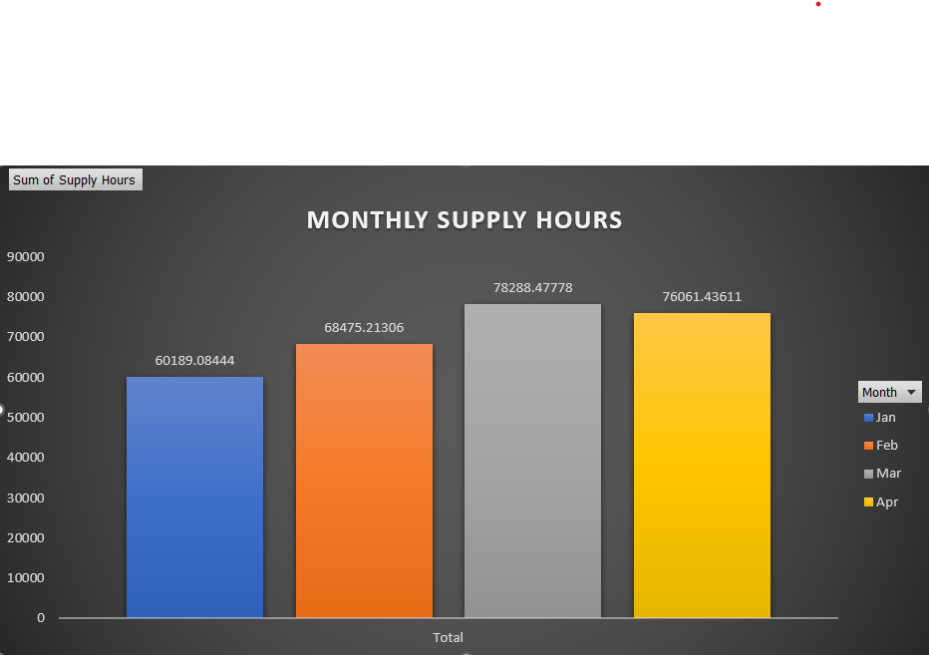
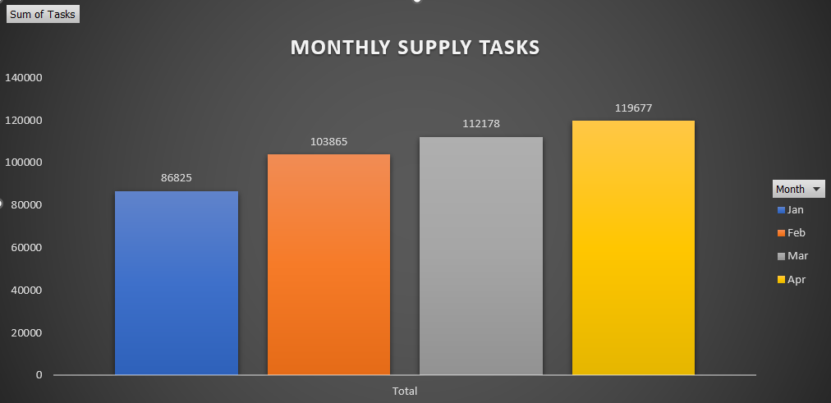
Observations:

Slide 3
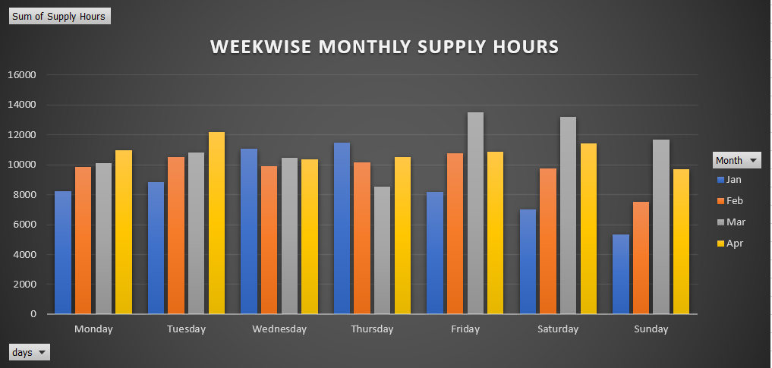

Slide 4
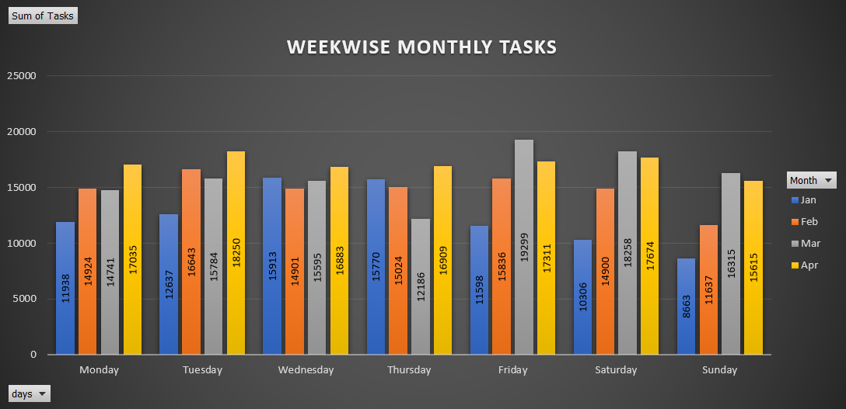

Slide 5
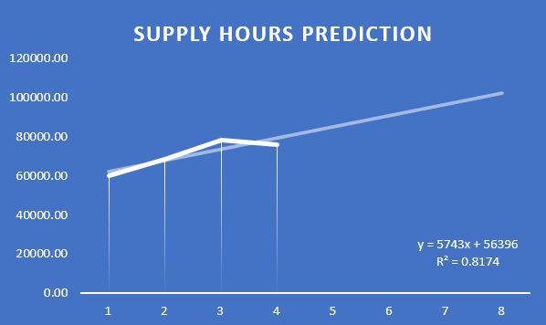
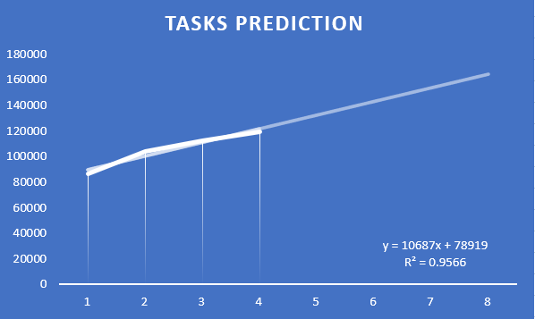

Slide 6
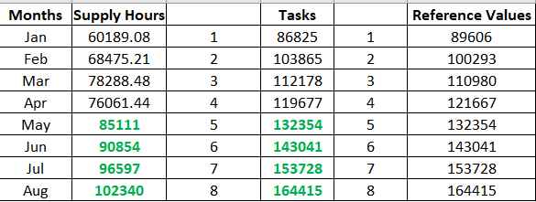

Slide 7
CONCLUSION
To enhance the supply of hours and tasks on Sundays, we can consider adjusting the targets specifically on Sundays and Mondays.
To address this issue, it is essential for us to focus more on Sundays and Mondays. Obtaining feedback from our partners, particularly regarding Sundays, will enable us to identify and resolve any underlying concerns.

