Slide 1

Plum Assignment
By
Somnath Guptha Anummalasetty

Slide 2
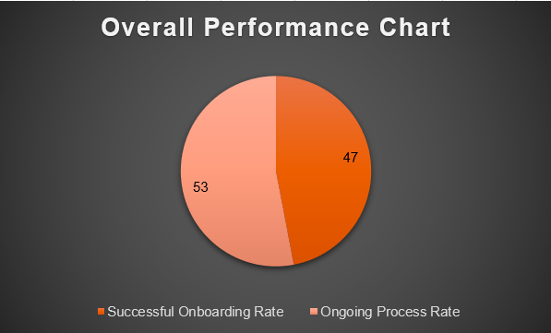
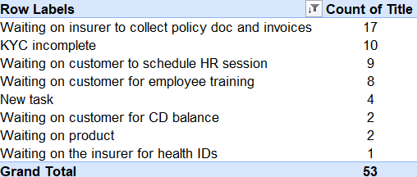
How are the efficiency numbers looking like? Can you share your views?
The Pie chart shows the overall performance of the “PLUM”.
The below table gives the count of customers at different stages of Onboarding.
According to the data provided, we can say that Plum’s “Onboarding team” is performing well in terms of efficiency numbers. The onboarding success rate stands at 47%.

Slide 3
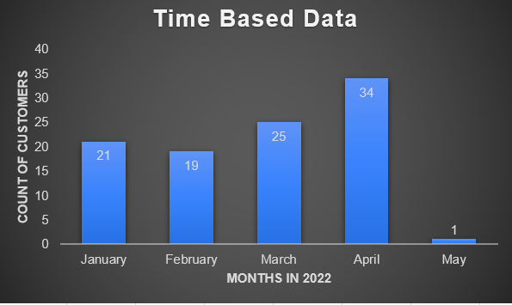
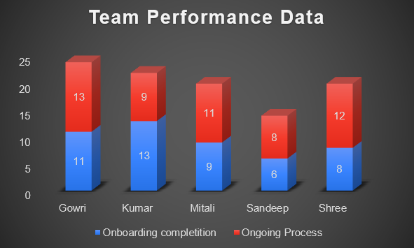
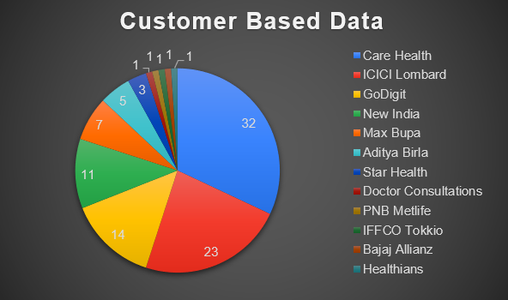
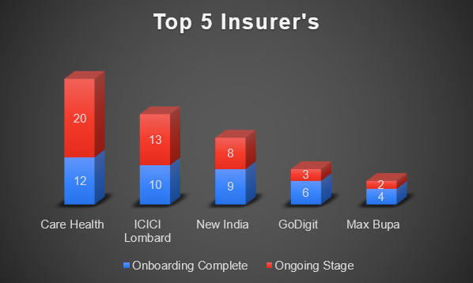
B. The different types of data we can infer from this data include:

Slide 4
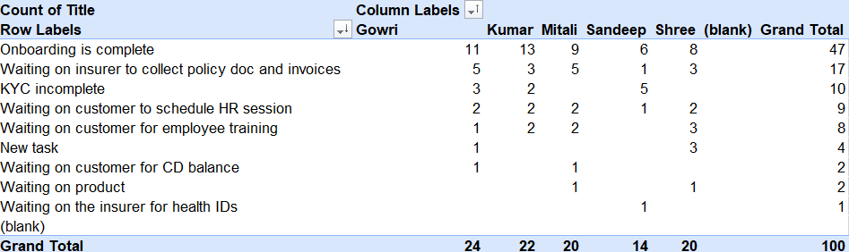
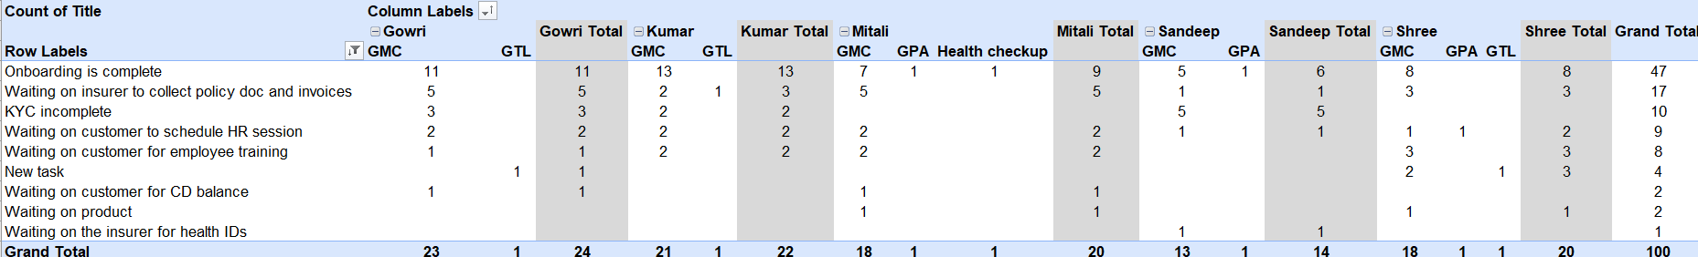
C. The tables represent the Slicing and Dicing of the given data with respect to Team Members and different types of policies:

Slide 5
Insights & Conclusion:
The fresh orders are significantly more compared to renewals (54% & 46%).
As of now we have 47% (24% fresh+23%renewals) of successful onboarded customers, if we fasten up collecting policy and invoices, success rate will be increased by 17%.
About 93% percent of customers opted GMC policies over other policies.
87% percent of the customers are handled by top 5 insurer’s.
The challenge we observed from the data set is majority of the orders are in processing stage.
“Gowri” has processed maximum number of orders and “Sandeep” has processed least number of orders.
From this we can conclude that, we have to concentrate more on orders from top 5 insurer’s which are in processing stage by putting more efforts from the Onboarding team. This will significantly increase the growth of the company with respect to the efficiency of onboarding team.

Slide 6
The following note provides suggestions for how to utilize data to improve customer onboarding processes:
Team member performance: By analyzing data such as the number of customers onboarded, time taken, and adherence to target time frames, we can identify the best-performing team members as well as those who require additional training and support.
Customer segmentation: By grouping customers based on factors such as industry, organization size, age, marital status and location, we can gain insights into how these factors impact the onboarding process. This can help the team tailor their approach to better serve specific customer segments.
Process improvement: Data analysis can help identify bottlenecks in the onboarding process and areas for improvement. For instance, if certain steps consistently take longer than others, the team can review and streamline those steps to reduce the overall onboarding time. However, it's important to ensure that the data is accurate and complete to avoid incorrect conclusions or ineffective solutions.

