Slide 1
GRAPH TRAVERSAL

Slide 2
QUESTION - 1

Slide 3
Inconsistent Subset
There are N variables x₁,x₂,...,x_{N} and M relations of the form x_{i} < x_{j} where i != j. A subset S of relations is called inconsistent if there does not exist any assignment of variables that satisfies all the relations in S. e.g, {x₁ < x₂, x₂ < x₃ , x₃ < x₁ } is inconsistent. You need to find if there is an inconsistent subset of M.

Slide 4
Inconsistent Subset (Contd..)
Hint 1
Think of creating a directed graph

Slide 5
Inconsistent Subset (Contd..)
Hint 1
Think of creating a directed graph
V = x₁,x₂,...,x_{N}
E = {(x_{i}, x_{j}) iff (x_{i} < x_{j}) in S}

Slide 6
Inconsistent Subset (Contd..)
Hint 2
How can you detect inconsistency in the graph?

Slide 7
Inconsistent Subset (Contd..)
Hint 2
How can you detect inconsistency in the graph?
Detect cycle in the graph

Slide 8
Inconsistent Subset (Contd..)
Solution
Use DFS to detect cycle
if we encounter a vertex which is already on the stack, we found a loop
all vertices are unvisited
create a stack S
push v onto S
while S is non-empty
peek at the top u of S
if u has neighbour which in S
there is a cycle
else if u has a unvisited neighbour w
push w onto S
else mark u as finished and pop S

Slide 9
QUESTION -2

Slide 10
Two Coloring
Suppose we have an undirected graph and we want to color all the vertices with two colors red and blue such that no two neighbors have the same color. Design an O(V+ E) time algorithm which finds such a coloring if possible or determines that there is no such coloring.

Slide 11
Two Coloring (Contd..)
Hint 1
Can you use BFS or DFS?

Slide 12
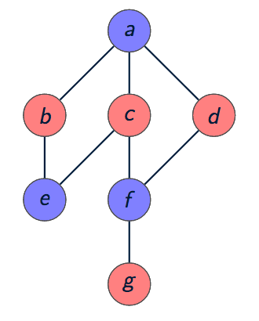
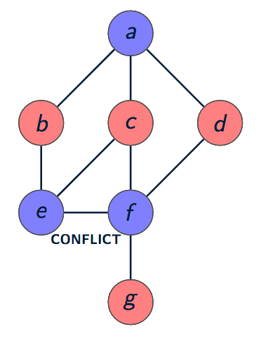
Two Coloring (Contd..)
Solution
Let’s use BFS

Slide 13
Two Coloring (Contd..)
Solution
Start with an arbitrary vertex v, color it, and run BFS from there.
v <- remove(queue)
for each neighbor w of v
if w is uncolored
give it color opposite(color(v)) and put w into queue
else if w is colored
compare to color of v
if different
then move on to next w.
if same
halt with failure.

Slide 14
Two Coloring (Contd..)
Q. Prove or disprove the following statement.
Coloring all the vertices of a undirected graph with two colors is possible if the graph has a cycle of odd length.

Slide 15
QUESTION -3

Slide 16
Universal Sink
When an adjacency-matrix representation is used, most graph algorithms require time Ω(V ²), but there are some exceptions.
Given an adjacency matrix for a directed graph G, determine whether G contains a universal sink (a vertex with in-degree |V | − 1 and out-degree 0) in time O(V ).

Slide 17
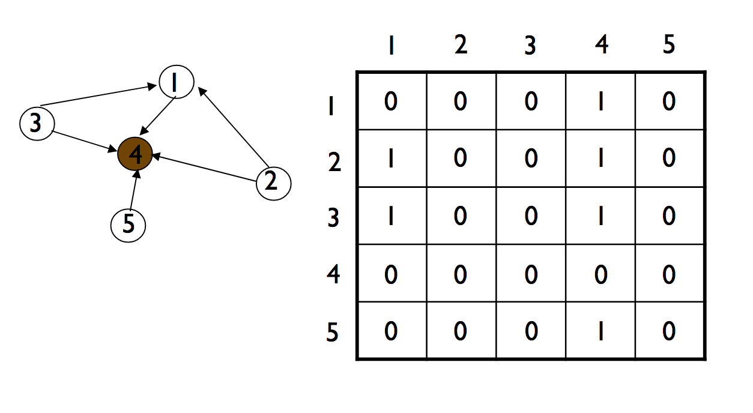
Universal Sink (Contd..)

Slide 18
Universal Sink (Contd..)
Hint 1
How can we determine whether a given vertex u is a universal sink?

Slide 19
Universal Sink (Contd..)
Hint 1
How can we determine whether a given vertex u is a universal sink?
The u-row must contain 0’s only
The u-column must contain 1’s only
A[u][u]=0

Slide 20
Universal Sink (Contd..)
Hint 1
Is-Sink(A, k)
1 let A be |V|×|V|
2 for j = 1 to |V|
3 if a_{kj} == 1
4 return FALSE
5 for i = 1 to |V|
6 if a_{ik} == 1 and i ≠ k
7 return FALSE
8 return TRUE

Slide 21
Universal Sink (Contd..)
Hint 1
Is-Sink(A, k)
1 let A be |V|×|V|
2 for j = 1 to |V|
3 if a_{kj} == 1
4 return FALSE
5 for i = 1 to |V|
6 if a_{ik} == 1 and i ≠ k
7 return FALSE
8 return TRUE
How long would it take to determine whether a given graph contains a universal sink if you were to check every single vertex in the graph?

Slide 22
Universal Sink (Contd..)
Hint 1
Is-Sink(A, k)
1 let A be |V|×|V|
2 for j = 1 to |V|
3 if a_{kj} == 1
4 return FALSE
5 for i = 1 to |V|
6 if a_{ik} == 1 and i ≠ k
7 return FALSE
8 return TRUE
How long would it take to determine whether a given graph contains a universal sink if you were to check every single vertex in the graph?
O(V²)

Slide 23
Universal Sink (Contd..)
Hint 1
Is-Sink(A, k)
1 let A be |V|×|V|
2 for j = 1 to |V|
3 if a_{kj} == 1
4 return FALSE
5 for i = 1 to |V|
6 if a_{ik} == 1 and i ≠ k
7 return FALSE
8 return TRUE
How long would it take to determine whether a given graph contains a universal sink if you were to check every single vertex in the graph?
O(V²)
Can you suggest an algorithm in O(V) ?

Slide 24
Universal Sink (Contd..)
Hint 2
If A[u][v]=1, then u cannot be a universal sink
If A[u][v]=0, then v cannot be a universal sink

Slide 25
Universal Sink (Contd..)

Slide 26
Universal Sink (Contd..)
Solution
Universal-Sink(A)
1 let A be |V|×|V|
2 i = j = 1
3 while i≤|V| and j≤|V|
4 if a_{ij} == 1
5 i = i + 1
6 else
7 j = j + 1
8 if i > |V|
9 return “no universal sink”
10 elsif Is-Sink(A,i) == FALSE
11 return “no universal sink”
12 else
13 return i “is a universal sink”

Slide 27
QUESTION - 4

Slide 28
Articulation Point
Let G = (V, E) be an undirected graph. A vertex v ∈ V is called a cut vertex or an articulation point if the removal of v (and all edges incident upon v) increases the number of connected components in G.
Find all cut vertices in G in O(V+E)

Slide 29
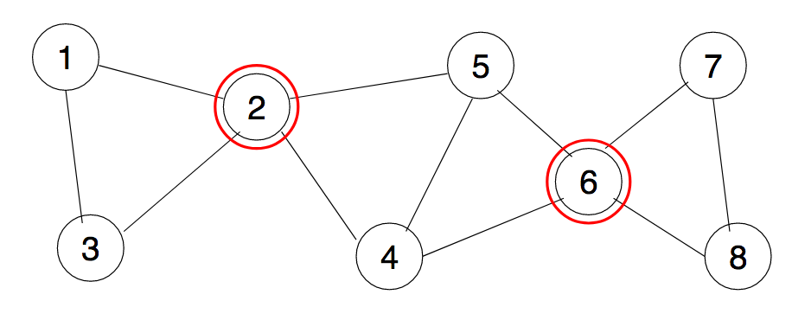
Articulation Point (Contd..)

Slide 30
Articulation Point (Contd..)
Hint 1
Use DFS tree and back edge

Slide 31
Articulation Point (Contd..)
Hint 2
The root of the DFS tree is an articulation point if and only if it has at least two children (subtree)
A non-root vertex v of a DFS-tree is an articulation point of G if and only if has a child s such that there is no back edge from s or any descendant of s to a proper ancestor of v
Leaves of a DFS-tree are never articulation points

Slide 32
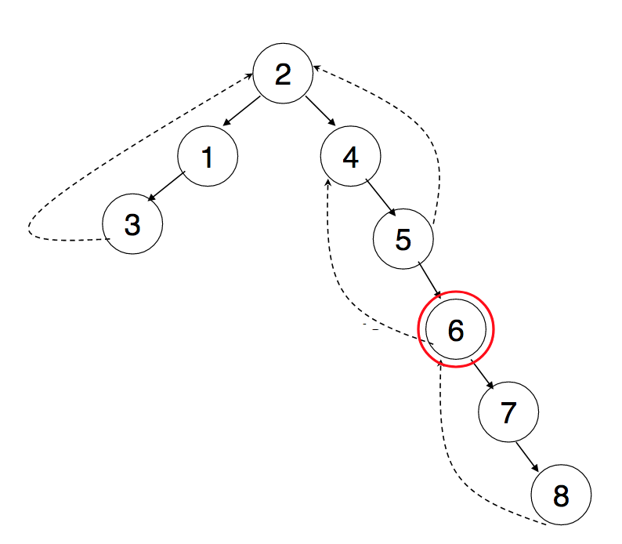
Articulation Point (Contd..)

Slide 33
Articulation Point (Contd..)
How do you know a subtree has a back edge climbing to an upper part of the tree?
low[v] = min { discover[v]; discover[w] : (u,w) is a back edge for some descendant u of v }
u is articulation point if it has a descendant v with
low(v)>=discover [u]
Notes:
For every node v, we need to find out the earliest visited vertex (the vertex with minimum discovery time) that can be reached from subtree rooted with v
If there is a subtree rooted at a children of v which does not have a back edge connecting to a SMALLER discovery time than discover[v], then v is an articulation point.

Slide 34
Articulation Point (Contd..)
Solution
GetArticulationPoints(i, d)
visited[i] = true
discover[i] = d
low[i] = d
childCount = 0
isArticulation = false
for each ni in adj[i]
if not visited[ni]
parent[ni] = i
GetArticulationPoints(ni, d + 1)
childCount = childCount + 1
if low[ni] >= discover[i]
isArticulation = true
low[i] = Min(low[i], low[ni])
else if ni != parent[i]
low[i] = Min(low[i], discover[ni])
if (parent[i] != null and isArticulation) or (parent[i] == null and childCount > 1)
Output i as articulation point

Slide 35
END

Slide 36
END

Slide 37
QUESTION - 6

Slide 38
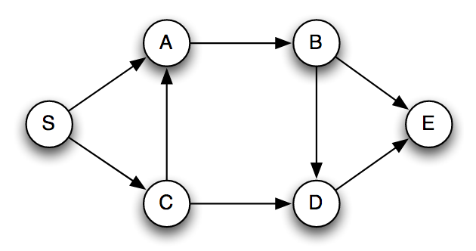
Longest Path
Given a directed acyclic graph G, design an O(V + E) time algorithm which finds the length of the longest path of the graph.

Slide 39
Longest Path (Contd..)
Hint 1
Find a topological sort of the given DAG

Slide 40
Longest Path (Contd..)
Hint 1
Find a topological sort of the given DAG
Let v₁, v₂, . . . , v_{n} be a topological sort
Let A[i] be the longest path of the graph starting at v_{i}.
Q. Find a formula for computing A[i].

Slide 41
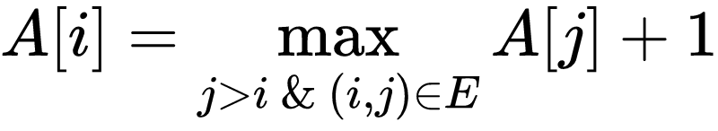
Longest Path (Contd..)
Hint 1 sol
Find a topological sort of the given DAG
Let v₁, v₂, . . . , v_{n} be a topological sort
Let A[i] be the longest path of the graph starting at v_{i}.
Q. Find a formula for computing A[i].

Slide 42
Longest Path (Contd..)
Hint 2
Q. If we compute A[1], A[2], . . . , A[n], what would be the final solution?

Slide 43
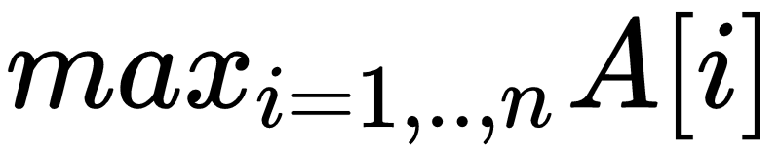
Longest Path (Contd..)
Hint 2 sol
Q. If we compute A[1], A[2], . . . , A[n], what would be the final solution?

Slide 44
Longest Path (Contd..)
Hint 3
Q. Write a dynamic program for filling array A

Slide 45
Longest Path (Contd..)
Hint 3 sol
Q. Write a dynamic program for filling array A
For i← n to 1 do:
A[i] = 0
For all out-neighbors of v_{i} such as v_{j} do
A[i] = max{A[i], A[j] + 1}
end for
end for

Slide 46
Longest Path (Contd..)
Hint 4
Q. Run DFS and compute A[i] at the end of DFS(v_{i})

Slide 47
Longest Path (Contd..)
Hint 4 sol
Procedure DFS(u)
color[u] =gray
A[u]←0
For all neighbors of u such as v do
If color[v] =white then
DFS(v)
end if
A[u] = max(A[u], A[v] + 1)
end for
end procedure

Slide 48
Longest Path
You are given an undirected acyclic graph G(V,E). You need to find a pair of vertices (i,j) such that the length of the path between i and j is maximum among all such pairs. The length of a path is the number of edges on the path.

Slide 49
Longest Path (Contd..)
Hint 1
There is a trivial O(V.(V + E)) algorithm to solve this

Slide 50
Longest Path (Contd..)
Hint 1 sol
Run BFS V times starting from each vertex
Find max
O(V(V+E))

Slide 51
Longest Path (Contd..)
Hint 1 sol
Run BFS V times starting from each vertex.
Find max
O(V(V+E))
Q. Can you give an O(V + E) algorithm?

Slide 52
Longest Path (Contd..)
Hint 2
Need to do BFS twice. How?

Slide 53
Longest Path (Contd..)
Hint 2 sol
Start BFS from any node x and find a node with the longest distance from x
Run another BFS from this endpoint to find the actual longest path.

Slide 54
Longest Path (Contd..)
Q. Prove that the end point found after the first BFS must be an end point of the longest path.

