Slide 1

AUTH CONTEXT, PROTECTED ROUTES AND ROLES
DAY 2 - SUNDAY 20 SEPTEMBER 2026 - 09:00 - 10:00

Slide 2
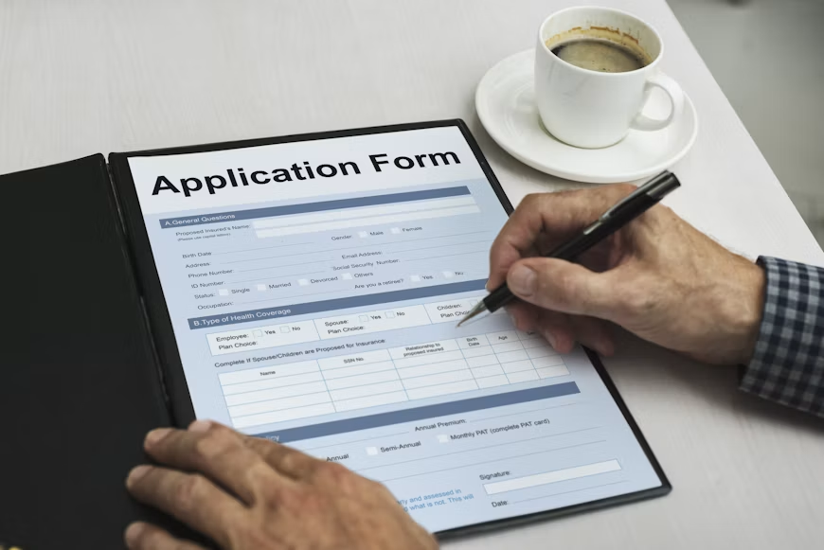
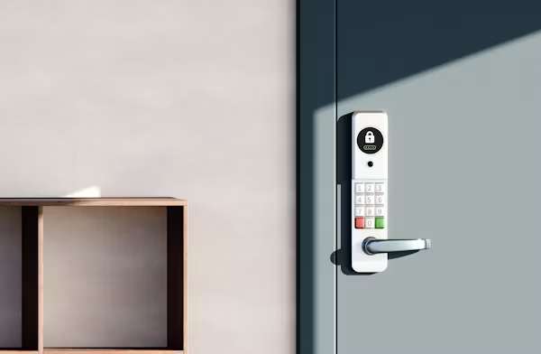
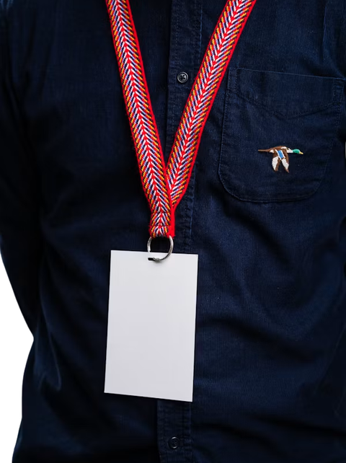
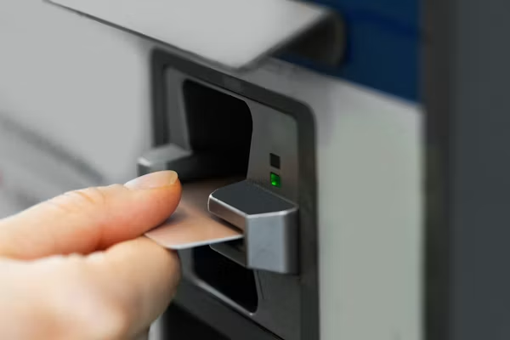
THE DESK AND THE DOOR
The desk asks who you are. The door asks what you can do.
AUTHENTICATION
AUTHORIZATION
TOKEN
ROLE
The desk. Somebody asks your name, finds you in the list, gives you a badge.
The door. Your badge says participant, so the organisers’ room stays closed.
The badge. You showed your ID once. After that you only show the badge.
What is printed on the badge: admin, facilitator or participant.

Slide 3



One - an app that remembers you.
Two - pages that block people who are not logged in.
Three - your name and your role in the corner, and a menu that changes by role.
Four - a logout button that really locks the door.
AT TEN O’CLOCK
Our pages are 3000. The server is 8080. Our pages only talk to 8080, never to the other services behind it.

Slide 4
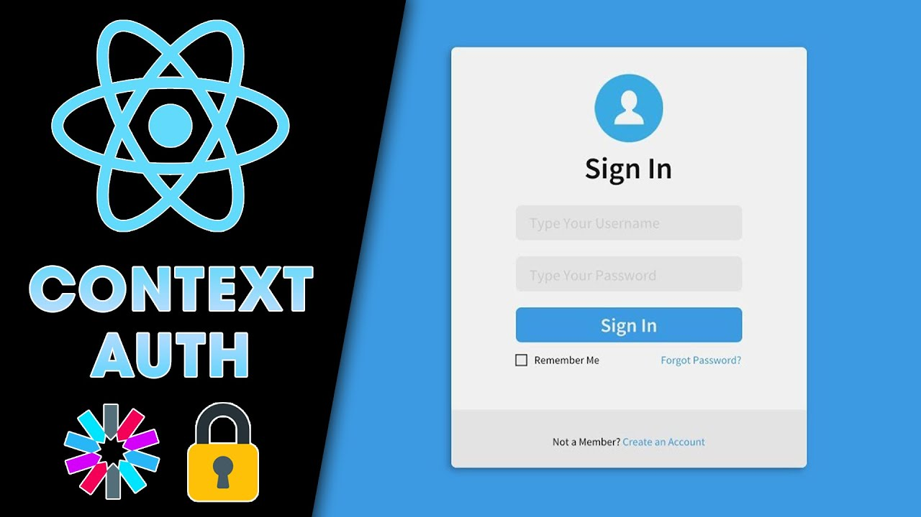
THE FLOW ON THE BOARD
Write it on the board before you start.
Login
Token
Auth Context
Current User
Role Access
Logout
Point at it before every part and say: we are here.

Slide 5
facilitator - schedules, sessions, attendance
admin - sees everything
THREE ROLES
participant - own profile, applications, results, certificates
Lowercase, always. The default is participant
The role is printed on the badge
The backend compares it letter by letter
The frontend hides what a role cannot use.
The gateway still refuses it. Both layers matter.
One token. Four roles. Different doors.

Slide 6



FIVE PARTS
PART 1 - 20 min
PART 2 - 10 min
Auth context + current user
Protected route
Three parts are the desk. The last part is the door.
PART 3 - 13 min
PART 4 - 9 min
PART 5 - 3 min
Users page + role change
Logout, inside the context
Dashboard layout

Slide 7

TRAPS & FIXES
Every trap has a clear fix.
middleware cannot read localStorage
Write the token into a cookie too
AuthProvider only around the dashboard
Wrap the whole app in app/layout.tsx
middleware.ts put inside app/
Put it at the project root, next to app/
Admin or ADMIN in the role check
Lowercase, exactly: admin, facilitator, participant

Slide 8
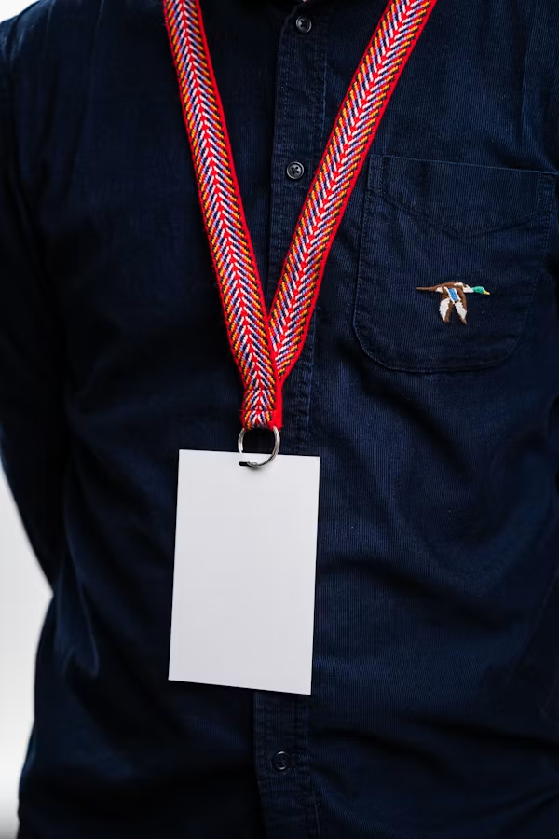
THE FILES
THE FILES YOU WILL TOUCH
Four files. Nothing else moves in my hour.
context.tsx
middleware.ts
layout.tsx
users/page.tsx
packages/auth/context/context.tsx - the auth context and logout.
At the project root, next to app/ - the protected route.
app/dashboard/layout.tsx and page.tsx - sidebar, name, role, logout.
app/dashboard/users/page.tsx - the list and the role dropdown.
Plus one line in app/layout.tsx: wrap the whole app in <AuthProvider>, not just the dashboard.
OTHERWISE THE LOGIN PAGE CANNOT USE useAuth().

Slide 9

PART 1 - 20 MIN
AUTH CONTEXT + CURRENT USER
The check happens once, and after that the whole conference knows you.
IT REMEMBERS
THEN WE TEST IT
  Are you logged in
  What is your name
  What is your badge, the role
  Built in packages/auth/context/context.tsx
  The name appears in the corner
  Press F5
  The name is still there
  The badge survived, you did not go back to the desk
NO /AUTH/ME? WE READ THE NAME AND ROLE OUT OF THE TOKEN ITSELF.

Slide 10



PROTECTED ROUTE
01
02
03
The trap. Middleware runs on the server. It cannot see localStorage.
That is why we save the token into a cookie as well. Token only in localStorage means the dashboard stays blocked even when you are logged in.
SAY IT OUT LOUD BEFORE YOU TYPE IT.
The door staff
Where it lives
The test
They check at the door, before you are inside. Middleware runs before the page even opens.
middleware.ts at the project root, next to app/ - not inside it, or Next.js never runs it.
Log out, then type the dashboard address by hand. Blocked. Do it slowly.

Slide 11
PART 3 - 13 MIN
DASHBOARD LAYOUT
Sidebar
Your name
Your role
Users link
Logout
Test by role
Log in as a participant: no Users link. Log in as admin: it is there. Same app, different menu.

Slide 12
PART 4 - 9 MIN
USERS PAGE AND ROLE CHANGE
Nobody gets a different conference. They get different rights inside one conference.
SAME CONFERENCE, DIFFERENT BADGE
SPELLING WARNING
  admin sees everything
  facilitator reads schedules, sessions, attendance
  participant sees their own profile, applications, results, certificates
  The default role is participant
  The backend compares letter by letter
  Admin and ADMIN both fail
  Like the name on a flight ticket, it must match the passport exactly
  Write it on the board and leave it there
CHANGE SOMEONE’S ROLE AND WATCH IT UPDATE. THEN OPEN THE PAGE AS A PARTICIPANT: BLOCKED.

Slide 13
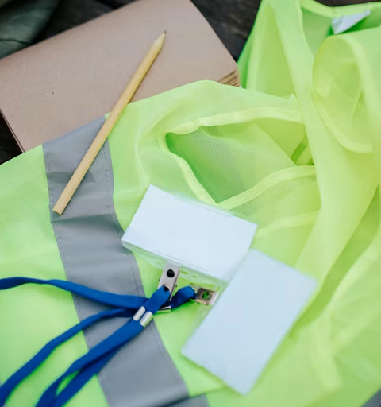

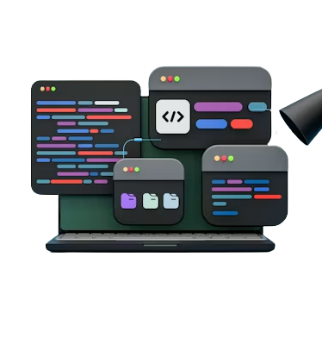
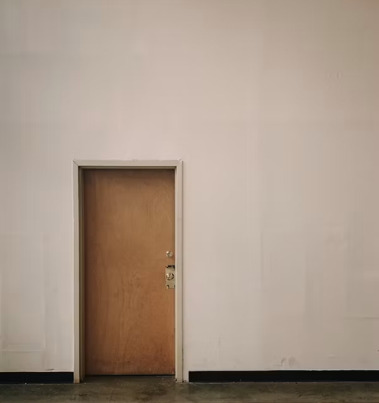
PART 5 - 3 MIN
LOGOUT
We throw the badge away, not the person.
THE STORY
WHAT IT DOES
WHERE IT LIVES
THE TEST
On the last evening the badge stops working. You are still the same person, but the doors do not open any more.
Clear the token. Clear the user. Go back to /.
It is already inside the auth context.
Click logout. Try the dashboard again. Blocked.
Click logout, then try the dashboard again. Blocked. End the hour there.
THE BADGE STOPS WORKING.

Slide 14
THE END
SUMAYA - SomNOG9 - DAY 2

