Slide 1
Welcome.

Slide 2
Project Workflow!
P-346 Group- 02
Members-
Kishore
Salman
Mandeep
Supriya
Rahul
Som

Slide 3
Project Workflow!
Check ,for nulls
Duplicates
Impute the nulls
Drop the duplicates
Apply Visualizations
Process the data
1
2
Read the data
Explore the data
Apply EDA

Slide 4
K-Means
  Elbow curve
  Silhouette Score
Hierarchical Clustering
  Plot Dendrogram
Apply NLP Tools
Recommender System
3
4
5
Remove stopwords.
Tokenization
Lemmatization
Vectorization
PCA
Apply Clustering
Cosine Similarity

Slide 5
1.
Data Processing
Here we merged all the excel sheets that the Netflix dataset had, using outer joins.
Example-
-netflix = pd.merge(title, director_edit, how = 'outer', on = 'show_id’)
-netflix.head()
Using this pd.merge we merged all the sheets which had the features namely-
Title
Director
Country
Cast
category

Slide 6
2.
EDA
In the Exploratory data analysis we applied some basic data manipulations and plotted visualizations for better understanding.
Manipulations like dealing with null values, dropping duplicate values, checking data types of features.
There were some values for each index so we had to group them together using the .groupby function.
Code-
-category_edit = category.groupby('show_id')['listed_in'].agg(lambda X: ‘, '.join(X)).reset_index()
-category_edit
Then we’ll apply the .info to get the null value counts.

Slide 7
netflix.info()
0 duration_minutes 4266 non-null object
1 duration_seasons 1970 non-null object
2 type 6235 non-null object
3 title 6235 non-null object
4 date_added 6223 non-null object
5 release_year 6234 non-null float64
6 rating 6223 non-null object
7 description 6233 non-null object
8 show_id 6232 non-null float64
9 director 4263 non-null object
10 country 5756 non-null object
11 cast 5663 non-null object
12 listed_in 6232 non-null object
As we can see there are some null values in some columns. So we have to fill them with imputation technique.
Example-
netflix['date_added'].fillna(str(datetime(1678,1,1)), inplace = True)
netflix['release_year'].fillna(1, inplace = True)
netflix['rating'].fillna('Nil', inplace = True)
netflix['description'].fillna('Nil', inplace = True)
netflix['description'].fillna('Nil', inplace = True)

Slide 8
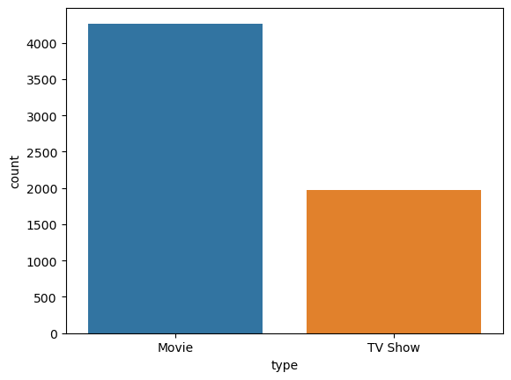
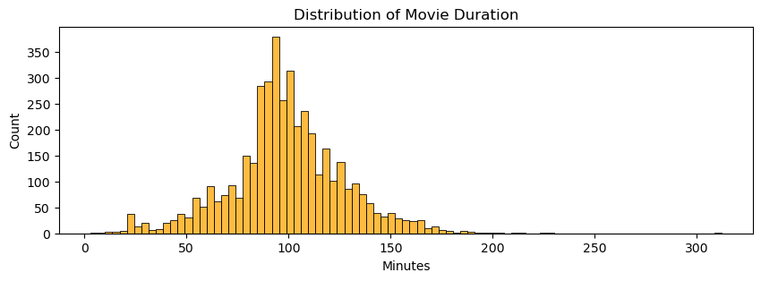
Now plot visualizations-
import seaborn as sns
# Graph of Duration in minutes of the Movies in Netflix
fig = plt.figure(figsize= (10,3))
sns.histplot(netflix[netflix['type']== 'Movie']['duration_minutes'], color = 'orange')
plt.title('Distribution of Movie Duration')
plt.xlabel('Minutes')
plt.show()
import seaborn as sns
import matplotlib.pyplot as plt
sns.countplot(x='type', data=netflix)
plt.show()

Slide 9
Now plot visualizations-
import seaborn as sns
# Graph of Duration in minutes of the Movies in Netflix
fig = plt.figure(figsize= (10,3))
sns.histplot(netflix[netflix['type']== 'Movie']['duration_minutes'], color = 'orange')
plt.title('Distribution of Movie Duration')
plt.xlabel('Minutes')
plt.show()
import seaborn as sns
import matplotlib.pyplot as plt
sns.countplot(x='type', data=netflix)
plt.show()

Slide 10
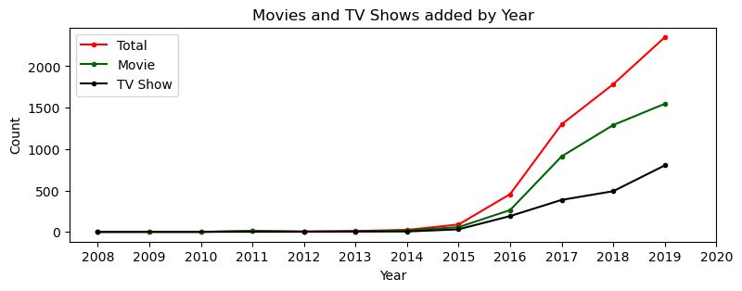
fig = plt.figure(figsize= (9,3))
plt.plot(year_count['year'], year_count['count'], marker = '.', label = 'Total', color ='red')
plt.plot(year_movie_count['year'], year_movie_count['count'], marker = '.', label = 'Movie', color = 'darkgreen')
plt.plot(year_show_count['year'], year_show_count['count'], marker = '.', label = 'TV Show', color = 'black')
plt.title('Movies and TV Shows added by Year')
plt.xlabel('Year')
plt.ylabel('Count')
plt.xticks(range(2008,2021))
plt.legend()
plt.show()

Slide 11
fig = plt.figure(figsize= (9,3))
plt.plot(year_count['year'], year_count['count'], marker = '.', label = 'Total', color ='red')
plt.plot(year_movie_count['year'], year_movie_count['count'], marker = '.', label = 'Movie', color = 'darkgreen')
plt.plot(year_show_count['year'], year_show_count['count'], marker = '.', label = 'TV Show', color = 'black')
plt.title('Movies and TV Shows added by Year')
plt.xlabel('Year')
plt.ylabel('Count')
plt.xticks(range(2008,2021))
plt.legend()
plt.show()

Slide 12
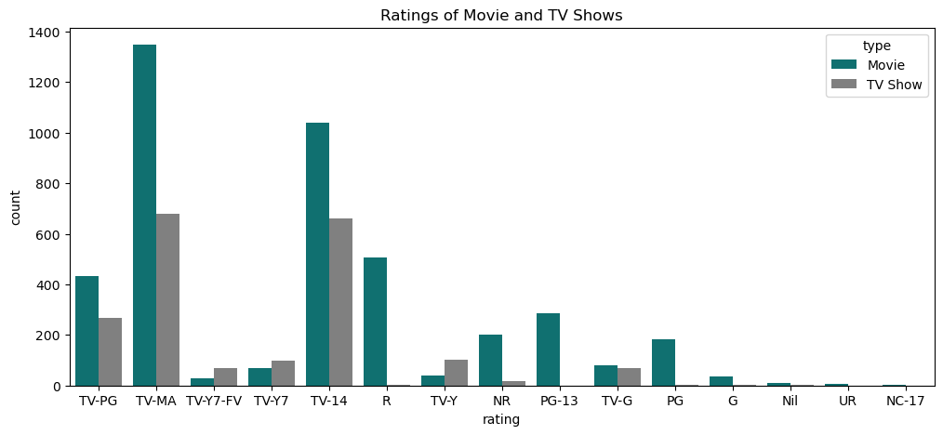
# Visualization of Ratings by type
fig = plt.figure(figsize= (12,5))
sns.countplot(data = netflix, x = 'rating', hue = 'type', palette = ['teal','grey'])
plt.title('Ratings of Movie and TV Shows')
plt.show()

Slide 13
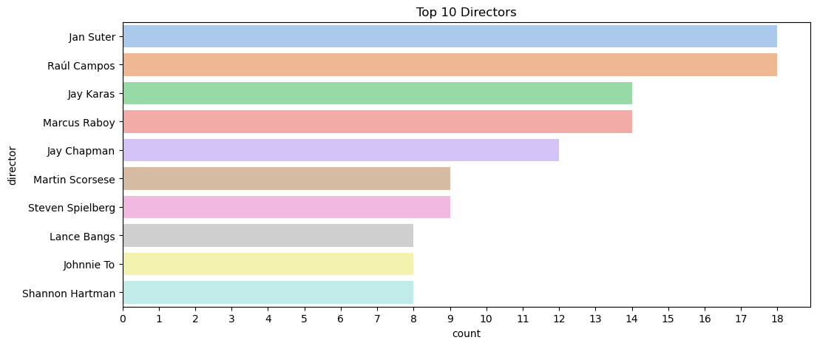
# Top 10 directors
fig = plt.figure(figsize= (12,5))
director_list = netflix[netflix['director'] != 'Nil']['director'].str.split(',').explode()
sns.countplot(y = director_list, order=director_list.value_counts().index[:10], palette='pastel')
plt.title('Top 10 Directors', fontsize =12)
plt.xticks(np.arange(0, 19))
plt.show()

Slide 14
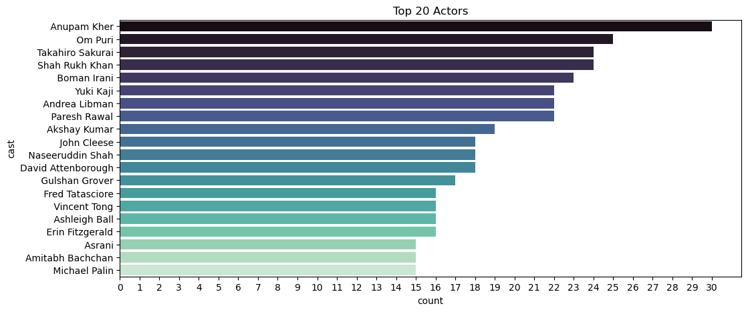
# Top 20 cast
fig = plt.figure(figsize= (12,5))
cast_list = netflix[netflix['cast'] != 'Nil']['cast'].str.split(',').explode()
sns.countplot(y = cast_list, order=cast_list.value_counts().index[:20], palette='mako')
plt.title('Top 20 Actors', fontsize =12)
plt.xticks(np.arange(0, 31))
plt.show()

Slide 15
3.
NLP
As this whole data consist of a number of textual data we have to preprocess them in order to apply clustering.
To preprocess we will be removing stop words, converting to lower case, applying lemmaization, tokenization, TF-IDF vectorization.
- Convert all text into their lower case.
- Remove punctuation marks.
columns_to_lower = ['title' , 'description', 'director', 'country', 'cast', 'listed_in']
netflix_text[columns_to_lower] = netflix_text[columns_to_lower].apply(lambda x: x.str.lower())
netflix_text[['description', 'director', 'country', 'cast', 'listed_in']] = netflix_text[['description', 'director', 'country', 'cast', 'listed_in']].apply(lambda x: x.str.replace('[{}]'.format(string.punctuation), ''))

Slide 16
- Removing Stop words.
import pandas as pd
from nltk.corpus import stopwords
from nltk.tokenize import word_tokenize
columns_to_remove_stopwords = ['description', 'director', 'country', 'cast', 'listed_in']
def remove_stopwords(text):
stop_words = set(stopwords.words('english'))
word_tokens = word_tokenize(text)
filtered_text = [word for word in word_tokens if word.lower() not in stop_words]
return ' '.join(filtered_text)
# Apply the remove_stopwords function to the specified columns
netflix_text[columns_to_remove_stopwords] = netflix_text[columns_to_remove_stopwords].applymap(remove_stopwords)
- Outputs.
0 planning awesome wedding grandfather polar bea... 1 jandino asporaat riffs challenges raising kids... 2 help three human allies autobots protect earth... 3 prison ship crash unleashes hundreds deceptico... 4 nerdy high schooler dani finally attracts inte...

Slide 17
Lemmatization
from nltk.stem import WordNetLemmatizer
import nltk
nltk.download('wordnet')
lemmatizer = WordNetLemmatizer()
netflix_text['clustering_attributes'] = lemmatize_verbs(netflix_text['clustering_attributes'])
Tokenization
from nltk.tokenize import TweetTokenizer
# Create a TweetTokenizer object
tweet_tokenizer = TweetTokenizer()
tokenizer = TweetTokenizer()
etflix_text['clustering_attributes'] = netflix_text['clustering_attributes'].apply(lambda x:tokenizer.tokenize(x))

Slide 18
Using TFIDF vectorizer to vectorize the corpus
# max features = 20000 to prevent system from crashing
tfidf = TfidfVectorizer(tokenizer=identity_tokenizer, stop_words='english', lowercase=False,max_features = 20000)
X = tfidf.fit_transform(clustering_data)
X.shape = (6234, 20000)
Now we have a bigger data than we had before because we applied vecorizarion.
To reduce the features and extract valuable features we have to apply dimensionality reduction technique I,e, PCA.
# using PCA to reduce dimensionality
pca = PCA(random_state=42)
pca.fit(X)

Slide 19
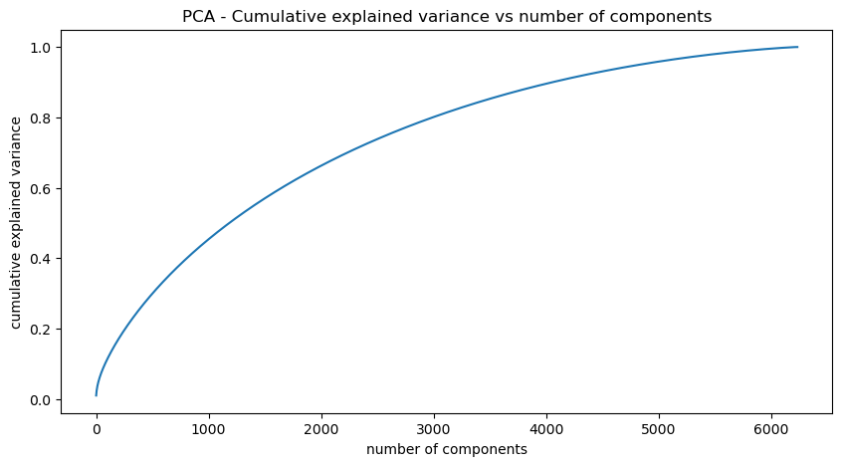
To get a optimal value of K we plotted the variance curve and we can see that more than 80 % of variane is explained by 4000 features, so we’ll take 4000 features.
# reducing the dimensions to 4000 using pca
pca = PCA(n_components=4000,random_state=42)
pca.fit(X)
x_pca.shape
--(6234, 4000)

Slide 20
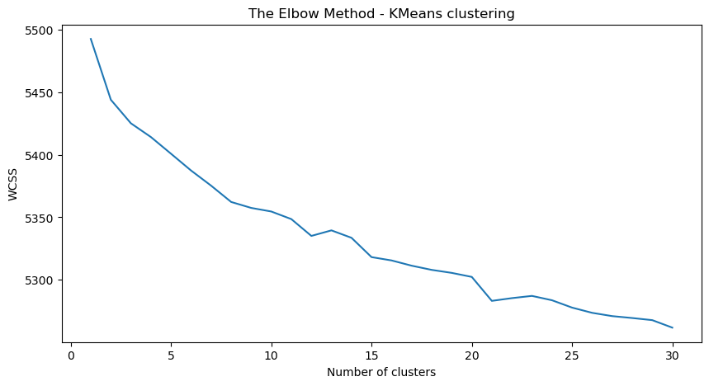
4.
CLUSTERING
i. K-Means Clustering.
-Elbow method to find the optimal value of k
wcss=[]
for i in range(1,31):
kmeans = KMeans(n_clusters=i,init='k-means++',random_state=64)
kmeans.fit(x_pca)
wcss_iter = kmeans.inertia_
wcss.append(wcss_iter)
number_clusters = range(1,31)
plt.figure(figsize=(10,5))
plt.plot(number_clusters,wcss)
plt.title('The Elbow Method - KMeans clustering')
plt.xlabel('Number of clusters')
plt.ylabel('WCSS')

Slide 21
4.
CLUSTERING
i. K-Means Clustering.
-Elbow method to find the optimal value of k
wcss=[]
for i in range(1,31):
kmeans = KMeans(n_clusters=i,init='k-means++',random_state=64)
kmeans.fit(x_pca)
wcss_iter = kmeans.inertia_
wcss.append(wcss_iter)
number_clusters = range(1,31)
plt.figure(figsize=(10,5))
plt.plot(number_clusters,wcss)
plt.title('The Elbow Method - KMeans clustering')
plt.xlabel('Number of clusters')
plt.ylabel('WCSS')

Slide 22
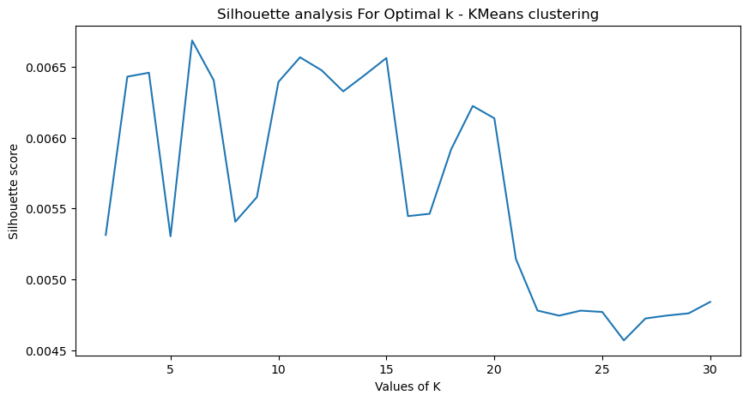
Plotting Silhouette score for different umber of clusters
from sklearn.metrics import silhouette_score
range_n_clusters = range(2,31)
silhouette_avg = []
for num_clusters in range_n_clusters:
# initialize kmeans
kmeans = KMeans(n_clusters=num_clusters,init='k-means++',random_state=33)
kmeans.fit(x_pca)
cluster_labels = kmeans.labels_
# silhouette score
silhouette_avg.append(silhouette_score(x_pca, cluster_labels))
plt.figure(figsize=(10,5))
plt.plot(range_n_clusters,silhouette_avg)
plt.xlabel('Values of K')
plt.ylabel('Silhouette score')
plt.title('Silhouette analysis For Optimal k - KMeans clustering')
plt.show()

Slide 23
Plotting Silhouette score for different umber of clusters
from sklearn.metrics import silhouette_score
range_n_clusters = range(2,31)
silhouette_avg = []
for num_clusters in range_n_clusters:
# initialize kmeans
kmeans = KMeans(n_clusters=num_clusters,init='k-means++',random_state=33)
kmeans.fit(x_pca)
cluster_labels = kmeans.labels_
# silhouette score
silhouette_avg.append(silhouette_score(x_pca, cluster_labels))
plt.figure(figsize=(10,5))
plt.plot(range_n_clusters,silhouette_avg)
plt.xlabel('Values of K')
plt.ylabel('Silhouette score')
plt.title('Silhouette analysis For Optimal k - KMeans clustering')
plt.show()

Slide 24
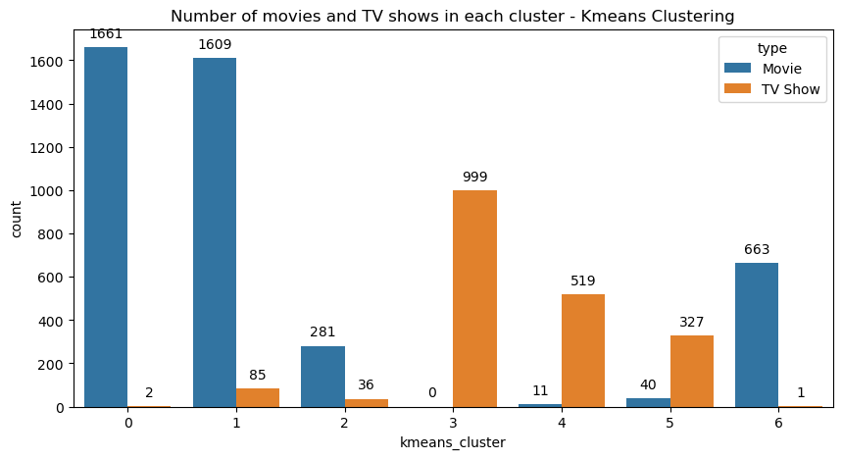
We can see that silhoutte score is highest at around 6 or 7.
So we can take 7 as the number of clusters.
Number of movies and tv shows in each cluster
plt.figure(figsize=(10,5))
q = sns.countplot(x='kmeans_cluster',data=netflix_text, hue='type')
plt.title('Number of movies and TV shows in each cluster - Kmeans Clustering')
for i in q.patches:
q.annotate(format(i.get_height(), '.0f'), (i.get_x() + i.get_width() / 2., i.get_height()), ha = 'center', va = 'center', xytext = (0, 10), textcoords = 'offset points')

Slide 25
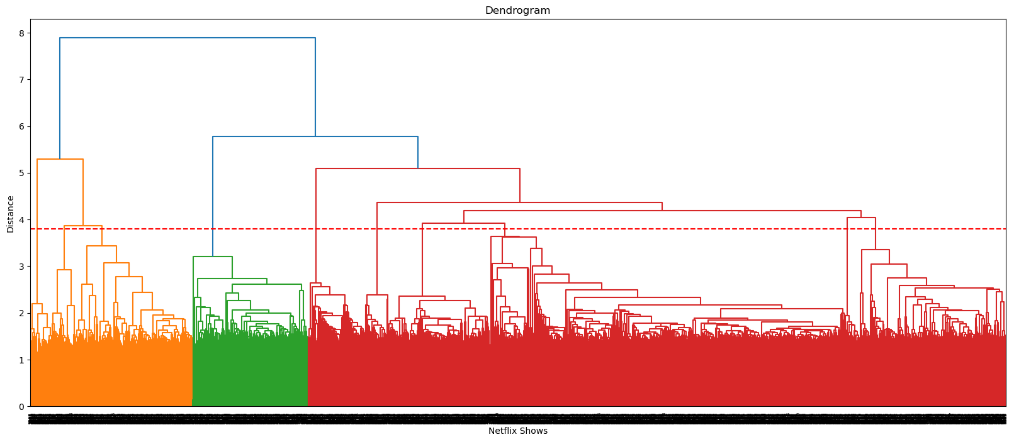
Hierarchical clustering.

Slide 26
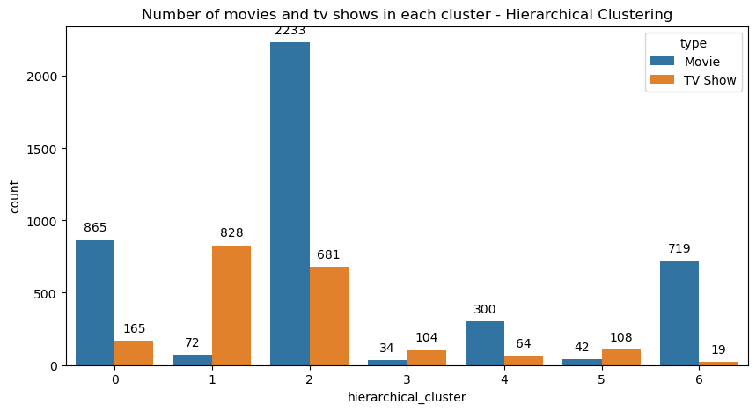
Fitting hierarchical clustering model
from sklearn.cluster import AgglomerativeClustering
hierarchical = AgglomerativeClustering(n_clusters=7, linkage='ward') # Adjust linkage as needed
labels = hierarchical.fit_predict(x_pca)
Number of movies and tv shows in each cluster
plt.figure(figsize=(10,5))
q = sns.countplot(x='hierarchical_cluster',data=netflix_text, hue='type')
plt.title('Number of movies and tv shows in each cluster - Hierarchical Clustering')
for i in q.patches:
q.annotate(format(i.get_height(), '.0f'), (i.get_x() + i.get_width() / 2., i.get_height()), ha = 'center', va = 'center', xytext = (0, 10), textcoords = 'offset points')

Slide 27
Content based recommender system:
converting tokens to string
def convert(lst):
return ' '.join(lst)
recommender_df['clustering_attributes'] = recommender_df['clustering_attributes'].apply(lambda x: convert(x))
Count vectorizer
CV = CountVectorizer()
converted_matrix = CV.fit_transform(recommender_df['clustering_attributes'])

Slide 28
To build our recommendation system we will be applying the concept of Cosine Similarity.
cos(A,B) = (a.b) / ( |a| * |b| )
# Cosine similarity
from sklearn.metrics.pairwise import cosine_similarity
cosine_similarity = cosine_similarity(converted_matrix)

Slide 29
Developing a function to get 10 recommendations for a show
indices = pd.Series(recommender_df.index)
def recommend_10(title, cosine_sim = cosine_similarity):
try:
recommend_content = []
idx = indices[indices == title].index[0]
series = pd.Series(cosine_sim[idx]).sort_values(ascending = False)
top10 = list(series.iloc[1:11].index)
# list with the titles of the best 10 matching movies
for i in top10:
recommend_content.append(list(recommender_df.index)[i])
print("If you liked '"+title+"', you may also enjoy:\n")
return recommend_content
except:
return 'We do not have this show on our platform'
Recommendations for 'breaking bad'
recommend_10('breaking bad')
Output-
If you liked 'breaking bad', you may also enjoy:
['better call saul’,
'have you ever fallen in love, miss jiang?’,
"marvel's the punisher",
'get shorty’,
'mindhunter’,
'jack taylor’,
'travelers’,
'rica, famosa, latina’,
'person of interest’,
'love']

Slide 30
Conclusions-
In this project, we worked on a text clustering problem wherein we had to classify/group the Netflix shows into certain clusters such that the shows within a cluster are similar to each other and the shows in different clusters are dissimilar to each other.
The dataset contained about 6234 records, and 8 attributes.
We began by dealing with the dataset's missing values and doing exploratory data analysis (EDA).
It was found that Netflix hosts more movies than TV shows on its platform, and the total number of shows added on Netflix is growing exponentially. Also, majority of the shows were produced in the United States, and the majority of the shows on Netflix were created for adults and young adults age group.
It was decided to cluster the data based on the attributes: director, cast, country, genre, and description. The values in these attributes were tokenized, preprocessed, and then vectorized using TFIDF vectorizer.
Through TFIDF Vectorization, we created a total of 20000 attributes.
We used Principal Component Analysis (PCA) to handle the curse of dimensionality. 4000 components were able to capture more than 80% of variance, and hence, the number of components were restricted to 4000.

Slide 31
We first built clusters using the k-means clustering algorithm, and the optimal number of clusters came out to be 7. This was obtained through the elbow method and Silhouette score analysis.
Then clusters were built using the Agglomerative clustering algorithm, and the optimal number of clusters came out to be 7. This was obtained after visualizing the dendrogram.
A content based recommender system was built using the similarity matrix obtained after using cosine similarity. This recommender system will make 10 recommendations to the user based on the type of show they watched.

Slide 32
Thank you!

