Slide 1
1. Course Motivation / Confidence Intervals
MGT 407e Probability & Statistics
Fall 2026
Peter K. Schott Yale School of Management & NBER

Slide 2
Motivation
Data, data, data!
Most of you won’t become data analysts, but all of you are exposed to data analysis professionally and personally
Wouldn’t it be great to have enough of a grasp of statistics to understand and critique what data analysts do, and to use AI as your own personal data staff?
That’s the main goal of this course…

Slide 3
Achieving Our Goal
Learn the vocabulary of data analysis
What is a standard error? How is it standard?
What is a confidence interval? How confident can you be?
What is a test statistic? What is it testing?
What is statistical significance? What makes it significant?
Why is 1.96 a magic number?
Learn how to make and evaluate statistical hypotheses
Form your own opinions about what a dataset can tell you
Learn how to describe statistical results in PLAIN ENGLISH
Learn a bit about the art of data analysis

Slide 4
Logistics
Topics
All slides, problem sets, videos, datasets, etc are located on Canvas
To meet with me, email a few times that work for you and I will pick
Please let me know if something is not working!
Meeting | Dates | Topic
1 | 8/14 | 1. Confidence Intervals
2 | 8/28 | 2. Hypothesis Testing
3 | 9/11 | 3. Bivariate OLS Regression
4 | 9/25 | 4. Multivariate OLS Regression
5 | 10/9 | 5. OLS Extensions
Note: All meetings are Fridays at 14:30. Each topic is the subject of a separate slide deck.

Slide 5
Software
Use AI as your own personal data staff!
ChatGPT via Clarity Platform
Portkey with Tauhid starting in 2 weeks
BUT be careful!!
See Canvas /files/4.videos for some simple instructions (may no longer be relevant if you already use AI)
Older methods
Excel: slides show how to do everything we cover in Excel
Stata: I use Stata and will sometimes use it to demonstrate
Any other software you like

Slide 6
Problem Sets
Schedule
Scope
Each problem has a stated goal
Problem sets are very ambitious!
Many problems only possible with AI
Due Date | Assignment | % of Final Grade
Wed 8/26 at 23:59 | Problem Set 1 | 10
wed 9/9 at 23:59 | Problem Set 2 | 10
Wed 9/23 at 23:59 | Problem Set 3 | 10
Wed 10/7 at 23:59 | Problem Set 4 | 10
TBD | Take Home Exam | 60

Slide 7
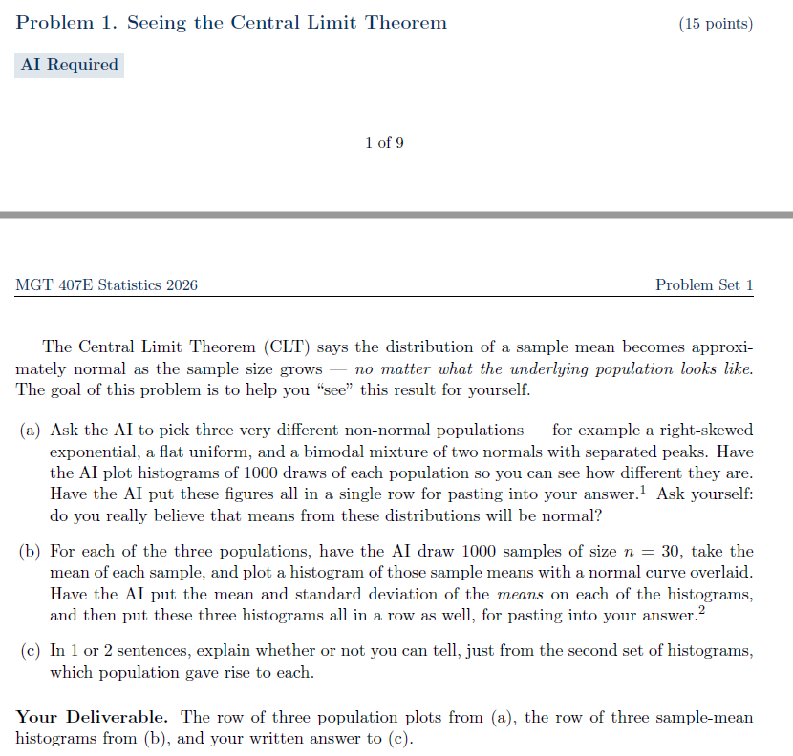

Slide 8
Problem Sets
Schedule
Scope
Each problem has a stated goal
Problem sets are very ambitious! Many problems only possible with AI
Please…
Upload your solutions by noted deadline
Follow sample answer format when constructing your solutions to hand in
Complete and upload your answers individually, but feel free to discuss them with your learning team, the TA or the professor
Use AI only when instructed
Do not spin your wheels….ask for help if you get stuck
Due Date | Assignment | % of Final Grade
Thu 8/26 at 23:59 | Problem Set 1 | 5
Thu 9/9 at 23:59 | Problem Set 2 | 5
Thu 9/23 at 23:59 | Problem Set 3 | 5
Thu 10/7 at 23:59 | Problem Set 4 | 5
TBD | Take Home Exam | 80

Slide 9
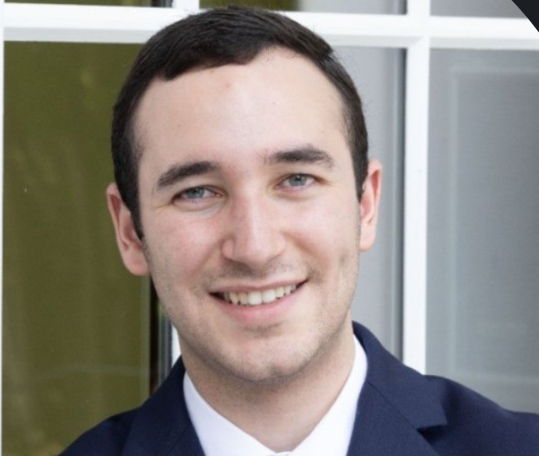
Your TA
Jacob M. Miller
Yale Economics PHD student
jacob.m.miller@yale.edu
Proposed schedule
Note: Jacob and I are going to experiment with AI Grading
Date | Time
Wed, Aug 19 | 7-8pm EST
Wed, Sep 2 | 7-8pm EST
Wed, Sep 16 | 7-8pm EST
Wed, Sep 30 | 7-8pm EST

Slide 10
OK, let’s get started!

Slide 11
Today
Meeting | Dates | Topic
1 | 8/14 | 1. Confidence Intervals
2 | 8/28 | 2. Hypothesis Testing
3 | 9/11 | 3. Bivariate OLS Regression
4 | 9/25 | 4. Multivariate OLS Regression
5 | 10/9 | 5. OLS Extensions

Slide 12
Today’s Concepts
Sample vs population
Confidence Interval
Margin of error
Statistical significance
Bootstrapping (if time)

Slide 13
Background: Population versus Sample

Slide 14
Population versus Sample
Population

Slide 15
Population versus Sample
Population
Sample

Slide 16
What is the Average Price of Dinner in Vienna?
Population
Sample

Slide 17
What is the Average Price of Dinner in Vienna?
All Restaurants in Vienna
Restaurants I Visited in July

Slide 18
Is the New Cancer Drug Effective?
All Patients
Patients in Drug Trial

Slide 19
What is the Average Price of a House?
All Houses
Houses in New Haven

Slide 20
Will the Republicans Keep the House?
All Voters on Election Day
Likely Voters Before Election Day

Slide 21
Will the Republicans Keep the House?
All Voters on Election Day
Likely Voters Before Election Day
Samples can differ from the population from which they are drawn due to random noise

Slide 22
Will the Republicans Keep the House?
All Voters on Election Day
Likely Voters Before Election Day
Samples are better approximations of the population when they are drawn randomly and when they are larger

Slide 23
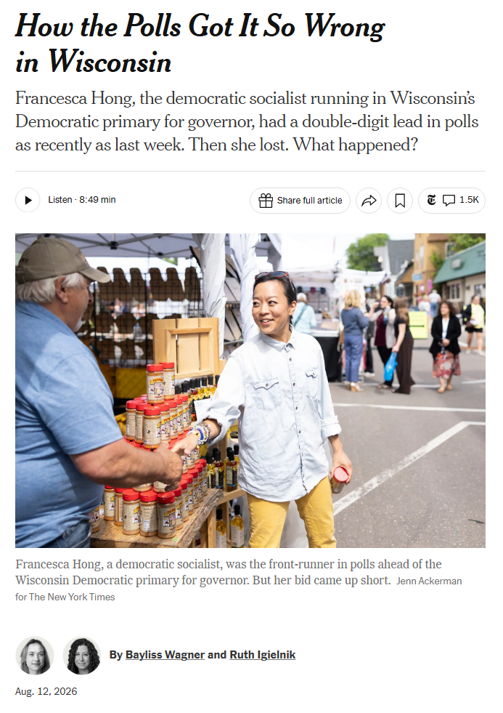

Slide 24
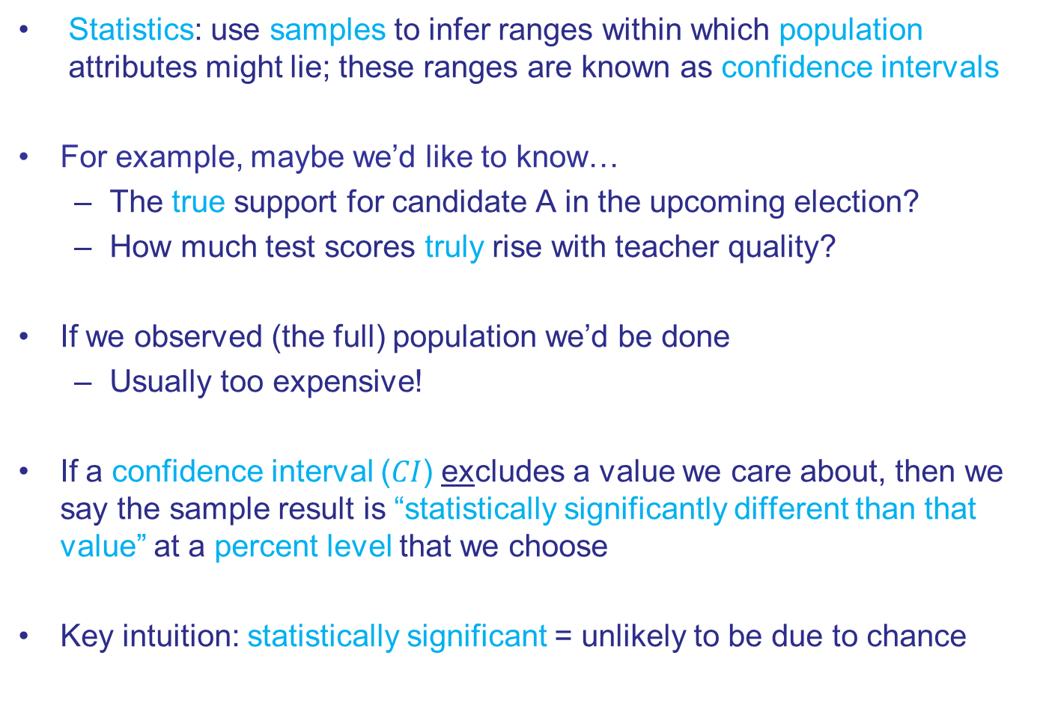
What is Statistics?
Statistics: use samples to infer ranges within which population attributes might lie; these ranges are known as confidence intervals
For example, maybe we’d like to know…
The true support for candidate A in the upcoming election?
How much test scores truly rise with teacher quality?
If we observed (the full) population we’d be done
Usually too expensive!
If a confidence interval ($CI$) excludes a value we care about, then we say the sample result is “statistically significantly different than that value” at a percent level that we choose
Key intuition: statistically significant = unlikely to be due to chance

Slide 25

Some Vocabulary
In Probability, you learned about distributions
E.g., normal and binomial
These distributions are characterized by parameters
A binomial distribution has probability of success p
A normal distribution has mean $μ$ and standard deviation $σ$

Slide 26



Some Vocabulary
In Probability, you learned about distributions
E.g., normal and binomial
These distributions are characterized by parameters
E.g., the normal distribution has mean $μ$ and standard deviation $σ$
$$σ$$
$$μ$$

Slide 27
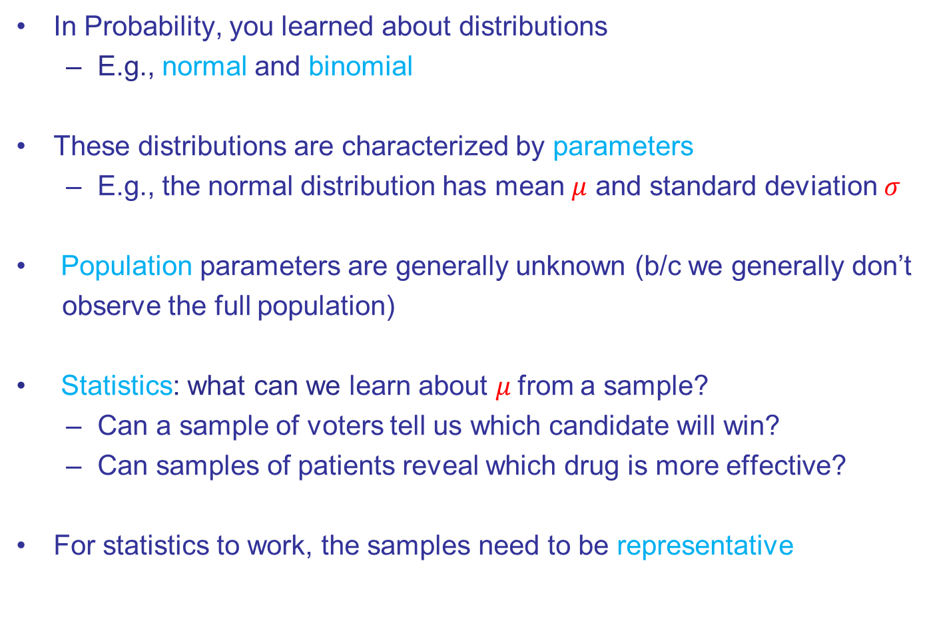
Some Vocabulary
In Probability, you learned about distributions
E.g., normal and binomial
These distributions are characterized by parameters
E.g., the normal distribution has mean $μ$ and standard deviation $σ$
Population parameters are generally unknown (b/c we generally don’t
observe the full population)
Statistics: what can we learn about $μ$ from a sample?
Can a sample of voters tell us which candidate will win?
Can samples of patients reveal which drug is more effective?
For statistics to work, the samples need to be representative

Slide 28
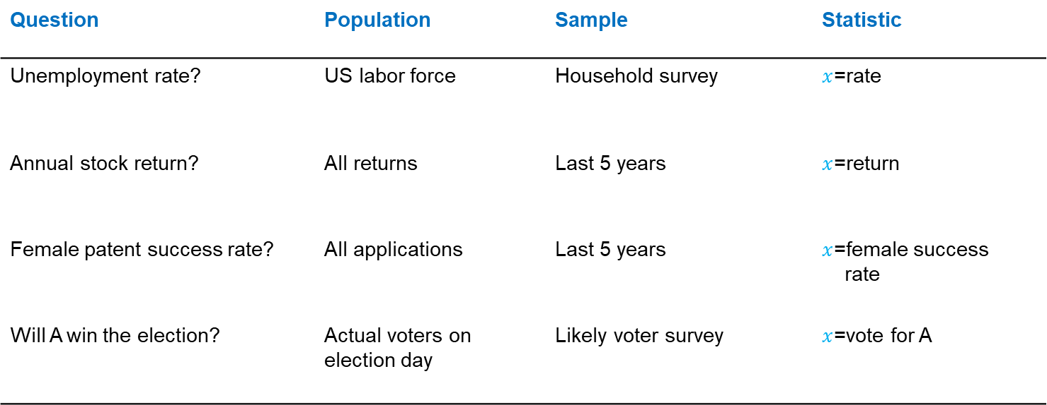
Sample vs Population Examples
Question | Population | Sample | Statistic
Unemployment rate? | US labor force | Household survey | $x$=rate
Annual stock return? | All returns | Last 5 years | $x$=return
Female patent success rate? | All applications | Last 5 years | $x$=female success rate
Will A win the election? | Actual voters on election day | Likely voter survey | $x$=vote for A

Slide 29
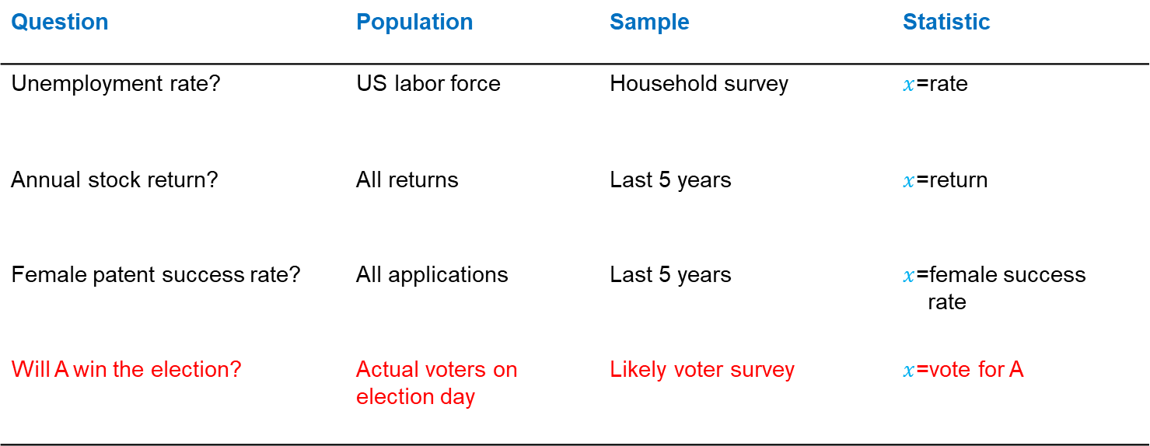
Sample vs Population Examples
Question | Population | Sample | Statistic
Unemployment rate? | US labor force | Household survey | $x$=rate
Annual stock return? | All returns | Last 5 years | $x$=return
Female patent success rate? | All applications | Last 5 years | $x$=female success rate
Will A win the election? | Actual voters on election day | Likely voter survey | $x$=vote for A

Slide 30
Example 1: Election Polling

Slide 31
Election Polling
Will candidate A win the upcoming election?
Fox News asks 1,100 likely voters: “Will you vote for A?”
We want to know: Is A’s true support (in the population) above 50%?
How could we possibly figure that out?
All Voters
51 percent say they will vote for candidate A
Polled by Fox
News

Slide 32
Polling Confidence Interval

Slide 33
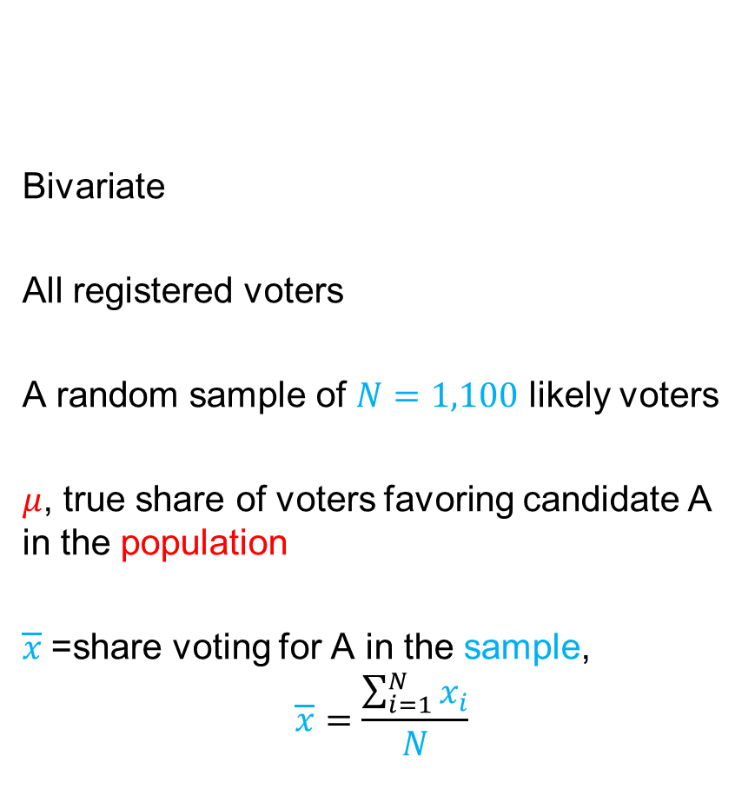
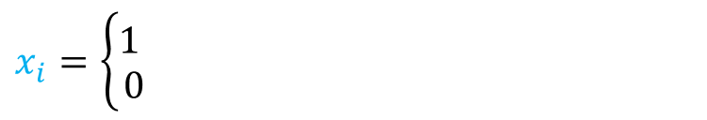
Technical Summary of Fox Poll
Random Variable
Distribution
Population
Sample
Parameter of interest
Test statistic
Bivariate
All registered voters
A random sample of $N=1,100$ likely voters
$μ$, true share of voters favoring candidate A in the population
$\overline{x}$=share voting for A in the sample, $$\overline{x}=\frac{\sum_{i=1}^{N}{x_{i}}}{N}$$
$$x_{i}=\left\{\begin{matrix}1 \\ 0\end{matrix}\right.$$
If individual i expresses support for A
If not

Slide 34
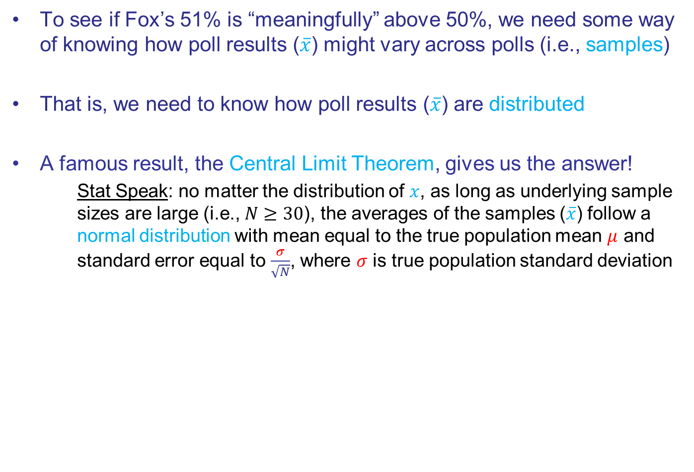
Confidence Interval
To see if Fox’s 51% is “meaningfully” above 50%, we need some way of knowing how poll results ($\overline{x}$) might vary across polls (i.e., samples)
That is, we need to know how poll results ($\overline{x}$) are distributed
A famous result, the Central Limit Theorem, gives us the answer!
Stat Speak: no matter the distribution of $x$, as long as underlying sample sizes are large (i.e., $N≥30$), the averages of the samples ($\overline{x}$) follow a normal distribution with mean equal to the true population mean $μ$ and standard error equal to $\frac{σ}{\sqrt{N}}$, where $σ$ is true population standard deviation

Slide 35
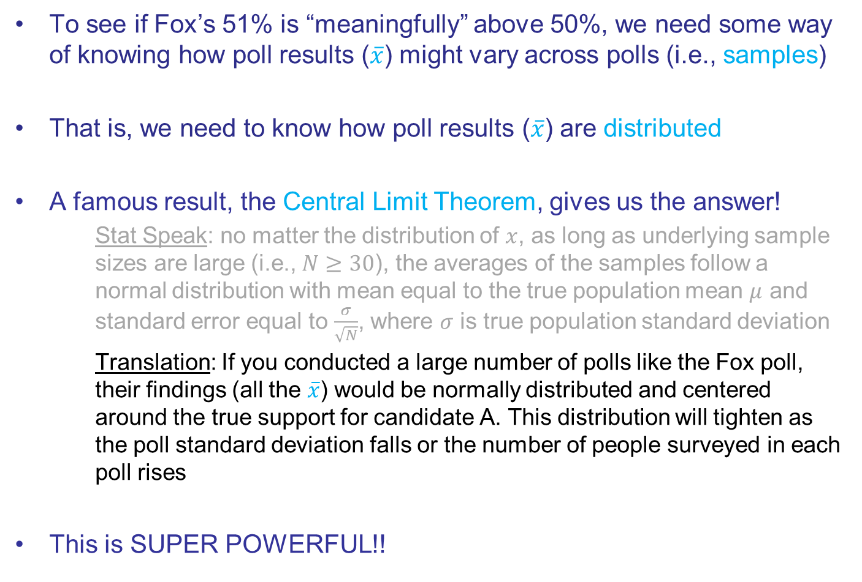
Confidence Interval
To see if Fox’s 51% is “meaningfully” above 50%, we need some way of knowing how poll results ($\overline{x}$) might vary across polls (i.e., samples)
That is, we need to know how poll results ($\overline{x}$) are distributed
A famous result, the Central Limit Theorem, gives us the answer!
Stat Speak: no matter the distribution of $x$, as long as underlying sample sizes are large (i.e., $N≥30$), the averages of the samples follow a normal distribution with mean equal to the true population mean $μ$ and standard error equal to $\frac{σ}{\sqrt{N}}$, where $σ$ is true population standard deviation
Translation: If you conducted a large number of polls like the Fox poll, their findings (all the $\overline{x}$) would be normally distributed and centered around the true support for candidate A. This distribution will tighten as the poll standard deviation falls or the number of people surveyed in each poll rises
This is SUPER POWERFUL!!

Slide 36

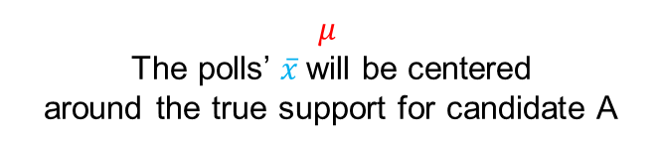
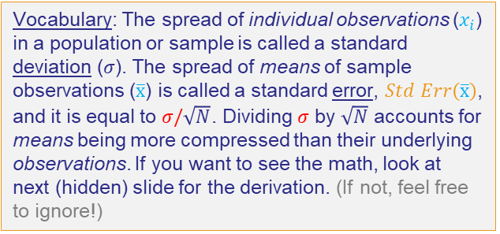





Polling Confidence Interval
Distribution of Poll Results, $N(μ, \frac{σ}{√N})$
$Std Err(\overline{x})=\frac{σ}{\sqrt{N}}$
Population
g
Fox
Gallup
Zogby
Etc
Central Limit Theorem
$${\overline{x}}_{1}$$
$${\overline{x}}_{2}$$
$${\overline{x}}_{3}$$
$${\overline{x}}_{j}$$
$$μ$$
The polls’ $\overline{x}$will be centered around the true support for candidate A
Vocabulary: The spread of individual observations ($x_{i}$) in a population or sample is called a standard deviation ($σ$). The spread of means of sample observations ($\overline{x}$) is called a standard error, $Std Err\left(\overline{x}\right)$, and it is equal to $σ/\sqrt{N}$. Dividing $σ$ by $\sqrt{N}$ accounts for means being more compressed than their underlying observations. If you want to see the math, look at next (hidden) slide for the derivation. (If not, feel free to ignore!)

Slide 37

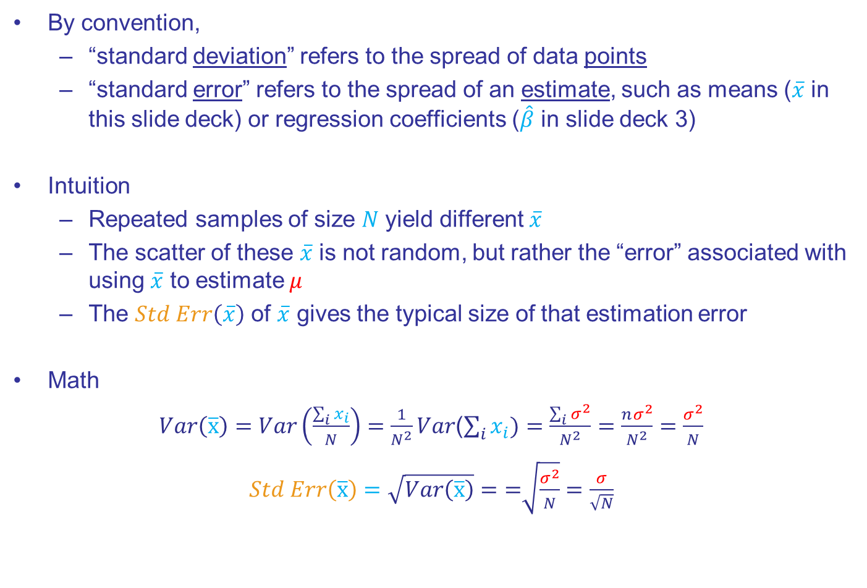
Standard “Deviation” vs Standard “Error” (Optional Slide)
By convention,
“standard deviation” refers to the spread of data points
“standard error” refers to the spread of an estimate, such as means ($\overline{x}$ in this slide deck) or regression coefficients ($\hat{β}$ in slide deck 3)
Intuition
Repeated samples of size $N$ yield different $\overline{x}$
The scatter of these $\overline{x}$ is not random, but rather the “error” associated with using $\overline{x}$ to estimate $μ$
The $Std Err\left(\overline{x}\right)$ of $\overline{x}$ gives the typical size of that estimation error
Math
$Var\left(\overline{x}\right)=$ $Var\left(\frac{\sum_{i}{x_{i}}}{N}\right)=\frac{1}{N^{2}}Var$($\sum_{i}{x_{i}})=\frac{\sum_{i}{σ^{2}}}{N^{2}}=\frac{nσ^{2}}{N^{2}}=$ $\frac{σ^{2}}{N}$
$Std Err\left(\overline{x}\right)=\sqrt{Var\left(\overline{x}\right)}=\text{=}\sqrt{\frac{σ^{2}}{N}}=\frac{σ}{\sqrt{N}}$
By definition, the variance of the population observations $x_{i}$ is $σ^{2}$
Sub in definition of mean
apply rules of variance

Slide 38
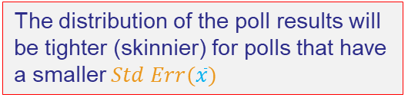

Polling Confidence Interval
Distribution of Poll Results, $N(μ, \frac{σ}{√N})$
$Std Err(\overline{x})=\frac{σ}{\sqrt{N}}$
Population
g
Fox
Gallup
Zogby
Etc
Central Limit Theorem
$${\overline{x}}_{1}$$
$${\overline{x}}_{2}$$
$${\overline{x}}_{3}$$
$${\overline{x}}_{j}$$
$$μ$$
The polls’ $\overline{x}$will be centered around the true support for candidate A
The distribution of the poll results will be tighter (skinnier) for polls that have a smaller $Std Err(\overline{x})$

Slide 39
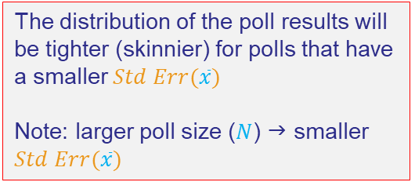
Polling Confidence Interval
Distribution of Poll Results, $N(μ, \frac{σ}{√N})$
$Std Err(\overline{x})=\frac{σ}{\sqrt{N}}$
Population
g
Fox
Gallup
Zogby
Etc
Central Limit Theorem
$${\overline{x}}_{1}$$
$${\overline{x}}_{2}$$
$${\overline{x}}_{3}$$
$${\overline{x}}_{j}$$
$$μ$$
The polls’ $\overline{x}$will be centered around the true support for candidate A
The distribution of the poll results will be tighter (skinnier) for polls that have a smaller $Std Err(\overline{x})$
Note: larger poll size ($N$) g smaller $Std Err(\overline{x})$

Slide 40
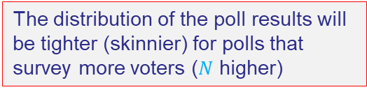

Polling Confidence Interval
Distribution of Poll Results, $N(μ, \frac{σ}{√N})$
$Std Err(\overline{x})=\frac{σ}{\sqrt{1100}}$
Population
g
Fox
Gallup
Zogby
Etc
Central Limit Theorem
$${\overline{x}}_{1}$$
$${\overline{x}}_{2}$$
$${\overline{x}}_{3}$$
$${\overline{x}}_{j}$$
$$μ$$
The polls’ $\overline{x}$will be centered around the true support for candidate A
The distribution of the poll results will be tighter (skinnier) for polls that survey more voters ($N$ higher)

Slide 41


Polling Confidence Interval
Distribution of Poll Results,$N(μ, \frac{σ}{√N})$
$Std Err(\overline{x})=\frac{σ}{\sqrt{5000}}$
Population
g
Fox
Gallup
Zogby
Etc
Central Limit Theorem
$${\overline{x}}_{1}$$
$${\overline{x}}_{2}$$
$${\overline{x}}_{3}$$
$${\overline{x}}_{j}$$
$$μ$$
The polls’ $\overline{x}$will be centered around the true support for candidate A
The distribution of the poll results will be tighter (skinnier) for polls that survey more voters ($N$ higher)

Slide 42

Polling Confidence Interval
Distribution of Poll Results, $N(μ, \frac{σ}{√N})$
$Std Err(\overline{x})=\frac{σ}{\sqrt{10,000}}$
Population
g
Fox
Gallup
Zogby
Etc
Central Limit Theorem
$${\overline{x}}_{1}$$
$${\overline{x}}_{2}$$
$${\overline{x}}_{3}$$
$${\overline{x}}_{j}$$
$$μ$$
The polls’ $\overline{x}$will be centered around the true support for candidate A
The distribution of the poll results will be tighter (skinnier) for polls that survey more voters ($N$ higher)

Slide 43
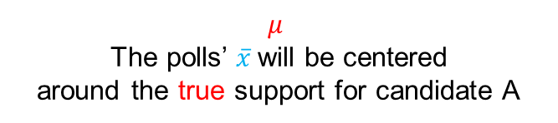
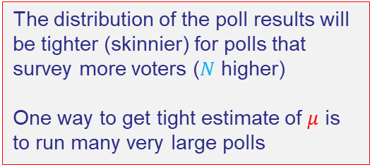
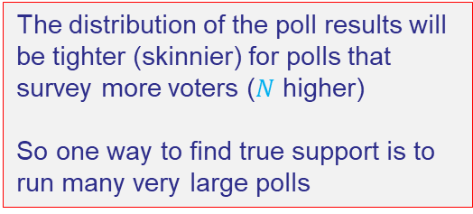
Polling Confidence Interval
Distribution of Poll Results, $N(μ, \frac{σ}{√N})$
$Std Err(\overline{x})=\frac{σ}{\sqrt{10,000}}$
Population
g
Fox
Gallup
Zogby
Etc
Central Limit Theorem
$${\overline{x}}_{1}$$
$${\overline{x}}_{2}$$
$${\overline{x}}_{3}$$
$${\overline{x}}_{j}$$
$$μ$$
The polls’ $\overline{x}$will be centered around the true support for candidate A
The distribution of the poll results will be tighter (skinnier) for polls that survey more voters ($N$ higher)
One way to get tight estimate of $μ$ is to run many very large polls

Slide 44
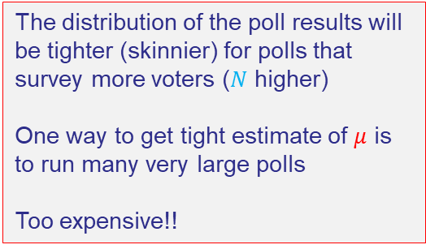
Polling Confidence Interval
Distribution of Poll Results, $N(μ, \frac{σ}{√N})$
$Std Err(\overline{x})=\frac{σ}{\sqrt{10,000}}$
Population
g
Fox
Gallup
Zogby
Etc
Central Limit Theorem
$${\overline{x}}_{1}$$
$${\overline{x}}_{2}$$
$${\overline{x}}_{3}$$
$${\overline{x}}_{j}$$
$$μ$$
The polls’ $\overline{x}$will be centered around the true support for candidate A
The distribution of the poll results will be tighter (skinnier) for polls that survey more voters ($N$ higher)
One way to get tight estimate of $μ$ is to run many very large polls
Too expensive!!

Slide 45
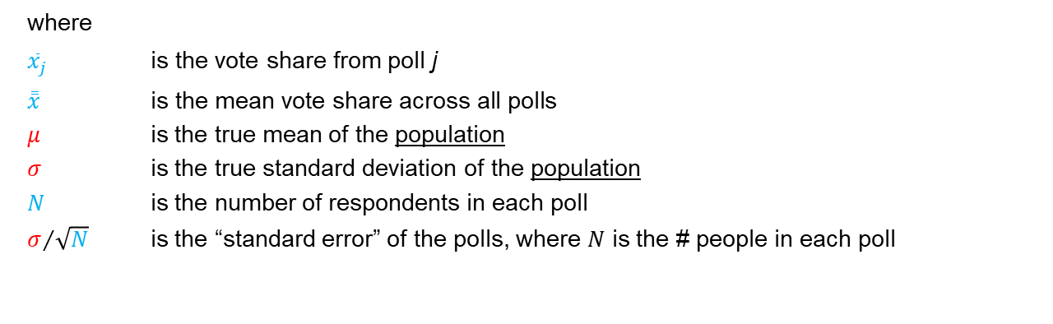
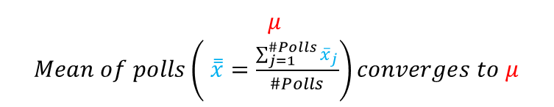

Key Stats
Distribution of Poll Results, $N(μ, \frac{σ}{√N})$
$Std Err(\overline{x})=\frac{σ}{\sqrt{N}}$
Population
g
Fox
Gallup
Zogby
Etc
Central Limit Theorem
$${\overline{x}}_{1}$$
$${\overline{x}}_{2}$$
$${\overline{x}}_{3}$$
$${\overline{x}}_{j}$$
$$μ$$
$Mean of polls\left( \overset{̿}{x}=\frac{\sum_{j=1}^{\#Polls}{{\overline{x}}_{j}}}{\#Polls}\right)converges to μ$
where
${\overline{x}}_{j}$ $\text{is} \text{the} \text{vote} \text{share} \text{from} \text{poll} \text{j}$
$\overset{̿}{x}$ $\text{is} \text{the} \text{mean} \text{vote} \text{share} \text{across} \text{all} \text{polls}$
$μ$ is the true mean of the population
$σ$ is the true standard deviation of the population
$N$ is the number of respondents in each poll
$σ/{\sqrt{N}}$ is the “standard error” of the polls, where $N$ is the # people in each poll

Slide 46
Central Limit Theorem g Data
The Fox poll was one of 77 polls conducted in the final month of the campaign
This is their distribution
A

Slide 47
Central Limit Theorem g Data
Normal distribution implied by the 77 polls
The Fox poll was one of 77 polls conducted in the final month of the campaign
This is their distribution
A

Slide 48
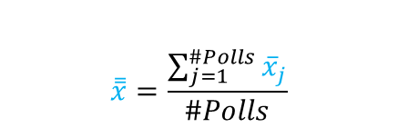

Central Limit Theorem g Data
Normal distribution implied by the 77 polls
The Fox poll was one of 77 polls conducted in the final month of the campaign
This is their distribution
$$\overset{̿}{x}=\frac{\sum_{j=1}^{\#Polls}{{\overline{x}}_{j}}}{\#Polls}$$
$converges to μ$

Slide 49
Central Limit Theorem g Data
Normal distribution implied by the 77 polls
The Fox poll was one of 77 polls conducted in the final month of the campaign
This is their distribution
OK, but what can you do if you have just one poll?
$$\overset{̿}{x}=\frac{\sum_{j=1}^{\#Polls}{{\overline{x}}_{j}}}{\#Polls}$$
$converges to μ$

Slide 50
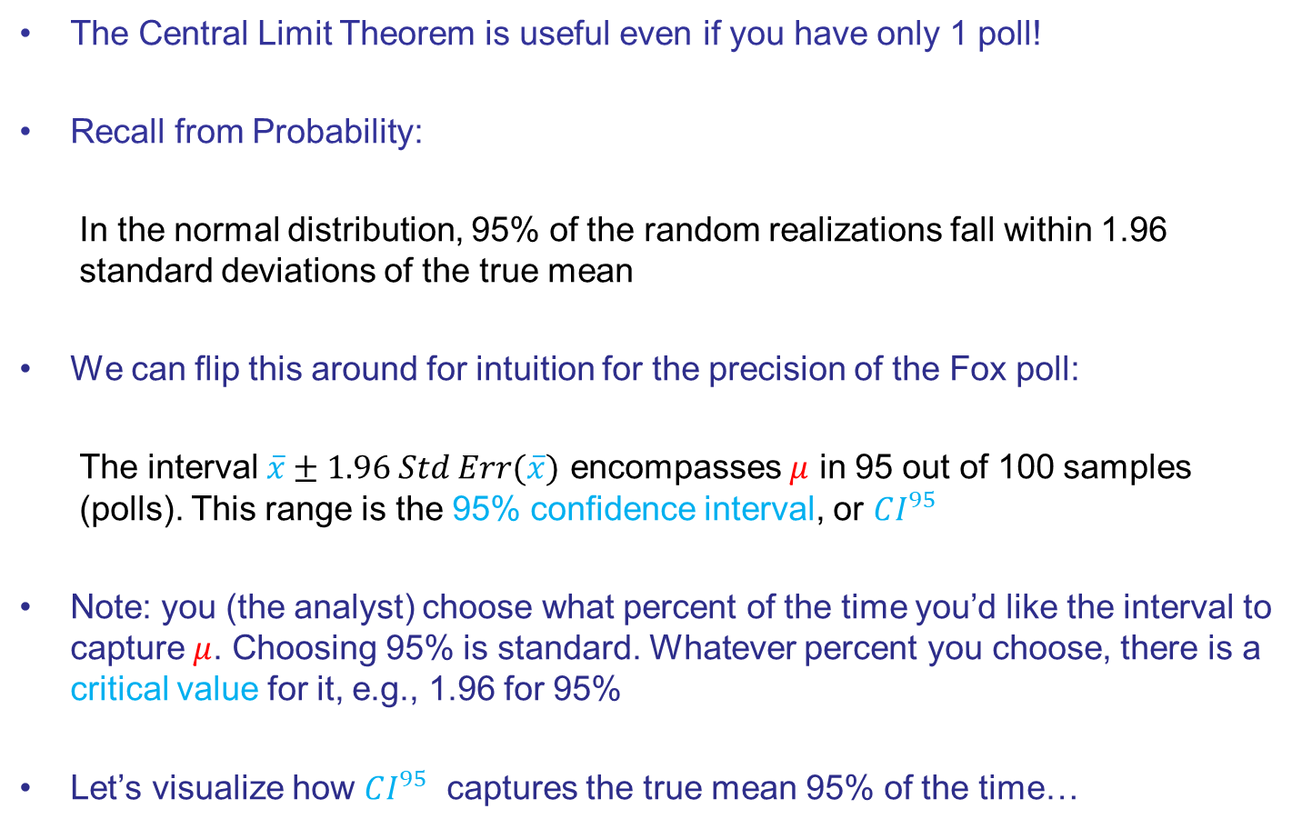
What if You Have Only 1 Poll?
The Central Limit Theorem is useful even if you have only 1 poll!
Recall from Probability:
In the normal distribution, 95% of the random realizations fall within 1.96 standard deviations of the true mean
We can flip this around for intuition for the precision of the Fox poll:
The interval $\overline{x}±1.96 Std Err(\overline{x})$ encompasses $μ$ in 95 out of 100 samples (polls). This range is the 95% confidence interval, or $CI^{95}$
Note: you (the analyst) choose what percent of the time you’d like the interval to capture $μ$. Choosing 95% is standard. Whatever percent you choose, there is a critical value for it, e.g., 1.96 for 95%
Let’s visualize how $CI^{95}$ captures the true mean 95% of the time…

Slide 51

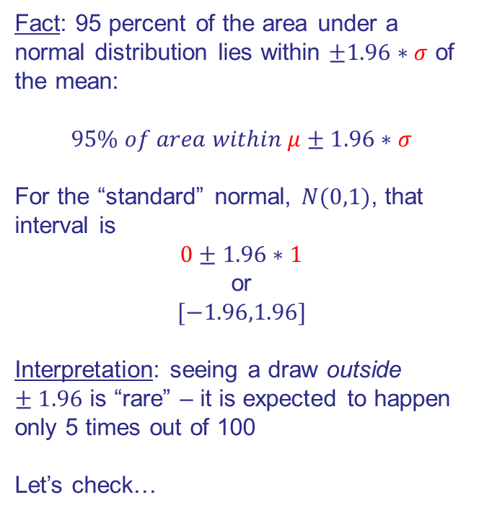
The “Standard” Normal Distribution $N(μ,σ)$
Fact: 95 percent of the area under a normal distribution lies within $±1.96∗σ$ of the mean:
$$95\% of area within μ±1.96∗σ$$
For the “standard” normal, $N(0,1)$, that interval is
$$0±1.96∗1$$
or
$$[−1.96,1.96]$$
Interpretation: seeing a draw outside $±1.96$ is “rare” – it is expected to happen only 5 times out of 100
Let’s check…
Standard Normal, i.e., $N(0,1)$
95%
2.5% each

Slide 52
Distribution of Draws from a Standard Normal, $N(0,1)$
After 10 draws, no values outside of [-1.96,1.96]

Slide 53
Distribution of Draws from a Standard Normal, $N(0,1)$
After 30 draws, still no values outside of [-1.96,1.96]

Slide 54
Distribution of Draws from a Standard Normal, $N(0,1)$
With 50 draws, we start to see values outside of -1.96,1.96]

Slide 55
Distribution of Draws from a Standard Normal, $N(0,1)$

Slide 56
Distribution of Draws from a Standard Normal, $N(0,1)$

Slide 57
Distribution of Draws from a Standard Normal, $N(0,1)$

Slide 58
Distribution of Draws from a Standard Normal, $N(0,1)$

Slide 59
Distribution of Draws from a Standard Normal, $N(0,1)$

Slide 60
Distribution of Draws from a Standard Normal, $N(0,1)$

Slide 61
Critical Values for $90\%$, $95\%$, and $99\%$ of Area Under $N(0,1)$
90%
95%
99%
2.5%
5%
0.5%

Slide 62
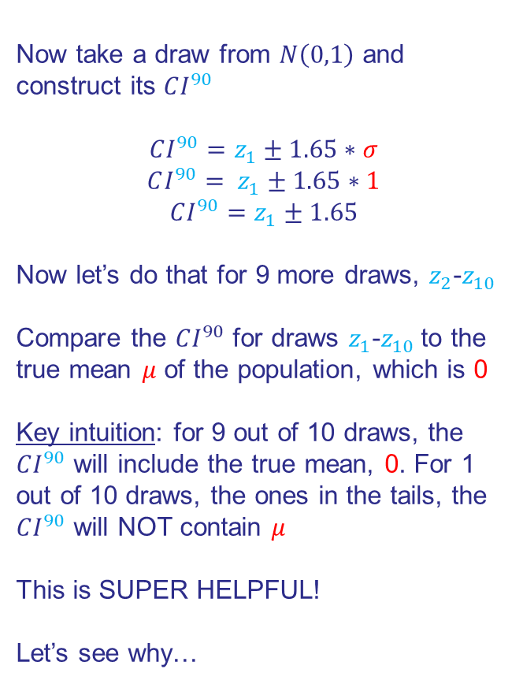
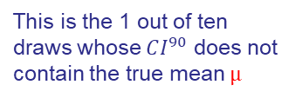

Constructing $CI^{90}$ Around Draw From $N(0,1)$
Now take a draw from $N\left(0,1\right)$ and construct its $CI^{90}$
$${CI^{90}=z}_{1}±1.65∗σ$$
$$CI^{90}= z_{1}±1.65∗1$$
$${CI^{90}=z}_{1}±1.65$$
Now let’s do that for 9 more draws, $z_{2}$-$z_{10}$
Compare the $CI^{90}$ for draws $z_{1}$-$z_{10}$to the true mean $μ$ of the population, which is 0
Key intuition: for 9 out of 10 draws, the $CI^{90}$ will include the true mean, 0. For 1 out of 10 draws, the ones in the tails, the $CI^{90}$ will NOT contain $μ$
This is SUPER HELPFUL!
Let’s see why…
Sample $CI^{90}$ vs $N(0,1)$Population
z₂
1.65
1.65
z₆
z₅
z₉
z₁
z₇
z₈
z₃
z₄
z₁₀
This is the 1 out of ten draws whose $CI^{90}$ does not contain the true mean $μ$

Slide 63
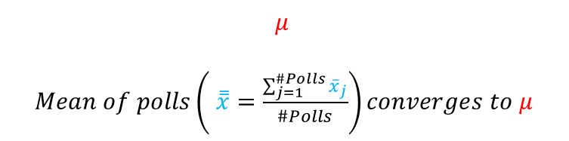





Apply $CI$ Intuition to the Fox Poll
Distribution of Poll Results
$Std Err(\overline{x})=\frac{σ}{\sqrt{N}}$
Population
g
Fox
Gallup
Zogby
Etc
Central Limit Theorem
$${\overline{x}}_{1}$$
$${\overline{x}}_{2}$$
$${\overline{x}}_{3}$$
$${\overline{x}}_{j}$$
$$μ$$
$Mean of polls\left( \overset{̿}{x}=\frac{\sum_{j=1}^{\#Polls}{{\overline{x}}_{j}}}{\#Polls}\right)converges to μ$

Slide 64


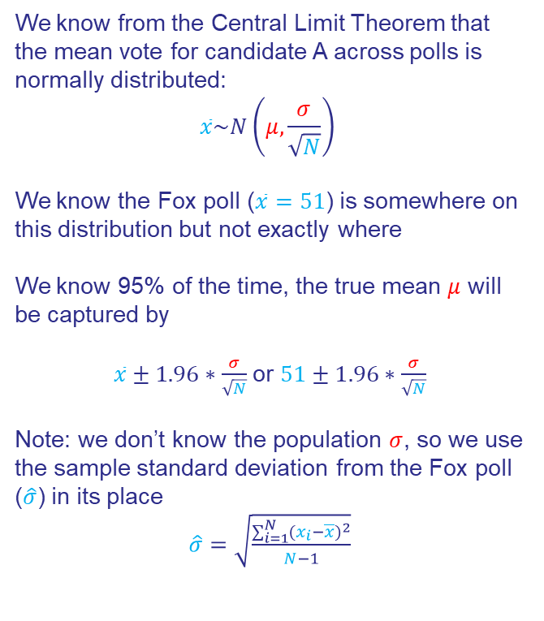



Fox Poll 95% Confidence Interval ($CI^{95}$)
We know from the Central Limit Theorem that the mean vote for candidate A across polls is normally distributed:
$$\overline{x}\sim N\left(μ,\frac{σ}{\sqrt{N}}\right)$$
We know the Fox poll ($\overline{x}=51$) is somewhere on this distribution but not exactly where
We know 95% of the time, the true mean $μ$ will be captured by
$\overline{x}±1.96∗\frac{σ}{\sqrt{N}}$ or $51±1.96∗\frac{σ}{\sqrt{N}}$
Note: we don’t know the population $σ$, so we use the sample standard deviation from the Fox poll ($\hat{σ}$) in its place
$\hat{σ}=\sqrt{\frac{\sum_{i=1}^{N}{(x_{i}−\overline{x})^{2}}}{N−1}}$
Distribution of Poll Results, $N(μ,\frac{σ}{\sqrt{N}})$
$$51−1.96∗\frac{σ}{\sqrt{N}}$$
$$51+1.96∗\frac{σ}{\sqrt{N}}$$
Fox
$Std Err\text{(}\text{x}\text{ ̅)}=\frac{σ}{\sqrt{N}}$
$$μ$$
True support for candidate A

Slide 65



Fox Poll 95% Confidence Interval ($CI^{95}$)
We know from the Central Limit Theorem that the mean vote for candidate A across polls is normally distributed:
$$\overline{x}\sim N\left(μ,\frac{σ}{\sqrt{N}}\right)$$
We know the Fox poll ($\overline{x}=51$) is somewhere on this distribution but not exactly where
We know 95% of the time, the true mean $μ$ will be captured by
$\overline{x}±1.96∗\frac{σ}{\sqrt{N}} \text{or} 51±1.96∗\frac{σ}{\sqrt{N}}$
Note: we don’t know the population $σ$, so we use the sample standard deviation from the Fox poll ($\hat{σ}$) in its place
$\hat{σ}=\sqrt{\frac{\sum_{i=1}^{N}{(x_{i}−\overline{x})^{2}}}{N−1}}$
Distribution of Poll Results, $N(μ,\frac{σ}{\sqrt{N}})$
$$51−1.96∗\frac{\hat{σ}}{\sqrt{N}}$$
$$51−1.96∗\frac{\hat{σ}}{\sqrt{N}}$$
Fox
$Std Err\text{(}\text{x}\text{ ̅)}=\frac{σ}{\sqrt{N}}$
$$μ$$
True support for candidate A

Slide 66
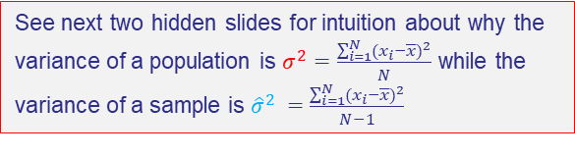

Fox Poll 95% Confidence Interval ($CI^{95}$)
We know from the Central Limit Theorem that the mean vote for candidate A across polls is normally distributed:
$$\overline{x}\sim N\left(μ,\frac{σ}{\sqrt{N}}\right)$$
We know the Fox poll ($\overline{x}=51$) is somewhere on this distribution but not exactly where
We know 95% of the time, the true mean $μ$ will be captured by
$\overline{x}±1.96∗\frac{σ}{\sqrt{N}} \text{or} 51±1.96∗\frac{σ}{\sqrt{N}}$
Note: we don’t know the population $σ$, so we use the sample standard deviation from the Fox poll ($\hat{σ}$) in its place
$\hat{σ}=\sqrt{\frac{\sum_{i=1}^{N}{(x_{i}−\overline{x})^{2}}}{N−1}}$
Distribution of Poll Results, $N(μ,\frac{σ}{\sqrt{N}})$
$$51−1.96∗\frac{\hat{σ}}{\sqrt{N}}$$
$$51−1.96∗\frac{\hat{σ}}{\sqrt{N}}$$
Fox
$Std Err\text{(}\text{x}\text{ ̅)}=\frac{σ}{\sqrt{N}}$
$$μ$$
True support for candidate A
See next two hidden slides for intuition about why the variance of a population is $σ^{2}=\frac{\sum_{i=1}^{N}{(x_{i}−\overline{x})^{2}}}{N}$ while the variance of a sample is ${\hat{σ}}^{2} =\frac{\sum_{i=1}^{N}{(x_{i}−\overline{x})^{2}}}{N−1}$

Slide 67
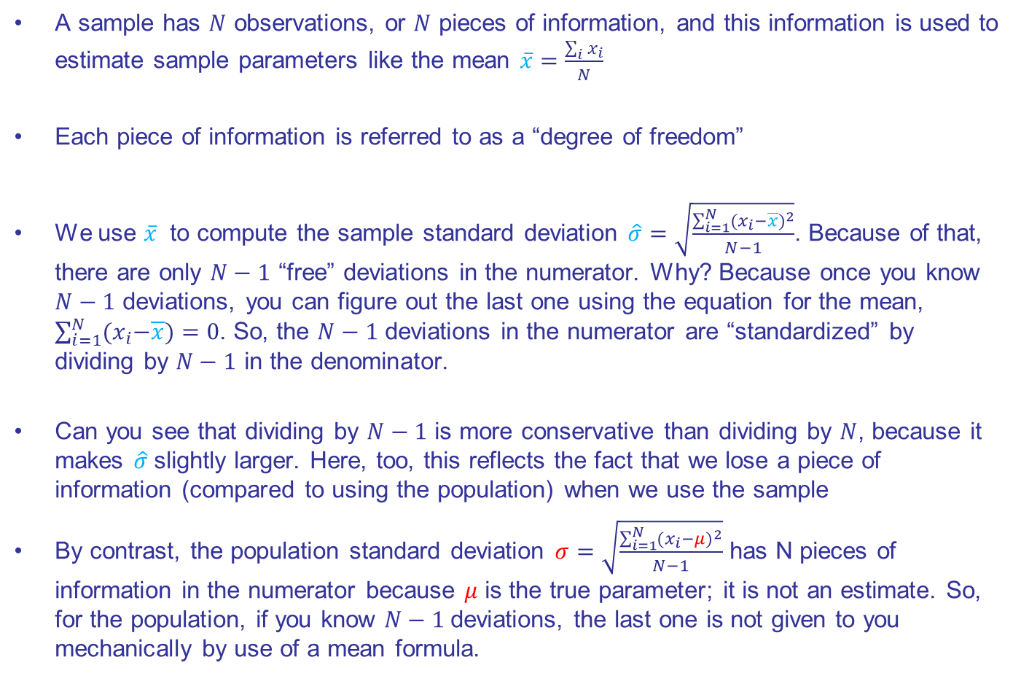
Degrees of Freedom
A sample has $N$ observations, or $N$ pieces of information, and this information is used to estimate sample parameters like the mean $\overline{x}=\frac{\sum_{i}{x_{i}}}{N}$
Each piece of information is referred to as a “degree of freedom”
We use $\overline{x}$ to compute the sample standard deviation $\hat{σ}=\sqrt{\frac{\sum_{i=1}^{N}{(x_{i}−\overline{x})^{2}}}{N−1}}$. Because of that, there are only $N−1$ “free” deviations in the numerator. Why? Because once you know $N−1$ deviations, you can figure out the last one using the equation for the mean, $\sum_{i=1}^{N}{{(x}_{i}−\overline{x})}=0$. So, the $N−1$ deviations in the numerator are “standardized” by dividing by $N−1$ in the denominator.
Can you see that dividing by $N−1$ is more conservative than dividing by $N$, because it makes $\hat{σ}$slightly larger. Here, too, this reflects the fact that we lose a piece of information (compared to using the population) when we use the sample
By contrast, the population standard deviation $σ=\sqrt{\frac{\sum_{i=1}^{N}{(x_{i}−μ)^{2}}}{N−1}}$ has N pieces of information in the numerator because $μ$ is the true parameter; it is not an estimate. So, for the population, if you know $N−1$deviations, the last one is not given to you mechanically by use of a mean formula.

Slide 68
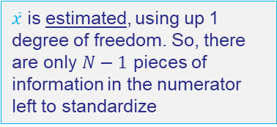
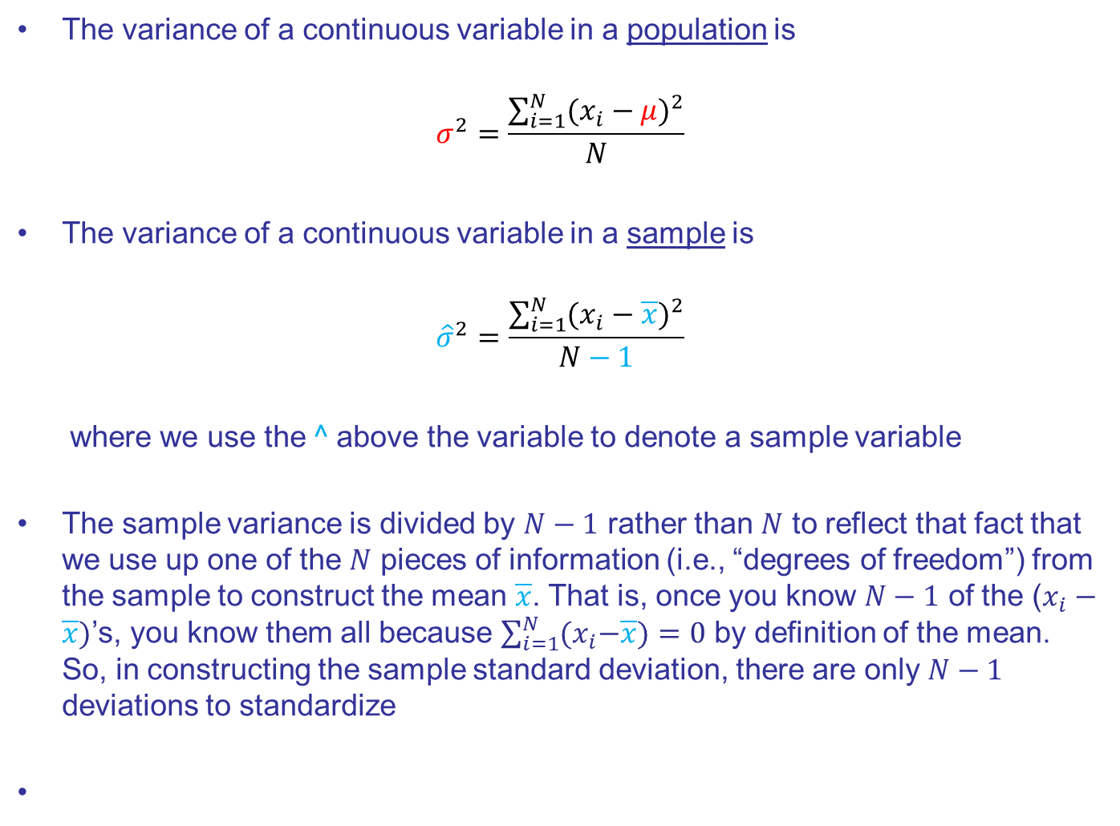

Population Variance vs Sample Variance
The variance of a continuous variable in a population is
$$σ^{2}=\frac{\sum_{i=1}^{N}{(x_{i}−μ)^{2}}}{N}$$
The variance of a continuous variable in a sample is
$${\hat{σ}}^{2}=\frac{\sum_{i=1}^{N}{(x_{i}−\overline{x})^{2}}}{N−1}$$
where we use the ^ above the variable to denote a sample variable
The sample variance is divided by $N−1$ rather than $N$ to reflect that fact that we use up one of the $N$ pieces of information (i.e., “degrees of freedom”) from the sample to construct the mean $\overline{x}$. That is, once you know $N−1$ of the ($x_{i}−\overline{x})$’s, you know them all because $\sum_{i=1}^{N}{{(x}_{i}−\overline{x})}=0$ by definition of the mean. So, in constructing the sample standard deviation, there are only $N−1$ deviations to standardize
$μ$ is the truth, so no correction in the denominator is needed
$\overline{x}$ is estimated, using up 1 degree of freedom. So, there are only $N−1$ pieces of information in the numerator left to standardize

Slide 69
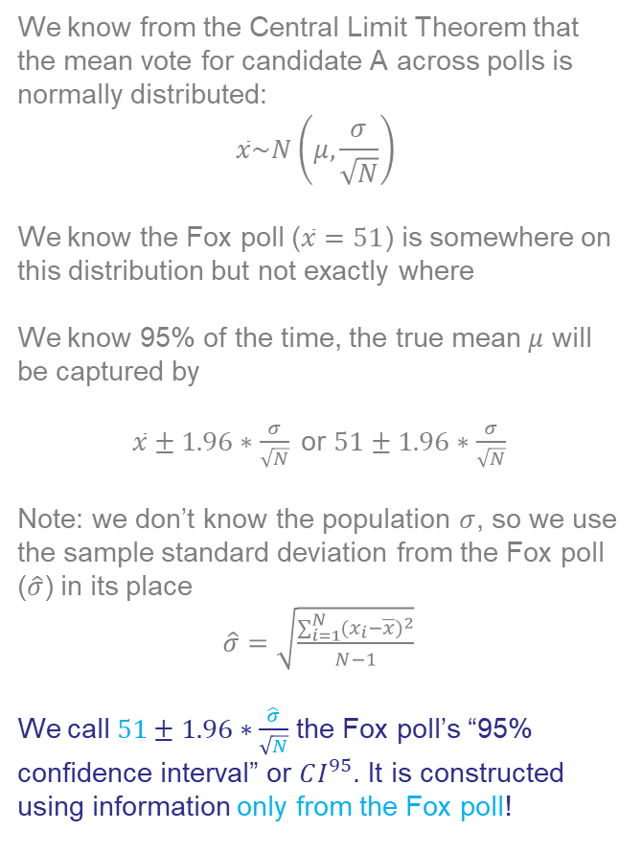

Fox Poll 95% Confidence Interval ($CI^{95}$)
We know from the Central Limit Theorem that the mean vote for candidate A across polls is normally distributed:
$$\overline{x}\sim N\left(μ,\frac{σ}{\sqrt{N}}\right)$$
We know the Fox poll ($\overline{x}=51$) is somewhere on this distribution but not exactly where
We know 95% of the time, the true mean $μ$ will be captured by
$\overline{x}±1.96∗\frac{σ}{\sqrt{N}} \text{or} 51±1.96∗\frac{σ}{\sqrt{N}}$
Note: we don’t know the population $σ$, so we use the sample standard deviation from the Fox poll ($\hat{σ}$) in its place
$\hat{σ}=\sqrt{\frac{\sum_{i=1}^{N}{(x_{i}−\overline{x})^{2}}}{N−1}}$
We call $51±1.96∗\frac{\hat{σ}}{\sqrt{N}}$ the Fox poll’s “95% confidence interval” or $CI^{95}$. It is constructed using information only from the Fox poll!
Distribution of Poll Results, $N(μ,\frac{σ}{\sqrt{N}})$
$$51−1.96∗\frac{\hat{σ}}{\sqrt{N}}$$
$$51−1.96∗\frac{\hat{σ}}{\sqrt{N}}$$
Fox
$Std Err=\frac{σ}{\sqrt{N}}$
$$μ$$
True support for candidate A

Slide 70
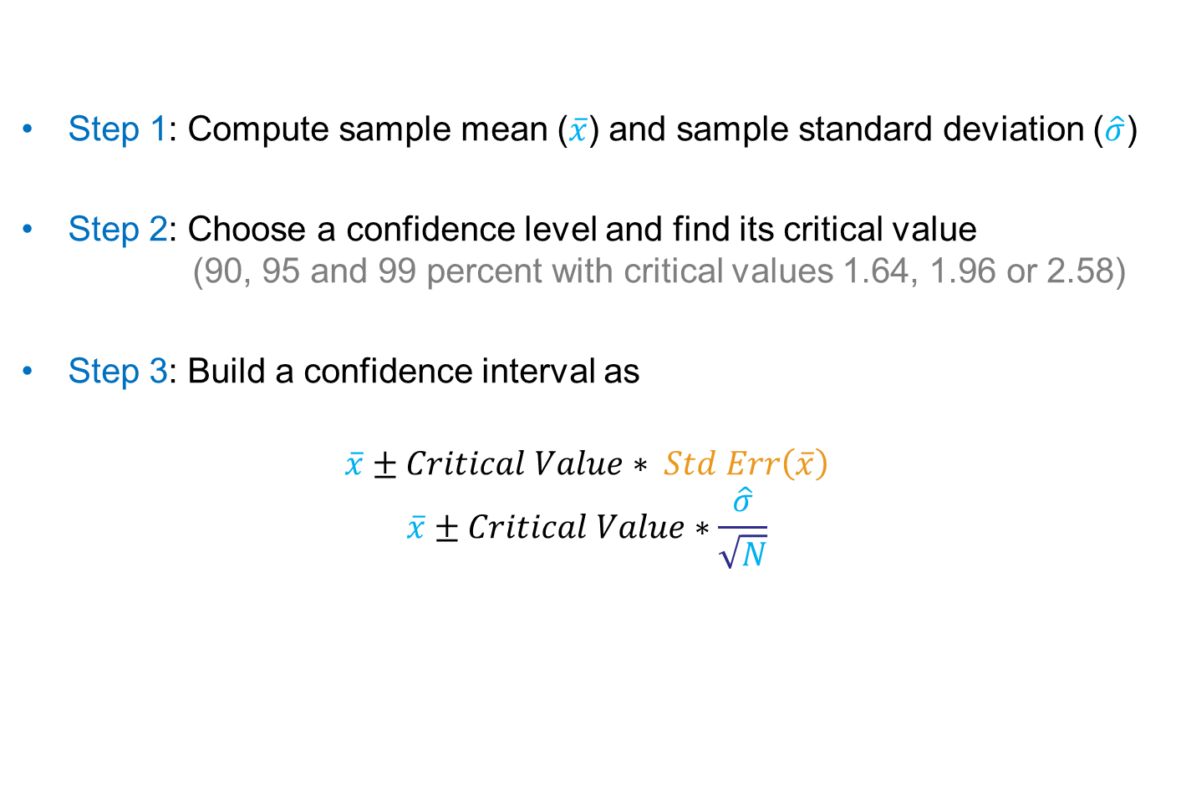
Recipe for Finding a Confidence Interval
Step 1: Compute sample mean ($\overline{x}$) and sample standard deviation ($\hat{σ}$)
Step 2: Choose a confidence level and find its critical value (90, 95 and 99 percent with critical values 1.64, 1.96 or 2.58)
Step 3: Build a confidence interval as
$$\overline{x}±Critical Value∗ Std Err\left(\overline{x}\right)$$
$$\overline{x}±Critical Value∗\frac{\hat{σ}}{\sqrt{N}}$$

Slide 71

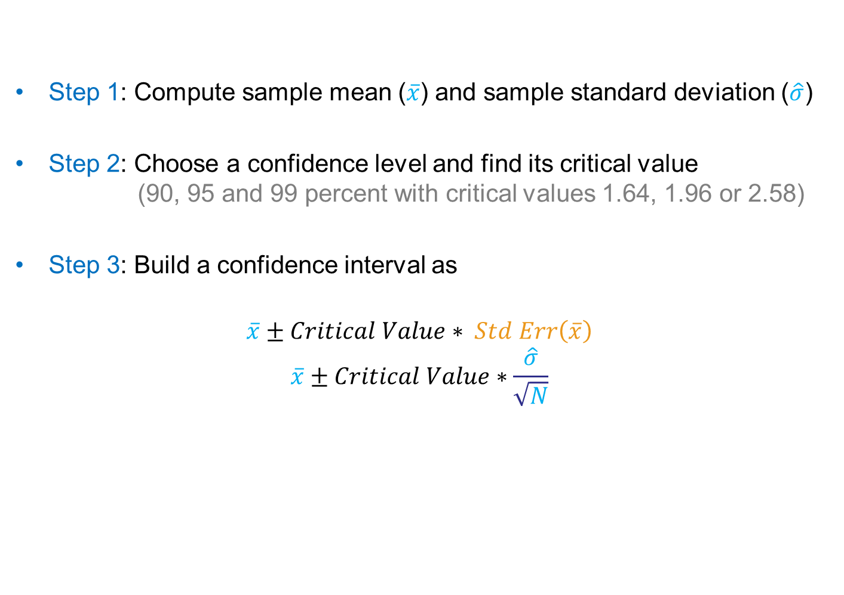
Recipe for Finding a Confidence Interval
Step 1: Compute sample mean ($\overline{x}$) and sample standard deviation ($\hat{σ}$)
Step 2: Choose a confidence level and find its critical value (90, 95 and 99 percent with critical values 1.64, 1.96 or 2.58)
Step 3: Build a confidence interval as
$$\overline{x}±Critical Value∗ Std Err\left(\overline{x}\right)$$
$$\overline{x}±Critical Value∗\frac{\hat{σ}}{\sqrt{N}}$$
Note: $Critical Value∗Std Err\left(\overline{x}\right)$ is known as the “margin of error”

Slide 72
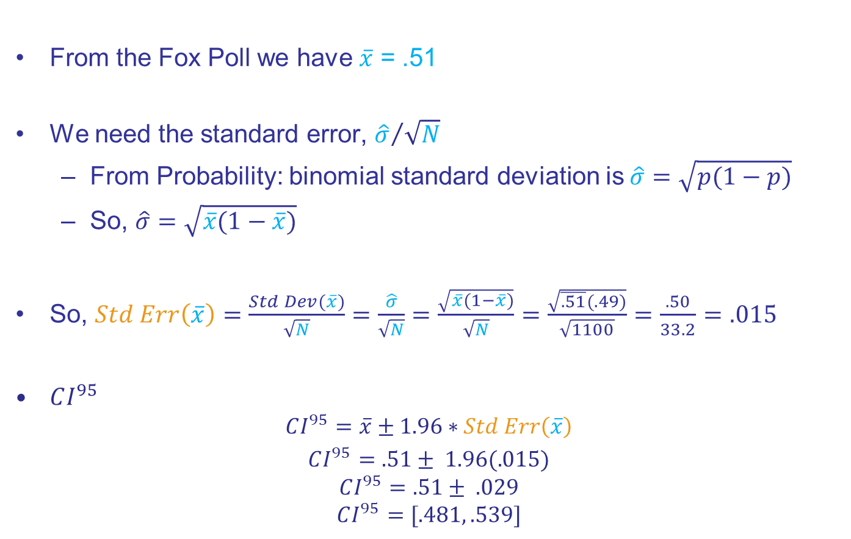
Computing the $CI^{95}$ of the Fox Poll
From the Fox Poll we have $\overline{x}$ = .51
We need the standard error, ${\hat{σ}}/{\sqrt{N}}$
From Probability: binomial standard deviation is$\hat{σ}=\sqrt{p(1−p)}$
So, $\hat{σ}=\sqrt{\overline{x}(1−\overline{x})}$
So, $Std Err\left(\overline{x}\right)=\frac{Std Dev(\overline{x})}{\sqrt{N}}=\frac{\hat{σ}}{\sqrt{N}}=\frac{\sqrt{\overline{x}(1−\overline{x})}}{\sqrt{N}}=$ $\frac{\sqrt{\overline{.51}(.49)}}{\sqrt{1100}}=\frac{.50}{33.2}=.015$
$CI^{95}$
$$CI^{95}=\overline{x}±1.96∗Std Err\left(\overline{x}\right)$$
$CI^{95}=.51± 1.96(.015)$
$$CI^{95}=.51± .029$$
$$CI^{95}=[.481, .539]$$

Slide 73
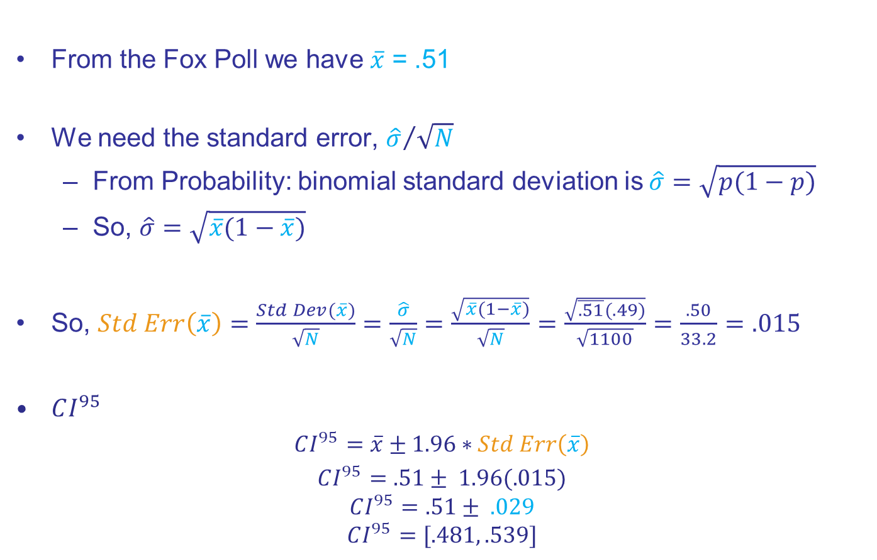
Computing the $CI^{95}$ of the Fox Poll
From the Fox Poll we have $\overline{x}$ = .51
We need the standard error, ${\hat{σ}}/{\sqrt{N}}$
From Probability: binomial standard deviation is$\hat{σ}=\sqrt{p(1−p)}$
So, $\hat{σ}=\sqrt{\overline{x}(1−\overline{x})}$
So, $Std Err\left(\overline{x}\right)=\frac{Std Dev(\overline{x})}{\sqrt{N}}=\frac{\hat{σ}}{\sqrt{N}}=\frac{\sqrt{\overline{x}(1−\overline{x})}}{\sqrt{N}}=$ $\frac{\sqrt{\overline{.51}(.49)}}{\sqrt{1100}}=\frac{.50}{33.2}=.015$
$CI^{95}$
$CI^{95}=\overline{x}±1.96∗Std Err\left(\overline{x}\right)$
$CI^{95}=.51± 1.96(.015)$
$$CI^{95}=.51± .029$$
$$CI^{95}=[.481, .539]$$
Poll’s “margin of error”

Slide 74


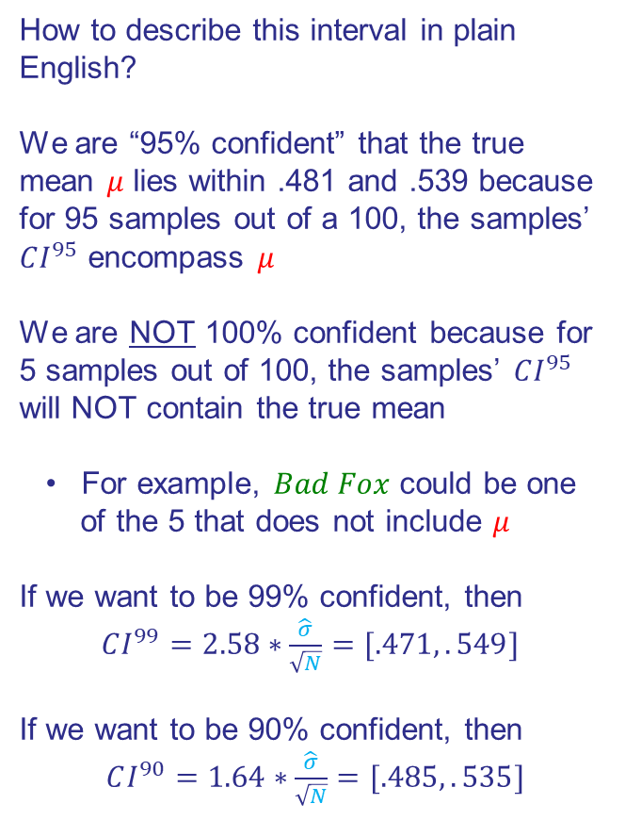
$CI^{95}$ Interpretation
How to describe this interval in plain English?
We are “95% confident” that the true mean $μ$ lies within .481 and .539 because for 95 samples out of a 100, the samples’ $CI^{95}$ encompass $μ$
We are NOT 100% confident because for 5 samples out of 100, the samples’ $CI^{95}$ will NOT contain the true mean
For example, $Bad Fox$ could be one
of the 5 that does not include $μ$
If we want to be 99% confident, then
$CI^{99}=2.58∗\frac{\hat{σ}}{\sqrt{N}}=[.471,.549]$
If we want to be 90% confident, then
$CI^{90}=1.64∗\frac{\hat{σ}}{\sqrt{N}}=[.485,.535]$
Distribution of Poll Results, $N(μ,\frac{σ}{\sqrt{N}})$
$$.481$$
$$.539$$
Fox
Bad Fox!
$$μ$$
True support for candidate A

Slide 75
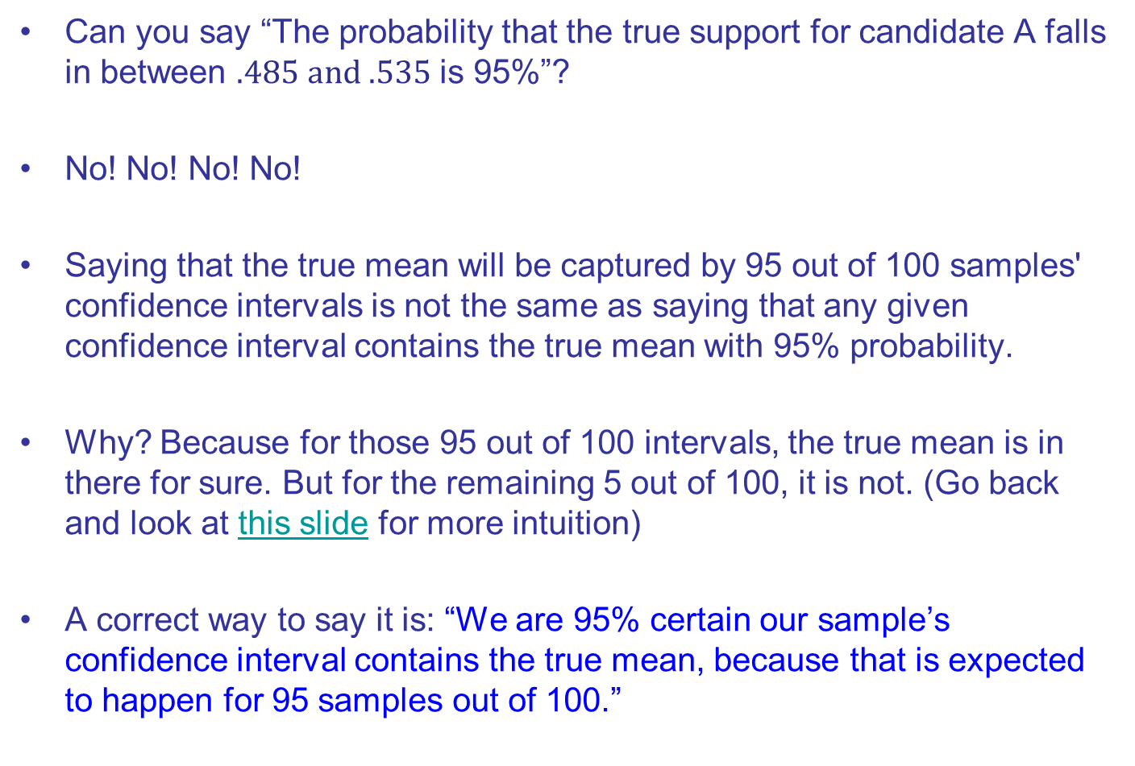
$CI^{95}$ Plain English
Can you say “The probability that the true support for candidate A falls in between $.485 and .535$ is 95%”?
No! No! No! No!
Saying that the true mean will be captured by 95 out of 100 samples' confidence intervals is not the same as saying that any given confidence interval contains the true mean with 95% probability.
Why? Because for those 95 out of 100 intervals, the true mean is in there for sure. But for the remaining 5 out of 100, it is not. (Go back and look at this slide for more intuition)
A correct way to say it is: “We are 95% certain our sample’s confidence interval contains the true mean, because that is expected to happen for 95 samples out of 100.”

Slide 76

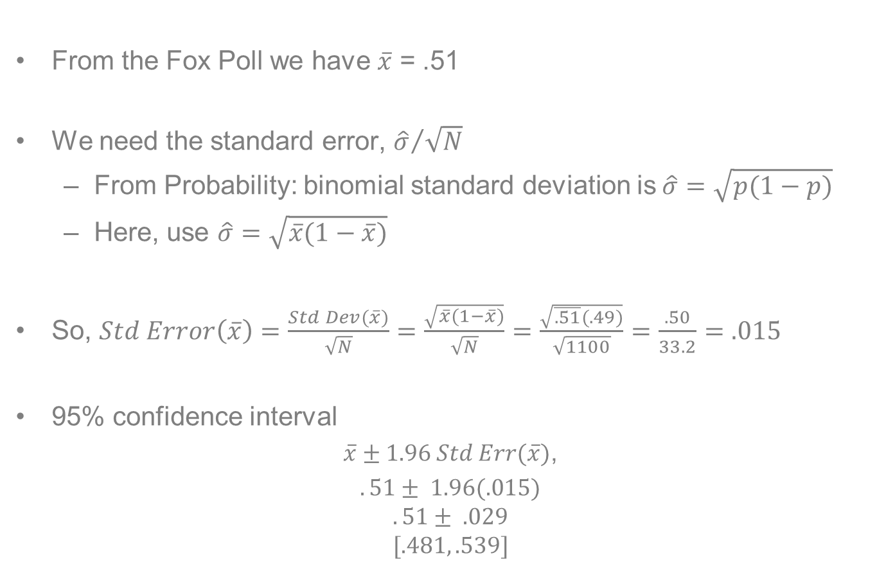
Computing the 95% CI of the Fox Poll
From the Fox Poll we have $\overline{x}$ = .51
We need the standard error, ${\hat{σ}}/{\sqrt{N}}$
From Probability: binomial standard deviation is$\hat{σ}=\sqrt{p(1−p)}$
Here, use $\hat{σ}=\sqrt{\overline{x}(1−\overline{x})}$
So, $Std Error\left(\overline{x}\right)=\frac{Std Dev(\overline{x})}{\sqrt{N}}=\frac{\sqrt{\overline{x}(1−\overline{x})}}{\sqrt{N}}=$ $\frac{\sqrt{\overline{.51}(.49)}}{\sqrt{1100}}=\frac{.50}{33.2}=.015$
95% confidence interval
$\overline{x}±1.96 Std Err(\overline{x})$,
$.51± 1.96(.015)$
$$.51± .029$$
$$[.481, .539]$$
Note: Pollsters often use .5 rather than the actual poll standard deviation to be conservative, because $\sqrt{\overline{x}(1−\overline{x})}$ is largest when p=.5.
In that case, the margin of error depends purely on $N$. Here, the difference for p=.5 and p=.51 is minimal.

Slide 77
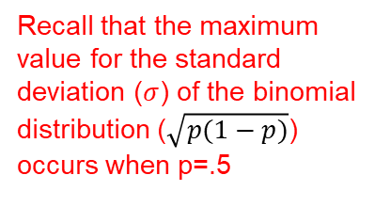
Standard Deviation of Binomial Distribution For values of p=(0,1)
Recall that the maximum value for the standard deviation ($σ$) of the binomial distribution ($\sqrt{p(1−p)}$) occurs when p=.5

Slide 78
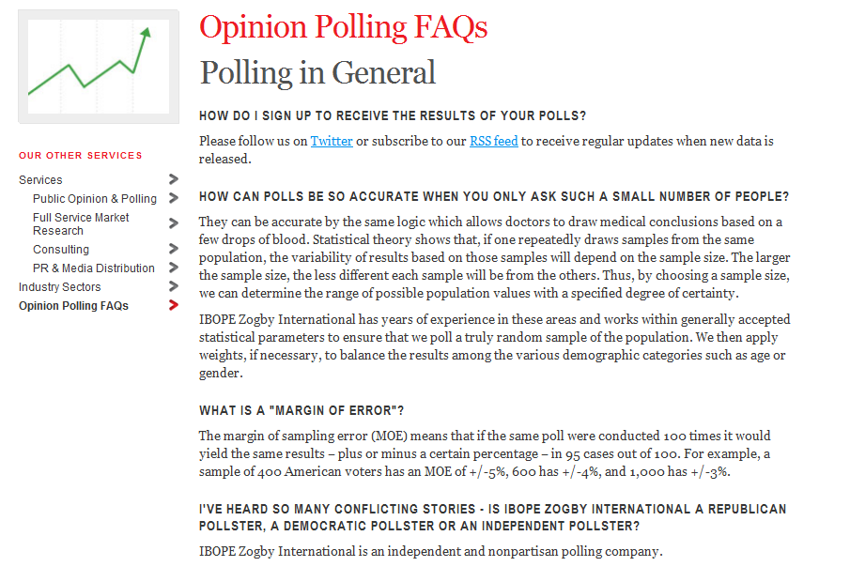
Zogby’s Definition of “Margin of Error”

Slide 79

Computing the 95% CI of the Fox Poll
95% confidence interval ($CI^{95}$)
$CI^{95}=\overline{x}±1.96 Std Err(\overline{x})$,
$.51± 1.96(.015)$
$$.51± .029$$
[.481, .539]
What do we conclude about candidate A’s chances of victory?
The $CI^{95}$ includes values $≤.50$. So we are NOT 95 percent confident that our candidate will win
Suppose same $\overline{x}=51$ result, but sample size 10x larger?
$CI^{95}$is then $.51± .004=[.506,.514]$
We are 95% confident that the true support is above .50, so we are 95% confident of victory

Slide 80
Be Careful!!!
Fox Poll

Slide 81
Be Careful!!!
Actual vote for candidate A in election was 52.3
Why do so many intervals exclude the true support?
Fox Poll

Slide 83
End

Slide 84
Broader Goals

Slide 85
Higher-Order Goals
Learn how to simplify!
Learn a bit about the “art” of data analysis
How to frame a question?
How to display the results?
How to talk about them so ordinary people can understand you?

Slide 86
Effective Data Analysis Stands on Three Legs
Issues (Questions)
Is this the best story for answering your question?
What kind of evidence can you bring to bear on this question?
Theory (Stories)
Data (Evidence)
Which story is most favored by the available evidence?

Slide 87
Tell Your Story in Three Languages
Pictures
Words
Numbers

Slide 88
Yale SOM Mission Statement

Slide 89
Yale Mission
The mission of the Yale School of Management is to educate leaders for business and society

Slide 90
Yale Mission
The mission of the Yale School of Management is to educate leaders for business and society
We seek students who care deeply about the problems afflicting our world. We equip them with the knowledge, the resources, and the networks to pursue positive and ambitious change—whether that takes the form of launching a business that can refashion its market, advancing far-reaching and rigorously considered policy initiatives, or steering a multinational corporation with keen awareness of and respect for its impact on workers, communities, and the environment.

Slide 91
Bootstrapping a Means Test (if Time)

Slide 92
Bootstrapping!
Classical statistical theory evolved when computation was very costly
Huge premium on analytical solutions like above
Today, computation is cheap, so a lot more can be done numerically
Bootstrapping (re-sampling) is a powerful numerical approach to statistical inference

Slide 93

History of Bootstrapping
Idea goes back to the 1930s
Formally introduced in 1979 by Bradley Efron
Instead of relying on analytical formulas or asymptotic theory, simulate the sampling distribution of a statistic by resampling with replacement from the observed data.
Basic idea: if a sample is representative, you can use re-sampling of it to determine the empirical distribution of your test statistic
So, instead of using the central limit theorem to get an analytic normal distribution for polls, re-sample the same poll many times to get an empirical distribution

Slide 94



Poll Reliability with Bootstrapping
We can use bootstrapping to construct an alternate Fox poll $CI^{95}$
Assuming the Fox poll sample is representative of the population, we treat sample as the population and repeatedly randomly sample from it with replacement
Bootstrap Sample 1
Bootstrap Sample 2
Bootstrap Sample 3
Bootstrap Sample 4
.
.
.
Bootstrap Sample 1000
$${\overline{x}}_{1}$$
$${\overline{x}}_{2}$$
$${\overline{x}}_{3}$$
$${\overline{x}}_{4}$$
.
.
.
$${\overline{x}}_{1000}$$
We can use the distribution of these bootstrap sample vote shares for candidate A to compute a bootstrap $CI^{95}$
Population
Fox
News
Sample

Slide 95

Recipe for Finding a Bootstrap Confidence Interval
Step 1: Take 1000 draws with replacement from your sample and compute the mean of each draw
Step 2: Plot or list the means
Step 3: Build the $CI^{95}$ using the 25th and 975th observations (out of 1000) from low to high

Slide 96


Poll Reliability with Bootstrapping
If we sort the 1000 ${\overline{x}}_{1}$ from low to high, the 25th and 975th observations give us the $CI^{95}$
In this case,
$CI_{Boot}^{95}$=.481 to .536
Recall that our analytical interval was
$CI^{95}$=.481 to .539

Slide 97
How to Actually Run a Bootstrap?
If you know how to code, you can write a program
If you know how to use a good statistical package like Stata, R, Matlab, or Python, you can use already-created routines
ChatGPT:
Prompt: Suppose a poll of 1100 likely voters reveals that 51 percent will vote for candidate A. Please do a bootstrap of this poll's sample using 1000 draws of 1100 with replacement and plot the resulting vote shares for candidate A in a histogram. Please also tell me the bootstrap 95 percent confidence interval

Slide 98
When to Bootstrap?
Can depend on setting and assumptions
If you are interested in this topic, this article provides an interesting discussion of the pros and cons in a particular setting. If the link breaks, google “LSE Blog ‘New poll suggests…’: How to tell when public opinion has really changed”

Slide 99



Three Approaches to $CI^{95}$
Share Voting for Candidate A?
Many Polls?
One Poll?
Distribution of polls converges to $N\left(μ,\frac{σ}{\sqrt{N}}\right)$
Use polls’ distribution to find $CI^{95}$
Construct $CI^{95}$ as $\overline{x}±1.96 Std Err(\overline{x})$
Bootstrap!
Use resampling to find $CI^{95}$

Slide 100
Extra Example if Time: How Good is Warren Buffett?

Slide 101

Expected Return of Berkshire Hathaway Class A
Berkshire Hathaway (BRK) is a multinational conglomerate holding company based in Omaha, Nebraska, led by Warren Buffett
BRK offers two classes of shares, A and B. Class A shares have superior voting rights. Class B shares are more affordable
What’s the expected annualized daily return of BRK-A?
How does that compare to the expected annualized daily return of the S&P500?

Slide 102
BRK-A vs SP500 data_Berkshire_raw.csv
What do you see?
Source: Yahoo Finance

Slide 103

Summary of BRK-A Data data_berkshire_raw.csv
Random Variable
Distribution
Population
Sample
Sample estimates
$x_{i}$, the annualized daily return of BRK-A on day i
Continuous
All BRK-A returns, past and present
Prices for 6421 trading days 1/1/00-7/15/25
Sample Mean $\overline{x}=\frac{\sum_{i=1}^{N}{x_{i}}}{N}$
Sample Variance ${\hat{σ}}^{2}=\frac{\sum_{i=1}^{N}{(x_{i}−\overline{x})^{2}}}{N−1}$

Slide 104


BRK-A Daily Return $CI^{95}$ data_Berkshire_raw.csv
Open the dataset noted above and compute the following
Construct the $CI^{95}$ for BRK-A
$\overline{x}$ = .0004, $\hat{σ}$ = .0138, $N$=6420, $StdError=\frac{.0138}{\sqrt{6420}}=.00017$
$CI_{BRK−A}^{95} = (.000061,.00073)$
Interpretation?
If we had 100 samples of 6420 daily returns, the confidence intervals of 95 of them would contain the true BRK-A return. So, given the $CI^{95}$ above, we are 95% confident that BRK-A’s daily return is greater than 0! That is, we expect Buffet to have a positive return on any given day

Slide 105

BRK-A Daily Return $CI^{95}$ data_Berkshire_raw.csv
Open the dataset noted above and compute the following
Construct the $CI^{95}$ for BRK-A
$\overline{x}$ = .0004, $\hat{σ}$ = .0138, $N$=6420, $StdError=\frac{.0138}{\sqrt{6420}}=.00017$
$CI_{BRK−A}^{95} = (.000061,.00073)$
Interpretation?
Now for S&P500
$\overline{x}$ = .0002, $\hat{σ}$ = .0123, $N$=6420, $StdError=\frac{.0123}{\sqrt{6420}}=.00015$
$CI_{SP500}^{95}= (−.000074,.00053)$
Does this result make sense? Let’s go back and look at the data

Slide 106
BRK-A vs SP500 data_Berkshire_raw.csv
Source: Yahoo Finance

Slide 107
Practice Exercise

Slide 108

Practice Exercise!
Suppose a poll finds that candidate X will receive $y$ percent of the vote. What are the 95 percent confidence intervals for $y=.45$ for samples sizes $N=100$ and $N=1000?$

Slide 109

Practice Exercise!
Suppose a poll finds that candidate X will receive $y$ percent of the vote. What are the 99 percent confidence intervals for $y=.45$ for samples sizes $N=100$ and $N=1000?$
$N=100$
$$CI^{99}=\overline{x}±2.58\frac{\sqrt{p(1−p)} }{\sqrt{N}}$$
$$CI^{99}=.45±2.58\frac{.5}{\sqrt{100}}$$
$$CI^{99}=.45±2.58\frac{.5}{10}$$
$$CI^{99}=[.321,.579]$$

Slide 110

Practice Exercise!
Suppose a poll finds that candidate X will receive $y$ percent of the vote. What are the 99 percent confidence intervals for $y=.45$ for samples sizes $N=100$ and $N=1000?$
$N=100$
$$CI^{99}=\overline{x}±2.58\frac{\sqrt{p(1−p)} }{\sqrt{N}}$$
$$CI^{99}=.45±2.58\frac{.5}{\sqrt{1000}}$$
$$CI^{99}=.45±2.58\frac{.5}{31.62}$$
$$CI^{99}=[.409,.491]$$

Slide 111
Additional Example

Slide 112
Example 4: Campaign Contributions

Slide 113


Campaign Contributions in Connecticut
Question: how do CT residents’ presidential campaign contributions compare across candidates?
Data: Random sample of 5,449 individual campaign contribution records for election year 2020. Note that these records exist only for “large” donors who contribute ≥ $200 over an election cycle, so heavily skewed

Slide 114

Summary of Campaign Contribution Sample
Random Variable
Distribution
Population
Sample
xxxxxxxx
Sample estimates
$x_{i}$, the contribution of individual i
Continuous
All registered voters
A random sample of $N=1,100$ likely voters
Sample Mean $\overline{x}=\frac{\sum_{i=1}^{N}{x_{i}}}{N}$
Sample Variance ${\hat{σ}}^{2}=\frac{\sum_{i=1}^{N}{(x_{i}−\overline{x})^{2}}}{N−1}$

Slide 115


Campaign Contribution 95 Percent Confidence Intervals
Open the dataset noted above and compute the following. The excel commands are in the table. Alternately, drop the file in Chat GPT and ask for these statistics
Construct the confidence interval
$\overline{x}$ = $96.37, $\hat{σ}$ = $295.75, N=5449, $StdError=\frac{295.75}{\sqrt{5449}}=4.0065$
90% confidence interval = $96.37±1.65(4.0065)=\left[\$89,\$103\right]$

