Slide 1
2. Hypothesis Testing
MGT 407e Probability & Statistics
Fall 2026
Peter K. Schott Yale School of Management & NBER & CEPR

Slide 2
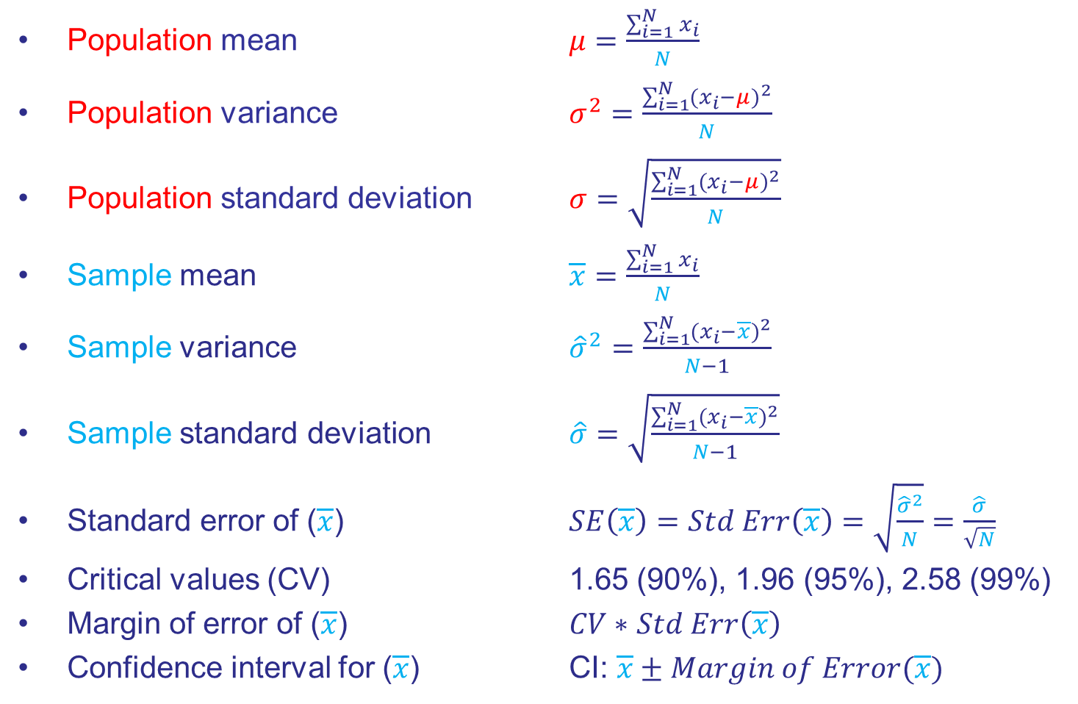
Vocabulary and Formulas 1
Population mean $μ$ $=\frac{\sum_{i=1}^{N}{x_{i}}}{N}$
Population variance $σ^{2}$ $=\frac{\sum_{i=1}^{N}{(x_{i}−μ)^{2}}}{N}$
Population standard deviation $σ=\sqrt{\frac{\sum_{i=1}^{N}{(x_{i}−μ)^{2}}}{N}}$
Sample mean $\overline{x}=\frac{\sum_{i=1}^{N}{x_{i}}}{N}$
Sample variance ${\hat{σ}}^{2}=\frac{\sum_{i=1}^{N}{(x_{i}−\overline{x})^{2}}}{N−1}$
Sample standard deviation $\hat{σ}=\sqrt{\frac{\sum_{i=1}^{N}{(x_{i}−\overline{x})^{2}}}{N−1}}$
Standard error of ($\overline{x}$) $SE\left(\overline{x}\right)=Std Err\left(\overline{x}\right)=\sqrt{\frac{{\hat{σ}}^{2}}{N}}=\frac{\hat{σ}}{\sqrt{N}}$
Critical values (CV) 1.65 (90%), 1.96 (95%), 2.58 (99%)
Margin of error of ($\overline{x}$) $CV∗$ $Std Err\left(\overline{x}\right)$
Confidence interval for ($\overline{x}$) CI: $\overline{x}±Margin of Error(\overline{x})$

Slide 3
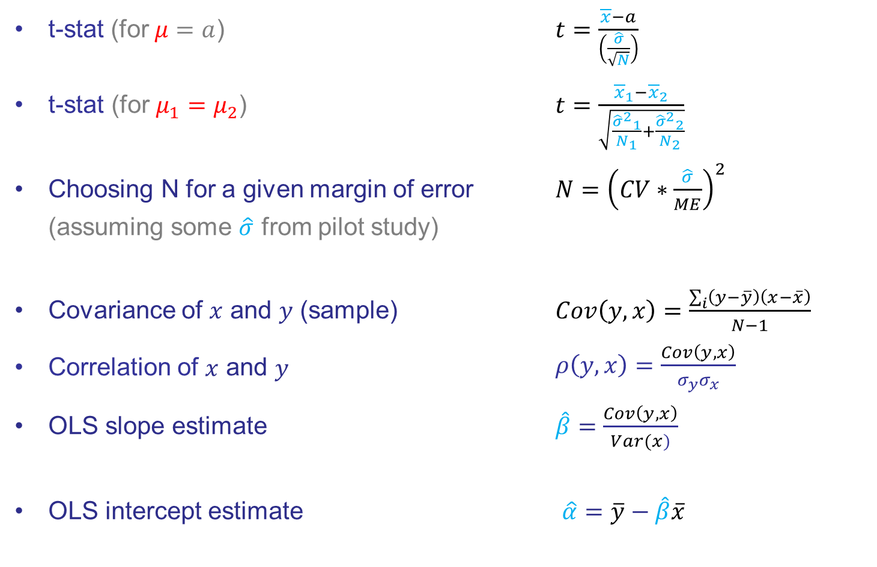
Vocabulary and Formulas 2
t-stat (for $μ=a$) $t=\frac{\overline{x}−a}{\left(\frac{\hat{σ}}{\sqrt{N}}\right)}$
t-stat (for $μ_{1}=μ_{2}$) $t=\frac{{\overline{x}}_{1}−{\overline{x}}_{2}}{\sqrt{\frac{{{\hat{σ}}^{2}}_{1}}{N_{1}}+\frac{{{\hat{σ}}^{2}}_{2}}{N_{2}}}}$
Choosing N for a given margin of error $N={\left(CV∗\frac{\hat{σ}}{ME}\right)}^{2}$ (assuming some $\hat{σ}$ from pilot study)
Covariance of $x$ and $y$ (sample) $Cov\left(y,x\right)=\frac{\sum_{i}{\left(y−\overline{y}\right)\left(x−\overline{x}\right)}}{N−1}$
Correlation of $x$ and $y$ $ρ\left(y,x\right)=\frac{Cov\left(y,x\right)}{σ_{y}σ_{x}}$
OLS slope estimate $\hat{β}=$ $\frac{Cov\left(y,x\right)}{Var(x)}$
OLS intercept estimate $\hat{α}=\overline{y}−\hat{β}\overline{x}$

Slide 4
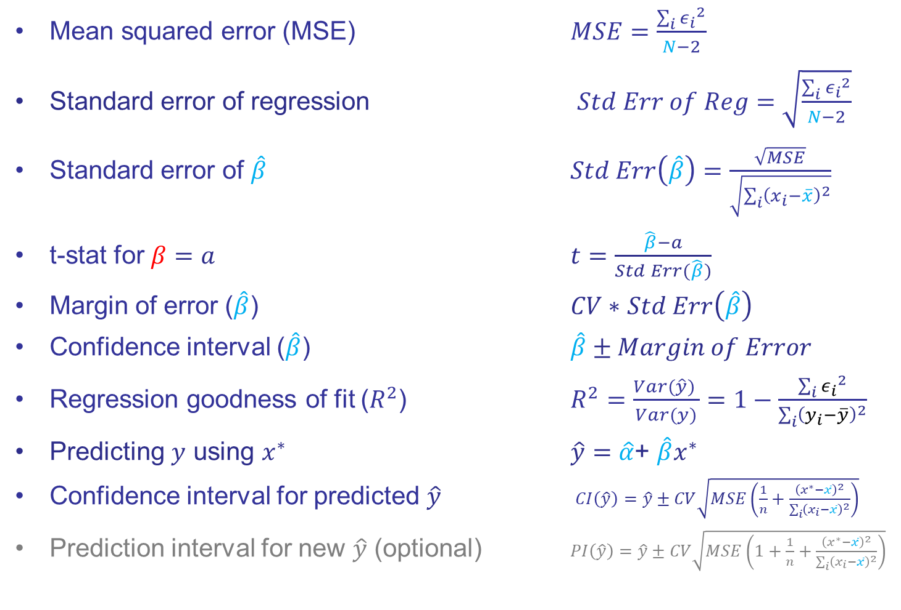
Vocabulary and Formulas 3
Mean squared error (MSE) $MSE=\frac{\sum_{i}{{ε_{i}}^{2}}}{N−2}$
Standard error of regression $Std Err of Reg=\sqrt{\frac{\sum_{i}{{ε_{i}}^{2}}}{N−2}}$
Standard error of $\hat{β}$ $Std Err\left(\hat{β}\right)=\frac{\sqrt{MSE}}{\sqrt{\sum_{i}{{\left(x_{i}−\overline{x}\right)}^{2}}}}$
t-stat for $β=a$ $t=\frac{\hat{β}−a}{Std Err(\hat{β})}$
Margin of error ($\hat{β}$) $CV∗$ $Std Err\left(\hat{β}\right)$
Confidence interval ($\hat{β}$) $\hat{β}±Margin of Error$
Regression goodness of fit ($R^{2}$) $R^{2}=\frac{Var(\hat{y}) }{Var(y)}=1−\frac{\sum_{i}{{ε_{i}}^{2}}}{\sum_{i}{{\left(y_{i}−\overline{y}\right)}^{2}}}$
Predicting $y$ using $x^{∗}$ $\hat{y}=$ $\hat{α}$+ $\hat{β}x^{∗}$
Confidence interval for predicted $\hat{y}$ $CI\left(\hat{y}\right)=\hat{y}±CV\sqrt{MSE\left(\frac{1}{n}+\frac{{\left(x^{∗}−\overline{x}\right)}^{2}}{\sum_{i}{{\left(x_{i}−\overline{x}\right)}^{2}}}\right)}$
Prediction interval for new $\hat{y}$ (optional) $PI\left(\hat{y}\right)=\hat{y}±CV\sqrt{MSE\left(1+\frac{1}{n}+\frac{{\left(x^{∗}−\overline{x}\right)}^{2}}{\sum_{i}{{\left(x_{i}−\overline{x}\right)}^{2}}}\right)}$

Slide 5
Today
Meeting | Dates | Topic
1 | 8/14 | Confidence Interval
2 | 8/28 | Hypothesis Testing
3 | 9/11 | Bivariate OLS Regression
4 | 9/25 | Multivariate OLS Regression
5 | 10/9 | OLS Extensions

Slide 6
Last Time / This Time
Last time
Course motivation
Population vs mean
Standard deviation vs standard error
90, 95 and 99 percent confidence intervals
This time
Hypothesis testing
What is a t-statistic?
What is a p-value?

Slide 7
Problem Set 1
My impression: AI is an amplifier of engagement, not an equalizer
Your reactions?
I am revising PS2 a bit given what I learned on PS 1.

Slide 8
Review
What does the Central Limit Theorem say?
Why is it so powerful?
What does it allow us to do?

Slide 9
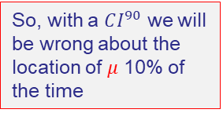
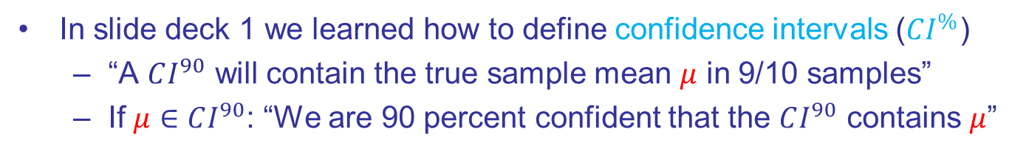
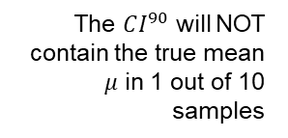
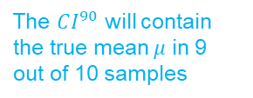

Motivation
In slide deck 1 we learned how to define confidence intervals ($CI^{\%}$)
“A $CI^{90}$ will contain the true sample mean $μ$ in 9/10 samples”
If $μ∈CI^{90}$: “We are 90 percent confident that the $CI^{90}$ contains $μ$”
Sample $CI^{90}$ vs $N(0,1)$Population
z₂
The $CI^{90}$ will contain the true mean $μ$ in 9 out of 10 samples
-1.65
1.65
z₆
z₅
z₉
So, with a $CI^{90}$ we will be wrong about the location of $μ$ 10% of the time
z₁
The $CI^{90}$ will NOT contain the true mean $μ$ in 1 out of 10 samples
z₇
z₈
z₃
z₄
z₁₀

Slide 10
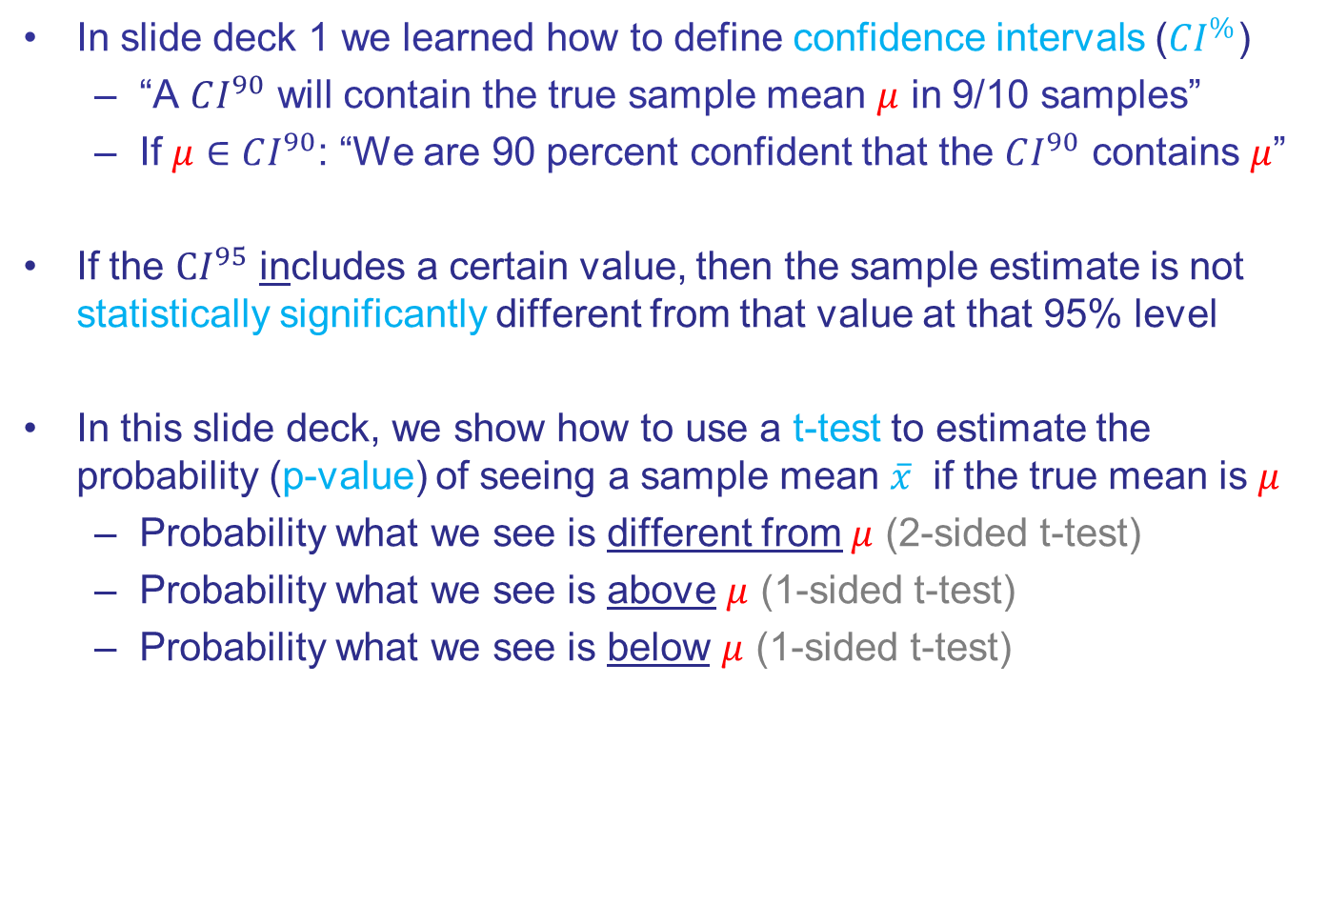
Motivation
In slide deck 1 we learned how to define confidence intervals ($CI^{\%}$)
“A $CI^{90}$ will contain the true sample mean $μ$ in 9/10 samples”
If $μ∈CI^{90}$: “We are 90 percent confident that the $CI^{90}$ contains $μ$”
If the $CI^{95}$ includes a certain value, then the sample estimate is not statistically significantly different from that value at that 95% level
In this slide deck, we show how to use a t-test to estimate the probability (p-value) of seeing a sample mean $\overline{x}$ if the true mean is $μ$
Probability what we see is different from $μ$ (2-sided t-test)
Probability what we see is above $μ$ (1-sided t-test)
Probability what we see is below $μ$ (1-sided t-test)

Slide 11
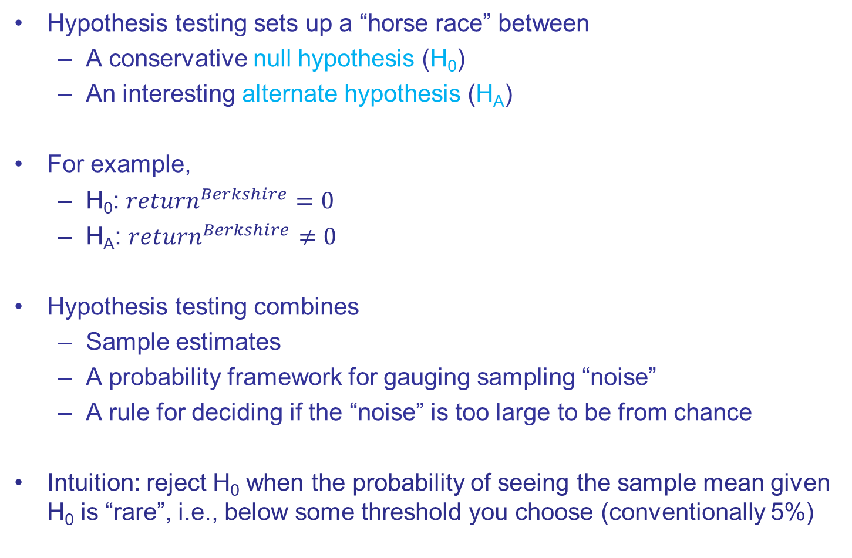
Hypothesis Testing
Hypothesis testing sets up a “horse race” between
A conservative null hypothesis (H₀)
An interesting alternate hypothesis (H_{A})
For example,
H₀: $return^{Berkshire}=0$
H_{A}: $return^{Berkshire}≠0$
Hypothesis testing combines
Sample estimates
A probability framework for gauging sampling “noise”
A rule for deciding if the “noise” is too large to be from chance
Intuition: reject H₀ when the probability of seeing the sample mean given H₀ is “rare”, i.e., below some threshold you choose (conventionally 5%)

Slide 12
Example: Tax Scoring (2-sided t-test)

Slide 13
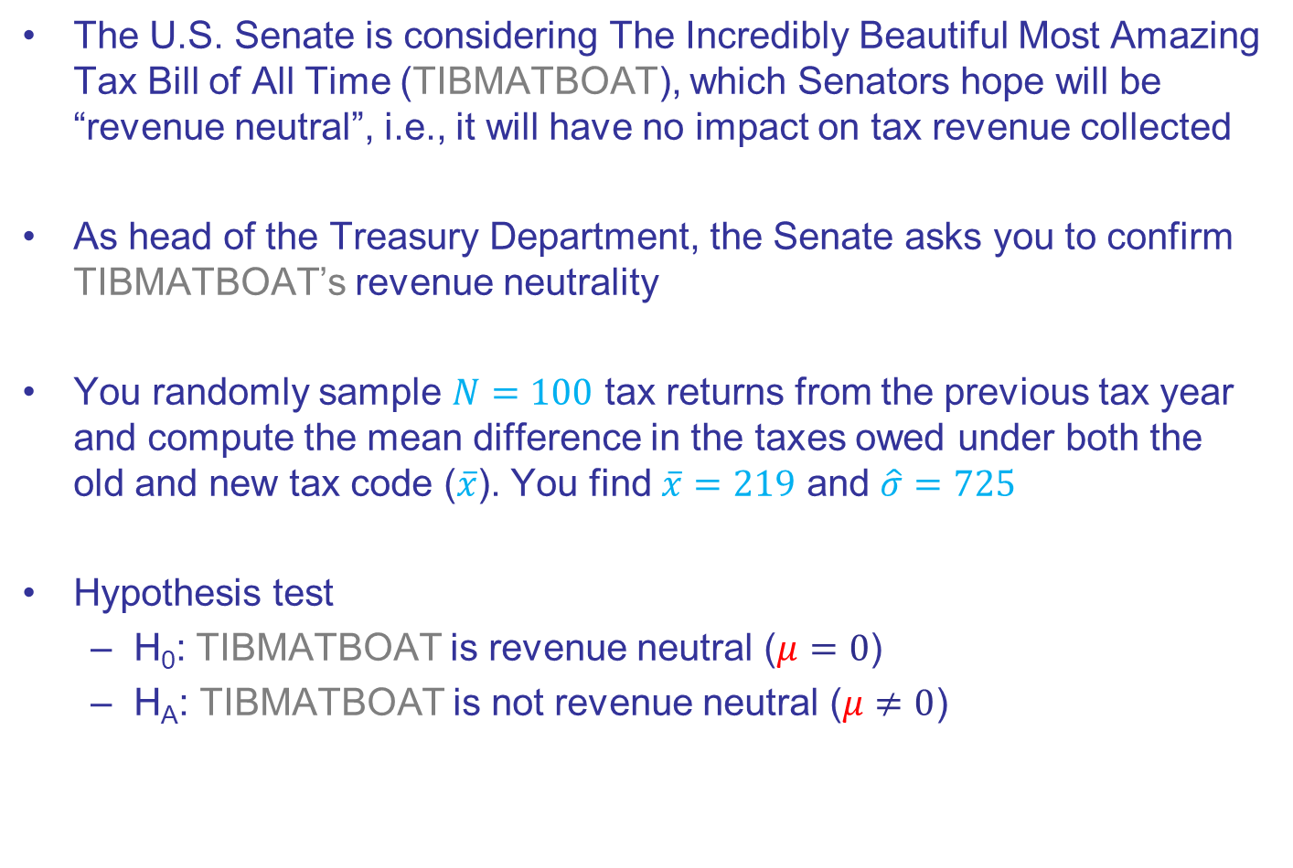
Tax Scoring
The U.S. Senate is considering The Incredibly Beautiful Most Amazing Tax Bill of All Time (TIBMATBOAT), which Senators hope will be “revenue neutral”, i.e., it will have no impact on tax revenue collected
As head of the Treasury Department, the Senate asks you to confirm TIBMATBOAT’s revenue neutrality
You randomly sample $N=100$ tax returns from the previous tax year and compute the mean difference in the taxes owed under both the old and new tax code ($\overline{x}$). You find $\overline{x}=219$ and $\hat{σ}=725$
Hypothesis test
H₀: TIBMATBOAT is revenue neutral ($μ=0$)
H_{A}: TIBMATBOAT is not revenue neutral ($μ≠0$)

Slide 14
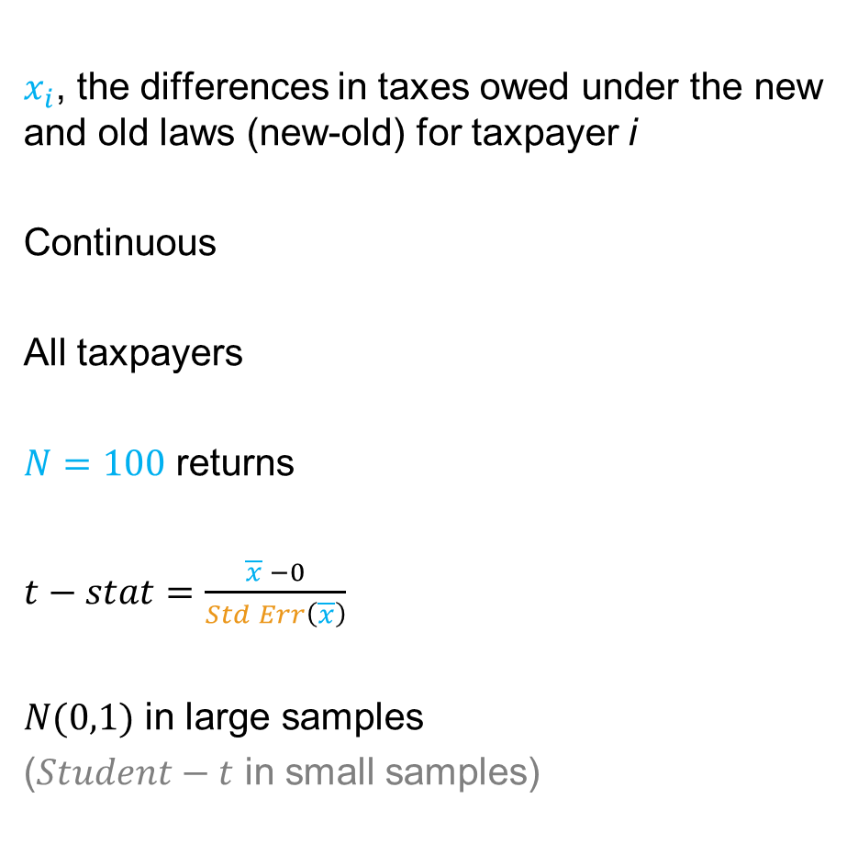
Summary of Tax Scoring Data
Random Variable xxxxxx
Distribution
Population
Sample
Test statistic
Test stat distribution
$x_{i}$, the differences in taxes owed under the new and old laws (new-old) for taxpayer i
Continuous
All taxpayers
$N=100$ returns
$t−stat=\frac{\overline{x} −0}{Std Err\left(\overline{x}\right)}$
$N(0,1)$ in large samples
($Student−t$ in small samples)
Null hypothesis value
We will show where the t-stat comes from in the next few slides

Slide 15
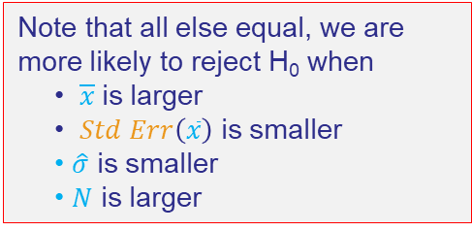
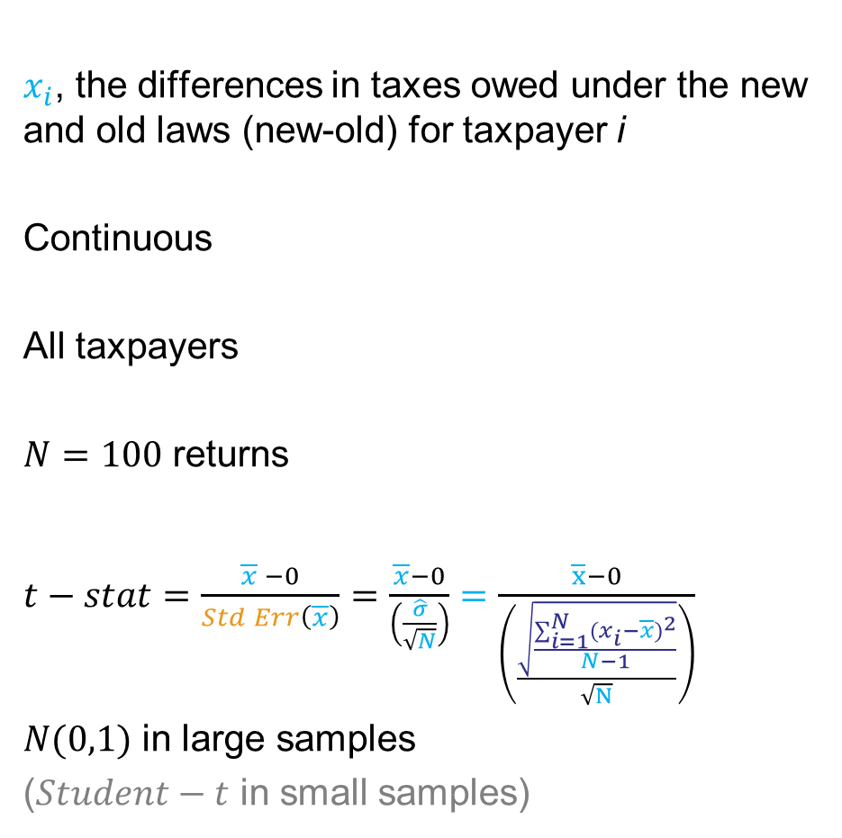
Summary of Tax Scoring Data
Random Variable xxxxxx
Distribution
Population
Sample
Test statistic
Test stat distribution
$x_{i}$, the differences in taxes owed under the new and old laws (new-old) for taxpayer i
Continuous
All taxpayers
$N=100$ returns
$t−stat=\frac{\overline{x} −0}{Std Err\left(\overline{x}\right)}=\frac{\overline{x}−0}{\left(\frac{\hat{σ}}{\sqrt{N}}\right)}=\frac{\overline{x}−0}{\left(\frac{\sqrt{\frac{\sum_{i=1}^{N}{(x_{i}−\overline{x})^{2}}}{N−1}}}{\sqrt{N}}\right)}$
$N(0,1)$ in large samples
($Student−t$ in small samples)
Note that all else equal, we are more likely to reject H₀ when
$\overline{x}$is larger
$Std Err\left(\overline{x}\right)$ is smaller
$\hat{σ}$ is smaller
$N$ is larger

Slide 16
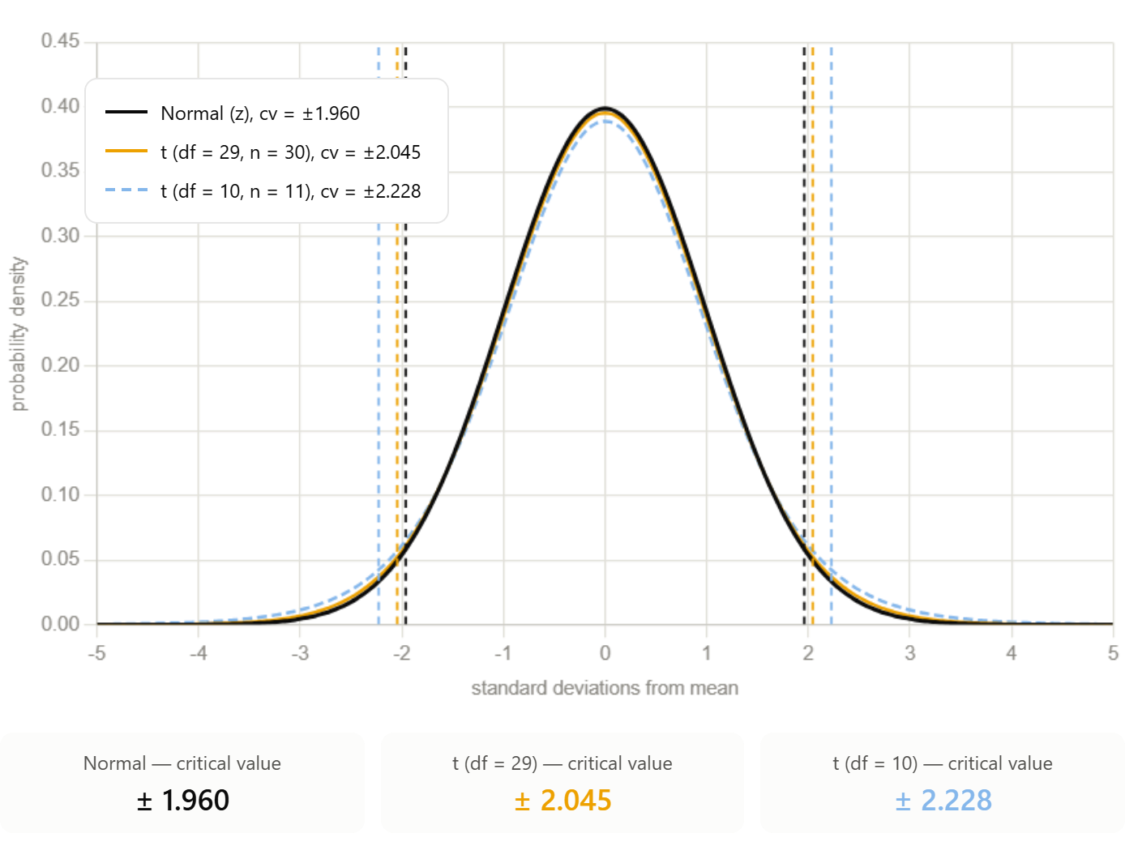

$N(0,1)$ vs $Student−t$ Distributions
The $Student−t$ distribution has fatter tails to reflect the greater uncertainty when sample size ($n$) is small
The tails keep getting fatter as $n$ declines
These fatter tails mean larger $CI^{95}$ critical values

Slide 17
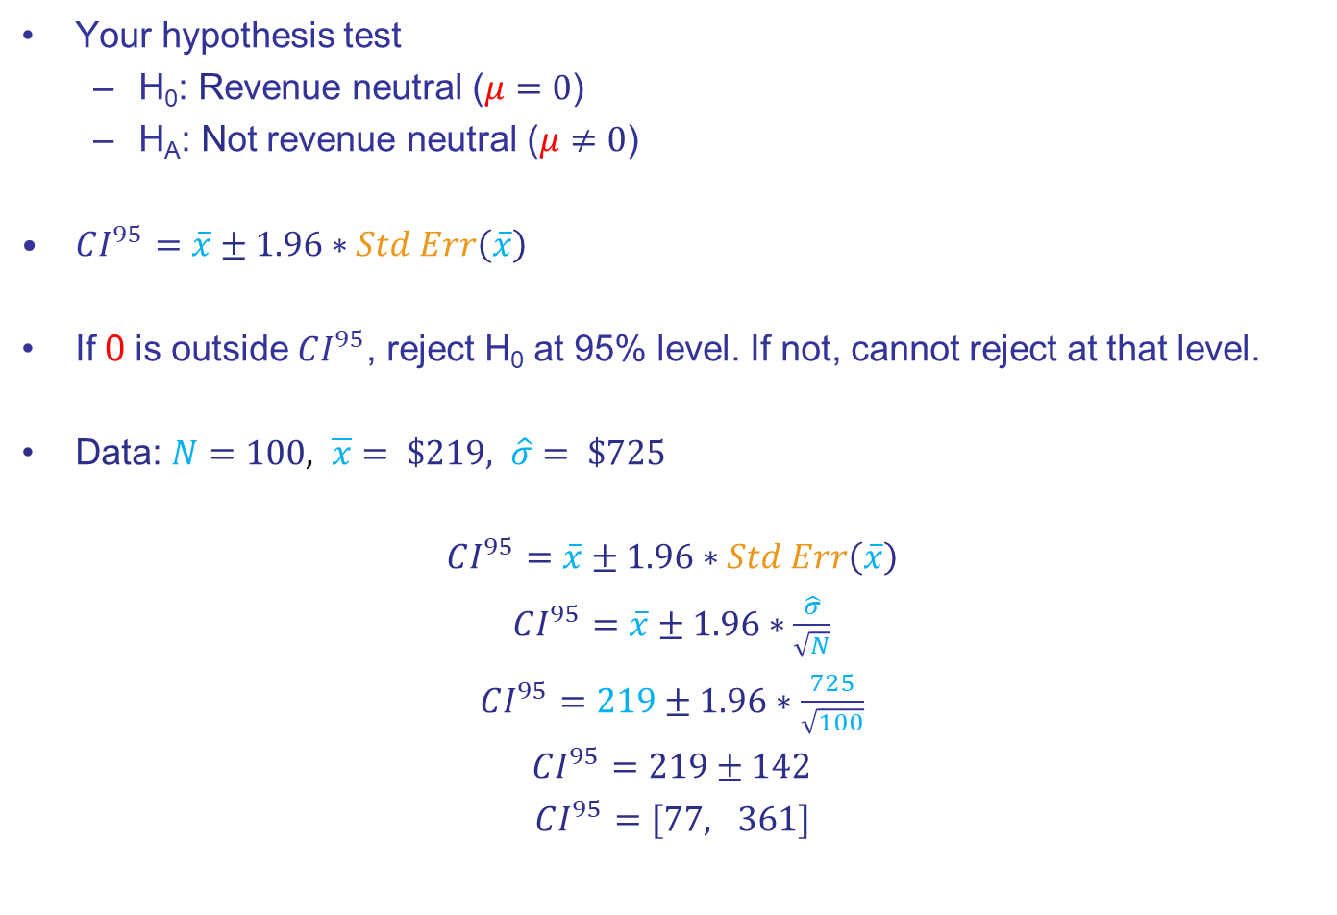
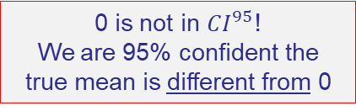
Review: the $CI^{95}$ Approach to Seeing if $μ=0$
Your hypothesis test
H₀: Revenue neutral ($μ=0$)
H_{A}: Not revenue neutral ($μ≠0$)
$CI^{95}=\overline{x}±1.96∗Std Err\left(\overline{x}\right)$
If 0 is outside $CI^{95}$, reject H₀ at 95% level. If not, cannot reject at that level.
Data: $N=100, \overline{x}= \$219, \hat{σ}= \$725$
$CI^{95}=\overline{x}±1.96∗Std Err\left(\overline{x}\right)$
$CI^{95}=\overline{x}±1.96∗\frac{\hat{σ}}{\sqrt{N}}$
$CI^{95}=219±1.96∗\frac{725}{\sqrt{100}}$
$CI^{95}=219±142$
$CI^{95}=[77, 361]$
0 is not in $CI^{95}$!
We are 95% confident the true mean is different from 0

Slide 18
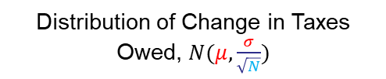




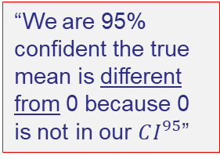
Review: the $CI^{95}$ Approach to Seeing if $μ=0$
Distribution of Change in Taxes Owed, $N(μ,\frac{σ}{\sqrt{N}})$
$Std Err\left(\overline{x}\right)=\frac{\hat{σ}}{\sqrt{N}}=\frac{725}{\sqrt{100}}=72.5$
“We are 95% confident the true mean is different from 0 because 0 is not in our $CI^{95}$”
$$77$$
$$361$$
$$0$$
219
True change in taxes owed in $

Slide 19
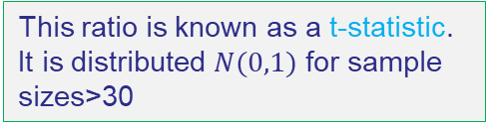
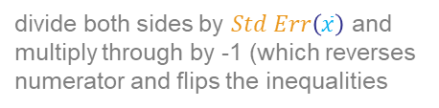


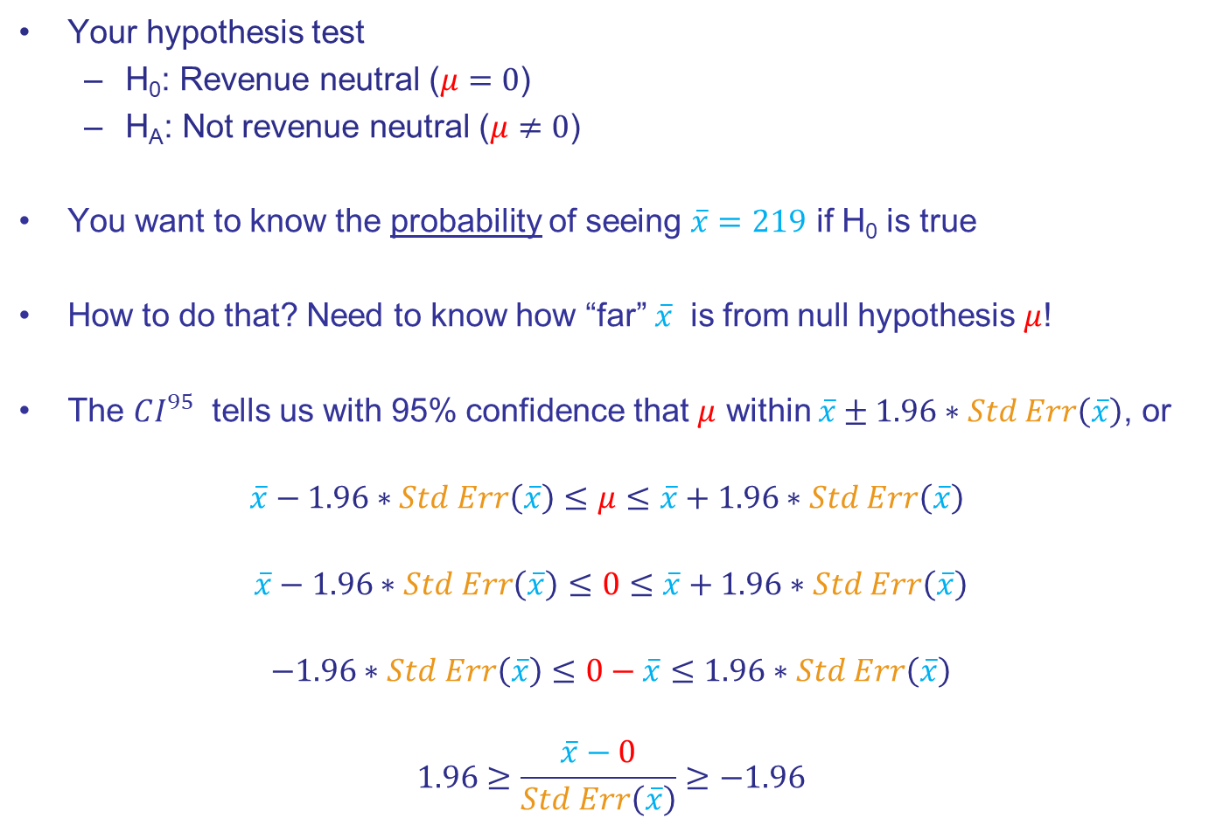
New: the $t−stat$ Approach to Seeing if $μ=0$
Your hypothesis test
H₀: Revenue neutral ($μ=0$)
H_{A}: Not revenue neutral ($μ≠0$)
You want to know the probability of seeing $\overline{x}=219$ if H₀ is true
How to do that? Need to know how “far” $\overline{x}$ is from null hypothesis $μ$!
The $CI^{95}$ tells us with 95% confidence that $μ$ within $\overline{x}±1.96∗Std Err\left(\overline{x}\right)$, or
$$\overline{x}−1.96∗Std Err\left(\overline{x}\right)≤μ≤\overline{x}+1.96∗Std Err\left(\overline{x}\right)$$
$$\overline{x}−1.96∗Std Err\left(\overline{x}\right)≤0≤\overline{x}+1.96∗Std Err\left(\overline{x}\right)$$
$$−1.96∗Std Err\left(\overline{x}\right)≤0−\overline{x}≤1.96∗Std Err\left(\overline{x}\right)$$
$$1.96≥\frac{\overline{x}−0}{Std Err\left(\overline{x}\right)}≥−1.96$$
Replace $μ$ with 0
subtract $\overline{x}$ from both sides
divide both sides by $Std Err\left(\overline{x}\right)$ and multiply through by -1 (which reverses numerator and flips the inequalities
This ratio is known as a t-statistic. It is distributed $N(0,1)$ for sample sizes>30

Slide 20
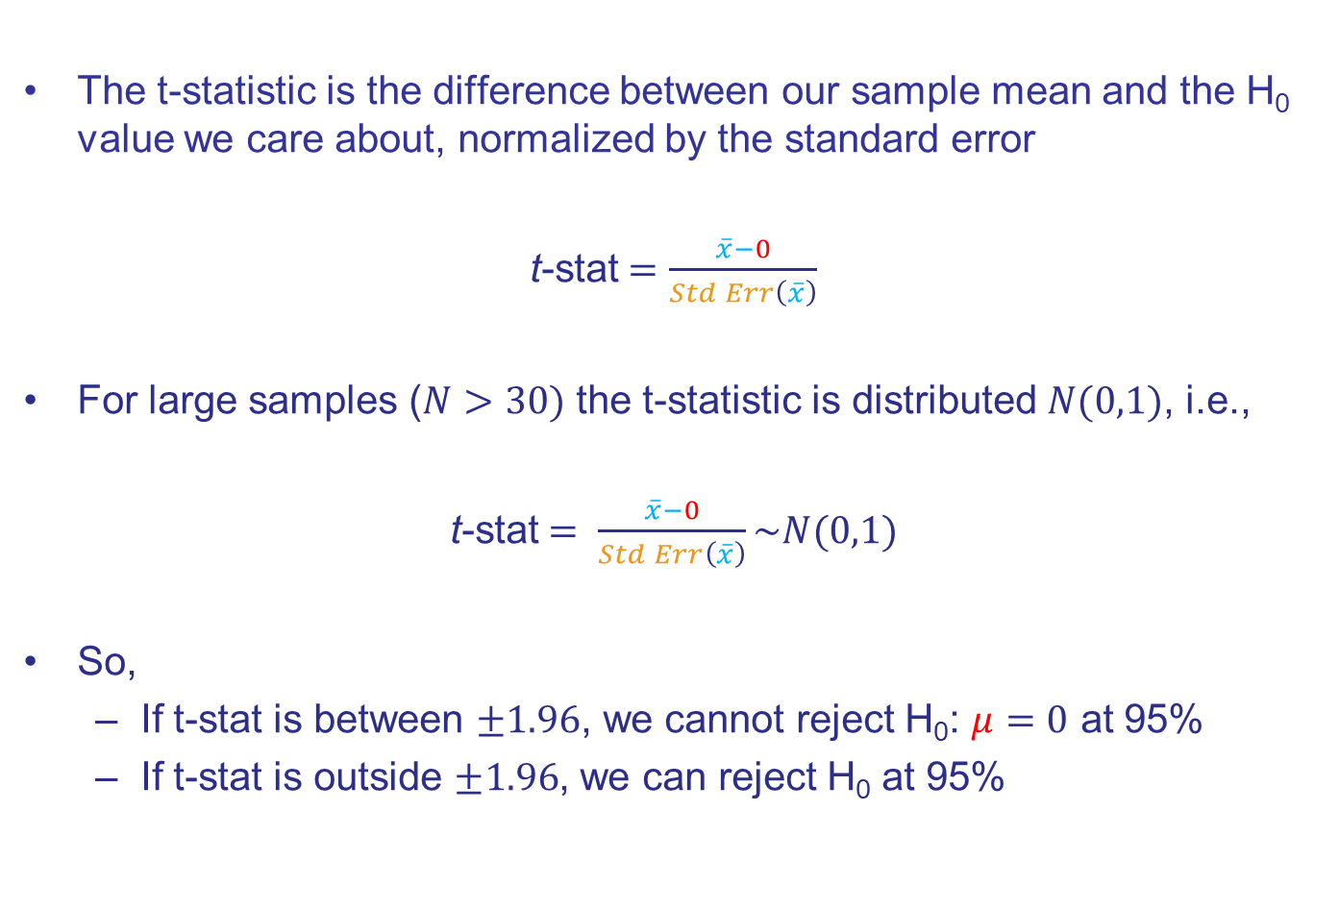
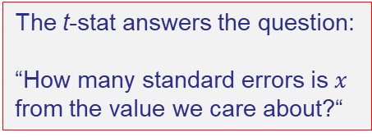
New: the $t−stat$ Approach to Seeing if $μ=0$
The t-statistic is the difference between our sample mean and the H₀ value we care about, normalized by the standard error
t-stat$=\frac{\overline{x}−0}{Std Err\left(\overline{x}\right)}$
For large samples ($N>30)$ the t-statistic is distributed $N(0,1)$, i.e.,
t-stat$= \frac{\overline{x}−0}{Std Err\left(\overline{x}\right)}\sim N(0,1)$
So,
If t-stat is between $±1.96$, we cannot reject H₀: $μ=0$ at 95%
If t-stat is outside $±1.96$, we can reject H₀ at 95%
The t-stat answers the question:
“How many standard errors is $x$ from the value we care about?“
FYI: the t-stat is sometimes called a z-score

Slide 21



How Likely is $\overline{x}$ if H₀ is True? Visualizing the t-statistic
Our hypothesis test
H₀: Revenue neutral ($μ=0$)
H_{A}: Not revenue neutral ($μ≠0$)
$\text{Data}\text{:}$ $N=100, \overline{x}= \$219, \hat{σ}= \$725$
t-stat$=\frac{\overline{x}−0}{Std Err\left(\overline{x}\right)}$=$\frac{\overline{x}−0}{{\hat{σ}}/{\sqrt{N}}}=\frac{219}{{725}/{\sqrt{100}}}=3.021$
Standard Normal, i.e., $N(0,1)$
H₀:$μ=0$
H_{A}:$μ≠0$

Slide 22
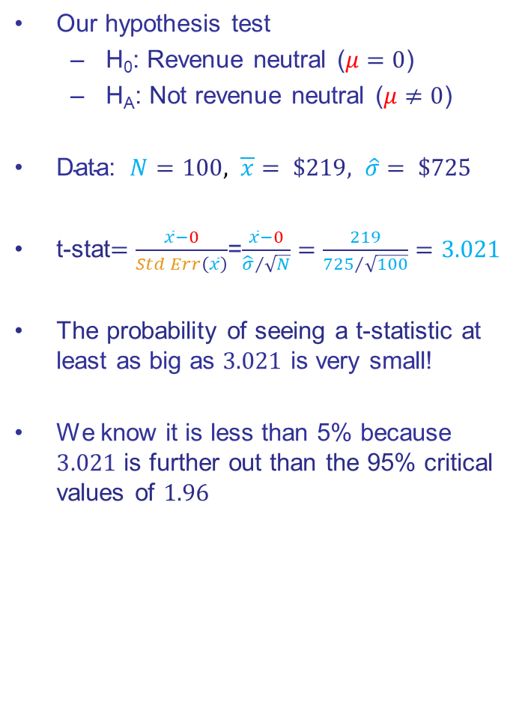

How Likely is $\overline{x}$ if H₀ is True? Visualizing the t-statistic
Our hypothesis test
H₀: Revenue neutral ($μ=0$)
H_{A}: Not revenue neutral ($μ≠0$)
$\text{Data}\text{:}$ $N=100, \overline{x}= \$219, \hat{σ}= \$725$
t-stat$=\frac{\overline{x}−0}{Std Err\left(\overline{x}\right)}$=$\frac{\overline{x}−0}{{\hat{σ}}/{\sqrt{N}}}=\frac{219}{{725}/{\sqrt{100}}}=3.021$
The probability of seeing a t-statistic at least as big as $3.021$ is very small!
We know it is less than 5% because $3.021$ is further out than the 95% critical values of $1.96$
Standard Normal, i.e., $N(0,1)$
H₀:$μ=0$
H_{A}:$μ≠0$

Slide 23
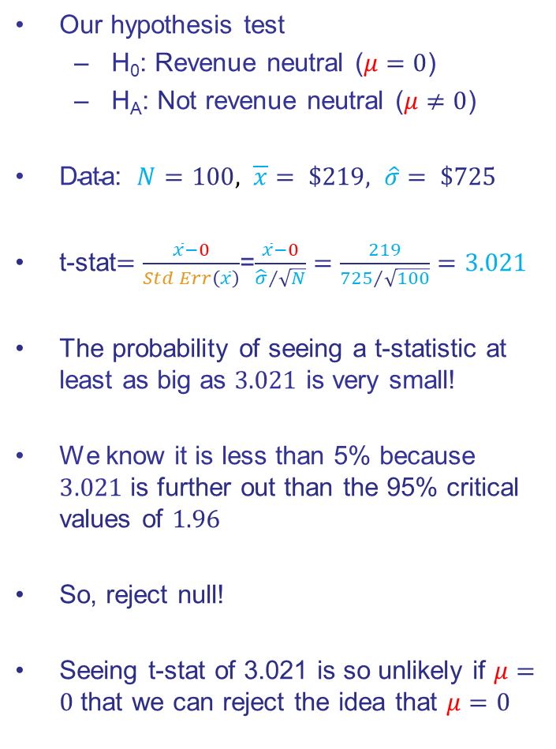
How Likely is $\overline{x}$ if H₀ is True? Visualizing the t-statistic
Our hypothesis test
H₀: Revenue neutral ($μ=0$)
H_{A}: Not revenue neutral ($μ≠0$)
$\text{Data}\text{:}$ $N=100, \overline{x}= \$219, \hat{σ}= \$725$
t-stat$=\frac{\overline{x}−0}{Std Err\left(\overline{x}\right)}$=$\frac{\overline{x}−0}{{\hat{σ}}/{\sqrt{N}}}=\frac{219}{{725}/{\sqrt{100}}}=3.021$
The probability of seeing a t-statistic at least as big as $3.021$ is very small!
We know it is less than 5% because $3.021$ is further out than the 95% critical values of $1.96$
So, reject null!
Seeing t-stat of 3.021 is so unlikely if $μ=0$ that we can reject the idea that $μ=0$
Standard Normal, i.e., $N(0,1)$
H₀:$μ=0$
H_{A}:$μ≠0$

Slide 24
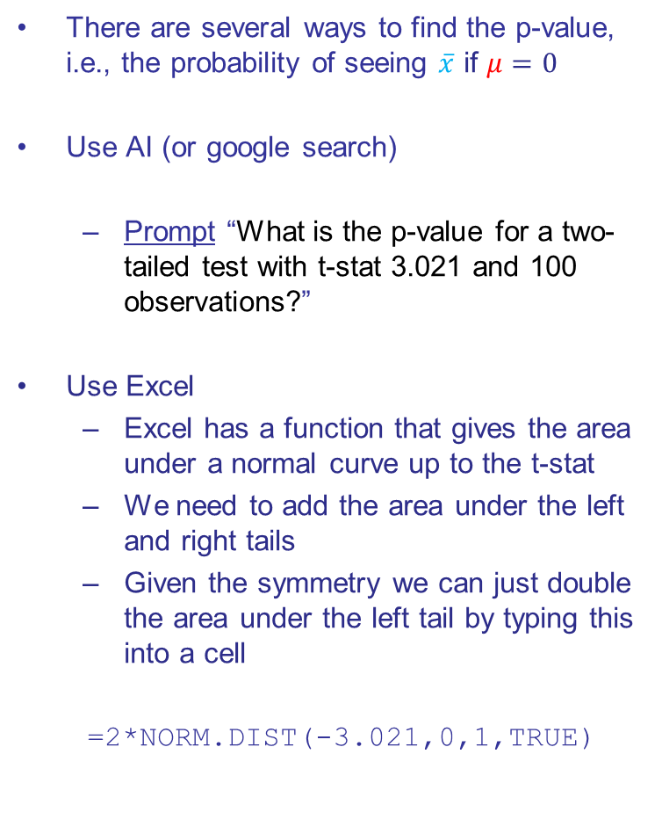
Finding the p-value
There are several ways to find the p-value, i.e., the probability of seeing $\overline{x}$ if $μ=0$
Use AI (or google search)
Prompt “What is the p-value for a two-tailed test with t-stat 3.021 and 100 observations?”
Use Excel
Excel has a function that gives the area under a normal curve up to the t-stat
We need to add the area under the left and right tails
Given the symmetry we can just double the area under the left tail by typing this into a cell
=2*NORM.DIST(-3.021,0,1,TRUE)
Standard Normal, i.e., $N(0,1)$
x
H₀:$μ=0$
H_{A}:$μ≠0$

Slide 25
Interpreting the p-value for the Senators
The p-value is 0.0025, or .00125 in each tail
What do you tell Congress?
“Senators, I examined a sample of tax returns and found that the average taxpayer would have to pay $219 more under the new law. The likelihood of seeing that large a difference if the bill were truly revenue neutral is very, very small, less than about a quarter of a percent. That’s so unlikely, I have to reject the idea that your bill is revenue neutral.”
Uh oh…
Standard Normal, i.e., $N(0,1)$
H₀:$μ=0$
H_{A}:$μ≠0$

Slide 26


Slide 27



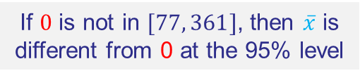



Comparing $CI^{95}$ and $t−stat$
$$\text{Confidence} \text{Interval} \text{Approach}$$
$$\text{t}\text{−}\text{stat} \text{Approach}$$
Change in Taxes Owed, $N(μ,\frac{σ}{\sqrt{N}})$
Standard Normal, i.e., $N(0,1)$
$Std Err\left(\overline{x}\right)=72.5$
p-value=0.25%
$$77$$
$$361$$
$$0$$
219
True change in taxes owed in $
H₀:$μ=0$
H_{A}:$μ≠0$
If $0$ is not in $[77, 361]$, then $\overline{x}$ is different from 0 at the 95% level
Same conclusion, but more info with p-value
If p-value<5%, null hypothesis can be rejected at the 5% level

Slide 28

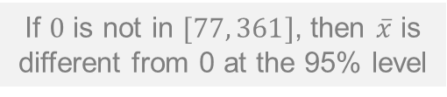
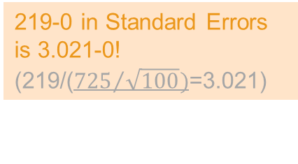



Comparing $CI^{95}$ and $t−stat$
$$\text{Confidence} \text{Interval} \text{Approach}$$
$$\text{t}\text{−}\text{stat} \text{Approach}$$
Change in Taxes Owed, $N(μ,\frac{σ}{\sqrt{N}})$
Standard Normal, i.e., $N(0,1)$
219-0 in Standard Errors is 3.021-0! (219/(${725}/{\sqrt{100}})$=3.021)
$Std Err\left(\overline{x}\right)=72.5$
p-value=0.25%
$$77$$
$$361$$
$$0$$
219
True change in taxes owed in $
H₀:$μ=0$
H_{A}:$μ≠0$
If $0$ is not in $[77, 361]$, then $\overline{x}$ is different from 0 at the 95% level
Same conclusion, but more info with p-value
If p-value<5%, null hypothesis can be rejected at the 5% level

Slide 29
Recipe for Hypothesis Testing
Step 1: State the hypotheses to be tested; choose confidence level, e.g., 95%
Step 2: Compute test statistic appropriate to your hypothesis
A test statistic is a standardized measure of the difference between a sample attribute and the value expected under H₀. It is constructed so that it can be compared to a distribution, e.g., a standard normal.
Step 3: Compute the p-value of the test statistic by determining the likelihood that it would be observed under H₀.
A p-value is the probability of observing at least the test statistic under the null hypothesis. It is found by comparing the test stat to its distribution
Step 4: Decide if the null hypothesis should be rejected based on the p-value

Slide 30
Example 2: Emissions Control (1-sided t-test)

Slide 31
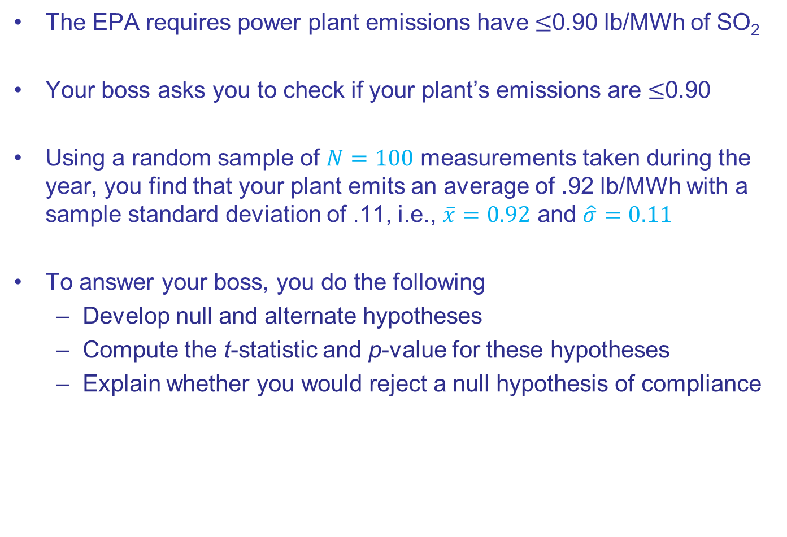
Emissions Control
The EPA requires power plant emissions have $≤$0.90 lb/MWh of SO₂
Your boss asks you to check if your plant’s emissions are $≤$0.90
Using a random sample of $N=100$ measurements taken during the year, you find that your plant emits an average of .92 lb/MWh with a sample standard deviation of .11, i.e., $\overline{x}=0.92$ and $\hat{σ}=0.11$
To answer your boss, you do the following
Develop null and alternate hypotheses
Compute the t-statistic and p-value for these hypotheses
Explain whether you would reject a null hypothesis of compliance

Slide 32
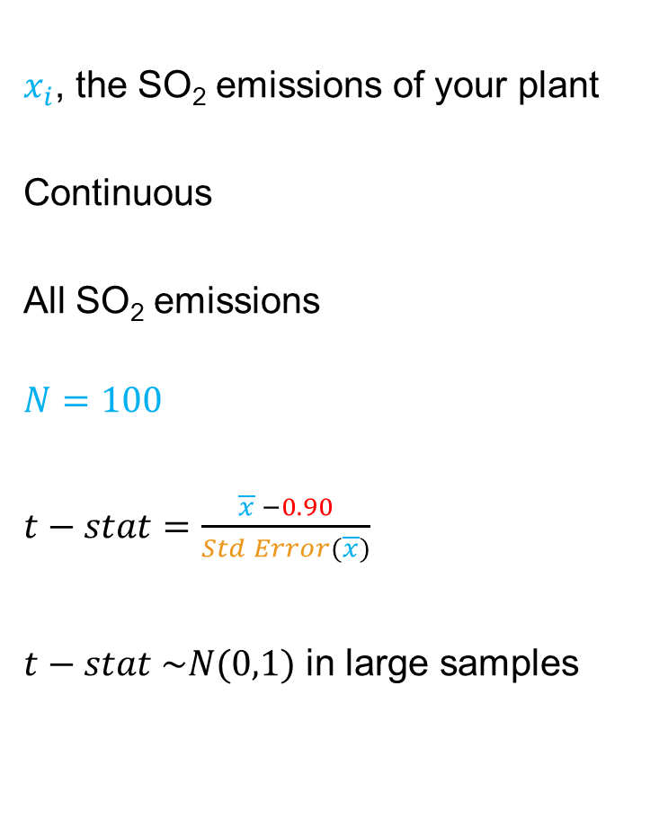
Summary of Emissions Compliance Data
Random Variable
Distribution
Population
Sample
Test statistic xxxxxxxxxxx
Test stat distribution
$x_{i}$, the SO₂ emissions of your plant
Continuous
All SO₂ emissions
$$N=100$$
$t−stat=\frac{\overline{x} −0.90}{Std Error(\overline{x})}$
$t−stat \sim N(0,1)$ in large samples
Null hypothesis value

Slide 33
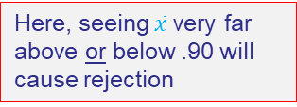
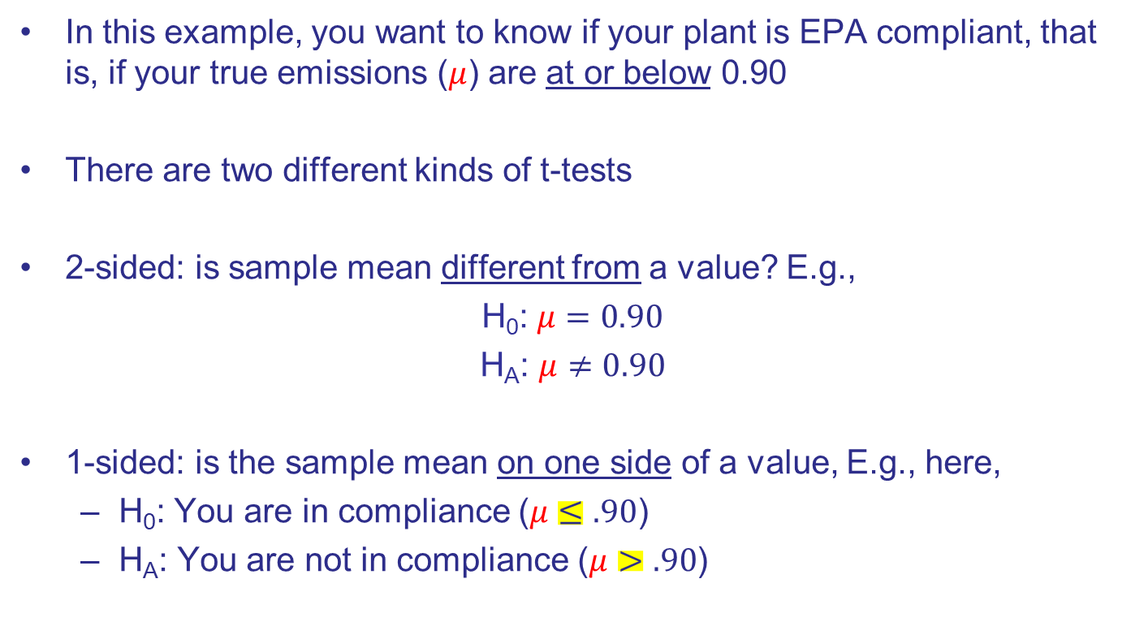
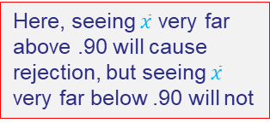
What is the Hypothesis Test Here?
In this example, you want to know if your plant is EPA compliant, that is, if your true emissions ($μ$) are at or below 0.90
There are two different kinds of t-tests
2-sided: is sample mean different from a value? E.g.,
H₀: $μ=0.90$
H_{A}: $μ≠0.90$
1-sided: is the sample mean on one side of a value, E.g., here,
H₀: You are in compliance ($μ≤.90$)
H_{A}: You are not in compliance ($μ>.90$)
Here, seeing $\overline{x}$very far above or below .90 will cause rejection
Here, seeing $\overline{x}$ very far above .90 will cause rejection, but seeing $\overline{x}$ very far below .90 will not

Slide 34
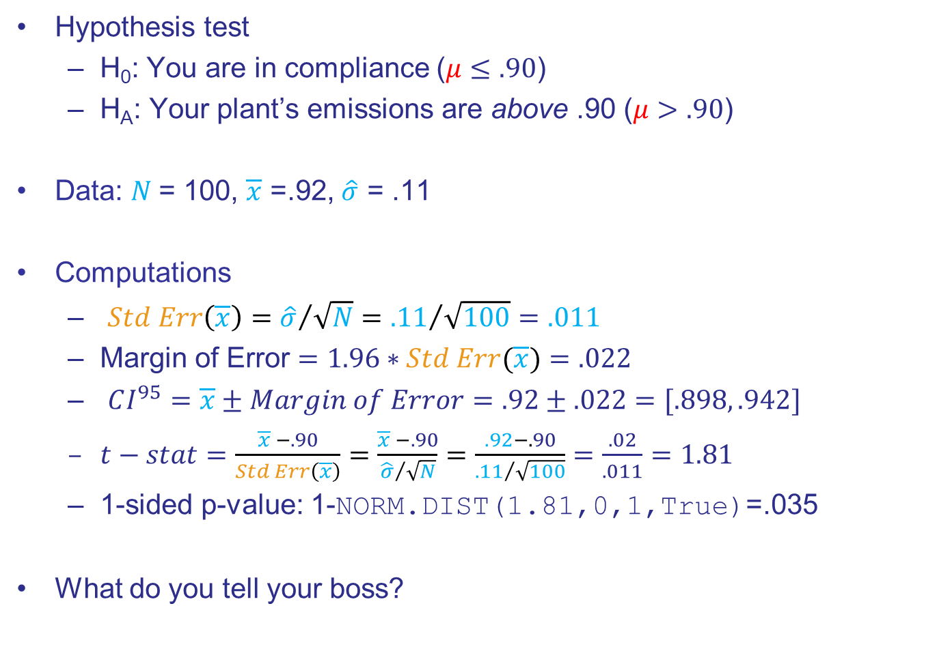
Emissions Compliance
Hypothesis test
H₀: You are in compliance ($μ≤.90$)
H_{A}: Your plant’s emissions are above .90 ($μ>.90$)
Data: $N$= 100, $\overline{x}$ =.92, $\hat{σ}$ = .11
Computations
$Std Err\left(\overline{x}\right)={\hat{σ}}/{\sqrt{N}}={.11}/{\sqrt{100}}=.011$
Margin of Error $=1.96∗Std Err(\overline{x})=.022$
$CI^{95}=\overline{x}±Margin of Error=.92±.022=[.898, .942]$
$t−stat=\frac{\overline{x} −.90}{Std Err\left(\overline{x}\right)}=\frac{\overline{x} −.90}{{\hat{σ}}/{\sqrt{N}}}=\frac{.92−.90}{{.11}/{\sqrt{100}}}=\frac{.02}{.011}=1.81$
1-sided p-value: 1-NORM.DIST(1.81,0,1,True)=.035
What do you tell your boss?

Slide 35

Emissions Compliance
Hypothesis test
H₀: You are in compliance ($μ≤.90$)
H_{A}: You are not in compliance ($μ>.90$)
Data: $N$= 100, $\overline{x}$ =.92, $\hat{σ}$ = .11
Computations
$Std Err\left(\overline{x}\right)$
${\hat{σ}}/{\sqrt{N}}={.11}/{\sqrt{100}}=.011$
$t−stat$
$\frac{\overline{x} −.90}{Std Err\left(\overline{x}\right)}=\frac{.92−.90}{.011}=\frac{.02}{.011}=1.81$

Slide 36

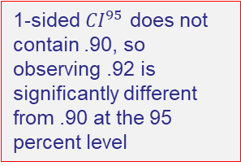
Computing the 1-Sided CI⁹⁵ for Emissions
Your hypothesis test
H₀: $μ≤.90$
H_{A}: $μ>.90$
For one-sided ${CI}^{95}$, put all the probability on one side
$$Prob\left(\frac{\overline{x}−μ}{Std Err\left(\overline{x}\right)}≤1.65\right)=.95$$
$CI_{1−sided}^{95}=$[$\overline{x}−1.65∗Std Err\left(\overline{x}\right),∞)$
$CI_{1−sided}^{95}=$[$.92−1.65∗.011,∞)$
$CI_{1−sided}^{95}=$[$.902,∞)$
Use 1.65 because you want all 5% in one tail!
1-sided $CI^{95}$ does not contain .90, so observing .92 is significantly different from .90 at the 95 percent level

Slide 37

1-Sided t-test
Hypothesis test
H₀: In compliance ($μ≤.90$)
H_{A}: Above compliance ($μ>.90$)
The t-stat from the last slide is 1.81
Standard Normal, i.e., $N(0,1)$

Slide 38

1-Sided t-test
Hypothesis test
H₀: In compliance ($μ≤.90$)
H_{A}: Above compliance ($μ>.90$)
The t-stat from the last slide is 1.81
Standard Normal, i.e., $N(0,1)$

Slide 39
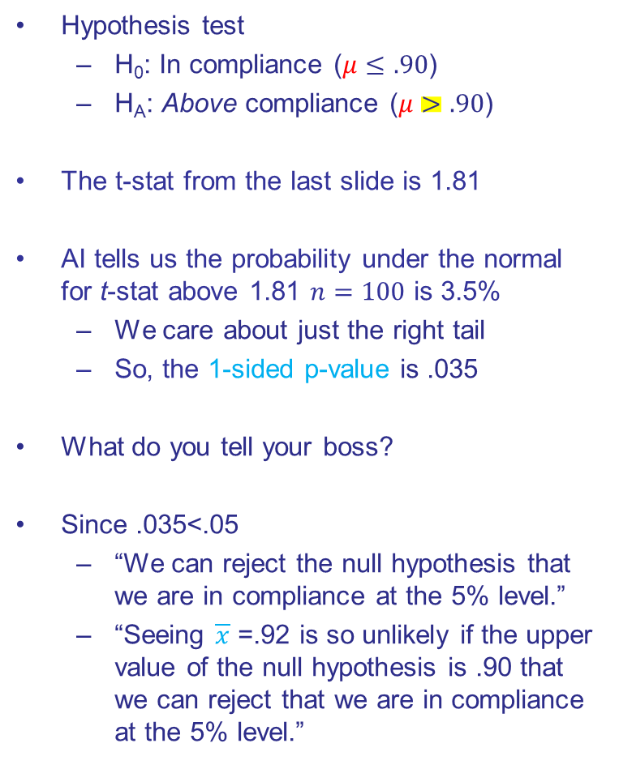
1-Sided t-test
Hypothesis test
H₀: In compliance ($μ≤.90$)
H_{A}: Above compliance ($μ>.90$)
The t-stat from the last slide is 1.81
AI tells us the probability under the normal for t-stat above 1.81 $n=100$ is 3.5%
We care about just the right tail
So, the 1-sided p-value is .035
What do you tell your boss?
Since .035<.05
“We can reject the null hypothesis that we are in compliance at the 5% level.”
“Seeing $\overline{x}$ =.92 is so unlikely if the upper value of the null hypothesis is .90 that we can reject that we are in compliance at the 5% level.”
Standard Normal, i.e., $N(0,1)$
Prompt: What is the probability under the normal of a t-stat greater than or equal to 1.81 with observations = 100?

Slide 40
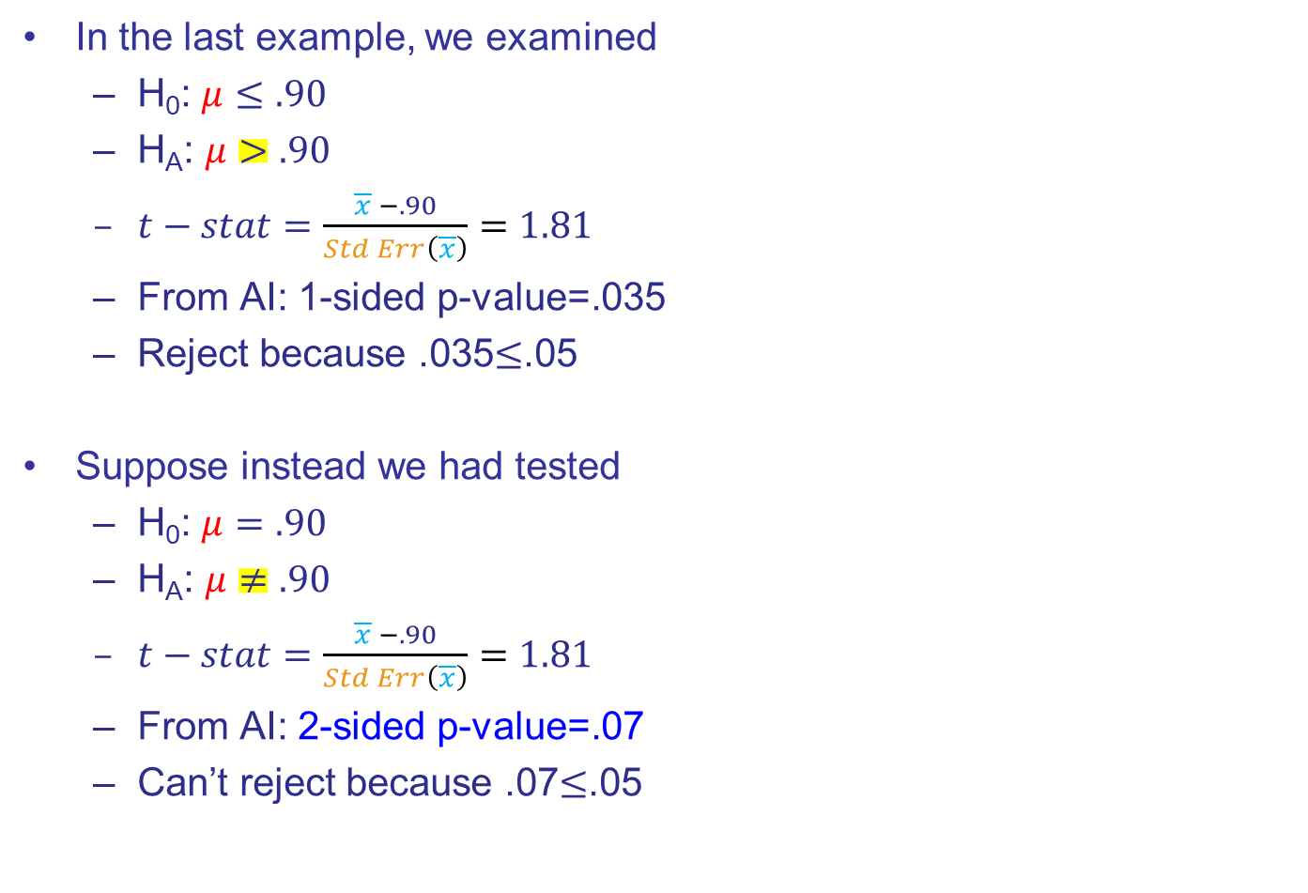
1- vs 2-Sided $t−test$ Want 95% Confidence in BOTH cases!
In the last example, we examined
H₀: $μ≤.90$
H_{A}: $μ>.90$
$t−stat=\frac{\overline{x} −.90}{Std Err\left(\overline{x}\right)}=1.81$
From AI: 1-sided p-value=.035
Reject because .035$≤$.05
Suppose instead we had tested
H₀: $μ=.90$
H_{A}: $μ≠.90$
$t−stat=\frac{\overline{x} −.90}{Std Err\left(\overline{x}\right)}=1.81$
From AI: 2-sided p-value=.07
Can’t reject because .07$≤$.05

Slide 41
Wait…..What?

Slide 42

1- vs 2-Sided $t−test$ Want 95% Confidence in BOTH cases!
1-sided
H₀: $μ≤.90$
H_{A}: $μ>.90$
$t−stat=\frac{\overline{x} −.90}{Std Err\left(\overline{x}\right)}=1.81$
1-sided p-value=.035
Reject because .035$≤$.05
2-sided
H₀: $μ=.90$
H_{A}: $μ≠.90$
$t−stat=\frac{\overline{x} −.90}{Std Err\left(\overline{x}\right)}=1.81$
2-sided p-value=.07
Can’t reject because .07$≤$.05
For a given probability you choose to be wrong, e.g., 5%, a 1-sided test is more likely to reject than a 2-sided test because you are looking in only 1 direction. So, you put all the probability of being wrong in that direction.
For a given probability you choose to be wrong, e.g., 5%, a 2-sided test is less likely to reject than a 1-sided test because you are looking in both directions. So, you have to split your probability of being wrong across both tails.

Slide 43

1- vs 2-Sided $t−test$ Want 95% Confidence in BOTH cases!
In the last example, we examined
H₀: $μ≤.90$
H_{A}: $μ>.90$
$t−stat=\frac{\overline{x} −.90}{Std Err\left(\overline{x}\right)}=1.81$
1-sided p-value=.035
Reject because .035$≤$.05
Suppose instead we had tested
H₀: $μ=.90$
H_{A}: $μ≠.90$
$t−stat=\frac{\overline{x} −.90}{Std Err\left(\overline{x}\right)}=1.81$
2-sided p-value=.07
Can’t reject because .07$≤$.05
1.65
The 95% critical value for a 1-sided t-test is 1.65, because that value puts 5% in the tail. It is not 1.96 because 1.96 is for 2.5% in the tail
1.96
1.96

Slide 44
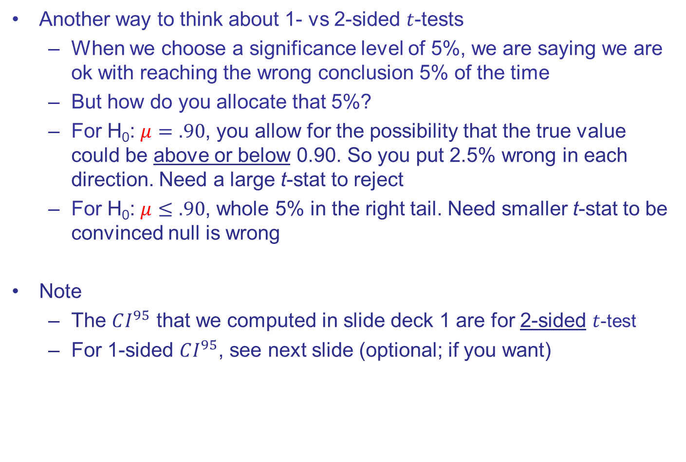
More 1- vs 2-Sided $t$-tests
Another way to think about 1- vs 2-sided $t$-tests
When we choose a significance level of 5%, we are saying we are ok with reaching the wrong conclusion 5% of the time
But how do you allocate that 5%?
For H₀: $μ=.90$, you allow for the possibility that the true value could be above or below 0.90. So you put 2.5% wrong in each direction. Need a large t-stat to reject
For H₀: $μ≤.90$, whole 5% in the right tail. Need smaller t-stat to be convinced null is wrong
Note
The $CI^{95}$ that we computed in slide deck 1 are for 2-sided $t$-test
For 1-sided $CI^{95}$, see next slide (optional; if you want)

Slide 45
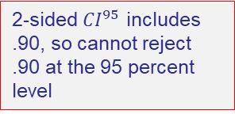
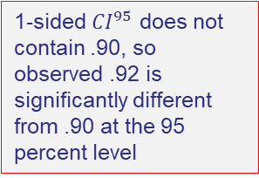
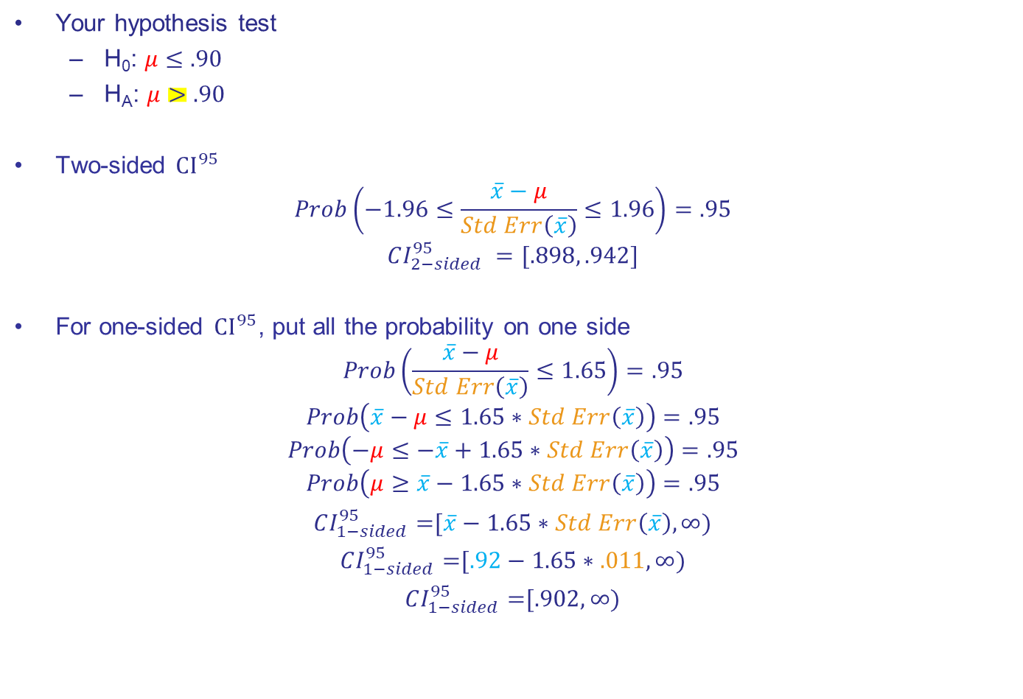
1-sided $CI^{95}$ Corresponding to 1-sided $t−test$
Your hypothesis test
H₀: $μ≤.90$
H_{A}: $μ>.90$
Two-sided ${CI}^{95}$
$$Prob\left(−1.96≤\frac{\overline{x}−μ}{Std Err\left(\overline{x}\right)}≤1.96\right)=.95$$
$$CI_{2−sided}^{95} =[.898, .942]$$
For one-sided ${CI}^{95}$, put all the probability on one side
$$Prob\left(\frac{\overline{x}−μ}{Std Err\left(\overline{x}\right)}≤1.65\right)=.95$$
$$Prob\left(\overline{x}−μ≤1.65∗Std Err\left(\overline{x}\right)\right)=.95$$
$$Prob\left(−μ≤−\overline{x}+1.65∗Std Err\left(\overline{x}\right)\right)=.95$$
$$Prob\left(μ≥\overline{x}−1.65∗Std Err\left(\overline{x}\right)\right)=.95$$
$CI_{1−sided}^{95}=$[$\overline{x}−1.65∗Std Err\left(\overline{x}\right),∞)$
$CI_{1−sided}^{95}=$[$.92−1.65∗.011,∞)$
$CI_{1−sided}^{95}=$[$.902,∞)$
2-sided $CI^{95}$ includes .90, so cannot reject .90 at the 95 percent level
Use 1.65 because you want all 5% in one tail!
1-sided $CI^{95}$ does not contain .90, so observed .92 is significantly different from .90 at the 95 percent level

Slide 46



Emissions Compliance (cont)
Your boss responds to your test by saying she’d like to do another test with a tighter margin of error, of .01, before moving forward
What sample size do you need to get that margin of error?
Margin of Error $=1.96∗Std Err(\overline{x})=1.96\frac{\hat{σ}}{\sqrt{N}}=.022$
We don’t know what $\hat{σ}$ will be with a new sample, but if we assume it will be the same as for $N=100$, we need $N$ such that
$1.96∗\frac{\hat{σ}}{\sqrt{N}}=.01$
$1.96∗\frac{\hat{σ}}{.01}$ $=\sqrt{N}$
$\sqrt{N}=$ $1.96∗\frac{.11}{.01}$
$$\sqrt{N}=21.56$$
$$N=465$$
replace .022 with .01
multiply both sides by $\frac{\sqrt{N}}{.01}$
sub in $\hat{σ}$ from first test
So, you tell your boss that if she wants a margin of error of .01, you need to boost the sample size to 465
flip right and left side, and compute
compute

Slide 47

Rule for Finding $N$ Needed to Get a Certain Margin of Error
Need to assume a sample standard deviation, $\hat{σ}$
Often get this from small-sample-size pilot study
Choose the margin of error ($Mar of Err$) you want
Choose the level of significance to get critical value ($CV$), e.g., 1.96
Solve for $N$ using $\hat{σ}$ , $CV$, and $Mar of Err$
$$N={\left(CV∗\frac{\hat{σ}}{Mar of Err}\right)}^{2}$$

Slide 48
Testing for Differences in Two Samples’ Means

Slide 49
Differences in Samples’ Means
The above examples test whether a sample’s mean is different from a particular value, like 0
It is often useful to test whether two samples have different means
Population
Sample1
Sample2

Slide 50
Differences in Samples’ Means
The above examples test whether a sample’s mean is different from a particular value, like 0
It is often useful to test whether two samples have different means
Sales
Strategy A
Strategy B

Slide 51
Differences in Samples’ Means
The above examples test whether a sample’s mean is different from a particular value, like 0
It is often useful to test whether two samples have different means
Mortality
Drug A
Drug B

Slide 52
Differences in Samples’ Means
The above examples test whether a sample’s mean is different from a particular value, like 0
It is often useful to test whether two samples have different means
Firm Productivity
Country A
Country B

Slide 53

Differences in Samples’ Means
The t-stat for a difference in two samples’ means is
$$t=\frac{{\overline{x}}_{1}−{\overline{x}}_{2}}{\sqrt{\frac{{{\hat{σ}}^{2}}_{1}}{N_{1}}+\frac{{{\hat{σ}}^{2}}_{2}}{N_{2}}}}$$
where
$N_{1}$, $N_{2}$ observations in two samples
${\overline{x}}_{1}$, ${\overline{x}}_{2}$ means of the two samples
${\hat{σ}}_{1}$, ${\hat{σ}}_{2}$ standard deviation in the two samples
The t-stat follows $N\left(0,1\right)$ for large samples
This test statistic is larger when
the difference in means is bigger
the variances are smaller
the sample sizes are larger
Does it make sense to you that we are more likely to reject when these things are true?

Slide 54

Intuition for the Difference in Samples’ Means t-statistic
The t-stat is larger when
the difference in means is bigger
the variances are smaller
the sample sizes are larger
The absolute value of the t-statistic gets bigger if the difference in means gets bigger – this pushes towards rejection of the null hypothesis
$$t=\frac{{\overline{x}}_{1}−{\overline{x}}_{2}}{\sqrt{\frac{{{\hat{σ}}^{2}}_{1}}{N_{1}}+\frac{{{\hat{σ}}^{2}}_{2}}{N_{2}}}}$$
It gets bigger if the variances are smaller
So, a given difference in means gets larger if one is “more confident” about the data, i.e., the variances are smaller, or the sample sizes are larger
It gets bigger if the sample sizes are larger

Slide 55
Hypothesis Tests ….
Are motivated by a question
Set up a horse race between a conservative null hypothesis and an interesting alternate hypothesis
Involve matching the hypotheses to the proper test statistic
Use sample data to assess the likelihood of observing the test statistic if the null hypothesis were true
Many statisticians spend time developing and evaluating test statistics and their analytical or bootstrap distributions so we can just look up whatever we need to answer a particular question
Conclude with an assessment of whether null hypothesis can be rejected (i.e., whether the result is “statistically significant”)

Slide 56
Example 3: Management Scores (if time)

Slide 57
Management Scores https://worldmanagementsurvey.org/
The World Management Survey is a cross-country, cross-industry, double-blind ongoing survey of firms’ management practices across 35 countries and 4 sectors. Data are available starting in 2002
Interviewers ask a series of questions about how firms manage their operations. Interviewers do not know what firm they are talking to, and interviewees are not aware their management practices are being assessed
Managers are scored along 4 dimensions of management practices
Operations: documenting process improvements, JIT, etc
Monitoring: performance, workers, etc.
Targets: what types (e.g., financial), transparency, etc.
Incentives: promotion criteria, firing policies, etc.
This info is used to assign an overall management score to each firm

Slide 58

Summary of Management Score Sample
Random Variable
Distribution
Population
Samples
Test statistic xxxxxxxxxxx
Test stat distribution
$x_{i}$, the management score of firm i
Continuous
All firms
$NChina=872$ Chinese firms, $NUS=947$ US firms
$$t=\frac{{\overline{x}}_{China}−{\overline{x}}_{US}}{\sqrt{\frac{{{\hat{σ}}^{2}}_{China}}{N_{China}}+\frac{{{\hat{σ}}^{2}}_{US}}{N_{US}}}}$$
$N\left(0,1\right)$ for large samples

Slide 59

US vs Chinese Management Scores data_wms.xlsx
Hypothesis Test
H₀: Management quality is the same in the US and China ($μ_{US}=μ_{China}$)
H_{A}: Management quality is higher in one of the two countries ($μ_{US}≠μ_{China}$) (two-sided test)

Slide 60

US vs China Management Scores Hypothesis Testing data_wms.xlsx
Hypothesis test
H₀: Management quality is the same ($μ_{US}=μ_{China}$)
H_{A}: Management quality is different ($μ_{US}≠μ_{China}$)
You find (see above Excel file)
$N_{China}$= 872 ${\overline{x}}_{China}$= 2.67 ${\hat{σ}}_{China}$=.62
$N_{US}$ = 947 ${\overline{x}}_{US}$ = 3.26 ${\hat{σ}}_{US}$ =.63
Test statistic
$$t=\frac{{\overline{x}}_{China}−{\overline{x}}_{US}}{\sqrt{\frac{{{\hat{σ}}^{2}}_{China}}{N_{China}}+\frac{{{\hat{σ}}^{2}}_{US}}{N_{US}}}}=\frac{2.67−3.26}{\sqrt{\text{.}\text{00044}+.00042}}=−20$$
p-value $≅$ 0

Slide 61

Difference in Means Hypothesis Testing in Excel data_wms.xlsx

Slide 62

Difference in Means Hypothesis Testing in Excel data_wms.xlsx
US scores
Click this if you included the column title in your ranges
Chinese scores
If you enter nothing, the default is 0

Slide 63

US vs China Management Scores t-Test in Excel data_wms.xlsx
$$t−statistic=\frac{{\overline{x}}_{China}−{\overline{x}}_{US}}{\sqrt{\frac{{{\hat{σ}}^{2}}_{China}}{N_{China}}+\frac{{{\hat{σ}}^{2}}_{US}}{N_{US}}}}$$
$t−statistic=\frac{2.67−3.26}{\sqrt{\frac{0.3948}{947}+\frac{0.3822}{872}}}=−20.2181$

Slide 64

US vs China Management Scores t-Test in Stata

Slide 65
Example 4: Management Scores Test with Bootstrap (if time)

Slide 66
Bootstrapping
We can also compare the means of two samples using bootstrapping
For both China and the US, we take 1000 random draws from our samples, with replacement
For each draw, we compute the mean management score for each country, and take their difference

Slide 67
Visualizing the Bootstrap
Take 872 draws with replacement
Take 947 draws with replacement
Do this 1000x, then plot
compute mean
compute mean
compute
difference

Slide 68

Are US Firms Better Managed than Chinese Firms?
Each point on this distribution is the difference in the means for one of the 1000 draws

Slide 69
Are US Firms Better Managed than Chinese Firms?
Mean 2.7
Mean 3.3
Actual difference is -.6

Slide 70
Are US Firms Better Managed than Chinese Firms?
Mean 2.7
Mean 3.3
The 1000 bootstrap differences pile up around the actual difference, -.59.
95% of them lie between -.65 and -.54, nowhere near 0
So, would you reject the null hypothesis of equal means?
Actual difference is -.6

Slide 71

Are US Firms Better Managed than Chinese Firms?
Mean 2.7
Mean 3.3
The middle 95% of the 1000 draws (the 2.5th to 97.5th percentiles) give a bootstrap $CI^{95}$ for the difference: [-.65, -.54]
Since 0 is far outside this interval, we reject the null at the 95% level!
Actual difference is -.6

Slide 72
US vs China Management Scores t-Test in Stata

Slide 73
Hypothesis Tests ….
Are motivated by a question
Set up a horse race between a conservative null hypothesis and an interesting alternate hypothesis
Involve matching the hypotheses to the proper test statistic
Use sample data to assess the likelihood of observing the test statistic if the null hypothesis were true
Many statisticians spend time developing and evaluating test statistics and their analytical or bootstrap distributions so we can just look up whatever we need to answer a particular question
Conclude with an assessment of whether null hypothesis can be rejected (i.e., whether the result is “statistically significant”)

Slide 74
End

Slide 75
Appendix

Slide 76
Simple Hypothesis Testing Examples

Slide 77
Two Simple Examples for Intuition
Flipping coins
Jury selection

Slide 78
Example 1: Flipping Coins
In Probability, you computed probability of various coin tosses
If a coin comes up heads 10x in a row, would you think it fair?
Hypothesis test
H₀: the coin is fair
H_{A}: the coin is biased
What is the probability that you get all heads after 10 tosses?
.5¹⁰ = .0009765625
Would you reject H₀?
If not, what is your probability threshold?
Can you see how H₀ is the conservative hypothesis?
We will ask if 10 heads in a row could plausibly be due to chance given this hypothesis

Slide 79

Example 2: Jury Diversity
Jurors in the United States are drawn randomly from eligible citizens
In a famous case, a jury pool was alleged to be unrepresentative
Of the 90 potential jurors, only 7 were African American (7.8%)
By contrast, 27% of eligible citizens were African American
Hypothesis test
H₀: The jury is racially representative
H_{A}: The jury was not racially representative
Analysis: what is the probability of 7 or fewer African Americans?
$p = .27, N=90, k=7$
By hand: $Prob\left(X=k\right)=\left({N \atop k}\right)p^{k}({1−p)}^{N−k}$
In Excel: =binom.dist(7, 90, 0.27, True)
$Prob$(X$≤$7)$=$.0000045
Would you reject H₀?

Slide 80
More Complex Examples
Do supermarkets sell more beer when it goes on sale?
Do supermarkets sell more beer on weekends when it goes on sale?
Does Warren Buffett beat the market?
Campaign contributions?

Slide 81
More Examples 1: Beer Sales

Slide 82


Beer Sales data_beer_raw.csv
In micro, you learn that quantity rises as the price falls
To test this hypothesis, we can use data on beer sales from retailer Dominick’s Fine Foods (part of Safeway)
The data they provide tracks the quantity of 12 packs of Miller Lite sold in sale weeks relative to the prior non-sale week. A sale week is defined as a week when a lower-than-average price is charged
Data: on canvas. The dataset has observations for 153 weeks. The main variable of interest is change_quantity. Note data_beer_raw.xlsx contains both the data and hypothesis test results
Hypothesis test
H₀: Beer sales do not change in sale weeks ($μ=0$)
H_{A}: Beer sales change in sale weeks ($μ≠0$)

Slide 83

Summary of Beer Data
Random Variable xxxxxx
Distribution
Population
Sample
Test statistic
Test stat distribution
$x_{i}$, the change in quantity sold during a sale week relative to the prior non-sale week
Continuous
All beer sales
$$N=153 weeks$$
$t=\frac{\overline{x} −0}{Std Error(\overline{x})}=\frac{\overline{x}}{\left(\frac{\hat{σ}}{\sqrt{N}}\right)}$
$N(0,1)$ in large samples

Slide 84
Summary of Beer Data data_beer_raw.csv
What do you see?

Slide 85

Beer Sales Hypothesis Testing in Excel data_beer_raw.xlsx
Hypothesis test
H₀: Beer sales do not change in sale weeks ($μ=0$)
H_{A}: Beer sales change in sale weeks ($μ≠0$)
Test statistic by hand
$t=\frac{\overline{x} −0}{Std Err(\overline{x})}=\frac{\overline{x}}{\left(\frac{\hat{σ}}{\sqrt{N}}\right)}=\frac{20.91}{\left(\frac{14.60}{\sqrt{153}}\right)}=\frac{20.9}{1.18}=17.7$
Very big!!

Slide 86

Beer Sales Hypothesis Testing in Excel data_beer_raw.xlsx
Hypothesis test
H₀: Beer sales do not change in sale weeks ($μ=0$)
H_{A}: Beer sales change in sale weeks ($μ≠0$)

Slide 87

Beer Sales Hypothesis Testing in Excel data_beer_raw.xlsx
Hypothesis test
H₀: Beer sales do not change in sale weeks ($μ=0$)
H_{A}: Beer sales change in sale weeks ($μ≠0$)

Slide 88

Beer Sales Hypothesis Testing in Excel data_beer_raw.xlsx
Hypothesis test
H₀: Beer sales do not change in sale weeks ($μ=0$)
H_{A}: Beer sales change in sale weeks ($μ≠0$)

Slide 89

Beer Sales Hypothesis Testing in Excel data_beer_raw.xlsx
Hypothesis test
H₀: Beer sales do not change in sale weeks ($μ=0$)
H_{A}: Beer sales change in sale weeks ($μ≠0$)
H_{A}: Beer sales higher in sale weeks ($μ>0$)

Slide 90
Beer Sales Hypothesis Testing in Excel data_beer_raw.xlsx
Hypothesis test
H₀: Beer sales do not change in sale weeks ($μ=0$)
H_{A}: Beer sales change in sale weeks ($μ≠0$)
H_{A}: Beer sales higher in sale weeks ($μ>0$)

Slide 91



One vs Two-Sided Test Normal Distributions Not Drawn to Scale
One-Sided Test
H₀: Beer sales do not change during ($μ=0$)
H_{A}: Beer sales are higher during sale ($μ>0$)
Two-Sided Test
H₀: Beer sales do not change during ($μ=0$)
H_{A}: Beer sales are different during sale ($μ≠0$)
p-value = 1.5e⁻⁷⁰
p-value = 2*1.5e⁻⁷⁰
17.7
-17.7
17.7

Slide 92
Beer Sales Hypothesis Testing in ChatGPT
See this video
Drop data_beer_raw.csv into ChatGPT.
Note: you must drop in the text file (.csv), not the excel file!
Note: copy file from canvas to your computer before you start
Ask ChatGPT to summarize the data
Does it look ok?
Ask ChatGPT to produce a histogram of the variable of interest
Does it look ok?
Ask Chat GPT to test if the mean of change_quantity is zero
Ask to see its calculations to make sure they make sense!

Slide 93

Beer Sales Hypothesis Testing in ChatGPT

Slide 94

Beer Sales Hypothesis Testing in ChatGPT

Slide 95
More Examples 2: Beer Sales in December vs Other Months

Slide 96
Beer Sales in December data_beer.xlsx
Dominick’s just heard about your proficiency with means testing
They want to hire you to tell them whether beer sales are even more effective around the holidays
You see that the data they’ve already given you (data_beer.csv) notes the month of each change_quantity observation
Hypothesis test
H₀: Beer sales are same in December as other months
H_{A}: Beer sales are different in December

Slide 97

Summary of Beer Sales In December Data
Random Variable xxxxxx
Distribution
Population
Sample
Test statistic xxxxxxxxxxx
Test stat distribution
$x_{i}$, the change in quantity sold during a sale week relative to the prior non-sale week
Continuous
All beer sales
$N=17$ (December) and $N=136$ (Other)
$$t=\frac{{\overline{x}}_{China}−{\overline{x}}_{US}}{\sqrt{\frac{{{\hat{σ}}^{2}}_{China}}{N_{China}}+\frac{{{\hat{σ}}^{2}}_{US}}{N_{China}}}}$$
Student t (~normal for large N)

Slide 98
Beer Sales Hypothesis Testing
Hypothesis test
H₀: Beer sales are same in December as other months
H_{A}: Beer sales are different in December
What do you see?
ChatGPT Prompt: “Please create a single figure that contains a comparison of the kernel density of observations for month 12 and a kernel density for the observations of all other months”

Slide 99
Beer Sales Hypothesis Testing in Excel

Slide 100

Beer Sales Hypothesis Testing in Excel

Slide 101

Beer Sales Hypothesis Testing in Excel (Other-Dec) Months
Not Large!
Reject?
Reject?
Because the $N<30$, we have to compare the test statistic to the Student t distribution rather than $N(0,1)$. That’s why the critical values look different. Excel and other software does this automatically

Slide 102
More Examples 3: Warren Buffett

Slide 103

Does Buffett Beat the Market?
Berkshire Hathaway (BRK) is a multinational conglomerate holding company based in Omaha, Nebraska, led by billionaire investor Warren Buffett
BRK offers two classes of shares, A and B. Class A shares have superior voting rights. Class B shares are more affordable
Does Berkshire Hathaway offer a better return than the S&P500?

Slide 104
Distribution of Daily Returns 2000 to Present
Source: Yahoo Finance

Slide 105

Summary of BRK-A and SP500 Data
Random Variable
Distribution
Population
Sample
Test statistic xxxxxxxxxxx
Test stat distribution
$x_{i}$, the daily return of BRK-A or SP500 on day i
Continuous
All BRK-A and SP500 returns, past and present
Prices for $N=6421$ trading days 1/1/00-7/15/25
$$t=\frac{{\overline{x}}_{BRK}−{\overline{x}}_{SP500}}{\sqrt{\frac{{{\hat{σ}}^{2}}_{BRK}}{N_{BRK}}+\frac{{{\hat{σ}}^{2}}_{SP500}}{N_{SP500}}}}$$
$N\left(0,1\right)$ for large samples

Slide 106

Does Buffett Beat the Market?
Hypothesis test
H₀: Returns for BRK are identical to those of SP500
H_{A}: Returns for one or the other are larger
Data:
$N_{BRK}$ = 6420 ${\overline{x}}_{BRK}$ = .00040 ${\hat{σ}}_{BRK}$ =.0138
$N_{SP500}$= 6420 ${\overline{x}}_{SP500}$= .00023 ${\hat{σ}}_{SP500}$=.0123
Test statistic
$$t=\frac{{\overline{x}}_{BRK}−{\overline{x}}_{US}}{\sqrt{\frac{{{\hat{σ}}^{2}}_{BRK}}{N_{BRK}}+\frac{{{\hat{σ}}^{2}}_{SP500}}{N_{SP500}}}}=0.74$$
p-value = .46, $CI^{95}= [−.00028, .00062]$
Cannot reject the null at the 95% level

Slide 107
More Examples 4: Campaign Contributions

Slide 108



Campaign Contributions in Connecticut
In the appendix to slide deck 1, we found that the average campaign contribution in CT was $96
Can we reject the hypothesis that the true contribution is $100?
Recall:

Slide 109

Summary of Campaign Contribution Sample
Random Variable
Distribution
Population
Sample
Test statistic
Test stat distribution
$x_{i}$, the contribution of individual i
Continuous
All donors
A random sample of N=5,449 contributions
$$t=\frac{\overline{x} −100}{Std Error(\overline{x})}=\frac{\overline{x}}{\left(\frac{\hat{σ}}{\sqrt{N}}\right)}$$
Student t (~normal for large samples)

Slide 110

Campaign Contribution Hypothesis Testing
Hypothesis test
H₀: The average contribution in CT is $100
H_{A}: The average is different from $100
Data:
$N$ = 5449
$\overline{x}$ = $96.37
$\hat{σ}=\sqrt{\frac{\sum_{i=1}^{N}{(x_{i}−\overline{x})^{2}}}{N−1}}$ = $295.75
Test statistic: $t=\frac{\overline{x} −100}{Std Error(\overline{x})}=\frac{\overline{x}−100}{\left(\frac{\hat{σ}}{\sqrt{N}}\right)}=\frac{−3.63}{\left(\frac{295.75}{\sqrt{5449}}\right)}=\frac{−3.63}{4.0065}=−.91$
p-value = 2*NORM.DIST(-0.9053,0,1,True)=$.36$
Do you reject the null?

Slide 111
Other

Slide 112
Motivation: What’s the Question?
Many questions we seek to answer compare outcomes across groups, e.g., how do medical outcomes vary with exposure to a new drug?
Most other questions focus on co-movement of cause and effect, e.g., do student test scores respond positively to teacher experience?
There is an art to asking the right question. Questions that are too broad will be hard to answer. Answers to very narrow questions may not apply to many situations
Too broad: How do taxes affect economic outcomes?
Too narrow: What is the effect of a one-cent increase in parking meter fees in Springfield on weekday parking between 2 and 4 PM in July?
Just right: How do small changes in parking prices affect the demand for short-term parking and congestion in city centers?

Slide 113
Guide to Economic Research Questions
Avoid questions that are
Too specific and parochial
Unconnected to a model motivating why the question matters
More about data mining than testing or building theory
Try to find questions that
Engage with economic theory and explore causal mechanisms
Generalize beyond one setting
Are transparent about assumptions and model uncertainty
Help us learn about how the economy works, not just how a specific policy affected a specific number in a specific place

Slide 114

History of the “Student t” Distribution See this article and this article for more
William Sealy Gosset invented/discovered the t-test in 1908 and published it under the pseudonym “Student” to maintain secrecy, per his firm’s policy.
Gosset worked at the Guinness Brewery in Dublin. He needed to estimate quantities such as the true mean weight and true mean quality of barley batches.
Because he worked with very small samples, (N<30), he could not make use of the Central Limit Theorem. After spending a year researching the appropriate test statistic under these circumstances at UCL in London, he characterized the t-distribution, which converges to the normal distribution for large N.
Intuitively, the t-distribution has fatter tails than a normal distribution, as one has less chance to observe “tail” events in small samples.

Slide 115

Intuition for the Student t Distribution

Slide 116





Election Example Re-Visited
Our hypothesis test
H₀: Revenue neutral ($μ=0$)
H_{A}: Not revenue neutral ($μ≠0$)
The $CI^{95}$ is
$Prob\left(\begin{aligned}\overline{x}−1.96∗SE(\overline{x}) \\ ≤μ≤ \\ \overline{x}+1.96∗SE(\overline{x})\end{aligned}\right)=.95$
If 0 is inside this interval, we cannot reject H₀. If it is outside this interval, we will reject
Distribution of Change in Taxes Owed
$\overline{x}−1.96∗SE$($\overline{x}$)
$\overline{x}+1.96∗SE$($\overline{x}$)
$$\overline{x}$$
$$μ$$
True Change in Taxes Owed

Slide 117


Election Example Re-Visited
Our hypothesis test
H₀: Revenue neutral ($μ=0$)
H_{A}: Not revenue neutral ($μ≠0$)
The $CI^{95}$ is
$Prob\left(\begin{aligned}\overline{x}−1.96∗SE(\overline{x}) \\ ≤μ≤ \\ \overline{x}+1.96∗SE(\overline{x})\end{aligned}\right)=.95$
Suppose H₀ is true. Then
$Prob\left(\begin{aligned}\overline{x}−1.96∗SE(\overline{x}) \\ ≤0≤ \\ \overline{x}+1.96∗SE(\overline{x})\end{aligned}\right)=.95$
Distribution of Change in Taxes Owed
$\overline{x}−1.96∗SE$($\overline{x}$)
$\overline{x}+1.96∗SE$($\overline{x}$)
$$\overline{x}$$
$$μ$$
True Change in Taxes Owed

Slide 118

Election Example Re-Visited
Our hypothesis test
H₀: Revenue neutral ($μ=0$)
H_{A}: Not revenue neutral ($μ≠0$)
The $CI^{95}$ is
$Prob\left(\begin{aligned}\overline{x}−1.96∗SE(\overline{x}) \\ ≤μ≤ \\ \overline{x}+1.96∗SE(\overline{x})\end{aligned}\right)=.95$
If 0 is inside this interval, we cannot reject H₀. If it is outside this interval, we will reject
Instead of asking “is 0 in my $CI^{95}$?”, we can ask “if H₀ is true, how far is $\overline{x}$ from 0 measured in standard deviation units?”, i.e.,
$t−stat= \frac{\overline{x} −0}{Std Err(\overline{x})}$
Distribution of Change in Taxes Owed
$\overline{x}−1.96∗SE$($\overline{x}$)
$\overline{x}+1.96∗SE$($\overline{x}$)
$$\overline{x}$$
$$μ$$
True Change in Taxes Owed

Slide 119

Total probability of $\left|t−stat\right|≥1.81$ is 7% because we care about deviations in both directions
3.5%
3.5%
3.5%

Slide 120
3.5%
3.5%
3.5%

