Slide 1
If you use the data in this presentation, please cite:
Survival of the Best Fit: Competition from Low Wage Countries and the (Uneven) Growth of US Manufacturing Plants. NBER Working Paper 9170.

Slide 2
Outline
Defining Low Wage Country Competition
Data Displays
References

Slide 3
Defining Low Wage Country “Competition”
Papers using this dataset should cite Bernard et al (2002).
This dataset contains two indexes of low wage country competition. Indexes are computed by four-digit SIC (1987 revision) manufacturing industry and year. Indexes are based on product-level US trade data compiled by Feenstra et al (2003). Products = 10 digit Harmonized System (HS) categories
Low wage countries are defined as those which have per capita GDP less than or equal to 5% of the US level. The PCGDP data for making this comparison are drawn from the 2000 World Bank CD-ROM. Though this group of countries is relatively stable over time, some countries move out of this cohort during the years covered by the index. See Bernard et al (2002) for more detail.

Slide 4
Defining Low Wage Country “Competition”
The dataset contains two indexes of low wage country competition, VSH and PSH
  VSH (Value Share Competition): share of US imports of industry i in year t originating in low wage countries
  VSH_{it} = (Imports_{it,Low Wage} / Imports_{it})
  PSH (Product Share Competition): share of products in industry i in year t imported from at least one low wage country
  PSH_{it} = (#Products_{it,Low Wage} / #Products_{it})

Slide 5
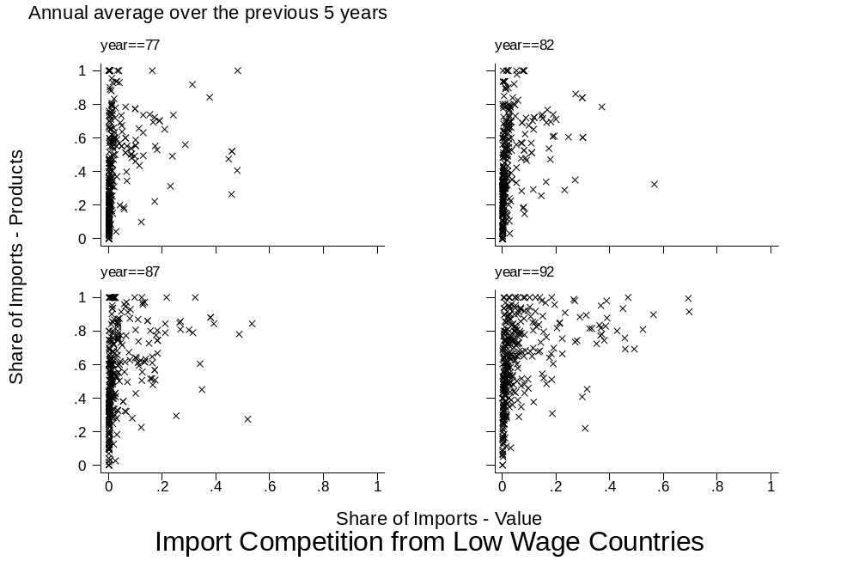
VSH_{i} and PSH_{i} Over Time
Each x is a four digit SIC manufacturing industry
1977
1982
Product Share (PSH_{i})
1987
1992
Value Share (VSH_{i})

Slide 6
Evolution of VSH_{it} and PSH_{it} by SIC4 Manufacturing Industry and Time
High Skill
Industry Input Vector
Low Skill
Capital
The low wage country competition indexes can be plotted by manufacturing industry in industry input intensity space to provide greater intuition. The next two slides will make use of Leamer (1987) endowment triangles. These triangles (simplexes) are formed by intersecting a three dimensional factor space with a plane. Industries can be plotted in this space via their use of the three factors: capital (K), skilled or non-production workers (NP) and low skill or production workers (P). The evolution of competition across industries can be tracked by plotting a kernal density of VSH_{it} or PSH_{it} across the simplex. In the figures to follow, colors are consistent across time and the same color scheme is used for both competition measures. Blue = low competition while red = high competition. Four representative manufacturing industries -- Socks, Gloves, Chemicals and Instruments -- are plotted to provide a sense of where industries are located.

Slide 7
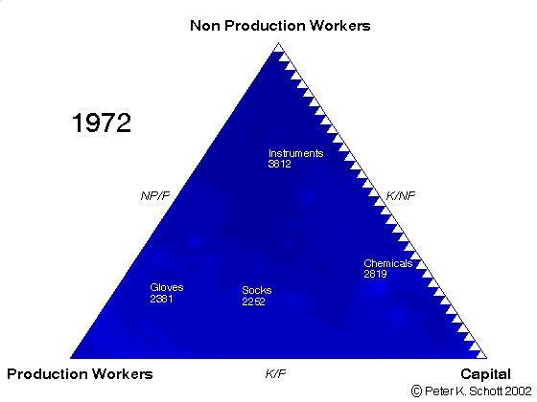
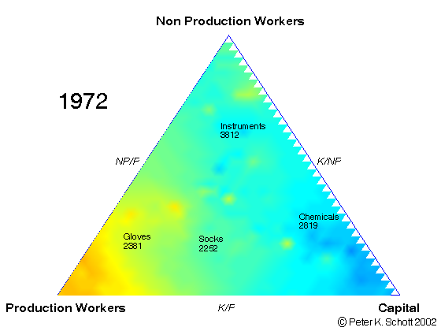
Evolution of Low Wage Country Competition Across US Manufacturing Industries, 1972-96
(Click on the image to start the movie)
VSH_{it} - Value Share
PSH_{it} - Product Share
Low Competition
High Competition

Slide 8
References
Bernard, Andrew A., J. Bradford Jensen and Peter K. Schott. 2002. Survival of the Best Fit: Competition from Low Wage Countries and the (Uneven) Growth of US Manufacturing Plants. NBER Working Paper 9170.
Feenstra, Robert C., John Romalis and Peter K. Schott. 2003. US Imports, Exports and Tariff Data, 1989-2001. NBER Working Paper 9387.
Leamer, Edward E. 1987. Paths of Development in the Three-Factor, n-Good General Equilibrium Model. Journal of Political Economy 95:961-999.

