Slide 1
If you use the data in this presentation, please cite:
Falling Trade Costs, Heterogenous Firms and Industry Dynamics. Yale School of Management Mimeo.

Slide 2
Outline
Defining Trade Costs
Data Displays
References

Slide 3
Defining Trade Costs
Papers using this dataset should cite Bernard et al (2002).
This dataset contains a measure of trade costs by four-digit SIC (1987) manufacturing industry and year. Indexes are based on product-level US trade data compiled by Feenstra et al (2003). Products = 10 digit Harmonized System (HS) categories

Slide 4
Defining Trade Costs
Total trade costs (TC) are the sum of ad valorem tariff and freight costs.
  TC = tariff_{it} + freight_{it}
  tariff costs are the sum of duties collected in industry i in year t divided by the customs value of imports
  tariff_{it} = duties_{it} / imports_{it}
  freight costs are the sum of freight and insurance charges in industry i in year t divided by the customs value of imports
  freight_{it} = (cif_{it} - imports_{it} ) / imports_{it}

Slide 5
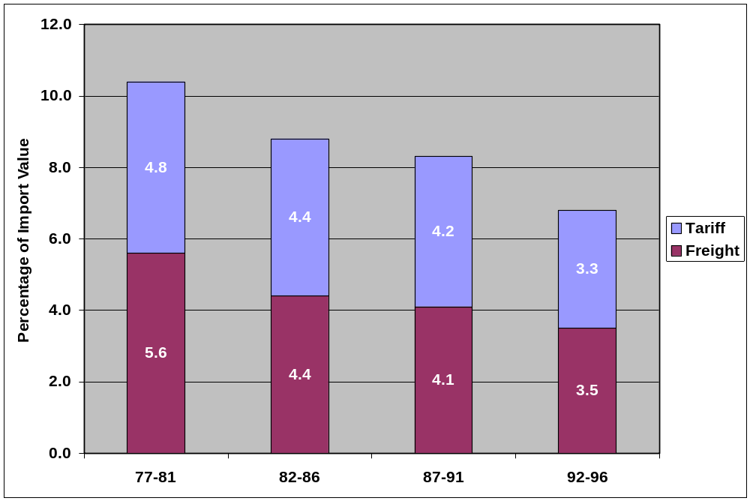
Average Manufacturing Industry Trade Costs Over Time
Average across SIC4 manufacturing industries during this five year period

Slide 6
Evolution of VSH_{it} and PSH_{it} by SIC4 Manufacturing Industry and Time
High Skill
Industry Input Vector
Low Skill
Capital
Trade costs can be plotted by manufacturing industry in industry input intensity space to provide greater intuition. The next two slides will make use of Leamer (1987) endowment triangles. These triangles (simplexes) are formed by intersecting a three dimensional factor space with a plane. Industries can be plotted in this space via their use of the three factors: capital (K), skilled or non-production workers (NP) and low skill or production workers (P). The evolution of trade costs can then be tracked by plotting a kernal density of TC_{it} across the simplex. In the following slides, colors are consistent across time in each figure. Blue = low trade costs while red = high trade costs. Four representative manufacturing industries -- Socks, Gloves, Chemicals and Instruments -- are plotted to provide a sense of where industries are located.

Slide 7
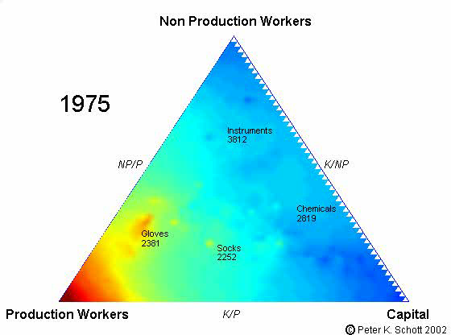
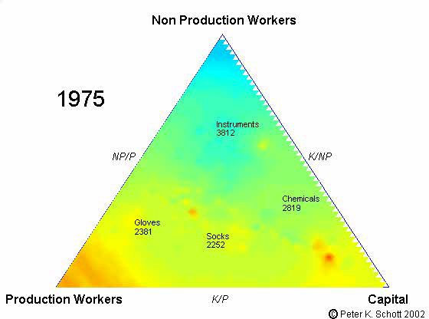
Evolution of Tariff_{i} and Freight_{i} , 1975 to 1996
Ad Valorem Tariffs
Ad Valorem Freight
Low (0%)
High (25%)
Low (0%)
High (15%)

Slide 8
References
Bernard, Andrew A., J. Bradford Jensen and Peter K. Schott. 2002. Falling Trade Costs, Heterogenous Firms and Industry Dynamics. Yale School of Management Mimeo.
Feenstra, Robert C., John Romalis and Peter K. Schott. 2003. US Imports, Exports and Tariff Data, 1989-2001. NBER Working Paper 9387.
Leamer, Edward E. 1987. Paths of Development in the Three-Factor, n-Good General Equilibrium Model. Journal of Political Economy 95:961-999.

