Slide 1
Crime Management System Project
By Jinisha Kataria and Dhruv Sompura

Slide 2
Introduction
1
Centralized Information
Incidents, suspects, officers, evidence, and reports.
2
Streamlined Processes
Efficiently tracking and resolving criminal cases.
3
Enhanced Investigation
Provides tools and insights to support law enforcement.

Slide 3
Project Objective
Develop a comprehensive and efficient crime management system.
Comprehensive Case Tracking
Enhanced Data Management
Improved Investigation
Real-Time Updates
Provide real-time updates to officers and investigators on case progress, suspect developments, and newly discovered evidence.
Securely store and retrieve crime records.
Streamline investigation processes and improve efficiency.
Enable detailed tracking of criminal cases, incidents, and investigations in real-time.

Slide 4

Key Features
1. Incident Tracking
2. Case Management
3. Reports Generation
4. Officer Database
5. Agency Database

Slide 5
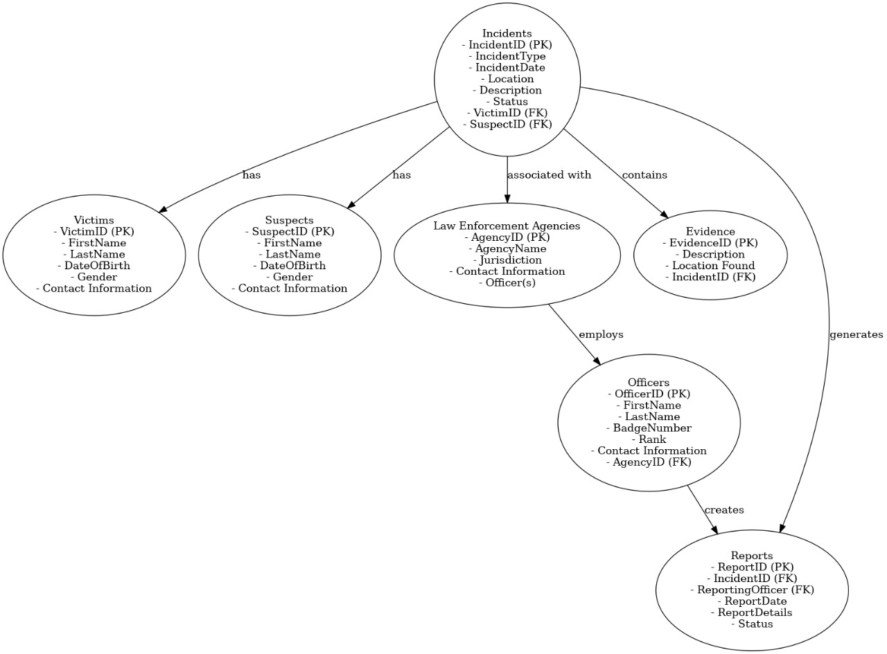
ER DIAGRAM

Slide 6
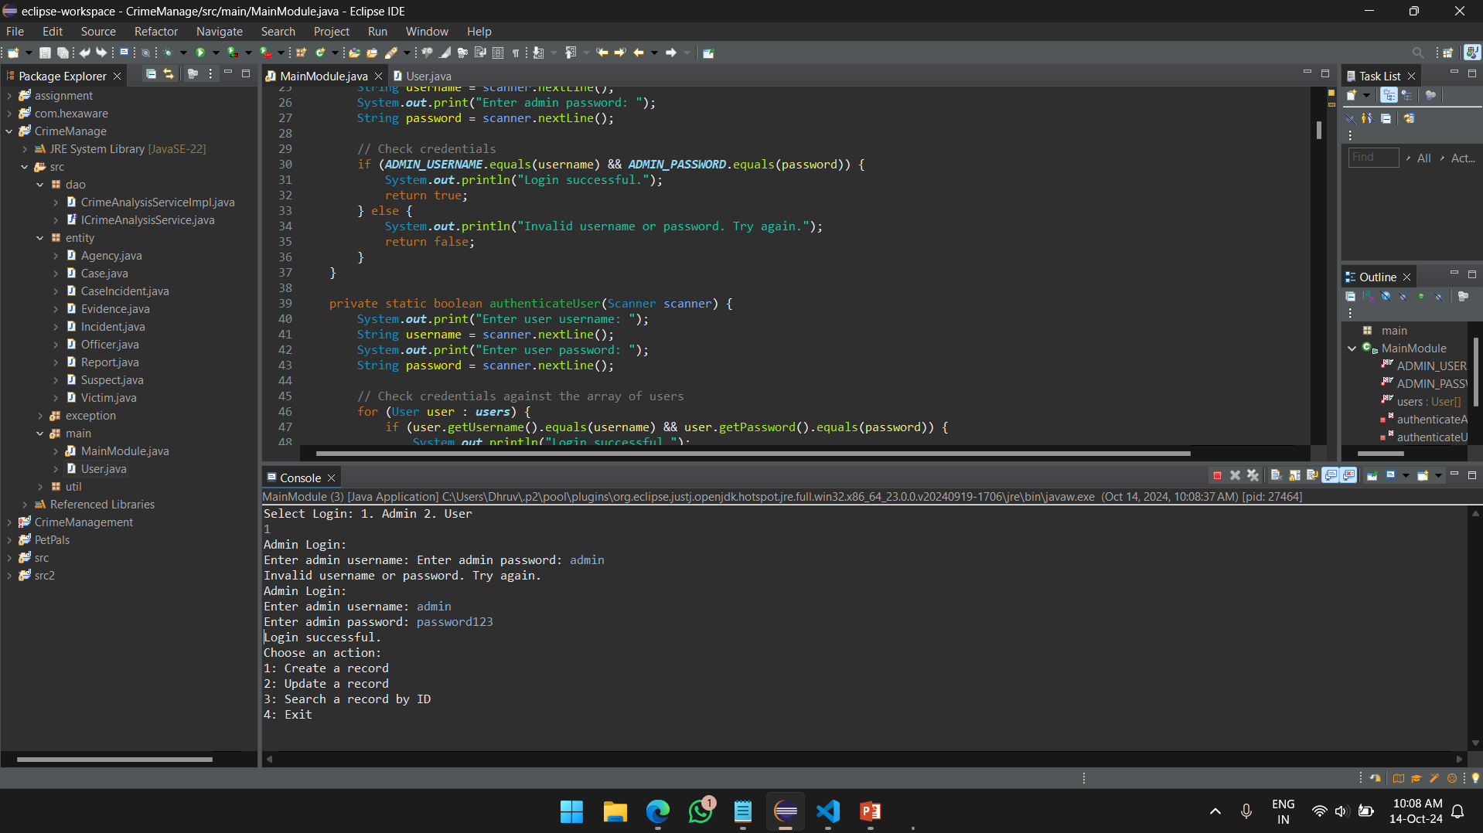
Project Implementation

Slide 7

Thank You
Let us know if you have any doubts

