Slide 1
Product Management System
Presented by –
G. M. Nazmul Hossain
Department of CSTE , NSTU.

Slide 2
OBJECTIVE
Deliver your products easily to customers.
Latest products are updated here.

Slide 3
Technology in Used
Frontend
Backend
HTML5
CSS3
JavaScript
JQuery
Twitter Bootstrap
php 5.5
Mysql

Slide 4
Why you will be interested in me ?

Slide 5

Home Page

Slide 6
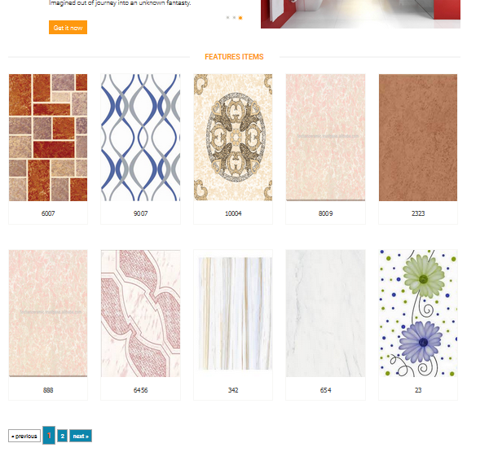
Latest Products

Slide 7

Advertisement

Slide 8
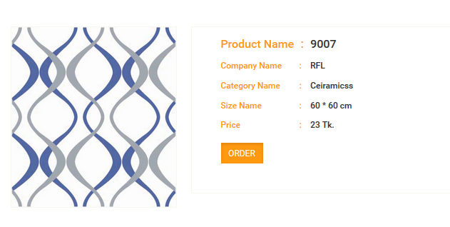
Product Details

Slide 9
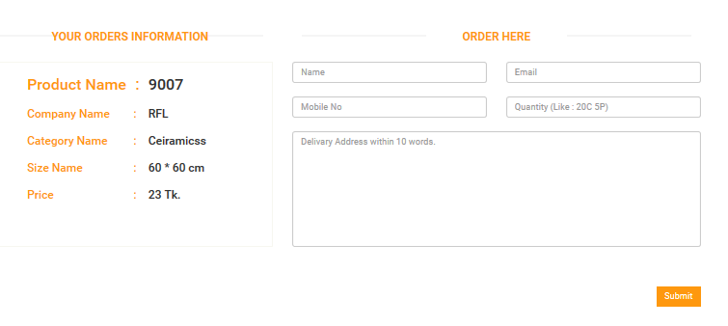
Order

Slide 10
What can I do for you ?

Slide 11
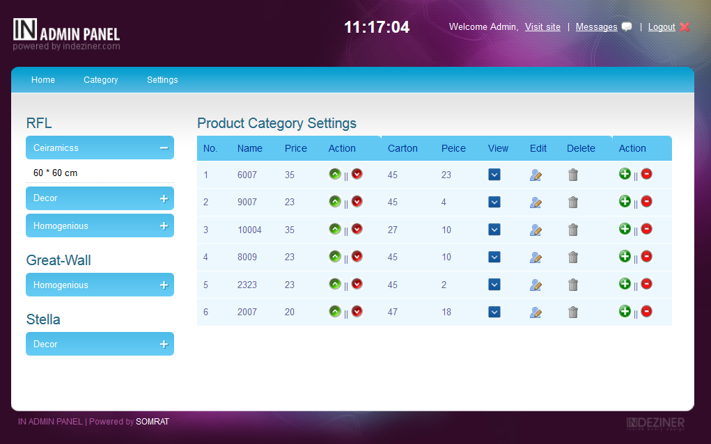

Slide 12
Future Plan
Add to cart will be added.
Payment method will be added.

Slide 13
???

Slide 14
Thanks To all for keeping patience

