Slide 1
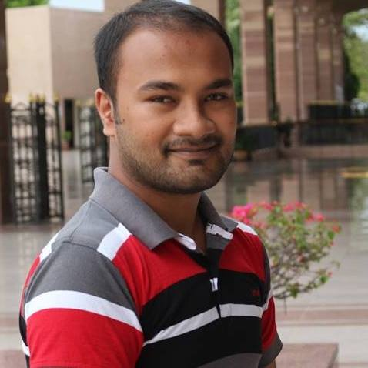







Md. Humayan
+8801794556952
Kabir
somrathumayan@gmail.com
humayankabir089
Web Developer
www.humayan.xyz
BSC
Computer Science and Engineering
Education
Uttara University, Bangladesh
2018-2022
HSC
SSC
GPA-4.90
GPA-5
Rajshahi Govt. City Collage
Naogaon Zilla School
2012-2014
2010-2012
Web Pages
CV Maker
Web Designer
HTML, CSS, PowerPoint
Experience
Since January, 2018
Since January, 2019
Humayan Kabir
Data Entry
Web Designer
Type, Edit, Formatting
Since October, 2020
2014-2019
HTML5 & CSS3
Skills
WORDPRESS
BOOTSTRAP 4
JAVASCRIPT
PHOTOSHOP

Slide 2
Md. Humayan
+8801794556952
Kabir
somrathumayan@gmail.com
humayankabir089
Web Developer
www.humayan.xyz
BSC
Computer Science and Engineering
Education
Uttara University, Bangladesh
2018-2022
HSC
SSC
GPA-4.90
GPA-5
Rajshahi Govt. City Collage
Naogaon Zilla School
2012-2014
2010-2012
Web Pages
CV Maker
Web Designer
HTML, CSS, PowerPoint
Experience
Since January, 2018
Since January, 2019
Humayan Kabir
Data Entry
Web Designer
Type, Edit, Formatting
Since October, 2020
2014-2019
HTML5 & CSS3
Skills
WORDPRESS
BOOTSTRAP 4
JAVASCRIPT
PHOTOSHOP

