Slide 1
Assignment 4 Writeup DO NOT TAG
Name:
GT Email:

Slide 2
Seq2Seq Results – Default configuration
RNN
Training Loss: ?
Training Perplexity: ?
Validation Loss: ?
Validation Perplexity: ?
LSTM
Training Loss: ?
Training Perplexity: ?
Validation Loss: ?
Validation Perplexity: ?
RNN-with-Attention
Training Loss: ?
Training Perplexity: ?
Validation Loss: ?
Validation Perplexity: ?
LSTM-with-Attention
Training Loss: ?
Training Perplexity: ?
Validation Loss: ?
Validation Perplexity: ?

Slide 3
Seq2Seq Explanation (RNN vs LSTM)
Compare your RNN result to your LSTM result and explain why they differ.

Slide 4
Seq2Seq Explanation (RNN vs RNN-with-Attention)
Compare your RNN result to your RNN-with-Attention result and explain why they differ.

Slide 5
Seq2Seq Results – Best model
Your best model after hyper-parameter tuning
Best model
Training Loss: ?
Training Perplexity: ?
Validation Loss: ?
Validation Perplexity: ?
List your best model hyper-parameter values including model type: ?

Slide 6
Seq2Seq Best model Learning Curves (Perplexity)

Slide 7
Seq2Seq Explanation – Best model
Explain the details of your best model. Explain what you did to improve your model’s performance and why

Slide 8
Transformer Results
Default configuration
Training Loss: ?
Training Perplexity: ?
Validation Loss: ?
Validation Perplexity: ?
Best model
Training Loss: ?
Training Perplexity: ?
Validation Loss: ?
Validation Perplexity: ?
List your best model hyper-parameter values: ?

Slide 9
Transformer Best model Learning Curves (Perplexity)

Slide 10
Transformer Explanation – Best model
Explain what you did here and why you did it to improve your model performance.

Slide 11
Transformer Translation (Best model) Results
Put translation results for your best model (1st 9 sentences) here
Input sentence | Back translation
‘<sos>'word_1’,’word_2’,….., '<eos>' | ‘<sos>'word_1’,’word_2’,….., '<eos>'
Table 1

Slide 12
Seq2Seq (Best model) Translation Results
Put translation results for your best model (1st 9 sentences) here
Input sentence | Back translation
‘<sos>'word_1’,’word_2’,….., '<eos>' | ‘<sos>'word_1’,’word_2’,….., '<eos>'
Table 2

Slide 13
Compare Seq2Seq to Transformer (Best models)
Compare your Seq2Seq best model results to your Transformer best model results both quantitatively and qualitatively and explain the differences.

Slide 14
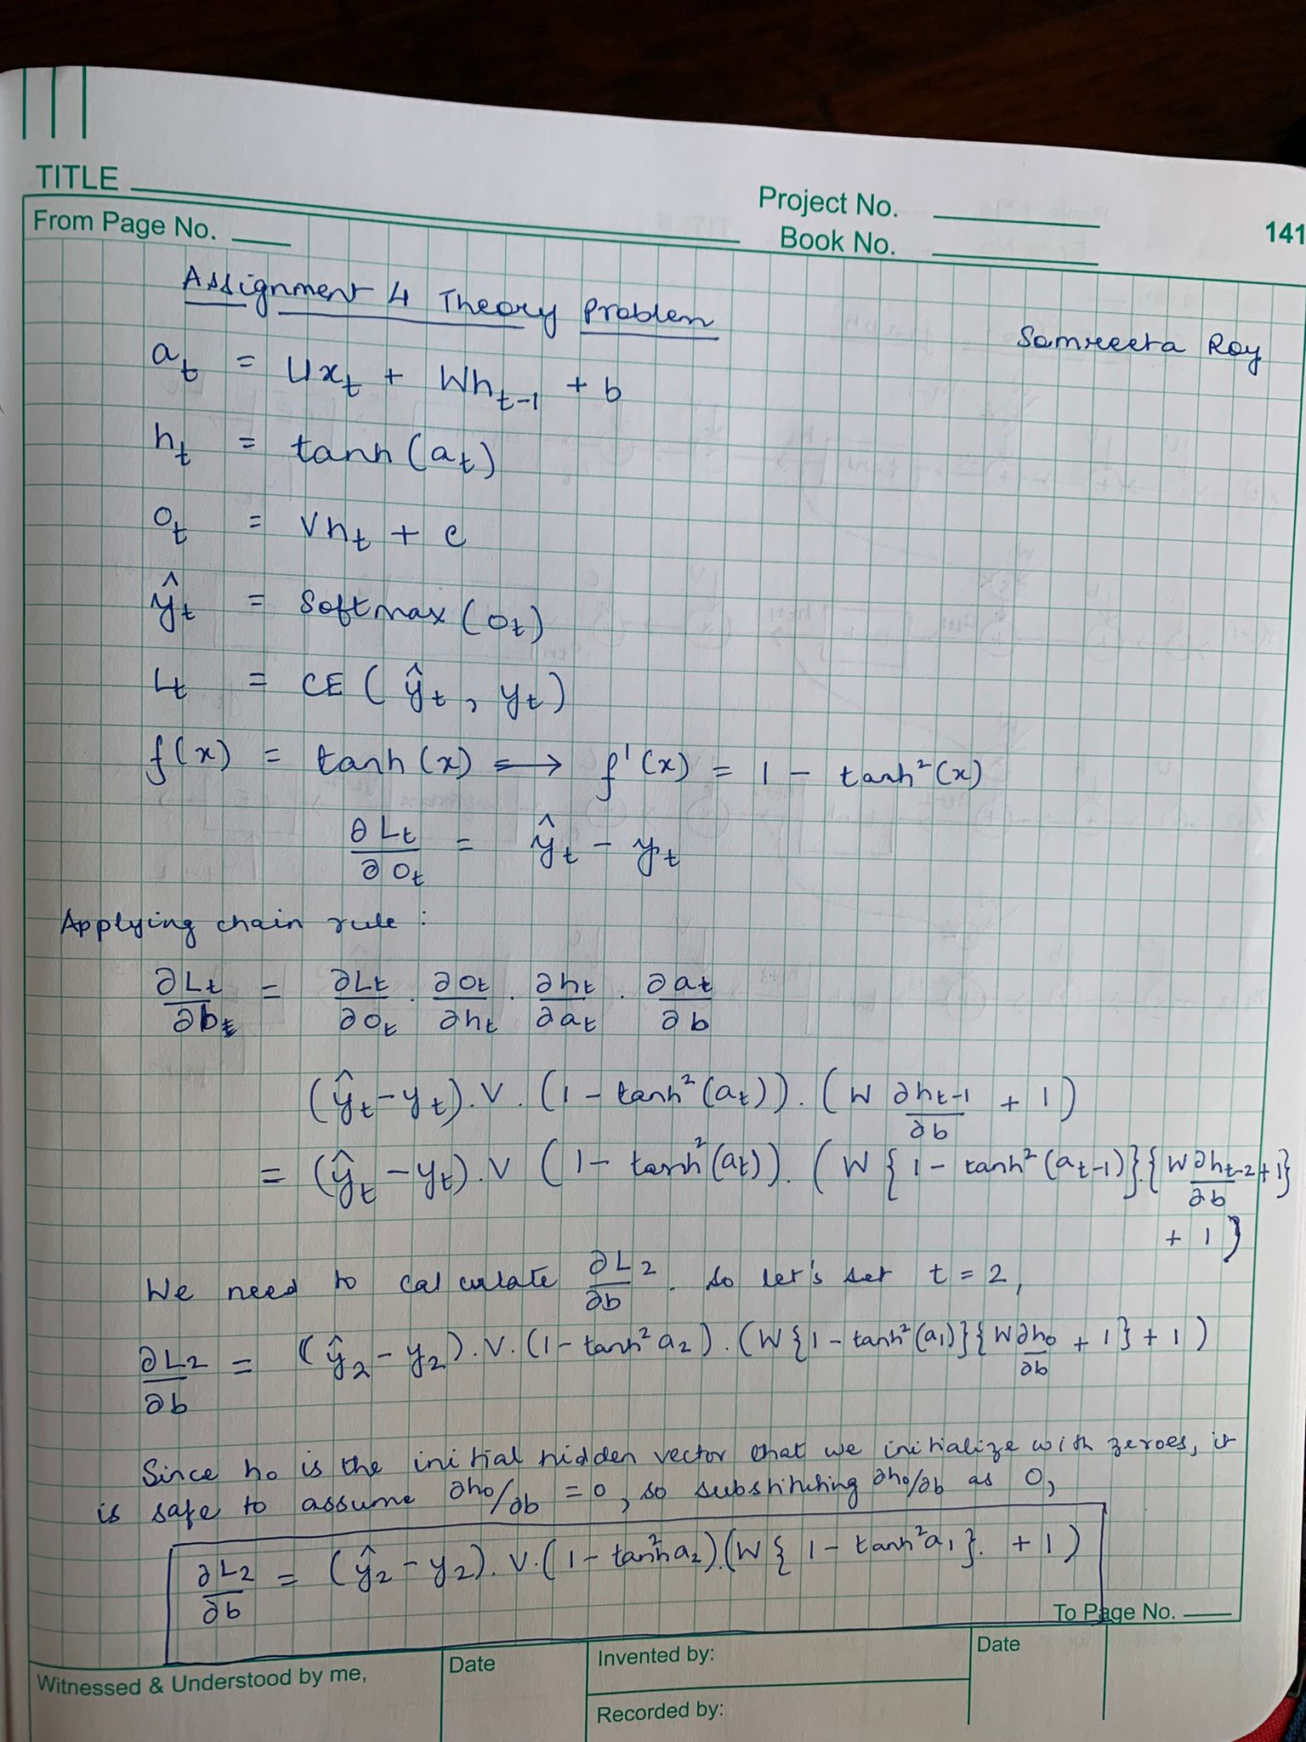
Theory question

Slide 15
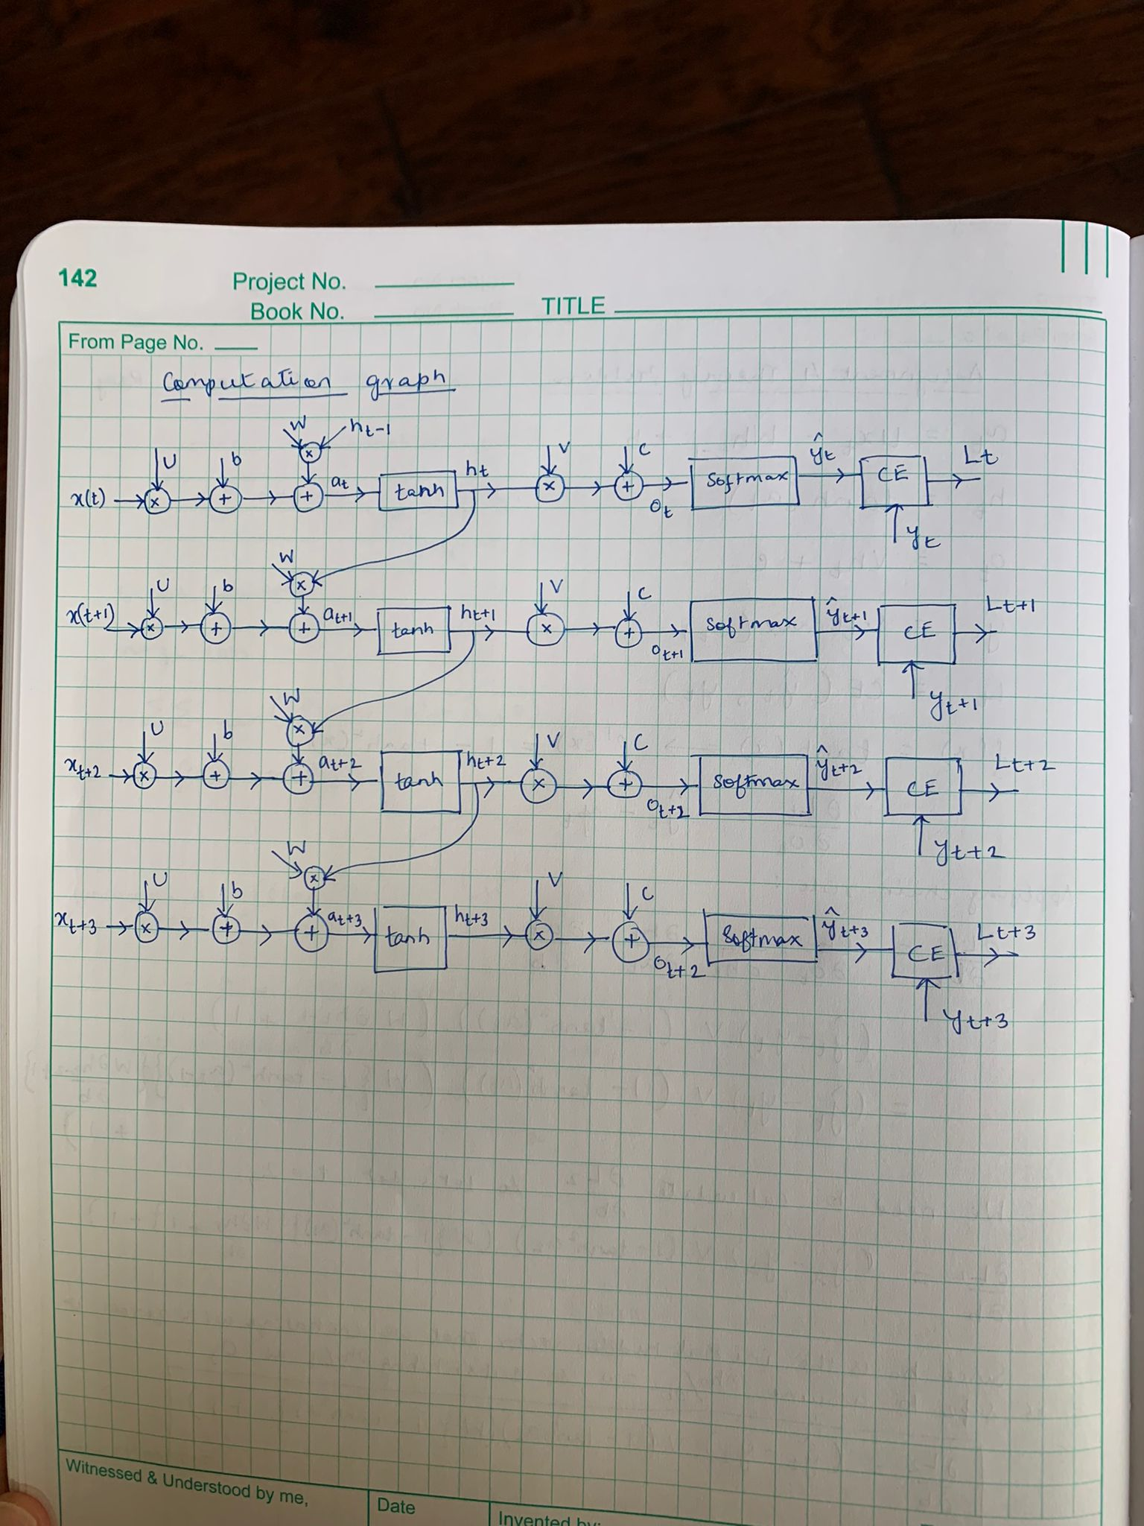
Theory question

Slide 16
Paper discussion
Name the paper you chose and answer the questions related to it
Add additional slides as necessary

