Slide 1
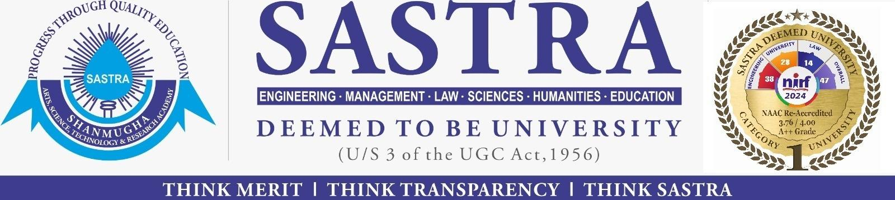
LLM Agentic Workflow for Automated Vulnerability Detection and Remediation in Infrastructure-as-Code
127003252 Someshwar S
127003056 Dhanvanth V
Guided By,
Dr.R.Alageswaran
Associate Dean-Student welfare & Professor , School of Computing
1
Notes:
1

Slide 2
LAYOUT OF THIS PRESENTATION
Literature survey
Architectural diagram
Modules
Conclusion
References
Code and Dataset
Abstract
Introduction
Objective
Base Paper
Problem Statement
2
16/02/2026

Slide 3
ABSTRACT
The rapid growth of Infrastructure-as-Code (IaC) in cloud-native environments has created serious security risks, as small misconfigurations in templates can lead to major data breaches.
As cloud systems become more complex, it becomes harder for developers to identify hidden and context-specific vulnerabilities using traditional security tools.
Current vulnerability detection methods mainly use static analysis tools, rule-based systems (such as CDK-Nag), and dynamic runtime analysis.
These tools work well for known issues, but they often fail to detect interdependent or complex vulnerabilities and produce many false positives because they cannot fully understand the infrastructure context.
3
16/02/2026

Slide 4
INTRODUCTION
Rise of Cloud Automation: In today’s digital world, organizations are widely adopting Infrastructure-as-Code (IaC) to automatically create and manage complex cloud environments.
Security Challenge: Although IaC improves speed and consistency, it also creates serious security risks. Small misconfigurations—such as unencrypted databases or open ports—can lead to major cloud data breaches (for example, the UniSuper Google Cloud incident).
Limitations of Current Tools: Traditional security tools depend on static, rule-based systems. They can detect simple errors but often miss context-specific and complex vulnerabilities caused by interactions between cloud resources.
Problem of False Positives: Existing tools generate many false positives, which overload developers with unnecessary alerts and do not fully understand the intent of the configuration.
4
16/02/2026

Slide 5
OBJECTIVE
Design and implement a multi-agent AI framework to automatically detect security vulnerabilities in Infrastructure-as-Code (IaC) templates.
Overcome the limitations of traditional static analysis tools by using Retrieval-Augmented Generation (RAG) to identify context-specific misconfigurations and reduce false positives.
Provide automated and actionable remediation guidance that integrates smoothly with CI/CD workflows, reduces manual effort, and improves overall cloud security scalability.
5
16/02/2026
Notes:
5

Slide 6
BASE PAPER
D. Toprani and V. K. Madisetti, "LLM Agentic Workflow for Automated Vulnerability Detection and Remediation in Infrastructure-as-Code," in IEEE Access, vol. 13, pp. 69175-69181, 2025, doi: 10.1109/ACCESS.2025.3560911.
URL: https://ieeexplore.ieee.org/stamp/stamp.jsp?tp=&arnumber=10965635&isnumber=10820123
6
16/02/2026

Slide 7
PROBLEM STATEMENT
Complexity of Cloud Infrastructure: As organizations rapidly adopt Infrastructure-as-Code (IaC), cloud environments are becoming too complex to manage manually, leading to frequent misconfigurations like unencrypted databases or open access ports.
Failure of Traditional Tools: Existing security tools (Static Analysis) operate on rigid rules. They are like "spellcheckers"—they catch simple typos but fail to understand the context, missing subtle, interdependent vulnerabilities.
High False Positives: Because current tools lack understanding, they often flag safe configurations as dangerous (False Positives). This overwhelms developers with useless alerts and causes "alert fatigue".
Lack of Automated Solutions: Current tools only find the problems but do not tell you how to fix them. This forces developers to manually research and patch security holes, which is slow and error-prone.
7
16/02/2026

Slide 8
LITERATURE SURVEY
AUTHOR | TITLE | APPROACH DESCRIPTION AND ACHIEVEMENTS | LIMITATIONS/ OBSERVATION | YEAR
2. Lian et al. | Configuration validation with large language models | Developed Ciri, a generic framework that employs Large Language Models (LLMs) as configuration validators without fine-tuning. | Hallucination and Non-determinism: LLMs can generate inconsistent or factually incorrect validation results. | 2023
3. N. Saavedra, J. F. Ferreira | GLITCH: Automated polyglot security smell detection in IaC | Proposed a framework using static analysis and technology-agnostic representations to identify patterns linked to misconfigurations and hardcoded secrets. | Faces challenges with dataset quality and maintaining accuracy in rapidly evolving cloud environments. | 2022
8
16/02/2026

Slide 9
LITERATURE SURVEY
AUTHOR | TITLE | APPROACH DESCRIPTION AND ACHIEVEMENTS | LIMITATIONS/ OBSERVATION | YEAR
4. E. Malul, Y. Meidan, et al. | GenKubeSec: LLM-based Kubernetes misconfiguration detection | demonstrated the effectiveness of LLMs in interpreting Kubernetes manifests to identify security misconfigurations and suggest remediations | Susceptible to false positives and relies heavily on well-labeled datasets; struggles with nuanced, context-specific vulnerabilities | 2024
5. S. Ullah, M. Han, et al. | LLMs Cannot Reliably Identify and Reason About Security Vulnerabilities | Conducted a comprehensive evaluation of LLMs to test their ability to identify and reason about security flaws in code. | Highlighted significant difficulties in handling nuanced misconfigurations and a tendency for LLMs to hallucinate without external context. | 2024
9
16/02/2026

Slide 10
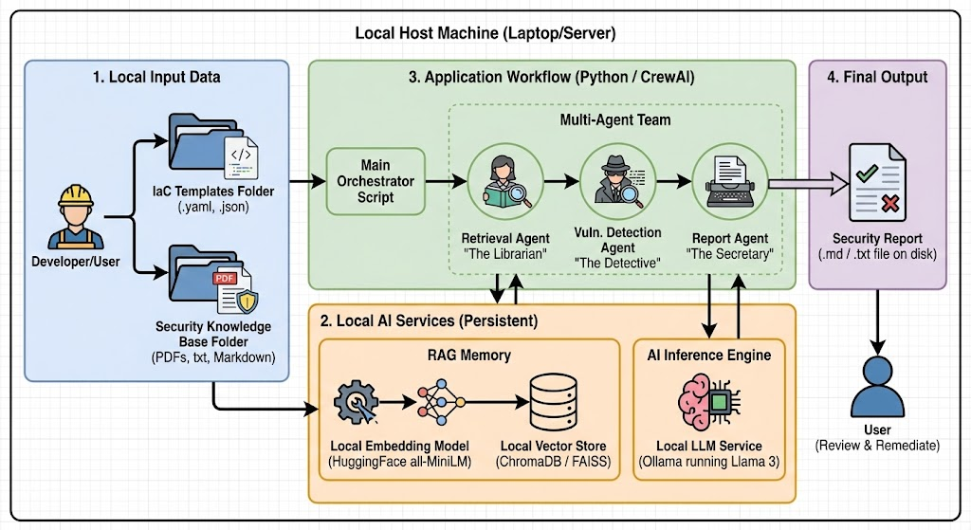
ARCHITECTURAL DIAGRAM
10
16/02/2026

Slide 11
MODULES
Module 1: Input and Knowledge Retrieval (RAG Module)
Submodule 1: Input Processing
Submodule 2: Vector Embedding
Submodule 3: Retrieval System
Module 2: Template Preprocessing
Submodule 1: Parsing
Submodule 2: Normalization
Module 3: Vulnerability Detection Agent
Submodule 1: Context Integration
Submodule 2: Semantic Analysis
Module 4: Remediation and Reporting
Submodule 1: Remediation Generation
Submodule 2: Report Generation
11
16/02/2026

Slide 12
CONCLUSION
An LLM-driven multi-agent system significantly enhances cloud security.
The solution uses RAG to understand IaC context, finding subtle, complex vulnerabilities.
The system has an 85% detection rate for complex misconfigurations with a low false positive rate.
Automated remediation integrates with CI/CD, reducing manual effort and improving cloud security.
12
18/02/2025

Slide 13
REFERENCES
Toprani, D., & Madisetti, V. K. (2025). LLM Agentic Workflow for Automated Vulnerability Detection and Remediation in Infrastructure-as-Code. IEEE Access.
Lian, X., Chen, Y., Cheng, R., Huang, J., Thakkar, P., Zhang, M., & Xu, T. (2023). Configuration validation with large language models. arXiv preprint arXiv:2310.09690.
Saavedra, N., & Ferreira, J. F. (2022, October). Glitch: Automated polyglot security smell detection in infrastructure as code. In Proceedings of the 37th IEEE/ACM international conference on automated software engineering (pp. 1-12).
Malul, E., Meidan, Y., Mimran, D., Elovici, Y., & Shabtai, A. (2024). Genkubesec: Llm-based kubernetes misconfiguration detection, localization, reasoning, and remediation. arXiv preprint arXiv:2405.19954.
Ullah, S., Han, M., Pujar, S., Pearce, H., Coskun, A., & Stringhini, G. (2024, May). Llms cannot reliably identify and reason about security vulnerabilities (yet?): A comprehensive evaluation, framework, and benchmarks. In 2024 IEEE symposium on security and privacy (SP) (pp. 862-880). IEEE.
14
18/02/2025

Slide 14
THANK YOU
15
18/02/2025
Notes:
14

