Slide 1

LLM Agentic Workflow for Automated Vulnerability
Detection and Remediation in Infrastructure-as-Code
127003252 Someshwar S
127003056 Dhanvanth V
Guided By, Dr.R.Alageswaran Associate Dean-Student Welfare & Professor, School of Computing
School of Computing
1
18/03/2026

Slide 2
LAYOUT OF THIS PRESENTATION
Base Paper Details
Abstract
Introduction
Literature Review
Limitations of Existing Systems
Problem Statement
Objective
Methodology
Hardware & Software Requirements
Flow Diagram / System Architecture
List of Modules
Module Explanations
Experimental Results
References
School of Computing
2
17/04/2026

Slide 3
BASE PAPER DETAILS
Base Paper Title | LLM Agentic Workflow for Automated Vulnerability Detection and Remediation in Infrastructure-as-Code
Journal Name | IEEE Access (Open Access Journal)
Year of Publication | 2025
Publisher Name | IEEE – Institute of Electrical and Electronics Engineers
Authors | Dheer Toprani, Vijay K. Madisetti – Georgia Institute of Technology, Atlanta, GA
DOI | 10.1109/ACCESS.2025.3560911
Base Paper Link | https://ieeexplore.ieee.org/document/10965635
School of Computing
3
17/04/2026

Slide 4
ABSTRACT
The rapid growth of Infrastructure-as-Code (IaC) in cloud-native environments has created serious security risks, as small misconfigurations in templates can lead to major data breaches.
As cloud systems become more complex, it becomes harder for developers to identify
hidden and context-specific vulnerabilities using traditional security tools.
This project implements a
multi-agent AI workflow using LLMs and Retrieval-Augmented Generation (RAG). The RAG module (50% complete) embeds AWS CIS Benchmark security best practices into a Amazon Bedrock (Claude 3.5 Sonnet V2) and a Pinecone vector store using Amazon Titan Text Embeddings V2, and successfully retrieves relevant security context for CloudFormation templates. The Vulnerability Detection Agent, Remediation Engine, and Report Generator are the next implementation phase.
School of Computing
4
17/04/2026

Slide 5
INTRODUCTION
Rise of Cloud Automation: Organizations widely adopt Infrastructure-as-Code (IaC) to automatically create and manage complex cloud environments using declarative templates.
Security Challenge: Although IaC improves speed and consistency, it introduces serious security risks. Misconfigurations — unencrypted databases, open ports, overly permissive IAM roles — can cause major data breaches (e.g., the UniSuper Google Cloud breach, 2024).
Limitations of Current Tools: Traditional security tools depend on static, rule-based systems. They detect simple errors but often miss context-specific and compound vulnerabilities caused by interactions between cloud resources.
Our Approach: An LLM-driven multi-agent pipeline augmented by RAG — combining semantic reasoning with a continuously updated security knowledge base to detect misconfigurations with high accuracy and generate actionable remediation guidance.
School of Computing
5
17/04/2026

Slide 6
LITERATURE REVIEW
Sl.No | Author / Title / Journal / Year | Technique Used | Merits | Limitations
1 | Toprani & Madisetti LLM Agentic Workflow for Automated Vulnerability Detection in IaC IEEE Access, 2025 | Multi-agent LLM + RAG (Claude 3.5, Titan Embeddings, OpenSearch) | 85% detection; context-aware compound vulnerability detection | ~15% false positives; 80–100s latency; evaluated on only 10 templates
2 | Lian et al. Configuration Validation with LLMs (Ciri) arXiv, 2023 | Zero-shot LLM as generic config validator | No fine-tuning; generalises across config types | High hallucination rate; inconsistent without external grounding
3 | Saavedra & Ferreira GLITCH: Polyglot Security Smell Detection in IaC IEEE/ACM ASE, 2022 | Technology-agnostic static analysis + ML pattern recognition | Works across Ansible, Puppet, Chef | Dataset quality issues; poor adaptability to new cloud services
School of Computing
6
17/04/2026

Slide 7
LITERATURE REVIEW
Sl.No | Author / Title / Journal / Year | Technique Used | Merits | Limitations
4 | Malul et al. GenKubeSec: LLM-Based Kubernetes Misconfiguration Detection arXiv, 2024 | LLM fine-tuned on Kubernetes manifests | Effective localization; rationale per finding | Domain-specific to K8s; false positives on edge cases
5 | Ullah et al. LLMs Cannot Reliably Identify Security Vulnerabilities (Yet?) IEEE S&P, 2024 | Benchmark of GPT-4, Claude, Gemini on 228 CVEs | Rigorous evaluation framework; identifies LLM failure modes | Up to 50% miss-rate on context-specific CVEs; hallucinations without grounding
6 | Minna et al. Analyzing Security Misconfigurations of Helm Charts arXiv, 2024 | LLM static analysis of Helm charts from Artifact Hub | First large-scale Helm security study | Limited to Helm; no remediation automation; high false positive rate
School of Computing
7
17/04/2026

Slide 8
LIMITATIONS OF EXISTING SYSTEMS
No Context-Aware Reasoning: Static rule engines like CDK-Nag match patterns against fixed rule sets. They cannot detect compound vulnerabilities — cases where two individually safe configurations become dangerous when combined.
Excessive False Positives (15–30%): Rule packs flag configurations that are valid in the organisation's specific context, generating alert fatigue and eroding developer trust.
Stale Security Knowledge: Rule packs updated infrequently. LLMs trained before new AWS advisories miss newly disclosed vulnerabilities and deprecated service recommendations without RAG grounding.
No Automated Remediation Guidance: Existing scanners identify issues but leave developers to research and apply fixes manually — increasing Mean Time to Remediation (MTTR).
Poor Scalability to Complex Templates: Conditional logic, parameterised resources, and cross-stack references cause both rule-based tools and zero-shot LLMs to produce redundant or missed alerts.
Weak CI/CD Integration: Most tools lack native pipeline hooks. Reports are not developer-friendly and difficult to feed into issue-tracking workflows automatically.
School of Computing
8
17/04/2026

Slide 9
PROBLEM STATEMENT
Complexity of Cloud Infrastructure: As organisations rapidly adopt IaC, cloud environments are too complex to manage manually — leading to frequent misconfigurations such as unencrypted databases or open access ports.
Failure of Traditional Tools: Existing security tools operate on rigid rules. They are like "spellcheckers" — they catch simple typos but fail to understand the context, missing subtle, interdependent vulnerabilities.
High False Positives: Because current tools lack semantic understanding, they often flag safe configurations as dangerous. This overwhelms developers with useless alerts and causes "alert fatigue".
Lack of Automated Remediation: Current tools only find the problems but do not provide actionable fixes. This forces developers to manually research and patch security issues, which is slow and error-prone.
Knowledge Staleness: LLMs and rule-based tools do not automatically incorporate newly released AWS security advisories or updated CIS Benchmark requirements, causing missed detections on emerging threats.
School of Computing
9
17/04/2026

Slide 10
OBJECTIVE
Design and implement a multi-agent AI framework to automatically detect security vulnerabilities in Infrastructure-as-Code (IaC) templates.
Overcome the limitations of traditional static analysis tools by using Retrieval-Augmented Generation (RAG) to identify context-specific misconfigurations and reduce false positives.
Build a structured Vulnerability Detection Agent that invokes Amazon Bedrock (Claude 3.5 Sonnet V2) with an enriched context (parsed template summary + retrieved CIS Benchmark snippets) and returns findings as structured JSON.
Generate automated, actionable remediation guidance for each finding, referencing specific CloudFormation properties and AWS security documentation.
Provide automated and actionable remediation guidance that integrates smoothly with CI/CD workflows (GitHub Actions, GitLab CI, Jenkins), reduces manual effort, and improves overall cloud security scalability.
School of Computing
10
17/04/2026

Slide 11
METHODOLOGY
Step | Module | Tool / Technology | Role in System
1 | CloudFormation Parsing | Python PyYAML + Custom Extractor | Parse & normalise YAML/JSON templates; extract security-relevant attributes
2 | Knowledge Embedding | Amazon Titan Text Embeddings V2 (1536-dim) | Embed CIS Benchmark & Well-Architected security documents into vectors
3 | Vector Store | Pinecone (serverless) | Store and retrieve security knowledge chunks via cosine similarity search
4 | RAG Retrieval | Top-K vector search (K=5) | Fetch relevant best practices per CloudFormation query
5 | LLM Inference | Amazon Bedrock — Claude 3.5 Sonnet V2 / Claude Sonnet 4.x | Detect vulnerabilities from enriched context; output structured JSON findings
6 | Orchestration | Custom Agent Pipeline (RetrievalAgent + WorkflowManager) | Coordinate agents in fixed sequential pipeline; manage state passing
7 | Report Generation | Markdown + Severity Classifier | Produce developer-facing report; CI/CD exit codes for build gating
School of Computing
11
17/04/2026

Slide 12
HARDWARE AND SOFTWARE REQUIREMENTS
Hardware
Software
Processor: Intel Core i7 / AMD Ryzen 7 or above
RAM: Minimum 16 GB (32 GB recommended for large-scale template scanning)
Storage: 30 GB free disk space (dependencies, datasets, reports)
GPU: Not required — inference runs on Amazon Bedrock (cloud)
Network: Stable internet required — AWS Bedrock API, Pinecone, boto3 calls
OS: Windows 10/11 (64-bit)
Primary Language: Python 3.10+
LLM Runtime: Amazon Bedrock — Claude 3.5 Sonnet V2 / Claude Sonnet 4.x
Embeddings: Amazon Titan Text Embeddings V2 (via AWS boto3 SDK)
Vector Database: Pinecone (primary cloud vector store)
Embedding Fallback: HuggingFace sentence-transformers (all-MiniLM-L6-v2)
Vector Store Fallback: FAISS / ChromaDB (local)
Pipeline: Custom RAG pipeline (RetrievalAgent + WorkflowManager)
AWS Services: Bedrock, IAM, boto3 SDK
Parsing: PyYAML (CloudFormation), jsonschema (validation)
Utilities: python-dotenv, pytest, tqdm, colorlog
IDE: VS Code
School of Computing
12
17/04/2026

Slide 13
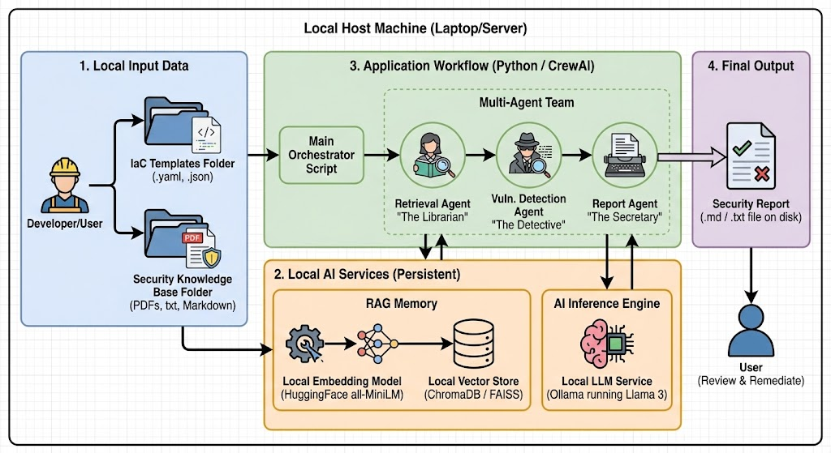
FLOW DIAGRAM / SYSTEM ARCHITECTURE
School of Computing
13
17/04/2026

Slide 14
LIST OF MODULES
Module 1: RAG Pipeline — Knowledge Base & Retrieval ✓ COMPLETED
Submodule 1: Knowledge Base Creation (CIS Benchmark PDF + GitHub IaC datasets)
Submodule 2: Document Embedding (Amazon Titan Text Embeddings V2)
Submodule 3: Vector Store Indexing & Retrieval (Pinecone)
Module 2: CloudFormation Template Parser & Normaliser ✓ COMPLETED
Submodule 1: YAML/JSON Parsing (with intrinsic function handling)
Submodule 2: Security Attribute Extraction (S3, IAM, SG, RDS)
Module 3: Vulnerability Detection Agent ✓ COMPLETED
Submodule 1: LLM Prompt Engineering (RAG context injection)
Submodule 2: LLM Semantic Analysis (Amazon Bedrock — Claude Sonnet)
Module 4: Remediation and Reporting ✓ COMPLETED
Submodule 1: Remediation Guidance Generation
Submodule 2: Markdown Report Generation + CI/CD Integration
School of Computing
14
17/04/2026

Slide 15
MODULE 1: RAG PIPELINE — KNOWLEDGE BASE & RETRIEVAL
What is RAG? Retrieval-Augmented Generation grounds LLM reasoning in a live knowledge base. Instead of relying solely on training data, the model reads freshly retrieved best-practice snippets for every query, eliminating stale recommendations and hallucinations. Why RAG for IaC Security? AWS security policies change frequently. Without RAG, an LLM may recommend deprecated configurations or miss newly discovered CVEs. RAG ensures the analysis always cites current CIS Benchmark rules. Implementation Steps: Step 1 — Knowledge Base Creation: AWS Security Hub CIS Benchmark PDF + GitHub CloudFormation templates. Chunked into ~500-word passages with 50-word overlap. Step 2 — Embedding: Amazon Titan Text Embeddings V2 → 1536-dimensional semantic vectors. Batch processing with exponential backoff on throttling. Step 3 — Pinecone Vector Store: Vectors indexed in Pinecone serverless with metadata (source, category, chunk_id). Index verified — document count confirmed. Step 4 — Top-K Retrieval: CloudFormation resource summary → Titan embedding → cosine similarity search → Top-5 relevant CIS passages returned and injected into LLM prompt.
School of Computing
15
17/04/2026

Slide 16
MODULE 2: CLOUDFORMATION TEMPLATE PARSER & NORMALISER
Input Handling:
Accepts CloudFormation templates in both YAML and JSON formats.
Handles intrinsic functions: !Ref, !Sub, !If, !Select, !Join, !GetAtt — replaced with safe string placeholders to prevent parser crashes.
Raises descriptive ParseError for malformed or empty Resources sections.
Security Attribute Extraction:
S3 Buckets: BucketEncryption, PublicAccessBlockConfiguration (all 4 flags), AccessControl, VersioningConfiguration.
IAM Roles & Policies: PolicyDocument wildcard actions (*), wildcard principals, overly broad Resource fields.
Security Groups: SecurityGroupIngress rules — flags CidrIp=0.0.0.0/0, port 22 and 3389 open to the internet.
RDS Instances: StorageEncrypted, MultiAZ, PubliclyAccessible, MasterUserPassword (hardcoded vs SSM reference).
Output:
Produces a plain-English resource summary (not raw YAML) with security risk signals for LLM context injection.
School of Computing
16
17/04/2026

Slide 17
MODULE 3: VULNERABILITY DETECTION AGENT
Prompt Engineering:
System prompt: LLM instructed to act as an AWS security expert with domain knowledge.
User prompt: CloudFormation resource summary + Top-5 retrieved CIS/Well-Architected snippets injected as numbered context blocks.
Explicit instruction: 'Do not hallucinate. Only flag real issues. Justify every finding against the retrieved best practices.'
LLM Inference (Amazon Bedrock — Claude Sonnet):
Amazon Bedrock invoked via boto3 converse API using Claude 3.5 Sonnet V2 / Claude Sonnet 4.x.
Structured JSON output: { vulnerabilities: [ { resource_id, resource_type, severity, title, description, evidence, remediation, confidence_score } ] }
JSON parse failure triggers one retry with a simplified prompt.
Validation:
Filters out findings missing required fields; assigns CRITICAL/HIGH/MEDIUM/LOW severity using heuristic overrides (e.g., hardcoded secret → CRITICAL minimum).
School of Computing
17
17/04/2026

Slide 18
MODULE 4: REMEDIATION AND REPORTING
Severity Classification:
Classify findings: CRITICAL / HIGH / MEDIUM / LOW using LLM output + heuristic overrides.
Examples: 'hardcoded secret' → CRITICAL; 'unrestricted SSH' → HIGH minimum; 'encryption disabled' → HIGH minimum.
Sort findings highest-severity-first in the final report.
Report Generation:
Markdown report sections: Executive Summary → Summary Table (by severity) → Detailed Findings → Remediation Checklist → References.
Each finding includes: Evidence, Remediation step, Best-Practice reference (CIS / AWS Well-Architected).
Saved to data/reports/generated/ with timestamped filename.
CI/CD Integration:
Exit codes: 0 (clean template), 1 (vulnerabilities found), 2 (scan error) — for GitHub Actions, GitLab CI, Jenkins build-gate enforcement.
School of Computing
18
17/04/2026

Slide 19
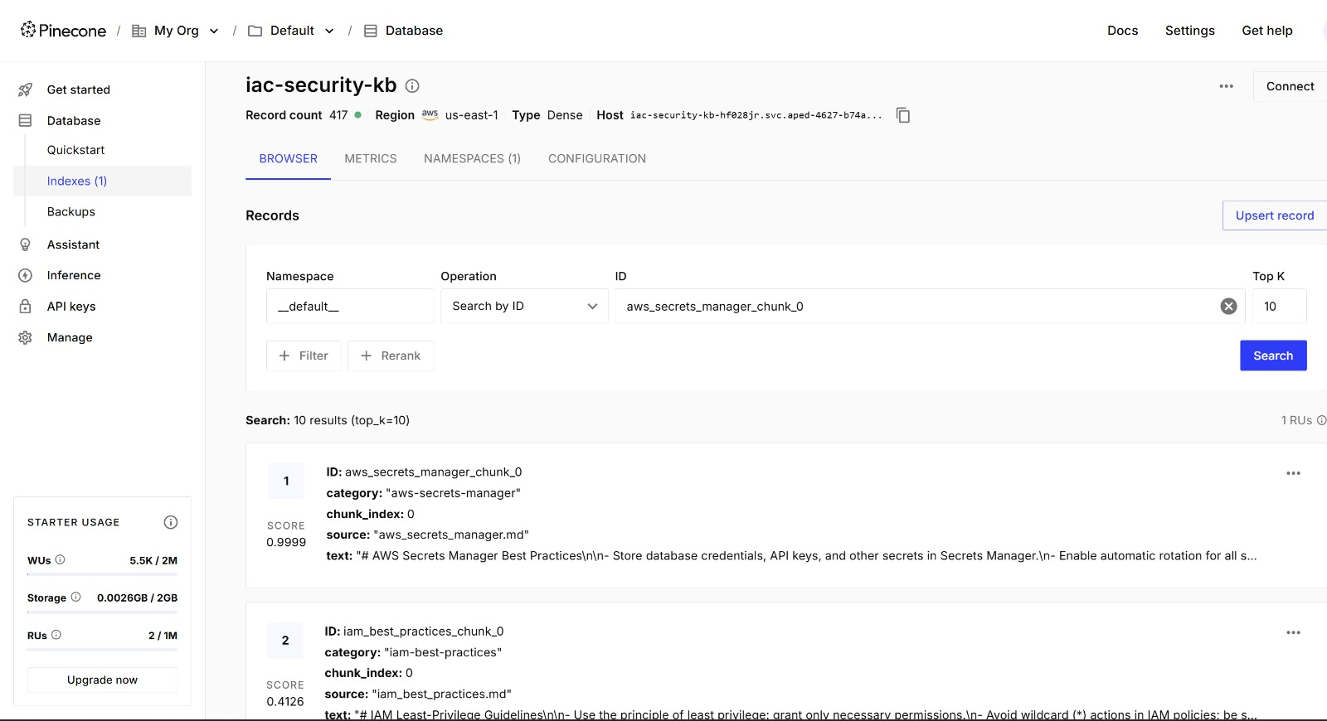
EXPERIMENTAL RESULTS – PREPROCESSING
Knowledge Sources | CIS Benchmark PDF + GitHub IaC Templates
Total Document Chunks | ~150–200 passages (~500 words each)
Embedding Model | Amazon Titan Text Embeddings V2
Dimensions | 1536-dimensional vectors
Vector Store | Pinecone (serverless index)
Index Status | Created and verified ✓
Test Query | Executed — relevant results returned ✓
Retrieval Top-K | K = 5 (configurable via .env)
School of Computing
19
17/04/2026

Slide 20
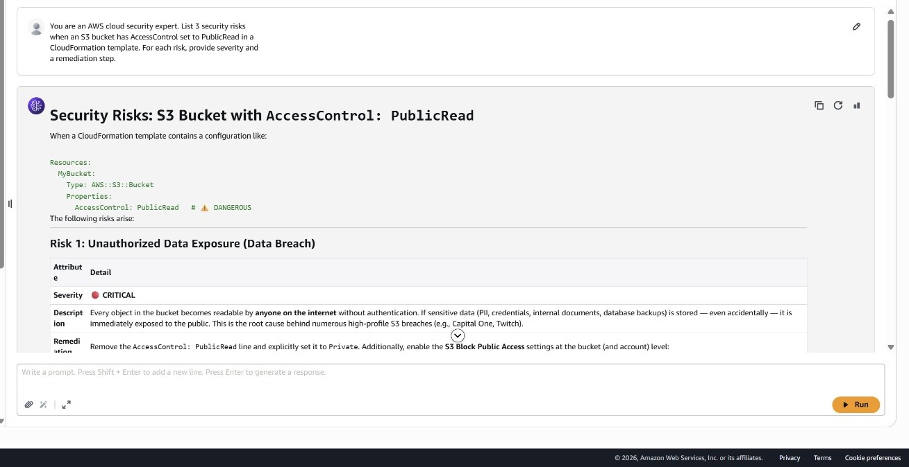
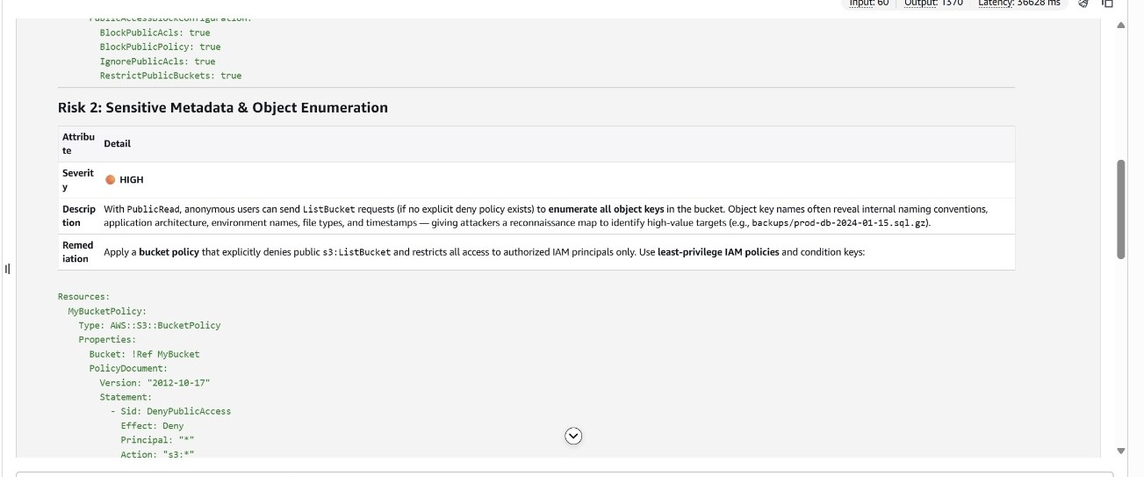
EXPERIMENTAL RESULTS – MODULE 1 (RAG END-TO-END QUERY TEST)
Sample Input :
Retrieved CIS Benchmark Passages:
Current Status: RAG pipeline fully functional. End-to-end tested: CloudFormation template → Titan V2 embedding → Pinecone retrieval → Top-5 CIS passages returned. Ready for integration with Bedrock Claude Sonnet (Module 3).
School of Computing
20
17/04/2026

Slide 21
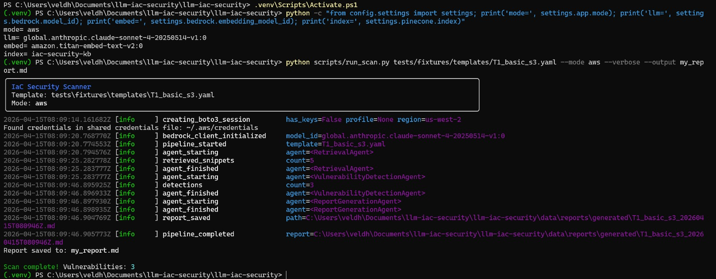
EXPERIMENTAL RESULTS – MODULE 2 (Vulnerability Detection)
:
School of Computing
20
17/04/2026

Slide 22
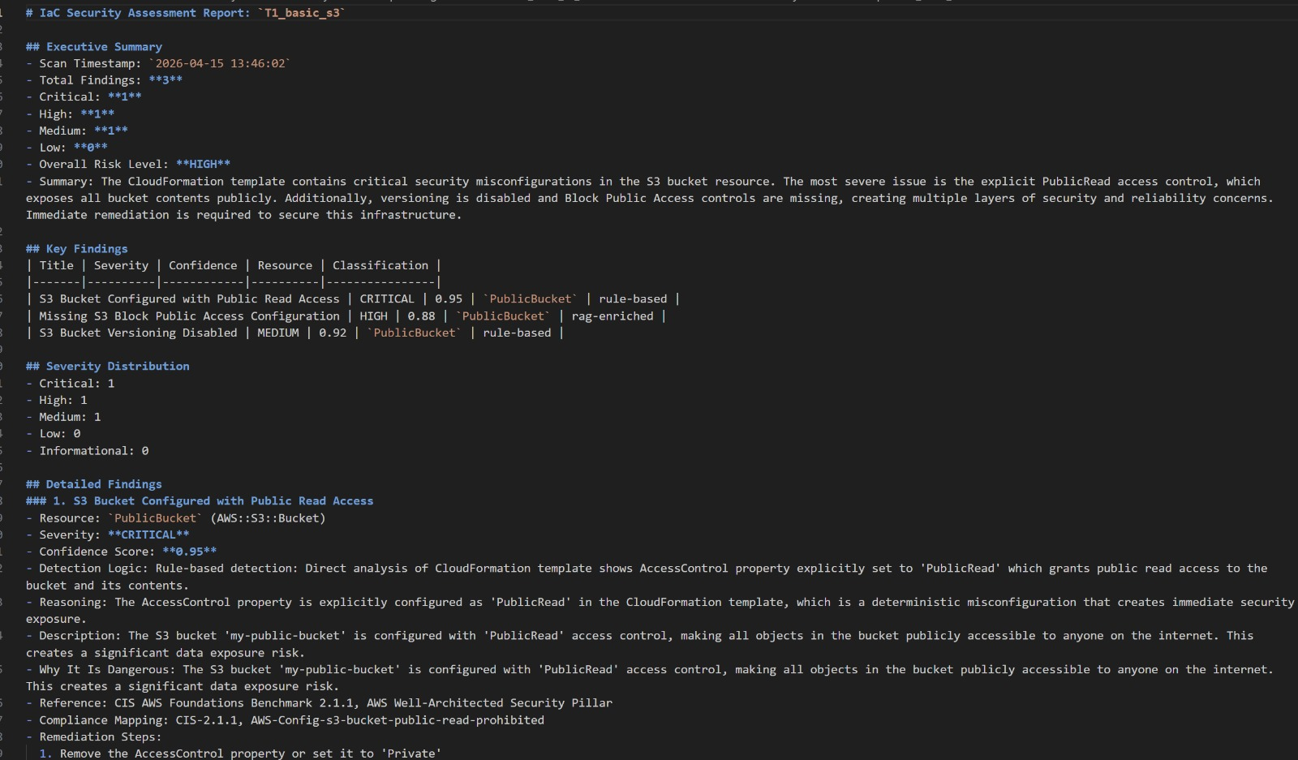
EXPERIMENTAL RESULTS – MODULE 3 (Report Generation)
:
School of Computing
20
17/04/2026

Slide 23
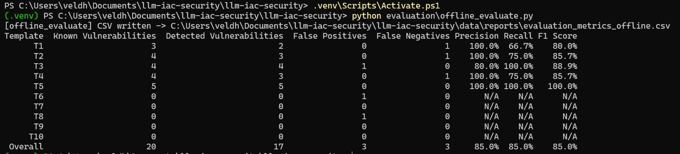
Evaluation results across 10 CloudFormation Templates
:
School of Computing
20
17/04/2026

Slide 24
REFERENCES
1. Toprani, D., & Madisetti, V. K. (2025). LLM Agentic Workflow for Automated Vulnerability Detection and Remediation in Infrastructure-as-Code. IEEE Access, vol. 13, pp. 69175–69181. DOI: 10.1109/ACCESS.2025.3560911
2. Lian, X., Chen, Y., Cheng, R., Huang, J., Thakkar, P., Zhang, M., & Xu, T. (2023). Configuration Validation with Large Language Models. arXiv preprint arXiv:2310.09690.
3. Saavedra, N., & Ferreira, J. F. (2022). GLITCH: Automated Polyglot Security Smell Detection in Infrastructure as Code. Proc. 37th IEEE/ACM ASE, pp. 1–12.
4. Malul, E., Meidan, Y., Mimran, D., Elovici, Y., & Shabtai, A. (2024). GenKubeSec: LLM-Based Kubernetes Misconfiguration Detection, Localization, Reasoning, and Remediation. arXiv:2405.19954.
5. Ullah, S., Han, M., Pujar, S., Pearce, H., Coskun, A., & Stringhini, G. (2024). LLMs Cannot Reliably Identify and Reason About Security Vulnerabilities (Yet?). IEEE Symposium on Security and Privacy (SP), pp. 862–880.
6. Minna, F., Massacci, F., & Tuma, K. (2024). Analyzing and Mitigating Security Misconfigurations of Helm Charts from Artifact Hub. arXiv:2403.09537.
7. AWS Well-Architected Framework — Security Pillar. Amazon Web Services, 2024. https://docs.aws.amazon.com/wellarchitected/latest/framework/welcome.html
8. CIS Benchmarks for Amazon Web Services. Center for Internet Security, 2024. https://www.cisecurity.org/cis-benchmarks
School of Computing
21
17/04/2026

Slide 25
THANK YOU
School of Computing
17/04/2026

