Slide 1



Shield Insurance
Data Analyst Intern at AtliQ Technologies
Codebasics Internship
Presented by
Manda. Soma sekhar

Slide 2
Topics
Company Overview
Objective
Dataset Overview
Dashboard
Recommendations
Conclusion

Slide 3
SHIELD INSURANCE
Independent, multi-channel insurance agency serving diverse customer needs.
Ohio & West Virginia: Medicare Advantage, Supplement & Part D plans for retirees.
Tampa Bay & Michigan: Homeowners, auto, flood, watercraft, commercial & liability coverage.

Slide 4
Project Objective
To create an interactive Power BI dashboard for Shield Insurance that :
Tracks revenue and customer trends over time
Analyzes sales by channel, policy type, and location
Segments customers by age group and city
Examines settlement patterns across customer profiles
This dashboard will help Shield Insurance boost sales performance, target customers more effectively, and make smarter, data-driven decisions.

Slide 5
Sheild Insurance Provides a Total of 9 Policies'
Policy Id
POL4321HEL
POL4331HEL
POL3309HEL
POL5319HEL
POL6303HEL
POL6093HEL
POL9221HEL
POL1048HEL
POL2005HEL
Base coverage amt(INR)
200000
300000
500000
750000
1000000
1500000
2500000
5000000
10000000
Base premiumamt(INR)
5000
7500
12000
16700
21500
31700
42500
76500
120000

Slide 6
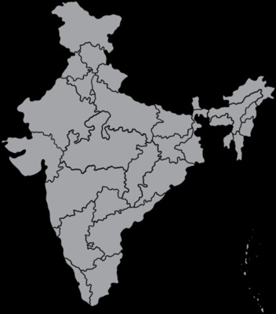




Cities
Delhi NCR
Indore
Mumbai
Chennai
Hyderabad

Slide 7
Online
Sales Mode
Offline
Online Website
Offline Agent
Online App
Offline Direct

Slide 8
Dataset
1. Dim Customer
2. Dim date
3. Dim policies
4. Fact premiums
5. Fact settlements

Slide 9
Recommendations
"Boost Top Channels – Fix low performers.“
"Prioritize 31–50, win back inactive.“
Offer Better Policy Combos – Combine popular and high-value policies.
Track Monthly Trends – Watch for sales drops and act quickly.
Improve Data Accuracy – Keep customer details complete and correct.

Slide 10
Conclusion
"This project turned raw insurance data into clear, actionable insights — enabling smarter decisions, higher revenue, and better customer retention. It showcases my ability to deliver business value through data analytics."

Slide 11


