Slide 1
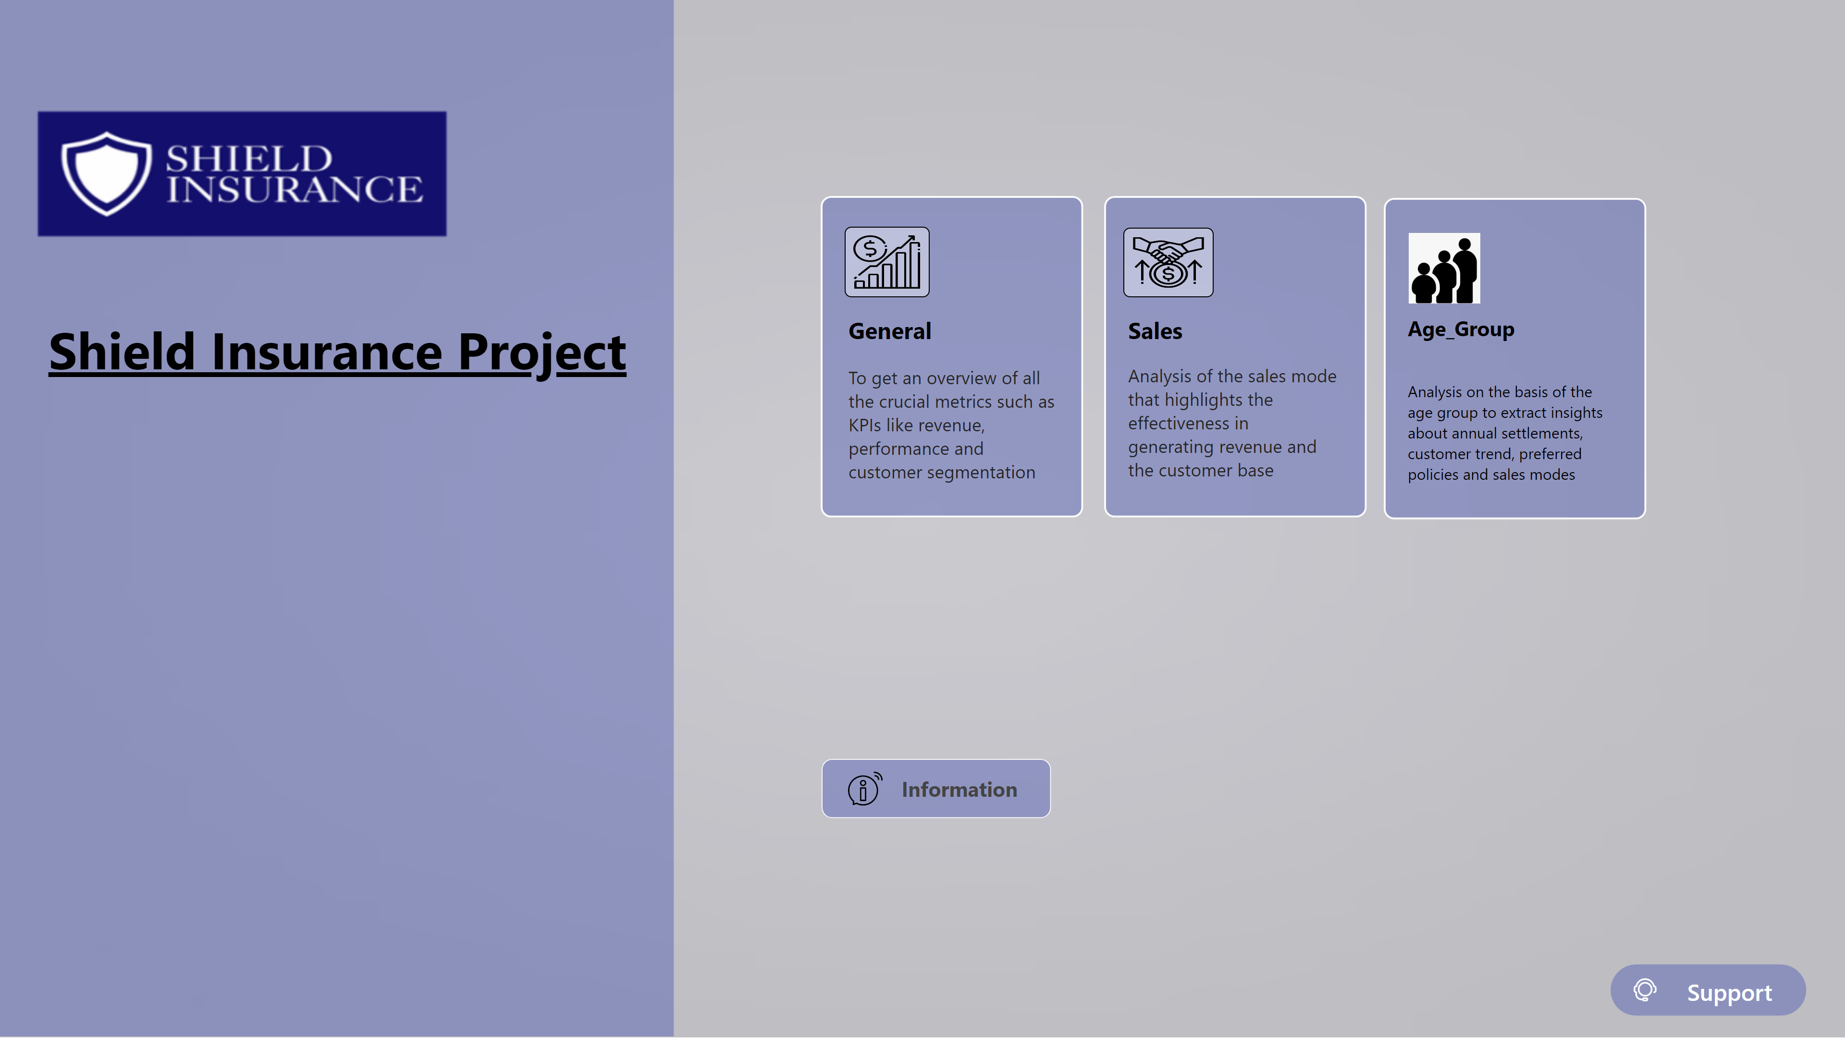
Home
Notes:
textbox
No alt text provided
shape
No alt text provided
image
No alt text provided
image
No alt text provided
actionButton
No alt text provided
actionButton
No alt text provided
actionButton
No alt text provided
actionButton
No alt text provided
Support Button
No alt text provided
textbox
No alt text provided
textbox
No alt text provided
textbox
No alt text provided
textbox
No alt text provided
textbox
No alt text provided
textbox
No alt text provided
textbox
No alt text provided
image
No alt text provided
image
No alt text provided
shape
No alt text provided
actionButton
No alt text provided
shape
No alt text provided
shape
No alt text provided
shape
No alt text provided
shape
No alt text provided
shape
No alt text provided
shape
No alt text provided
shape
No alt text provided
shape
No alt text provided
shape
No alt text provided
shape
No alt text provided
shape
No alt text provided
shape
No alt text provided
shape
No alt text provided
shape
No alt text provided
actionButton
No alt text provided
shape
No alt text provided
shape
No alt text provided
shape
No alt text provided
actionButton
No alt text provided
shape
No alt text provided
shape
No alt text provided
shape
No alt text provided
shape
No alt text provided
shape
No alt text provided
shape
No alt text provided
actionButton
No alt text provided
actionButton
No alt text provided
shape
No alt text provided
actionButton
No alt text provided
shape
No alt text provided
shape
No alt text provided
actionButton
No alt text provided
actionButton
No alt text provided
actionButton
No alt text provided
actionButton
No alt text provided
image
No alt text provided
actionButton
No alt text provided

Slide 2
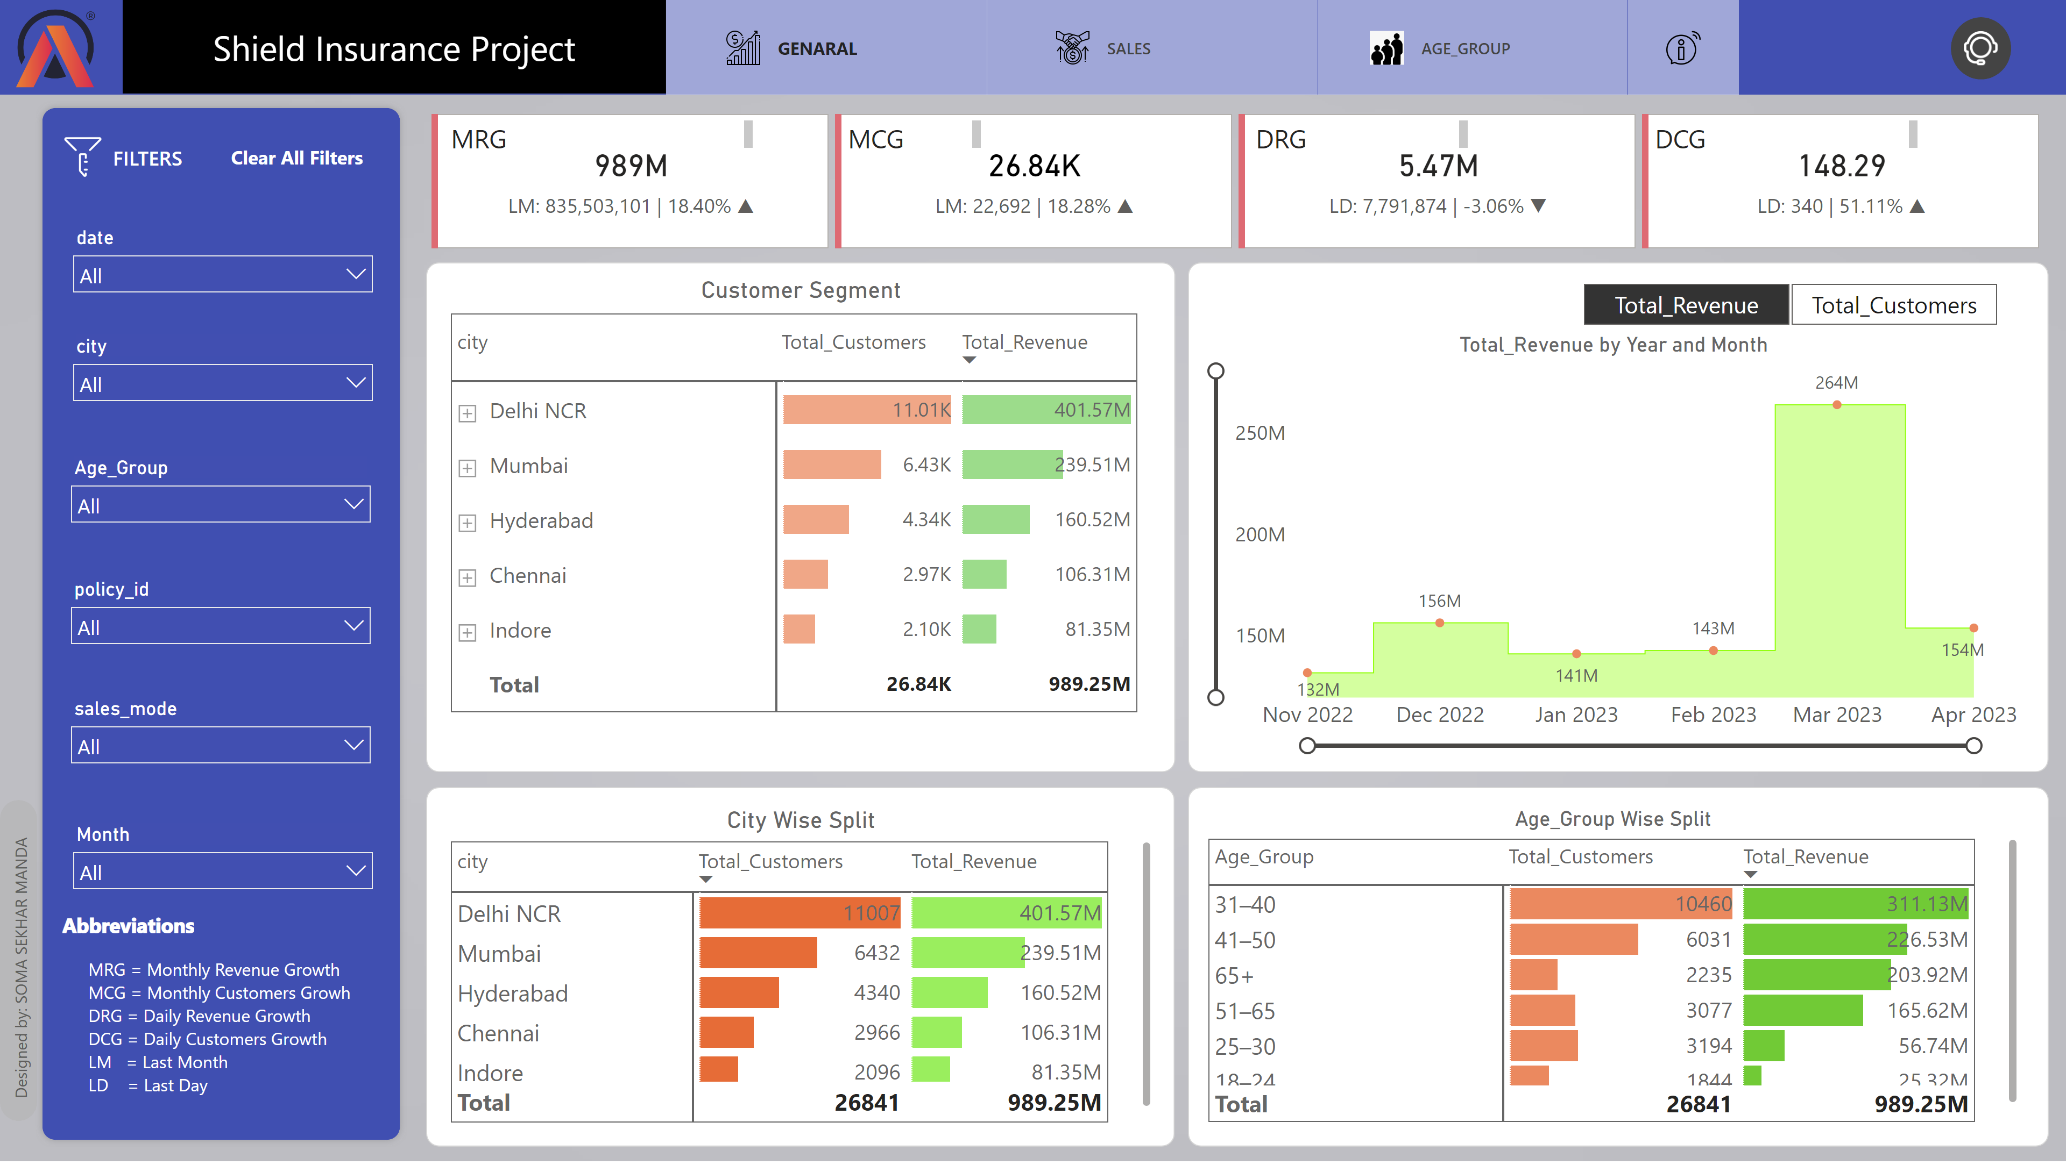
Genaral
Notes:
AB Signature
No alt text provided
City Wise Split
No alt text provided
Age_Group Wise Split
No alt text provided
cardVisual
No alt text provided
textbox
No alt text provided
textbox
No alt text provided
textbox
No alt text provided
textbox
No alt text provided
slicer
No alt text provided
shape
No alt text provided
shape
No alt text provided
shape
No alt text provided
shape
No alt text provided
slicer
No alt text provided
textbox
No alt text provided
AB Signature
No alt text provided
slicer
No alt text provided
image
No alt text provided
slicer
No alt text provided
slicer
No alt text provided
slicer
No alt text provided
shape
No alt text provided
slicer
No alt text provided
shape
No alt text provided
actionButton
No alt text provided
actionButton
No alt text provided
actionButton
No alt text provided
actionButton
No alt text provided
image
No alt text provided
actionButton
No alt text provided
shape
No alt text provided
shape
No alt text provided
Customer Segment
No alt text provided
shape
No alt text provided
Clear all filters
No alt text provided
areaChart
No alt text provided
shape
No alt text provided
actionButton
No alt text provided
shape
No alt text provided
shape
No alt text provided
shape
No alt text provided
shape
No alt text provided
shape
No alt text provided
shape
No alt text provided
shape
No alt text provided
shape
No alt text provided
shape
No alt text provided
shape
No alt text provided
shape
No alt text provided
shape
No alt text provided
shape
No alt text provided
shape
No alt text provided
actionButton
No alt text provided
shape
No alt text provided
shape
No alt text provided
shape
No alt text provided
actionButton
No alt text provided
shape
No alt text provided
shape
No alt text provided
shape
No alt text provided
shape
No alt text provided
shape
No alt text provided
shape
No alt text provided
actionButton
No alt text provided
actionButton
No alt text provided
shape
No alt text provided
actionButton
No alt text provided
shape
No alt text provided
shape
No alt text provided
actionButton
No alt text provided
actionButton
No alt text provided
actionButton
No alt text provided
actionButton
No alt text provided
image
No alt text provided
actionButton
No alt text provided

Slide 3
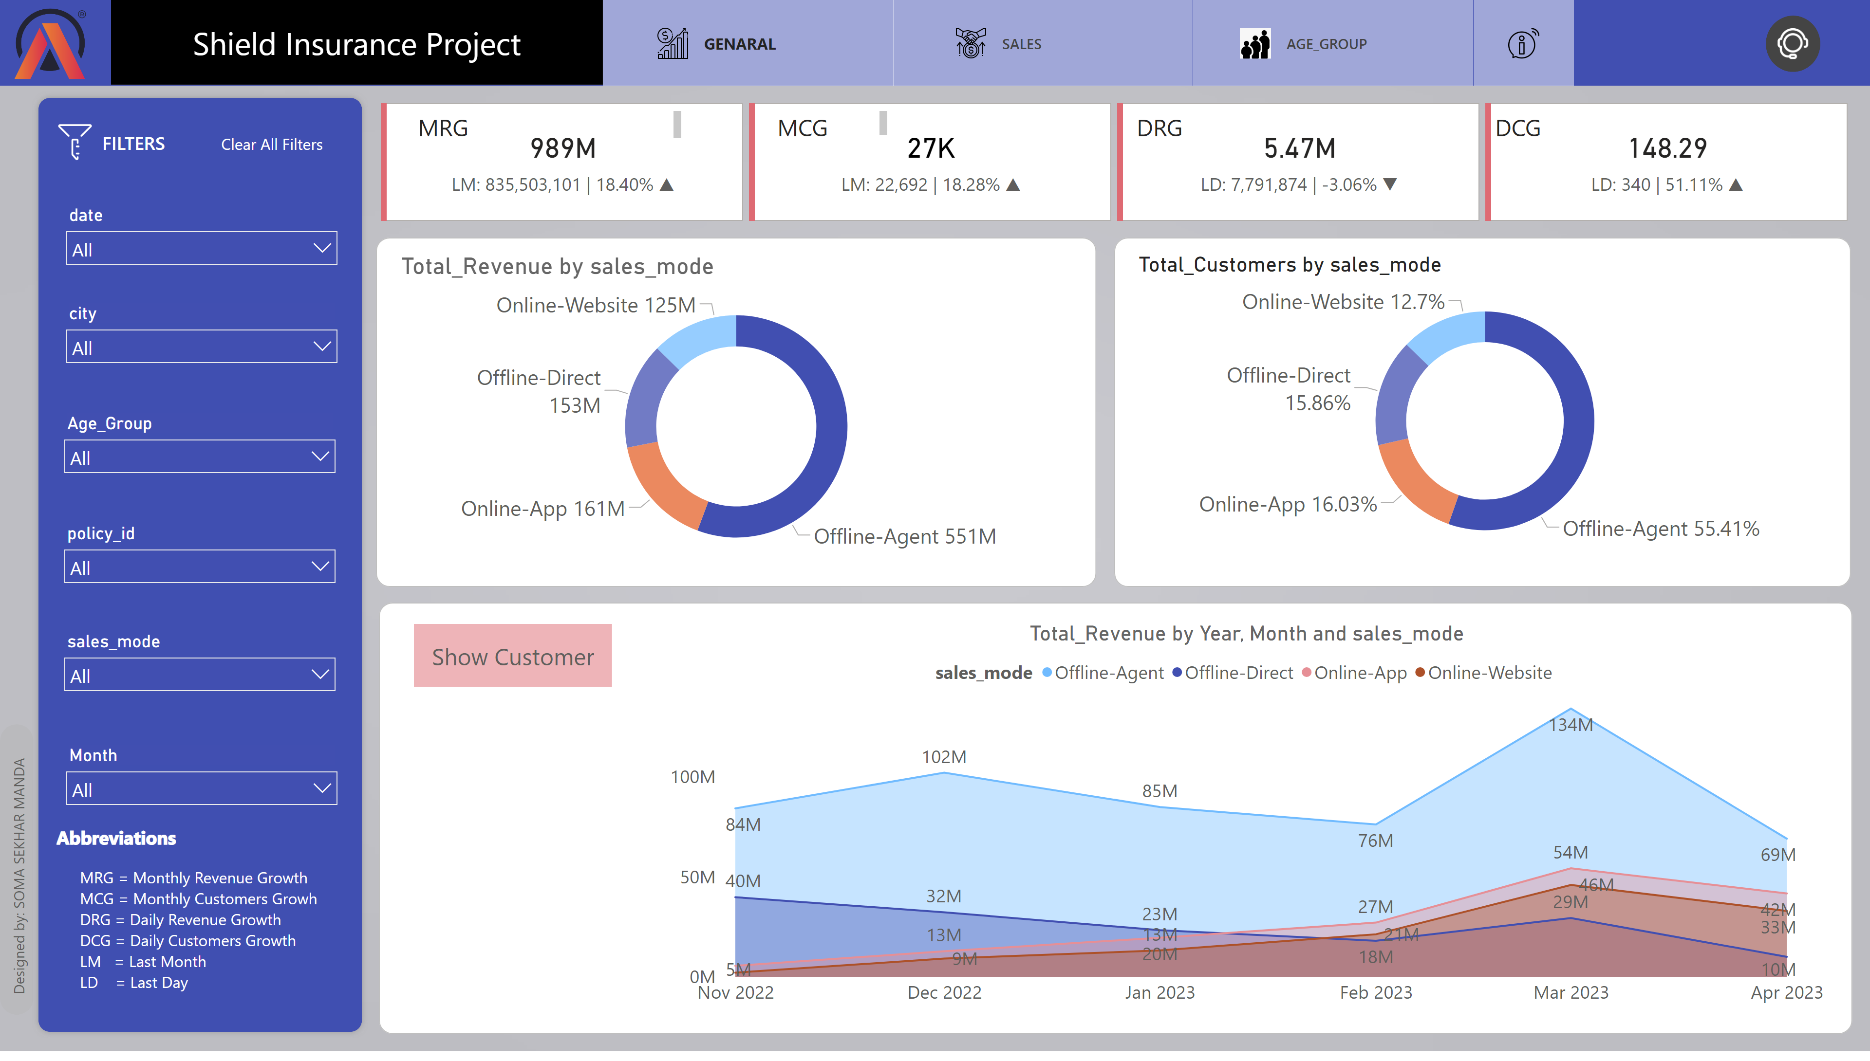
Sales
Notes:
donutChart
No alt text provided
donutChart
No alt text provided
shape
No alt text provided
actionButton
No alt text provided
actionButton
No alt text provided
shape
No alt text provided
actionButton
No alt text provided
shape
No alt text provided
shape
No alt text provided
actionButton
No alt text provided
actionButton
No alt text provided
actionButton
No alt text provided
actionButton
No alt text provided
image
No alt text provided
actionButton
No alt text provided
actionButton
No alt text provided
actionButton
No alt text provided
actionButton
No alt text provided
actionButton
No alt text provided
image
No alt text provided
actionButton
No alt text provided
shape
No alt text provided
shape
No alt text provided
shape
No alt text provided
shape
No alt text provided
Customer
No alt text provided
areaChart
No alt text provided
actionButton
No alt text provided
areaChart
No alt text provided
cardVisual
No alt text provided
textbox
No alt text provided
textbox
No alt text provided
textbox
No alt text provided
textbox
No alt text provided
shape
No alt text provided
slicer
No alt text provided
textbox
No alt text provided
AB Signature
No alt text provided
slicer
No alt text provided
image
No alt text provided
slicer
No alt text provided
slicer
No alt text provided
slicer
No alt text provided
shape
No alt text provided
slicer
No alt text provided
shape
No alt text provided
actionButton
No alt text provided
shape
No alt text provided
actionButton
No alt text provided
shape
No alt text provided
shape
No alt text provided
shape
No alt text provided
shape
No alt text provided
shape
No alt text provided
shape
No alt text provided
shape
No alt text provided
shape
No alt text provided
shape
No alt text provided
shape
No alt text provided
shape
No alt text provided
shape
No alt text provided
shape
No alt text provided
shape
No alt text provided
actionButton
No alt text provided
shape
No alt text provided
shape
No alt text provided
shape
No alt text provided
actionButton
No alt text provided
shape
No alt text provided
shape
No alt text provided
shape
No alt text provided
shape
No alt text provided
shape
No alt text provided
shape
No alt text provided

Slide 4
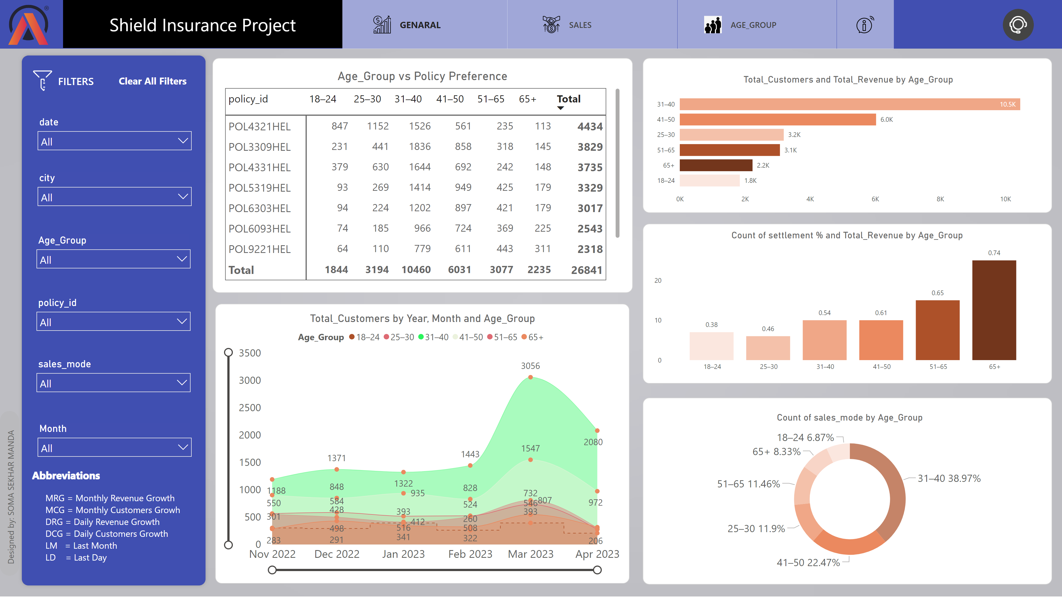
Age_group
Notes:
shape
No alt text provided
shape
No alt text provided
shape
No alt text provided
shape
No alt text provided
shape
No alt text provided
shape
No alt text provided
shape
No alt text provided
shape
No alt text provided
shape
No alt text provided
shape
No alt text provided
shape
No alt text provided
shape
No alt text provided
shape
No alt text provided
shape
No alt text provided
actionButton
No alt text provided
shape
No alt text provided
shape
No alt text provided
slicer
No alt text provided
shape
No alt text provided
slicer
No alt text provided
slicer
No alt text provided
slicer
No alt text provided
image
No alt text provided
slicer
No alt text provided
AB Signature
No alt text provided
textbox
No alt text provided
slicer
No alt text provided
shape
No alt text provided
shape
No alt text provided
shape
No alt text provided
actionButton
No alt text provided
image
No alt text provided
actionButton
No alt text provided
actionButton
No alt text provided
actionButton
No alt text provided
actionButton
No alt text provided
actionButton
No alt text provided
image
No alt text provided
actionButton
No alt text provided
actionButton
No alt text provided
actionButton
No alt text provided
actionButton
No alt text provided
shape
No alt text provided
shape
No alt text provided
actionButton
No alt text provided
actionButton
No alt text provided
shape
No alt text provided
actionButton
No alt text provided
shape
No alt text provided
Age_Group vs Policy Preference
No alt text provided
shape
No alt text provided
donutChart
No alt text provided
shape
No alt text provided
areaChart
No alt text provided
shape
No alt text provided
clusteredBarChart
No alt text provided
shape
No alt text provided
columnChart
No alt text provided
Clear all filters
No alt text provided
shape
No alt text provided
shape
No alt text provided
shape
No alt text provided
shape
No alt text provided
shape
No alt text provided
shape
No alt text provided
actionButton
No alt text provided
shape
No alt text provided
shape
No alt text provided
shape
No alt text provided
actionButton
No alt text provided

