Slide 1
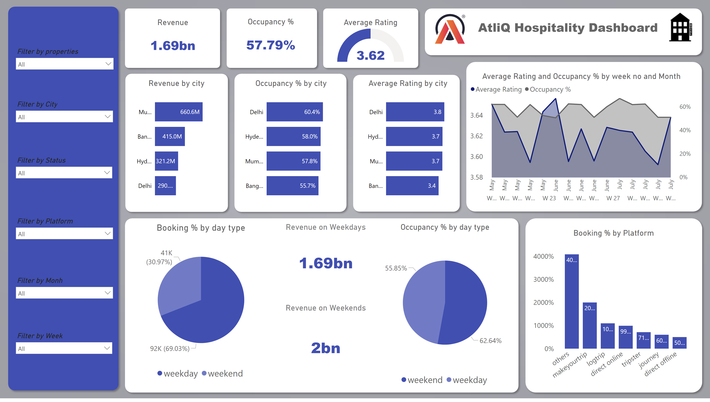
City and Booking Behavior Analysis
Notes:
shape
No alt text provided
Revenue
No alt text provided
shape
No alt text provided
Occupancy %
No alt text provided
shape
No alt text provided
Average Rating
No alt text provided
shape
No alt text provided
image
No alt text provided
textbox
No alt text provided
image
No alt text provided
shape
No alt text provided
shape
No alt text provided
shape
No alt text provided
shape
No alt text provided
clusteredBarChart
No alt text provided
clusteredBarChart
No alt text provided
clusteredBarChart
No alt text provided
areaChart
No alt text provided
shape
No alt text provided
shape
No alt text provided
Booking % by day type
No alt text provided
Occupancy % by day type
No alt text provided
Revenue on Weekdays
No alt text provided
Revenue on Weekends
No alt text provided
Booking % by Platform
No alt text provided
slicer
No alt text provided
slicer
No alt text provided
slicer
No alt text provided
slicer
No alt text provided
slicer
No alt text provided
slicer
No alt text provided
shape
No alt text provided

Slide 2
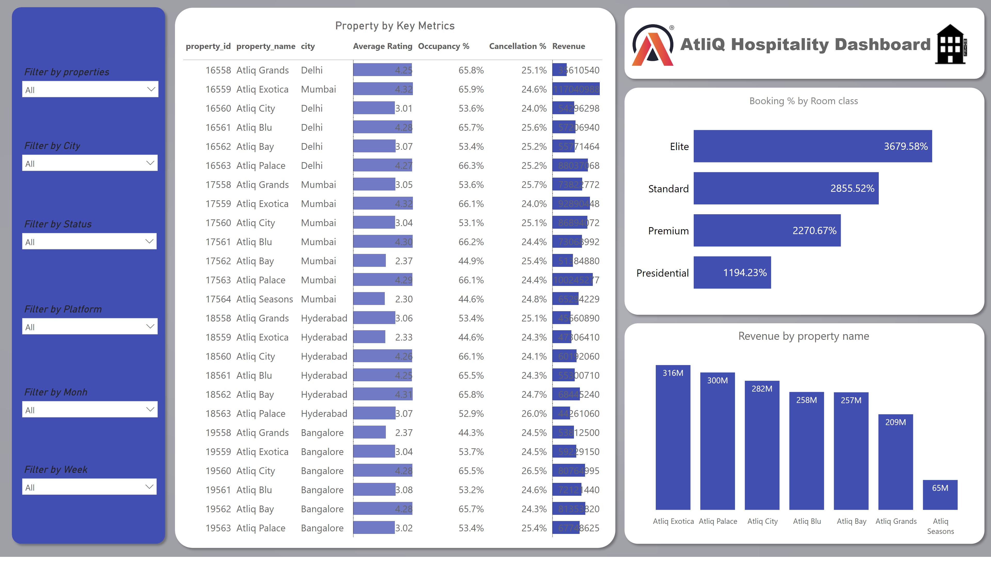
Property Performance Analysis
Notes:
slicer
No alt text provided
slicer
No alt text provided
slicer
No alt text provided
slicer
No alt text provided
slicer
No alt text provided
slicer
No alt text provided
shape
No alt text provided
Property by Key Metrics
No alt text provided
shape
No alt text provided
image
No alt text provided
textbox
No alt text provided
image
No alt text provided
shape
No alt text provided
Booking % by Room class
No alt text provided
shape
No alt text provided
Revenue by property name
No alt text provided
shape
No alt text provided

Slide 3
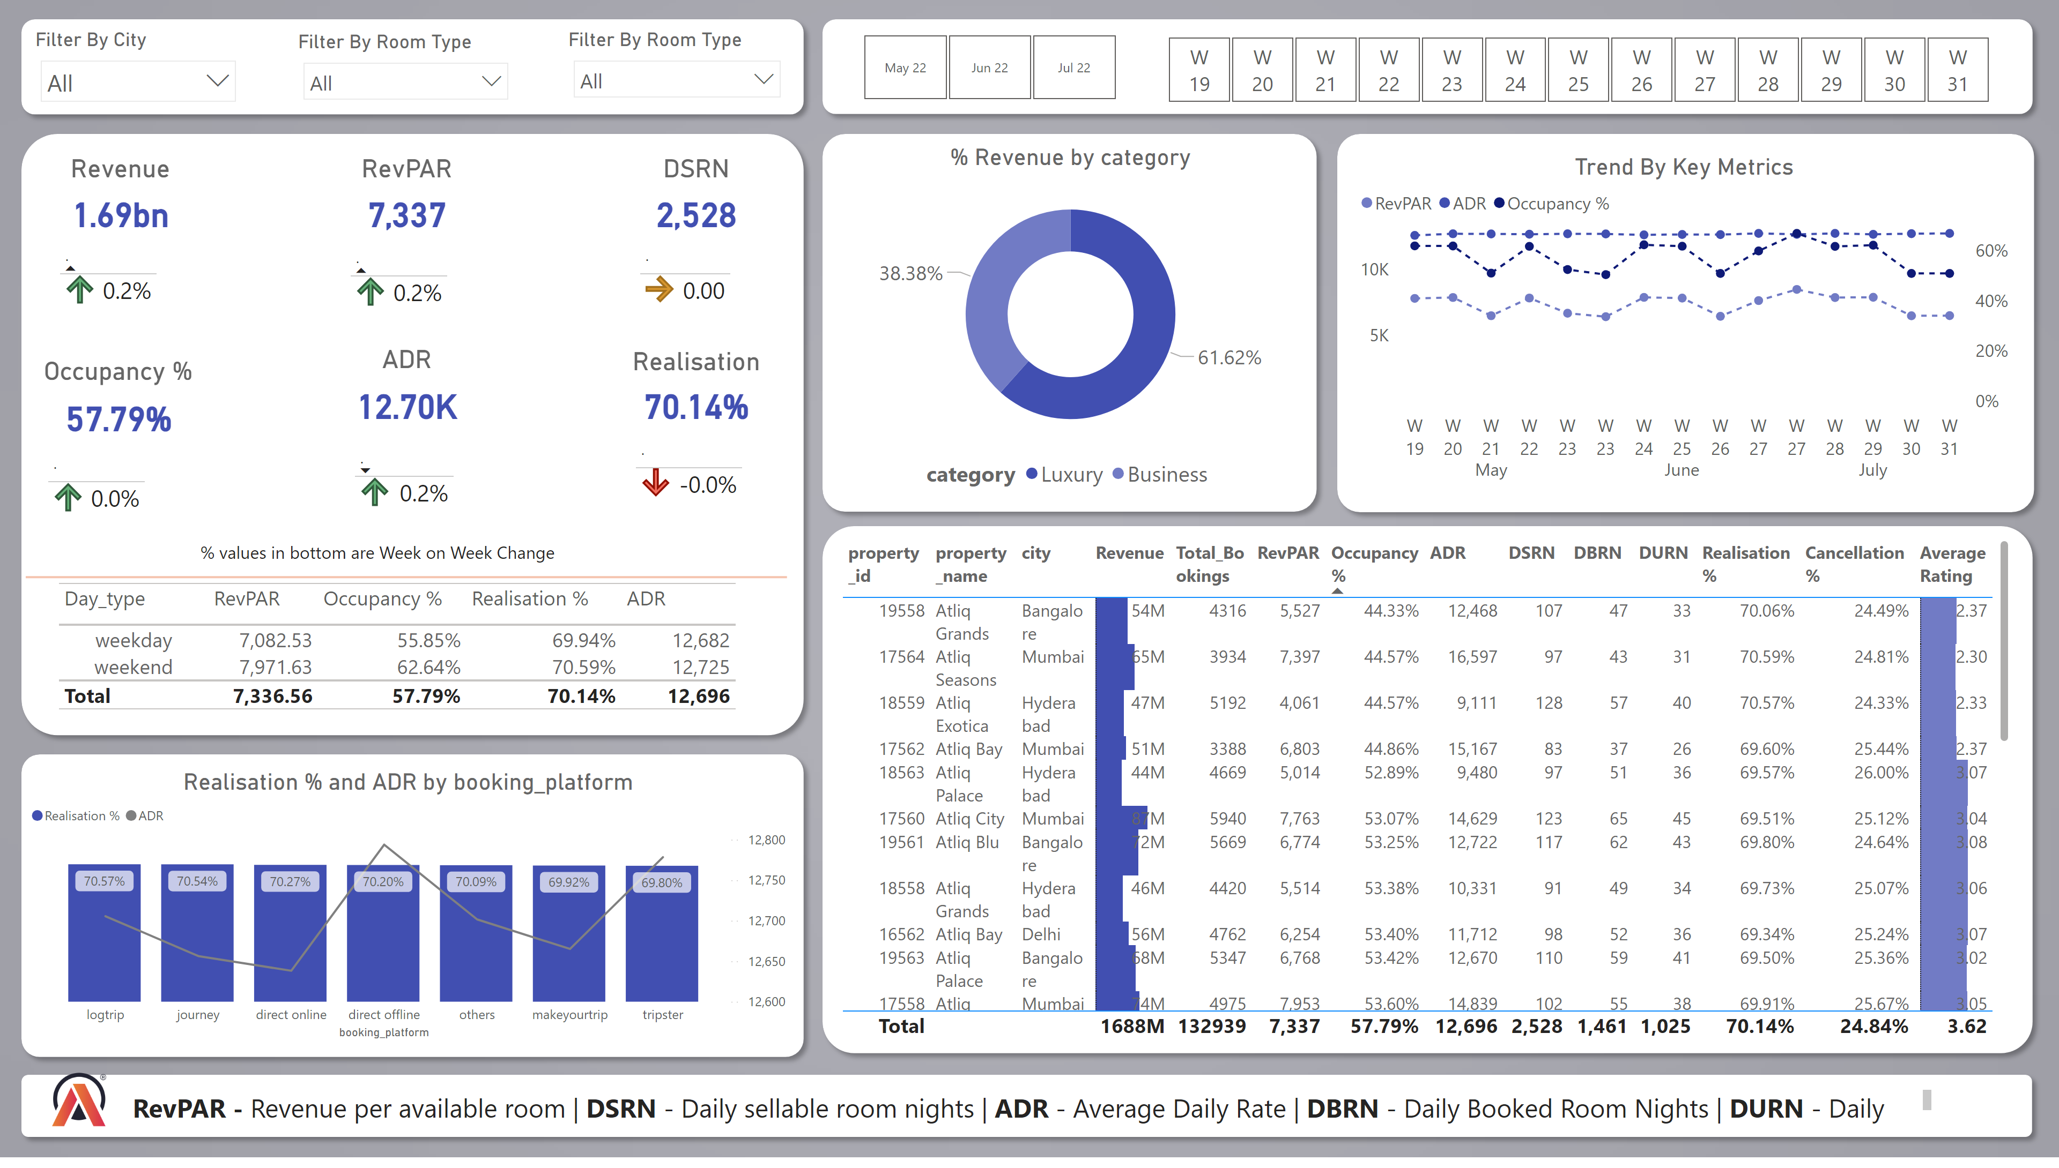
Revenue Perormance Overview
Notes:
tableEx
No alt text provided
Filter By City
No alt text provided
Filter By Room Type
No alt text provided
slicer
No alt text provided
Filter By Room Type
No alt text provided
Revenue
No alt text provided
tableEx
No alt text provided
% Revenue by category
No alt text provided
RevPAR
No alt text provided
tableEx
No alt text provided
DSRN
No alt text provided
Occupancy %
No alt text provided
ADR
No alt text provided
Realisation
No alt text provided
tableEx
No alt text provided
tableEx
No alt text provided
tableEx
No alt text provided
tableEx
No alt text provided
lineStackedColumnComboChart
No alt text provided
tableEx
No alt text provided
Trend By Key Metrics
No alt text provided
shape
No alt text provided
shape
No alt text provided
shape
No alt text provided
shape
No alt text provided
shape
No alt text provided
shape
No alt text provided
textbox
No alt text provided
shape
No alt text provided
textbox
No alt text provided
image
No alt text provided
shape
No alt text provided
shape
No alt text provided
Filter By Room Type
No alt text provided

