Slide 1
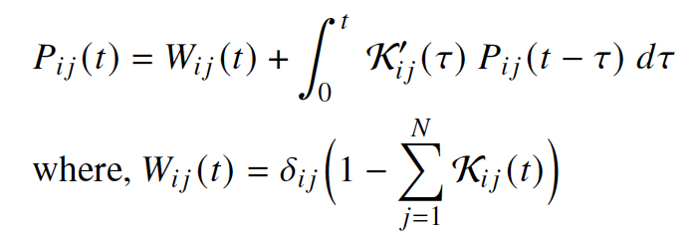

















Pre-processing
Deep Neural Network
Post-processing
Recovery states
Transition time distributions
Hidden
1
Hidden
2
Inputs
$$H_{11}$$
$$H_{21}$$
$$S_{1}$$
Transformation
$$K_{12}$$
$${\tilde{K}}_{12}$$
$$H_{12}$$
$$H_{22}$$
Output
$$S_{2}$$
Single or multi hazards
System damage
.
.
Transformation
Recovery
curve
Resilience metrics
$$K_{23}$$
$${\tilde{K}}_{23}$$
.
.
.
.
.
.
.
.
$$\tilde{F}$$
Inverse
transformation
$$S_{N−1}$$
Transformation
$$K_{NN−1}$$
$${\tilde{K}}_{N−1 N}$$
$$S_{N}$$
$$H_{1M}$$
$$H_{2M}$$
Markov-Renewal Equation

