Slide 1
03/13/2025
MOOSE Stochastic Tools Module Training Session
Developers: Som Dhulipala, Zach Prince, Peter German
MOOSE International Workshop 2025

Slide 2
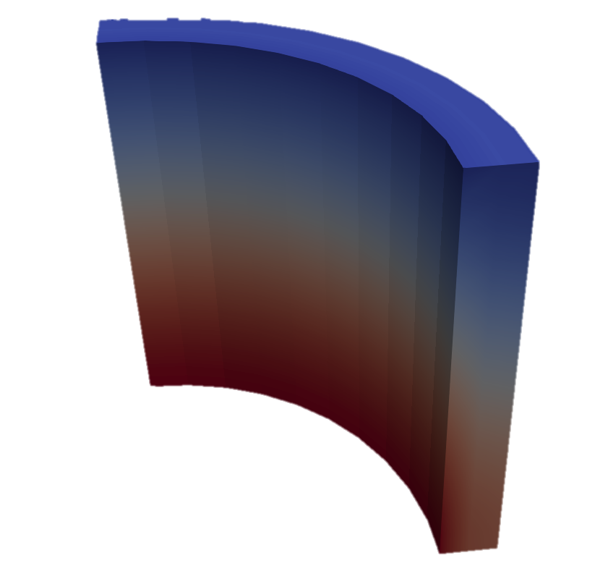
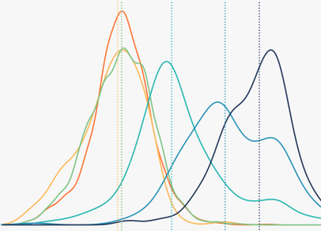
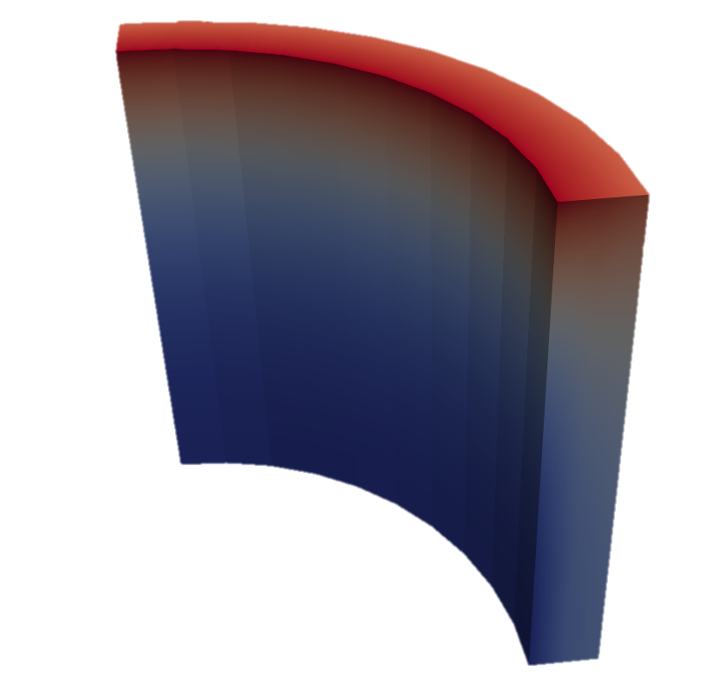

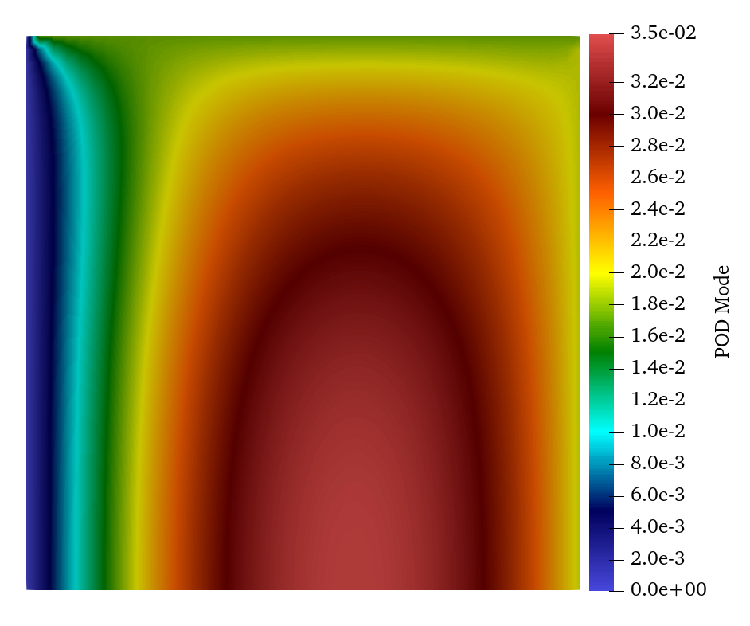
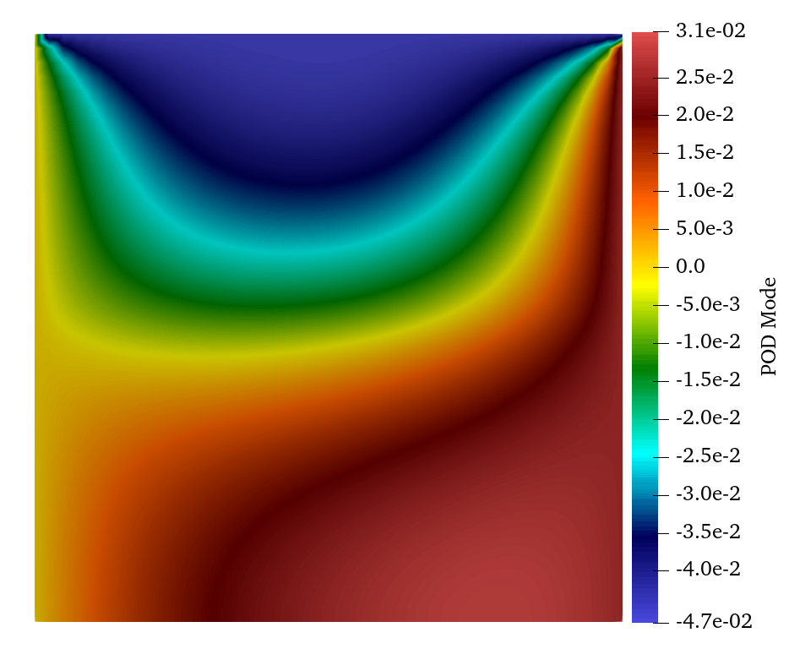
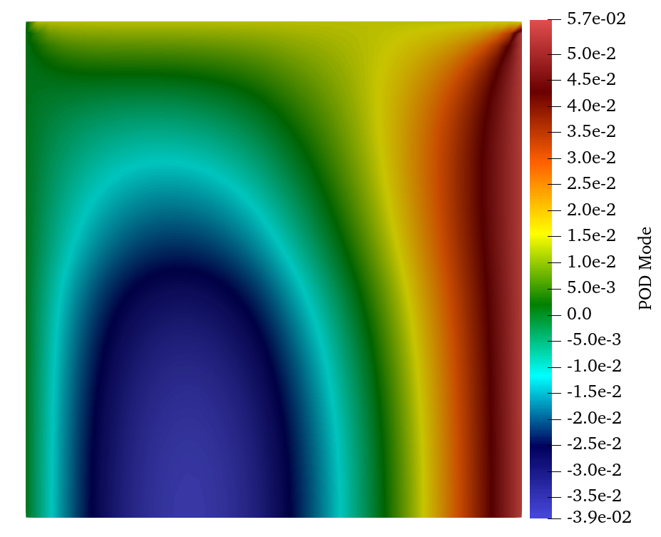
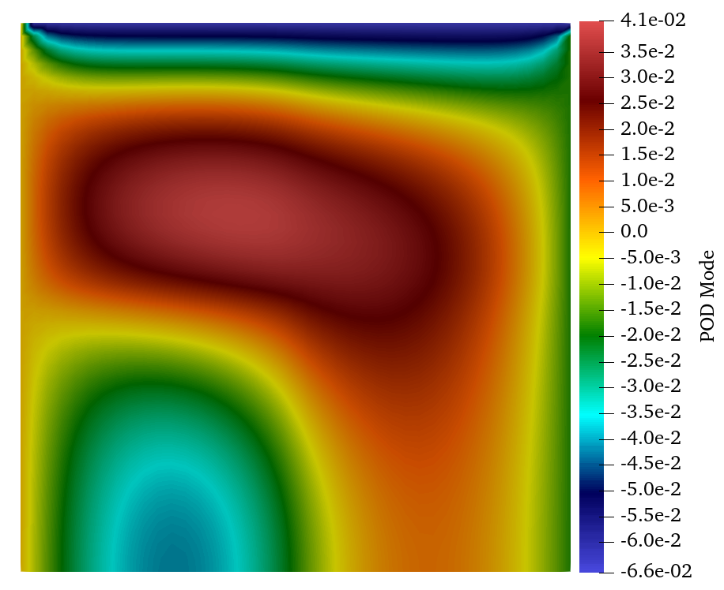
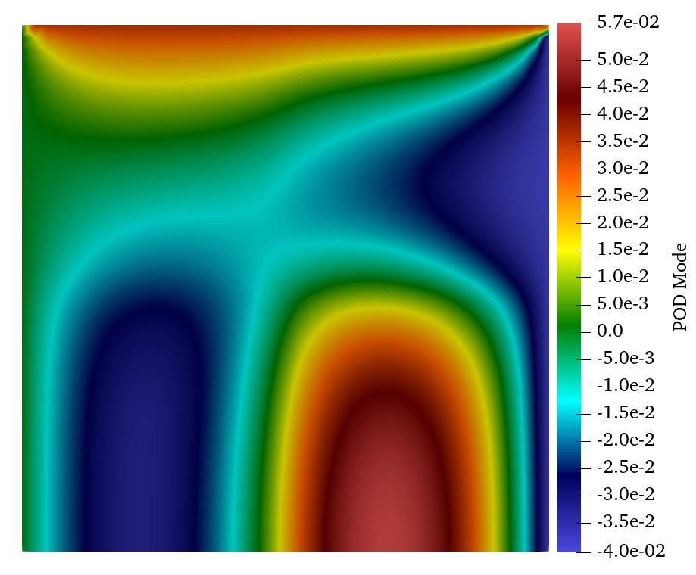
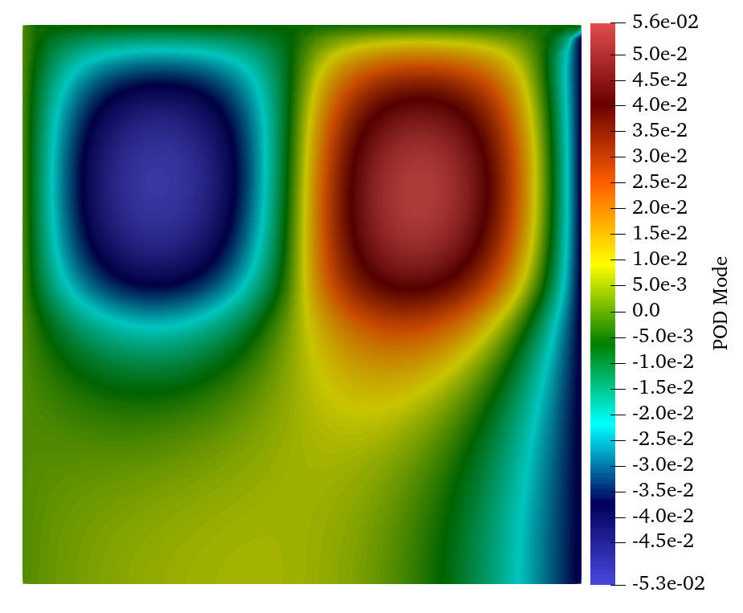
The MOOSE Stochastic Tools Module
Provide a MOOSE interface for performing stochastic analysis on MOOSE-based models.
Sample parameters, run applications, and gather data that is both efficient (memory and runtime) and scalable.
Perform UQ and sensitivity analysis with distributed data with advanced variance reduction methods
Parallel Scalable Inverse Bayesian UQ for parameter and model error estimation
Train meta-models to develop fast-evaluating surrogates of the high-fidelity multiphysics model
Harness advanced machine learning capabilities through the C++ front end of Pytorch [1]
Use active learning models for building surrogates
Provide a pluggable interface for these surrogates.
Use POD (Proper Orthogonal Decomposition)-based dimensionality reduction methods to build mappings between solution variables and latent (low-dimensional) spaces
General process for forward UQ
UQ on modeling TRSIO Particle Ag release
POD modes of a 2D heat conduction problem
Introduction

Slide 3
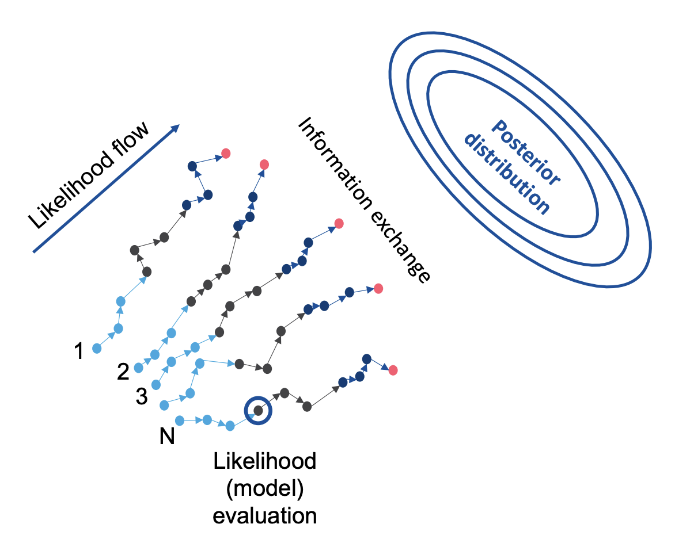
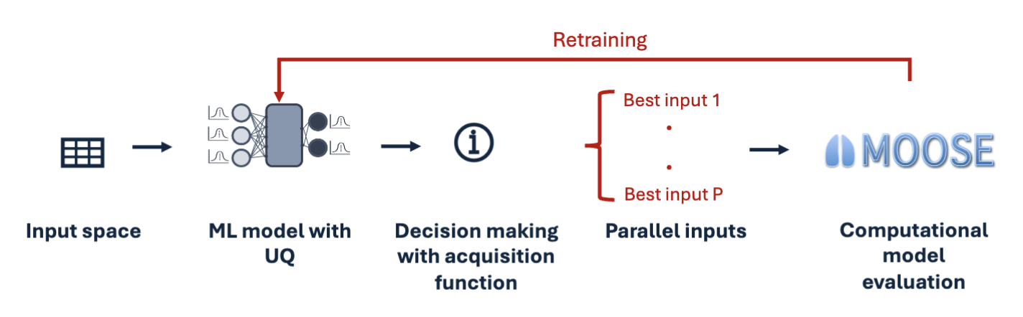
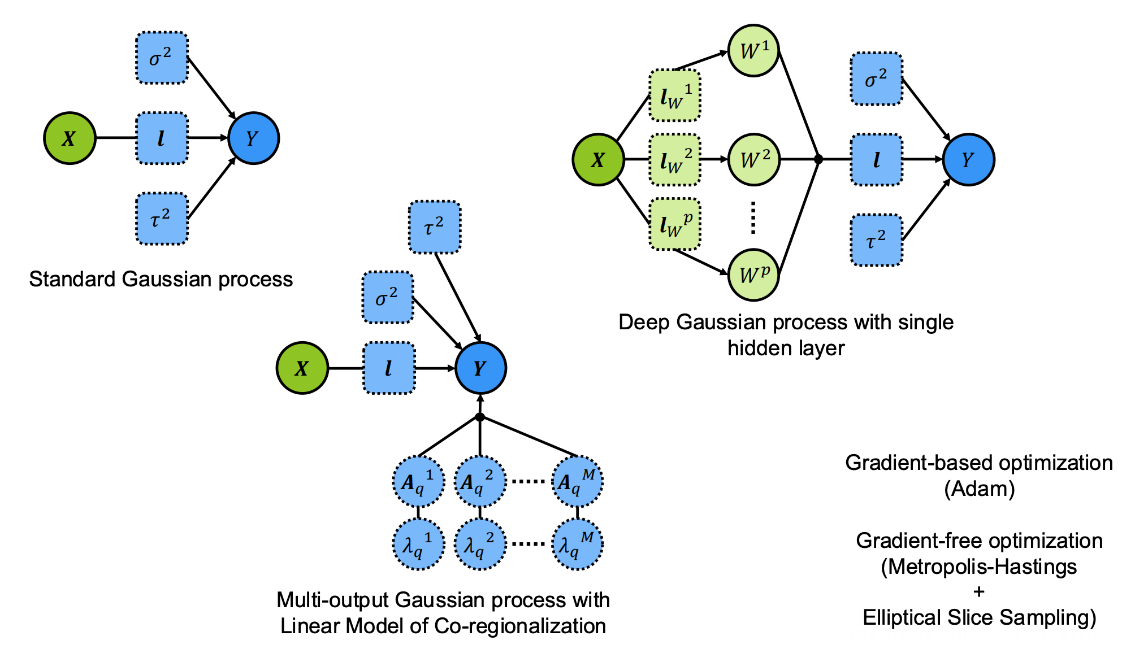
Recent developments in MOOSE STM
Parallel active learning
Parallel Markov chain Monte Carlo: for Bayesian UQ
Gaussian process variants

Slide 4
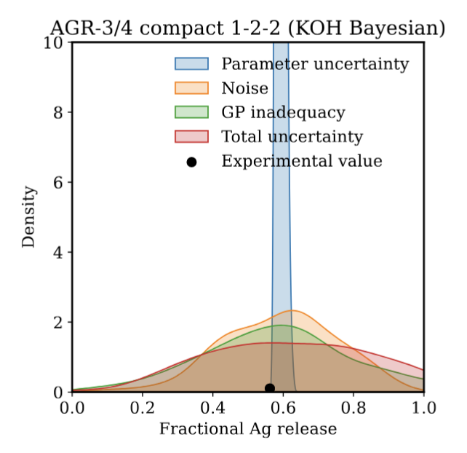
Focus of this training session
Part 1: forward uncertainty quantification
Uncertainty propagation through Monte Carlo sampling
Sensitivity analysis using Sobol indices
Rare events analysis using parallel subset simulation [EXCLUDE]
Part 2: Bayesian (inverse) uncertainty quantification
Model parameter uncertainties
Model parameter + noise uncertainties
Model parameter + noise + model inadequacy uncertainties
Part 3: active learning
Training a Gaussian process surrogate with Monte Carlo sampling
Use of an acquisition function
Solving optimization problems with Bayesian optimization
TRISO fuel fission product release
Introduction

Slide 5
Part 1: Forward uncertainty quantification
Uncertainty propagation through Monte Carlo sampling
Sensitivity analysis using Sobol indices
Rare events analysis using parallel subset simulation

Slide 6
Uncertainty propagation to model outputs
Uncertain input parameters
MOOSE computational model
Uncertain model outputs
Statistics: mean, standard deviation, etc.
Part 1: Forward UQ

Slide 7
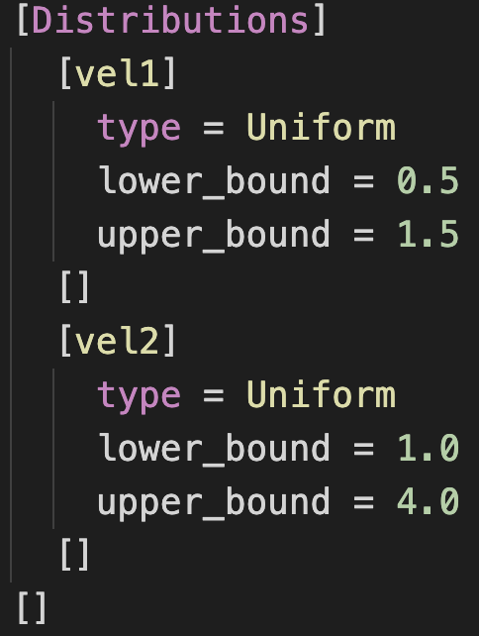
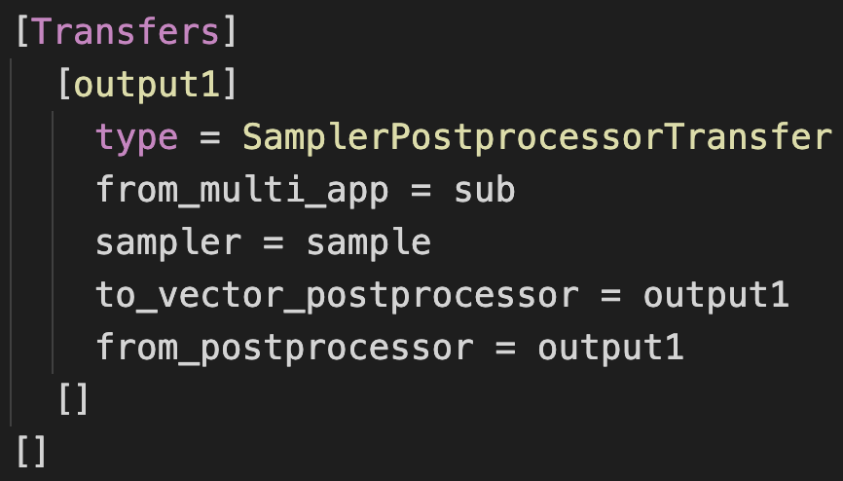
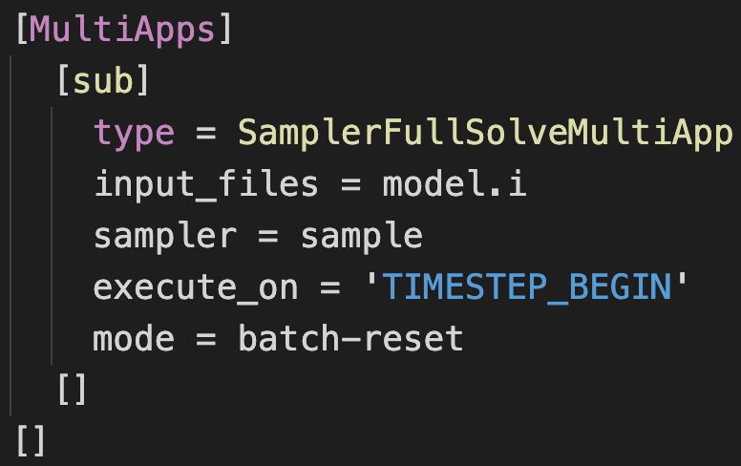
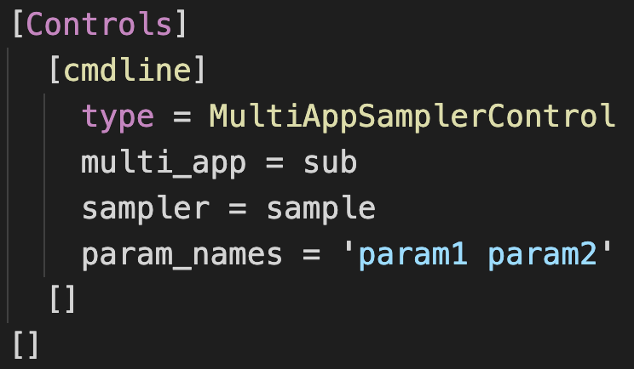
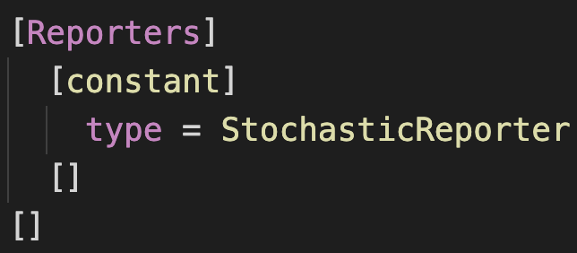
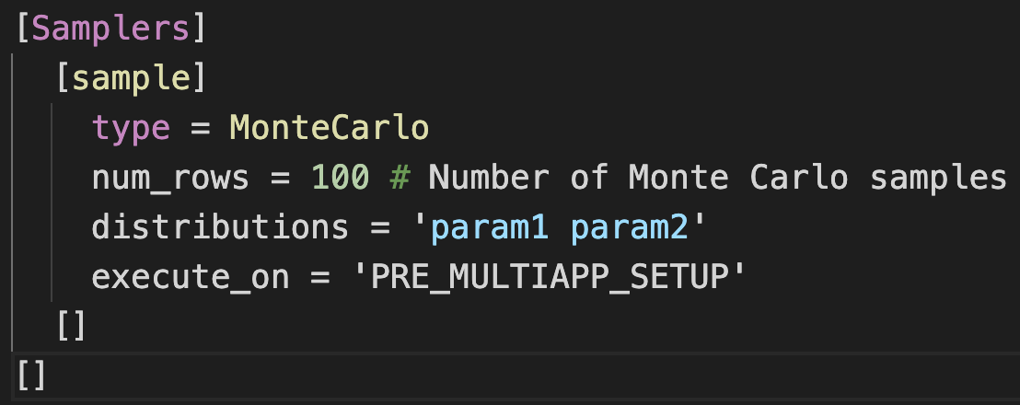
Uncertainty propagation to model outputs
3. MultiApps
5. Transfers
1. Distributions
4. cmdline controls
6. Reporters
2. Samplers
Part 1: Forward UQ

Slide 8
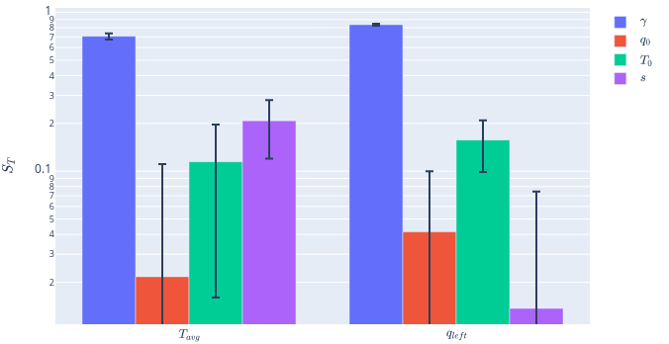
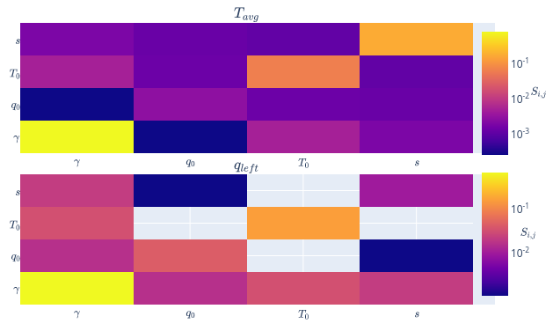
Sobol sensitivity analysis
Uncertain input parameters
First order sensitivity indices
MOOSE computational model
Second order sensitivity indices
Sensitive input parameters
Part 1: Forward UQ

Slide 9
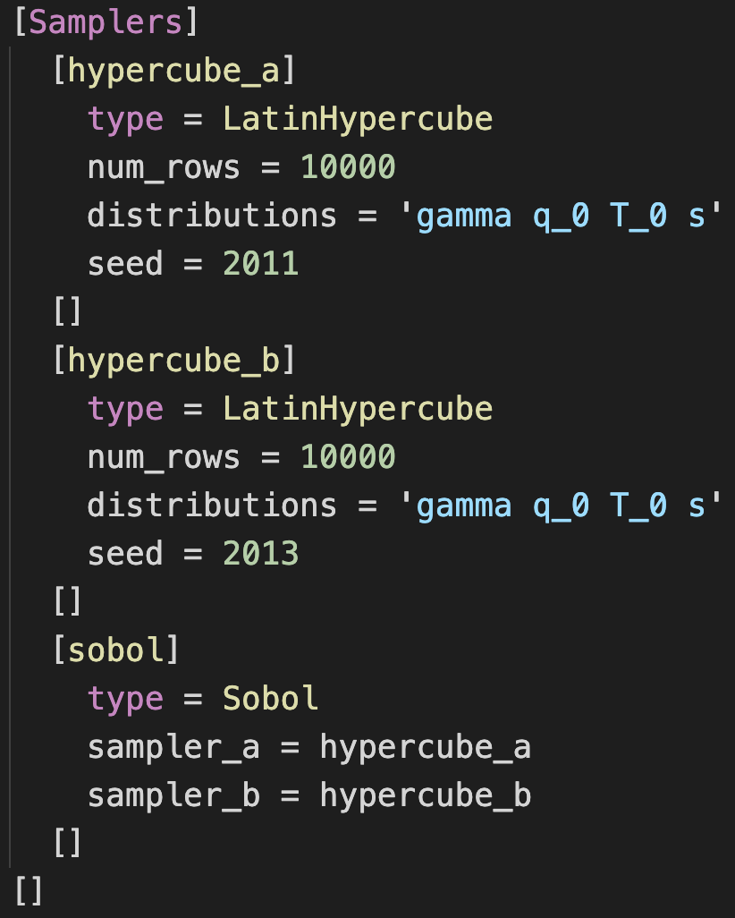
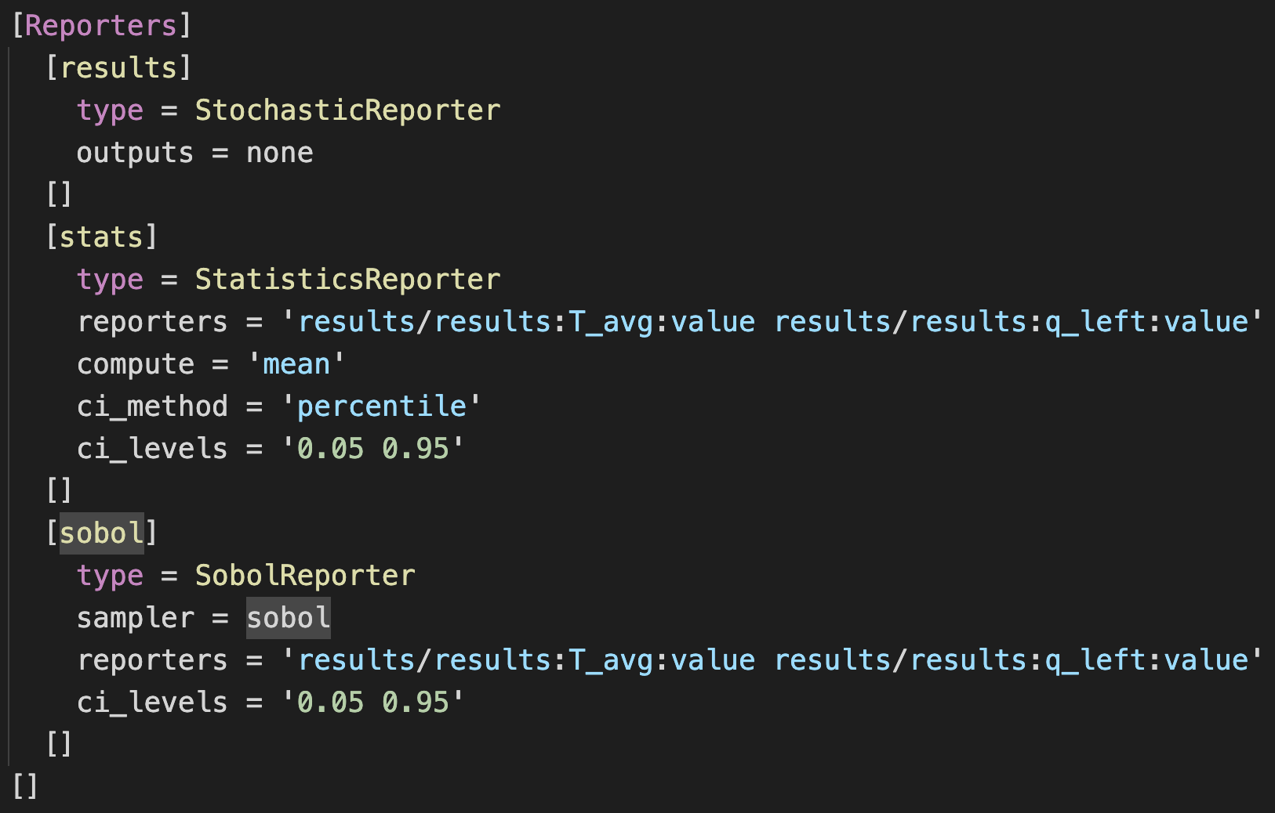
Sobol sensitivity analysis
2. Reporters
Sobol reporter
Samplers
Sobol sampler
Part 1: Forward UQ

Slide 10
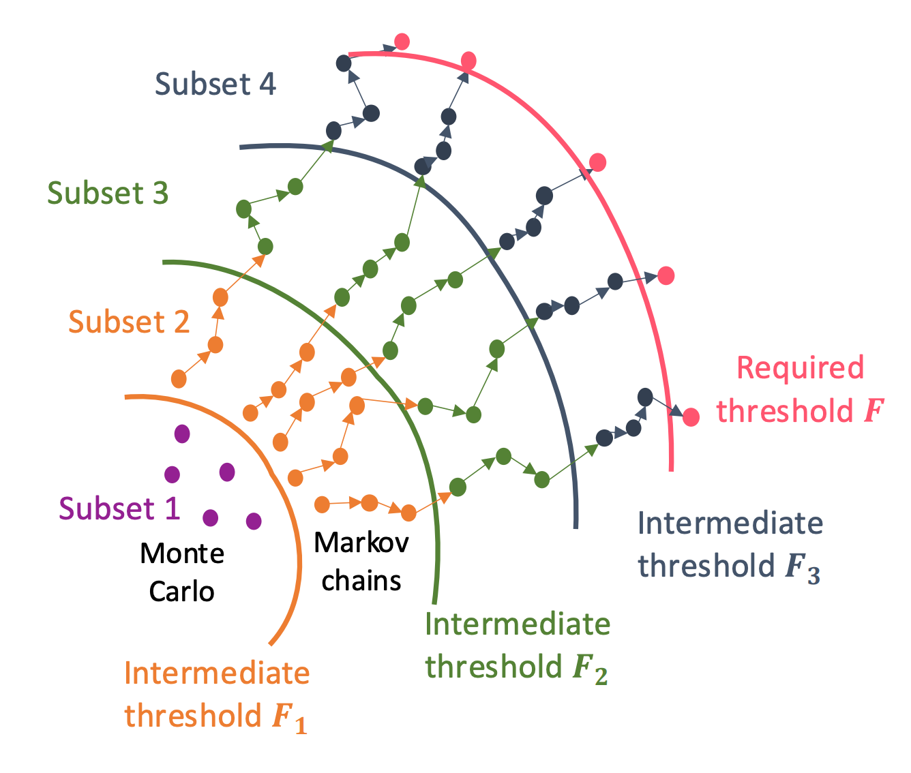
Rare events analysis: parallel subset simulation
Uncertain input parameters
MOOSE computational model
Failure probability; input parameter distribution causing model failures
Quantify rare events with failure probabilities ranging 1E-2 to 1E-8
Part 1: Forward UQ

Slide 11
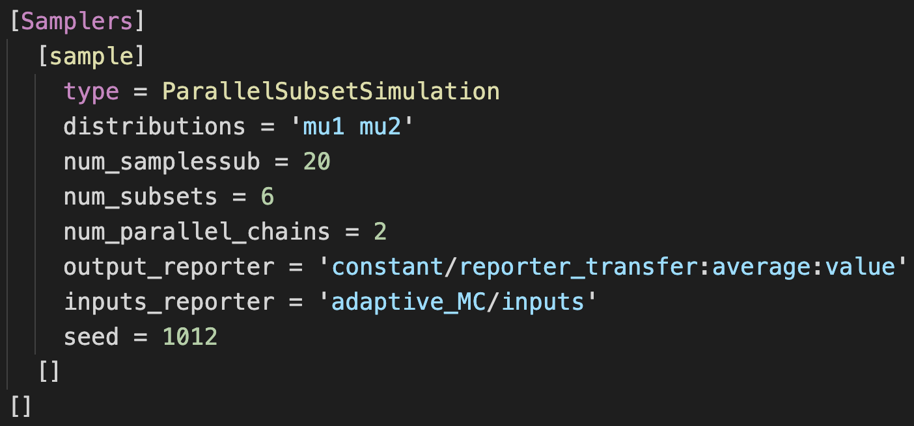
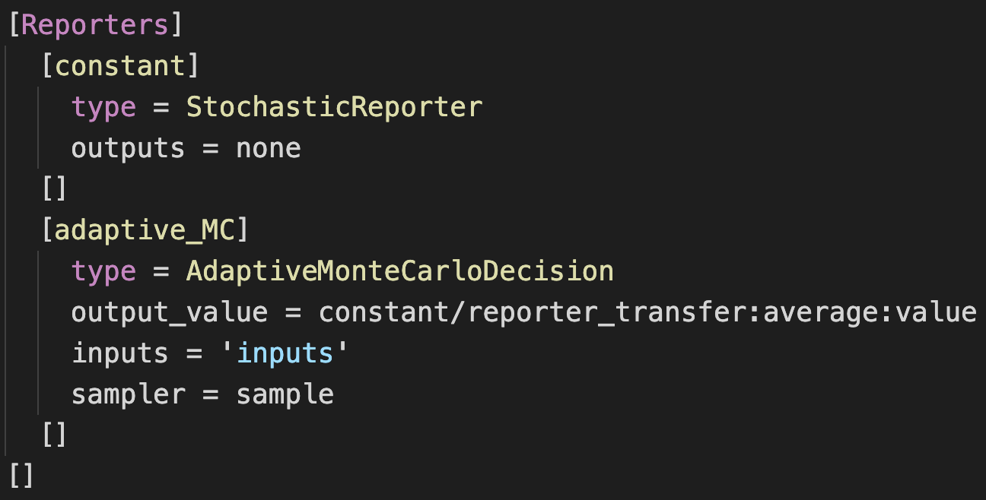
Rare events analysis: parallel subset simulation
Samplers
Parallel subset simulation sampler
2. Reporters
Adaptive Monte Carlo decision
Part 1: Forward UQ

Slide 12
Part 2: Bayesian (inverse) uncertainty quantification
Model parameter uncertainties
Model parameter + noise uncertainties
Model parameter + noise + model inadequacy uncertainties

Slide 13
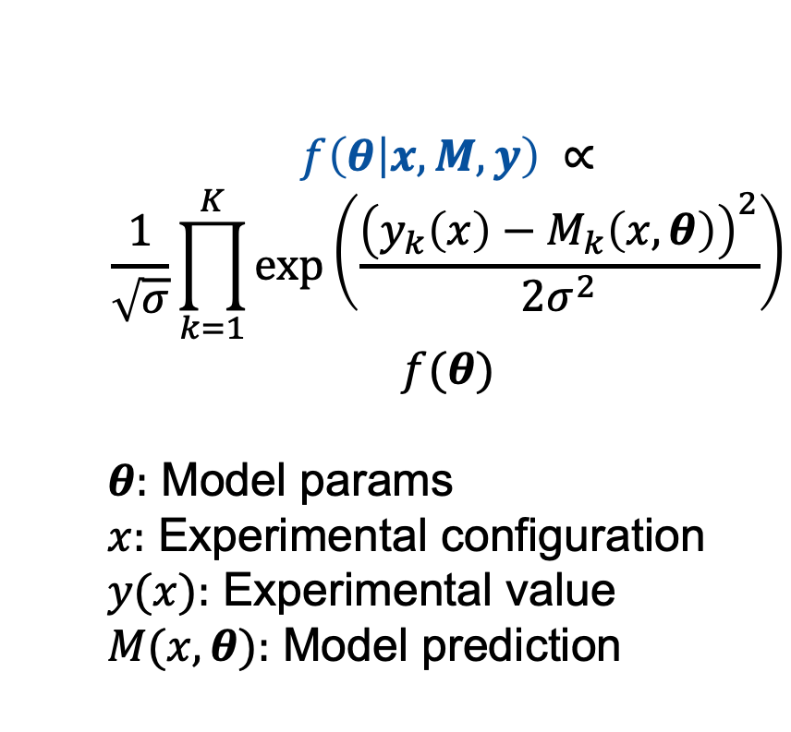
Quantify model parameter uncertainties
Unknown input parameters
Required distribution
$$f\left(θ | x, M, y\right) ∝$$
$$\frac{1}{\sqrt{σ}}\prod_{k=1}^{K}{\exp\left(\frac{{\left(y_{k}\left(x\right)−M_{k}\left(x, θ\right)\right)}^{2}}{2σ^{2}}\right)}$$
$$f(θ)$$
$θ:$ Model params
$x:$ Experimental configuration
$y(x):$ Experimental value
$M(x,θ):$ Model prediction
Likelihood function
MOOSE computational model
Experimental data
Prior
Probability distributions of best input parameters such that the model predictions match experiments
Part 2: Bayesian (inverse) UQ

Slide 14
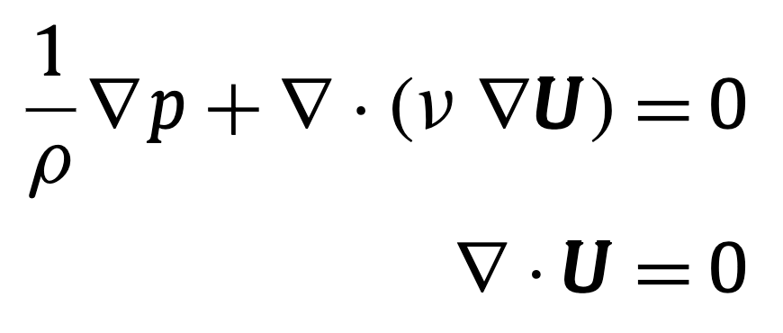


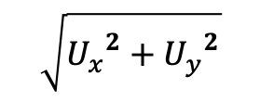

Quantify model parameter uncertainties
$$U_{x1}$$
“Experimental data”
Resultant velocities at 9 locations in the domain
Resultant velocities: experimental data
Locations: experimental configurations
Ux1 = 1.0, Uy1 = 2.5
(treated as unknown)
Predictive model
Predict resultant velocities at 9 locations in the domain
Infer the unknown Ux1, Uy1 such that predictions match experiments
$$U_{y1}$$
$$p=0$$
$$\sqrt{{U_{x}}^{2}+{U_{y}}^{2}}$$
Part 2: Bayesian (inverse) UQ

Slide 15
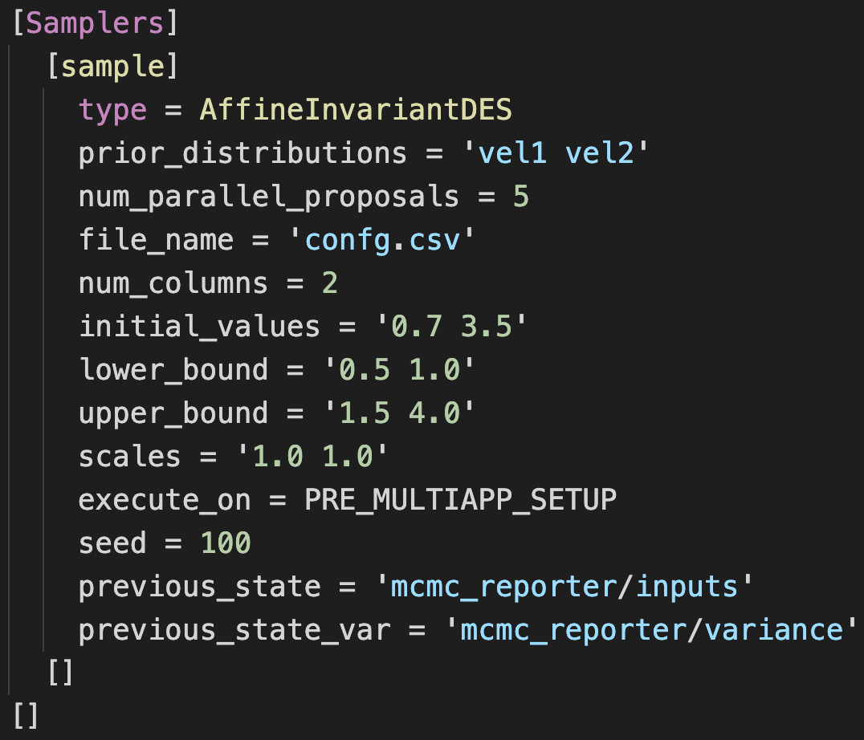
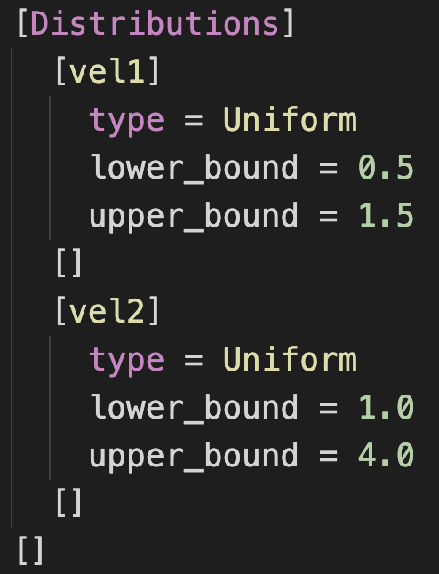
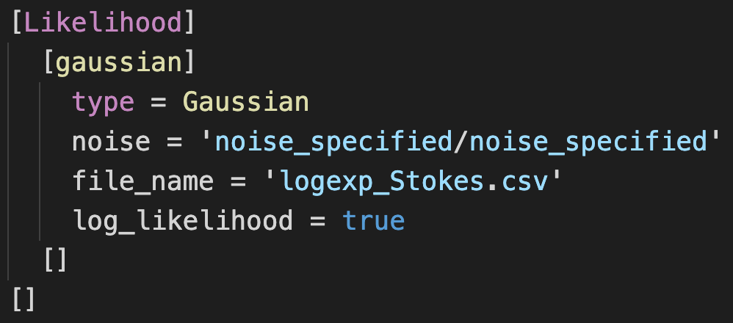
Quantify model parameter uncertainties
Distributions
Priors
3. Samplers
Differential evolution MCMC
2. Likelihood
Part 2: Bayesian (inverse) UQ

Slide 16
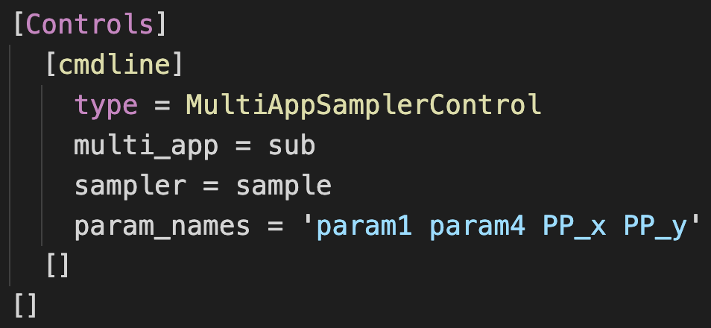
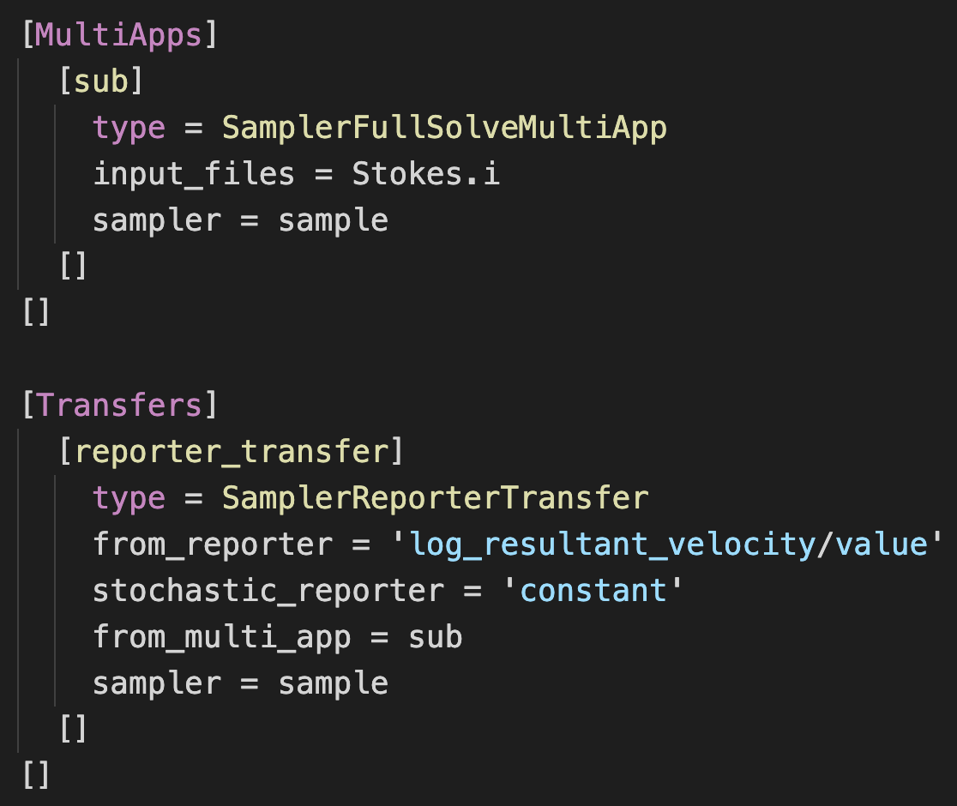
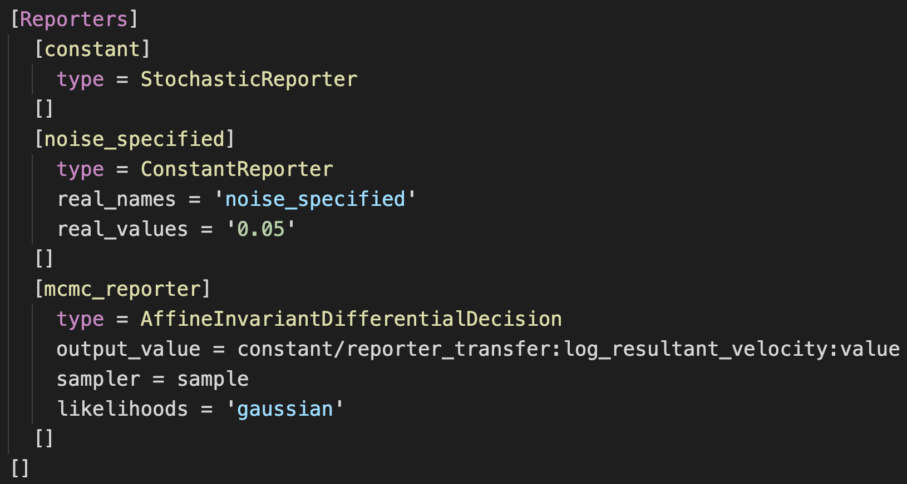
Quantify model parameter uncertainties
5. Controls
6. Reporters
Decision-making
4. MultiApps and Transfers
Part 2: Bayesian (inverse) UQ

Slide 17
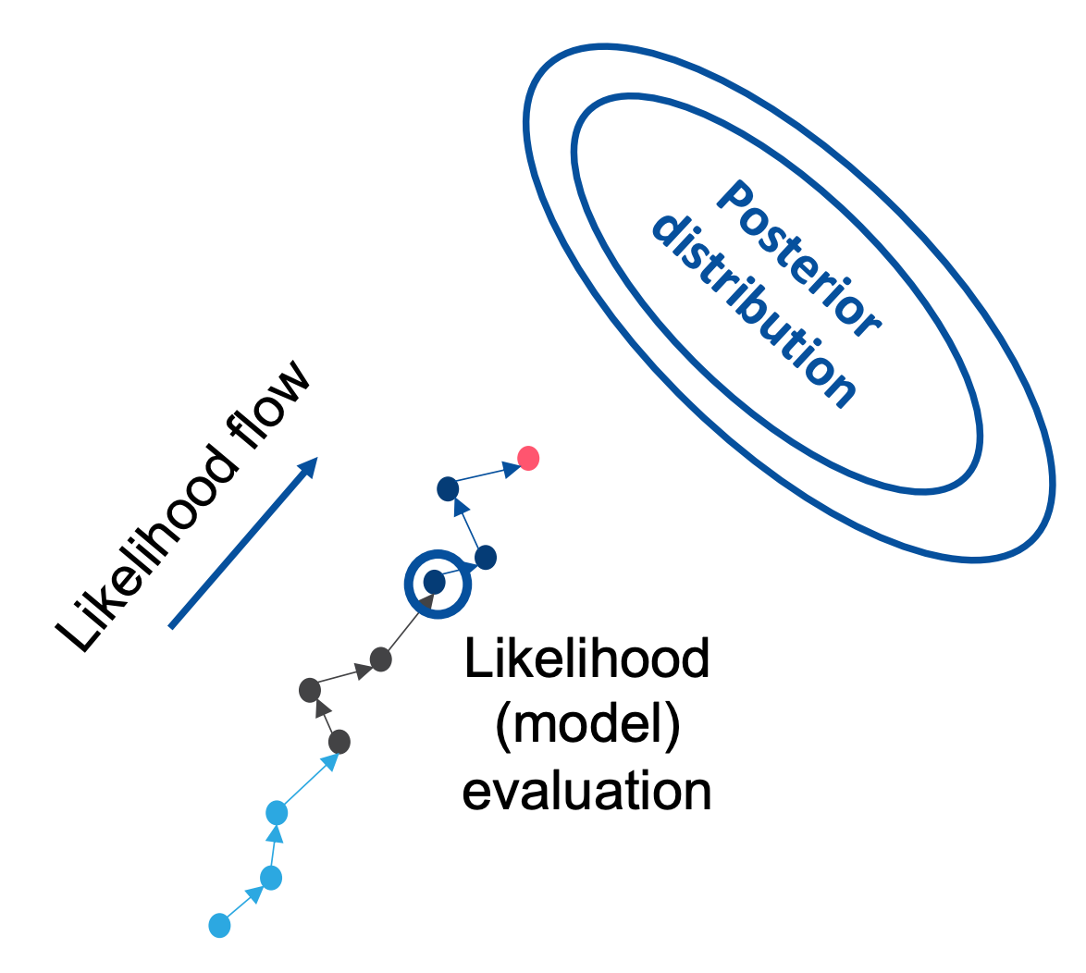
Computational engine
Serial Markov chain Monte Carlo (MCMC)
Parallel multiple chain MCMC
Part 2: Bayesian (inverse) UQ

Slide 18
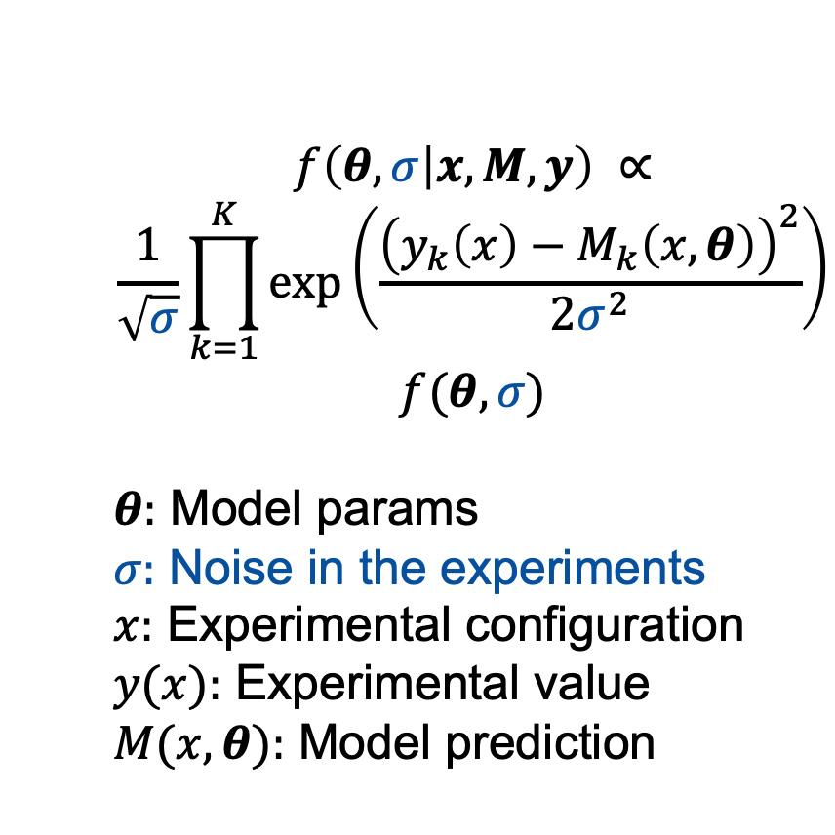
Quantify model parameter + noise uncertainties
Unknown input parameters
Required distribution
$$f\left(θ,σ | x, M, y\right) ∝$$
$$\frac{1}{\sqrt{σ}}\prod_{k=1}^{K}{\exp\left(\frac{{\left(y_{k}\left(x\right)−M_{k}\left(x, θ\right)\right)}^{2}}{2σ^{2}}\right)}$$
$$f(θ,σ)$$
$θ:$ Model params
$σ:$ Noise in the experiments
$x:$ Experimental configuration
$y(x):$ Experimental value
$M(x,θ):$ Model prediction
Unknown noise
Likelihood function
MOOSE computational model
Experimental data
Prior
Probability distributions of best input parameters and noise such that the model predictions match experiments
Part 2: Bayesian (inverse) UQ

Slide 19
Quantify model parameter + noise uncertainties
“Experimental data”
Resultant velocities at 9 locations in the domain
Resultant velocities: experimental data
Locations: experimental configurations
Ux1 = 1.0, Uy1 = 2.5
(treated as unknown)
Added Gaussian noise of 0.4
(treated as unknown)
Predictive model
Predict resultant velocities at 9 locations in the domain
Infer the unknown Ux1, Uy1 such that predictions match experiments
Infer the unknown noise value
$$U_{x1}$$
$$U_{y1}$$
$$p=0$$
$$\sqrt{{U_{x}}^{2}+{U_{y}}^{2}}$$
Part 2: Bayesian (inverse) UQ

Slide 20
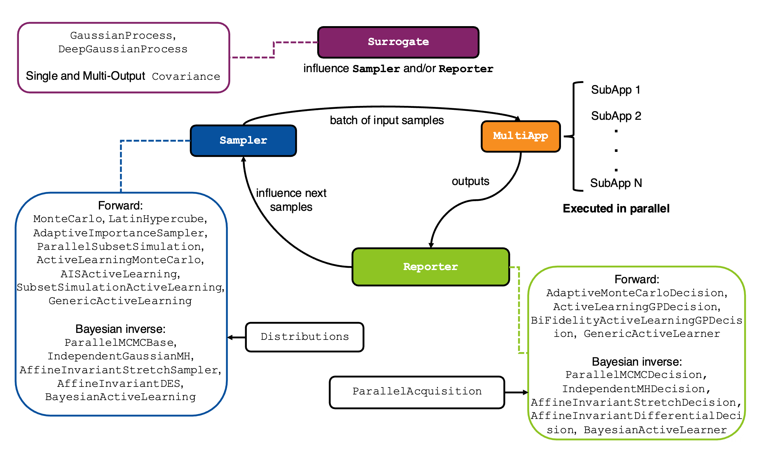
A note on the code architecture
Part 2: Bayesian (inverse) UQ

Slide 21
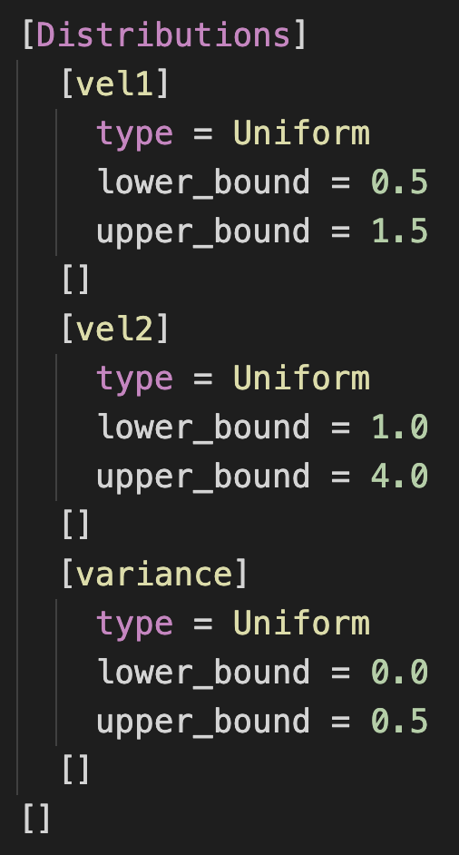
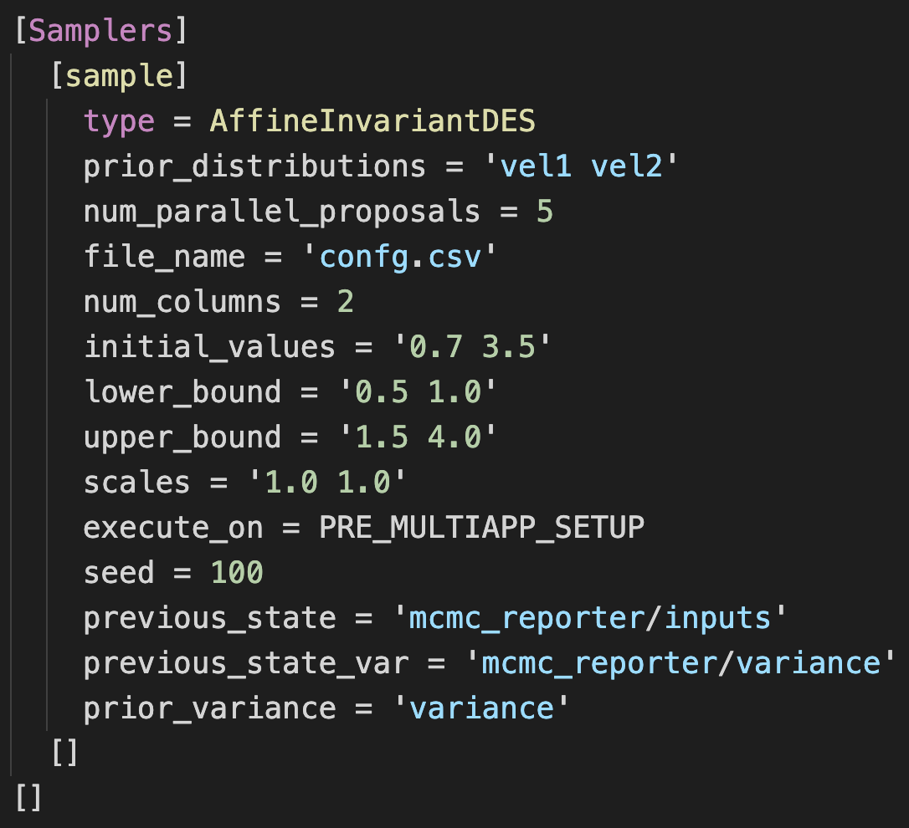
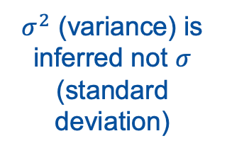
Quantify model parameter + noise uncertainties
$σ^{2}$ (variance) is inferred not $σ$ (standard deviation)
Distributions
Priors
2. Samplers
Differential evolution MCMC
Part 2: Bayesian (inverse) UQ

Slide 22
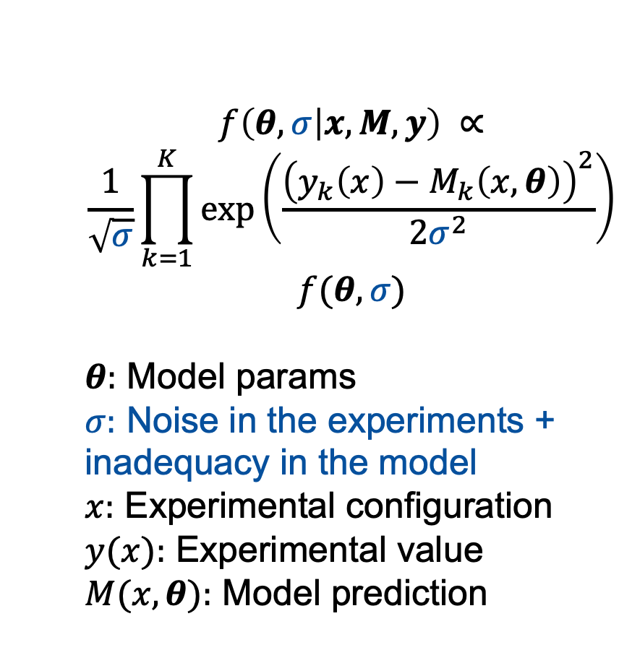
Quantify model parameter + noise + model inadequacy uncertainties
Required distribution
Unknown input parameters
Inadequacy in the model
$$f\left(θ,σ | x, M, y\right) ∝$$
$$\frac{1}{\sqrt{σ}}\prod_{k=1}^{K}{\exp\left(\frac{{\left(y_{k}\left(x\right)−M_{k}\left(x, θ\right)\right)}^{2}}{2σ^{2}}\right)}$$
$$f(θ,σ)$$
$θ:$ Model params
$σ:$ Noise in the experiments + inadequacy in the model
$x:$ Experimental configuration
$y(x):$ Experimental value
$M(x,θ):$ Model prediction
Likelihood function
Unknown noise
MOOSE computational model
Prior
Experimental data
Probability distributions of best input parameters, noise, and model inadequacy such that the model predictions match experiments
Part 2: Bayesian (inverse) UQ

Slide 23
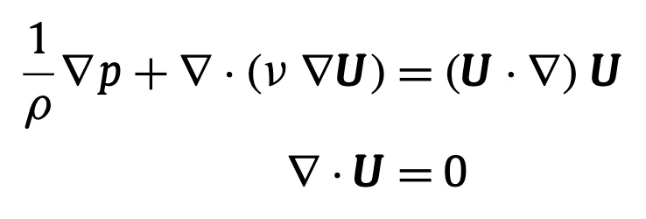
Quantify model parameter + noise + model inadequacy uncertainties
“Experimental data”
Resultant velocities at 9 locations in the domain
Resultant velocities: experimental data
Locations: experimental configurations
Ux1 = 1.0, Uy1 = 2.5
(treated as unknown)
Added Gaussian noise of 0.4
(treated as unknown)
Predictive model
Predict resultant velocities at 9 locations in the domain
Infer the unknown Ux1, Uy1 such that predictions match experiments
Infer the unknown noise value
$$U_{x1}$$
$$U_{y1}$$
$$p=0$$
$$\sqrt{{U_{x}}^{2}+{U_{y}}^{2}}$$
Part 2: Bayesian (inverse) UQ

Slide 24
Part 3: Active learning and Bayesian optimization
Training a Gaussian process surrogate with Monte Carlo sampling
Use of an acquisition function (active learning)
Solving optimization problems with Bayesian optimization

Slide 25
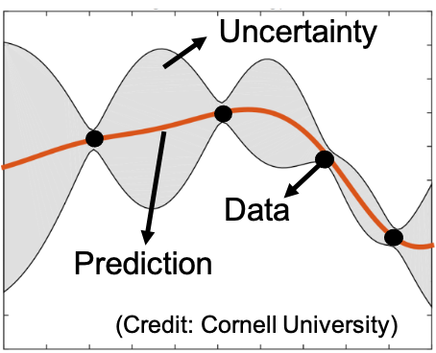
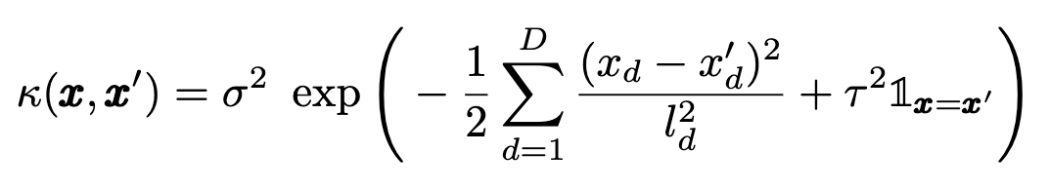
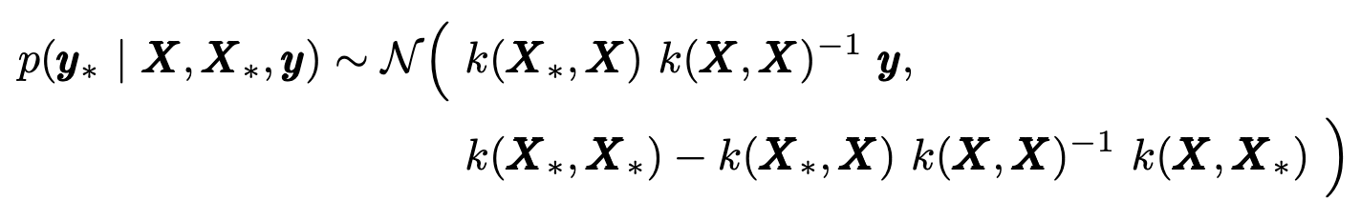
Training and loading a Gaussian process surrogate
GP is a Bayesian/probabilistic machine learning model
Part 3: Active learning

Slide 26
Training and loading a Gaussian process surrogate
$$U_{x1}$$
Training data
Resultant velocity at the center point in the domain
Ux1, Uy1
(treated as variable inputs)
$$U_{y1}$$
$$p=0$$
$$\sqrt{{U_{x}}^{2}+{U_{y}}^{2}}$$
Part 3: Active learning

Slide 27
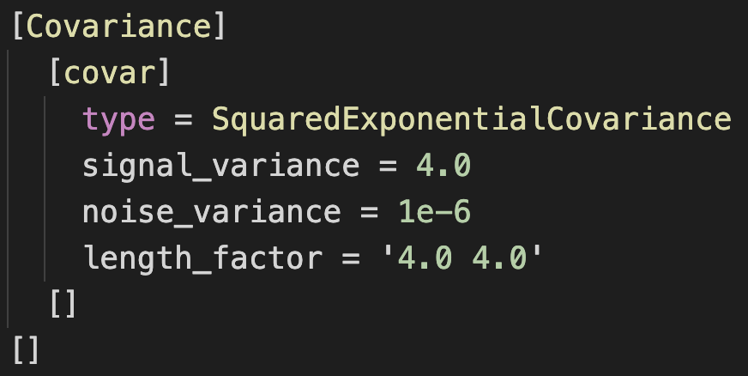
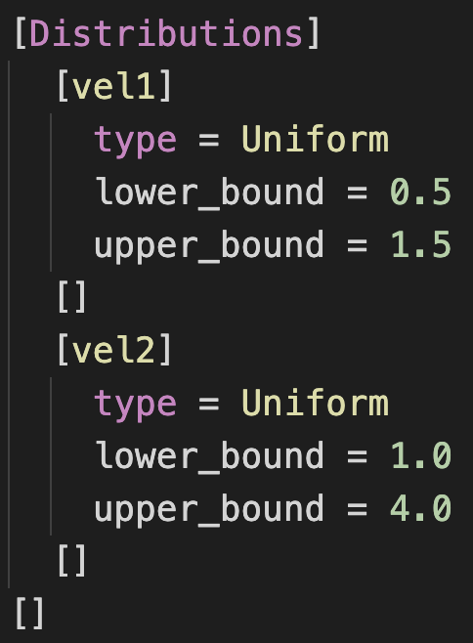
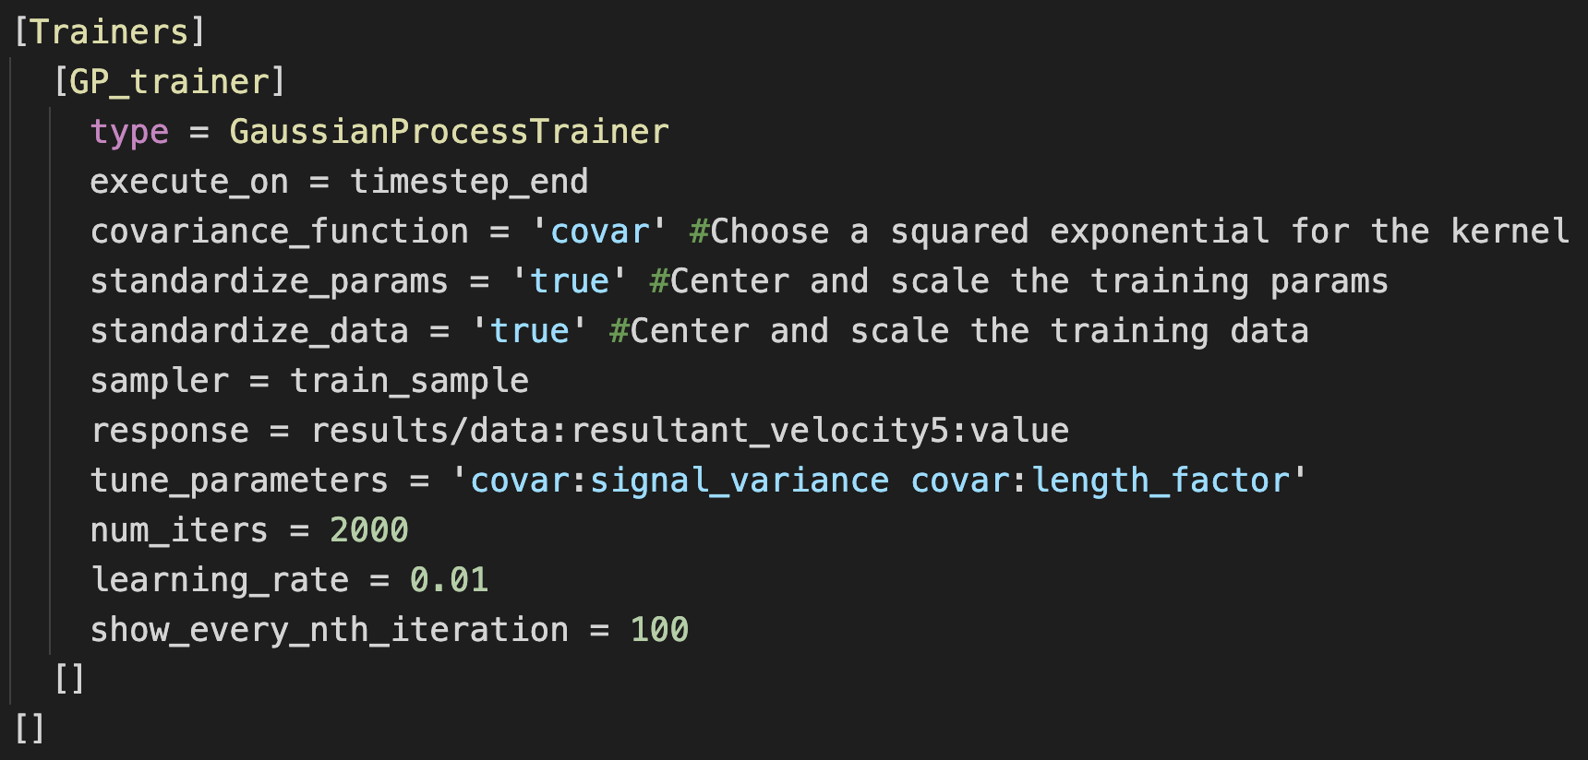
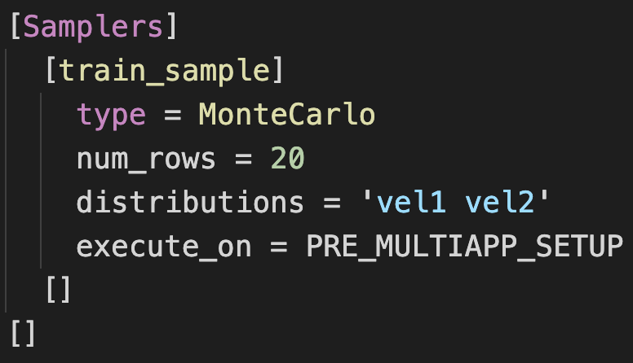

Training and loading a Gaussian process surrogate
4. Covariance
1. Distributions
3. Trainers
5. Outputs
2. Samplers
Part 3: Active learning

Slide 28



Training and loading a Gaussian process surrogate
Samplers
Test samples
2. Surrogates
Gaussian process
3. Reporters
Evaluate pre-trained GP
Part 3: Active learning

Slide 29

Training a GP with active learning
- Global surrogate development
- Bayesian UQ
- Rare events analysis
- Optimization
Local penalization
Part 3: Active learning

Slide 30

Training a GP with active learning
Part 3: Active learning

Slide 31
Training a GP with active learning
$$U_{x1}$$
Training data
Resultant velocity at the center point in the domain
Ux1, Uy1
(treated as variable inputs)
$$U_{y1}$$
Acquisition function: Expected Improvement for Global Fit (EIGF)
$$p=0$$
$$\sqrt{{U_{x}}^{2}+{U_{y}}^{2}}$$
Part 3: Active learning

Slide 32





Training a GP with active learning
3. Trainers
GP active learning trainer
4. Surrogates
Evaluate a GP surrogate
1. Sampler
Active learning sampler
5. Reporters
Active learning decision making
2. ParallelAcquisition
Part 3: Active learning

Slide 33
Bayesian optimization
$$U_{x1}$$
Optimization objective
Resultant velocities at 9 locations in the domain
Resultant velocities: experimental data
Do not know Ux1, Uy1
Given experimental data, optimize for Ux1, Uy1
Acquisition functions: Expected Improvement, Probability of Improvement, Upper Confidence Bound
$$U_{y1}$$
$$p=0$$
$$\sqrt{{U_{x}}^{2}+{U_{y}}^{2}}$$
Part 3: Active learning

Slide 34

Bayesian optimization
Part 3: Active learning

Slide 35
Thank you! (Som.Dhulipala@inl.gov, Peter.German@inl.gov, Zachary.Prince@inl.gov) Acknowledgements: This work is funded by the INL Laboratory Directed Research and Development (LDRD), Nuclear Energy Advanced Modeling and Simulations (NEAMS), Advanced Materials and Manufacturing Technologies (AMMT), and Nuclear Energy University Partnerships (NEUP) programs. This work has utilized the high-performance computing resources at the Idaho National Laboratory.

