Slide 1
Term Project: Fraudulent Activities in Bank Transactions
Sreenivasulu Somu
Department of Data Science, Bellevue University
DSC530-T303 Data Exploration and Analysis (2251-1)
Mr. Matthew Metzger

Slide 2

Statistical/Hypothetical Question
Question: Are there significant patterns or indicators in the transaction characteristics that could help detect potentially fraudulent activities in the bank transactions ?
For the analysis, below five variables were identified, these could potentially impact the fraud detection in bank transactions.
Sno | Variable | Description
1 | TransactionAmount | The monetary value of the transaction.
2 | CustomerAge | The age of the customer making the transaction
3 | TransactionDuration | The time taken to complete the transaction (in seconds)
4 | LoginAttempts | The number of login attempts made before the transaction
5 | AccountBalance | The balance in the account after the transaction

Slide 3
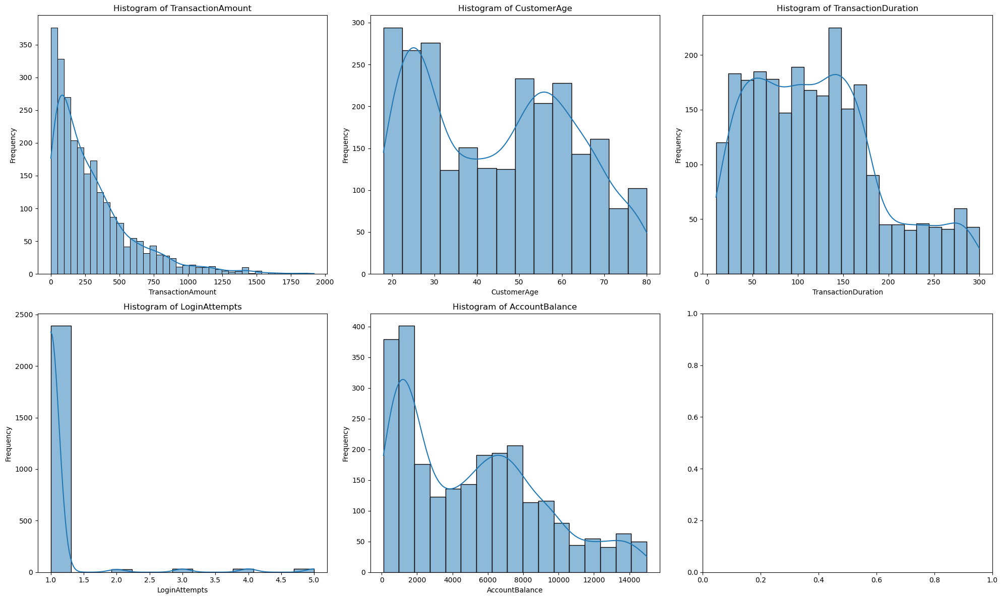
Histogram

Slide 4
Analysis of Histograms
Analysis of Histograms and Descriptive Statistics
TransactionAmount: The distribution is right-skewed with most transactions being of lower amounts. There are some outliers with very high transaction amounts, which could be legitimate large transactions or potentially fraudulent activities.
CustomerAge: The distribution appears to be roughly normal, with most customers between 20-60 years old. There are some outliers at both ends, which could represent very young or very old customers.
TransactionDuration: Right-skewed distribution with most transactions taking less than 200 seconds. Outliers with very long durations could indicate technical issues or complex transactions.
LoginAttempts: Highly skewed distribution with most transactions having only 1 login attempt. Outliers with multiple login attempts could be indicators of potentially fraudulent activities.
AccountBalance: Right-skewed distribution with a wide range of account balances. Outliers with very high balances could represent high-value accounts or potential errors.
Note: Outliers in these variables should be investigated further to determine if they represent legitimate transactions or potential fraud. For this analysis, the outliers are not excluded as they might be important for fraud detection.

Slide 5
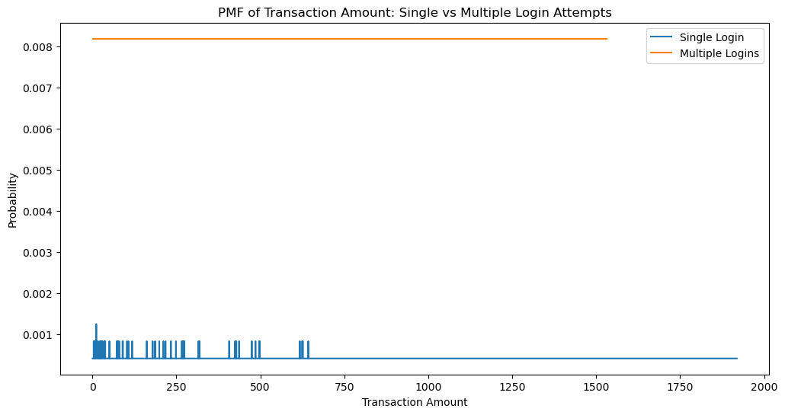
PMF Comparison
Compare the PMF of Transaction Amount for transactions for Single vs. Multiple login attempts.
The comparison shows the difference in transaction amount distributions between transactions with single login and those with multiple login attempts.
The significant difference indicate potential fraudulent activities associated with multiple login attempts.

Slide 6
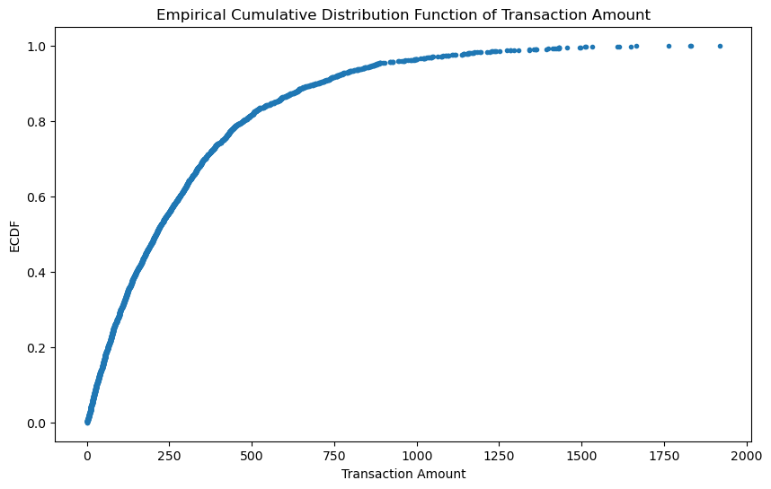
Cumulative Distribution Function (CDF)
The CDF of TransactionAmount shows the cumulative probability of transaction amounts. This can help identify thresholds for normal transaction amounts and potential outliers that might indicate fraudulent activities.

Slide 7
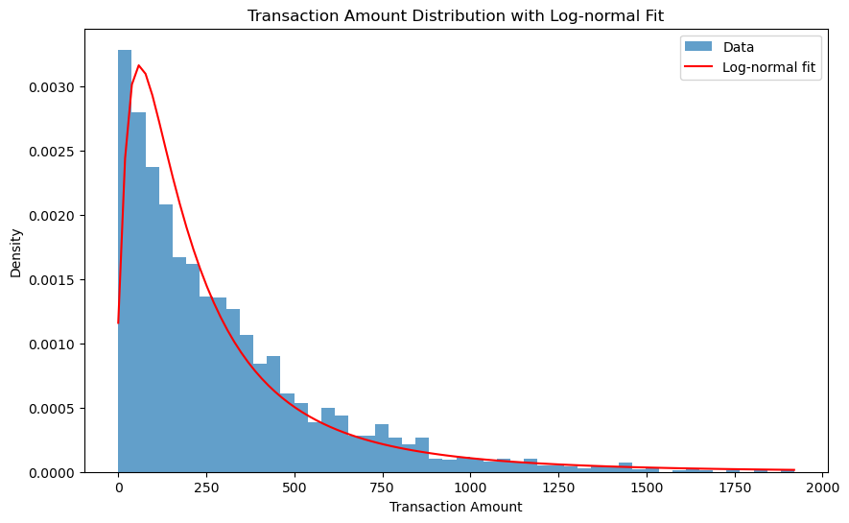
Log-normal Distribution
The log-normal distribution appears to fit the TransactionAmount data reasonably well, capturing the right-skewed nature of financial transactions. Deviations from this distribution might indicate unusual or potentially fraudulent transactions.

Slide 8
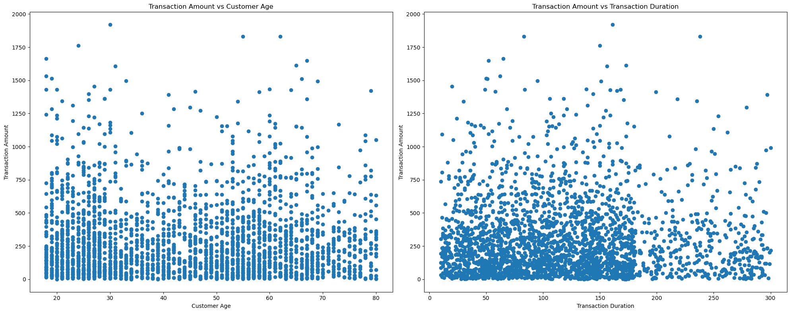
Scatter Plots
Correlation is
0.0044
Correlation is
-0.0256
Transaction Amount vs Customer Age:
No strong linear correlation
Larger transactions are more common among middle-aged customers
Transaction Amount vs Transaction Duration:
Weak positive correlation
Larger transactions slightly longer
General observations:
Low correlation coefficients
Possible non-linear relationships or range-specific patterns
Potential relevance for fraud detection
Hypothesis:
Test if multiple login attempts correlate with higher transaction amounts

Slide 9
P-value = 0.742
Based on the P-value, following are the interpretation
P-value (0.742) > 0.05 significance level
Fail to reject null hypothesis
No significant difference in transaction amounts between single and multiple login attempts
Login attempts likely not a strong predictor of transaction amount
Other factors may have more influence on transaction amounts

Slide 10
Regression Coefficients
CustomerAge: -0.599 (slight negative impact)
TransactionDuration: 0.047 (minimal positive impact)
LoginAttempts: -7.753 (strong negative impact)
Intercept: 323.335 (baseline transaction amount)
R-squared: -0.009 (very poor model fit)
The regression analysis examines the impact of customer age, transaction duration, and login attempts on transaction amounts.
Coefficients indicate each variable's influence: customer age and login attempts have negative effects, while transaction duration has a minimal positive impact. The intercept represents the baseline transaction amount.
The negative R-squared value (-0.009) suggests the model performs poorly, explaining less variance than a horizontal line. This indicates that the chosen variables may not be strong forecast of transaction amounts.
To improve fraud detection, further refinement is needed. This may include exploring additional variables, non-linear relationships, or applying more advanced statistical techniques to better capture the complexities of fraudulent activities.

Slide 11
Thank You

