Slide 1
Teacher Student collaboration system

Slide 2
CSE 3224 : Information System Design and Software Engineering Lab
2
Submitted by :
Mahir Rashid ID: 15-01-04-11 Tasnim Mashrur Mahee ID: 15-01-04-13 Atiqul Islam Chowdhury ID: 15-01-04-14
Md. Saiful Islam ID: 15-01-04-027
Submitted to :
Tanvir Ahmed Belal
Lecturer,
Department of CSE,
AUST
Shoeb Mohammad Shahriar
Lecturer,
Department of CSE,
AUST

Slide 3
WHY Teacher-Student Collaboration System
Reducing communication gap between teacher & student
Making sharing process more dynamic
Time consuming and rearranging hotchpotch things

Slide 4
Project SUMMARY
Basically It will stand for the welfare of students and teachers in an institute.
First of all there will be two part in our application.
From the teacher part teacher has to upload the information or materials or
the marks .
Student have their own interface from there they can find out the info about
course and the materials and quiz marks against their course.
There will be different section for material and marks do student can find out
easily.

Slide 5
Project Requirements
Programming Language : C#
IDE : Microsoft Visual Studio with asp.net Framework (MVC)
Database : Microsoft SQL server

Slide 6
Data flow diagram

Slide 7
Data Flow Diagram
Graphical representation of the flow of data through an information System
Shows what kind of information will be input to and output from the system
Illustrates where data comes from, where it goes and how it gets stored in an information System

Slide 8
Types of data flow diagram
Context Level Diagram
Level 0 Diagram
Level 1 Diagram

Slide 9
Main process
Process 1.0 : Course Process
Process 2.0 : Quiz Process
Process 3.0 : Materials Process

Slide 10
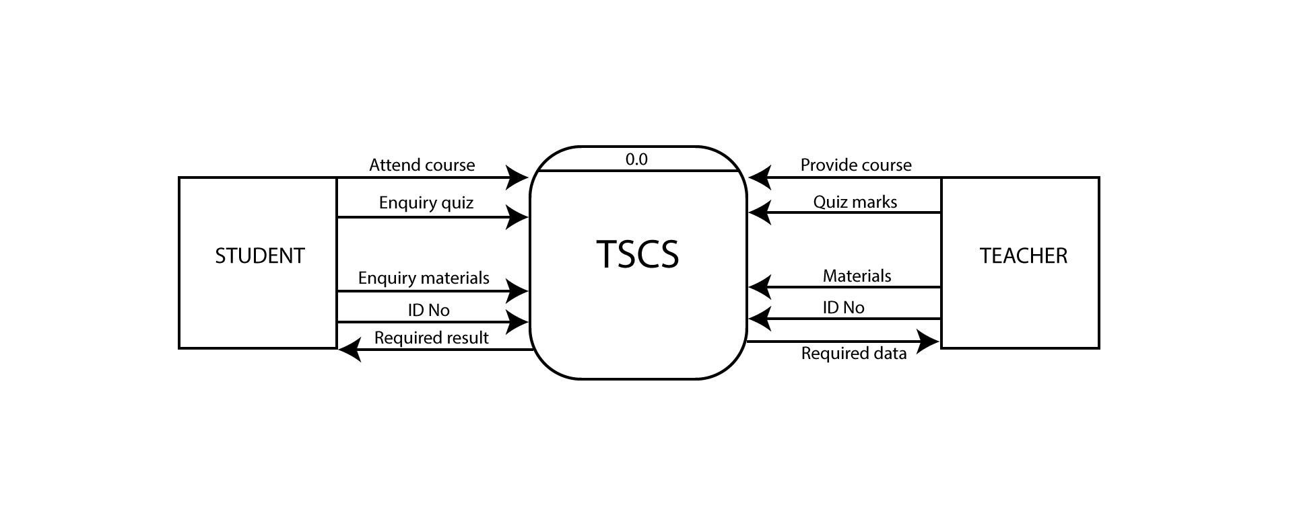
Context Level Diagram

Slide 11
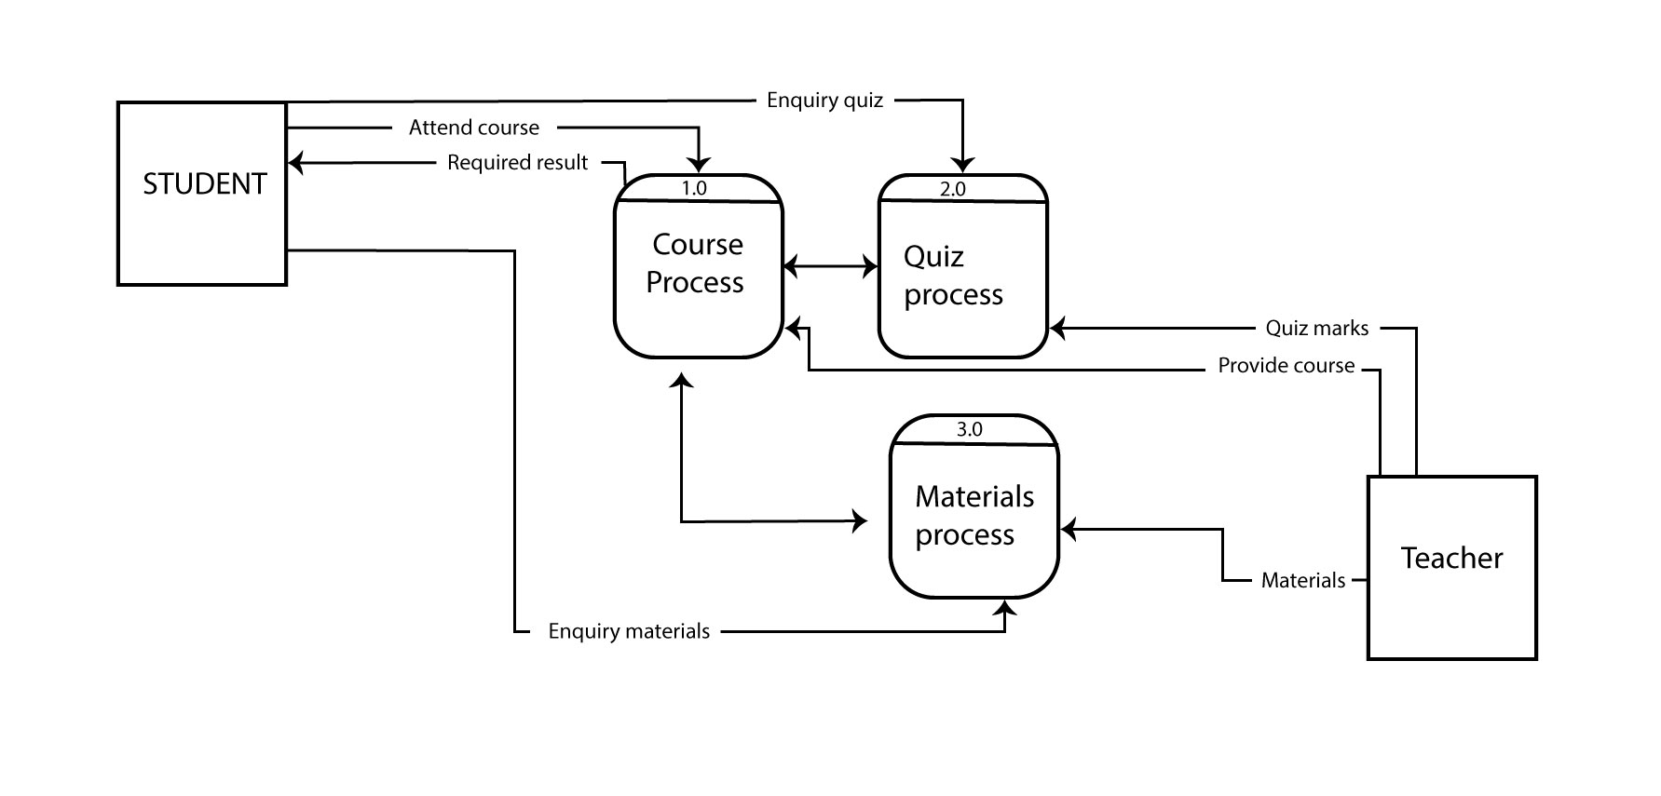
Level 0 Diagram

Slide 12
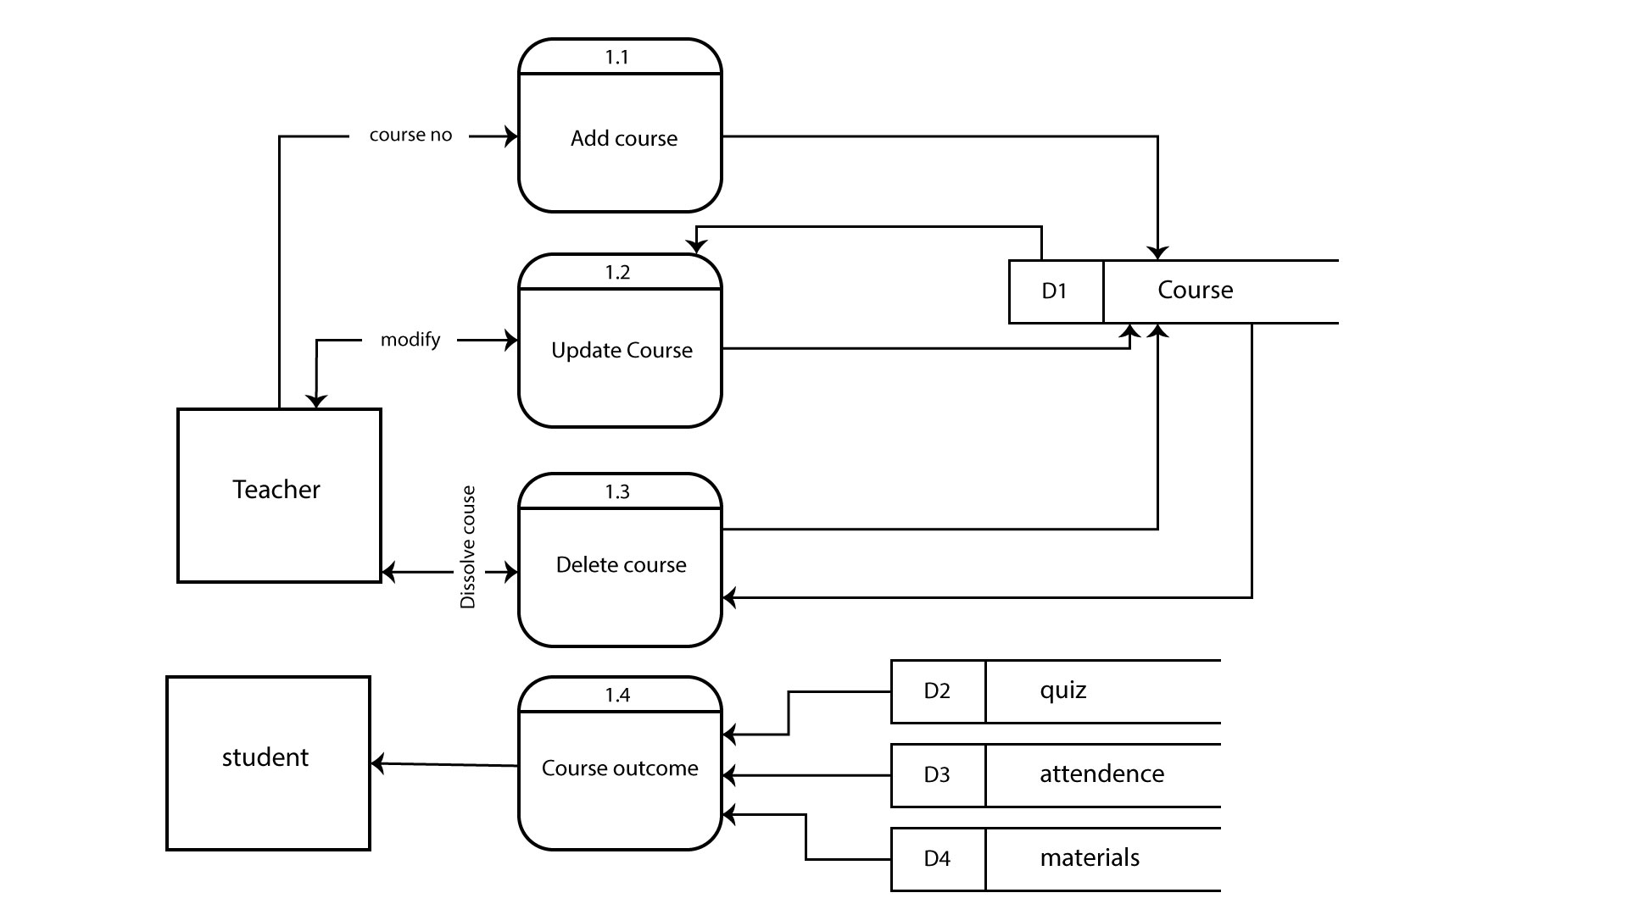
Level 1: course process

Slide 13
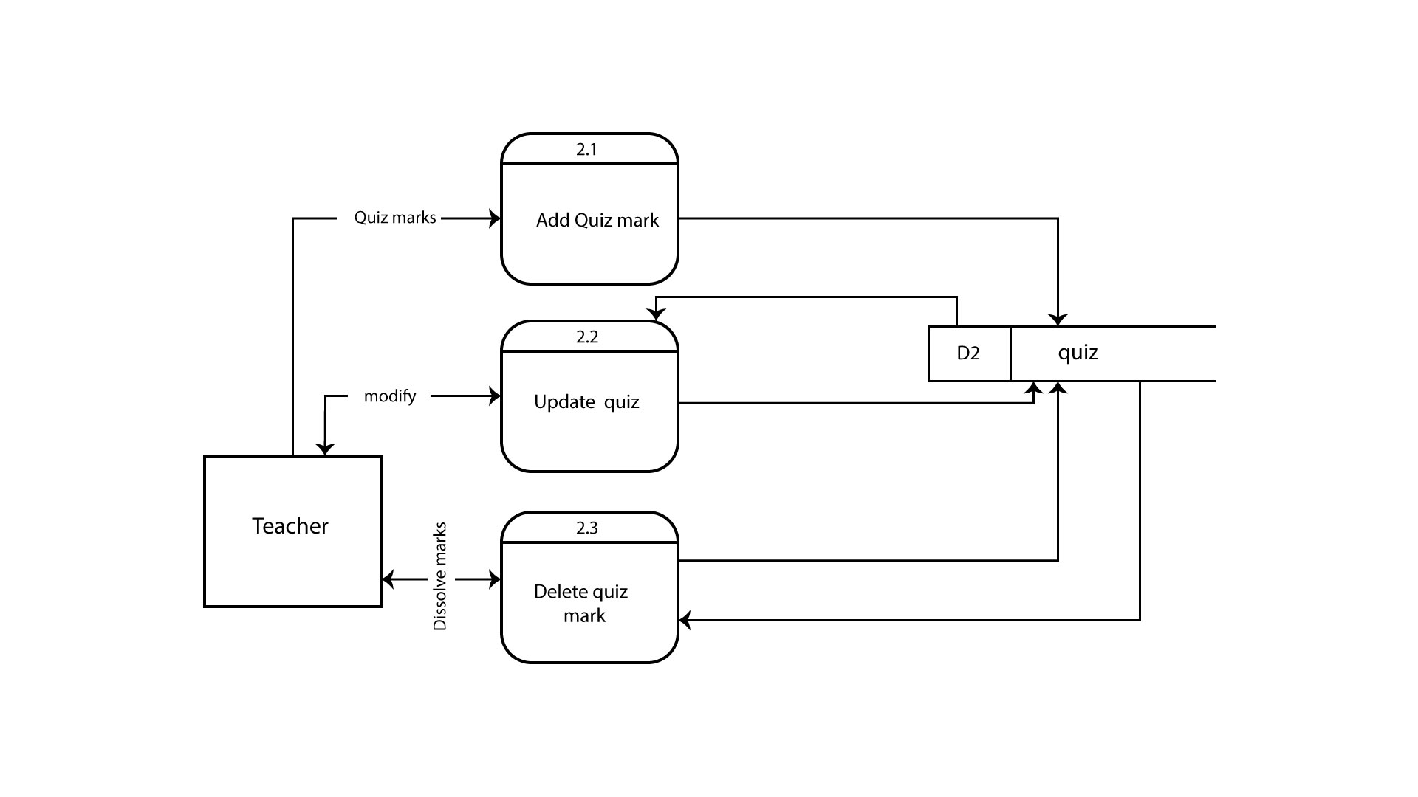
Level 1: quiz process

Slide 14
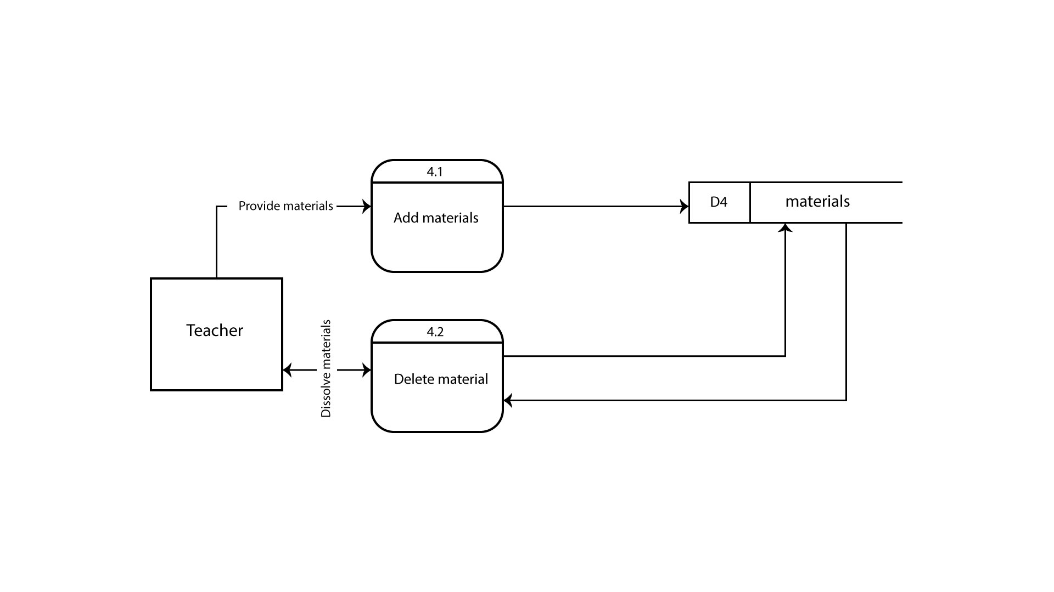
Level 1: materials process

Slide 15
Use Case Diagram

Slide 16
Actors
There are 2 actors :
Teacher
Student

Slide 17
Functions of actors
Teacher :
- Can create course, add, delete, update marks of quiz and provide
materials to system
Student :
- Can take course, get marks of quiz and get materials and other information from the system

Slide 18
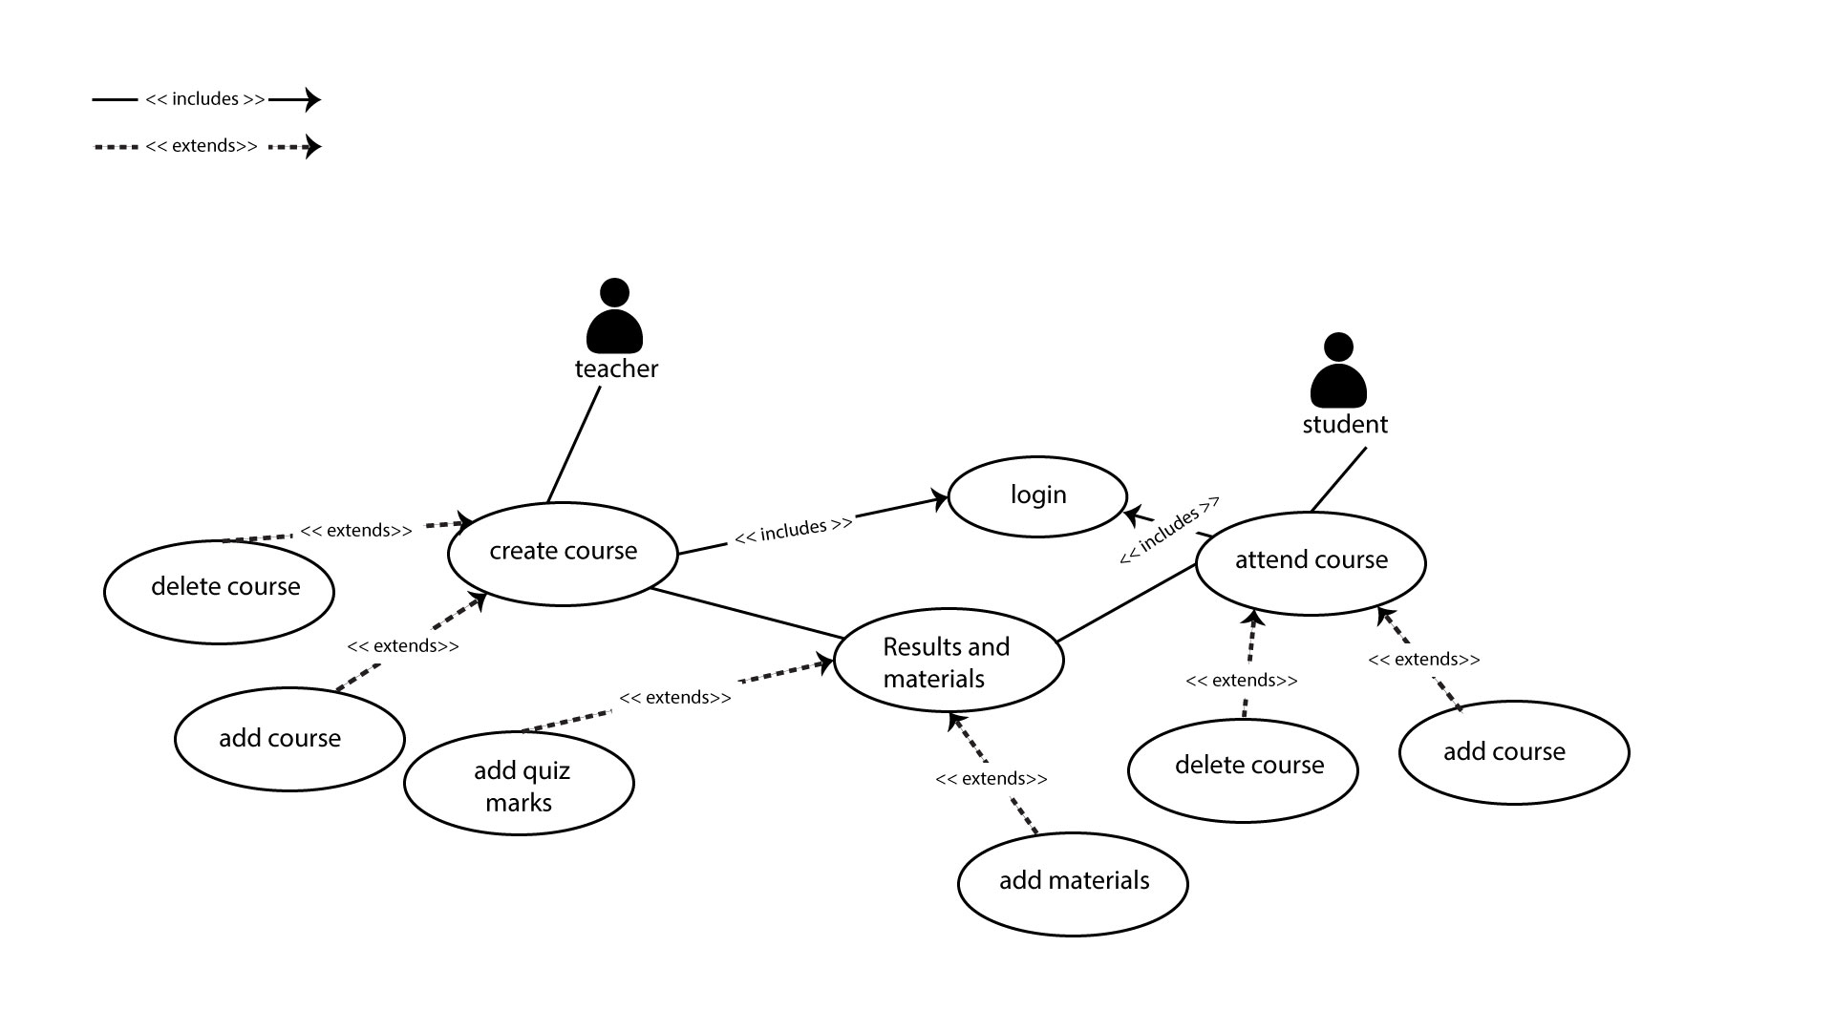
Confirm Purchase
Use case diagram

Slide 19
Entity Relationship Diagram

Slide 20
Entity Relationship Diagram
An entity-relationship diagram (ERD) is a graphical representation of an information system that shows the relationship between people, objects, places, concepts or events within that system.
Elements of an ERD :
- Entity
- Attribute
- Relationship

Slide 21
Entities:
Which are represented by rectangles. An entity is an object or concept about which you want to store information.
Relationships :
Which are represented by diamond shapes, show how two entities share information in the database.
Attributes :
Which are represented by ovals. A key attribute is the unique, distinguishing characteristic of the entity.

Slide 22
ENTITY SET NAMES
Teacher ( for sharing materials, takes courses, takes attendance)
Courses ( every course info. given to teacher & students)
Materials (provided by teacher & students can download it)
Students (for student id)
Quizes ( for adding marks of quiz of every student)

Slide 23
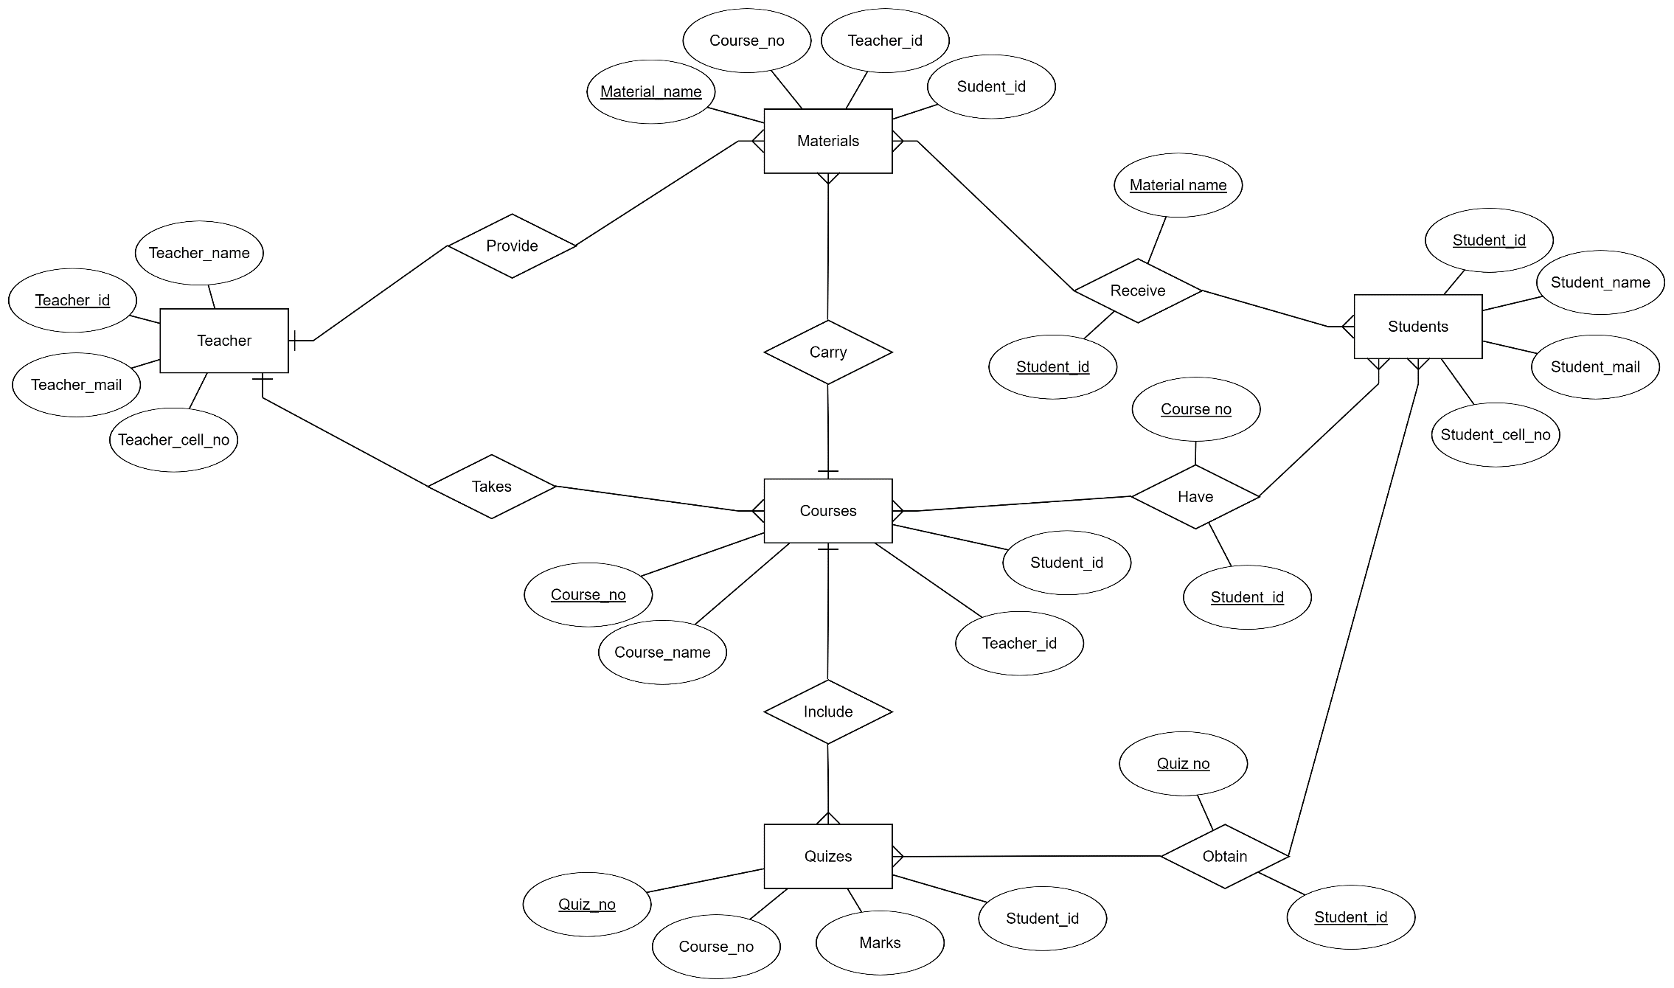
13
Confirm Purchase
ER Diagram of the system

Slide 24
Project Demonstration
In the terms of project accomplish we had almost done all the area of it.
Separate database for student and teacher
Creating course by teachers
Different database and sharing system for material and quiz against the course.

Slide 25


Slide 26
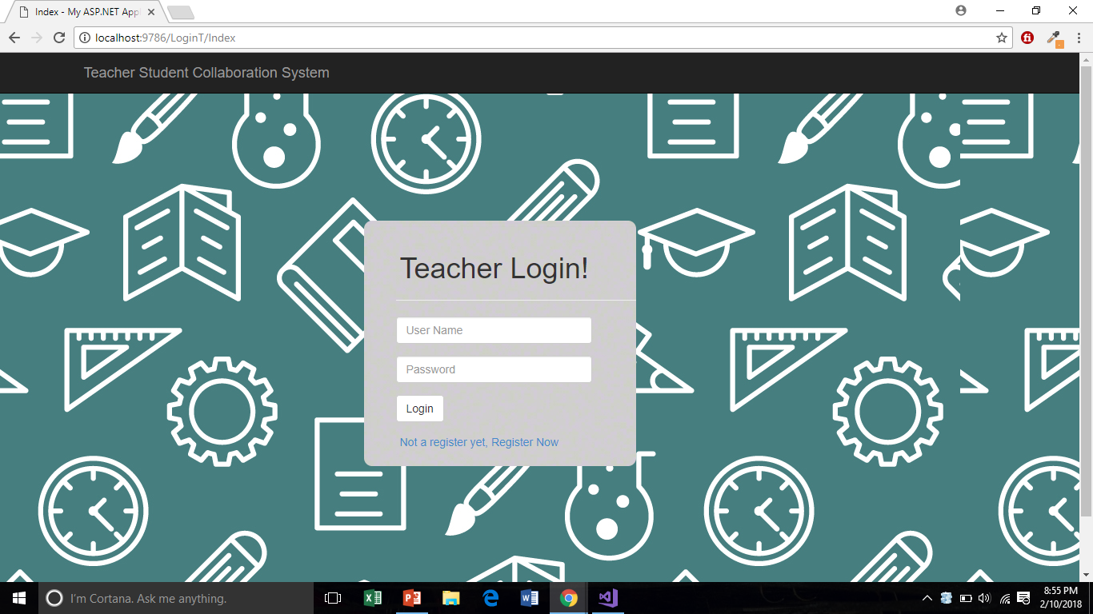

Slide 27
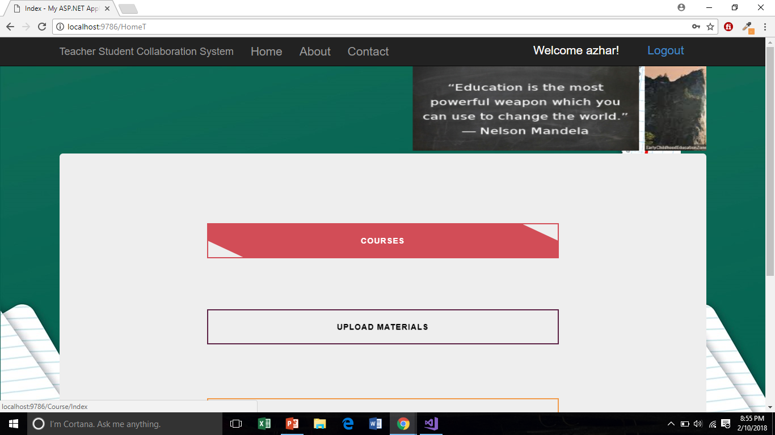

Slide 28
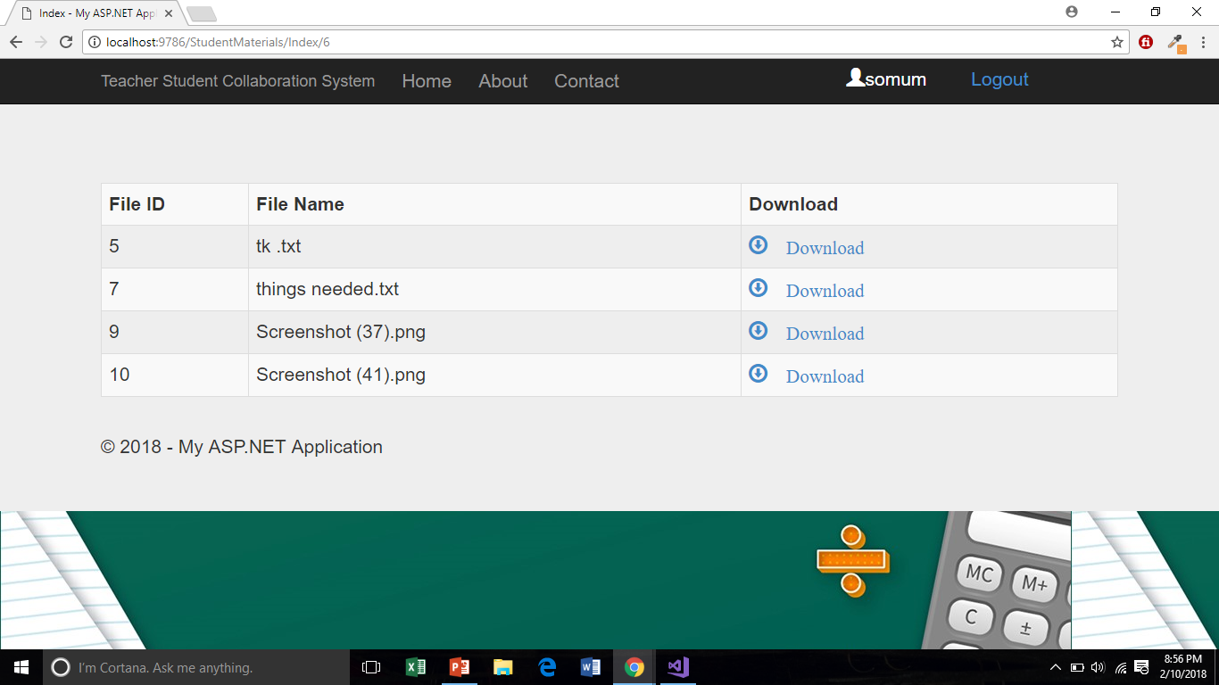

Slide 29
Future Plan
Individual profile for students.
Real-time problem solution by leaving comments and reply.
Sending results of students in their profile dynamically without showing it publicly.

Slide 30
Conclusion
At the end we can say its all about solving the problems Of communication between teachers and students. With its dynamic process hope we can deport sharing problems. So all the sides can get complication free information gathering way. Though it has many shortcomings but in future we will try to improve it.

Slide 31
Any Questions?

Slide 32
Thank You ☺

