Slide 1
Looping Statements
© Oxford University Press 2013. All rights reserved.

Slide 2
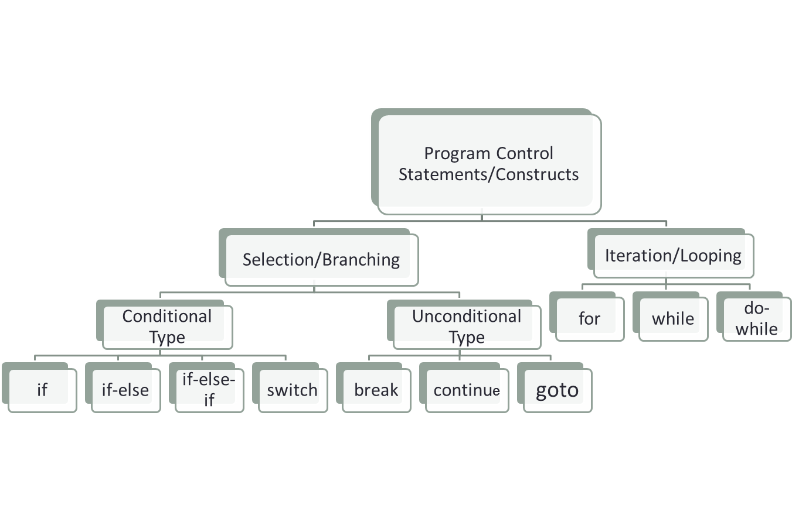
PROGRAM CONTROL STATEMENTS/CONSTRUCTS IN ‘C’
© Oxford University Press 2013. All rights reserved.

Slide 3

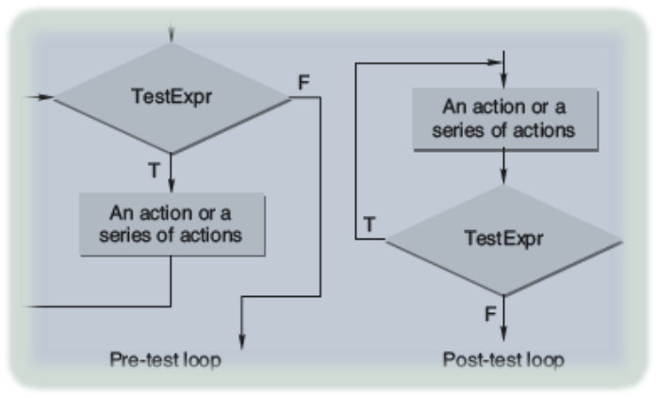
ITERATION AND REPETITIVE EXECUTION
A loop allows one to execute a statement or block of statements repeatedly. There are mainly two types of iterations or loops – unbounded iteration or unbounded loop and bounded iteration or bounded loop.
A loop can either be a pre-test loop or be a post-test loop as illustrated in the diagram.
© Oxford University Press 2013. All rights reserved.

Slide 4
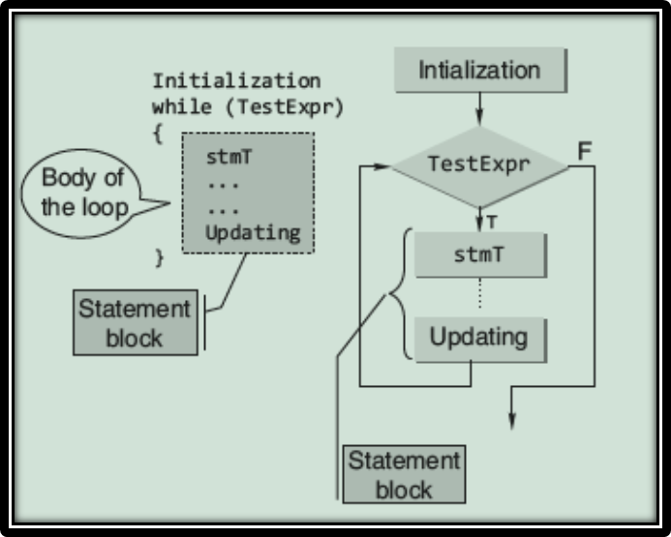
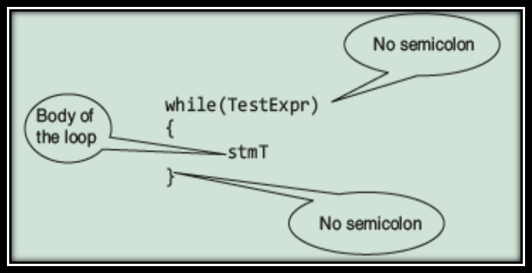
“WHILE” CONSTRUCT
while statement is a pretest loop. The basic syntax of the while statement is shown below:
Expanded Syntax of “while” and its Flowchart Representation
© Oxford University Press 2013. All rights reserved.

Slide 5
AN EXAMPLE
#include <stdio.h>
int main()
{
int c;
c=5; // Initialization
while(c>0)
{ // Test Expression
printf(“ \n %d”,c);
c=c-1; // Updating
}
return 0;
}
This loop contains all the parts of a while loop. When executed in a program, this loop will output
5
4
3
2
1
© Oxford University Press 2013. All rights reserved.

Slide 6
TESTING FOR FLOATING-POINT ‘EQUALITY’
float x;
x = 0.0;
while(x != 1.1)
{
x = x + 0.1;
printf(“1.1 minus %f equals %f\n”, x, 1.1 -x);
}
The above loop never terminates on many computers, because 0.1 cannot be accurately represented using binary numbers.
Never test floating point numbers for exact equality, especially in loops.
The correct way to make the test is to see if the two numbers are ‘approximately equal’.
© Oxford University Press 2013. All rights reserved.

Slide 7
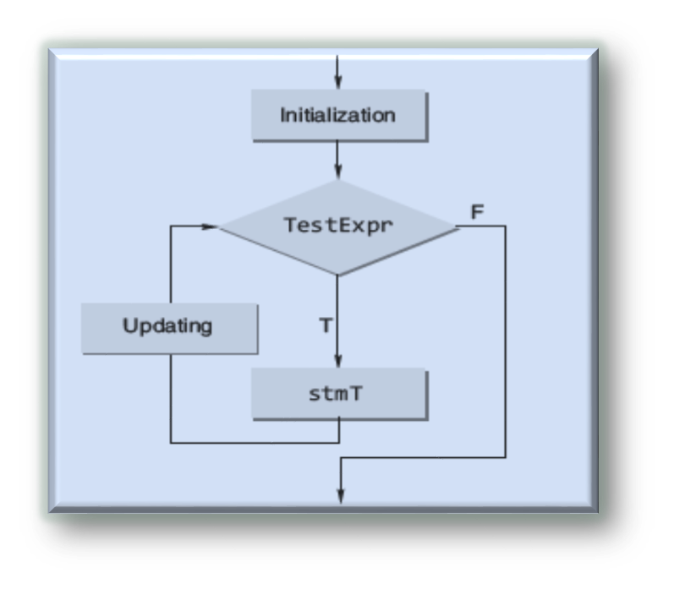
“FOR” CONSTRUCT
The general form of the for statement is as follows:
for(initialization; TestExpr; updating)
stmT;
for construct
flow chart
© Oxford University Press 2013. All rights reserved.

Slide 8
EXAMPLE
#include <stdio.h>
int main()
{
int n, s=0, r;
printf(“\n Enter the Number”);
scanf(“%d”, &n);
for(;n>0;n/=10)
{
r=n%10;
s=s+r;
}
printf(“\n Sum of digits %d”, s);
return 0;
}
© Oxford University Press 2013. All rights reserved.

Slide 9
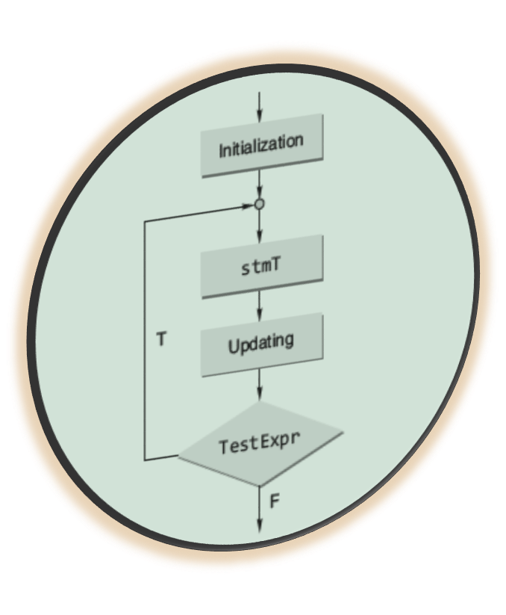

“DO-WHILE” CONSTRUCT
The C do-while loop
The form of this loop construct is as follows:
do
{
stmT; /* body of statements would be placed here*/
}while(TestExpr);
© Oxford University Press 2013. All rights reserved.

Slide 10
POINT TO NOTE
With a do-while statement, the body of the loop is executed first and the test expression is checked after the loop body is executed. Thus, the do-while statement always executes the loop body at least once.
© Oxford University Press 2013. All rights reserved.

Slide 11
AN EXAMPLE
#include <stdio.h>
int main()
{
int x = 1;
int count = 0;
do {
scanf(“%d”, &x);
if(x >= 0) count += 1;
} while(x >= 0);
printf(“count=%d\n”,count);
return 0;
}
© Oxford University Press 2013. All rights reserved.

Slide 12
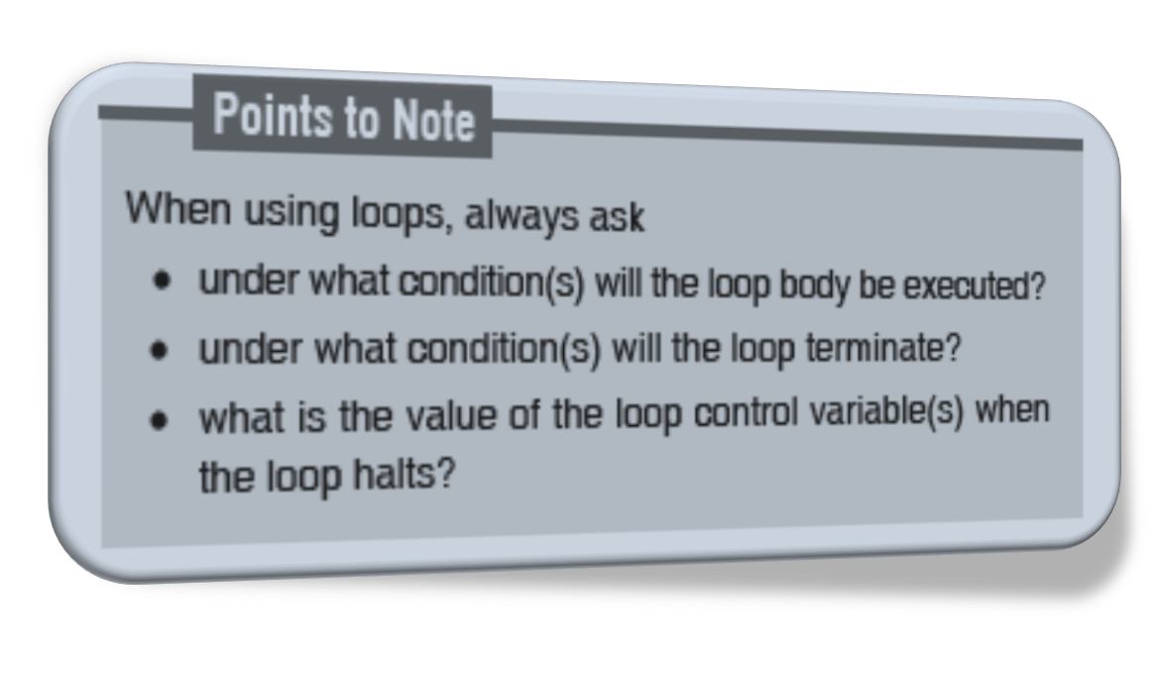
WHICH LOOP SHOULD BE USED???
© Oxford University Press 2013. All rights reserved.

Slide 13
NESTED LOOPS
A nested loop refers to a loop that is contained within another loop.
If the following output has to be obtained on the screen
1
2 2
3 3 3
4 4 4 4
then the corresponding program will be
#include <stdio.h>
int main()
{
int row, col;
for(row=1;row<=4;++row)
{
for(col=1;col<=row;++col)
printf(“%d \t”, row);
printf(“\n”);
}
return 0;
}
© Oxford University Press 2013. All rights reserved.

Slide 14
GOTO STATEMENT
The following program is used to find the factorial of a number.
#include <stdio.h>
int main()
{
int n, c;
long int f=1;
printf(“\n Enter the number:”);
scanf(“%d”,&n);
if(n<0)
goto end;
for(c=1; c<=n; c++)
f*=c;
printf(“\n FACTORIAL IS %ld”, f);
end:
return 0;
}
The control is unconditionally transferred to the statement associated with the label specified in the goto statement. The form of a goto statement is
goto label_name;
Suggestion: Avoid “goto” statements at all cost!!
© Oxford University Press 2013. All rights reserved.

Slide 15
10. SPECIAL CONTROL STATEMENTS
“return” statements
“break” statements
“continue” statements
© Oxford University Press 2013. All rights reserved.

Slide 16
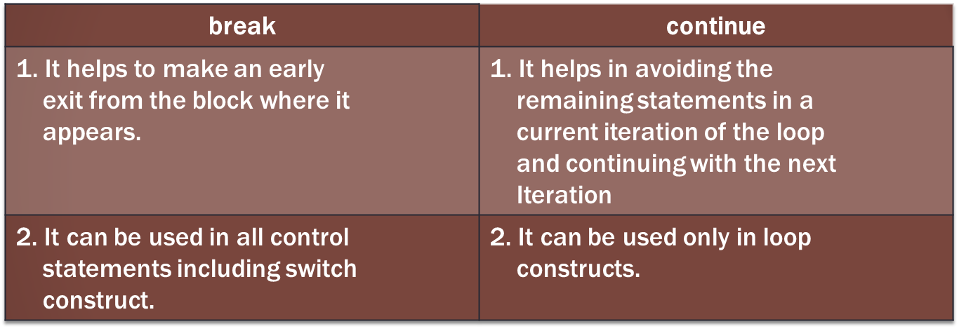
“BREAK” AND “CONTINUE” STATEMENTS
© Oxford University Press 2013. All rights reserved.

Slide 17
“BREAK” STATEMENT EXAMPLE
#include <stdio.h>
int main ()
{
/* local variable definition */
int a = 10;
/* while loop execution */
while( a < 20 )
{
printf("value of a: %d\n", a);
a++;
if( a > 15)
{
/* terminate the loop using break statement */
break;
}
}
return 0;
}
© Oxford University Press 2013. All rights reserved.

Slide 18
OUTPUT FROM PREVIOUS PROGRAM
value of a: 10
value of a: 11
value of a: 12
value of a: 13
value of a: 14
value of a: 15
© Oxford University Press 2013. All rights reserved.

Slide 19
“CONTINUE” STATEMENT EXAMPLE
#include <stdio.h>
int main ()
{
/* local variable definition */
int a = 10;
/* do loop execution */
do
{
if( a == 15)
{
/* skip the iteration */
a = a + 1;
continue;
}
printf("value of a: %d\n", a);
a++;
}while( a < 20 );
return 0;
}
© Oxford University Press 2013. All rights reserved.

Slide 20
OUTPUT FROM PREVIOUS PROGRAM
value of a: 10
value of a: 11
value of a: 12
value of a: 13
value of a: 14
value of a: 16
value of a: 17
value of a: 18
value of a: 19
COMMENT: Notice the “printf” step when a=15 has been skipped
© Oxford University Press 2013. All rights reserved.

Slide 21
COMMON PROGRAMMING ERRORS
Writing expressions like a<b<c or a==b==c etc.
Use of = instead of ==
Forgetting to use braces for compound statement
Dangling else
Use of semicolon in loop
Floating point equality
© Oxford University Press 2013. All rights reserved.

