Slide 1
Strings

Slide 2
De-limiters in C
In C a string is defined to be a null-terminated character array.
The null character ('\0') is used to indicate the end of the string.
Like any other arrays, C does not impose range checking of array indices for strings.
Declaration of an array allocates a fixed space for it. You need not use the entire space.
Instead you can store your data in the initial portion of the array. It is, therefore, necessary to put a boundary of the actual data.
This is the reason why we pass the size parameter to functions along with arrays.
  Strings handle it differently, namely by putting an explicit marker at the end of the actual data.

Slide 3

Delimiter \0
Here we use an array of size 30.
The string "IIT Kharagpur, 721302" is stored in the first 21 locations.
This is followed by the null character.
A total of 22 characters is needed to represent this string of length 21.
Whatever follows after this null character is irrelevant for defining the string.

Slide 4

Delimiter \0
Whatever follows after this null character is irrelevant for defining the string.
If we set the element at location 6 to '\0', the array looks like:
Considered as a string this stands for "IIT Kh".

Slide 5
In built functions
C offers some built-in functions for working with strings. They assume (null-terminated) strings as input and create (null-terminated) strings.
You do not have to append the null character explicitly. For example, the statement
  strcpy(A,"IIT Kharagpur"); copies the string "IIT Kharagpur" to the character array A and also appends the required null character at the end of it.
In order to use these string functions you should #include <string.h>. No additional libraries need be linked during compilation time.

Slide 6
Reading and writing a string
#include<stdio.h>
main()
{
char month[15];
printf("Enter the string");
gets(month);
printf("The string is %s\n",month);
}
Another way to read a string consisting of alphabets, digits, blanks, punctuation symbols is:
scanf(“%[^\n]”,str);
Which reads all characters till Enter key (ie. \n) is not pressed.

Slide 7
What is a String?
A string is an array of characters terminated by the NULL character
  Data type is array of characters
  The NULL character is a character with a numeric value of zero
    In C, it is represented by the escape sequence, \0 (NUL)
String constant (or string literal)
  Any series of characters enclosed in double quotes
    Ex. "Hello world"
String example program
  stores a string constant
  stores individual elements
    note: character constants
    note: terminate with '\0‘ to make the character array a string
/* strings1.c */
#include <stdio.h>
int main()
{
int i;
char str1[] = "Hello world";
char str2[5];
str2[0]='M';
str2[1]='E';
str2[2]='3';
str2[3]='0';
str2[4]='\0';
printf("str1==%s\n",str1);
for(i=0; i<5; i++)
{
printf("str2[%d]==%c\n",i,str2[i]);
}
return 0;
}
What is an array?
strings1.c
Notes:
Run strings1.c in ChIDE. It prints out str1 ("Hello world") using the %s (string format specification). It also prints out str2 ("ME30") one element at time, including the NUL character (\0)
Characters are coded most often using the ASCII code. The decimal value of ASCII code for NUL is zero. The decimal value of the ASCII code for zero AS A CHARACTER is 48.

Slide 8
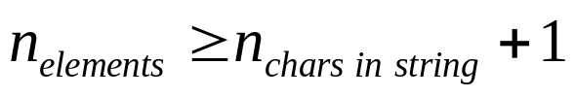
Initializing String Variables
/* strings1.c */
#include <stdio.h>
int main()
{
int i;
char str1[] = "Hello world";
char str3[12] = "Hello world";
char str2[5];
str2[0]='M';
str2[1]='E';
str2[2]='3';
str2[3]='0';
str2[4]='\0';
printf("str1==%s\n",str1);
for(i=0; i<5; i++)
{
printf("str2[%d]==%c\n",i,str2[i]);
}
return 0;
}
Declare as an array of type char
  Can initialize implicitly
  or explicitly (using a string constant or using individual characters and a terminating NULL character)
    If explicit, make sure that:

Slide 9
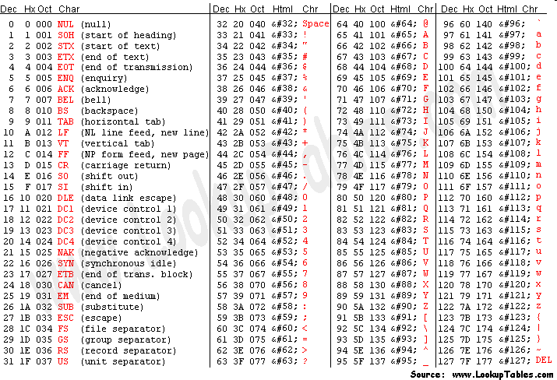
American Standard Code for Information Interchange (ASCII) Table

Slide 10
Printing Strings to stdout
/* strings1.c */
#include <stdio.h>
int main()
{
int i;
char str1[] = "Hello world";
char str3[12] = "Hello world";
char str2[5];
str2[0]='M';
str2[1]='E';
str2[2]='3';
str2[3]='0';
str2[4]='\0';
printf("str1==%s\n",str1);
for(i=0; i<5; i++)
{
printf("str2[%d]==%c\n",i,str2[i]);
}
return 0;
}
Can print an entire string using printf and %s format specification
Can print individual elements of a string by indexing and using %c format specification
Notes:
Stream == "a communications channel to a file, device, or process." http://www.cs.utah.edu/dept/old/texinfo/glibc-manual-0.02/library_11.html
The data type FILE is used to represent stream objects
printf prints to the stream standard output (stdout)

Slide 11
Strings - Practice 1
Declare:
  A string variable named me30, and initialize it to hold the string, "ME 30 rocks!"
Determine
  The minimum number of character array elements needed to store the string
  length of the string
  What is stored in me30[2]?
  What is stored in me30[12]?
Notes:
char me30[]="ME 30 rocks"
The minimum number of elements
strlen("ME 30 rocks"); --> 11 the NUL character is NOT counted, so 12 elements are needed.
The third character (me30[2]) is a 'space'. The ASCII code is 32.
The thirteenth character (me30[12]) is ‘\0’, the NUL character.

Slide 12
Strings - Practice 1 - solution
Declare:
  char me30[]="ME 30 rocks!"
  13
    Try sizeof(me30)/sizeof(char)
    Or strlen(me30)+ 1
  me30[2]== space
  What is stored in me30[12]== ‘\0’
Notes:
char me30[]="ME 30 rocks"
The minimum number of elements
strlen("ME 30 rocks"); --> 11 the NUL character is NOT counted
The third character is a 'space'. The ASCII code is 32.
The twelfth character is ‘\0’, the NUL character.

Slide 13
Manipulating Strings in C
No native support for strings in C
  #include <string.h>

Slide 14
Copying and Concatenating Strings
to copy str2 to str1 (order resembles assignment):
  strcpy(str1, str2);
    str1 = str2; /* Will NOT work!! */
to add (concatenate) str2 to the end of str1:
  strcat(str1, str2);
    returns the value of str1 with str2 added to the end
      Note: it clobbers the /0 at the end of str1
      Make sure that str1 has room for str2
Notes:
str1 = str2; just makes str1 now contain the pointer to str2. Remember that the name of an array is essentially a constant pointer to the first element of the array.

Slide 15
Finding the Length of a String
Use strlen(string)
  returns length of the string

Slide 16
User defined functions for string length
int strlength(char str[])
{
int count=0;
while(str[count]!=‘\0’) count++;
return(count);
}

Slide 17
User defined functions for string copy
void strcpy(char dst[], char src[])
{
int i, length;
length=strlength(src);
for(i=0;i<=length;i++)
dst[i]=src[i];
}
Why does the loop execute length+1 times?

Slide 18
User defined functions for comparision of two strings
void strcomp(char string1[], char string2[])
{
int i, length, length1, length2;
length1=strlen(string1);
length2=strlen(string2);
length=(length1<length2)?length1:length2;
for(i=0;i<=length;i++)
if(string1[i]<string2[i]) return -1;
else if(string1[i]>string2[i]) return 1;
return 0;
}

