Slide 1
MTP Seminar
Latency Analysis in Serverless Architectures
Nishant Baranwal Somy (15CS30044)
Supervisor : Professor Sandip Chakraborty

Slide 2
Table of Contents
Background
Problem Motivation
Contributions
Literature Survey
Gap Analysis
Problem Statement
Experiments and Results
Conclusion
Future Work
References

Slide 3
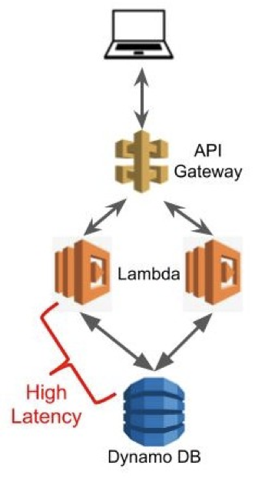
Serverless Computing
Function as a Service (FaaS) model.
Allows users to write and deploy code without the hassle of worrying about the underlying infrastructure.
Pricing is based on the actual amount of resources consumed by an application, rather than on pre-purchased units of capacity.
Although called serverless, physical servers are still used but developers do not need to be aware of them.
Cloud provider runs the server, and dynamically manages the allocation of machine resources.
Source : https://www.cloudflare.com/learning/serverless/what-is-serverless/

Slide 4
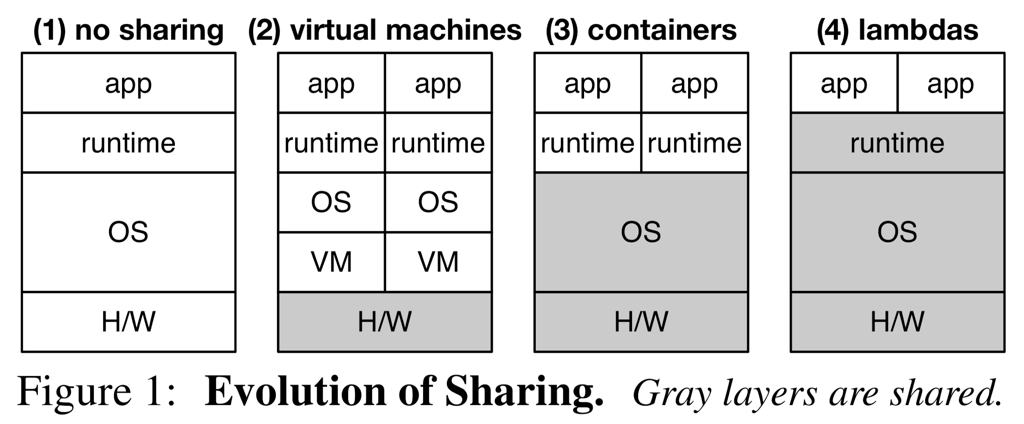
Evolution of Serverless
AWS lambda supports runtimes Node.js, Python,
Ruby, Java,
Go, .NET, etc.
Source : [1]
Notes:
For example runtimes supported by lambda : node js, python, java, etc.

Slide 5
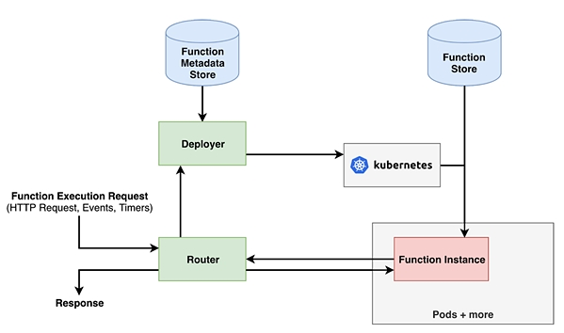
How Serverless platforms work?
Orchestrator
Source : https://www.infoq.com/articles/serverless-performance-cost/

Slide 6

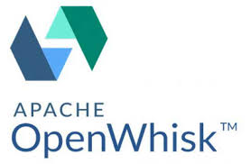




Platforms
AWS Lambda
(most popular)
(2014)
“Focus of this project”
Microsoft Azure Functions
(2016)
Google Cloud
Functions
(2016)
Open Source Platforms
Source : Google Images
Notes:
Zimki (2006), first platform
AWS Lambda (2014), most popular
Google Cloud Functions (2016)
IBM Cloud Functions (2016), uses Apache OpenWhisk
Microsoft Azure Functions, provides on-premise services (Azure Stack)
Open Source : Apache OpenWhisk, OpenLambda, Greengrass, OpenFaaS

Slide 7
Pros of Serverless
Cheaper than the traditional cloud.
Resource efficient. No idle time.
Easily scalable thanks to autoscaling feature.
Higher productivity! Servers headache of cloud providers.
Fine grained billing. “Pay as you go computing”
Notes:
developers only need to implement business logic. They do not need to setup servers, network config, etc.

Slide 8
Cons of Serverless
Vendor lock-in. Migration problems.
Bad performance for infrequently used applications thanks to cold starts.
Resource constraints like compute time and memory.
Custom monitoring and debugging not possible.
Privacy and security in hands of cloud providers.

Slide 9

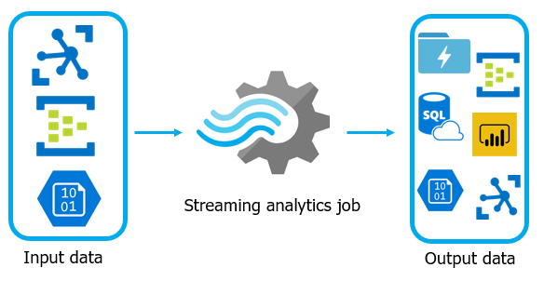

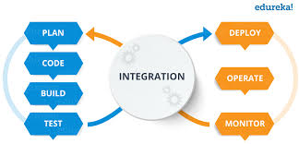
Applications
Basically, all applications involving short response times.
Source : Google Images
Notes:
Internet of Things applications
Virtual assistants and chat bots
Image rich applications
Agile and continuous integration pipelines
Serverless streaming analytics
Machine learning model training and deployment

Slide 10
Problem Motivation
Serverless platforms isolate and execute functions in separate containers, and do not exploit the interactions among functions for performance. These practices lead to high startup delays for function executions and inefficient resource usage.
Many of such applications interact with a database in the backend. Even if we ignore the startup delays, in the normal executions also when the container is warm, the delay is 5 times more as compared to a dedicated server.
This delay increases even more when the database and the lambda function is not placed in the same location.

Slide 11
Contributions
Latency analysis
Between IaaS and FaaS.
When same lambda function is accessed from multiple locations.
Between GET requests and POST requests when deployed using lambda.
When one lambda calls another lambda (Nested lambda).
Between in-memory caching and external caching.
When multiple lambda functions are cascaded at different depths.

Slide 12
Literature Survey
Scott Hendrickson et al [1] (HotCloud, 2016), have created OpenLambda, an open source serverless platform to promote building of next-generation web services and applications using serverless computation.
Istemi et al [2] (ATC, 2018), have created SAND which introduces two key techniques: application-level sandboxing and hierarchical message bus which achieves 43% speedup in image-processing applications.
Ana Klimovic et al [3] (ATC, 2018), explore the suitability of different cloud storage services (e.g., object stores and distributed caches) as remote storage for serverless analytics.
Liang Wang et al [4] (ATC, 2018), have studied different serverless platforms and characterized their performance in terms of security, scalability, cold start latency and resource efficiency.
Notes:
continue to next slide. many papers have seen various implementation techs and compared performance in terms of security, cold start latency, etc.

Slide 13
Gap Analysis
None of the works so far have compared serverless architecture to serverful architecture on the basis of performance.
Even though most of the serverless applications are web applications that involve interaction with database in the backend, none of the existing works focus on studying latency for interactive applications in serverless architecture.
Today, many of the serverless platforms have server farms in various parts of the world, hence, strategic placement of lambda functions and databases becomes an important case study for increasing performance of these applications.

Slide 14
Problem Statement
Characterizing latency in serverless architectures with respect to database applications and strategies to improve it.
Studying latency between components with increasing levels of dependency.
Improving performance by placing cache optimally across lambda.
Notes:
Determining optimal strategy for placement of lambda functions and database in applications using pipeline of lambda functions.

Slide 15
Experiments and Results
Platform used : Amazon AWS Lambda (most popular)
Application studied : Web based DB read and write
Experiments :
Traditional (IaaS) vs Serverless (FaaS)
Serverless : clients spread across the globe
Using cache between lambda and database
Nested lambda latency
Cascading lambda with different levels
Notes:
Platform used : Amazon AWS Lambda (most popular)
Application studied : Web based DB read and write
Experiments :
Traditional (IaaS) vs Serverless (FaaS)
Serverless : clients spread across the globe
Sharing variables across lambda calls
Delegating to lambdas
Nested lambda latency
Nested lambda across globe
Queuing in lambda invocations

Slide 16
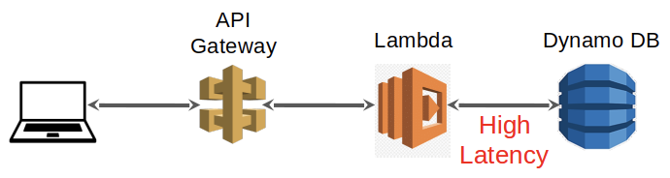
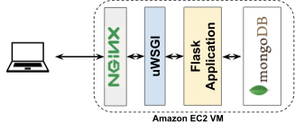
1. Traditional vs Serverless
Studied latency differences of deploying a web application on dedicated servers and that with lambda functions.
Experimental Setup :
Traditional : EC2 instances with MongoDB on backend
Serverless : AWS lambda with AWS DynamoDB on backend
Both lambda and DynamoDB placed at same location
Locations studied : Mumbai, London, California, Canada Central, Singapore
Hypothesis : It should be same as DB and lambda deployed in the same location as EC2.

Slide 17
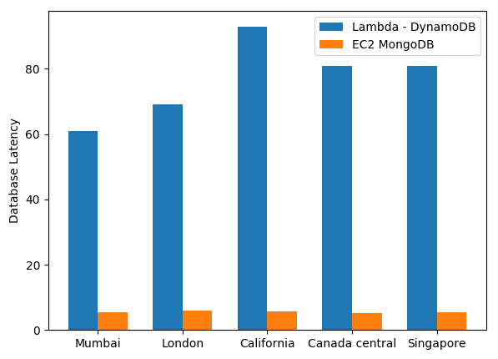
Results
Huge difference
between
lambda
and
mongoDB

Slide 18
Observations
The latency seen in Serverless is much greater than that in Traditional (approximately 6 times larger).
This latency is too large (> 60 ms). Usually 50 ms is tolerable (Ex: in AR/VR applications)
This is just a vanilla setup, the latencies are bound to increase when lambda and database are in different locations.
This calls for some kind of caching mechanism which is going to be the heart of subsequent experiments.

Slide 19
2. Clients spread across globe
Studied latency and billing differences in invoking lambda functions when clients are present in different locations.
Experimental Setup :
Lambda function location : Mumbai
Application is simple web application using DynamoDB in the backend
Clients located at India : Mumbai, USA : North California, Europe : London, Australia : Sidney, Japan : Tokyo.
Used EC2 instances at different locations to emulate clients.
Used AWS API gateway to expose lambda function URLs
Compared 2 types of requests : POST and GET
Hypothesis : It should be different across locations due to different number of hops be across locations.

Slide 20
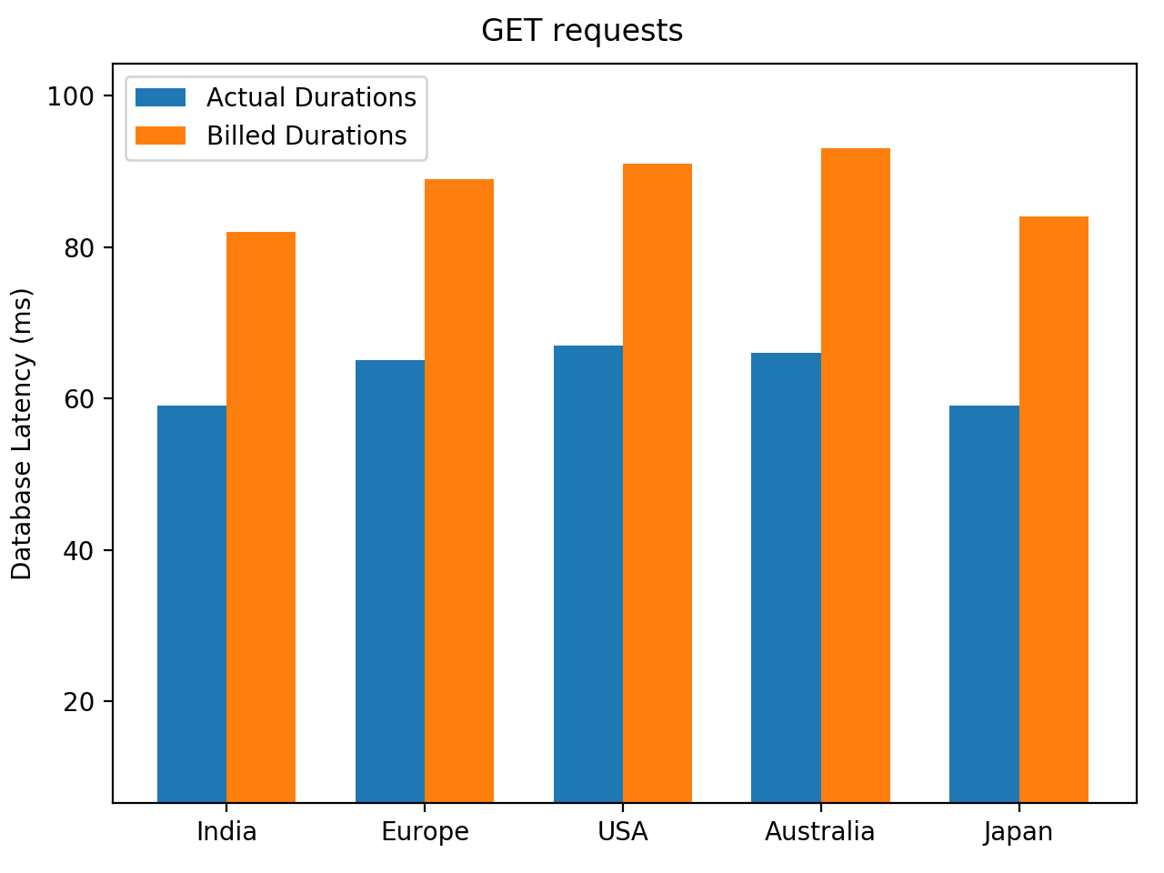
Results
Uniform difference between actual duration and billed duration
Almost Similar lambda runtimes across clients

Slide 21
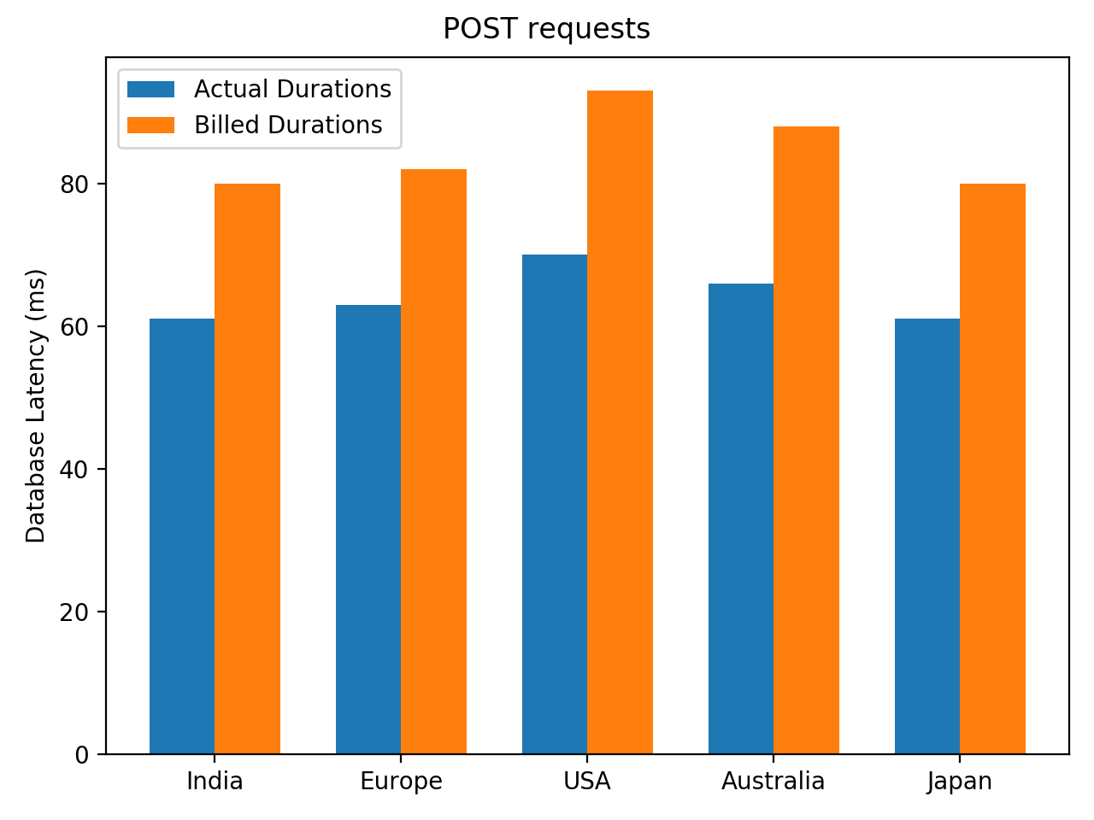
Results
Uniform difference between actual duration and billed duration
Almost Similar lambda runtimes across clients

Slide 22
Observations
The locations of client don’t affect the running time of lambda functions.
The billed durations and actual duration of making a DB call is uniform across different client locations.
The billed durations and actual duration do not differ much for GET and POST requests.
This suggests that the client TCP connections are actually handled by API gateway exposing the lambda functions through URLs.
The lambda function only receives the parameters, executes and returns the result. The client location is unknown to it.

Slide 23
Observations
We also observe that the latency is uniformly high across different client locations.
The difference between billed duration and actual DB call duration is very low compared to actual DB call duration, meaning that major portion of runtime is wasted while waiting for DB calls to return.
This suggests that we can make the DB calls faster by placing some cache in between for read (GET) requests or delegating it to other lambda functions for write (POST) requests.

Slide 24
Approach
For write calls, we delegate the responsibility to another lambda function whose only job is to write data to DB.
For read calls, we store the records in some cache. It can be done by using :
external cache
using global variables as cache
For the next set of experiments, we will be analysing the latency in using these approaches.

Slide 25
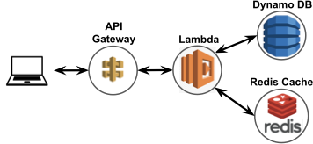
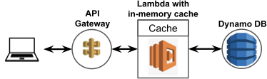
3. Cache between lambda and DB
Studied latency differences of using various cache between lambda and DB
Experimental Setup :
AWS lambda
For comparisons used DynamoDB directly, used Global variables as cache, used redis cache as cache
Hypothesis : Using global variables should give least latency as the variables would be stored nearest to lambda.

Slide 26
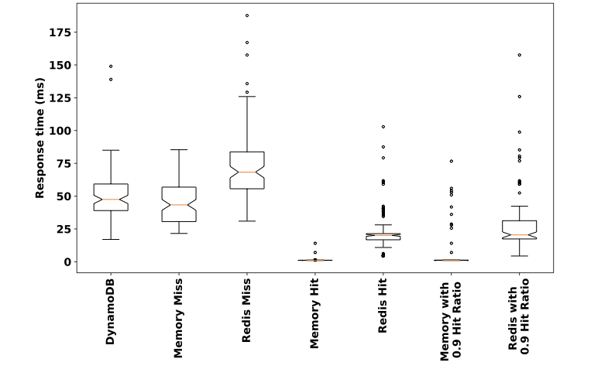
Results
Global variable cache hit latency is negligible

Slide 27
Observations
The latency seen with global variable cache is negligible.
The latency in order from best to worst is global cache hit, redis cache hit, global cache miss, direct DynamoDB access and then redis cache miss.
The global variables works best but it comes with a constraint. We observed that the global variables are shared only across lambda invocations within same sessions. After a cold start, the global variables are reset.
Also, this problem would come when load is high and multiple containers are running at the same time. The lambda invocations in 2 different containers would be unknown to each other.
Hence, it makes sense to delegate read calls for lambda too.

Slide 28
4. Nested Lambda
Here, we analyse the latency incurred when calling one lambda from another lambda
Experimental Setup :
AWS lambda
Used a vanilla function for inner lambda
Outer lambda invokes inner lambda synchronously
Both lambda functions deployed at same location
Hypothesis : As the lambda functions are deployed at same location, the latency between calling one lambda from another should be negligible

Slide 29
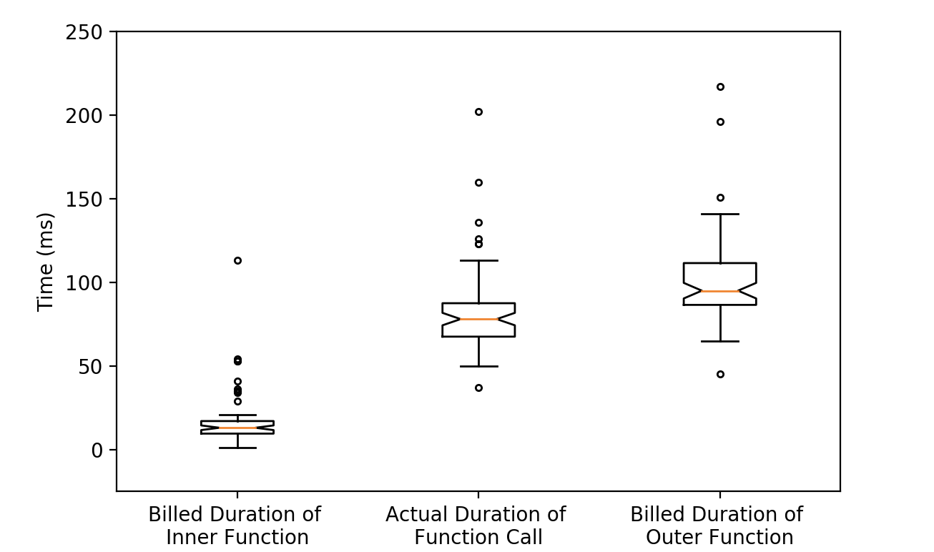
Results
The billed duration of inner function is negligible but the actual duration of function call inside outer function is very high

Slide 30
Observations
Billed duration of inner function is negligible as it is a vanilla function.
The actual duration of function call seen inside outer function is very large.
Note that this duration will increase if there is a cache miss inside inner function during read operations.
The actual duration is comparable to that of a DB call (approx 60 ms).
This suggests that some kind of queuing of requests is taking place with these invocations.

Slide 31
Observations
This also says that nested lambda doesn’t yield much benefit for read operations.
Even though this is not beneficial for DB read operations, nested lambda is beneficial for write operations, when outer function can call inner function asynchronously and doesn’t have to wait for it to return.
In the next experiment we will be seeing how latency is affected on cascading multiple lambdas at different levels.

Slide 32
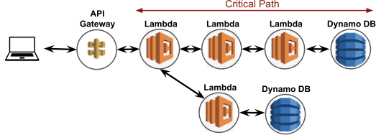
5. Cascaded Lambda
Here, we analyse the latency incurred when calling nested lambda at multiple levels
Experimental Setup :
AWS lambda
Used DB write at the innermost lambda
Outer lambda invokes inner lambda synchronously
All lambda functions deployed at same location
Hypothesis : As the lambda functions are deployed at same location, the latency between calling one lambda from another should be uniform

Slide 33
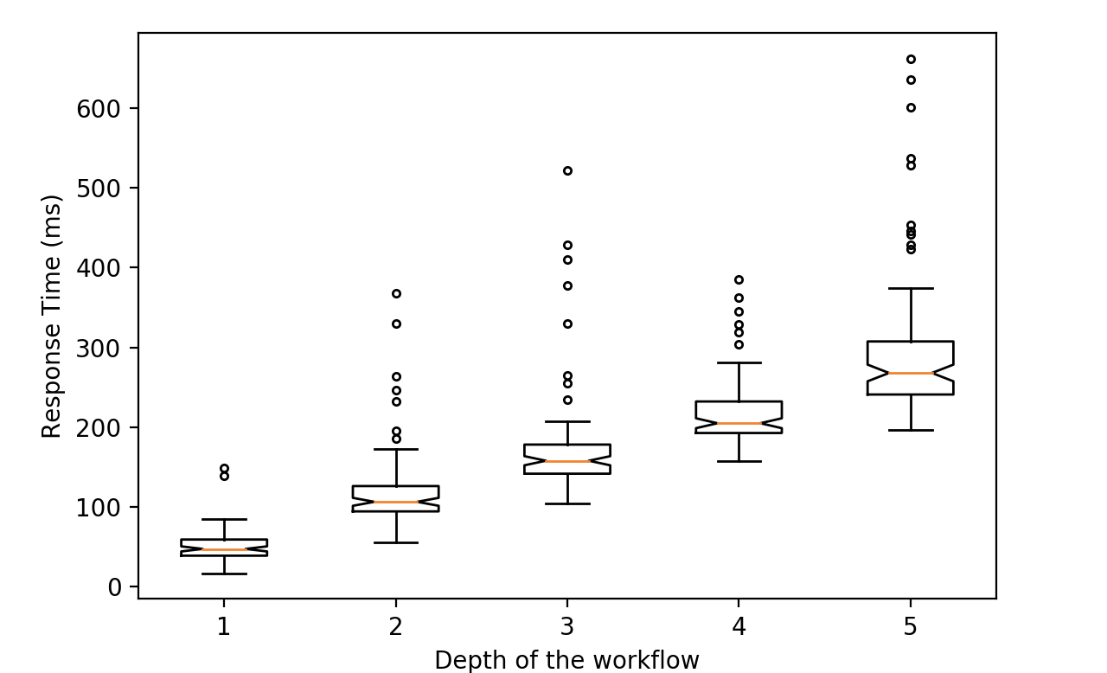
Results
The latency of nested functions increases linearly with levels

Slide 34
Observations
As we can see the nested lambda latency increases linearly across the levels.
Using this information, we can increase the performance of an application using cascaded lambda by running a single lambda with all its components instead of running them one after the other.
The uniform difference across different levels of lambda also strengthens the hypothesis that this latency is governed by the queuing delay at the location of deployment.
Hence, it's important to know what kind of queuing mechanism is in use.
By calling same function recursively, we may be able to overcome the constraint of limited running time.

Slide 35
Conclusion
Even though serverless has so many benefits, performance wise it still lags behind traditional approaches.
Experiments done in this project give us important insights on working of serverless platforms, specifically AWS lambda.
Shared global variables provide an easy way of caching but we need to find some turnaround for sharing these variables across runtimes.
We also observe that the 2 functions had individual cold starts, this implies that they are running in separate runtimes.

Slide 36
Conclusion
Multiple lambda functions can be cascaded to overcome time constraints for time-intensive applications.
Multiple lambda functions can be combined if the series of lambda functions to be used is known beforehand to reduce response time.
There is scope for further evolution of serverless architectures by sharing runtimes.

Slide 37
Future Work :
We would like to study what kind of queuing mechanisms is being used for these invocations and suggest methods to improve latency.
Current platforms use separate runtimes for individual functions. We would like to explore whether we can share this runtime across separate functions. This would also mitigate the problem of cold start and the increased response time due to queuing.

Slide 38
References
Hendrickson, Scott, et al. "Serverless computation with openlambda." 8th {USENIX} Workshop on Hot Topics in Cloud Computing (HotCloud 16). 2016.
Akkus, Istemi Ekin, et al. "{SAND}: Towards High-Performance Serverless Computing." 2018 {USENIX} Annual Technical Conference ({USENIX}{ATC} 18). 2018.
Klimovic, Ana, et al. "Understanding ephemeral storage for serverless analytics." 2018 {USENIX} Annual Technical Conference ({USENIX}{ATC} 18). 2018.
Wang, Liang, et al. "Peeking behind the curtains of serverless platforms." 2018 {USENIX} Annual Technical Conference ({USENIX}{ATC} 18). 2018.

Slide 39
References
Lloyd, Wes, et al. "Improving Application Migration to Serverless Computing Platforms: Latency Mitigation with Keep-Alive Workloads." 2018 IEEE/ACM International Conference on Utility and Cloud Computing Companion (UCC Companion). IEEE, 2018.
Oakes, Edward, et al. "{SOCK}: Rapid Task Provisioning with Serverless-Optimized Containers." 2018 {USENIX} Annual Technical Conference ({USENIX}{ATC} 18). 2018.
Ishakian, Vatche, Vinod Muthusamy, and Aleksander Slominski. "Serving deep learning models in a serverless platform." 2018 IEEE International Conference on Cloud Engineering (IC2E). IEEE, 2018.

Slide 40
CREDITS
Special thanks to
Professor Sandip Chakraborty
Professor Soumya Kanti Ghosh
Dr. Sourav Kanti Addya
Bishakh Chandra Ghosh

Slide 41
THANKS!
Any questions?

