Slide 1
What affects Etsy’s sales?
Group K: Soumya Nayak, Andre Han, Lucy Hwang, Serena Wu
Measuring Etsy’s most impactful variables to sales

Slide 2
Introduction

Slide 3
Etsy background & business problem
Etsy is an American e-commerce company, founded in 2005 that provides a global Internet marketplace for handmade items and art.
Sellers create personal shops through the Etsy Website, which is collectively searched by buyers. There are 9 broad categories of goods that may be sold: Holiday sales, jewelry & accessories, clothing & shoes, home & living, wedding & party, toys & entertainment, arts & collectibles, craft supplies, gifts & gift cards
Business goal
We want to find out what variables lead to higher sales count for Etsy sellers. This can help small businesses and artists grow and focus more on growing, optimizing, and promoting these impactful variables.

Slide 4
Data retrieval & preprocessing

Slide 5
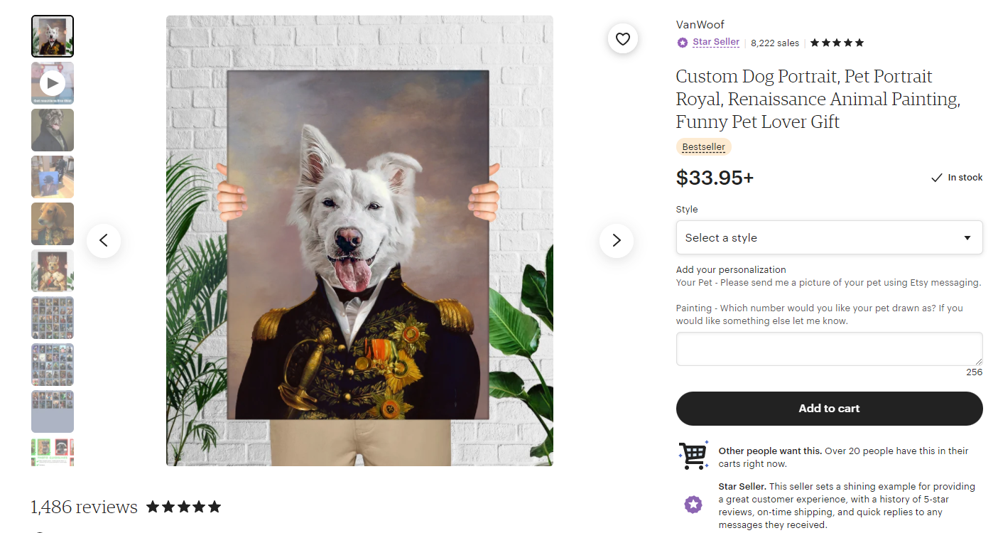

Web scraping
Category
Art & Collectibles > Drawing & Illustration
Variables scraped
Link
Business_name
Sale_count
Price_current
Price_original
Review_count
Seller_name
Store_rating
shipping_location
In_stock_status
Ready_to_ship_in
Extra_Status
InCartCount
Shipping
Highlight
Item_name
Estimated_shipping_arrival
Shipping_cost

Slide 6
Variable overview
Variables used
Variables scraped
Target:
sale_count
Link
Business_name
Sale_count
Price_current
Price_original
Review_count
Seller_name
Store_rating
shipping_location
In_stock_status
Ready_to_ship_in
Extra_Status
InCartCount
Shipping
Highlight
Item_name
Estimated_shipping_arrival
Shipping_cost
Raw
Price_current
Discount
Review_count
Store_rating
Shipping_arrival
Dummy coded
Bestseller
Popular_now
Etsy_pick
Free_shipping
USA
Instant_download

Slide 7
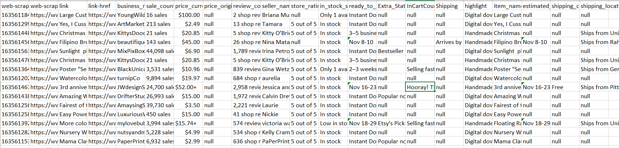
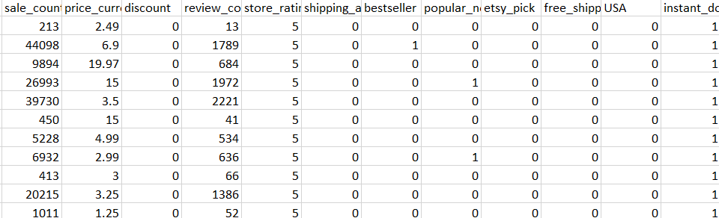
Python - cleaning
Before
Methods used
Refindall: to get only the numbers
Date formatting
Dummy coding relevant variables
Variable type conversion
Null values dropped or converted
After
1,180 rows

Slide 8
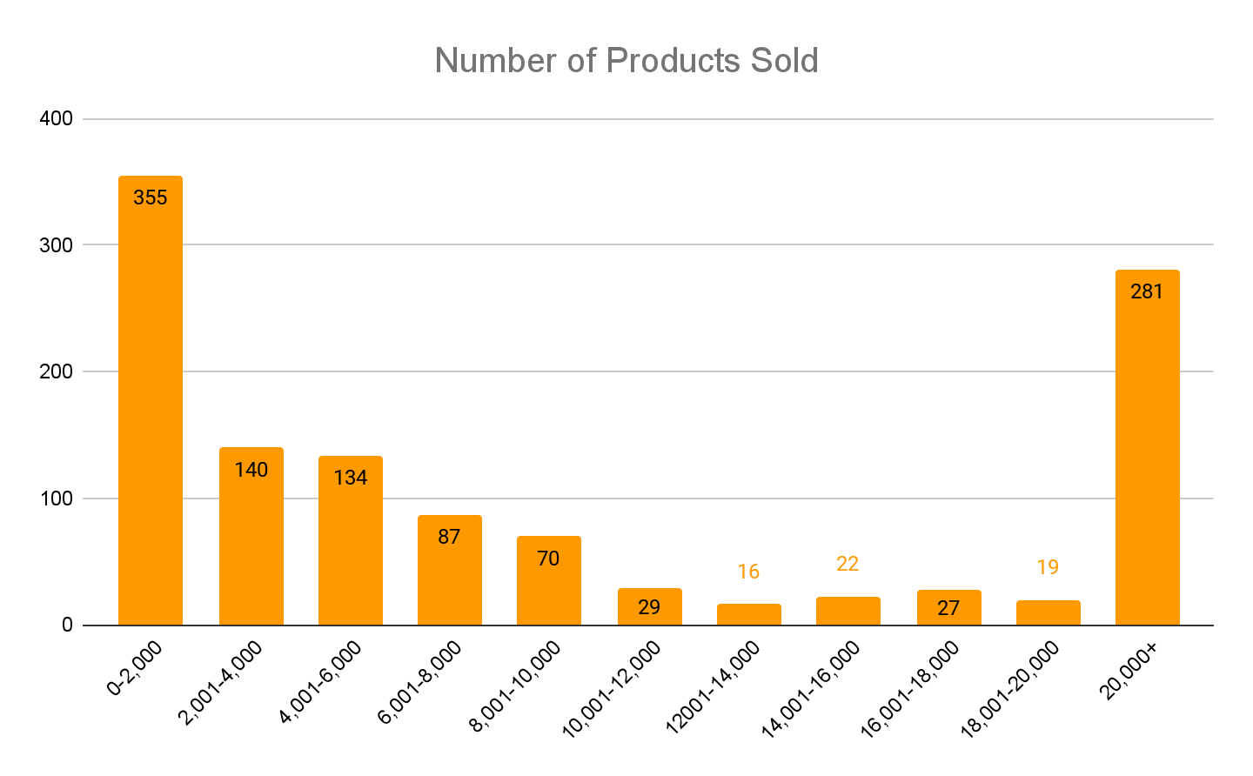
EDA - Sales

Slide 9
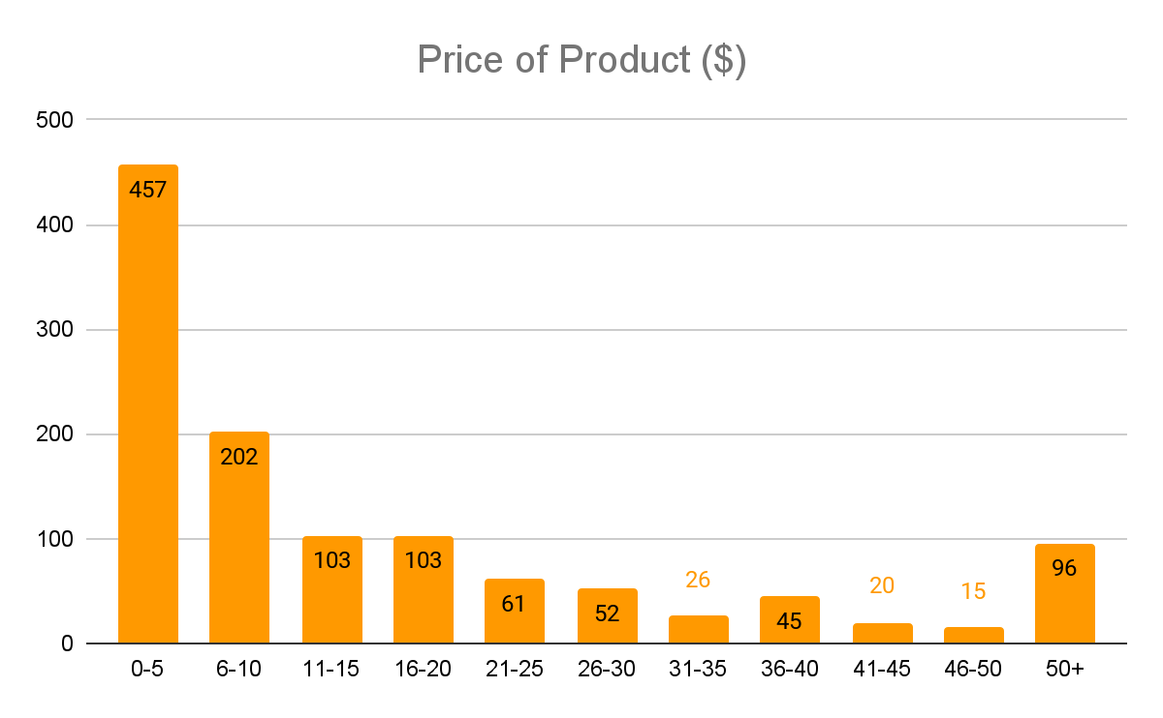
EDA - Price

Slide 10
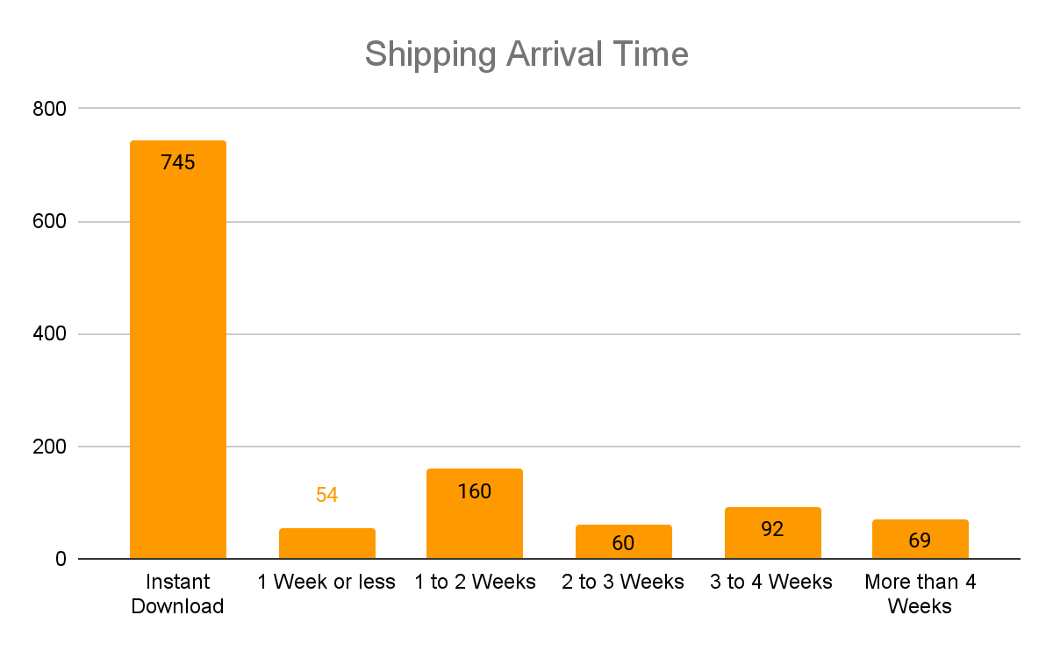
EDA - Shipping Arrival

Slide 11
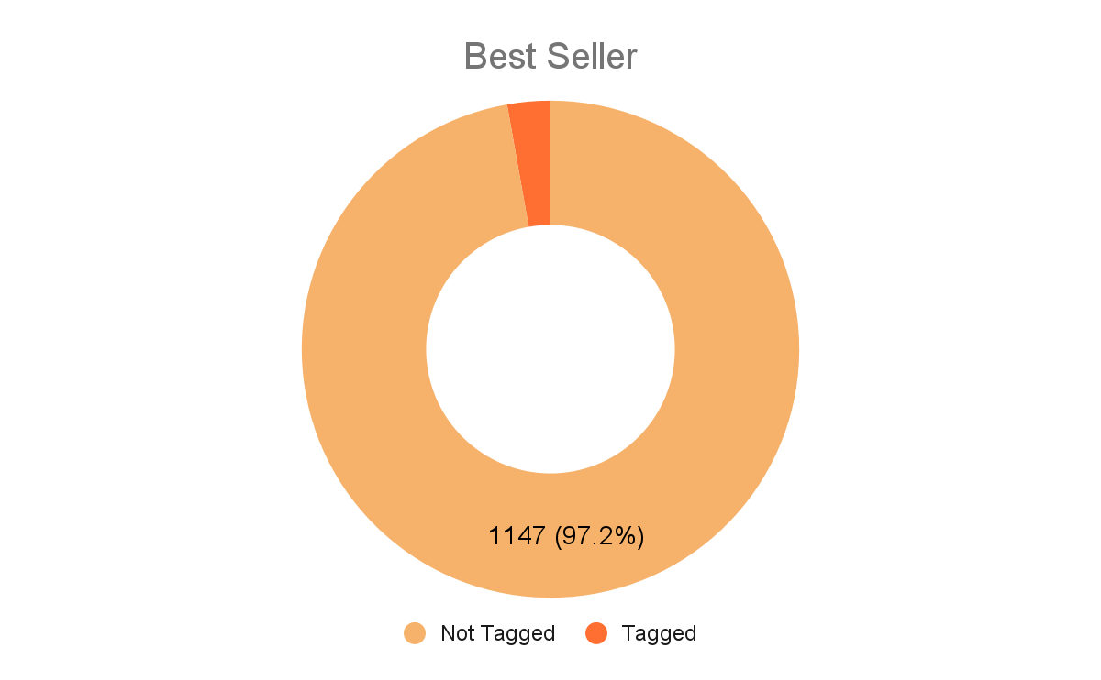
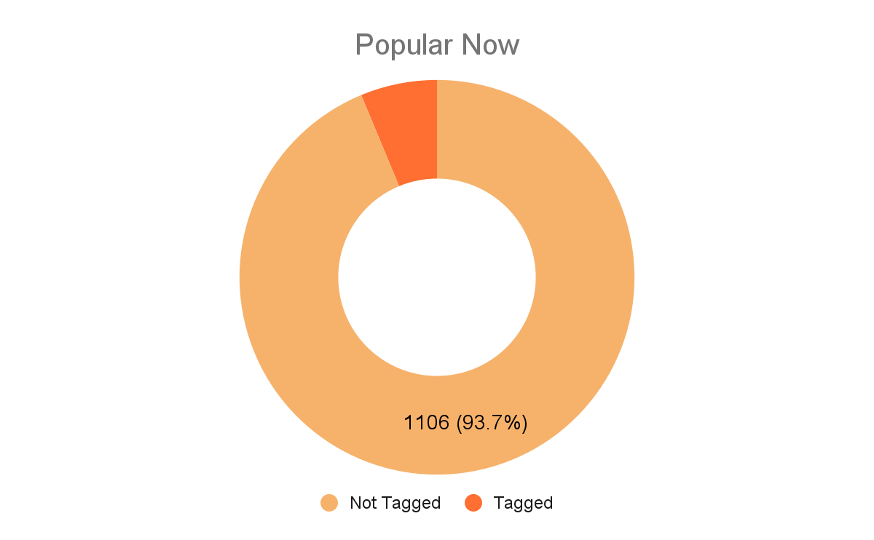
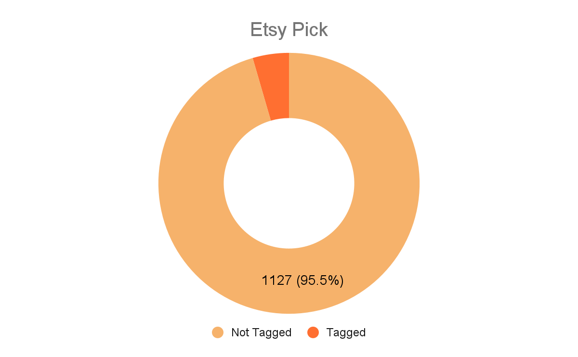
EDA - Highlights

Slide 12
Analysis

Slide 13
Overview
Models & purposes
Linear regression
Uncover any direct relationships with sales count and the variables, and look at their coefficients and p-value
K-Means
Cluster to see if there is similarity within listings in relation to sales count, that maybe we can form sub-groups with more relevant features as well as create recommendations

Slide 14
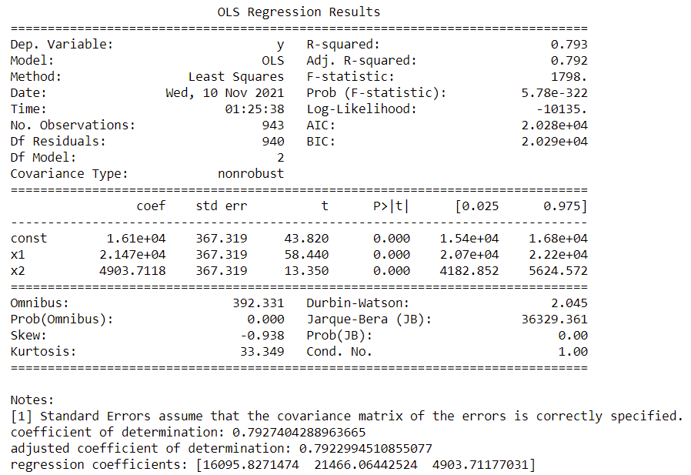
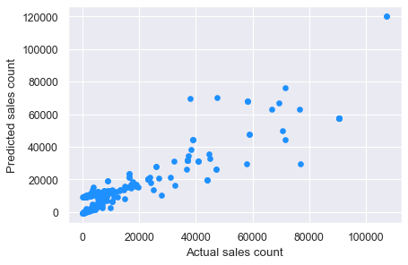
Linear Regression Outcomes
Predictors considered
Price_current, review_count, store_rating, discount, instant_download, tagged
Significant predictors
review_count, instant_download

Slide 15
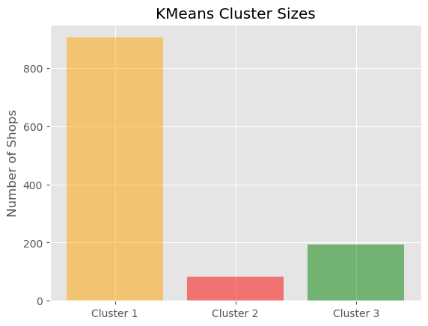
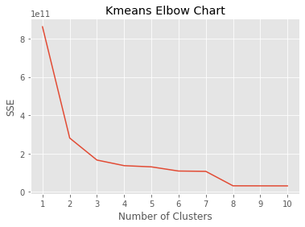
K-Means - Clustering

Slide 16
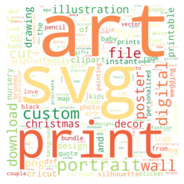

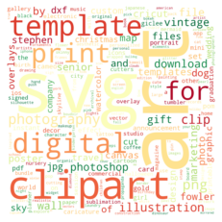
K-Means - Word Clouds
Cluster 1
Cluster 2
Cluster 3

Slide 17
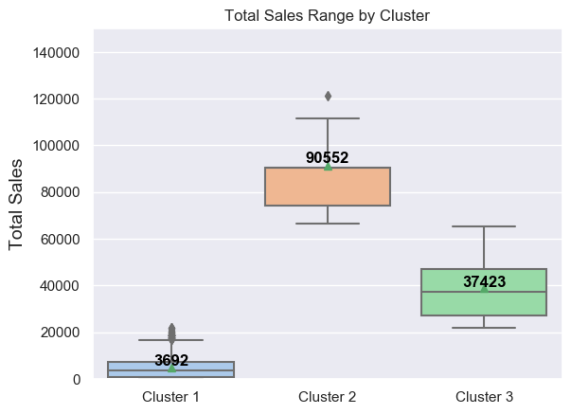
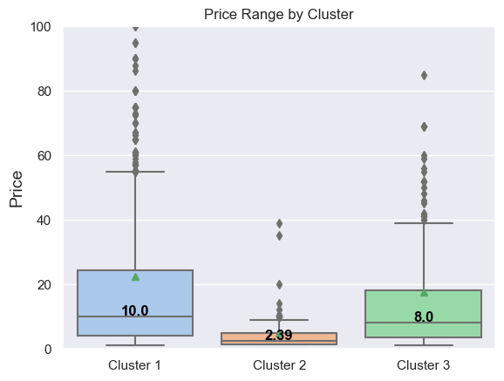
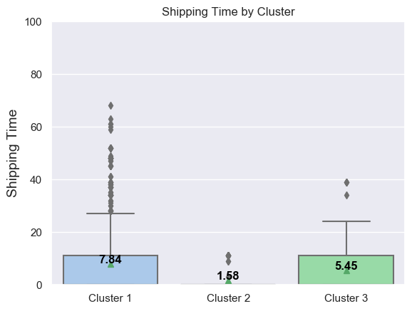
K-Means - Analysis

Slide 18
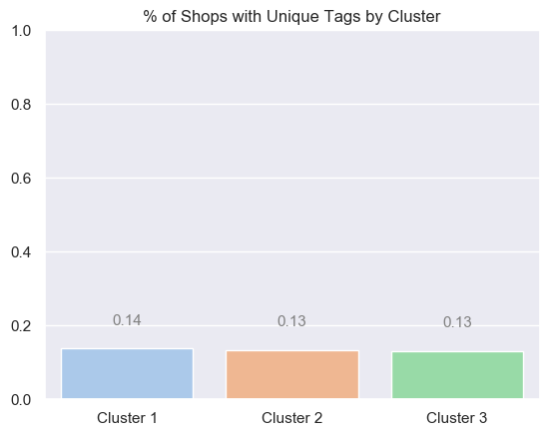
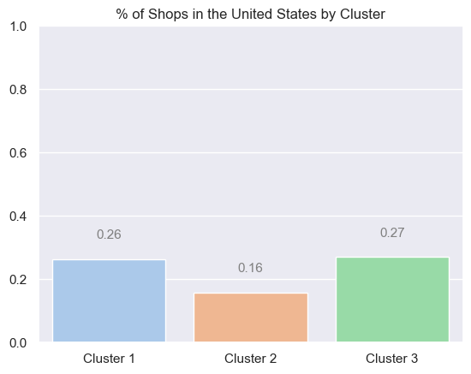
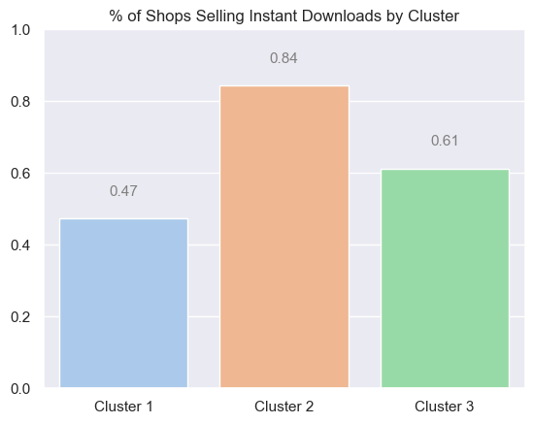
K-Means - Analysis

Slide 19
Takeaways
1.
Reviews matters
2.
Digital is preferred
3.
Know your audience

Slide 20
Conclusion

Slide 21
Recommendations
Actions
Increase Reviews
Follow-up nudges:: email and marketing campaigns: “hey don’t forget to leave a review!”
Incentivize reviews: leave a review, get x% off your next order
Increase Presence
Promotional campaigns: partnering with other artists, channels, etc for increasing awareness
Keyword Selection: with further research, use the clustering algorithm to leverage your product as a recommendation
Brand Positioning
K-Means to scope out the competition: understand the other sellers in your cluster and position your brand accordingly
Leverage success factors: we found that digital is quite popular in sales, see what is working for other sellers and use this

Slide 22
Risks
1.
Dataset problems
2.
Multicollinearity
3.
Etsy’s realm of control
Notes:
Linear regression standard error was very high, this points to an opportunity to improve our dataset. With more data from various categories, more time to research and clean the dataset, we could decrease this standard error.
Multicollinearity within the dataset since it is from the same subcategory, there is a lot of overlap within the products. To improve this, we could expand to more categories in Etsy that differentiate itself to better form clusters and prediction.
Etsy’s realm of control, at the end of the day this is Etsy’s domain. To better suggest how to help artists on Etsy, we would need more information on Etsy’s backend and how they rank seller’s, and insight on their algorithm itself.

Slide 23
Appendix

Slide 24
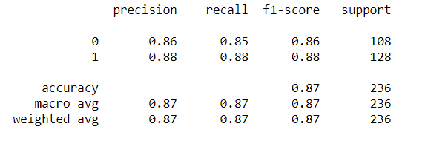
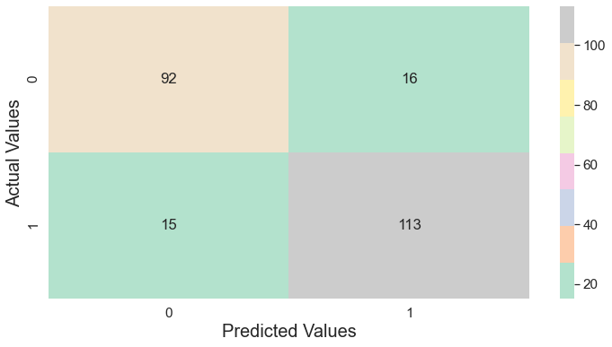
Logistic regression accuracy
We performed logistic regression on instant_downloads to measure the accurate predictability of instant downloads.
Classification report
Confusion matrix

Slide 25
Model exploration and challenges
Classification
on highlight column (highlights the product type e.g., digital, handmade etc)
No actionable insights achieved
Classification
on Extra_Status column (Bestseller, Etsy’s pick, popular now)
86% line items not tagged; not enough data

