Slide 1

National Institute of technology Raipur
Minor project presentation
Joint mode selection and resource allocation for hcran
Submitted to | Submitted by
Dr Pavan Kumar Mishra | Amit Porwal (18118006)
 | Somya Srivastava (18118080)
 | Vaibhav Yadav (18118084)

Slide 2
Heterogeneous Cloud Radio Access Network (H-CRAN)
Basic RAN Architecture –
Antennas
Radios
Baseband units (BBUs)
Incorporation of Cloud Computing –
Baseband Unit Pool
Remote Radio Head Network
Fronthaul or Transport Network
Inclusion of Heterogeneous Networks (HetNets)

Slide 3
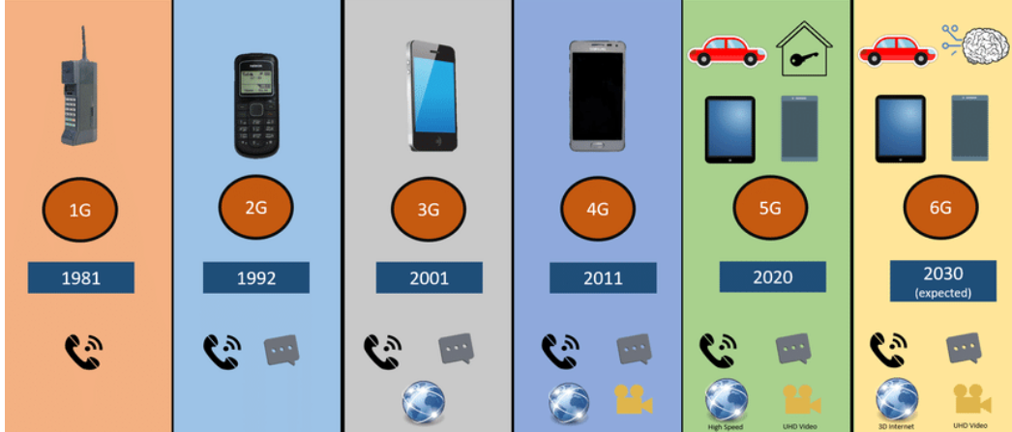
Evolution of Technology over time
1G Developed in 1980 and completed by 1990s
Based on analog systems, speed upto 2.4 kbps
2G Developed in 1992 ,Based on digital systems ,
speed upto 64 kbps.
3G Developed in between late 1990s and 2000s,
speed upto 125kbps to 2Mbps
4G Developed in 2010 , speed upto 100 Mbps
5G Major phase of technology currently improving, speed upto 1 Gbps

Slide 4
Need of H-CRAN
Challenges in implementation of modern networks –
Use of multiple small antennas and base stations
Frequency band and availability of spectrum
Convoluted Architecture
H-CRAN offers –
Spectral efficiency
Energy efficiency
Handling the convoluted architecture
More closely resembles a practical implementation
Offloading workload

Slide 5
Types of Users
Device to Device (D2D) –
Direct Communication between two mobile users
Without traversing the Base Station (BS)
Can occur on unlicensed spectrum
Cellular User –
Conventional method
All communications go though BS
Centralised and controlled

Slide 6
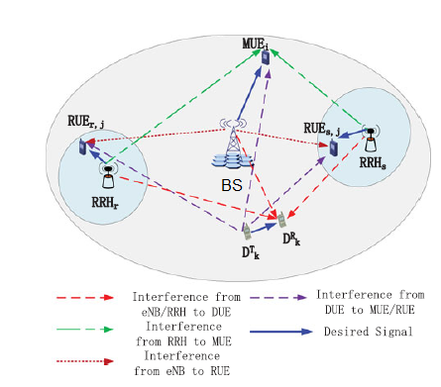
SYSTEM MODEL
We have considered one BS
all are assumed to be distributed randomly within the coverage of BS (macro cell).

Slide 7
Major challenges
RRM algorithms for HCRAN are developed with increasing network capacity, improving reliability, minimizing total transmit power, or protecting cellular links from interference
CHALLENGES ARE ENLISTED :
Mode Selection(MS): Determines whether D2D candidates in the proximity of each other should communicate in direct mode using the D2D link or in cellular mode
Power Control (PC): This is an efficient solution to decrease the interference for D2D underlaid cellular network, so that overall performance of system increases.
Pairing: is a concept which exists only when D2D links are reusing cellular resources
Resource Allocation: is a process of selecting radio resources for each cellular and D2D link, which can be done jointly with MS and pairing

Slide 8
Mode Selection Using Machine learning techniques
Mode Selection : Depending upon the distance in between the transmitter and the receiver , they can either be in the D2D mode or in the cellular mode. In the current work we have used centralized base station which decides the mode.
Advantage of the D2D :
1 D2D can enhance energy efficiency (EE), since the mobile terminals use less transmission power when communicating directly between each other.
2)D2D communication can also reduce communication delay and increase network throughput, due to its short distance communication.

Slide 9
Unsupervised learning technique
K means algorithm is an iterative algorithm that tries to partition the dataset into K pre-defined distinct non-overlapping subgroups (clusters) where each data point belongs to only one group.
Fuzzy ART is an unsupervised learning clustering algorithm. It is a type of Adaptive Resonance Theory (ART) network approach, which similarly to K-Means algorithm uses single prototypes to internally represent and dynamically adjust clusters
The DBSCAN depends on a density based concept of clusters. The basic ideology applied in DBSCAN is that a point belongs to a cluster if it lies in close proximity to many points from that cluster
Minimum Entropy Clustering (MEC) algorithm, depends on the minimization of the conditional entropy of clusters . MEC is an iterative algorithm starting with an initial partition given by any other clustering methods except the random initialization.

Slide 10
Resource allocation
In order to enhance the macro system’s throughput, efficient D2D communication is employed, results in increase in the network efficiency. Apart, network efficiency (throughput, energy efficiency, spectrum efficiency and delay) can be significantly improved through D2D communication, where nearby users can directly communicate with each other without referring to BS. The nearby devices reuse the cellular user’s resource block, thus resulting in performance degradation through interference. Therefore, to improve the throughput, a proper and efficient resource allocation scheme is required.

Slide 11
Resource Allocation using Machine Learning
Artificial Neural Networks –
Large Number of neurons
Hidden Layers and activation function
Allocating Remote Radio Heads to Users –
Location
Use of Resource Blocks
Allocating Baseband units to Remote Radio Heads –
Priority Based
Lowest Number of Resource Blocks

Slide 12
Resource Allocation using Machine Learning (continued)
Generation of Dataset –
Grid of fixed size
Putting users at random locations
Putting Remote Radio Heads in random locations
Training –
Utilising the randomly generated dataset
Validation –
Utilising the system to optimise unseen part of dataset

Slide 13
RESOURCE ALLOCATION USING OPTIMIZATION
Prospective enablers of 5G
HCRAN includes macro base station (BS) and femto/pico/small BSs, incorporates cloud computing and supports D2D communication .
Seven cell architecture used.
D2D communication using Cellular User’s resource block, without referring Base Station
To improve the throughput and efficient D2D communication, a proper and efficient resource allocation scheme is required.

Slide 14
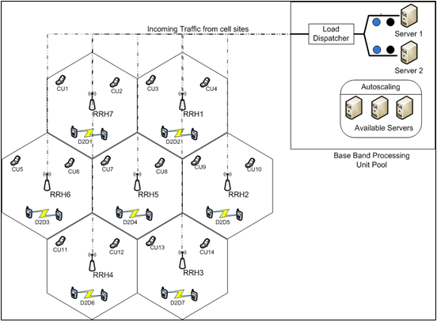
7 CELL ARCHITECHTURE of HCRAN
MAIN GOALS
Assign cellular user’s resource block to D2D user in one to many fashion
Optimize the resource allocation scheme using swarm intelligent based TLBO algorithm.

Slide 15
OPTIMISATION TECHNIQUE
TLBO (Teaching Learning Based Optimization) BASED RESOURCE ALLOCATION SCHEME
TLBO is also a population-based algorithm aiming to reach the global optimum solution from the set of solutions
Teacher and Learner
The teacher influences the learner’s output
Apart from the teacher, the learners can also interact to obtain a better outcome.
Two elementary phases
Teaching phase
Learning phase

Slide 16
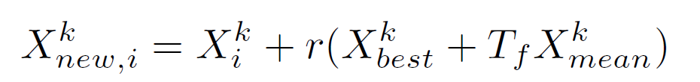
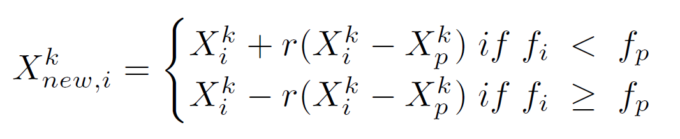
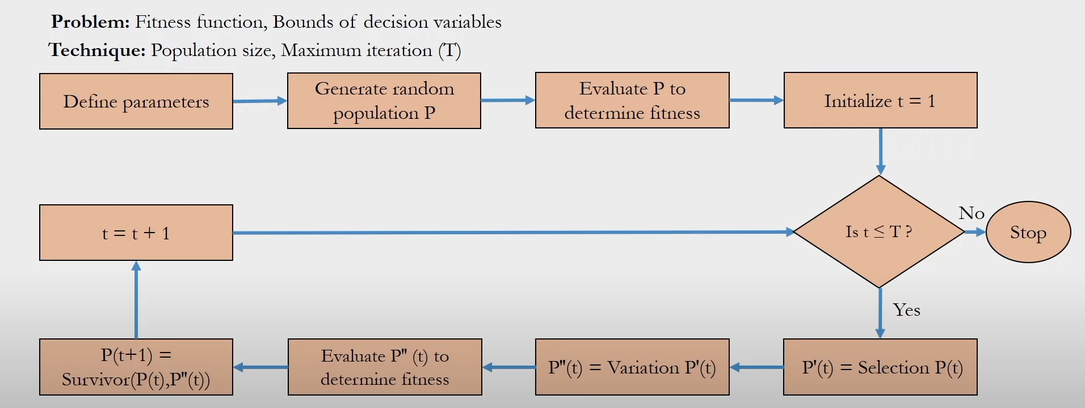
TEACHER’S PHASE
LEARNERS’S PHASE
FLOW CHART

