Slide 2
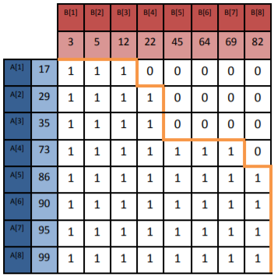
Merge Matrix
Construction of Matrix:
Consider two sorted arrays, A and B, with |A| and |B| elements, respectively.
To Merge the two arrays: in each step, pick the smallest (regardless of array) yet-unused array element. Alongside this process, we construct the Merge Path.

Slide 3
Merge Matrix
Construction of Matrix:
Start in the upper left corner of the grid, i.e., at the upper left corner of M[1,1]. If A[1]>B[1], move one position to the right; else move one position downward. Continue similarly as follows: consider matrix position (i,j) whose upper left corner is the current end of the merge path: if A[i]>B[j], move one position to the right and increase j; else move one position downward and increase i; having reached the right or bottom edge of the grid, proceed in the only possible direction.
Traversing a Merge Path from beginning to end, picking in each rightward step the smallest yet-unused element of B, and in each downward step the smallest yet-unused element of A, yields the desired merger.

Slide 4
Merge Matrix
Observations:
Any contiguous segment of a Merge Path is composed of a contiguous sequence of elements of A and of a contiguous sequence of elements of B
Given two non-overlapping segments of a merge path, all array elements composing the later segment are greater than or equal to all those in the earlier segment

Slide 5
Merge Matrix
Observations:
Any partitioning of a given Merge Path of input arrays A and B into non-overlapping segments that jointly comprise the entire path, followed by the independent merger of each corresponding sub-array pair and the concatenation of the results in the order of the corresponding Merge-Path segment produces a single sorted array comprising all the elements of A and B
Partitioning a Merge Path into equisized segments and merging the corresponding array pairs in parallel balances the load among the merging processors.

Slide 6
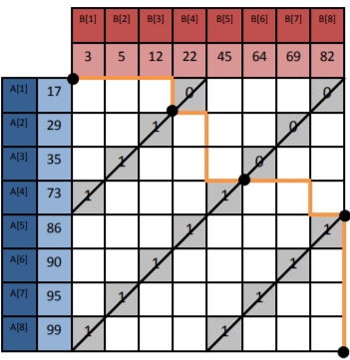
Merge Path and Cross Diagonals
Regardless of the route followed by a Merge Path, and thus regardless of the contents of A and B, the i’th point along a Merge Path lies on the i’th cross diagonal of the grid and thus of the Merge Matrix M.
Partitioning a given merge path into p equisized contiguous segments is equivalent to finding its intersection points with p-1 equispaced cross diagonals of M
The entries along any cross diagonal of M form a monotonically nonincreasing sequence

Slide 7
Merge Path and Cross Diagonals
Given sorted input arrays A and B, they can be partitioned into p pairs of sub-arrays corresponding to p equisized segments of the corresponding merge path. The p-1 required partition points can be computed independently of one another (optionally in parallel), in at most log2(min(|A|,|B|)) steps per partition point, with neither the matrix nor the path having to actually be constructed.
Let (i, j) be the highest point on a given cross diagonal M such that M [i, j − 1] = 1 if exists, otherwise let (i, j) be the lowest point on that cross diagonal. Then, P (M) passes through (i, j).

