Slide 1
News_WhatsApp Bot

Slide 2
Problem Statement
We all know that news is very important for every citizen of the country. Getting the right news is more important than that.
So, when a person shares some news, there is a very high possibility of having an error while writing some news, or uploading the news on a social media platform.
The smallest error can create very large problems at some level.
Moreover, for journalists and news readers, they need to post the news and update the platforms with the latest news. This takes a lot of time. So, in order to make this process automatic, and reduce the errors,

Slide 3
Problem Statement
There was a need for such a system which can automatically share some news from a system (resource or website) and share it on a social media platform (like Facebook or share to some friends on WhatsApp/Instagram).
Also, for a normal user like us, many of us do not read the news daily, which is very important to be updated with the headlines of what is going in our country.
So, if we share atleast 5 news to all our important people and friends in life, it will create awareness among citizens and will have a greater tendency that our acquaintances go through the headlines daily and are updated.
Using this application, the script will automatically do this work without putting efforts to find the important news of the day and write to our friends.

Slide 4
Introduction
Our project aims to scrape all the latest news from “The Economic Times” website and share it to all the friends the user wants to share on WhatsApp.
It also takes the screenshots of the news from the website for a better understanding of the news.
All the news are scrapped parallely which gives an advantage to the project by saving a lot of overall time rather than scrapping each news serially.

Slide 5


Technologies Used
Javascript
NodeJs
Puppeteer
Selenium
Cheerio

Slide 6
Working
STEP 1: News Scrapping
It will scrape the details of the top N trending news from The Economic Times Website like headline & Link of the news and downloads the related image. Data will be stored in output.json file.
STEP 2: WhatsApp Automation
Second part of script include successfully login in WhatsApp using userdatadir module & then sharing the news one by one to all the friends which includes headline and briefing of all the news with the images of the news.

Slide 7
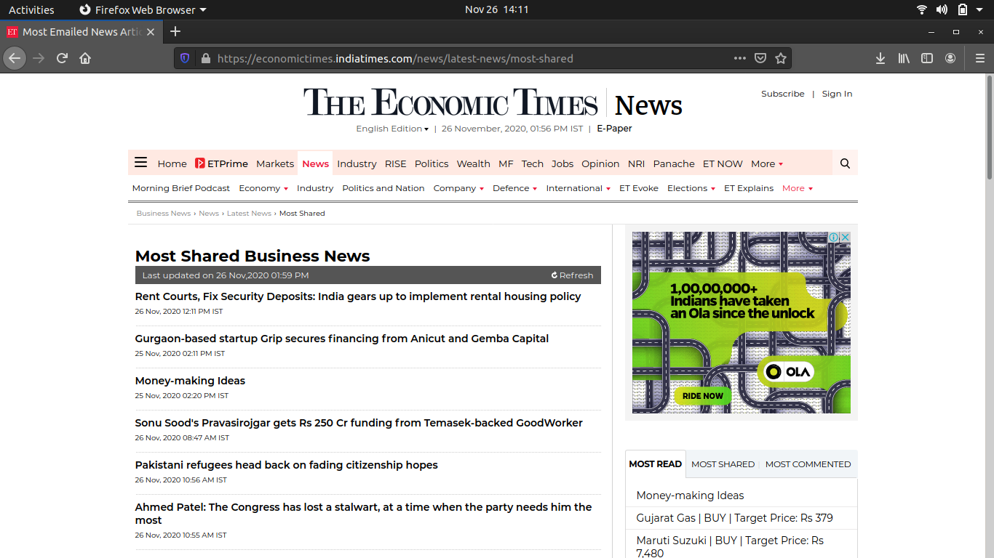

Slide 8
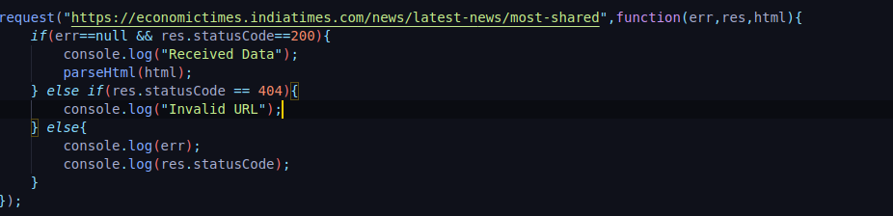

Slide 9
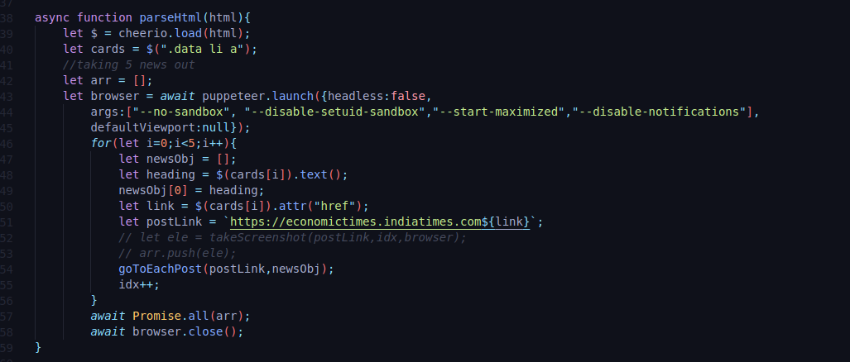

Slide 10
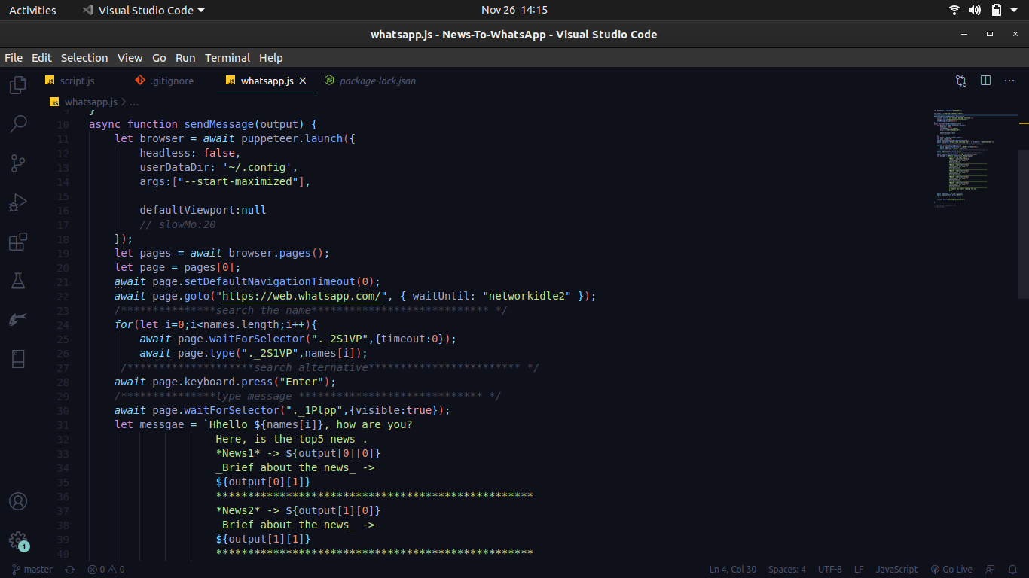

Slide 11
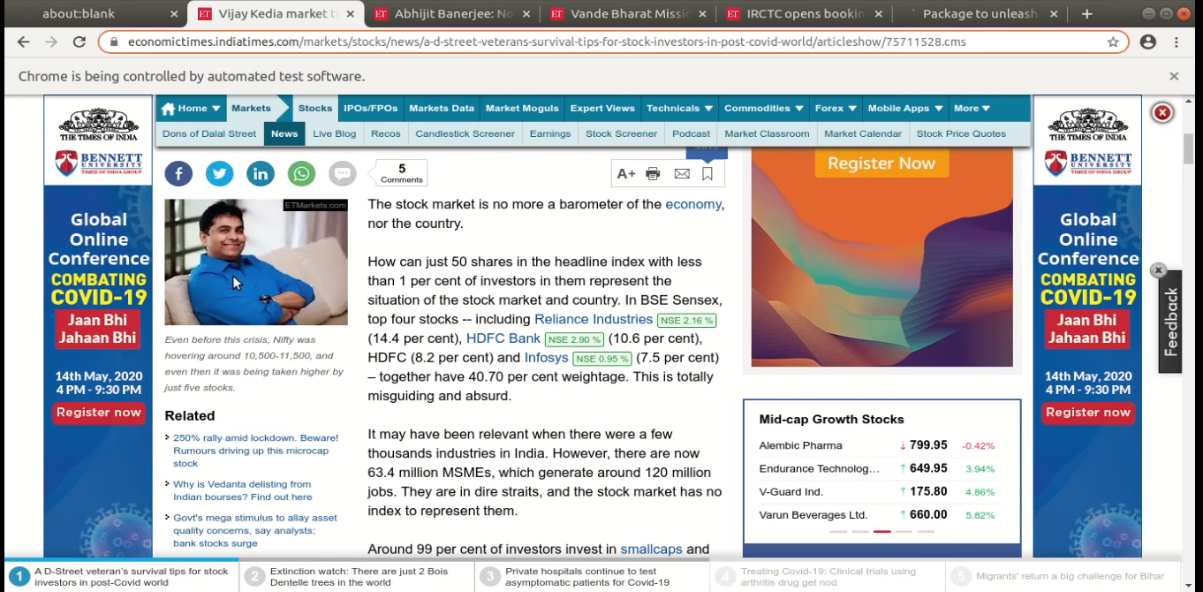

Slide 12
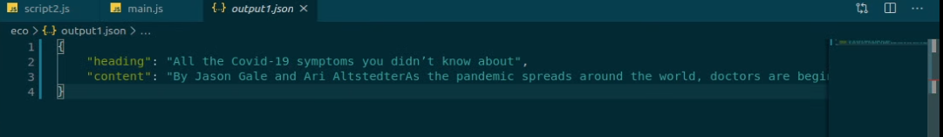

Slide 13
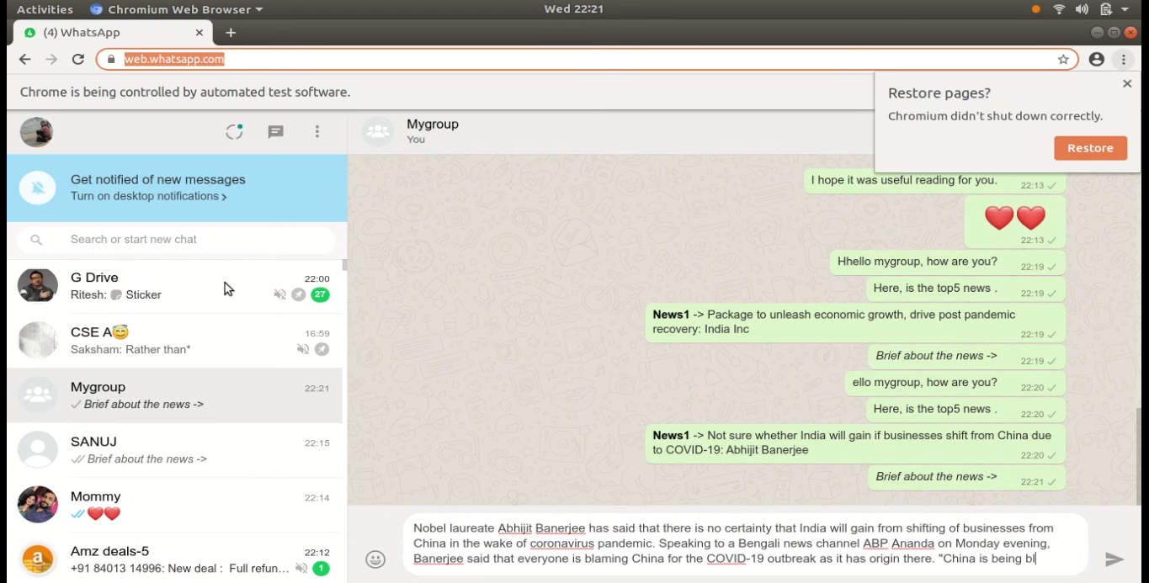
Output

Slide 14
Conclusion
The News WhatsApp Bot developed using Javascript fully meets the objectives of the system which it has been developed.
The system have been designed such that no human intervention is required after the script runs.
We have successfully designed an application which can quickly share the important facts and news to all your selected friends where a human could have taken a lot of time.

Slide 15
Future Scope
This project can be further extended in uploading and sharing news to other social media platforms.
We can add more features to the application as required by the user.
The news extraction bot can be useful to people like journalists, students preparing for ISA and UPSC exams.
They may need to get all the briefing and important news from different websites and resources to go through in lesser time. So, all they need to do is run the script, which will give them data quickly as it runs parallely through all the links on the websites.
We can extract information of the news related to one particular field like sports, crime, jobs vacancies , etc. These features will be very beneficial and can give surprising results.

Slide 16
Thank You!!

