Slide 1
Music Playlist Analyzer Project
Somya Khurana
12507049
MSc Data Science (D2538)
Department of Computer Applications
Roll No : RD2538A02

Slide 2
Problem Statement & Objectives
Problem: Manual playlist management lacks analytics and personalization.
Objectives:
Build a system to manage songs, playlists, and users.
Provide analytics like top artists, genres, playlist stats.
Improve music discovery through data insights.

Slide 3
Proposed Solution / System Overview
A web-based music analytics platform.
Features playlist management, song search, analytics dashboards.
Uses SQL + Flask + Matplotlib for visual insights.

Slide 4
System Architecture / Design
Components: Database, Backend (Flask), Frontend (HTML/CSS), Analytics Engine.
Workflow: User → Flask App → SQL Queries → Analytics → Visual Output.
Tech Stack: Python, Flask, MySQL, Matplotlib, Bootstrap.

Slide 5
Implementation & Key Features
Search Songs
Playlist creation, add/remove songs
Analytics: Top artists, genre distribution, active hours
Clean UI with Bootstrap

Slide 6
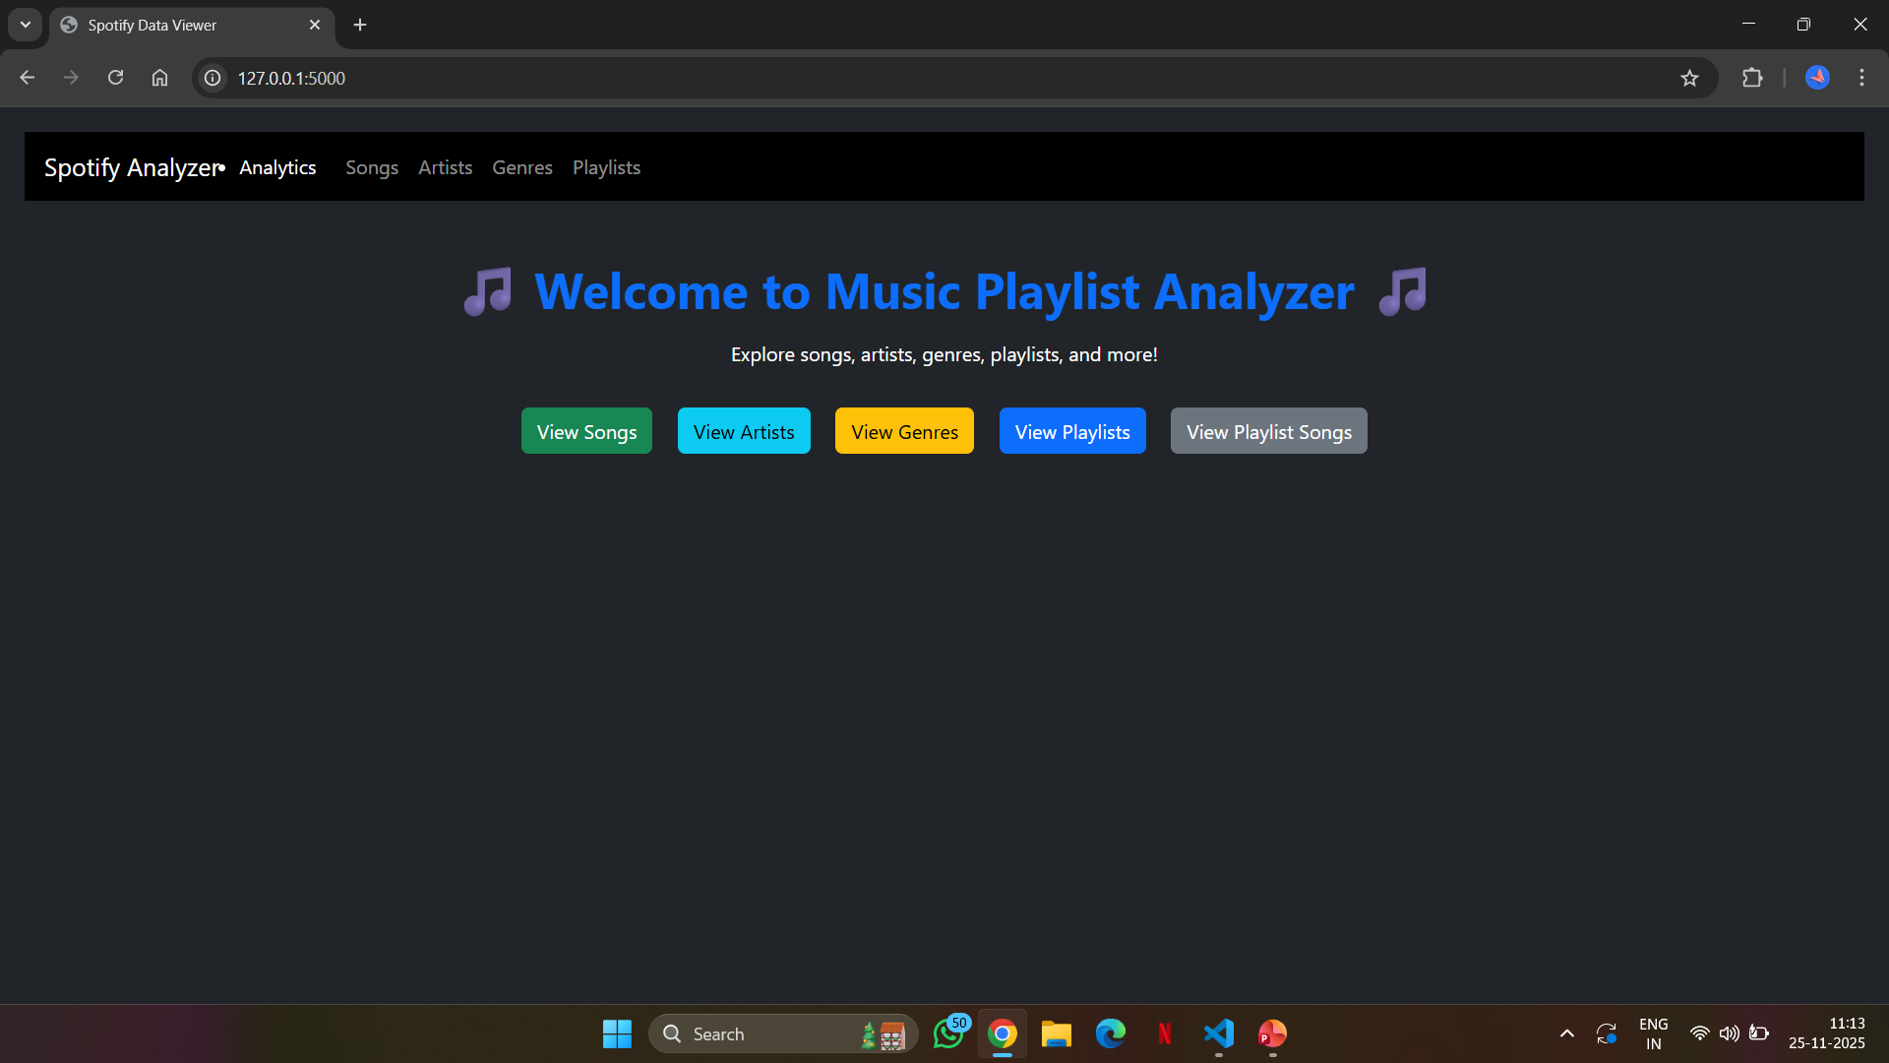
Results & Testing
Verified CRUD operations for songs/playlists.
Tested analytics outputs (graphs & tables).

Slide 7
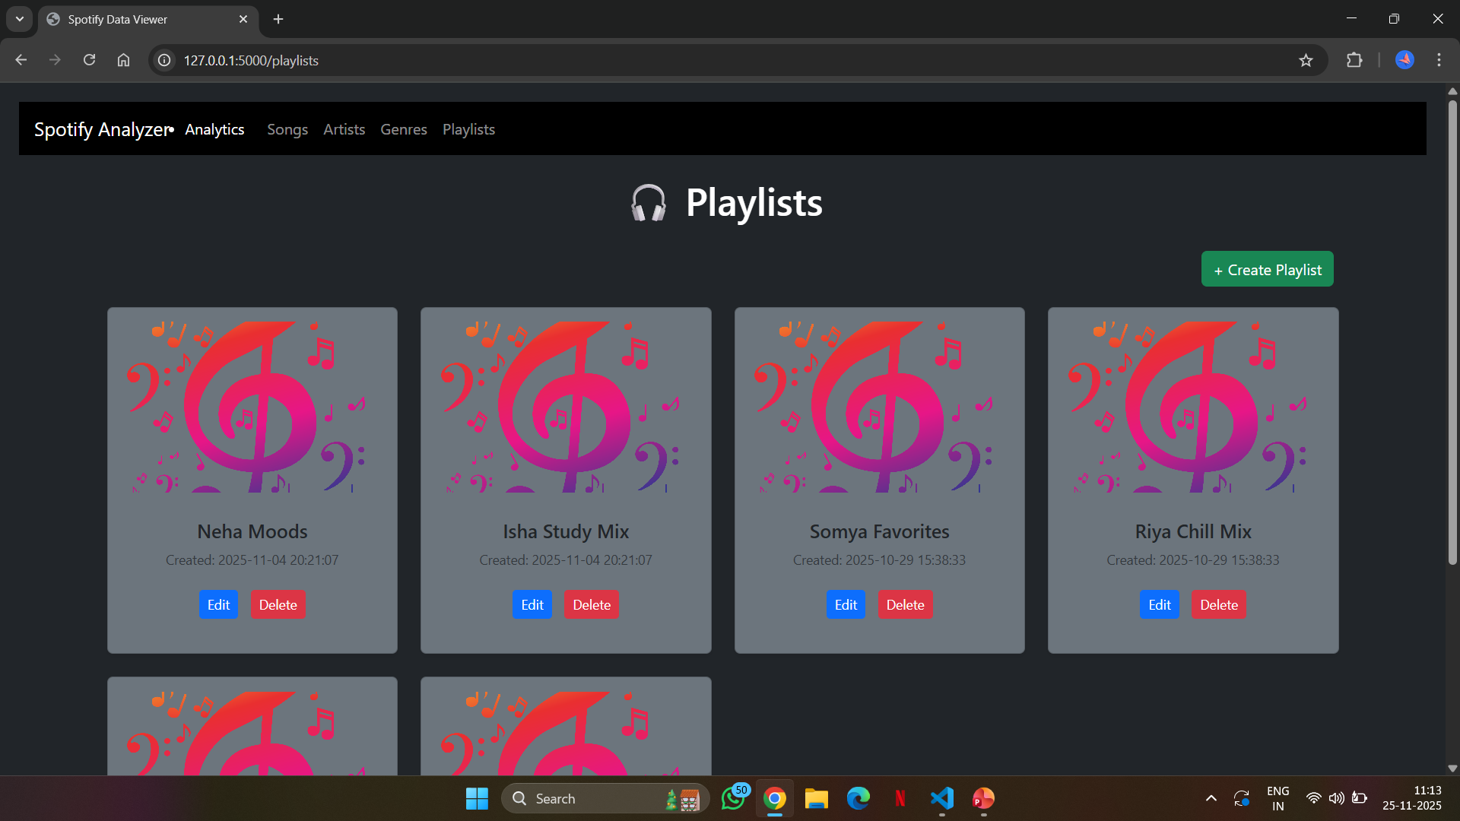
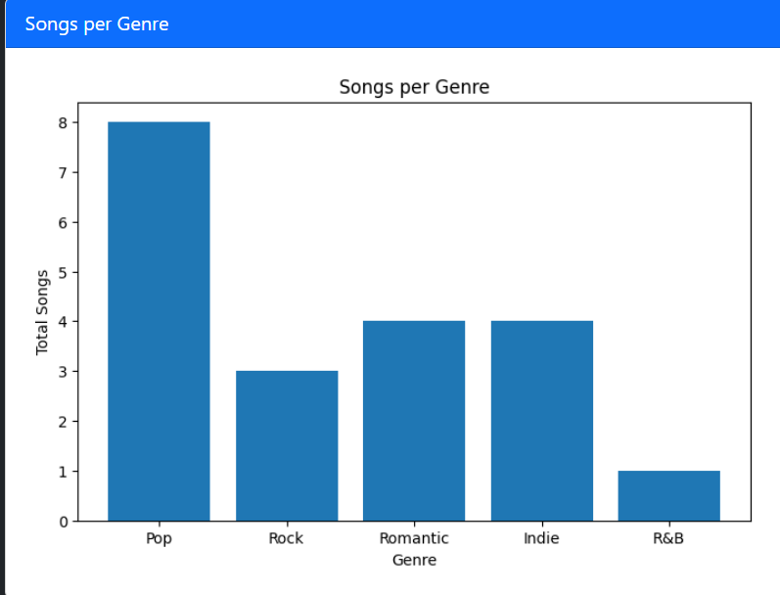
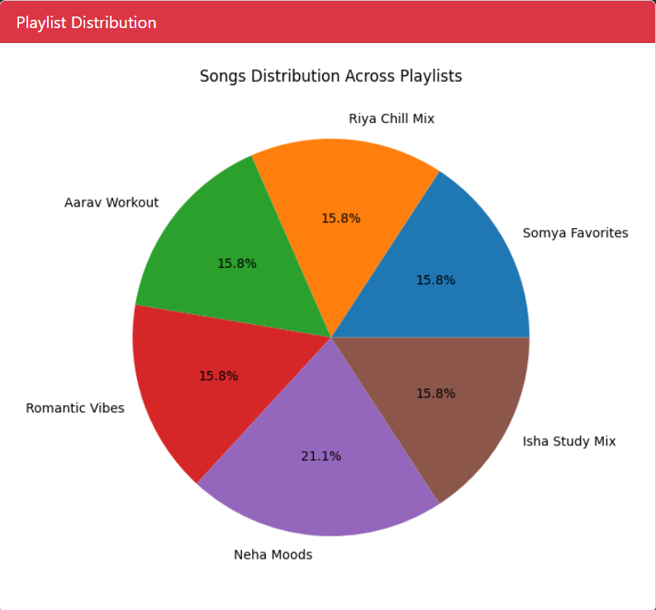
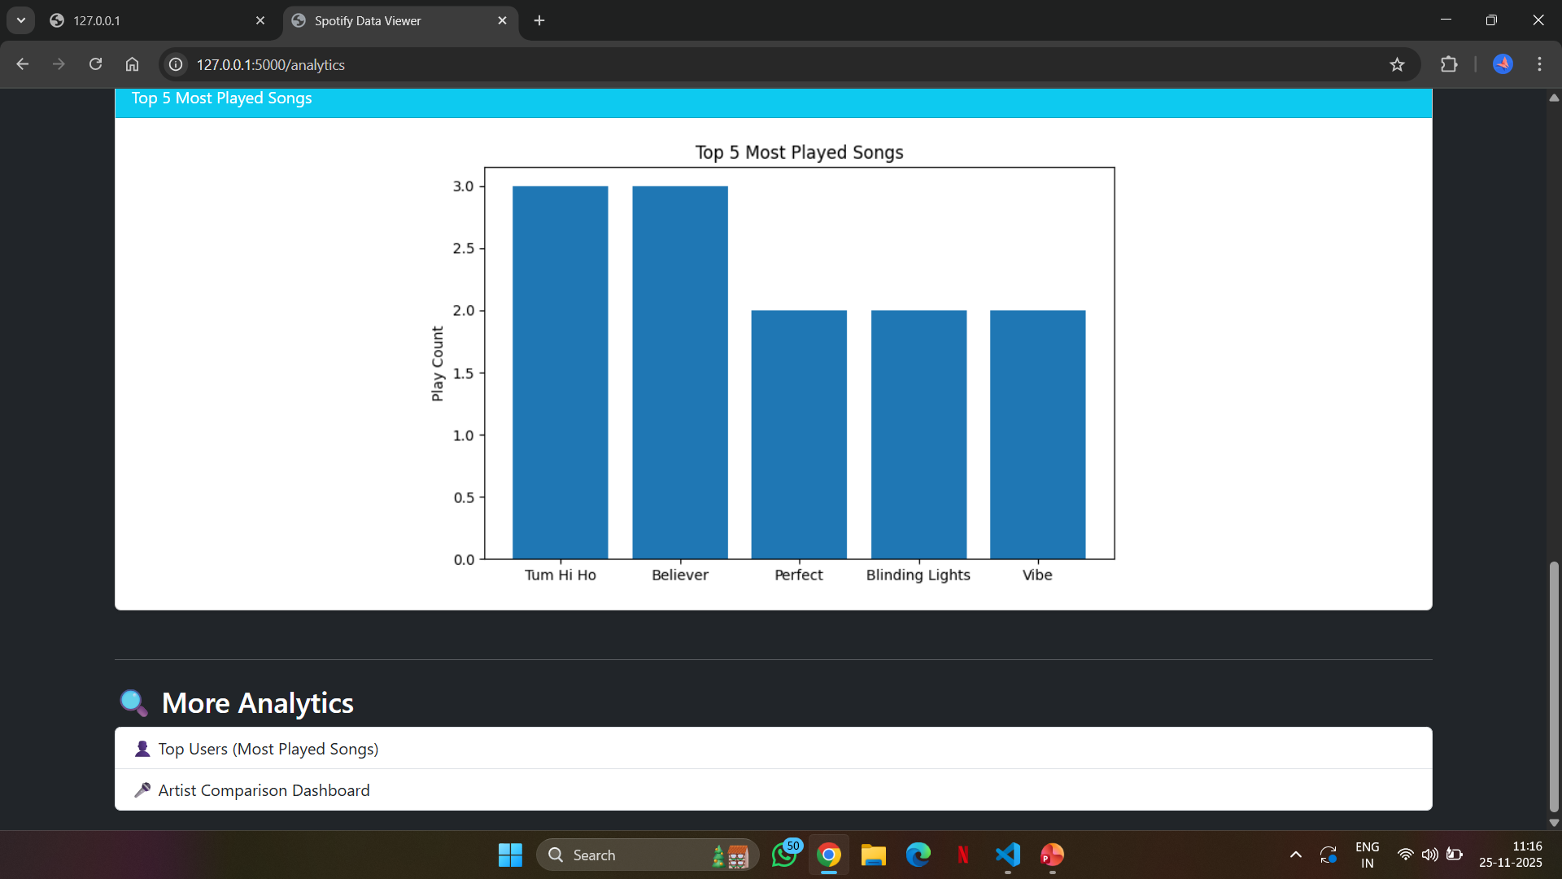

Slide 8
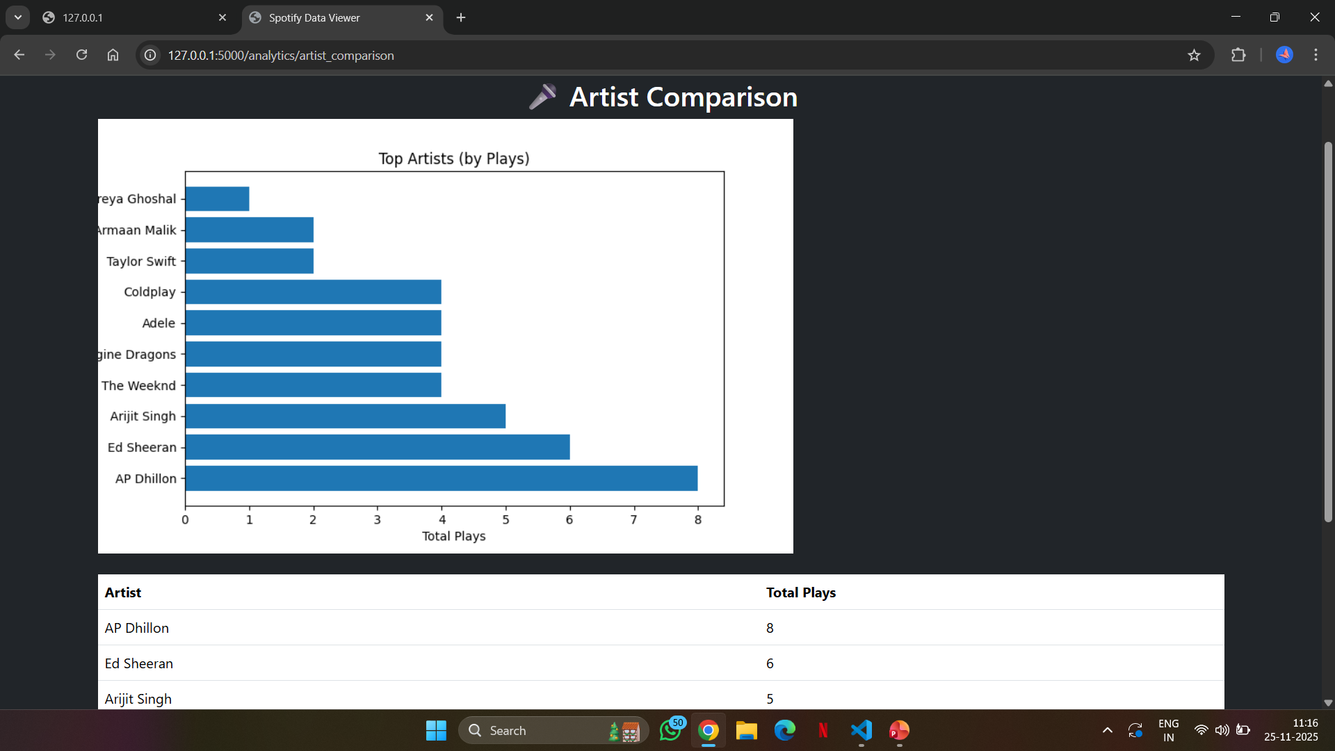

Slide 9
Challenges & Learnings
Challenges: SQL joins, graph rendering in Flask, database expansion.
Learnings: Flask routing, analytics with SQL, using Matplotlib in web apps.

Slide 10
Future Scope & Conclusion
Future Scope:
Add user recommendations
Machine learning-based playlist suggestions
Real-time streaming analytics
Conclusion: Successfully built a playlist analyzer with visualization insights.

Slide 11
thankyou

