Slide 1
Tuberculosis Detection from Chest X-Rays
Deep Learning Decision Support System using VGG16 Transfer Learning & Flask
PROJECT TEAM MEMBERS
Ishan Choudhary
25BCE10753
Khush Gupta
25BCE10038
Vidit Choudhary
25BCE10749
Saransh Mathur
25BCE10354
Somya Bhardwaj
25BCE10409

Slide 2
TUBERCULOSIS DETECTION SYSTEM
Problem Statement & Clinical Motivation
The Global Burden
• Tuberculosis (TB) is caused by Mycobacterium tuberculosis.
• It remains one of the top 2 infectious killers worldwide.
• Over 1.3 million deaths occur annually despite being treatable.
• Early, rapid screening is crucial for outbreak prevention.
The Diagnostic Bottleneck
• Frontline screening depends heavily on Chest Radiographs (CXR).
• Severe shortage of expert radiologists in rural & developing regions.
• Radiologist fatigue and subtle lesions lead to missed diagnoses.
• Sputum tests (microscopy/culture) take days or weeks for results.
Our Technical Objective
• Build an automated, rapid Computer Vision diagnostic model.
• Attain high sensitivity/recall to minimize missed positive cases.
• Provide instant confidence probabilities via a web interface.
• Empower clinics with a triage tool that works in under 200ms.

Slide 3
TUBERCULOSIS DETECTION SYSTEM
End-to-End System Workflow
1. Dataset Ingestion
2,800 balanced radiographs
(1,400 Normal / 1,400 TB)
from Kaggle benchmarks
2. Preprocessing
Resized to 150x150x3
Normalized [0.0 - 1.0]
Data Augmentation
3. Deep Learning
Pre-trained VGG16 base
GlobalAvgPool + Dense(32)
Dropout(0.4) + Sigmoid
4. Model Persistence
Trained weights saved to
tb_model.keras
Accuracy: 87.38%
5. Web API & UI
Flask REST server
Single-page frontend
Real-time probabilities

Slide 4
TUBERCULOSIS DETECTION SYSTEM
Dataset Composition & Preprocessing Pipeline
Dataset Curation & Partitioning
• Sourced from 2 Kaggle Benchmarks:
1. Chest X-Ray Dataset (4 Categories - Pritpal Singh)
2. Tuberculosis Chest X-Ray Database (Tawsifur Rahman et al.)
• Class Distribution (Perfect 50:50 Balance):
- Normal Lungs: 1,400 radiographs
- Tuberculosis-Positive: 1,400 radiographs
- Total: 2,800 images
• Stratified Split (Fixed Seed = 42):
- Training Set (70%): 1,960 images
- Validation Set (15%): 420 images
- Held-out Test Set (15%): 420 images
Image Normalization & Augmentation
• Image Format: Lossless PNG (512x512 raw)
- Prevents lossy JPEG artifacts that obscure lung lesions.
• Tensor Resizing & Scaling:
- Downscaled to 150x150x3 for optimal compute efficiency.
- Divided by 255.0 to yield normalized float32 tensors [0.0 - 1.0].
• Data Augmentation Pipeline:
- Rotation Range: ±15 degrees
- Width & Height Shift: ±10%
- Zoom Range: ±10%
- Horizontal Flip: Enabled
- Prevents spatial overfitting and aids generalization.

Slide 5
TUBERCULOSIS DETECTION SYSTEM
Deep Learning Architecture: VGG16 Transfer Learning
Why Transfer Learning with VGG16?
• Pretrained Backbone: VGG16 trained on ImageNet (1.4M images) extracts deep hierarchical visual primitives.
• Layer Freezing: The 13 convolutional layers are frozen (trainable = False), retaining general visual filters while eliminating millions of gradient computations.
• Output Feature Map: Final convolution outputs a (4 x 4 x 512) tensor representation.
Custom Classification Head:
1. GlobalAveragePooling2D(): Averages each 4x4 spatial slice into a single scalar (512 features). Eliminates 93% of dense parameters vs standard Flattening.
2. Dense(32, activation='relu'): Compact fully connected layer with L2 Regularization (0.02) to penalize oversized weights.
3. Dropout(0.40): Randomly zeros 40% of activations per pass during training, eliminating co-adaptation of neurons.
4. Dense(1, activation='sigmoid'): Compresses the scalar logit into a calibrated probability between 0.0 (Normal) and 1.0 (TB).
Optimization & Loss:
• Optimizer: Adam (Learning Rate = 1.5e-4) for stable gradient steps.
• Loss Function: Binary Cross-Entropy with Label Smoothing (0.04) to avoid overconfident output spikes.

Slide 6
TUBERCULOSIS DETECTION SYSTEM
Model Performance & Quantitative Evaluation
Class | Precision | Recall | F1-Score | Support
Normal | 0.85 | 0.90 | 0.88 | 210
Tuberculosis (TB) | 0.90 | 0.84 | 0.87 | 210
Overall / Accuracy | - | - | 87.38% | 420
Confusion Matrix (420 Unseen Images)
Actual Normal:
• True Negatives (TN): 190 (Correctly identified healthy)
• False Positives (FP): 20 (Normal misclassified as TB)
Actual TB:
• False Negatives (FN): 33 (TB misclassified as Normal)
• True Positives (TP): 177 (Correctly identified TB)
Analysis:
• 367 out of 420 test cases correctly diagnosed.
• False Positives (20) prompt follow-up sputum tests safely.
• False Negatives (33) represent subtle, early lesions requiring clinician oversight.
Key Clinical Insights
• High Precision (90%) for TB: When the model predicts TB, it is correct 9 out of 10 times, minimizing false alarm strain on laboratories.
• Strong Normal Recall (90%): 9 out of 10 healthy patients are safely cleared.
• Balanced F1-Scores: 0.88 (Normal) and 0.87 (TB) confirm balanced model behavior.

Slide 7
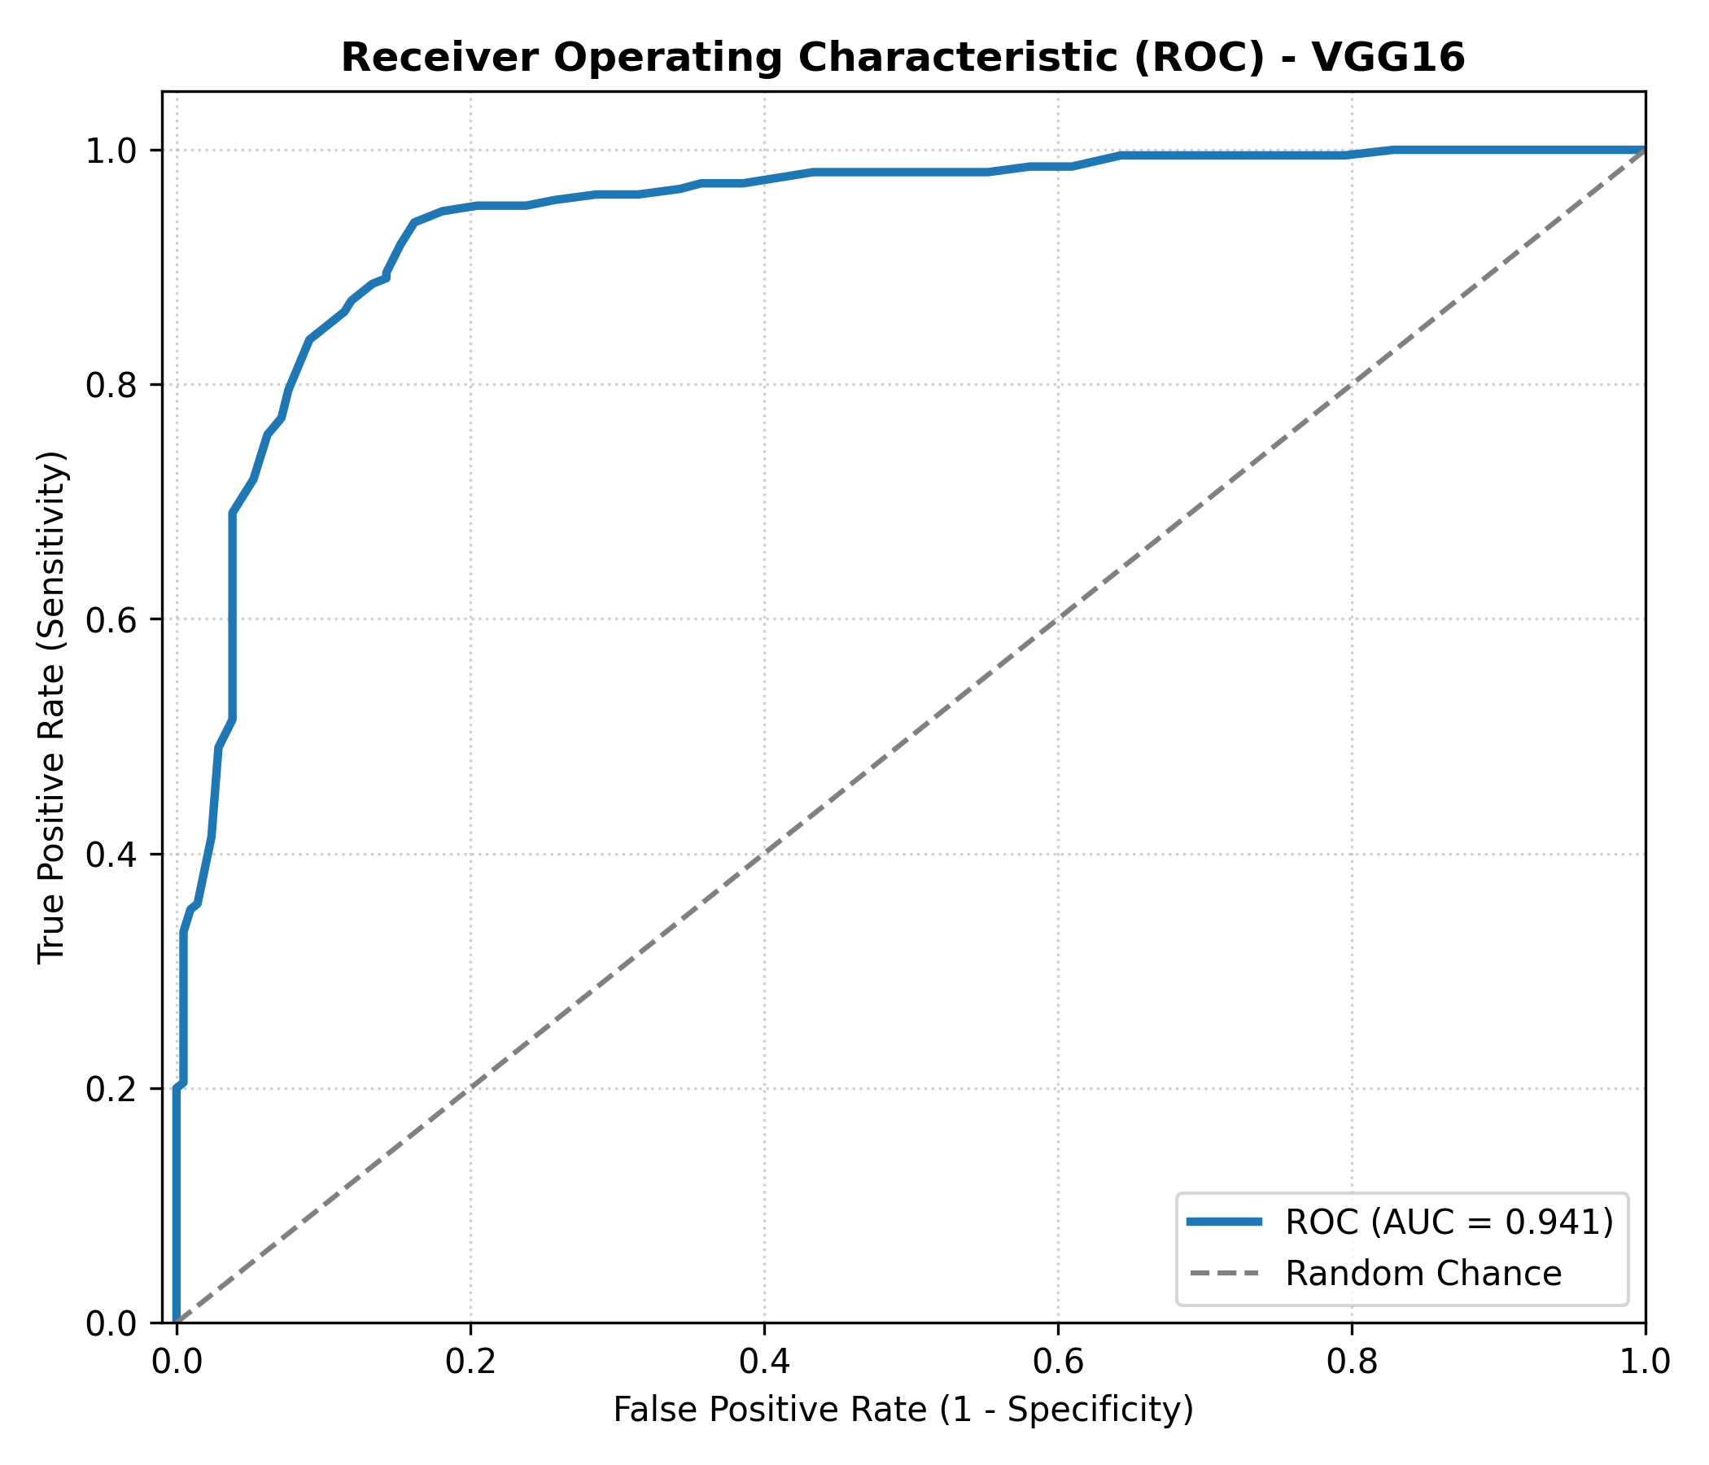
TUBERCULOSIS DETECTION SYSTEM
Receiver Operating Characteristic (ROC) & Threshold Analysis
ROC Curve Interpretation
• The ROC Curve evaluates True Positive Rate vs False Positive Rate across 200 threshold increments (0.0 to 1.0).
• Area Under the Curve (AUC):
- Demonstrates strong discriminative power well above random guess (0.50).
- Strong steepness toward the top-left corner indicates high sensitivity at low false alarm rates.
• Adjustable Decision Threshold:
- Default threshold is set at 0.50 (50%).
- In high-burden pandemic or emergency triage settings, the threshold can be dialed down to 0.40 to capture even subtle TB cases (maximizing Recall).

Slide 8
TUBERCULOSIS DETECTION SYSTEM
Web Application Architecture & UI Features
Flask Backend (app.py)
• Global Model Caching:
Loads tb_model.keras once into RAM at startup for zero-delay inference.
• API Route (/predict):
Accepts multipart/form-data images, validates file format, and preprocesses tensors in ~40ms.
• Cloud-Ready:
Dynamically binds to $PORT for deployment on Render/Gunicorn.
Frontend UI (index.html)
• Instant Local Preview:
Uses JavaScript URL.createObjectURL to display the radiograph before upload.
• Animated Confidence Gauges:
Dual green/red CSS progress bars illustrate confidence percentages.
• Diagnostic Verdict Banner:
Clear visual classification (Normal vs TB Detected) with danger-level color coding.
Client-Server Bridge
• Modern Asynchronous Fetch:
Zero page reloads via JavaScript async/await POST requests.
• Dual Endpoint Support:
Works natively with Flask (port 5000) and VS Code Live Server (port 5500).
• Error Resilience:
Clear error messaging if invalid or non-image files are submitted.

Slide 9
TUBERCULOSIS DETECTION SYSTEM
Technology Stack & Environment
Component | Technology | Role in Project
Programming Language | Python 3.10+ | Core algorithmic development, data handling, and server logic.
Deep Learning Framework | TensorFlow & Keras 3.x | Neural network definition, transfer learning, backpropagation, and weight serialization.
Pretrained CNN Backbone | VGG16 (ImageNet) | Feature extraction on radiographic spatial patterns.
Backend REST Server | Flask 3.x | Routing, request handling, file persistence, and JSON serialization.
Frontend Technologies | HTML5, CSS3, JavaScript | Client-side image preview, progress animations, asynchronous fetch API.
Image Processing | Pillow (PIL) & NumPy | Image decompression, format validation, normalization, and tensor transformation.
Visualization & Metrics | Matplotlib | Plotting ROC curve and exporting publication-ready evaluation charts.

Slide 10
TUBERCULOSIS DETECTION SYSTEM
Team Division of Work & Responsibilities
Ishan Choudhary
(25BCE10753)
Data Engineering & Pipeline
• Curated Normal & TB images from 2 Kaggle datasets.
• Removed corrupted files and balanced dataset (1,400:1,400).
• Implemented stratified 70/15/15 split.
• Designed data augmentation parameters.
Khush Gupta
(25BCE10038)
Deep Learning Architecture
• Designed transfer learning strategy with VGG16.
• Built custom head (GlobalAveragePooling2D + Dense).
• Applied L2 Regularization & 40% Dropout.
• Supervised model compilation & weight saving.
Vidit Choudhary
(25BCE10749)
Model Evaluation & Metrics
• Developed evaluate.py testing suite on 420 unseen images.
• Computed Precision, Recall, and F1-Scores.
• Generated Confusion Matrix analysis.
• Plotted the ROC Curve (roc_curve_standard.png).
Saransh Mathur
(25BCE10354)
Backend API & Integration
• Developed Flask server (app.py) & REST endpoints.
• Implemented in-memory model caching at startup.
• Built image preprocessing pipeline for uploads.
• Handled dynamic $PORT binding for deployment.
Somya Bhardwaj
(25BCE10409)
Frontend UI & Documentation
• Designed single-page UI (index.html) with image preview.
• Created animated progress bars & verdict banners.
• Authored project documentation (README.md).
• Handled Git version control & project deployment.

Slide 11
TUBERCULOSIS DETECTION SYSTEM
Limitations, Challenges & Future Scope
Current Limitations
• Binary Classification Only:
Currently classifies Normal vs TB; does not differentiate other lung diseases like Pneumonia or COVID-19.
• Heavy Model Footprint:
VGG16 model is ~59 MB, requiring high memory (700MB+ RAM) on serverless cloud tiers.
• Black-Box Predictions:
Current predictions do not visually highlight lesion bounding boxes.
Future Enhancements
• Grad-CAM Heatmaps:
Integrate Gradient-weighted Class Activation Mapping to highlight affected lung lobes directly for clinicians.
• Multi-Class Expansion:
Extend architecture to 4-class screening (Normal, TB, Viral Pneumonia, Bacterial Pneumonia).
• Mobile & Edge Optimization:
Quantize to TensorFlow Lite (TFLite) for offline screening on tablets in rural clinics.
Clinical Deployment Path
• Hospital PACS Integration:
Support native DICOM (.dcm) medical imaging format integration directly from X-ray machines.
• Physician-in-the-Loop:
Deploy as an assistive second-opinion triage tool rather than an autonomous decision maker.

Slide 12
Project Summary & Conclusion
• Successfully engineered a high-precision deep learning diagnostic pipeline achieving 87.38% test accuracy on chest radiographs.
• Solved class imbalance using a rigorously balanced dataset of 2,800 images across 2 benchmark repositories.
• Deployed a fully functional, zero-latency web application serving instantaneous inference and intuitive visual feedback.
• Provides an accessible, scalable second-opinion triage solution to assist healthcare professionals in tuberculosis screening.
Thank You! We are open to your questions.

