Slide 1

School of Computer Science & IT, DAVV, Indore
Campus Grievance Redressal System
Mid-Term Presentation-II
MCA (Integrated) IV Semester
Jan-May 2026
Submitted by Guided By
Somya Ranawat Dr. Mohit Kumar Varma

Slide 2

Aim:
To create a system for reporting, tracking, and resolving campus grievances efficiently and transparently.

Slide 3
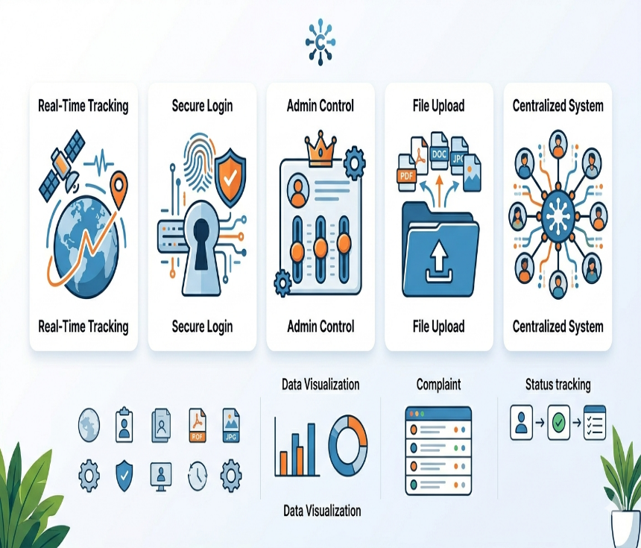
Objectives :
Real-time status tracking
Admin-based resolution system
Secure authentication
Record maintenance
Easy grievance submission
Image upload as proof

Slide 4
Functional and Non-Functional Requirements
Functional Requirements
The functional requirements describe the core features of the system:
User registration and login functionality
Submission of grievances by faculties
Categorization of complaints
Viewing and tracking complaint status
Admin dashboard for managing complaints
Updating grievance status (Pending, In Progress, Resolved)
Managing categories of complaints
Sending notifications or updates to users

Slide 5
Non-Functional Requirements
The non-functional requirements define the quality attributes of the system:
Performance: The system should respond quickly to user requests
Security: User data must be protected with proper authentication and authorization
Reliability: The system should function without failure
Usability: The interface should be user-friendly and easy to navigate
Scalability: The system should handle increasing number of users
Availability: The system should be accessible at all times

Slide 6
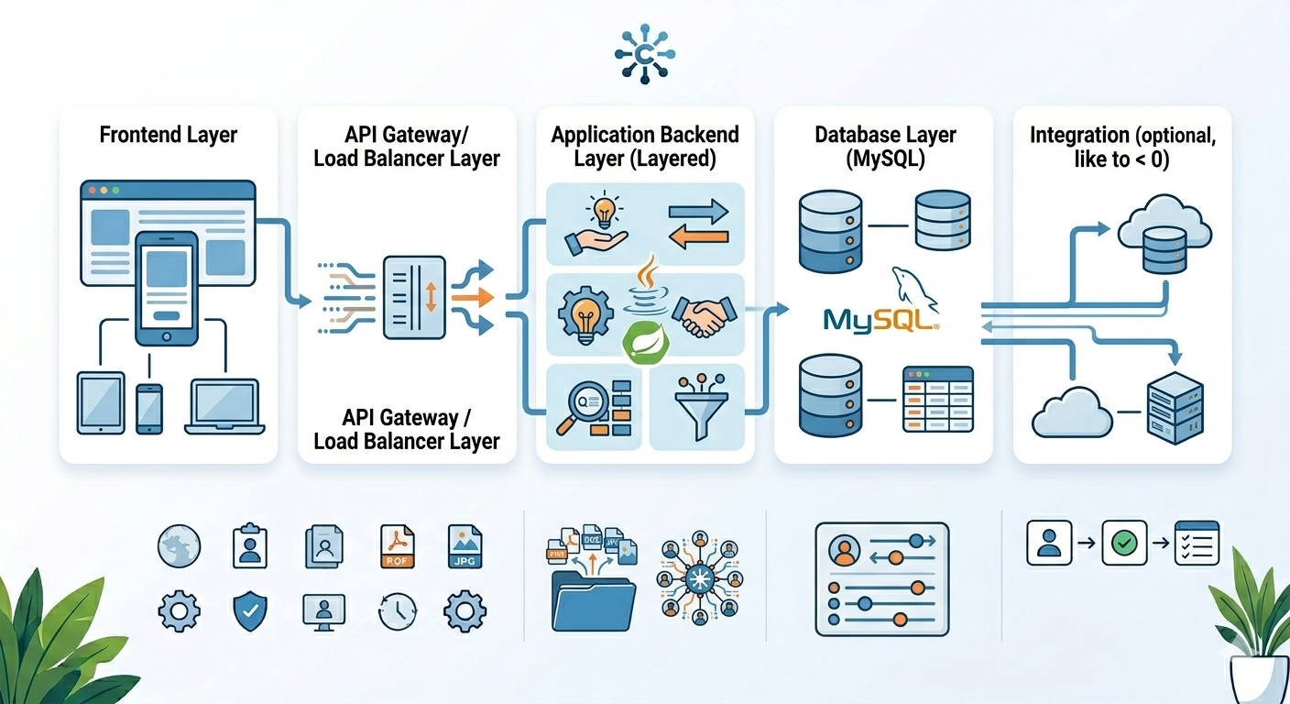
Technologies Used :
Backend: Java, Spring Boot
Database: MySQL
ORM: Hibernate (JPA)
Frontend: Thymeleaf
Security: Spring Security + JWT
Tools: Maven, Postman

Slide 7
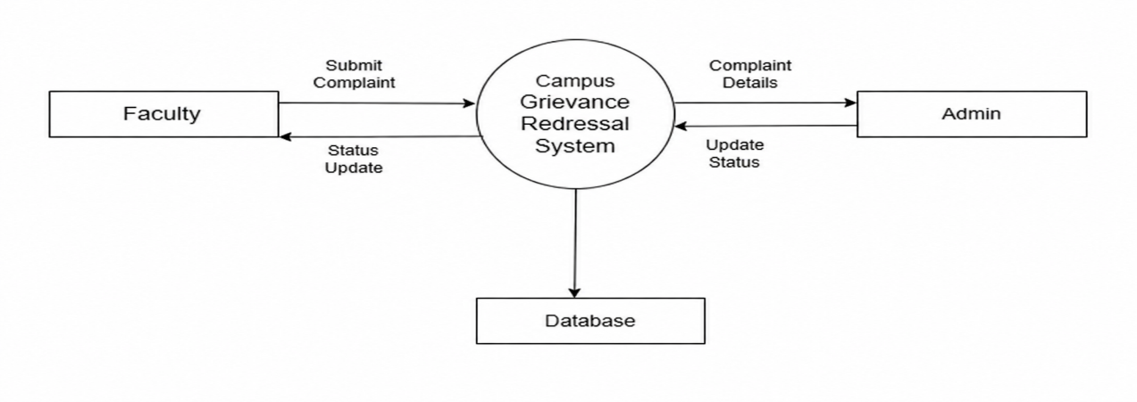
DFD(Data Flow Diagram)
DFD LEVEL 0

Slide 8
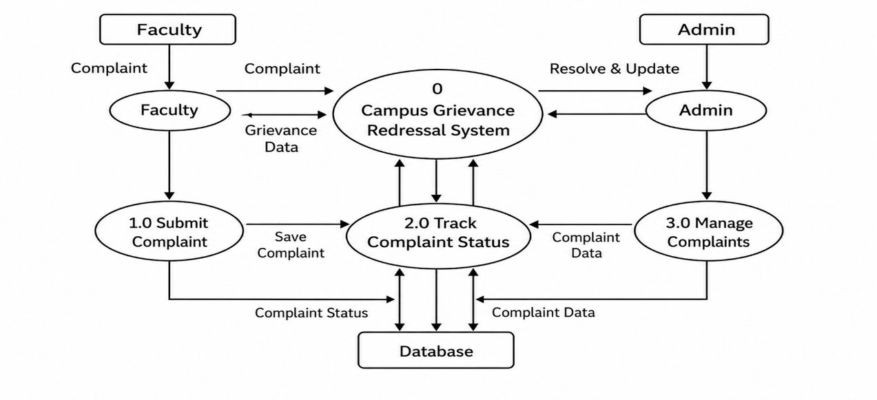
DFD LEVEL 1

Slide 9
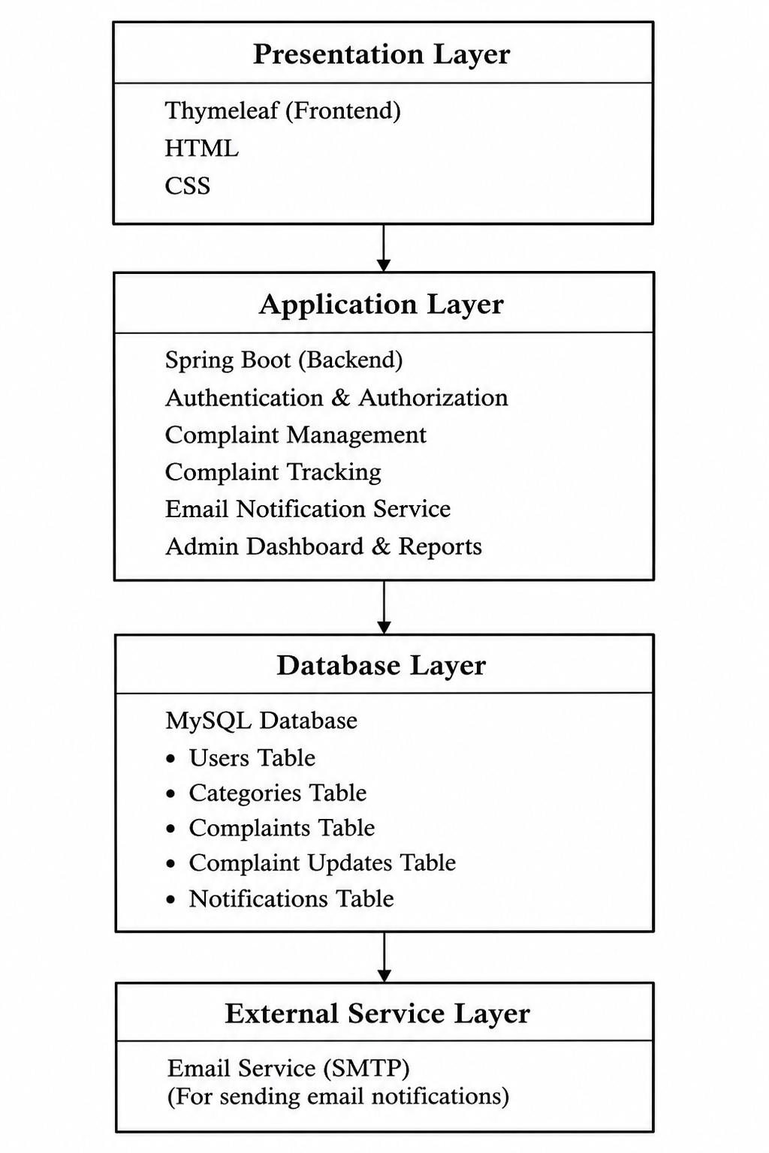
System Architecture

Slide 10
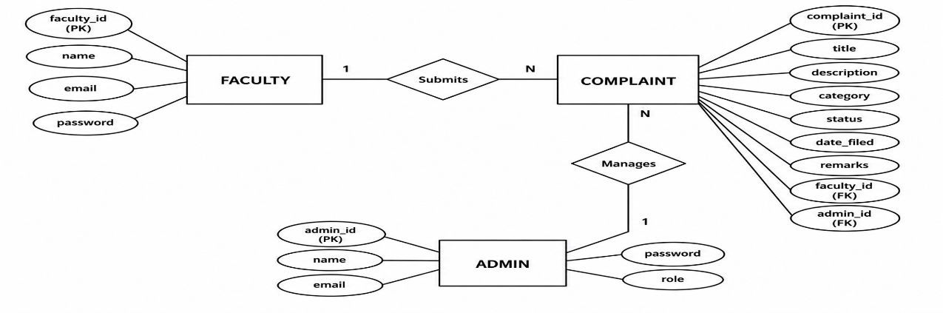
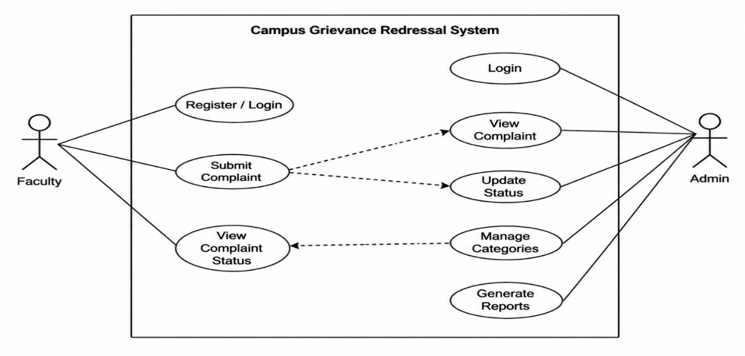
ER Diagram
Use Case Diagram

Slide 11
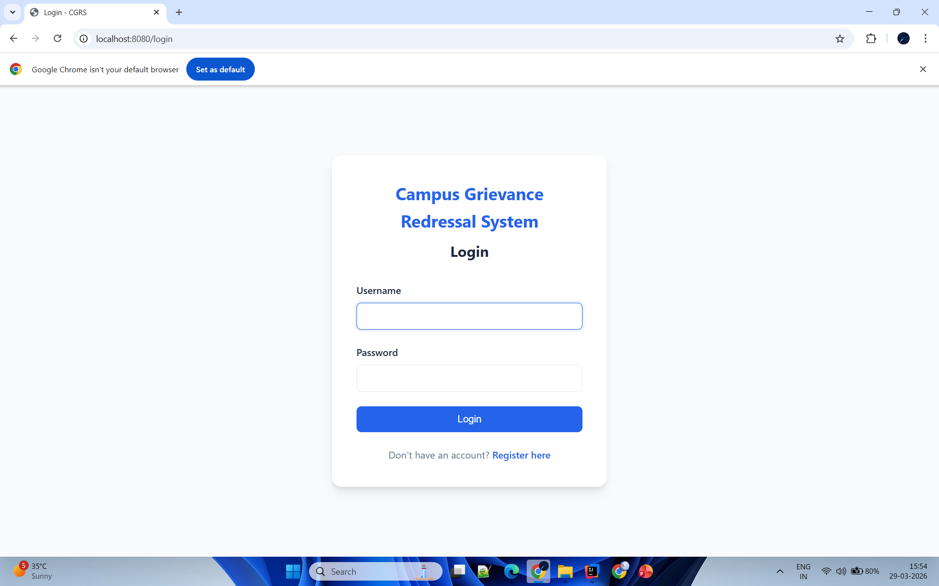
User Login Page :
This page allows users to log in securely into the system.

Slide 12
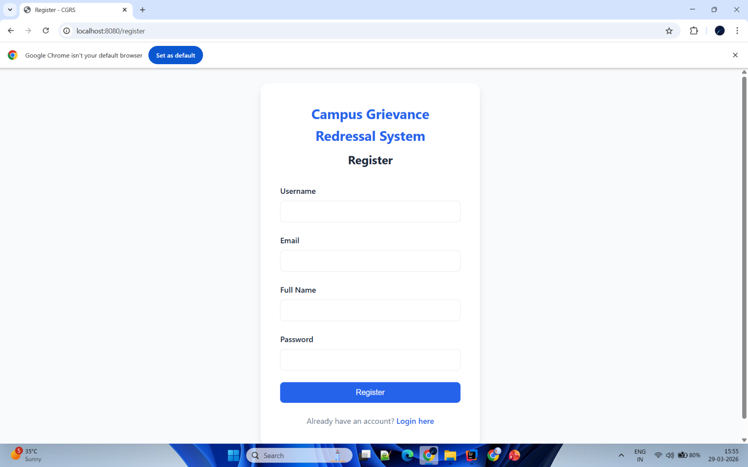
User Register Page :
Here, users enter their details like name ,email and password to create an account

Slide 13
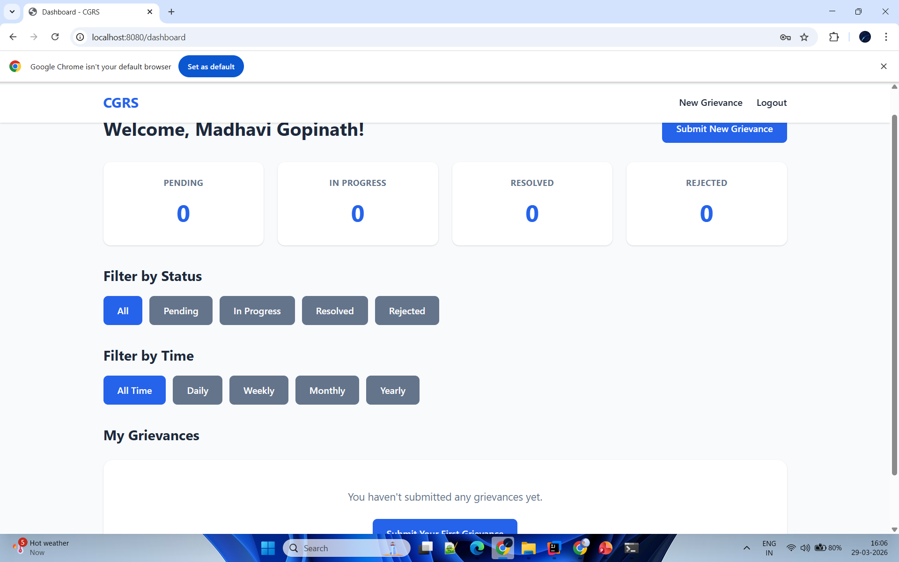
User Grievance Submission Page:
This page allows users to submit their grievance easily.

Slide 14
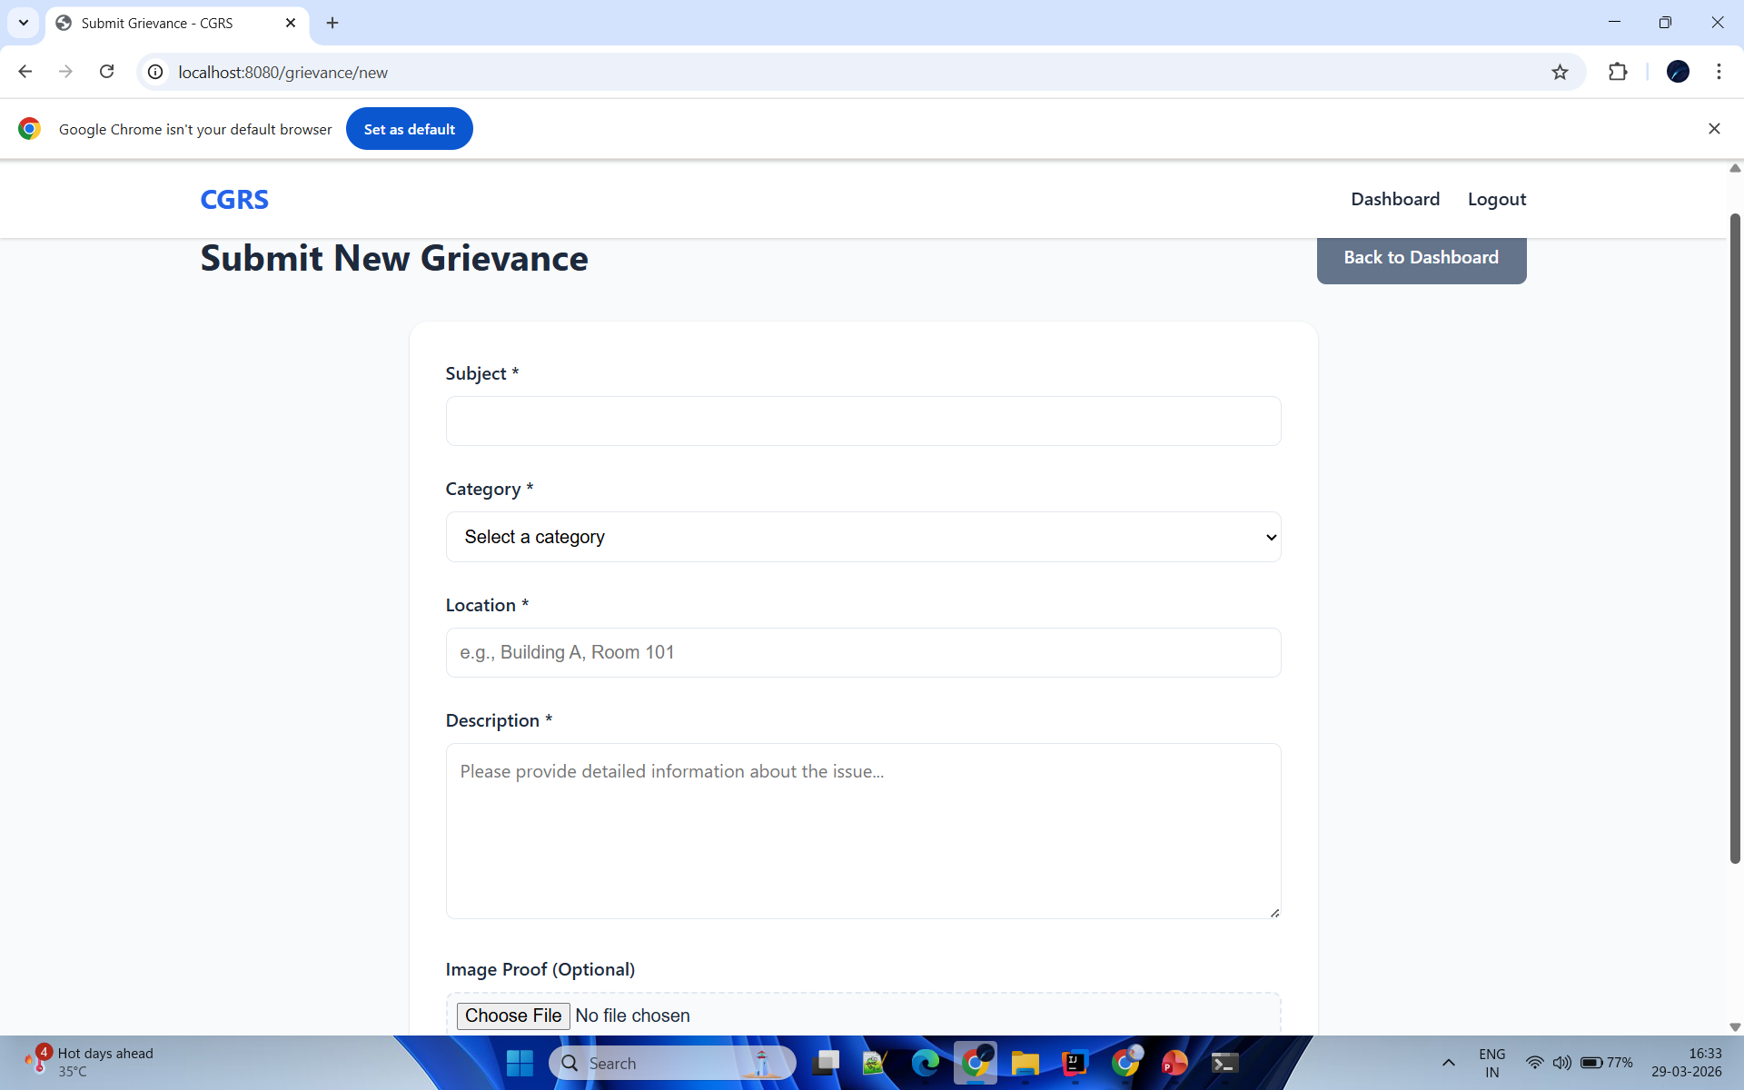
Grievance Details Submission Page :
Here, users provide detailed information about their grievances and can upload image as proof

Slide 15
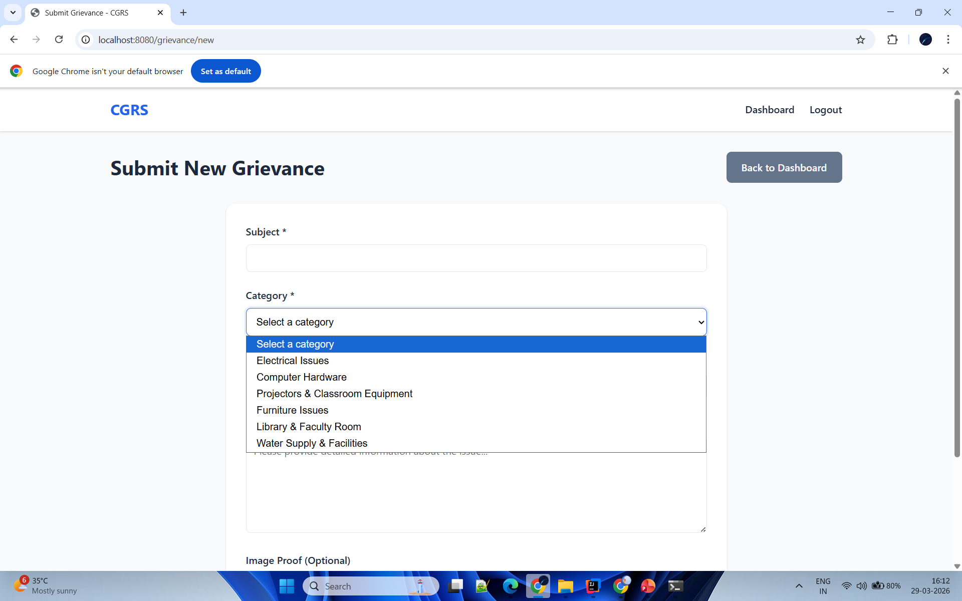
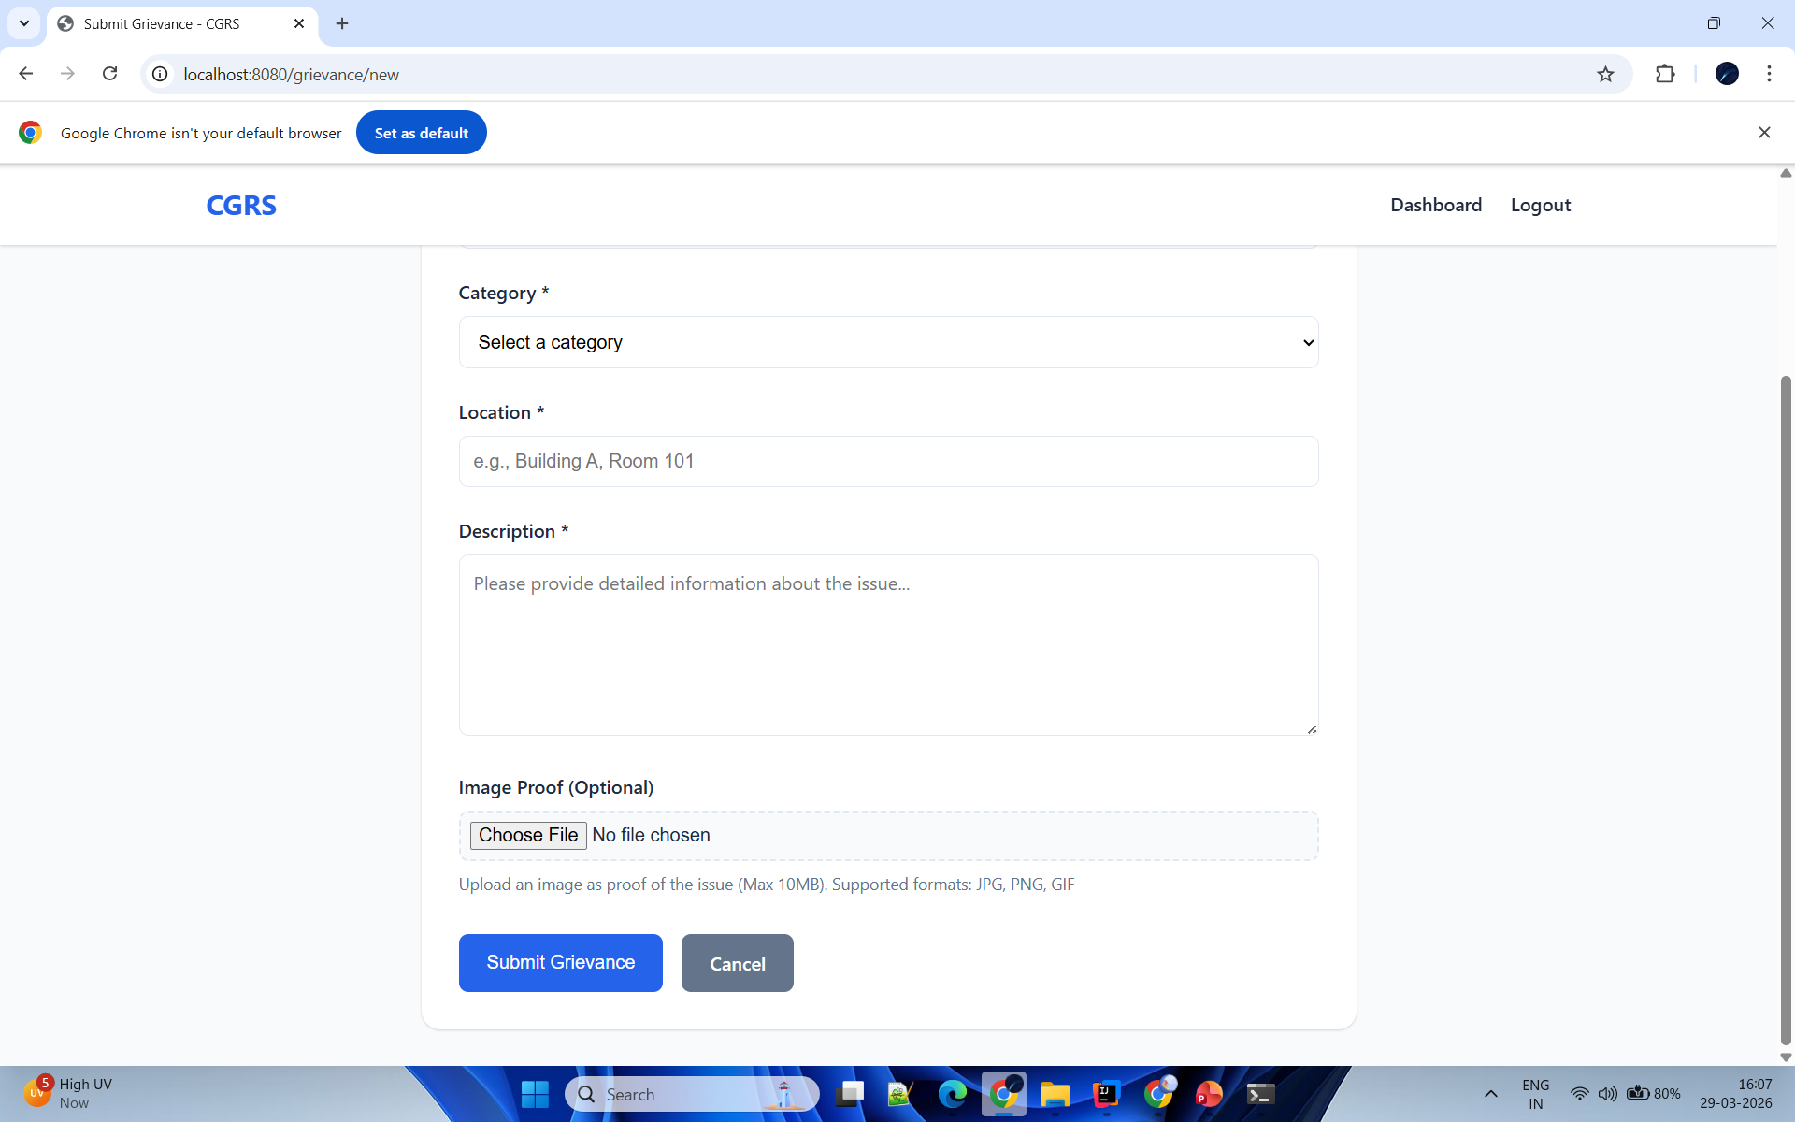

Slide 16
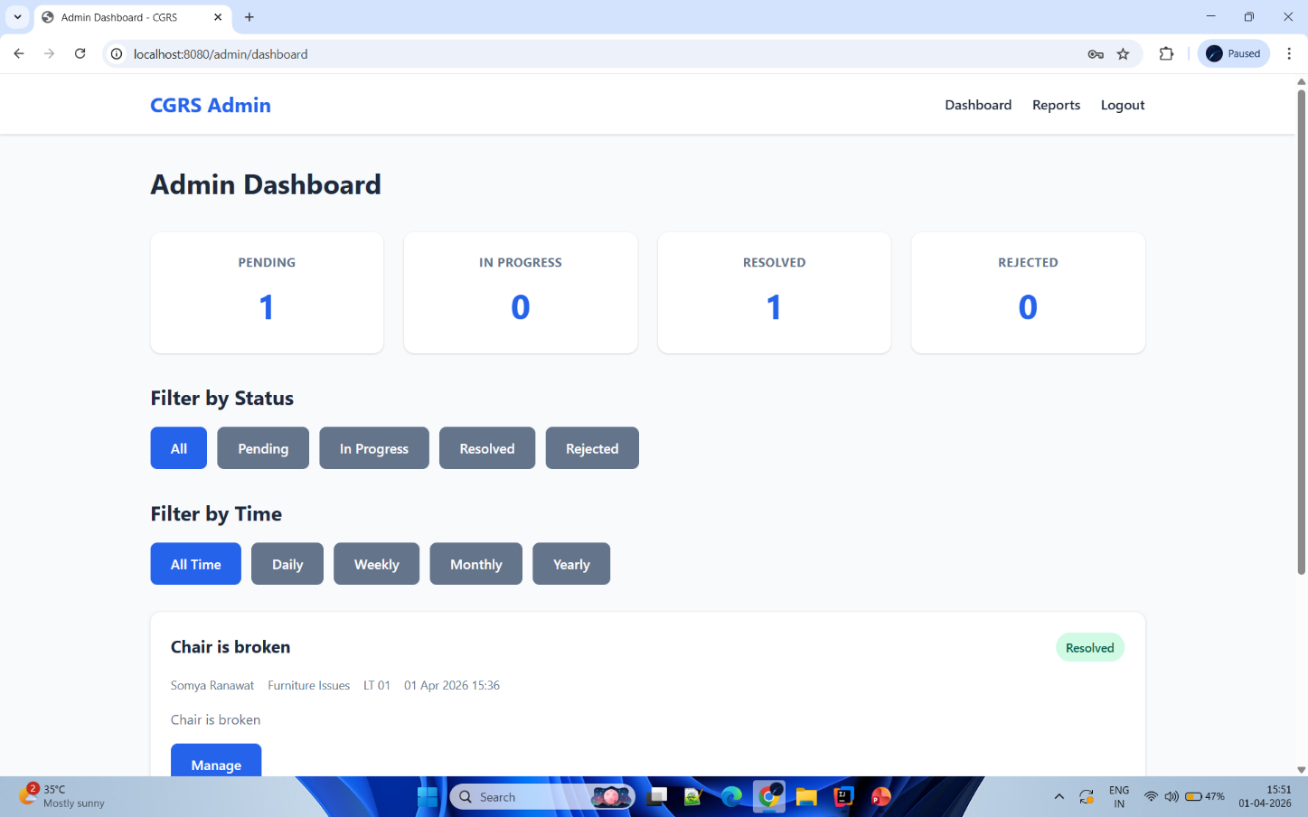
Admin Dashboard:
This is the admin dashboard where the admin can view all grievances in one place

Slide 17
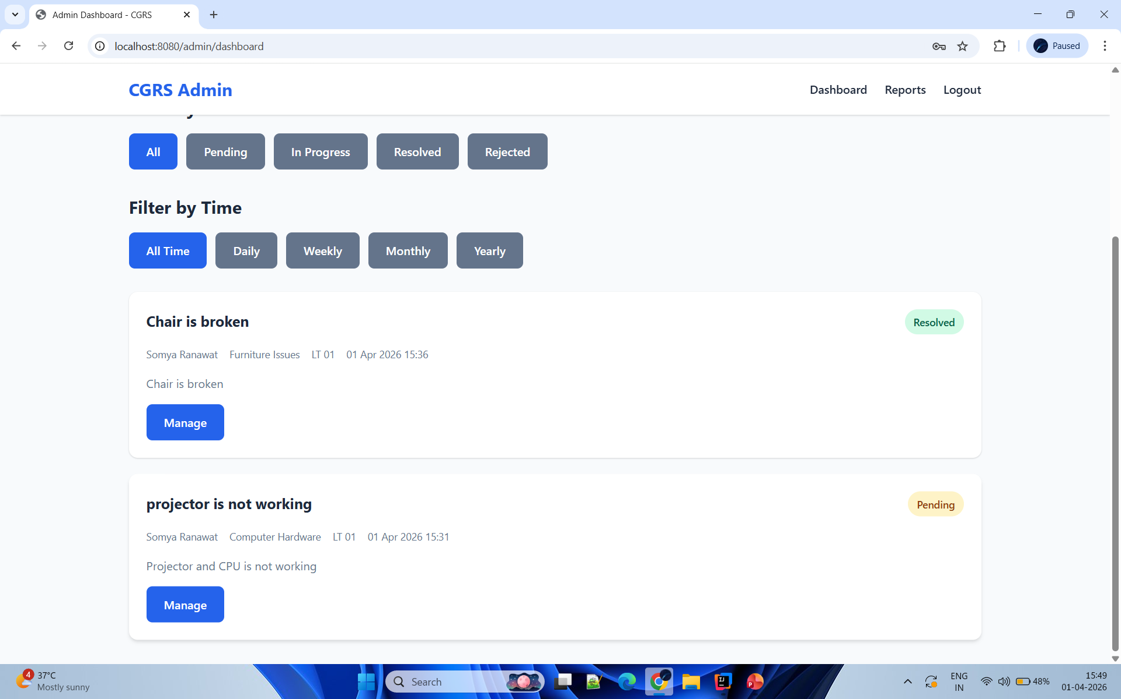
Admin Grievance Management Page :
Admin can manage grievances by reviewing ,updating and resolving them

Slide 18
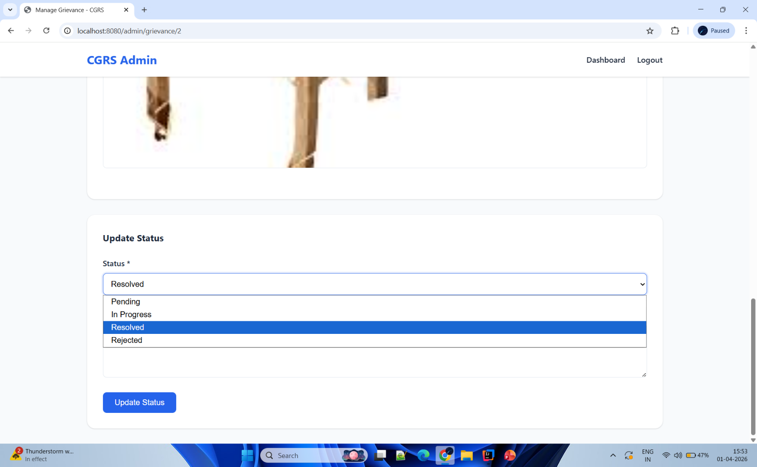
Grievance Status Update :
Admin updates the status of grievances and users can track it in real time

Slide 19
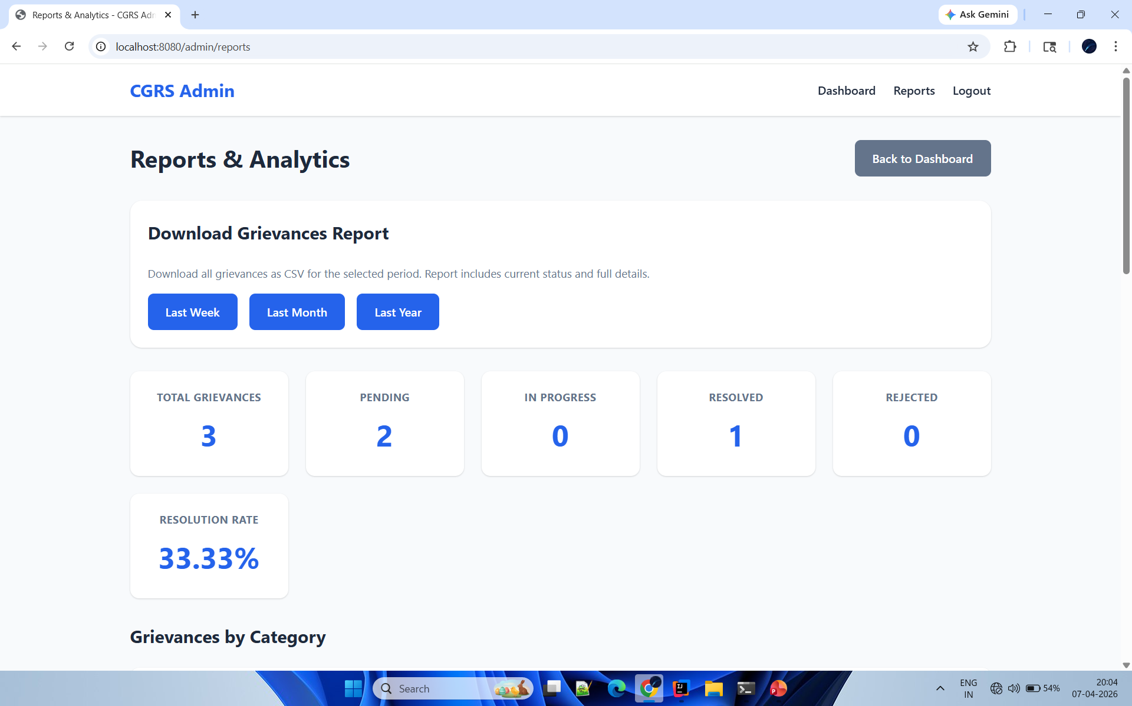
Report & Analytics Page :

Slide 20

Conclusion :
Reduces Complaint Resolution Time
Provides a Centralized Complaint Management System
Ensures Better Communication between Users and Admin
Enables Real-Time Tracking of Complaints
Reduces Manual Work

Slide 21
References :
Spring Boot Documentation - spring.io
Thymeleaf Official Website - thymeleaf.org
MySQL Database Documentation - mysql.com
Apache Maven Documentation - maven.apache.org
RESTful API Design Guidelines

Slide 22


