Slide 1
CS6350 Project Presentation Topic - AIRLINE PREDICTION AND COMPARATIVE ANALYSIS OF AIRLINE DELAYS USING MACHINE LEARNING TECHNIQUES
Amit Gupta - axg1629300
Deepan Verma - dxv160430
Komal Mukadam - kjm160030
Saumya Dixit - sxd160630
Somya Singh - sxs161331

Slide 2
Problem Statement
On-time performance of airlines schedule is a key factor in maintaining current customer satisfaction and attracting new ones. However, flight schedules are often subjected to irregularity. This irregularity and delays cause monetary losses to the airlines industry. Accessibility of this information to the user would enable him/her to make a wiser choice and they will not miss any connecting flights.
In this project, we are predicting flight delays which in turn if known before could be handled to reduce such monetary losses. We are also analyzing major contributors and impacts of flight delays – which airports are majorly affected, which routes, during which time of day majorly delays are happening, which month of year etc.

Slide 3
Motivation & Challenges
Prediction of Airline delays will cause monetary benefits to aviation department.
It will enable users to make wise choices – like saving their time, not missing their connecting flights etc.
The following were the major challenges faced:
Data handling and Refining
Data Preprocessing
Identifying the major factors affecting flight delays.

Slide 4
Technical Approach
Pre-processing the data
Logistic Regression – Precision, Recall, Accuracy, F1, Area under ROC Curve
Linear Regression – Delay Prediction, MSE
Analysis Plots

Slide 5
Arrival Delay for DFW:
1. Precision = 0.25
2. Recall = 0.59
3. F1 = 0.35
4. Accuracy = 0.54
5. Area under ROC = 0.55877
6. Mean Square Error = 0.2351
7.Confusion Matrix
 |  | Predicted Class
 |  | True | False
Actual Class | True | 80241.0 | 72134.0
 | False | 16739.0 | 24183.0

Slide 6
Departure Delay for DFW:
1. Precision = 0.24
2. Recall = 0.61
3. F1 = 0.35
4. Accuracy = 0.55
5. Area under ROC = 0.5736
6. Mean Square Error = 0.2278
7.Confusion Matrix
 |  | Predicted Class
 |  | True | False
Actual Class | True | 83682.0 | 71913.0
 | False | 14901.0 | 23264.0

Slide 7
Departure Delay for Flights from DFW-JFK
1. Precision = 0.27
2. Recall = 0.40
3. F1 = 0.33
4. Accuracy = 0.59
5. Area under ROC = 0.5250
6.Confusion Matrix
 |  | Predicted Class
 |  | True | False
Actual Class | True | 236.0 | 127.0
 | False | 72.0 | 48.0

Slide 8
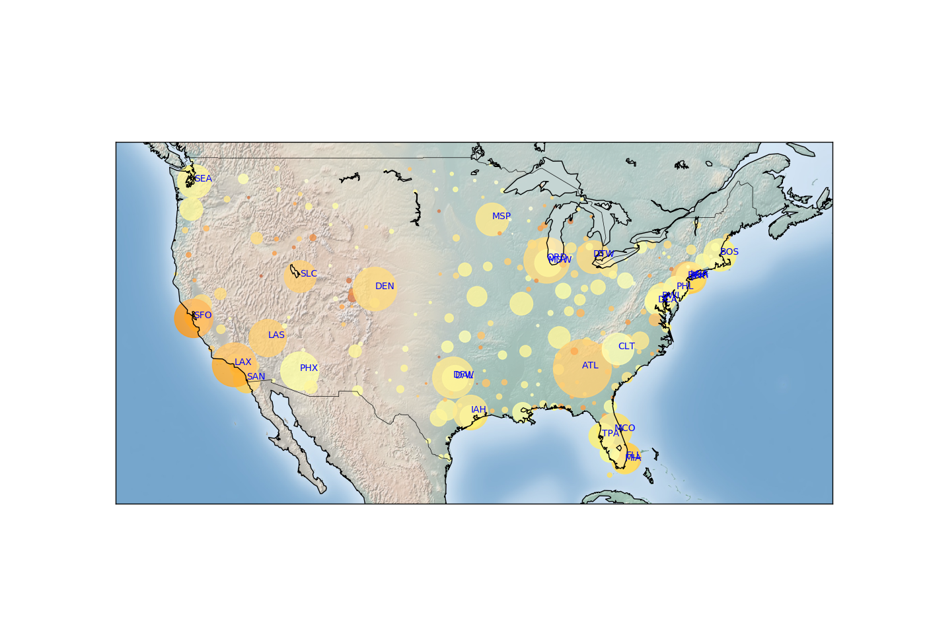
Experiment & Results
Airports with in comparative delay proportion

Slide 9
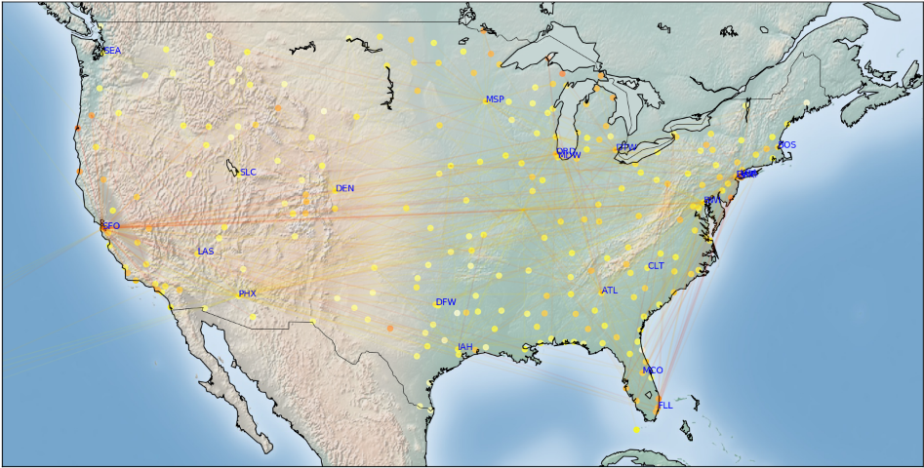
Delay Representation in Flight Routes

Slide 10
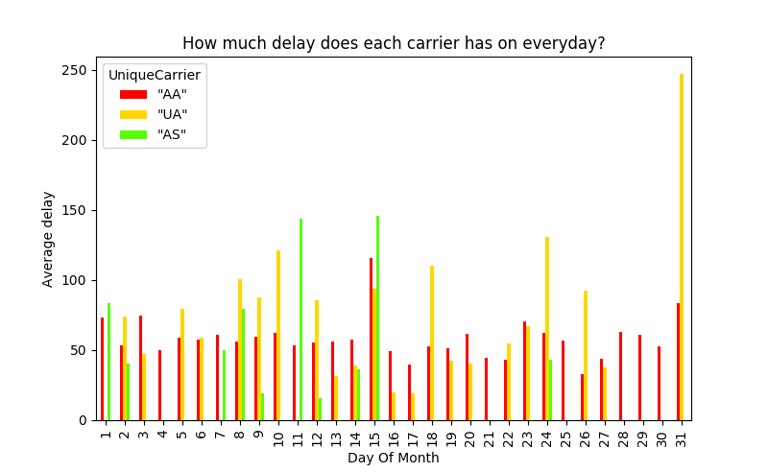
Everyday Delay for each carrier

Slide 11
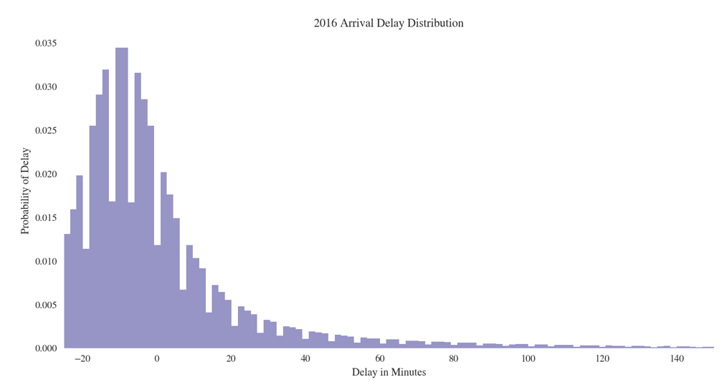
Arrival Delay Distribution

Slide 12
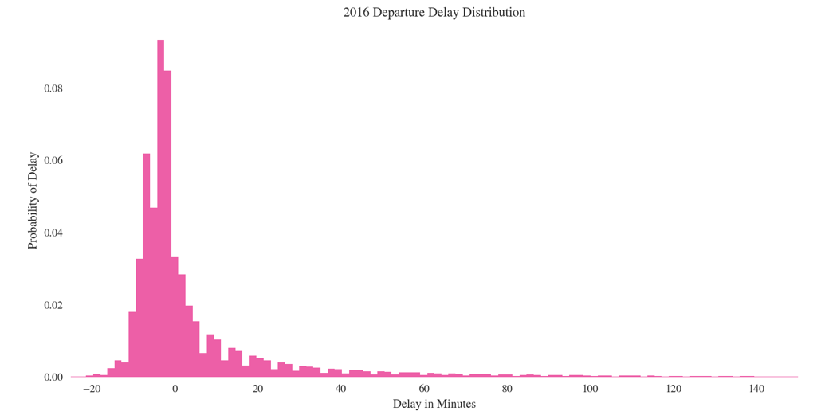
Departure Delay Distribution

Slide 13
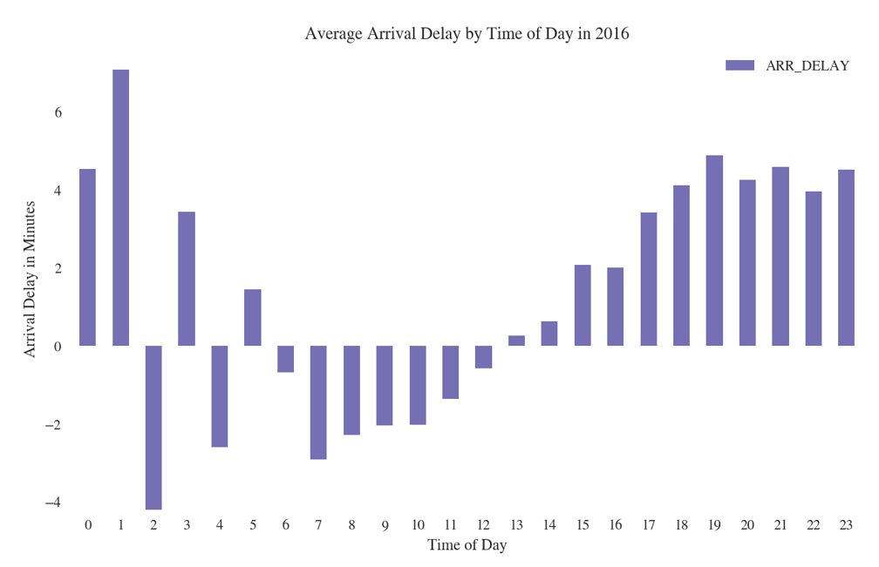
Average Arrival Delay By Time Of Day

Slide 14
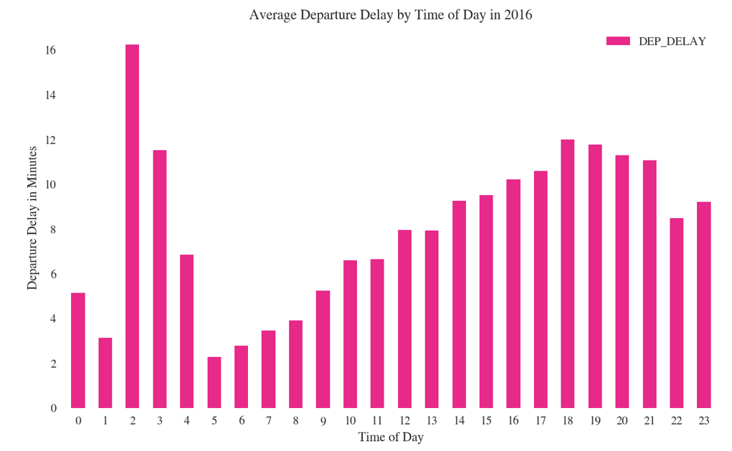
Average Departure Delay By Time Of Day

Slide 15
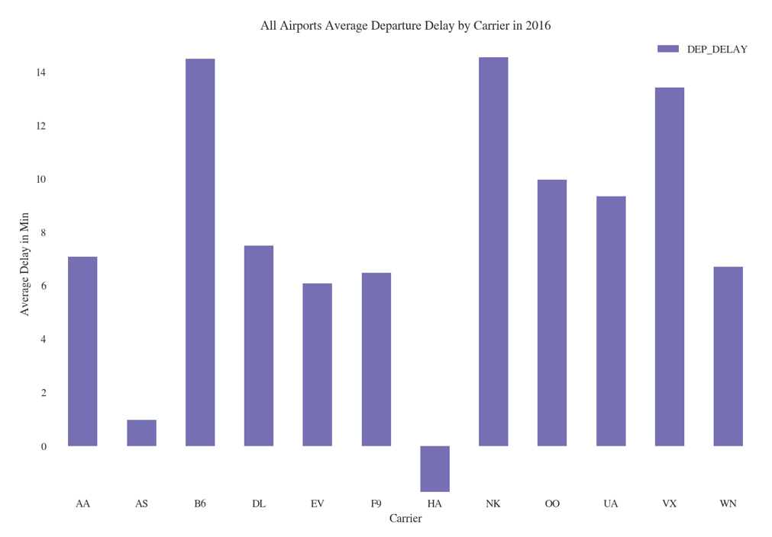
Airports Departure Delay By Carrier

Slide 16
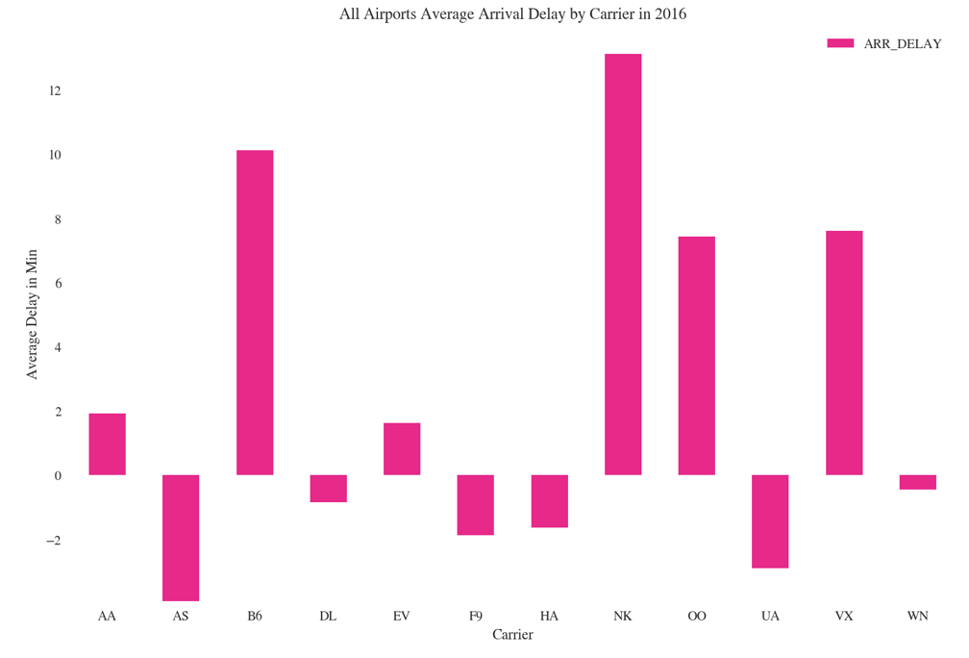
Airports Arrival Delay By Carrier

Slide 17
Conclusion
With the accuracy and MSE we've got as the result of our Regression, we could conclude that the delay is being satisfactorily predicted.
Various analysis plots included gives a good idea of delay vs contributing factors.
Analysis also represents the majorly affected airports, routes, cities, carriers etc. by flight delays.

Slide 18
Future Work
Real-time interface wherein user while searching for flights and during reservation can get delay estimates.
The model could be refined to include separate predictions for holidays, time and days during which more people prefer to travel etc.
To include more data as the training dataset to improve the predictions further.

