Slide 1

Department of Computer Science and Engineering
Fault-Tolerant Algorithm Design for Sensor Fusion in Autonomous Vehicle Systems
By
[VELAGALA SOMYA SRI] – [92400118621]

Slide 2
TABLE OF CONTENTS
Sl. No. | Contents Details | Slide Number
1 | Introduction | 3
2 | Review of Related Work | 4
3 | Research Gap | 6
4 | Research Methodology | 7
5 | Mathematical Foundation | 9
6 | Proposed Fusion Algorithm | 10
7 | Complexity Analysis | 12
8 | Experimental Set-up | 13
9 | Results & Discussion | 14
10 | Key Observations | 18
11 | Limitations & Future Work | 19
12 | Conclusion | 20
13 | References | 21
Title: Fault-Tolerant Algorithm Design for Sensor Fusion in Autonomous Vehicle Systems

Slide 3
INTRODUCTION
Why fusion needs fault tolerance
Research objectives
A self-driving car combines lidar, radar and cameras; each is accurate in some conditions and fails in others.
The textbook weighted average is optimal only when every input is healthy; a stuck or drifting sensor passes straight into the estimate.
Because weights follow nominal accuracy, a false reading from a precise sensor is often trusted the most.
Question: given n readings with up to f wrong, how to combine them, and what does the protection cost in time?
Sensor and fault model
Stuck, offset, drift, noise burst and spike faults on five redundant sensors.
1
Interval-agreement fusion
Sort-and-sweep consensus, then inverse-variance weighting of the survivors.
2
Guarantees and complexity
Containment and bounded-influence propositions; O(n log n) time, O(n) space.
3
Monte Carlo comparison
Against mean, weighted mean, median and median-gated weighted mean.
4
Title: Fault-Tolerant Algorithm Design for Sensor Fusion in Autonomous Vehicle Systems

Slide 4
REVIEW OF RELATED WORK (1/2)
Table 1 (a): Data fusion, fault taxonomy and fault detection
Author(s), Year | Paper / Setting | Key idea and relevance to this work
Hall & Llinas, 1997 [1] | An Introduction to Multisensor Data Fusion | Combining sources gives better accuracy and more dependable inference than any single source: the case for redundancy.
Khaleghi et al., 2013 [2] | Multisensor Data Fusion: A Review of the State-of-the-Art | Organises fusion difficulties around data quality: imperfect, outlying, conflicting and correlated measurements.
Van Brummelen et al., 2018 [10] | Autonomous Vehicle Perception: Technology of Today and Tomorrow | Every sensing technology degrades in some conditions (rain, glare, multipath): the practical reason for redundancy.
Avižienis et al., 2004 [3] | Basic Concepts and Taxonomy of Dependable and Secure Computing | Separates fault, error and failure; fault tolerance stops errors turning into failures through detection and redundancy.
Isermann, 2005 [4] | Model-Based Fault Detection and Diagnosis | Tests the residual between model prediction and measurement; a slowly growing fault can be absorbed before the residual is large.
Title: Fault-Tolerant Algorithm Design for Sensor Fusion in Autonomous Vehicle Systems

Slide 5
REVIEW OF RELATED WORK (2/2)
Table 1 (b): Filtering and agreement-based methods
Author(s), Year | Paper / Setting | Key idea and relevance to this work
Kalman, 1960 [5]; Bar-Shalom et al., 2001 [6] | Linear filtering; Estimation with Applications to Tracking and Navigation | Innovation sequence can reject readings that disagree with the prediction; inverse-variance weighting is minimum-variance when all sensors are healthy.
Lamport, Shostak & Pease, 1982 [7] | The Byzantine Generals Problem | Some participants may behave arbitrarily and the rest must still agree: the fault model behind this study.
Marzullo, 1990 [8] | Tolerating Failures of Continuous-Valued Sensors | Each sensor gives an interval; the region consistent with n − f intervals is found by sorting end-points and contains the truth.
Brooks & Iyengar, 1996 [9] | Robust Distributed Computing and Sensing Algorithm | Hybrid: interval-overlap test plus weighted averaging, giving both accuracy and precision.
Comparison: mean and weighted mean have no defence against a wrong input; the median ignores accuracy; Kalman gating needs a model; Marzullo returns a region, not a refined estimate.
Title: Fault-Tolerant Algorithm Design for Sensor Fusion in Autonomous Vehicle Systems

Slide 6
RESEARCH GAP
Four gaps in teaching material and small projects, and where this paper closes them
Ingredients appear separately
Fault model, detection rule, fusion rule, complexity analysis and evaluation are rarely shown together in one worked pipeline.
Closed by: Sec. III–V (full pipeline)
Baselines are too weak
Comparisons skip the median, which already tolerates a minority of faults, so gains look larger than they are.
Closed by: five-method comparison (Sec. VI)
1
2
Added value is not quantified
How much interval agreement plus inverse-variance weighting adds over the median is seldom measured.
Closed by: RMSE, unsafe rate, flags (Sec. VI-E, F)
Where it stops working is hidden
Behaviour when more than f sensors fail, and sensitivity to the interval factor k, is rarely reported.
Closed by: 3-fault runs and k study (Sec. VI-H)
3
4
Title: Fault-Tolerant Algorithm Design for Sensor Fusion in Autonomous Vehicle Systems

Slide 7
RESEARCH METHODOLOGY
Overview: simulation-based comparative study with known ground truth
1
2
3
4
5
Generate truth
x(t) = 40 + 10 sin(2πt/300) + 0.01t m, 600 steps of 0.1 s.
Simulate sensors
Five sensors with independent Gaussian noise, σ = 0.10 to 0.50 m.
Inject faults
Stuck, offset, drift, burst or spike on 0–3 sensors for 120–259 steps.
Agree and fuse
Intervals z ± kσ, sort-and-sweep, flag outliers, weight the rest.
Evaluate
RMSE, unsafe rate, precision / recall and run time against four baselines.
Simulation track (Sec. III)
Fusion and evaluation (Sec. IV–VI)
Fused estimate = inverse-variance mean of the sensors that agree
One time step at a time: no training and no history. Cost per cycle O(n log n) time, O(n) space, so behaviour can be traced by hand.
Title: Fault-Tolerant Algorithm Design for Sensor Fusion in Autonomous Vehicle Systems

Slide 8
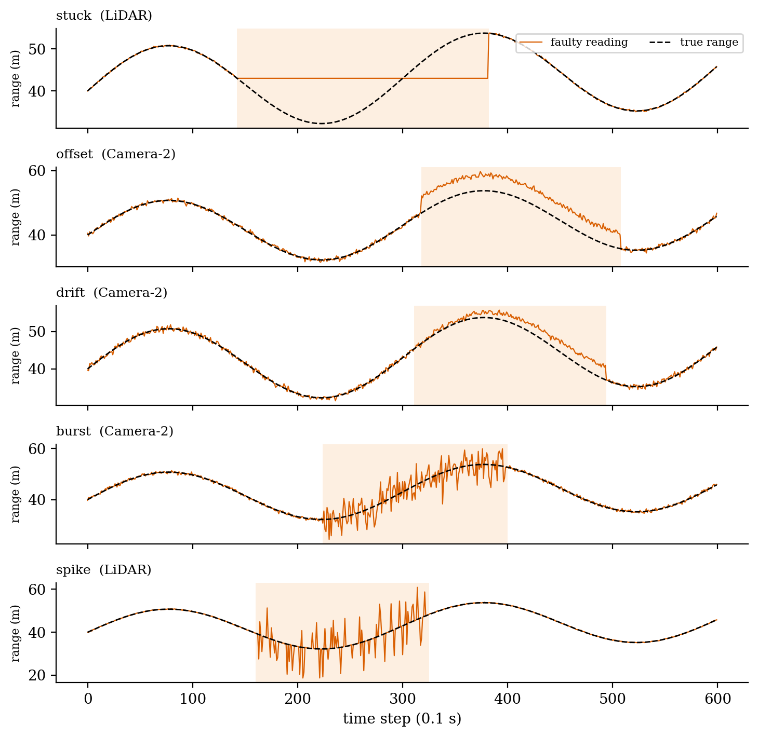
SENSOR AND FAULT MODEL
Five sensors (σ in m): LiDAR 0.10, Radar-1 0.25, Camera-1 0.50, Camera-2 0.40, Radar-2 0.20. Design bound f = 2 of n = 5, so f < n/2.
Stuck
Output freezes at the value it had when the fault began.
1
Offset
Constant error of 2–5 m, positive or negative, is added.
2
Drift
Error grows linearly from zero to 3–6 m over the window.
3
Burst
Noise standard deviation becomes ten times its normal value.
4
Spike
With probability 0.3 per step an outlier of 5–15 m is added.
5
Figure 2: The five injected fault types (shaded = fault window)
Title: Fault-Tolerant Algorithm Design for Sensor Fusion in Autonomous Vehicle Systems

Slide 9
MATHEMATICAL FOUNDATION
Table 2: Quantities used by the fusion rule
Quantity | Expression | Meaning
Sensor model | z_i = x + e_i, e_i ~ N(0, σ_i²) | Healthy sensor reports truth plus noise; a faulty one reports anything.
Weighted mean | x̂ = Σ w_i z_i / Σ w_i, w_i = 1/σ_i² | Minimum variance when all healthy; σ ≈ 0.081 m for these five sensors.
Interval | I_i = [ z_i − kσ_i , z_i + kσ_i ] | Range each sensor says should contain the truth.
Agreement count | c(y) = | { i : y ∈ I_i } |, c* = max c(y) | Region R where c = c*; ties go to the one nearest the median.
Consistent set | S = { i : I_i ∩ R ≠ ∅ } | Sensors outside S are flagged as faulty.
Fused estimate | x̂ = Σ_S w_i z_i / Σ_S w_i | Same weighting, restricted to the consistent sensors.
Proposition 1: containment
If at most f sensors are faulty and healthy intervals contain x, then c(x) ≥ n − f, so c* ≥ n − f and the truth lies in a region of that count.
Proposition 2: bounded influence
A surviving sensor satisfies |z_i − x| ≤ kσ_i + (hi − lo). A fault can hide only by being small.
Title: Fault-Tolerant Algorithm Design for Sensor Fusion in Autonomous Vehicle Systems

Slide 10
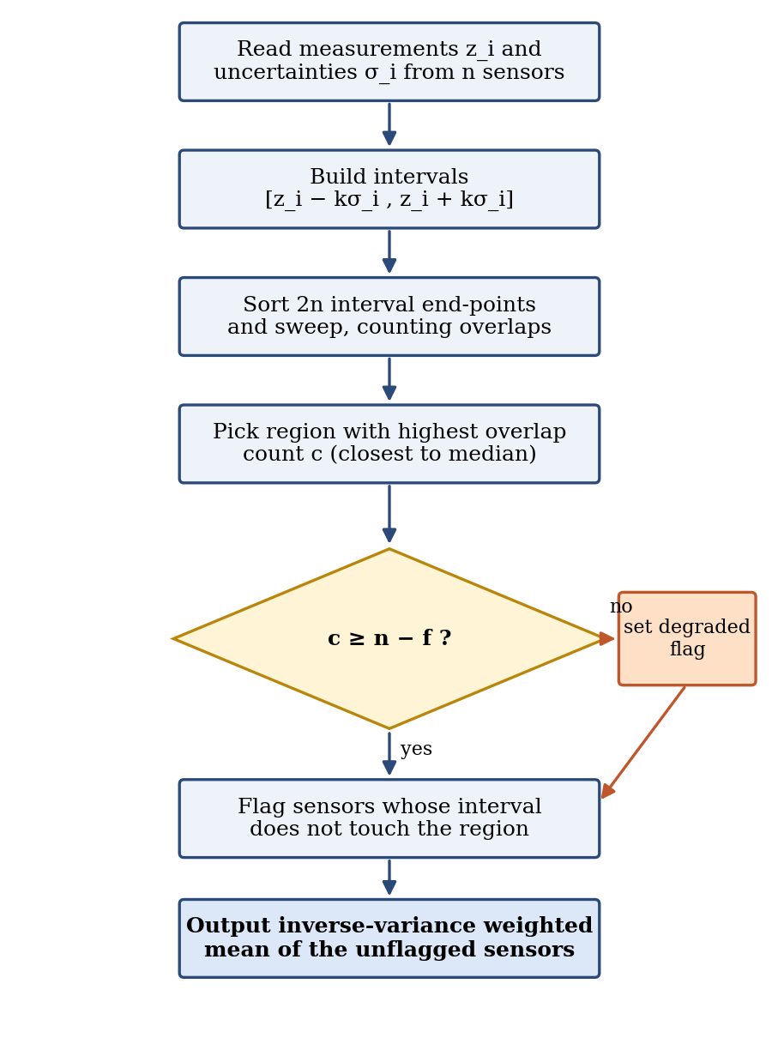
PROPOSED FUSION ALGORITHM
Build intervals
[z_i − kσ_i, z_i + kσ_i] for every sensor; 2n end-points in one list.
1
Sort and sweep
Starts before ends on ties; counter +1 at a start, −1 at an end.
2
Pick the region
Highest overlap count c*; ties go to the stretch closest to the median.
3
Flag and mark
Flag sensors that miss the region; mark degraded if c* < n − f.
4
Fuse the survivors
Return the inverse-variance weighted mean, the flagged set and the marker.
5
Figure 3: Flowchart of the fusion routine
Title: Fault-Tolerant Algorithm Design for Sensor Fusion in Autonomous Vehicle Systems

Slide 11
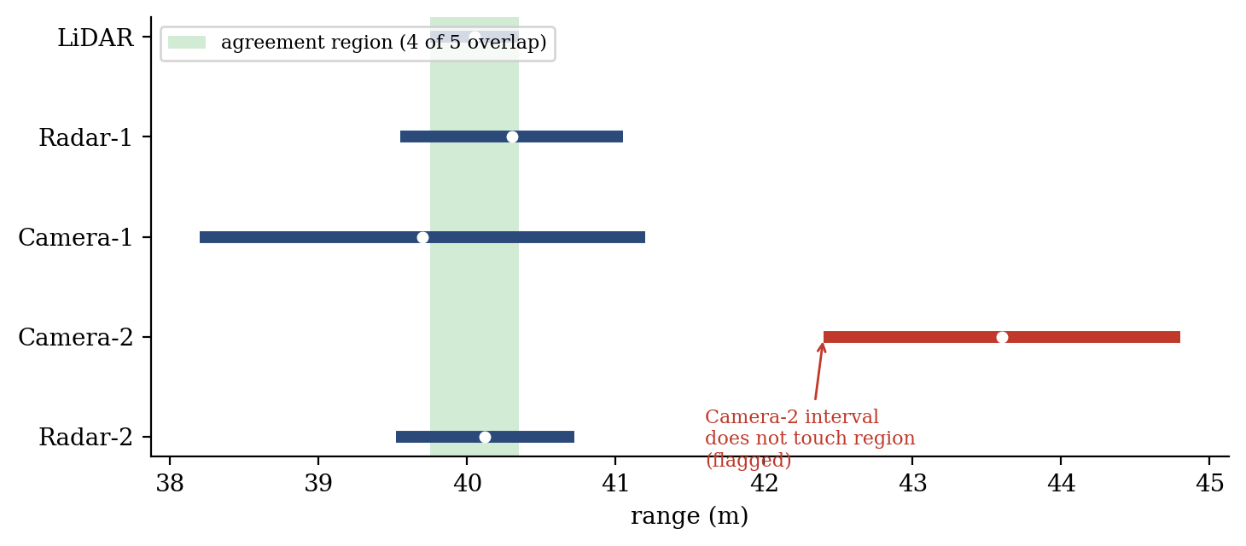
WORKED EXAMPLE
Method | Estimate (m) | Error (m)
Simple mean | 40.754 | 0.754
Weighted mean | 40.225 | 0.225
Median | 40.120 | 0.120
Median-gated IVW | 40.080 | 0.080
Proposed method | 40.080 | 0.080
Figure 4: Intervals z ± 3σ at one step; true range 40.00 m
0.080 m
error of the proposed method (simple mean: 0.754 m)
Four of five intervals overlap on [39.75, 40.35], so c* = 4 ≥ n − f = 3.
Camera-2 (offset fault, reads 43.60 m) has interval [42.40, 44.80], misses the region and is flagged.
Weights 100, 16, 4, 25 sum to 145; fused estimate = 5811.6 / 145 = 40.080 m.
A single hand-picked step to show the mechanics; performance claims rest on the Monte Carlo results.
Title: Fault-Tolerant Algorithm Design for Sensor Fusion in Autonomous Vehicle Systems

Slide 12
COMPLEXITY ANALYSIS
Table 3: Time cost of one fusion cycle with n sensors
O(n log n)
time per fusion cycle
Component | Complexity | Reason
Interval construction | O(n) | One pass over the sensors
Sorting end-points | O(n log n) | 2n values sorted by position
Sweep and counting | O(n) | One pass over 2n sorted events
Region selection | O(n) | Scan of segments, median of readings
Flagging | O(n) | Compare each interval with the region
Weighted mean | O(n) | One pass over unflagged sensors
Total per cycle | O(n log n) | Dominated by the sort
O(n)
working space per cycle
0.029 ms
per call at n = 5, a negligible share of a 100 ms sensing cycle
The median costs expected O(n) and the weighted mean O(n), so the proposed routine is asymptotically a little more expensive. In exchange it returns the flagged set, which neither of the others does. Working memory is O(n); nothing is carried between steps.
Title: Fault-Tolerant Algorithm Design for Sensor Fusion in Autonomous Vehicle Systems

Slide 13
EXPERIMENTAL SET-UP
Implementation
Python 3 with NumPy and Matplotlib; single thread; fixed seeds (2026, 77, 5, 9) so every run can be repeated.
Sensors and signal
n = 5 (LiDAR, Radar-1, Camera-1, Camera-2, Radar-2); 600 steps of 0.1 s per run; synchronised samples.
Fault settings
0, 1, 2 and 3 faulty sensors (3 is beyond the design limit); f = 2, k = 3; random type and window.
Repetitions
150 runs per configuration in the main comparison; 100 per fault type; 60 per setting in the k study.
Methods compared
Simple mean, weighted mean (IVW), median, median-gated IVW, and the proposed interval-agreement method.
Metrics
RMSE, unsafe-estimate rate (error > 1.0 m), worst-case error, precision, recall and false-alarm rate.
Title: Fault-Tolerant Algorithm Design for Sensor Fusion in Autonomous Vehicle Systems

Slide 14
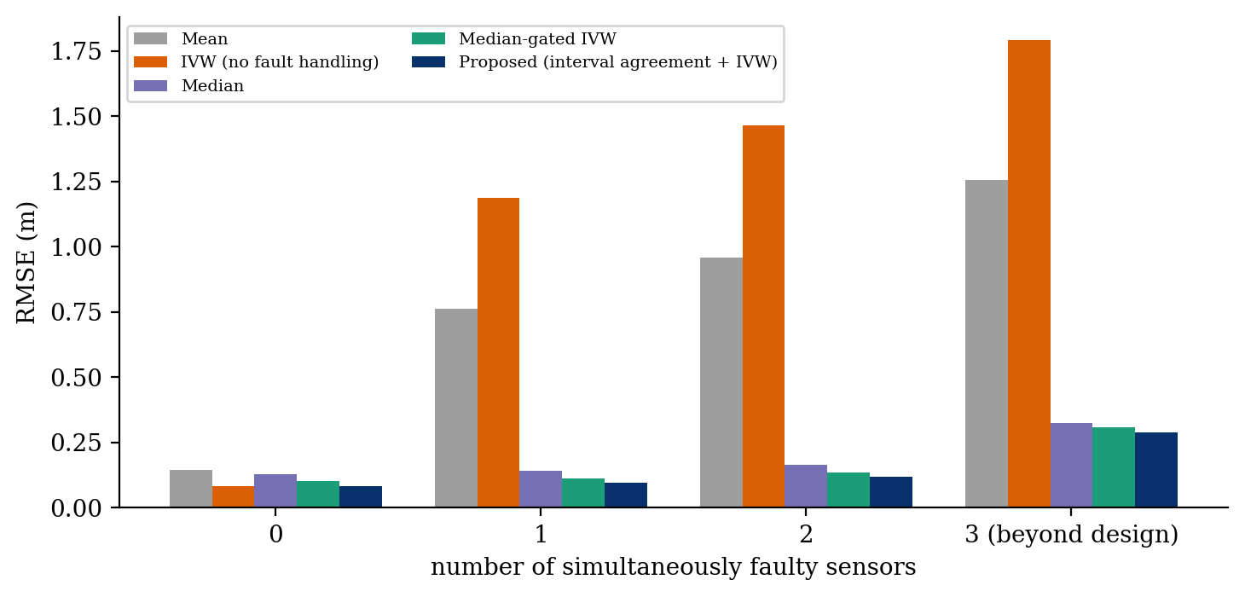
RESULTS: ESTIMATION ACCURACY
0.095 m
RMSE, 1 faulty sensor (weighted mean: 1.187 m)
0.118 m
RMSE, 2 faulty sensors (median: 0.164 m)
Figure 5: RMSE of the five fusion methods vs. number of faulty sensors
0.287 m
RMSE, 3 faulty sensors; still lowest, but no longer guaranteed
With no faults the proposed method equals the weighted mean (0.081 m) and beats the median and simple mean.
With one fault the weighted mean is worst (1.187 m); the proposed method gives 0.095 m against 0.141 m for the median.
Beyond the design limit (3 faults) every method degrades; worst error reaches about 14.4 m.
Title: Fault-Tolerant Algorithm Design for Sensor Fusion in Autonomous Vehicle Systems

Slide 15
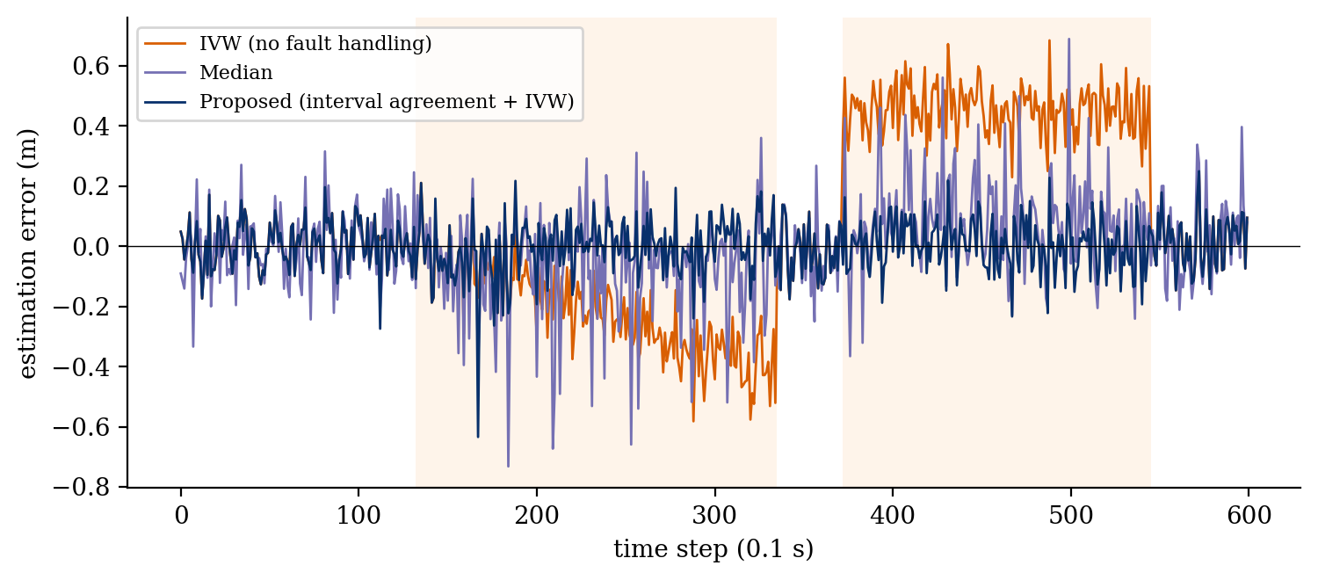
RESULTS: FAULT DETECTION
> 0.97
flag precision in every configuration
0.65–0.73
recall; missed steps are early drift and quiet spikes
Figure 6: Error over time in one run (Radar-1 drifts, Radar-2 offset)
Faulty | Method | Precision | Recall | False alarm
1 | Median-gated IVW | 0.754 | 0.772 | 0.017
1 | Proposed | 0.992 | 0.727 | 0.000
2 | Median-gated IVW | 0.838 | 0.751 | 0.021
2 | Proposed | 0.991 | 0.704 | 0.001
≤ 0.3 %
false alarms, vs. 1.4–2.8 % for the gated baseline
Title: Fault-Tolerant Algorithm Design for Sensor Fusion in Autonomous Vehicle Systems

Slide 16
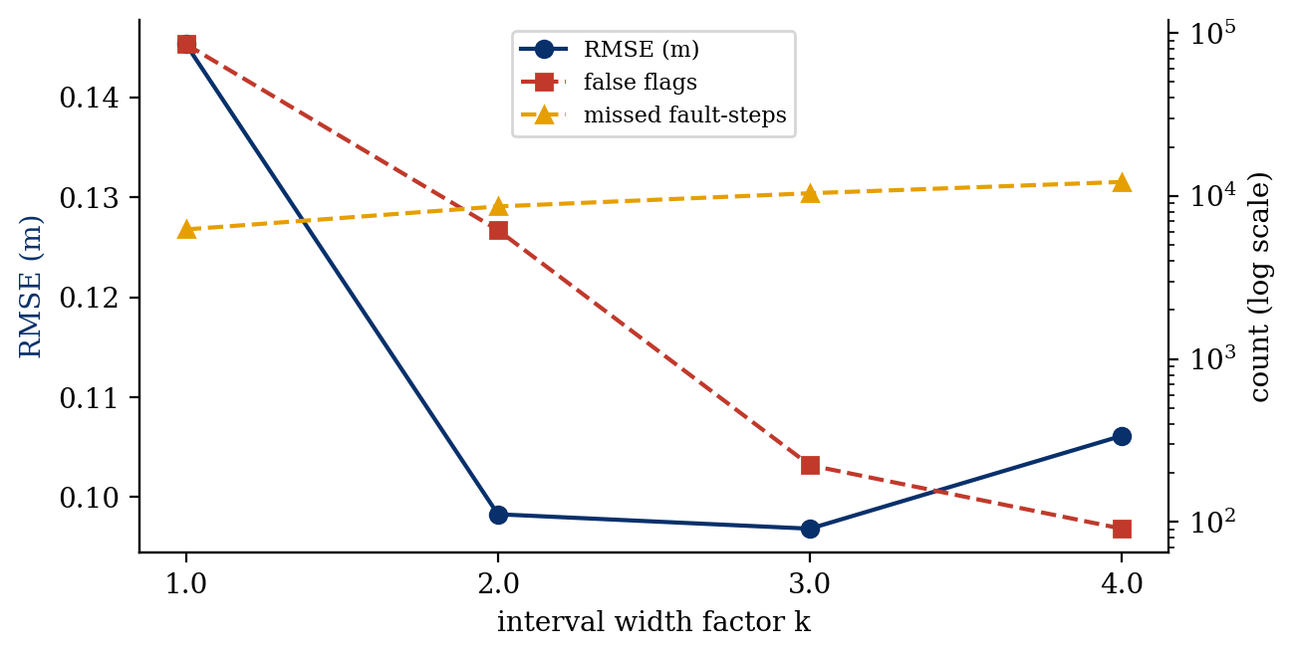
RESULTS: FAULT TYPES AND FACTOR k
Table 4: RMSE (m) by fault type, one faulty sensor
Fault | Median | Gated IVW | Proposed | Recall
Stuck | 0.144 | 0.114 | 0.090 | 0.881
Offset | 0.145 | 0.114 | 0.088 | 0.991
Drift | 0.142 | 0.115 | 0.096 | 0.699
Burst | 0.140 | 0.116 | 0.105 | 0.633
Spike | 0.133 | 0.106 | 0.083 | 0.300
Figure 7: Effect of k on RMSE, false flags, missed steps
Proposed method has the lowest RMSE for every fault type; spike recall is low because spikes hit only about 30 % of window steps.
k = 1 gives 85,430 false flags; k = 4 lets small faults hide (12,195 missed steps).
k = 3 gave the lowest RMSE (0.097 m): a default, to be tuned per sensor set.
k = 3
RMSE 0.097 m, 223 false flags, 0.006 % unsafe steps
Title: Fault-Tolerant Algorithm Design for Sensor Fusion in Autonomous Vehicle Systems

Slide 17
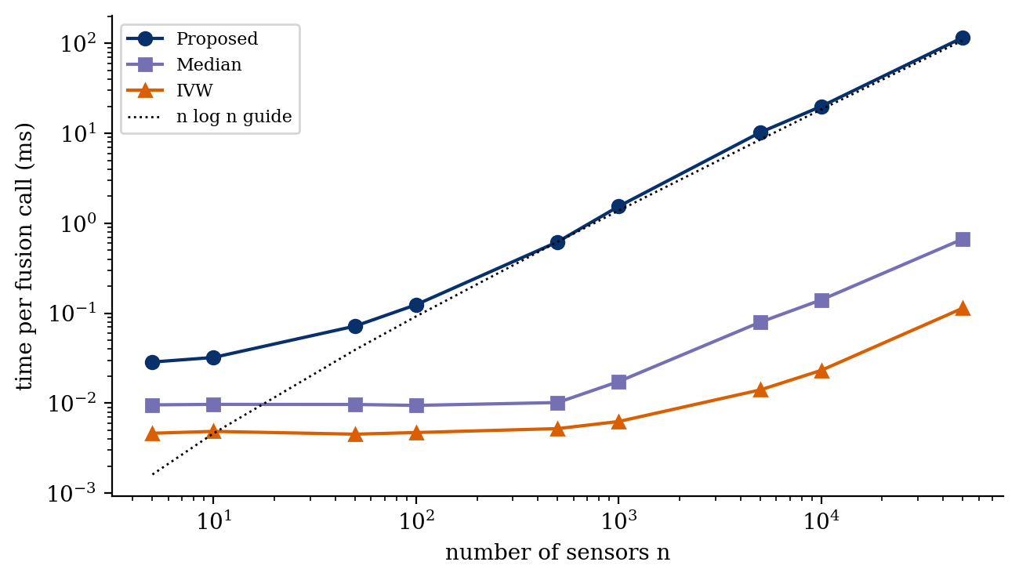
RESULTS: RUN TIME
0.029 ms
per call at n = 5
13.0× / 13.3×
measured vs. n log n growth, n = 1,000 → 10,000
116 ms
per call at n = 50,000 sensors
Figure 8: Time per fusion call vs. number of sensors (log–log)
From n = 1,000 to 10,000 the time grows by 13.0×, close to the 13.3× expected from n log n scaling.
Slower than the median by a large constant: the sweep is interpreted Python, the median is compiled NumPy.
The numbers show the growth rate, not achievable embedded timings.
Title: Fault-Tolerant Algorithm Design for Sensor Fusion in Autonomous Vehicle Systems

Slide 18
KEY OBSERVATIONS
Protection costs nothing on healthy data
With no faulty sensor the proposed method matches the weighted mean (0.081 m RMSE).
1
Accurate is not the same as safe
One faulty sensor makes the weighted mean the worst method (1.187 m); it trusts precise sensors even when they fail.
2
Best at the design limit
With f = 2 of 5 the proposed method reaches 0.118 m, ahead of the gated baseline (0.134 m) and the median (0.164 m).
3
The guarantee ends beyond f
With three faulty sensors all methods degrade; worst error is about 14.4 m even though RMSE stays lowest (0.287 m).
4
Precise flags, modest margin
Precision is above 0.97 but recall only 0.65–0.73; gains over the median are a few centimetres, large only over the mean.
5
Title: Fault-Tolerant Algorithm Design for Sensor Fusion in Autonomous Vehicle Systems

Slide 19
LIMITATIONS & FUTURE WORK
Limitations and challenges
Future work
One scalar per sensor, one dimension; real fusion handles vectors, covariances and tracks.
Noise levels σ must be known: too small flags healthy sensors, too large lets faulty ones pass.
Independent noise is assumed; two cameras behind one windscreen may fail together.
f must be fixed in advance; beyond it the containment guarantee does not apply.
All data are simulated and timing is Python-only; the tie-break is a heuristic.
Embed the agreement test in a Kalman filter so history helps catch slow drifts.
Extend intervals to boxes or ellipsoids for multi-dimensional states.
Persist flags over several steps; estimate σ online.
Inject faults into recorded driving data and test correlated failures.
Measure the degraded flag; compare with Brooks–Iyengar; port to C/C++ on automotive hardware.
Title: Fault-Tolerant Algorithm Design for Sensor Fusion in Autonomous Vehicle Systems

Slide 20
CONCLUSION
O(n log n)
time per cycle; O(n) space
0.095 m
RMSE with 1 fault vs. 1.187 m (weighted mean)
> 0.97
precision of flagged sensors
k = 3
default interval factor; tune per sensor set
Intervals z ± kσ, a sort-and-sweep consensus and inverse-variance weighting tolerate up to f faulty sensors out of n.
Two propositions: the truth lies in a region of count ≥ n − f, and an undetected fault can only deviate by a few multiples of the sensor noise.
In simulation it matched the weighted mean on healthy data and gave the lowest RMSE with one or two faulty sensors.
Margins over the median are small and nothing rescues the estimate once a majority fails; results are simulated, scalar and independent-noise.
Robustness comes from the interval test and accuracy from the weighting, so they need not be traded off when each sensor's uncertainty is known.
Title: Fault-Tolerant Algorithm Design for Sensor Fusion in Autonomous Vehicle Systems

Slide 21
REFERENCES
[1] D. L. Hall and J. Llinas, “An introduction to multisensor data fusion,” Proc. IEEE, vol. 85, no. 1, pp. 6–23, 1997.
[2] B. Khaleghi, A. Khamis, F. O. Karray, and S. N. Razavi, “Multisensor data fusion: A review of the state-of-the-art,” Information Fusion, vol. 14, no. 1, pp. 28–44, 2013.
[3] A. Avižienis, J.-C. Laprie, B. Randell, and C. Landwehr, “Basic concepts and taxonomy of dependable and secure computing,” IEEE TDSC, vol. 1, no. 1, pp. 11–33, 2004.
[4] R. Isermann, “Model-based fault-detection and diagnosis – status and applications,” Annual Reviews in Control, vol. 29, no. 1, pp. 71–85, 2005.
[5] R. E. Kalman, “A new approach to linear filtering and prediction problems,” J. Basic Engineering, vol. 82, no. 1, pp. 35–45, 1960.
[6] Y. Bar-Shalom, X. R. Li, and T. Kirubarajan, Estimation with Applications to Tracking and Navigation. New York, NY, USA: Wiley, 2001.
[7] L. Lamport, R. Shostak, and M. Pease, “The Byzantine generals problem,” ACM TOPLAS, vol. 4, no. 3, pp. 382–401, 1982.
[8] K. Marzullo, “Tolerating failures of continuous-valued sensors,” ACM Trans. Computer Systems, vol. 8, no. 4, pp. 284–304, 1990.
[9] R. R. Brooks and S. S. Iyengar, “Robust distributed computing and sensing algorithm,” Computer, vol. 29, no. 6, pp. 53–60, 1996.
[10] J. Van Brummelen, M. O’Brien, D. Gruyer, and H. Najjaran, “Autonomous vehicle perception: The technology of today and tomorrow,” Transp. Res. Part C, vol. 89, pp. 384–406, 2018.
[11] T. H. Cormen, C. E. Leiserson, R. L. Rivest, and C. Stein, Introduction to Algorithms, 4th ed. Cambridge, MA, USA: MIT Press, 2022.
[12] International Organization for Standardization, ISO 26262:2018, Road vehicles – Functional safety, 2018.
Title: Fault-Tolerant Algorithm Design for Sensor Fusion in Autonomous Vehicle Systems

