Slide 1
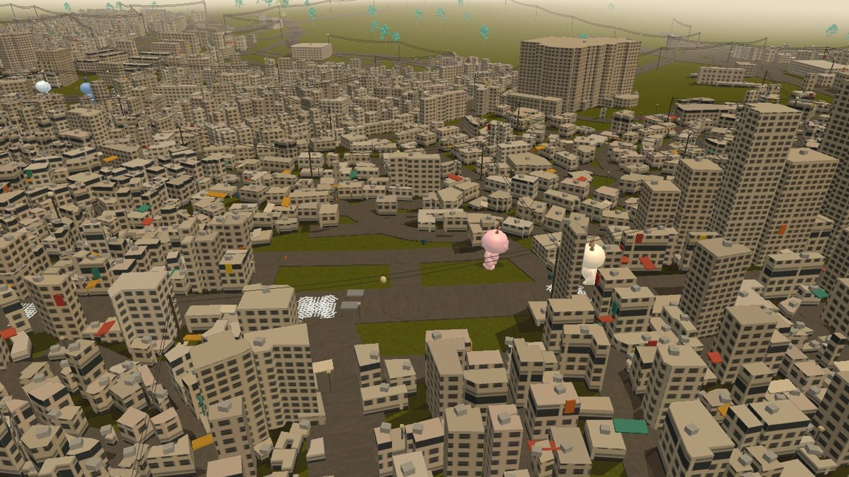
PRE-SEED · 2026
rando
Meet the people around you — a live social layer over the real city.
Live demo — randoirl.vercel.app · Itaewon, Seoul
every visual in this deck is the running product
Notes:
Open the live demo before you start talking. Everything they will see tonight is running product.

Slide 2
PROBLEM
Social media promised connection. It delivered scrolling.
01
We are surrounded by people and talk to none of them. A full bar, a full café, a full street — everyone on their phone, including you.
02
Meeting someone new in real life has become genuinely rare. Not because people stopped wanting it — third places lost their social scripts, and cold-approaching a stranger now reads as strange.
03
No easy way exists to turn "we're in the same place" into a conversation. Dating apps skip the room you're standing in. Social media shows you people you'll never stand near.
RANDO
02
Notes:
Three beats. Do not rush the second one — the loss of social scripts is the real mechanism.

Slide 3
INSIGHT
The problem was never a lack of people. It's a lack of permission.
Every crowded district already has the supply — hundreds of people within a five-minute walk who would say yes to a conversation. What's missing is a socially acceptable reason to start one. Give two strangers a shared context and the approach stops being weird.
Rando manufactures that context, on location, in real time.
RANDO
03
Notes:
This is the thesis. Pause after 'permission'.

Slide 4
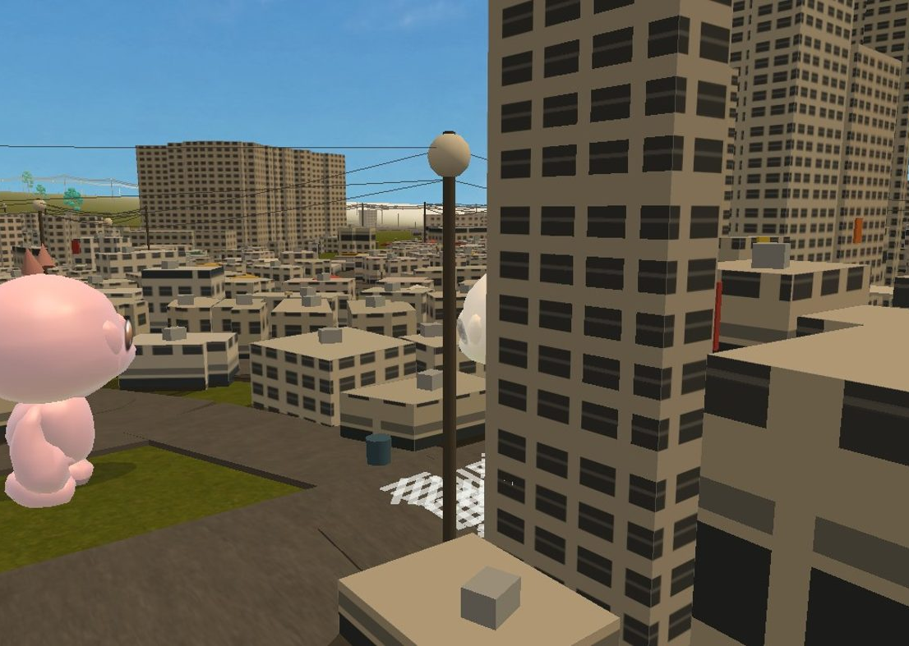
SOLUTION
See who's nearby. Talk. Then walk over.
Open the app, see who's around.
Everyone nearby appears as an anonymous character in a 3D twin of the district.
Zone-level, never precise.
Location snaps to a named zone ("by the crossing"), never GPS coordinates. Visibility is opt-in and one tap to kill.
Talk before you meet.
Public feed and 1-to-1 chat mean the first face-to-face moment is a continuation, not a cold open.
Live product — street level in 3D Itaewon. The characters are people who are actually there.
RANDO
04
Notes:
Point at the character in the frame: that is a person who is actually there.

Slide 5
HOW IT WORKS
Borrowed party-game mechanics, played in the real world
QUESTS
LOBBIES
CHAT FIRST
Mario Party, but in real life.
Jackbox, but in real life.
Warm intros, not cold approaches.
GPS-triggered missions strangers complete together — two-person tasks that only fire when you're both standing in the same place. The quest is the icebreaker; nobody has to invent an opening line.
Themed 2D rooms tied to real venues. A group gathers in the lobby, a randomized minigame reveals itself, and the shared-room energy of a party game plays out — except the room is an actual bar or bookstore.
In-app chat runs before, during, and after. You've already exchanged messages with the person across the room — walking over is step two, not step one.
RANDO
05
Notes:
Name the references out loud — Mario Party and Jackbox do the explaining for you.

Slide 6
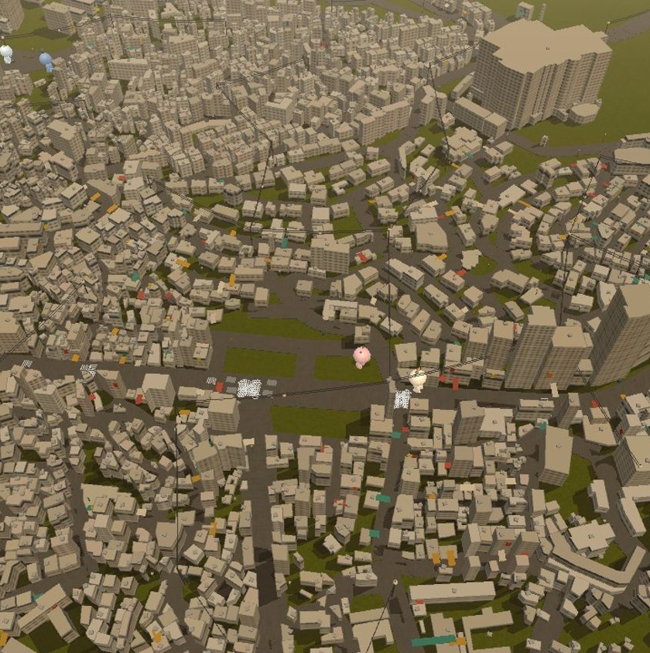
THE WORLD
A digital twin of the district — not a map with pins
4,471 real buildings from the Korean government building registry — true footprints, floor counts, and heights, not procedural filler.
Named venues & districts with day/night cycle matched to Seoul time.
Archetype NPCs — Chill, Chaos, Sporty — keep streets alive between users; more archetypes planned.
Venue-special quests — a real bar hands out a QR code as proof you finished its quest. The world is built to keep absorbing the real city.
The live world from above: Itaewon-ro and its alley network, rendered from government registry data.
RANDO
06
Notes:
4,471 is the number to land. Registry data, not procedural filler.

Slide 7
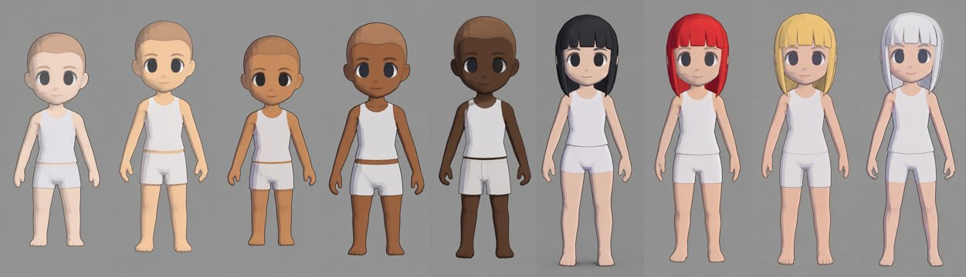
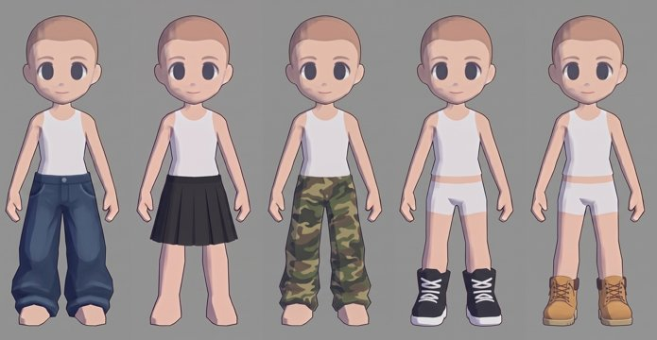
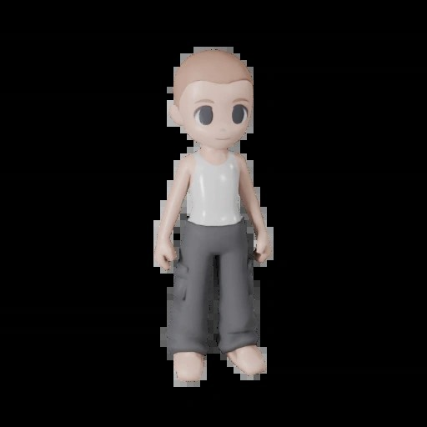
IDENTITY
Identity you own: one base character, endless variants
A full customization catalog is generated and already converted to rigged 3D: one skeleton, swappable hair / tops / bottoms / shoes, with color handled as material tints. All of it runs in the deployed app's engine.
Auto-rigged 3D conversion (34-joint skeleton)
Skin tones and hair colors — texture swaps on shared base meshes
Wardrobe: 10 bottoms, 6 shoes, tops
RANDO
07
Notes:
This is product depth: the catalog exists and is already rigged in the deployed engine.

Slide 8
MARKET VALIDATION
Every piece of this behavior already exists at scale
LOCATION LAYERS WORK
PEOPLE PAY TO MEET STRANGERS
THE PROBLEM IS INSTITUTIONAL
Pokémon GO proved hundreds of millions of people will walk city streets directed by a game layer — and that venues will pay to be part of it (sponsored PokéStops). Rando keeps the layer and makes the other players the point.
Stranger-dinner apps (Timeleft), Bumble BFF, running crews — a fast-growing category of products whose only job is introducing strangers offline. Demand is proven; they all schedule it days ahead. Rando does it live, where you already are.
Loneliness is now policy: the US Surgeon General's 2023 advisory, loneliness ministers in the UK and Japan. The gap between connectivity and connection is the defining social problem of this decade.
RANDO
08
Notes:
Adjacent markets prove each half of the behavior separately. Rando is the combination.

Slide 9
BUSINESS MODEL
Venues pay for verified foot traffic.
Sponsored quests
District priority
Cosmetics, later
A bar buys a quest slot; completing it requires being physically inside and scanning the venue's QR code. The venue pays for provable bodies in the room — not impressions.
Venues pay for placement in a district's quest rotation and labeled presence in the 3D world (their building, their name, their glow).
The character system is the consumer monetization surface — outfits and archetype skins — switched on once density is proven, never before.
EXAMPLE UNIT
— priced against what venues already spend on promoters and portal ads.
[ # venues ]
per district ×
[ ₩/month ]
sponsorship =
[ ₩ district-month ]
RANDO
09
Notes:
Verified foot traffic is the product venues buy. Cosmetics only after density.

Slide 10
TRACTION — FIRST FIELD TEST
10 strangers, one night, zero prompting
10
PUBLIC FEED · ITAEWON
real strangers live in Itaewon in one night
"sketching by the crossing, come say hi"
rando-b64b44 first real public message!
rando-9b9b3b yo from bogwang, can you hear me?
1st
rando-c70313 Sup
session produced organic public chat
rando-3db7db What's up mfs
Emanuelkong Yoooo hi guys
Shared
Malone Hello 🤣🔥
WhiteMonkey yoo
users showed the app to friends unprompted, in person
WHAT HASN'T HAPPENED YET
In-person meetups converting from the app. That's a density problem, not a demand problem — with a handful of users spread across a district, no two are reliably in the same zone at the same time. It's exactly the gap the Itaewon-only launch is designed to close.
RANDO
10
Notes:
Read the honesty block yourself, do not let them find it. Density problem, not demand problem.

Slide 11
COMPETITION
Everyone else schedules it, screens it, or skips it
↑ Live · spontaneous
rando
Density playbook, not a waitlist
The world is a moat
Pokémon GO
Registry-data digital-twin pipeline rebuilds any city in days; competitors ship map pins.
One district at a time with on-the-ground launch ops — the only strategy that survives the cold-start.
Social media
Safety by architecture
In-house distribution
Zone-coarse presence, anonymous handles, identity-verification (본인인증) scaffold already built.
A founder who has grown audiences to 60k+ — launch content is a core competency, not a spend line.
Dating apps
Meetup · Timeleft
↓ Scheduled
← On a screen
In the room →
RANDO
11
Notes:
The quadrant is empty for a structural reason: live plus in-the-room needs density ops.

Slide 12
ADOPTION STRATEGY
Win one district, then copy the playbook
PHASE 1 · NOW
PHASE 2
PHASE 3
Itaewon only.
Seoul's districts.
Any city.
Concentrate every user in one nightlife district to hit real zone density. Weekly launch nights, venue-partner quests with QR proof, FXIENDS-style short-form content aimed at the district's actual crowd.
Repeat district-by-district — Hongdae, Seongsu, Gangnam — each a contained density problem with its own venues and quest set. Same mechanics, new geography.
The stack is already city-agnostic: the world builds from public building-registry and OSM data, and quests/lobbies are templated per venue. District playbook + local content partner = a new city launch.
Success metric: strangers meeting in person from the app, every week.
RANDO
12
Notes:
Phase 1 is the whole conversation. Phases 2 and 3 are the same playbook, copied.

Slide 13
TEAM
Two brothers: distribution and product
CEO · GROWTH & CONTENT
CTO · ALL OF ENGINEERING
Emanuel Kong
Tony Kong
Built Kingmaker Marketing from zero to $7k+/month across 10+ clients.
Sole builder of everything in this deck: the 3D registry-twin engine, real-time presence and chat on Supabase, the safety/verification stack, and the generative character pipeline.
Built FXIENDS to 60k+ TikTok and 29k+ YouTube followers — knows how to make a local scene show up.
Ships daily; the demo is deployed and live right now.
RANDO
13
Notes:
Distribution and product, one each. The demo is live right now — offer to open it.

Slide 14
THE ASK
Prove the loop in one district
Launch operations
Weekly Itaewon launch nights, venue partnerships, on-the-ground community seeding until zone density sustains itself.
Trust & safety
Korean identity verification (본인인증) integration and moderation — the foundation is built; the provider contract needs funding.
Product velocity
Quest/lobby content system, more archetypes, iOS/Android wrappers over the deployed web engine.
Milestone
Recurring stranger-to-stranger meetups every week in Itaewon — the number that unlocks district #2.
RANDO
14
Notes:
No number on the slide — anchor on the milestone, name the amount in the room.

Slide 15
rando
Proximity is permission.
randoirl.vercel.app — open it tonight, someone might be by the crossing
Emanuel Kong · Tony Kong
Notes:
Leave the demo open on screen while they ask questions.

