Slide 1
Building An E-Commerce Website For An Electronics Store
Instructor: Ms. Lê Thị Minh Châu

Slide 2
Table of contents
01
02
04
05
03
About us
Technologies
Reason for choosing the topic
Demo
Conclusion

Slide 3
01
About us

Slide 4
Our team
Phạm Hoàng Phước
18110040
Đặng Hoàng Sơn
18110043
Ngô Minh Thành
18110045

Slide 5
02
Reason for choosing the topic

Slide 6

E-commerce Website
Approach more potential customers
Expand consumption markets
Shop for products conveniently
Save time
Reduce operating
Management costs

Slide 7




Survey
User-friendly design
Optimized page loading speed
Diverse product management system
The payment and transportation systems are safe and convenience

Slide 8
03
Technologies

Slide 9


React and Next.JS

Slide 10


MongoDB and Cloudinary

Slide 11

Chatbot

Slide 12
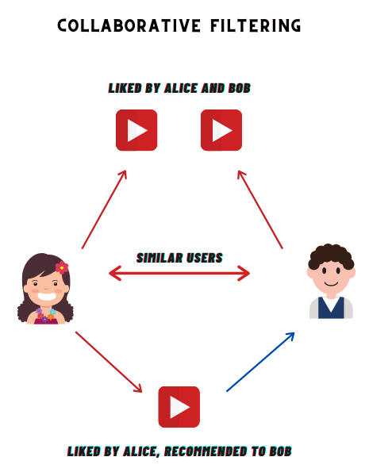
Collaborative Filtering

Slide 13
04
Demo
https://electronics-store-v2.vercel.app/

Slide 14
05
Conclusion

Slide 15
Strength
Drawbacks
A user-friendly and professional interface.
Quick web page loading
Online customer support
Various forms of payment
Send confirm mail when order payment successful.
Assist managers in easily managing data.
Only one manager has the admin account.
There is no system to automatically approve user comments.
The mobile interface is not great.
Coupon management is not good.
There is no way to check the existence of email.
There are not many way to login yet.

Slide 16
Things to update in the future
To make a webhook for the thirdparty delivery update order status automatically
Provide users with discount code notifications.
Integrate multiple login methods, such as Google and Facebook.
Email and phone verification feature that is valid
Enhanced responsiveness
Using React Native to build a mobile version
Create an automated system that can check user comments before publishing.

Slide 17
Thanks!
Do you have any questions?

